Slide 1
Variable names
📦

Slide 2
Variables - names
Names can contain letters, numbers and underscores _

Slide 3
Variables - names
Names can contain letters, numbers and underscores _
Names must start with a letter or an underscore _

Slide 4
Variables - names
Names can contain letters, numbers and underscores _
Names must start with a letter or an underscore _
Names can be anything except Scala keywords

Slide 5
Variables - names
Names can contain letters, numbers and underscores _
Names must start with a letter or an underscore _
Names can be anything except Scala keywords
var var = 3 // Error
var println = "Cat" // OK but don’t do it

Slide 6
Variables - names
Names can contain letters, numbers and underscores _
Names must start with a letter or an underscore _
Names can be anything except Scala keywords
Descriptive, not too long, not too short
var var = 3 // Error
var println = "Cat" // OK but don’t do it

Slide 7
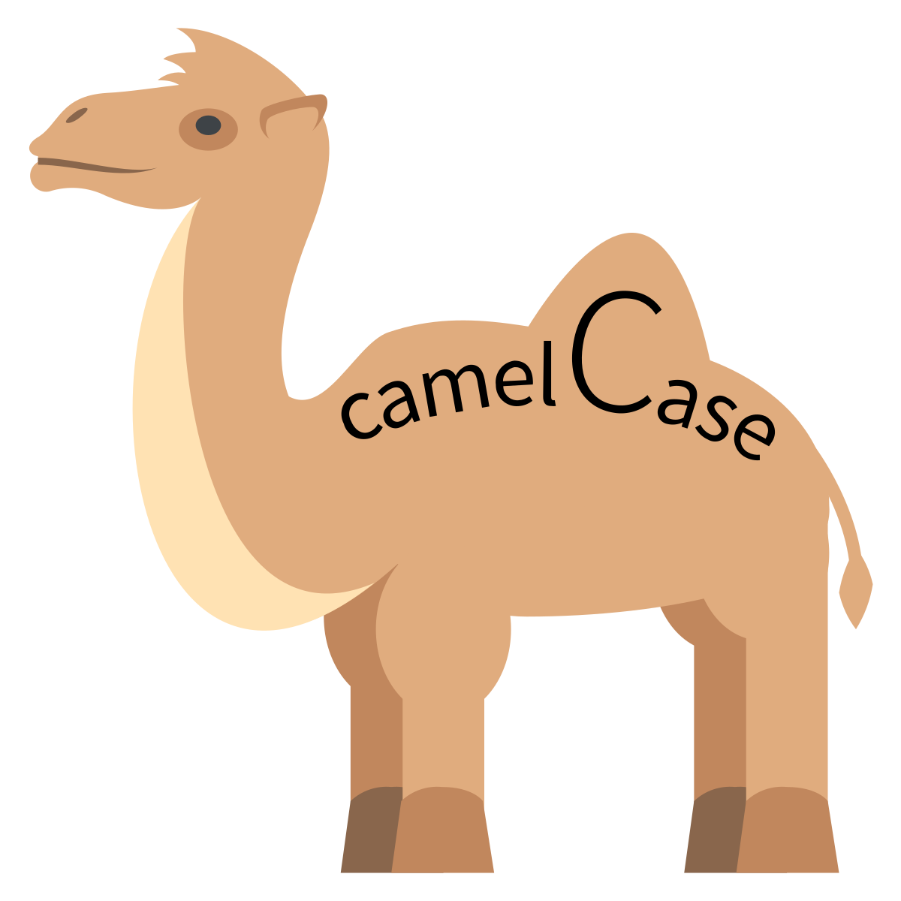
Variables - names
Names can contain letters, numbers and underscores _
Names must start with a letter or an underscore _
Names can be anything except Scala keywords
Descriptive, not too long, not too short
Naming convention - camelCase - productPricePerUnit
var var = 3 // Error
var println = "Cat" // OK but don’t do it

