Slide 1
session5: visualise data in R

Slide 2
Content
Visualising Data in R with ggplot2
General data visualisation tips

Slide 3
What can data visualisation do ?
help you to explore & understand your data
communicate your data

Slide 4
Visualising data in R with ggplot2
There are many ways to plot graphs in R
Base R has visualisation commands
ggplot2 package allows you to ‘layer’ features of graphs
works well with tidy data
it is part of the tidyverse, load it now with
library(ggplot2) or library(tidyverse)
(called ggplot2 because the first version had problems! confusingly the main command is still called just ggplot )

Slide 5
ggplot2 resources
ggplot is hugely popular (hundreds thousands of users)
lots of resources
but there is a bit of a learning curve
“It’s hard to succinctly describe how ggplot2 works because it embodies a deep philosophy of visualisation.”
most useful reference websitehttps://ggplot2.tidyverse.org/reference/index.html

Slide 6
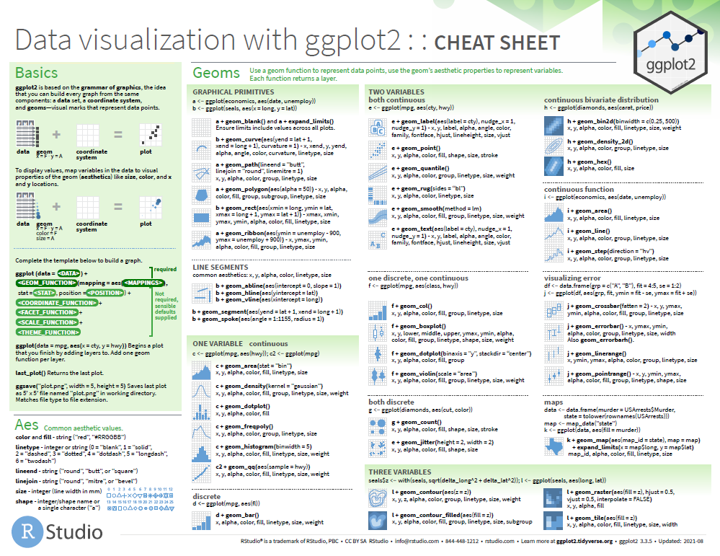
‘cheatsheet’ in folder of this course project

Slide 7
Structure of a ggplot command
takes a while to get used to the structure.
Different syntax possible
In general:
ggplot(DATA) + GEOM_FUNCTION(aes(WHICH COLUMNS INFLUENCE AESTHETICS))
I usually start by copying & pasting some existing code & modifying it.

Slide 8
What is a ‘aes’ ?
aes sets the columns that influence the aesthetics of the plot
it can go either after the GEOM part or after the DATA part
ggplot(DATA) + GEOM(aes(x=COLUMN))
ggplot(DATA, aes(x=COLUMN)) + GEOM()
makes a difference if you add other geoms

Slide 9
What is a ‘geom’ ?
A geom is a visual aspect of a graph.
dots
lines
bars
Look at the ggplot2 cheatsheet for more options.

Slide 10
move to the file : ** 5-visualise-script-ggplot.R **

Slide 11
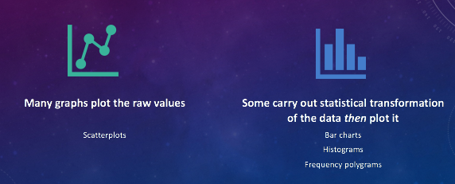
raw value plots vs summaries

Slide 12
Drawing a bar graph
geom_bar
ggplot(data = cchic) + geom_bar(mapping = aes(x = vital_status))

Slide 13
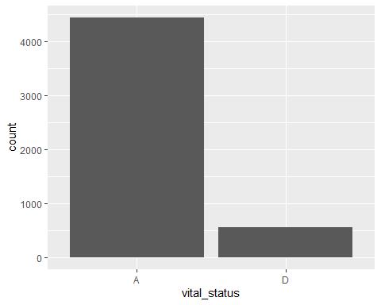

Slide 14
Adding a second aesthetic
ggplot(data = cchic) + geom_bar(mapping = aes(x = vital_status, fill = sex))

Slide 15
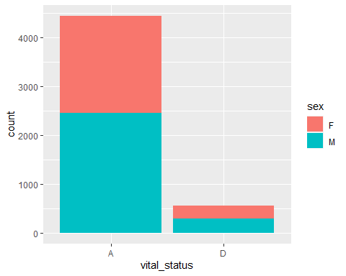

Slide 16
Scaling bars to 1
ggplot(data = cchic) + geom_bar(mapping = aes(x = vital_status, fill = sex), position = "fill")

Slide 17
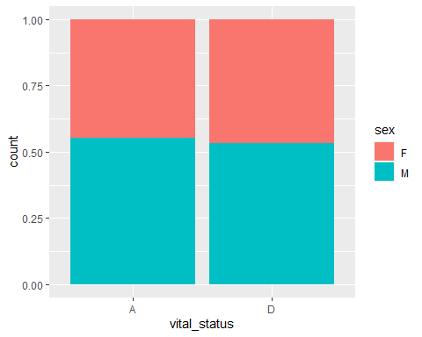

Slide 18
A few more general datavis guidelines to consider

Slide 19
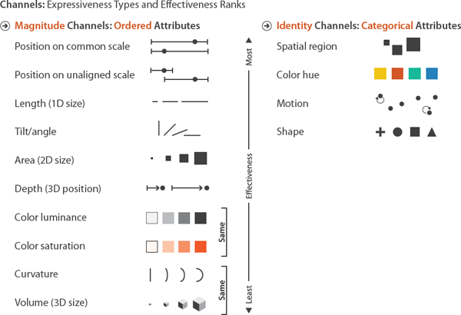
Position on X & Y axis is most effective communicator - use it for your prime variables
from Visualization Analysis & Design by Tamar Munzner

Slide 20
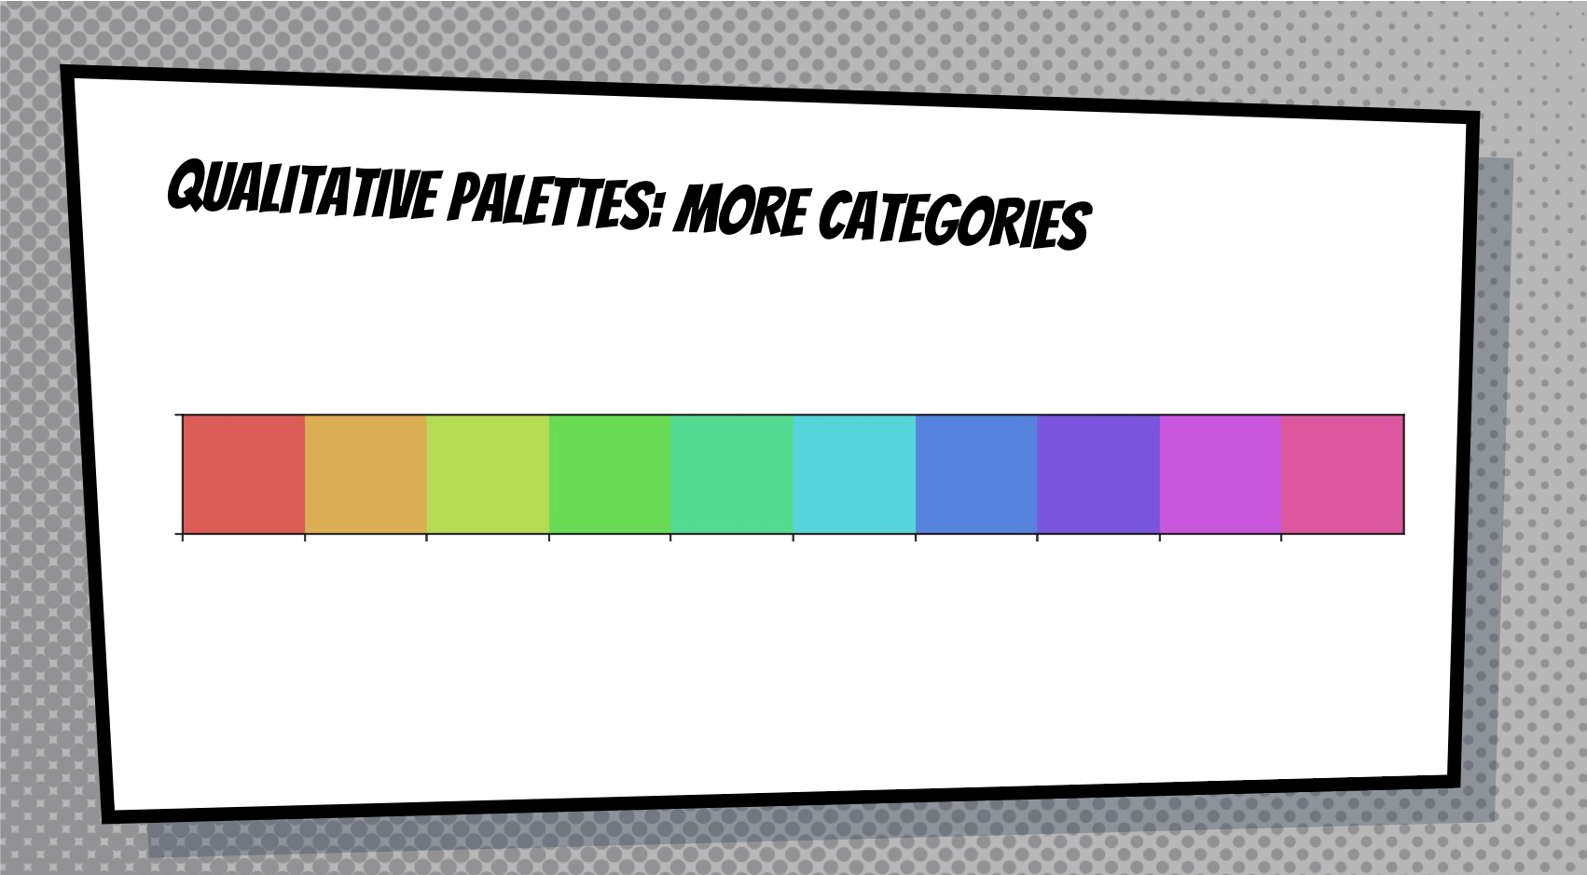

Slide 21
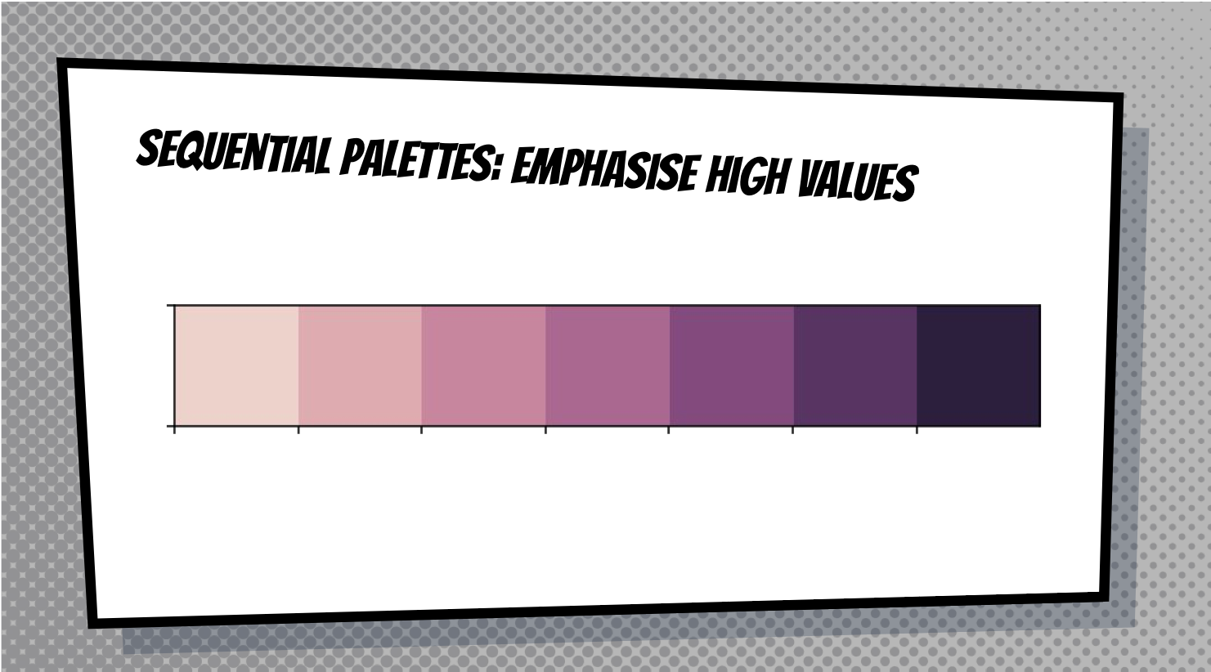

Slide 22
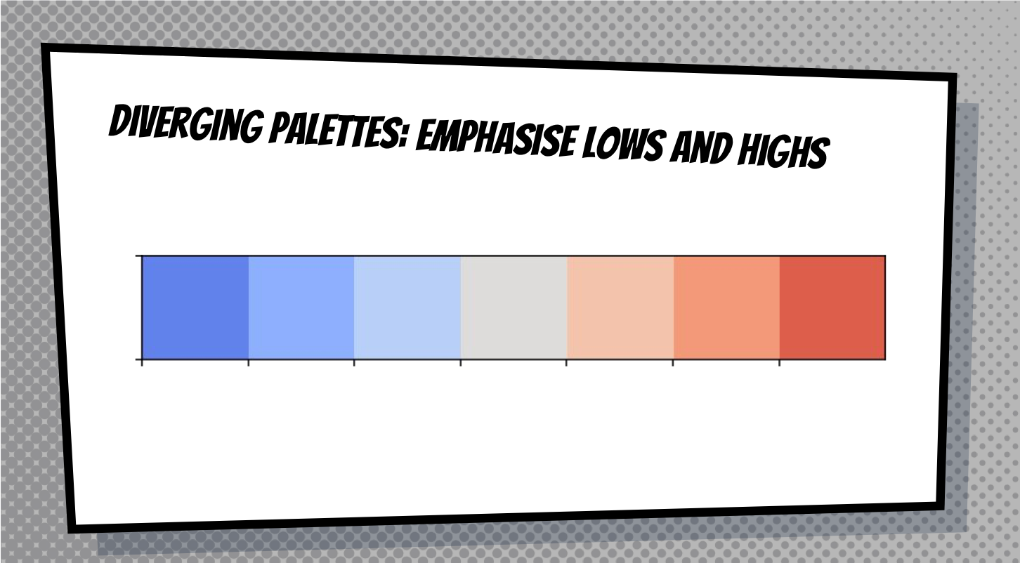

Slide 23
