Slide 1
Region: ERCOT

Slide 2
Methodology

Slide 3
Data Source
How did we get this data
Snl excel and scraping
Focus on US

Slide 4
Precursor Variable Definitions
Prediction delta = real historical price (avg over month) - predicted forward price (at as of date), grouped by time delta and averaged or found variance
Delta (time delta) = # days before the 1st day of the predicting term
dt [-30, 10*365]
Add example of how each variable is found

Slide 5
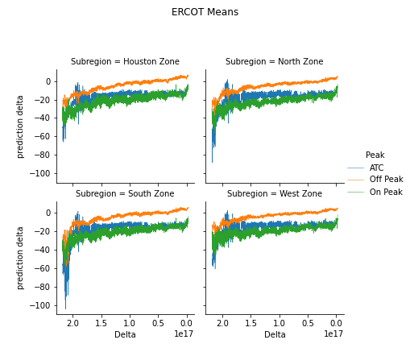
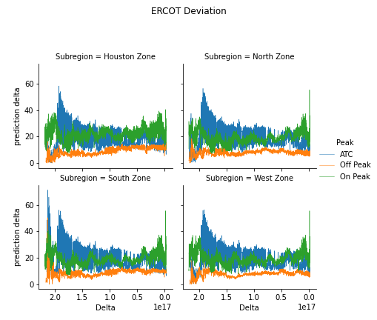
Notes:
Test case: Pick a start date and see every 365 days and look at the spread and the delta – pull market forwards 10 yrs out (so asofdate = 2010) and all the way up to 2019 → how much the price has moved for each forward date
Between every Jan 1 of year x, see how much the forwards moved over the year (could have changed)
Same as of date, but term over next 10 yrs (looking always at January)
See for jan 1 2010 and dec 31 2010 within year time frame

Slide 6
Case – Term June 2020 Predictions

Slide 7
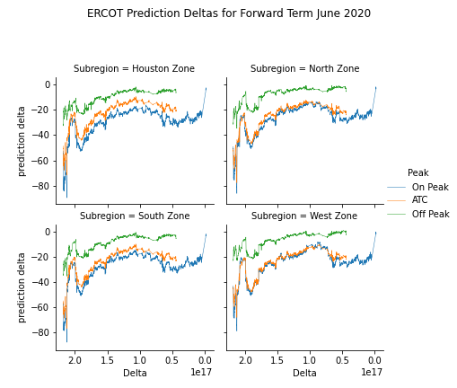

Slide 8
One year out

Slide 9
Means

Slide 10
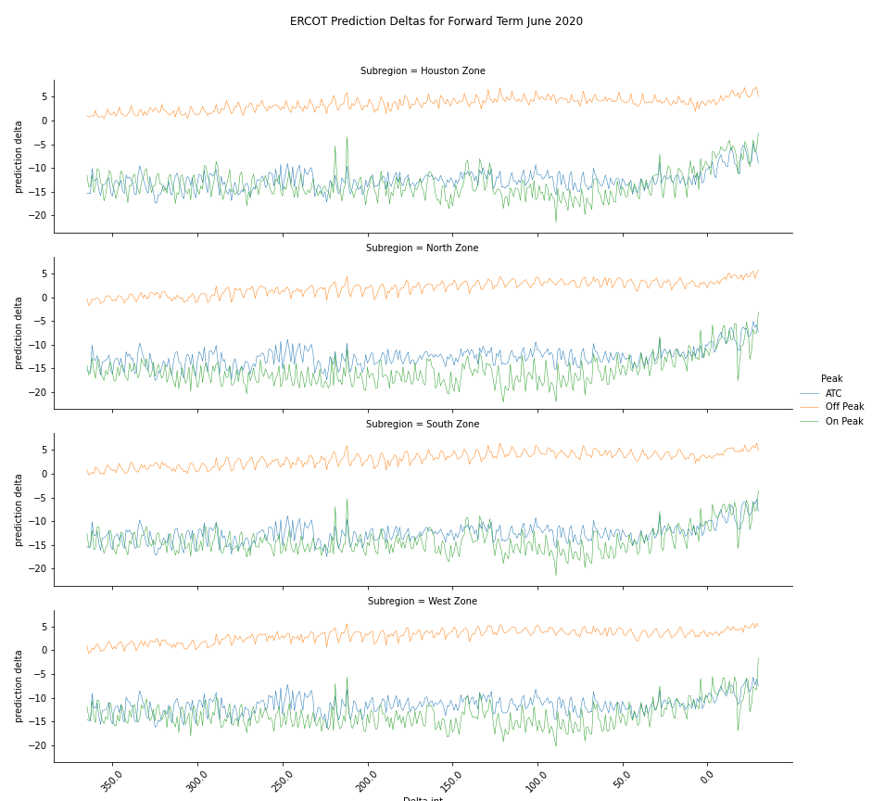
post 1st day of Term month

Slide 11
post 1st day of Term month
Lowest monthly intersection error
High Peaks between day 225 and 200 for ATC for Houston, South and West Zones

Slide 12
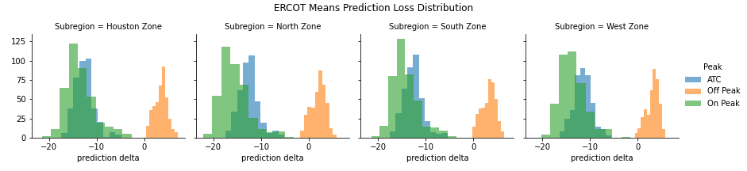

Slide 13
Off peak is less volatile but under predicting on average
On peak is more volatile (greater spread) and over predicting on average.

Slide 14
Volatility

Slide 15
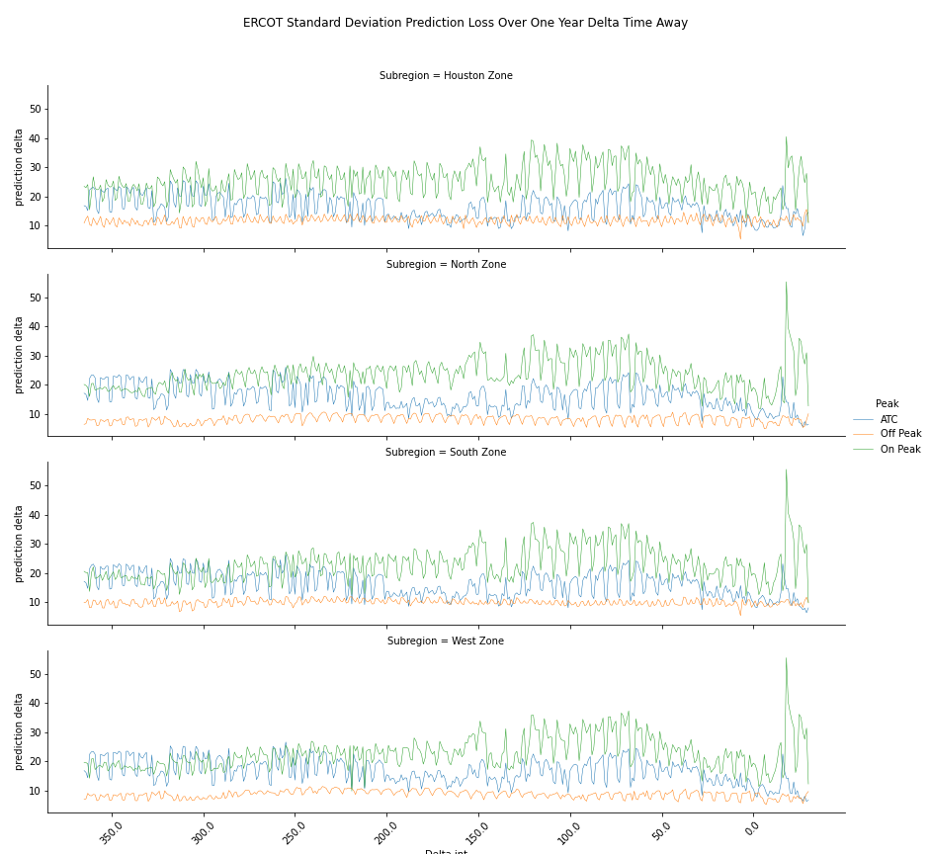
post 1st day of Term month

Slide 16
post 1st day of Term month
Volatility highest between 150 days our and 50 days out for On Peak
Lowest monthly intersection volatility

Slide 17
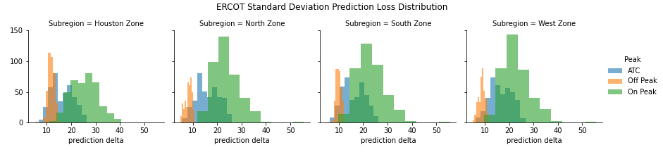
Volatility is highest for on peak forwards

Slide 18
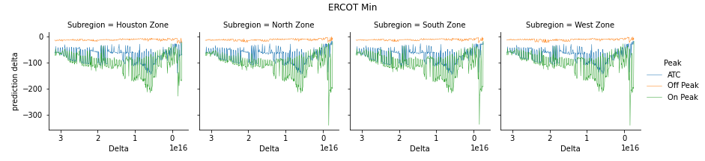
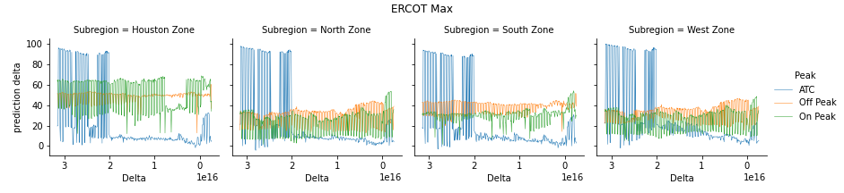
Notes:
These high values are a result of forward prices predicted at over 100 during certain summer months (mainly in August)

Slide 19
Max

Slide 20
10 Year overview

Slide 21
TEST DEAL

Slide 22
Variation over year of As of Dates
Due to data inconsistencies with SNL, there are only historical futures and real time data for dates between 2013 June to 2020 June.
Let’s observe how the forwards move over the years on June 1st of 2014-2019 based on the as of date from June 18st, 2013 – June 18 2014.
ATC only
X axis = as of date, y axis = grouped by term year - mean and var of forward values
Y’ axis = grouped mean and grouped var of prediction deltas
Notes:
Test case: Pick a start date and see every 365 days and look at the spread and the delta – pull market forwards 10 yrs out (so asofdate = 2010) and all the way up to 2019 → how much the price has moved for each forward date
Between every Jan 1 of year x, see how much the forwards moved over the year (could have changed)
Same as of date, but term over next 10 yrs (looking always at January)
See for jan 1 2010 and dec 31 2010 within year time frame

Slide 23
Observation of means and variance changing as years go on between groups of as of dates

Slide 24
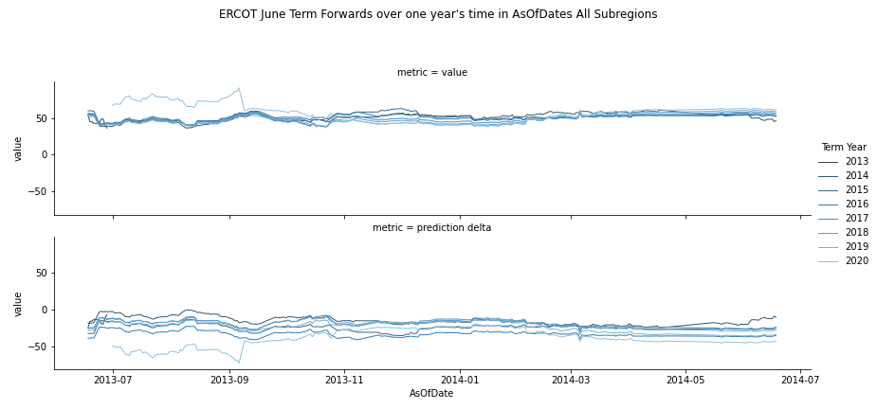

Slide 25
2020 deviation from other yearly forwards
2020 Overestimation by > 50 if dealt in

Slide 26
APPENDIX

Slide 27
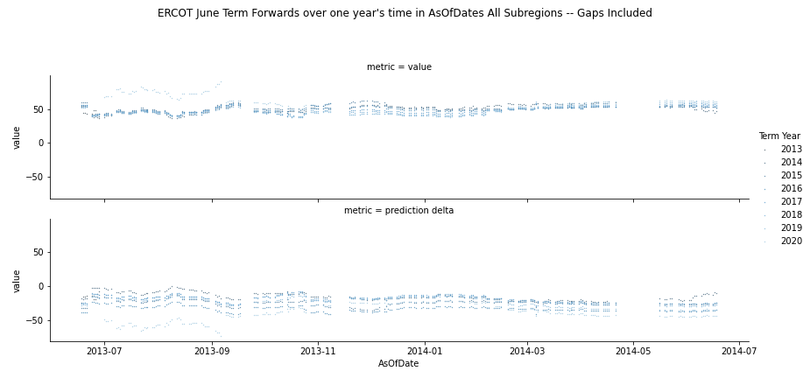
Data Consistency

Slide 28
Data Consistency
Data missing?

Slide 29
Overall Market Movement (Previous Data)

Slide 30
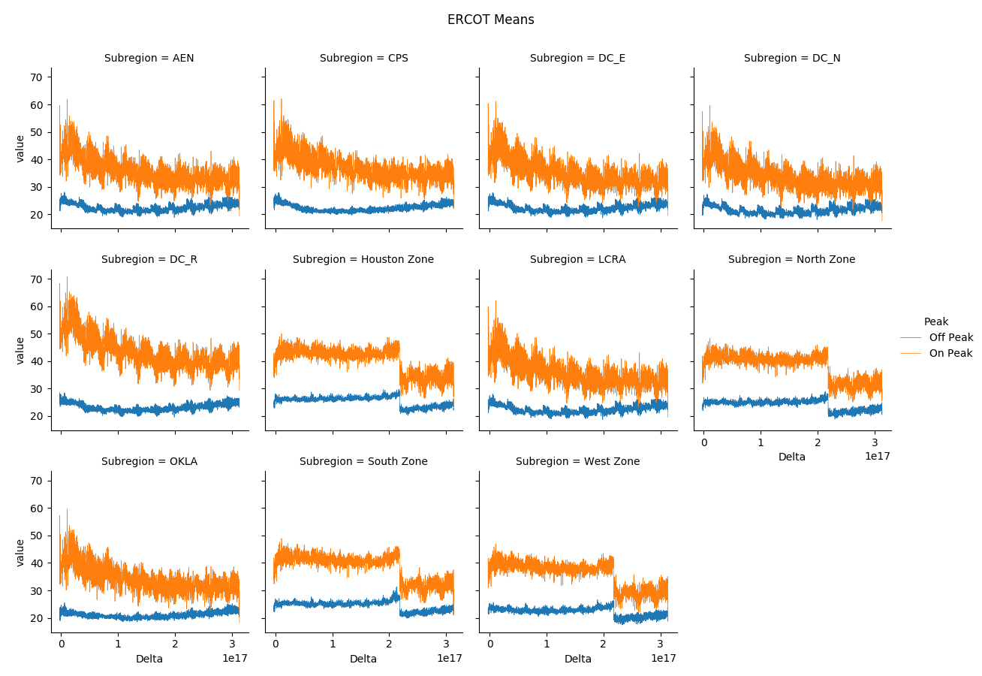

Slide 31
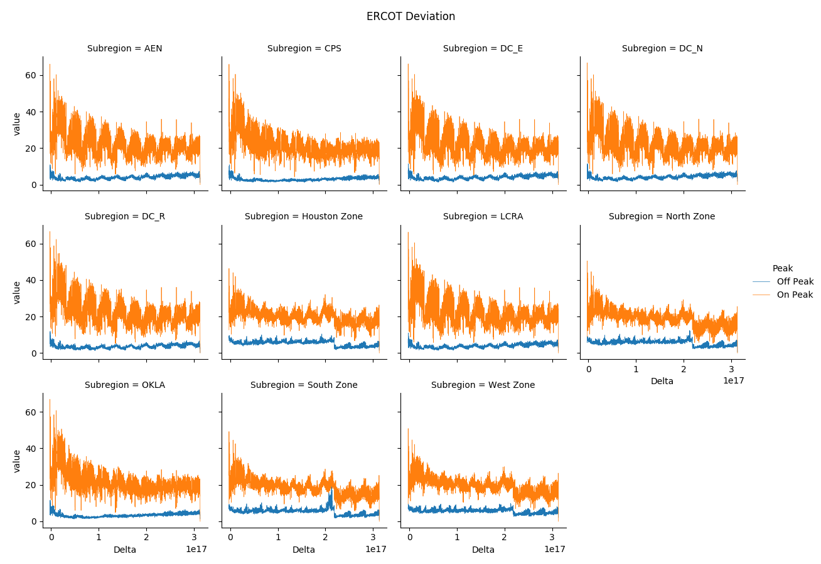

Slide 32
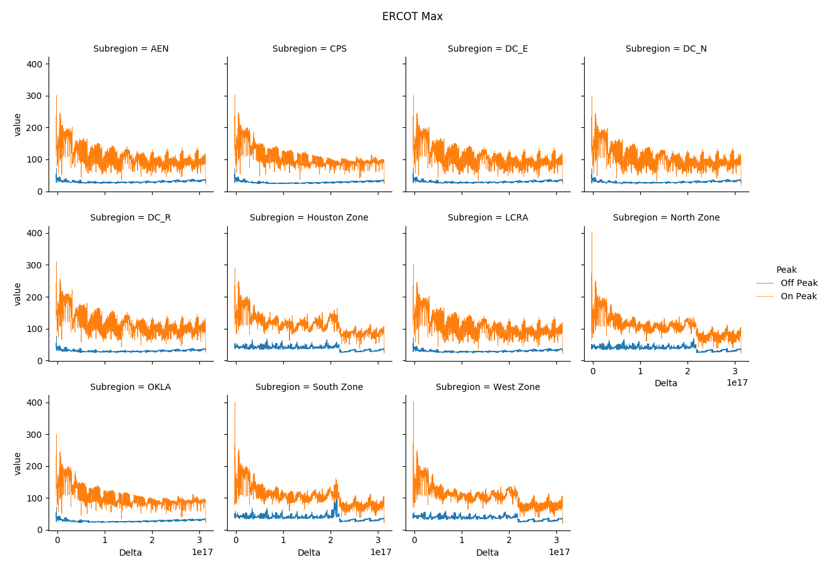

Slide 33
