Slide 1
Region: ERCOT

Slide 2
Case – Term June 2020 Predictions

Slide 3
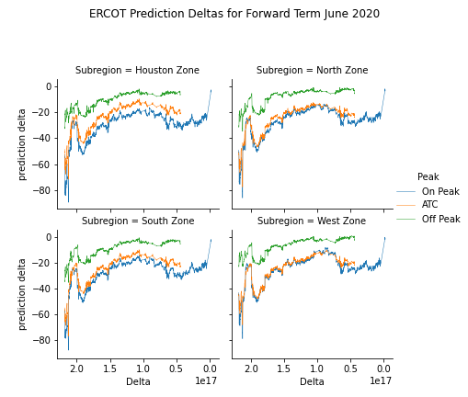

Slide 4
One year out

Slide 5
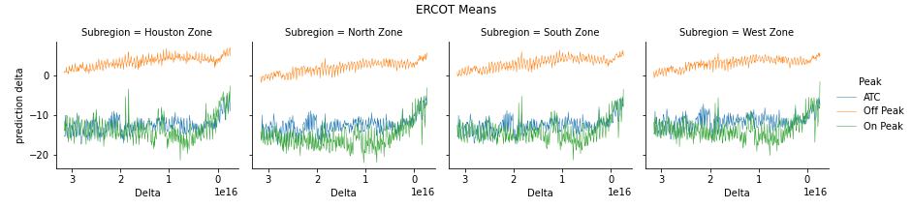
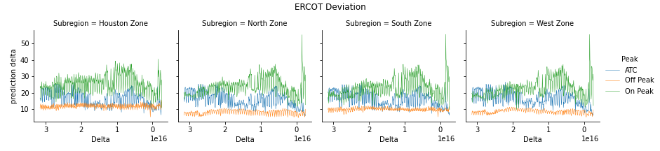

Slide 6
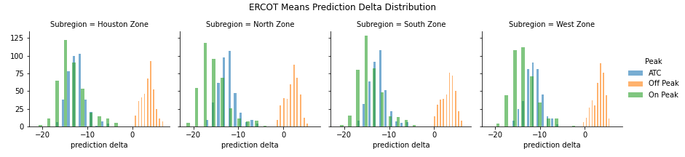
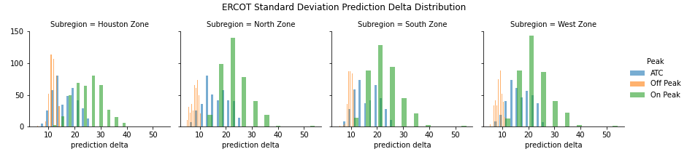

Slide 7
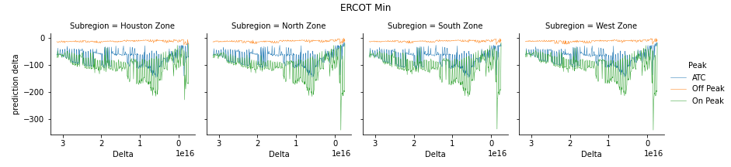
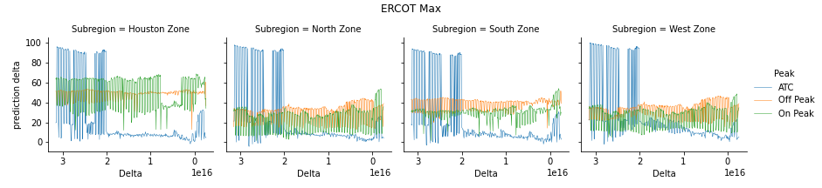
Notes:
Pinpoint and see which months/years

Slide 8
10 Year overview

Slide 9
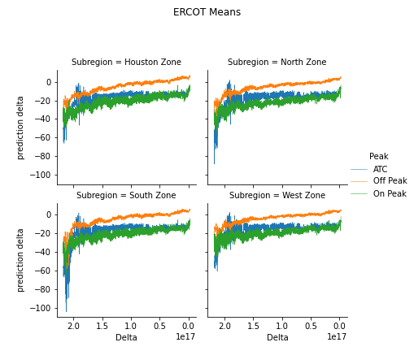
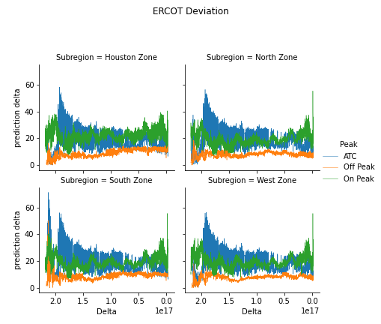
Notes:
Test case: Pick a start date and see every 365 days and look at the spread and the delta – pull market forwards 10 yrs out (so asofdate = 2010) and all the way up to 2019 → how much the price has moved for each forward date
Between every Jan 1 of year x, see how much the forwards moved over the year (could have changed)
Same as of date, but term over next 10 yrs (looking always at January)
See for jan 1 2010 and dec 31 2010 within year time frame

Slide 10
APPENDIX

Slide 11
Overall Market Movement (Previous Data)

Slide 12
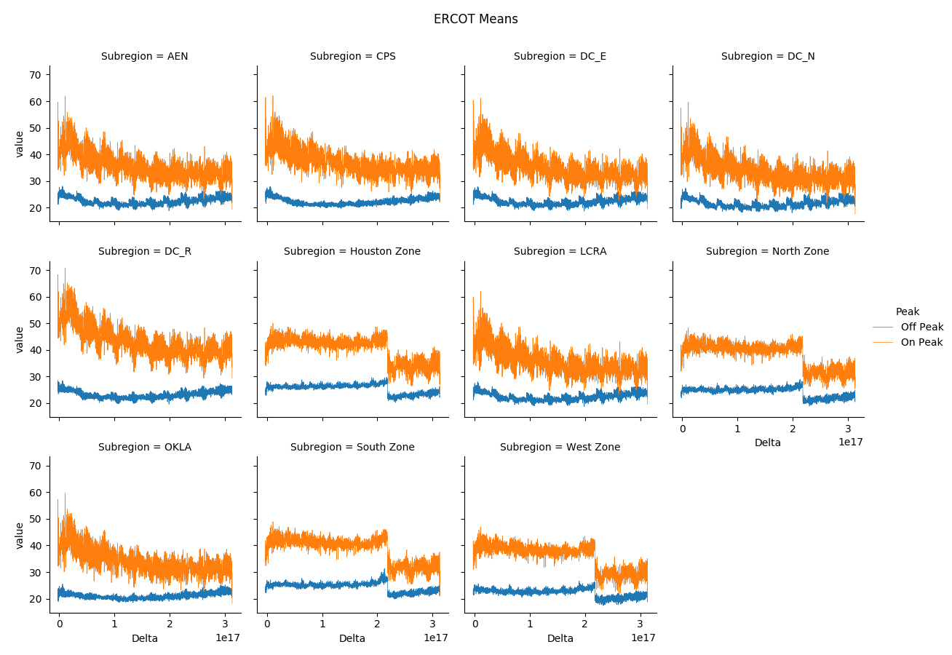

Slide 13
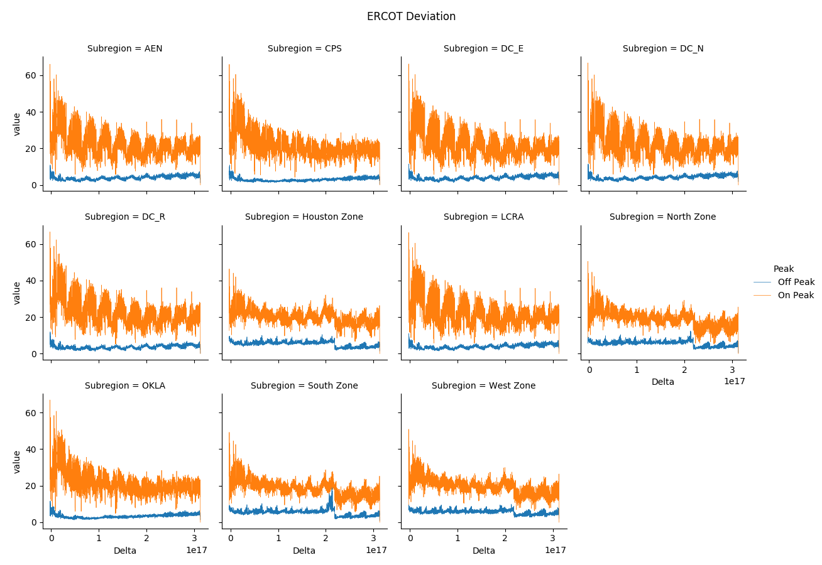

Slide 14
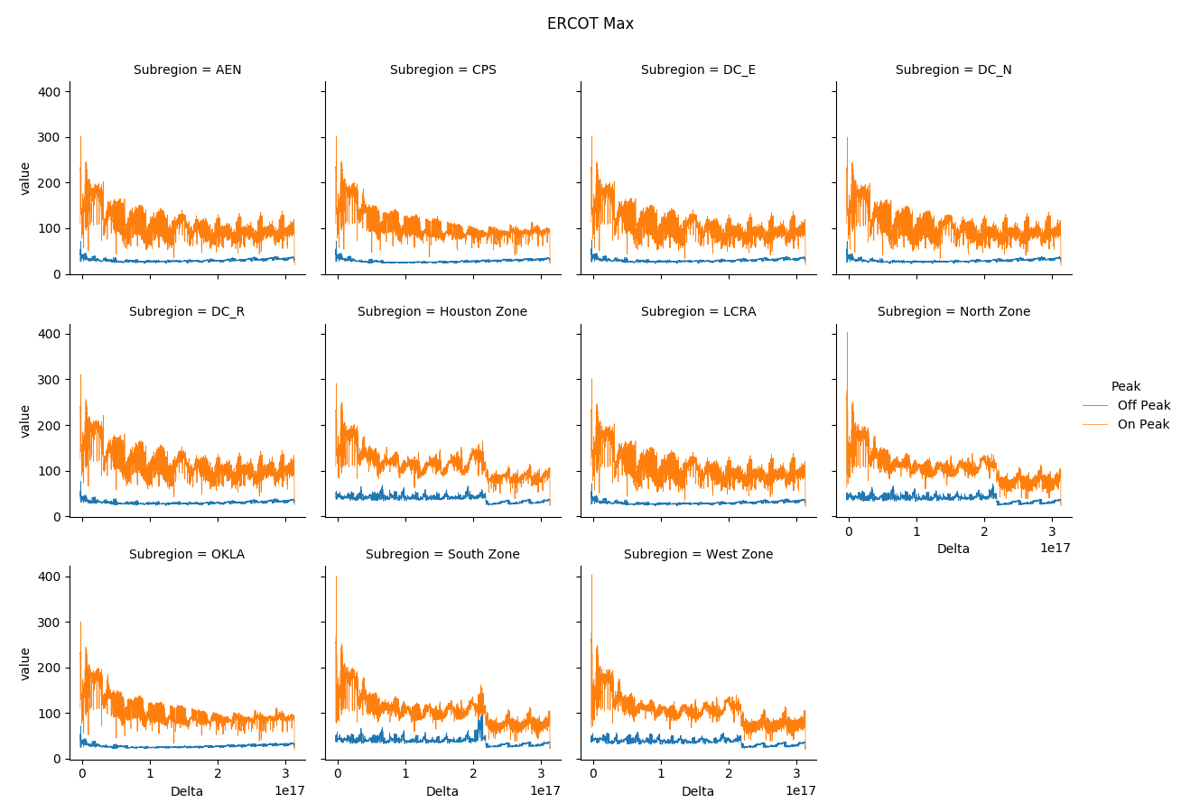

Slide 15
