Slide 1
US ERCOT Power Markets
Futures Price Automated Data Collection and Real Price Prediction Analysis
Jiyoo Jeong
Summer 2020

Slide 2
Objectives
Gather data from the S&P Global Market Intelligence Platform (AKA SNL)
Currently the Futures market data has no method of being downloaded other than via Excel and manual lookups
Use 10-Year market level real time and previous data to observe trends in Futures & Forwards
How well are real time prices predicted?

Slide 3
Methodology
Scraping:
Python Selenium Library
Each Market region (ERCOT, CAISO/WEST, Alberta, etc..) takes a few days to run currently since it has to go through every day of the last 10 years.
Analysis:
ERCOT market data was combined with respective As Of Dates, and ATC prices were calculated from the On and Off Peak data provided
Looked at the entire market in whole by converting standard time parameters (dates) to time deltas (number of days from Term Date). Markets were grouped by Subregion, Peak Type, then an Average or Standard Deviation was taken to observe how varied or consistent market movements/trends are

Slide 4
Key Variable Definitions
As Of Date: Date the forwards are priced on
i.e. If you look at forwards for October 2020 today, the As Of Date is today.
Term: Date of monthly average of the forward prices
i.e. If you look at forwards for October 2020 today, the Term date is October 1st, 2020
Time Delta: # days before the 1st day of the predicting term
Term Date – As Of Date
Prediction Loss: real time price (avg over month) - predicted forward price (at as of date), grouped by time delta and averaged or found variance
Note: Prediction loss < 0 is an over prediction of the term’s futures prices

Slide 5
Variable & Analysis Methodology Walk Through – Term June 2020 Predictions

Slide 6
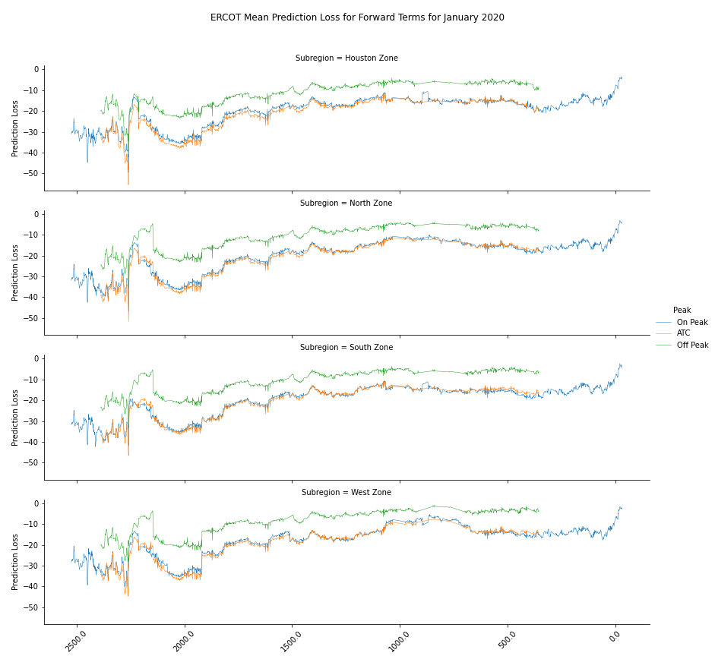

Slide 7
10 Year overview

Slide 8
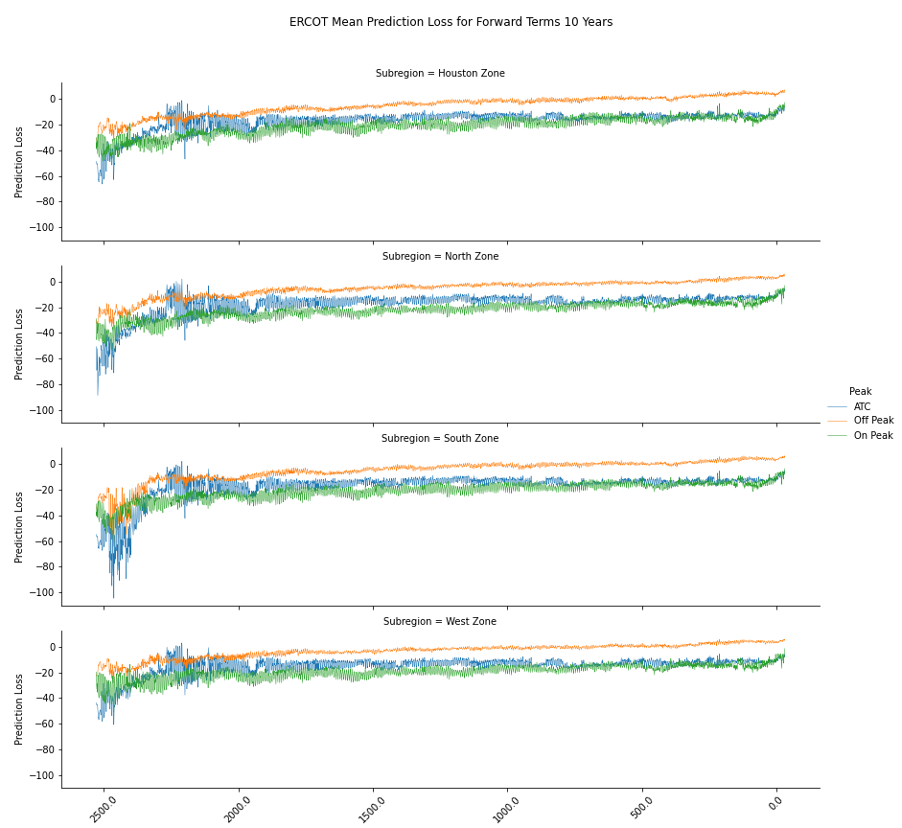

Slide 9
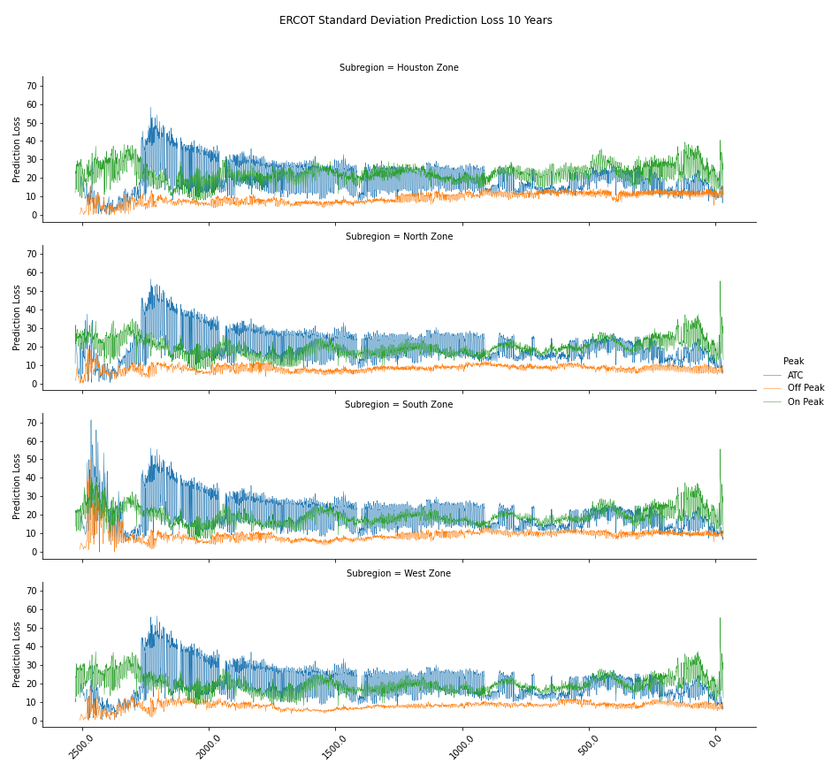

Slide 10
Snapshot View: One year out

Slide 11
Means

Slide 12
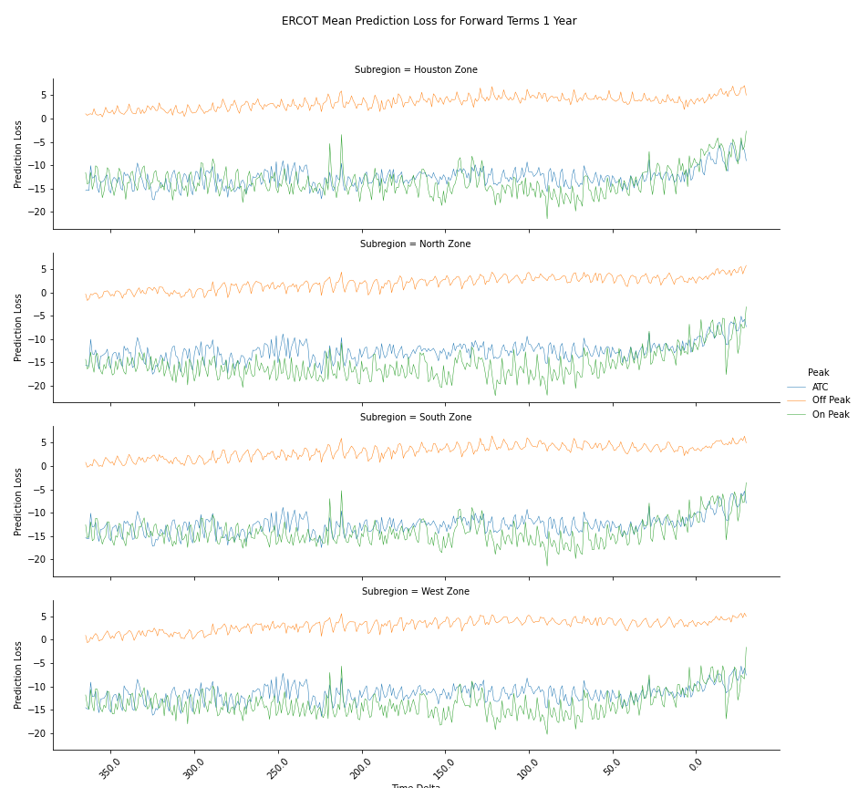
post 1st day of Term month

Slide 13
post 1st day of Term month
Gradual Movement to Prediction Loss 0 due to futures predictive prices being replaced by real time prices.
High Peaks between day 225 and 200 for ATC for Houston, South and West Zones

Slide 14
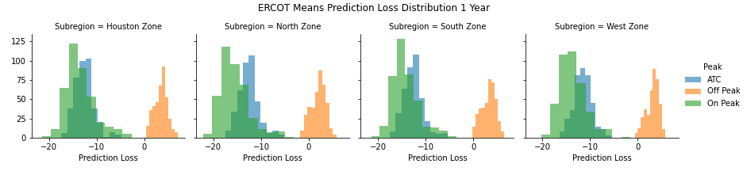

Slide 15
Off peak is less volatile but under predicting on average
On peak is more volatile (greater spread) and over predicting on average.

Slide 16
Volatility

Slide 17
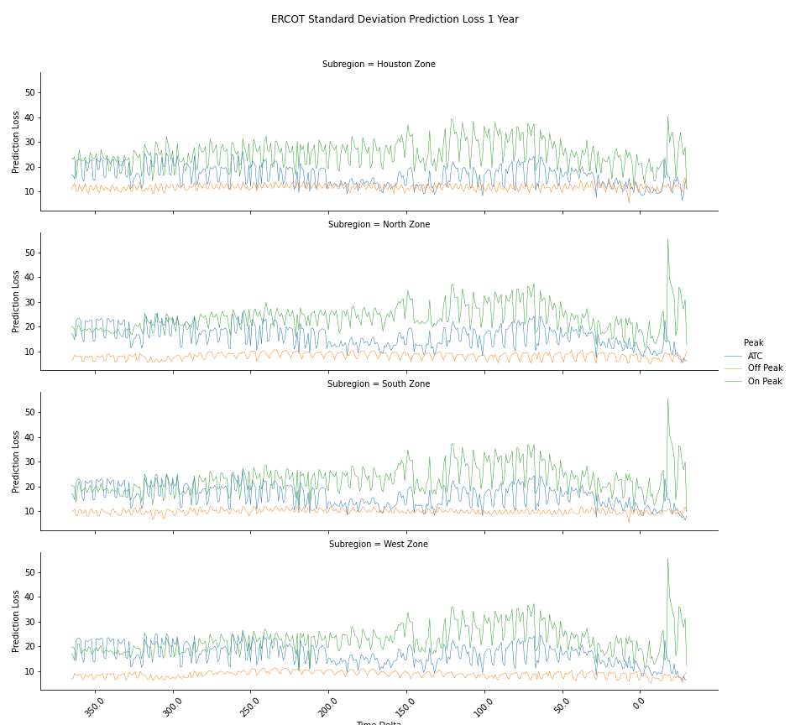
post 1st day of Term month

Slide 18
post 1st day of Term month
Volatility highest between 150 days our and 50 days out for On Peak
Volatility sharply increases then decreases as the actionable date approaches

Slide 19
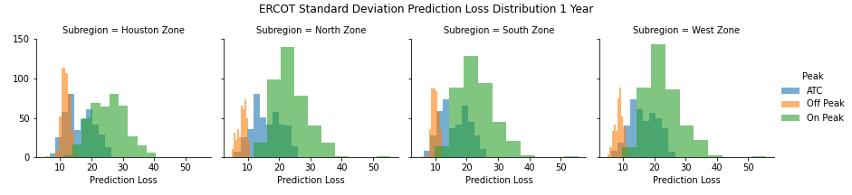
Volatility is highest for on peak forwards

Slide 20
Min & Max

Slide 21
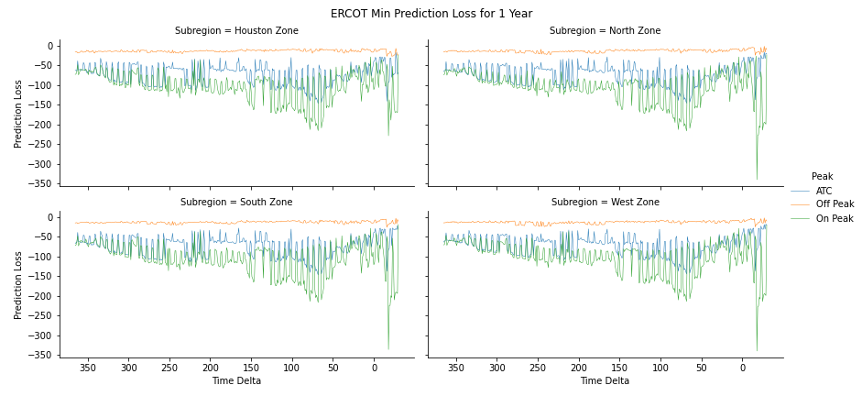
Low minimums for On peak indicate an over prediction as the date gets closer.
This can be linked to how certain summer months (June-Sept) predict futures prices to be very large (>100)

Slide 22
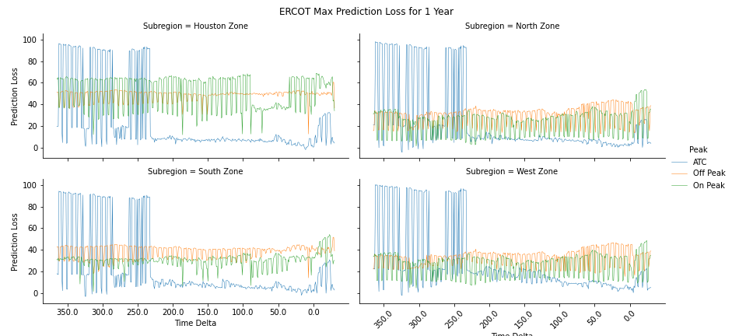
High maximums in prediction loss with further time out due indicate large underestimation in backwards time.
2019/9/1 seems to see be the reason for increased prediction loss
Notes:
These high values are a result of forward prices predicted at over 100 during certain summer months (mainly in August)

Slide 23
Price Variations based on the As Of Date

Slide 24
Variation Over 1 Year of As of Dates
Objective:
Observe how the forwards move over the Term years for Jan 1st of 2016-2020 based on the as of date from Jan 1st, 2015 – Dec 31 2015.
For an overall observation, we look at ATC only
X axis = As Of Date
Y axis = grouped by term year - mean and variance of forward values
Note: due to no available data from SNL for futures prior to 2012, there are only historical futures and real time data for dates between 2013 June to 2020 June.
Notes:
Test case: Pick a start date and see every 365 days and look at the spread and the delta – pull market forwards 10 yrs out (so asofdate = 2010) and all the way up to 2019 → how much the price has moved for each forward date
Between every Jan 1 of year x, see how much the forwards moved over the year (could have changed)
Same as of date, but term over next 10 yrs (looking always at January)
See for jan 1 2010 and dec 31 2010 within year time frame

Slide 25
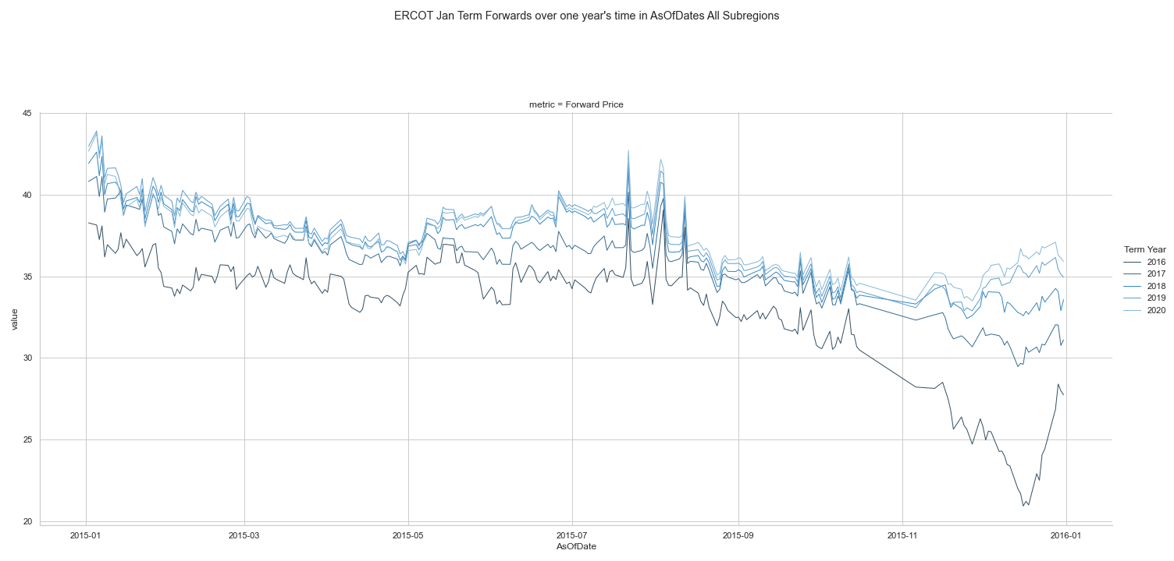
Similar shape in trends as years increase, with upward shifts in FP.

Slide 26
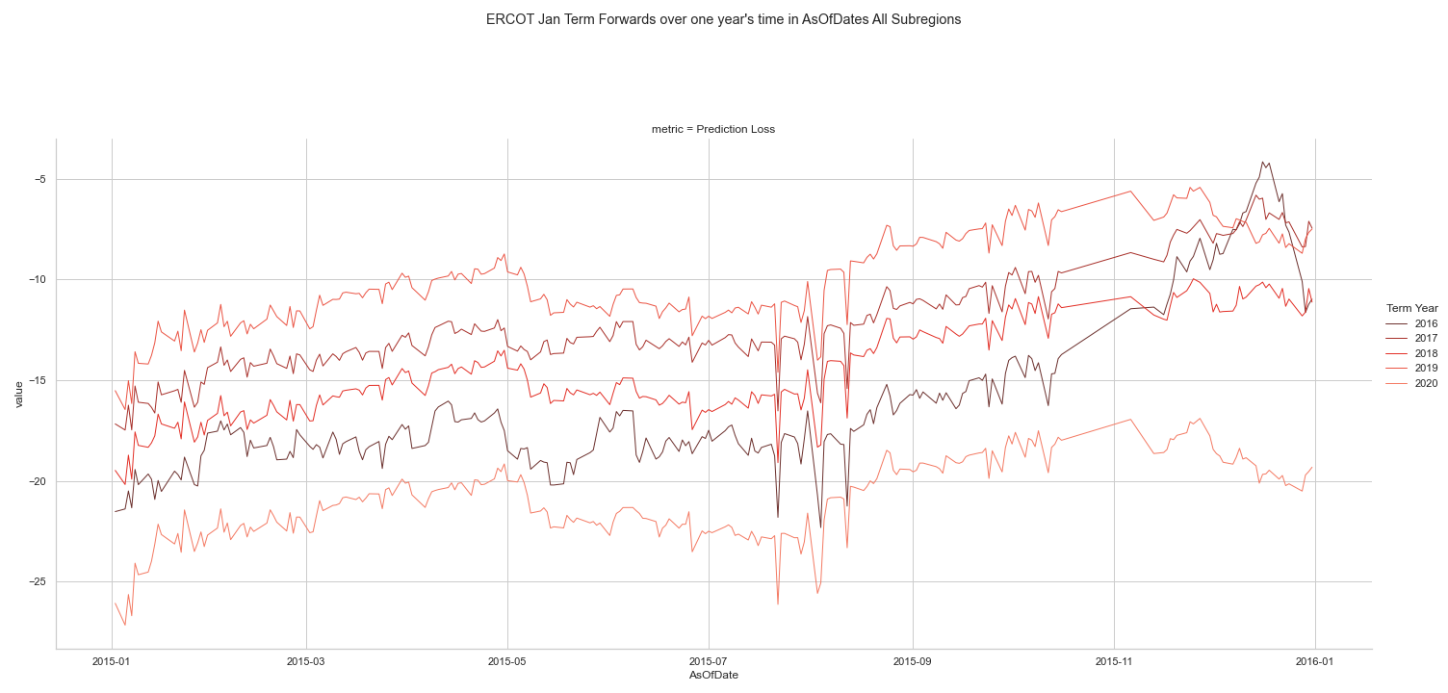
Term Year is not consistent with prediction losses over 1- year of As Of Dates
Different years show closer predictions than others even if it is further out
Notes:
Note: in comparison to the all Terms, (not just Jan) the range is similar of PL is similar.

Slide 27
2019
2017
2018
Not in expected order of earliest to latest
2016
2020
Notes:
Note: in comparison to the all Terms, (not just Jan) the range is similar of PL is similar.

Slide 28
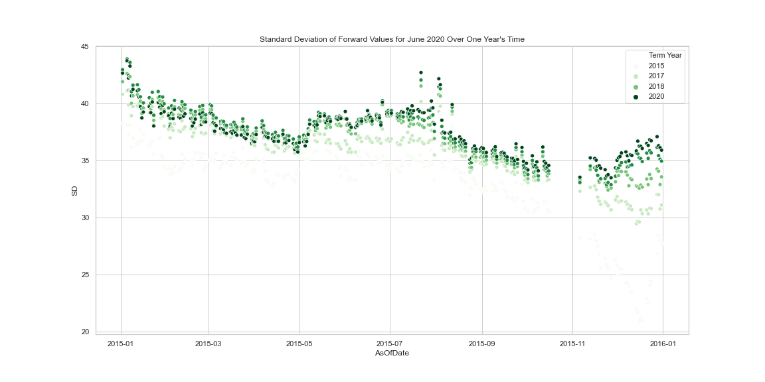
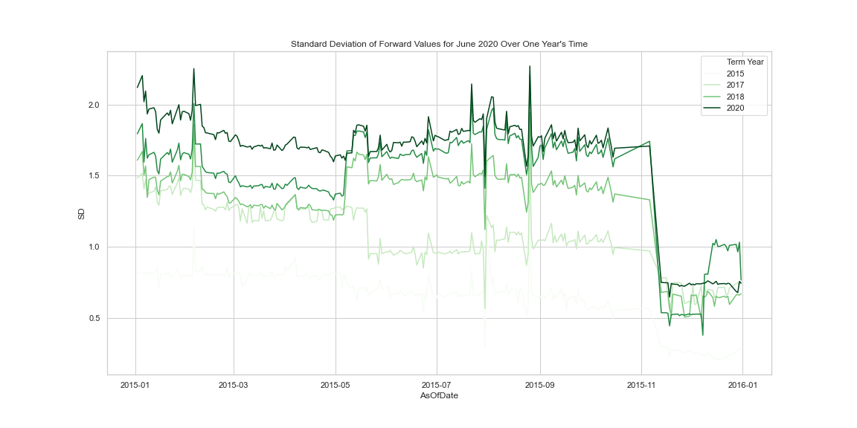
Drop in SD: convergence in FV Pricing across various years as the As Of Date approaches end of our year snapshot.
Standard Deviation of Forward Values for Jan Over One Year’s AOD Time
High volatility from year beginning at January to around November, drops significantly after November begins. Peak volatility From months Jan-March and July-September.

Slide 29
Example trade 1: As of Date is 2/6/15
Example trade 2: As of Date is 8/26/15
Example trade 3: As of Date is 11/06/15

Slide 30
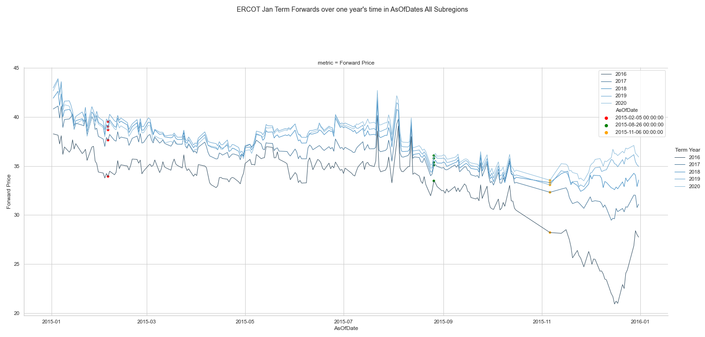
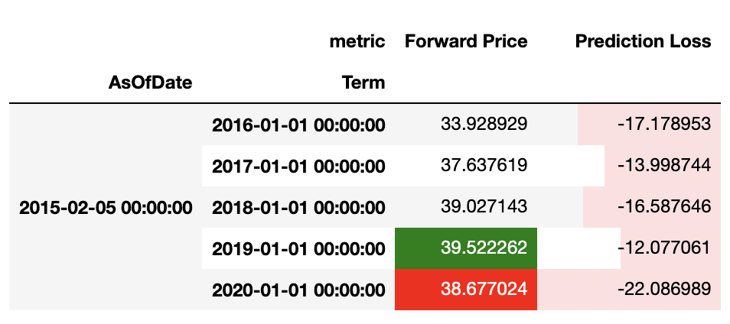
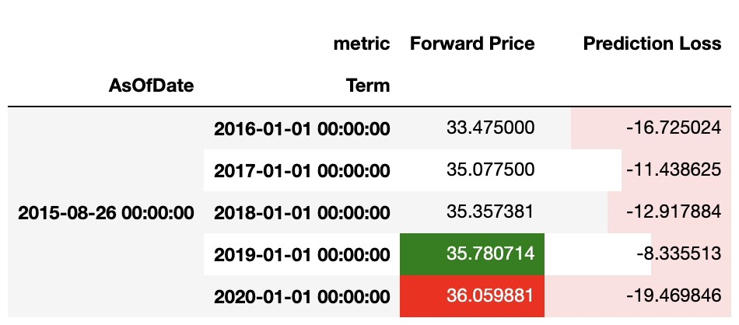
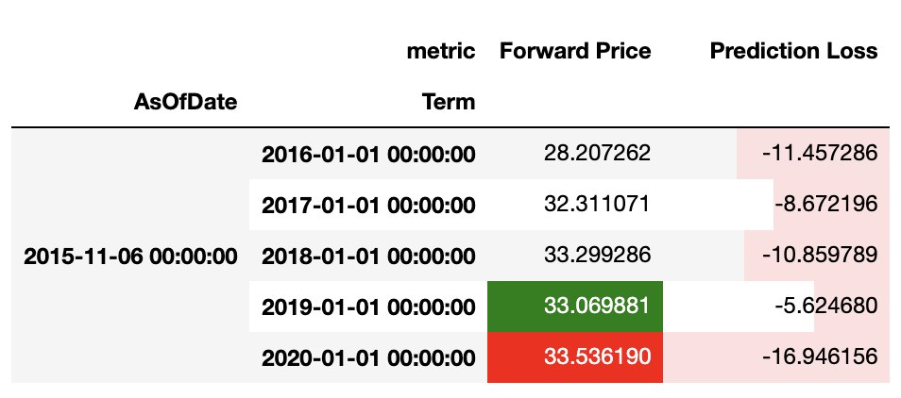
Forward Value with Lowest (greatest error) Prediction Loss
Forward Value with Highest (least error) Prediction Loss
Example trade 1: As of Date is 2/5/15
Example trade 2: As of Date is 8/26/15
Example trade 3: As of Date is 11/06/15
PL Mean: -16.386
PL SD: 3.789
least volatile, highest error
PL Mean: -13.777
PL SD: 4.385
PL Mean: -10.712
PL SD: 4.167
Lowest error
Lowest PL

Slide 31
Conclusions & Findings

Slide 32
Outcomes
Python Script
Scrapes daily excel files, read, clean and concatenate Forwards Data available on SNL Market Intelligence Platform!
ERCOT market level analysis of futures prices
Futures predictions from 2012-2020 overall follow expected trends of decreasing errors as time gets closer
Variations in the 10-Year view fluctuate when further out due to uncertainty, decrease, then increase again within approximately 2-3 years due to increased trading volumes
A 1-year look shows Off Peak prices generally under predict real prices, while ATC and On peak over predict
1-year volatility view shows increased volatility during month of Term and High volatility between 150 and 50 days out, most likely due to trading
Variation of 2015 deals
High volatility is experienced for all January terms in 2015-2020 when the As of Date is between Jan-March or July-September
Volatility Decreases as the year closes, from November to end of December
Each year generally follows the same trendline in Forward Prices (predictions), and Prediction Loss, with slight shifts between different Term Years.
Lowest prediction error if pricing in Nov-December rather than earlier in the year.
Notes:
Test case: Pick a start date and see every 365 days and look at the spread and the delta – pull market forwards 10 yrs out (so asofdate = 2010) and all the way up to 2019 → how much the price has moved for each forward date
Between every Jan 1 of year x, see how much the forwards moved over the year (could have changed)
Same as of date, but term over next 10 yrs (looking always at January)
See for jan 1 2010 and dec 31 2010 within year time frame

Slide 33
What’s Next
Local to Cloud Movement
Validation of Data Consistency (Are all dates on SNL, and if so, are all of them downloaded?)
Upload to Azure Databricks for daily automation of As Of Date Futures predictions
Generalization of Findings
How does the pricing vary over a year time not just in 2015, but other years?
What do other markets and their Submarkets look like?
How does this affect the Prius Pricing Model? Test a deal today using these trends?

Slide 34
Thank You!

Slide 35
APPENDIX

Slide 36
Data Consistency

Slide 37
Data Consistency
Data missing?

Slide 38
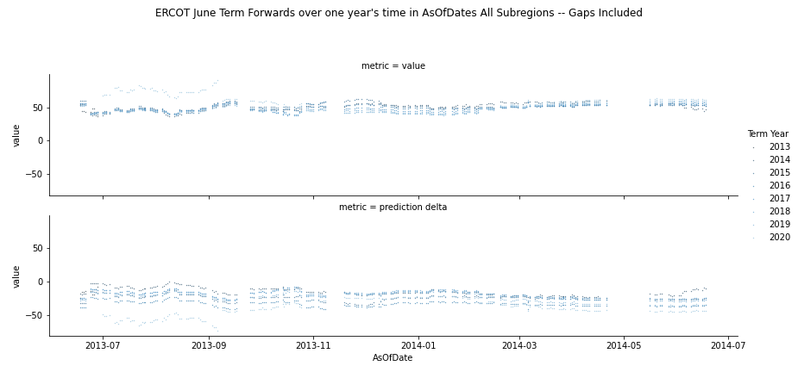
Data Consistency
Data missing?

Slide 39
Overall ERCOT Market Movement (Previous Data)

Slide 40
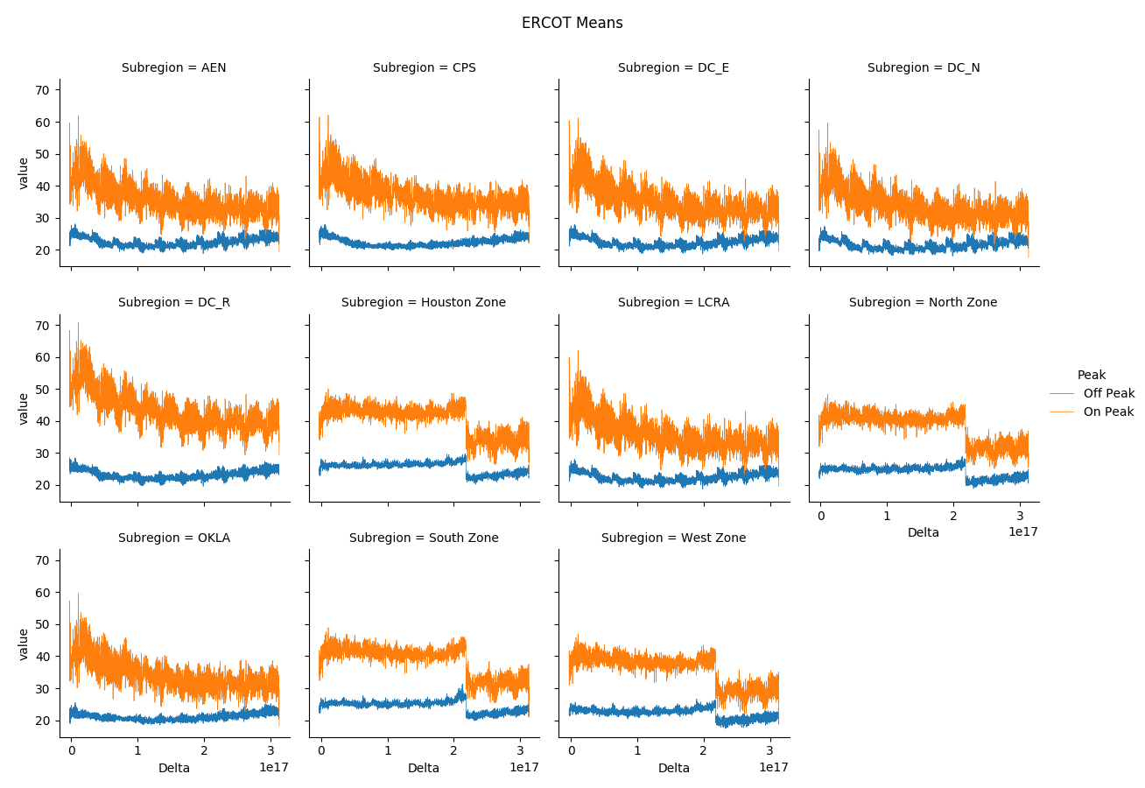

Slide 41
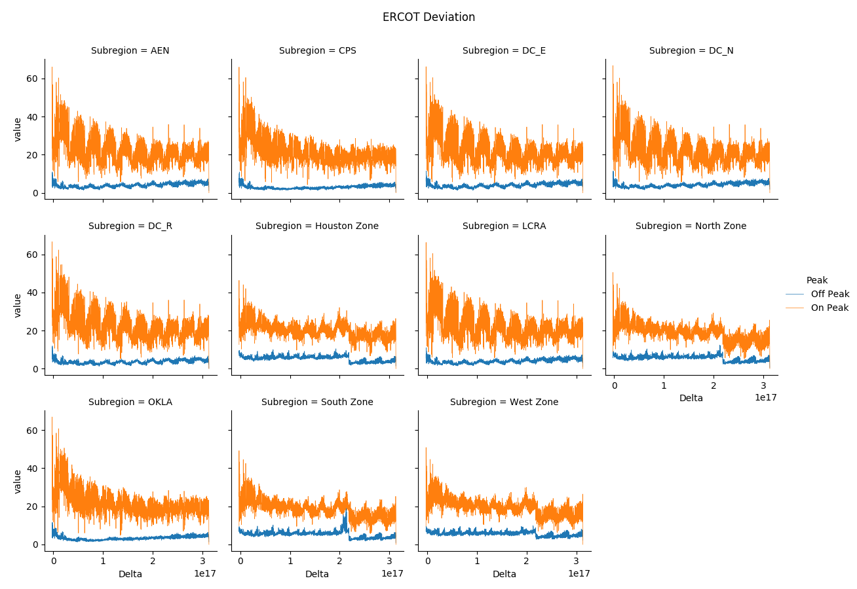

Slide 42
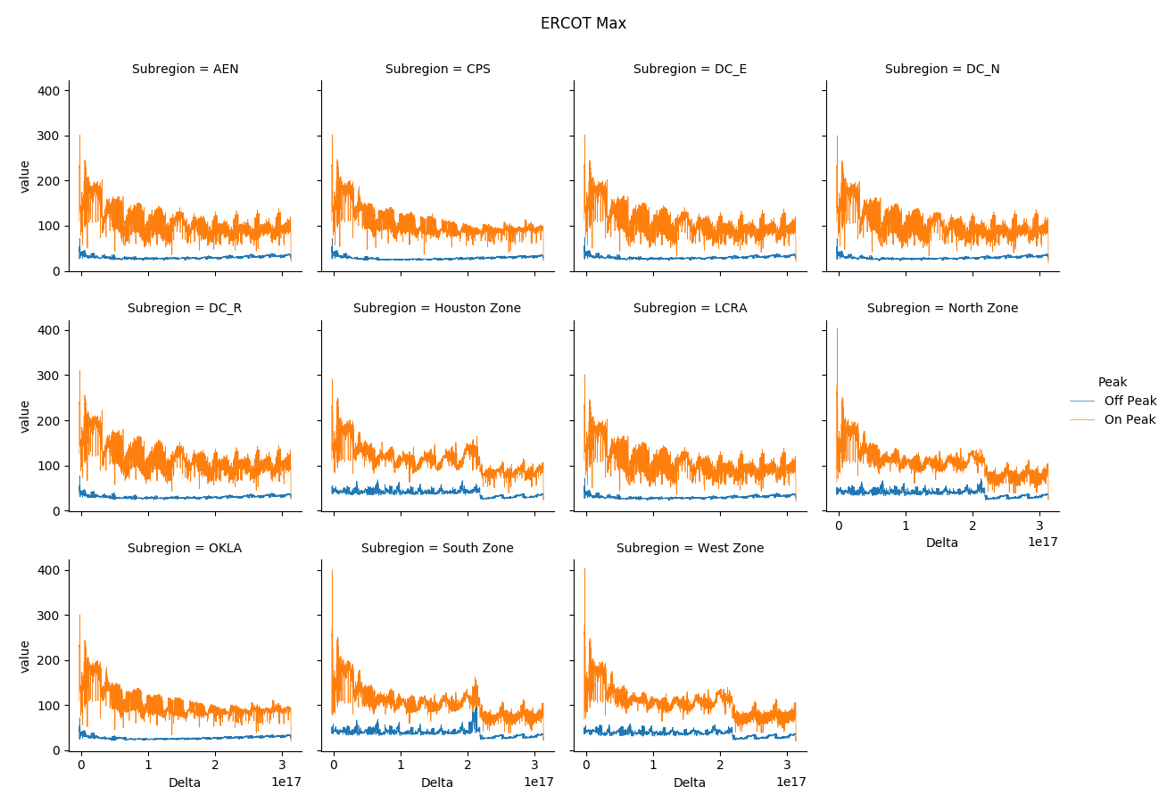

Slide 43
