Slide 1

Data Can Deceive
Causal Roadmaps with AI
Module A · Welcome + Intro
August 5, 2026 · 12:00–12:20 ET
Welcome from Kathryn, Andy, Robert, and Auriane
Module A · Welcome + Intro
INStats · August 5, 2026
Notes:
Welcome participants and confirm that all workshop times shown in this deck are Eastern Time.
[Sources]
- /Users/andywilson1/Library/CloudStorage/Box-Box/Active/Instats Causal Roadmaps AI Workshop Aug 5 2026/Modules/A/SegmentA_Welcome.tex
- /Users/andywilson1/Library/CloudStorage/Box-Box/Active/Instats Causal Roadmaps AI Workshop Aug 5 2026/Modules/A/art/InStats_RWL.png
- /Users/andywilson1/Library/CloudStorage/Box-Box/Active/Instats Causal Roadmaps AI Workshop Aug 5 2026/planning/Workshop Outline.docx
[/Sources]

Slide 2
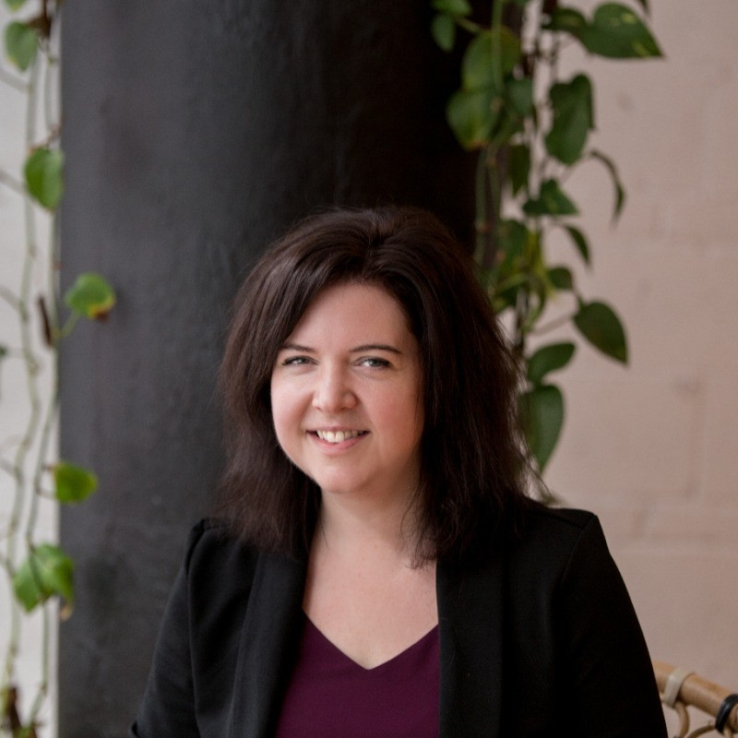
Kathryn Morrison
Module A · 12:00–12:20 ET
PhD · PStat
Co-founder and President, Precision Analytics
Accredited statistician with more than twenty peer-reviewed publications. Her consulting spans genomics, clinical research, and statistical technology.
In this workshop: opening context, causal foundations, audit-first AI, and calibration of the conclusions.
Module A · Welcome + Intro
INStats · August 5, 2026
Notes:
Introduce Kathryn and connect her consulting experience to the opening discussion of why polished analyses can still fail.
[Sources]
- /Users/andywilson1/Library/CloudStorage/Box-Box/Active/Instats Causal Roadmaps AI Workshop Aug 5 2026/Modules/A/intros/bios.txt
- /Users/andywilson1/Library/CloudStorage/Box-Box/Active/Instats Causal Roadmaps AI Workshop Aug 5 2026/Modules/A/intros/Kathryn Morrison info.png
- /Users/andywilson1/Library/CloudStorage/Box-Box/Active/Instats Causal Roadmaps AI Workshop Aug 5 2026/Modules/A/intros/Kathryn Morrison.jpg
- /Users/andywilson1/Library/CloudStorage/Box-Box/Active/Instats Causal Roadmaps AI Workshop Aug 5 2026/planning/Workshop Outline.docx
[/Sources]

Slide 3
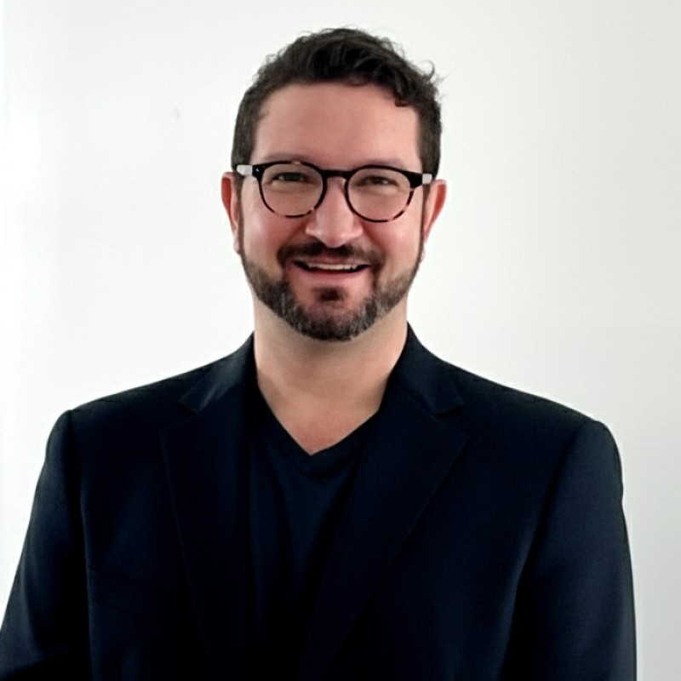
Andy Wilson
Module A · 12:00–12:20 ET
PhD · MStat
Adjunct Professor, University of Utah
Teaches Causal Methods in Public Health and co-develops the open-source Causal Navigator through Tao of RWD.
In this workshop: the causal roadmap, live Navigator demonstration, and TMLE walkthrough.
Module A · Welcome + Intro
INStats · August 5, 2026
Notes:
Introduce Andy's focus on practical causal methods and the Causal Navigator.
[Sources]
- /Users/andywilson1/Library/CloudStorage/Box-Box/Active/Instats Causal Roadmaps AI Workshop Aug 5 2026/Modules/A/intros/bios.txt
- /Users/andywilson1/Library/CloudStorage/Box-Box/Active/Instats Causal Roadmaps AI Workshop Aug 5 2026/Modules/A/intros/Andy Wilson.jpg
- /Users/andywilson1/Library/CloudStorage/Box-Box/Active/Instats Causal Roadmaps AI Workshop Aug 5 2026/Modules/A/SegmentA_Welcome.tex
- /Users/andywilson1/Library/CloudStorage/Box-Box/Active/Instats Causal Roadmaps AI Workshop Aug 5 2026/planning/Workshop Outline.docx
[/Sources]

Slide 4

Robert Platt
Module A · 12:00–12:20 ET
PhD
Professor of Biostatistics, McGill University
Co-lead of the Canadian Network for Observational Drug Effect Studies (CNODES), with a focus on pharmacoepidemiology using claims and EHR data.
In this workshop: a concrete example of why the causal roadmap matters.
Module A · Welcome + Intro
INStats · August 5, 2026
Notes:
Introduce Robert's example as the handoff from the welcome into the substantive workshop.
[Sources]
- /Users/andywilson1/Library/CloudStorage/Box-Box/Active/Instats Causal Roadmaps AI Workshop Aug 5 2026/Modules/A/intros/bios.txt
- /Users/andywilson1/Library/CloudStorage/Box-Box/Active/Instats Causal Roadmaps AI Workshop Aug 5 2026/Modules/A/intros/Robert Platt.jpg
- /Users/andywilson1/Library/CloudStorage/Box-Box/Active/Instats Causal Roadmaps AI Workshop Aug 5 2026/planning/Workshop Outline.docx
[/Sources]

Slide 5

Auriane Journet
Module A · 12:00–12:20 ET
MScPH student
McGill University · President, UAEM McGill
Auriane supports the workshop's live delivery.
In this workshop: screen share and production support, including the live Navigator session.
Module A · Welcome + Intro
INStats · August 5, 2026
Notes:
Introduce Auriane and clarify her visible role in the live Navigator session.
[Sources]
- /Users/andywilson1/Library/CloudStorage/Box-Box/Active/Instats Causal Roadmaps AI Workshop Aug 5 2026/Modules/A/intros/bios.txt
- /Users/andywilson1/Library/CloudStorage/Box-Box/Active/Instats Causal Roadmaps AI Workshop Aug 5 2026/Modules/A/intros/Auriane Journet.jpg
- /Users/andywilson1/Library/CloudStorage/Box-Box/Active/Instats Causal Roadmaps AI Workshop Aug 5 2026/planning/Workshop Outline.docx
[/Sources]

Slide 6
Before we begin
Module A · 12:00–12:20 ET
Chat prompt
Which step in your current study
feels least defensible?
Add one step or decision in the chat.
Module A · Welcome + Intro
INStats · August 5, 2026
Notes:
Collect several answers. Return to them in Module H.
[Sources]
- /Users/andywilson1/Library/CloudStorage/Box-Box/Active/Instats Causal Roadmaps AI Workshop Aug 5 2026/Modules/A/SegmentA_Welcome.tex
- /Users/andywilson1/Library/CloudStorage/Box-Box/Active/Instats Causal Roadmaps AI Workshop Aug 5 2026/planning/Workshop Outline.docx
[/Sources]

Slide 7
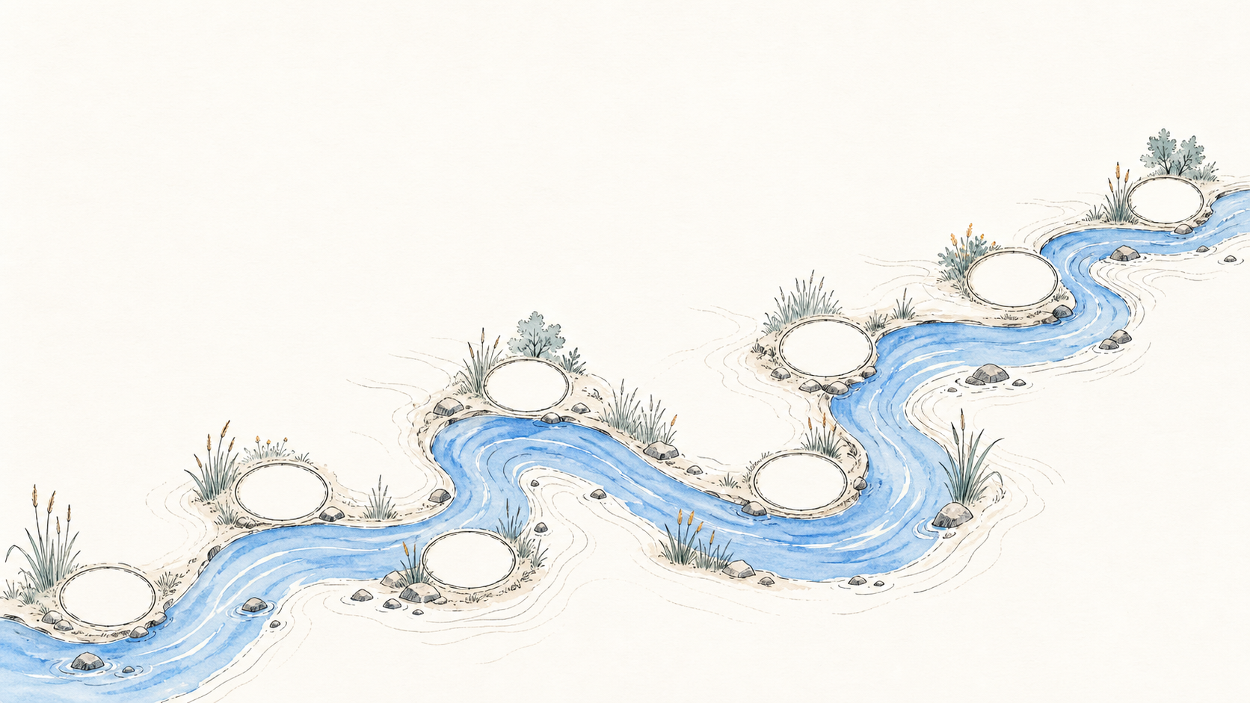
Workshop journey · 12:00–5:00 ET
A Welcome B Robert C Foundations D Roadmap E AI audit F Navigator G TMLE H Close
H
G
F
D
Break · 4:10–4:20
B
E
C
Lunch · 2:45–3:15
A
Break · 1:25–1:35
Notes:
Use the river as a quick visual overview. The next seven slides preview Modules B through H.
[Sources]
- /Users/andywilson1/Library/CloudStorage/Box-Box/Active/Instats Causal Roadmaps AI Workshop Aug 5 2026/planning/Workshop Outline.docx
- /Users/andywilson1/Library/CloudStorage/Box-Box/Active/Instats Causal Roadmaps AI Workshop Aug 5 2026/Modules/A/art/river-journey.png
[/Sources]

Slide 8
Example with Robert Platt
Module B · 12:20–12:45 ET
B
The research question
What looked persuasive
What went wrong — and the consequence
Where the failure sits in the eight-step Navigator
Module B · Example with Robert Platt
INStats · August 5, 2026
Notes:
Preview Robert's example without giving away the case details. The module moves from the question to the consequence.
[Sources]
- /Users/andywilson1/Library/CloudStorage/Box-Box/Active/Instats Causal Roadmaps AI Workshop Aug 5 2026/planning/Workshop Outline.docx
- /Users/andywilson1/Library/CloudStorage/Box-Box/Active/Instats Causal Roadmaps AI Workshop Aug 5 2026/Modules/A/intros/bios.txt
[/Sources]

Slide 9
Foundations
Module C · 12:45–1:25 ET
C
Association versus intervention
Counterfactual contrasts; confounders, mediators, and colliders
Target-trial protocol and time-zero alignment
Pneumonia-vaccine example and its crude paradox
Module C · Foundations
INStats · August 5, 2026
Notes:
Preview the foundations module and name the pneumonia-vaccine example that continues through the day.
[Sources]
- /Users/andywilson1/Library/CloudStorage/Box-Box/Active/Instats Causal Roadmaps AI Workshop Aug 5 2026/planning/Workshop Outline.docx
[/Sources]

Slide 10
The Roadmap
Module D · 1:35–2:20 ET
D
Protocol: population, strategies, time zero, follow-up, outcome, contrast
DAG: measured and unmeasured common causes
Observed-data mapping and identification assumptions
Estimand, estimator, sensitivity plan, and interpretation
Module D · The Roadmap
INStats · August 5, 2026
Notes:
Preview the eight-step roadmap as the organizing structure for the live Navigator and TMLE sessions.
[Sources]
- /Users/andywilson1/Library/CloudStorage/Box-Box/Active/Instats Causal Roadmaps AI Workshop Aug 5 2026/planning/Workshop Outline.docx
[/Sources]

Slide 11
Audit-First AI
Module E · 2:20–2:45 ET
E
Review an AI-generated roadmap field
Accept, correct, or reject it
Name the evidence required
Record the decision in the audit log
Module E · Audit-First AI
INStats · August 5, 2026
Notes:
Preview the participant audit exercise. Emphasize that the evidence requirement matters more than fluency.
[Sources]
- /Users/andywilson1/Library/CloudStorage/Box-Box/Active/Instats Causal Roadmaps AI Workshop Aug 5 2026/planning/Workshop Outline.docx
[/Sources]

Slide 12
Live Navigator
Module F · 3:15–4:10 ET
F
Start from Quick Start using the no-login manual route
Complete eight steps from prepared entries
Use AI Copilot once, if the presenter account is ready
Export the study summary
Discussion pauses: treatment strategy · unmeasured confounding · interpretation
Module F · Live Navigator
INStats · August 5, 2026
Notes:
Preview the live demo contract and the three planned discussion pauses.
[Sources]
- /Users/andywilson1/Library/CloudStorage/Box-Box/Active/Instats Causal Roadmaps AI Workshop Aug 5 2026/planning/Workshop Outline.docx
[/Sources]

Slide 13
TMLE
Module G · 4:20–4:55 ET
G
Start from the estimand already defined in Navigator
Compare crude, g-computation, IPW, and TMLE estimates
Review the outcome model, treatment model, and targeting update
Inspect overlap and state what TMLE cannot repair
Module G · TMLE
INStats · August 5, 2026
Notes:
Preview the TMLE walkthrough at a high level. Detailed derivations are not part of this module preview.
[Sources]
- /Users/andywilson1/Library/CloudStorage/Box-Box/Active/Instats Causal Roadmaps AI Workshop Aug 5 2026/planning/Workshop Outline.docx
[/Sources]

Slide 14
Close + Kit
Module H · 4:55–5:00 ET
H
Protocol · roadmap · audit · estimation · interpretation
Participant workshop kit
Right-heart-catheterization worked example
Exit question: What will you change before your next model is fit?
Module H · Close + Kit
INStats · August 5, 2026
Notes:
Preview the closing module and show participants where the reusable materials will live.
[Sources]
- /Users/andywilson1/Library/CloudStorage/Box-Box/Active/Instats Causal Roadmaps AI Workshop Aug 5 2026/planning/Workshop Outline.docx
[/Sources]

