Slide 1

Pneumonia Vaccine Navigator
Simplified, complete worked example
Module F · Participant guide
Synthetic teaching data
Instats · August 5, 2026
Notes:
Open by connecting this module directly to the roadmap work completed in Module D.
[Sources]
- modules/F/pneumonia-navigator-student-guide.md
- modules/D/art/InStats_RWL.png

Slide 2
1. Start with the causal question
Question
Among adults in a synthetic health-system cohort, what is the effect of pneumococcal vaccination at baseline, versus no vaccination, on 12-month pneumonia hospitalization?
A=1
A=0
Y
Target
vaccination
no vaccination
12-month hospitalization
average risk difference
Synthetic data only: the result teaches workflow, not clinical effectiveness.
Notes:
Participant reference slide. This deck is designed to stand alone without presenter commentary.
[Sources]
- modules/F/pneumonia-navigator-student-guide.md
- modules/F/causal-roadmap-pneumonia-worked-example.md

Slide 3
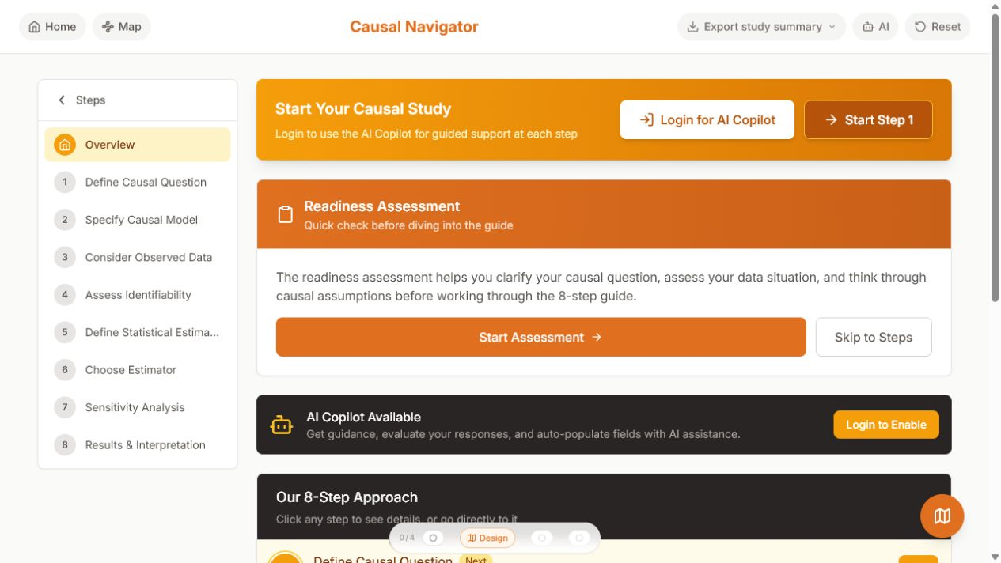
The Navigator is an eight-step spine
Overview
1 Question
2 Causal model
3 Observed data
4 Identification
5 Estimand
6 Estimator
7 Sensitivity
8 Interpretation
Each answer constrains the next.
Notes:
The live website can be used without login for manual entry and Markdown/text export.
[Sources]
- https://navigator.tao-rwd.com/navigator
- modules/F/art/navigator-overview.png

Slide 4
Steps 1-2: protocol first, then the DAG
Question + model
Protocol
▪
Population: 5,000 simulated adults.
W
age · prior pneumonia · prior vaccine
▪
Treatment: vaccination at baseline.
▪
Outcome: pneumonia hospitalization by 12 months.
A
Y
▪
Contrast: average risk difference.
vaccination
pneumonia
Adjustment set: age, prior pneumonia, and prior vaccination.
Notes:
The full five-node, nine-edge DAG is provided in the participant kit.
[Sources]
- modules/F/pneumonia.dagitty.txt
- modules/F/pneumonia-navigator-student-guide.md

Slide 5
Steps 3-4: map the data, then audit identification
Data + assumptions
5,000
1,627
334
Identification assumptions
people
vaccinated
events
▪
Exchangeability: holds given W in the simulation.
▪
Positivity: propensities stay about 0.08-0.91.
▪
Consistency: one baseline treatment version.
▪
No interference: assumed.
Point-treatment cohort · no missingness · complete 12-month outcomes
In real EHR data, every one of these needs evidence.
Notes:
The assumptions are true by construction only in the synthetic data-generating process.
[Sources]
- modules/F/data/pneumonia_data.csv
- modules/F/outputs/pneumonia_diagnostics.csv
- modules/F/causal-roadmap-pneumonia-worked-example.md

Slide 6
Steps 5-6: estimand before estimator
Target + method
CAUSAL TARGET
Primary estimator
E[Y¹] - E[Y⁰]
TMLE
STATISTICAL ESTIMAND
▪
Q(A,W): outcome regression
Eₓ{E(Y|A=1,W)
- E(Y|A=0,W)}
▪
g(W): treatment mechanism
▪
Learners: GLM, glmnet, ranger
▪
CI: efficient influence function
The estimator targets the quantity already chosen.
Notes:
This slide is the bridge to Module G. The learner library is prespecified in the completed R script.
[Sources]
- modules/F/code/pneumonia_navigator_tmle.R
- modules/F/causal-roadmap-pneumonia-worked-example.md

Slide 7
Step 7: plan how the conclusion could fail
Sensitivity
Unmeasured confounding
Could residual frailty or healthcare-seeking move the RD by +3 points?
Outcome error
Would imperfect pneumonia coding change direction or magnitude?
Selection
What if death, disenrollment, or EHR capture is informative?
Estimation
Do alternative learners or propensity truncation change the result?
A confidence interval does not measure these causal gaps.
Notes:
Sensitivity analyses address causal and measurement assumptions that are outside ordinary sampling uncertainty.
[Sources]
- modules/F/pneumonia-navigator-student-guide.md
- modules/F/causal-roadmap-pneumonia-worked-example.md

Slide 8
The sign reversal is the teaching result
Results
12-month risk difference (percentage points)
Crude: +0.76 pp
TMLE: -3.04 pp
95% CI: -4.61 to -1.47 pp
Synthetic teaching result - not clinical evidence
Notes:
The adjusted methods agree on direction. Agreement does not by itself validate the real-world assumptions.
[Sources]
- modules/F/outputs/pneumonia_results.csv
- modules/F/code/pneumonia_navigator_tmle.R

Slide 9
Step 8: conclude only what the design supports
Interpretation
Supported
Still unknown
In this known simulation, adjustment reverses the crude association and recovers a protective direction close to the causal truth.
▪
Clinical vaccine effectiveness
▪
Safety
▪
Transportability to patients
▪
Real EHR confounding and measurement error
▪
Population transmission effects
The defensible conclusion is about the workflow, not the vaccine.
Notes:
Use the full completed roadmap for the exact limitations and interpretation wording.
[Sources]
- modules/F/causal-roadmap-pneumonia-worked-example.md
- modules/F/pneumonia-navigator-student-guide.md

Slide 10
Your turn: defend one Navigator entry
Workshop prompt
Choose one field from Steps 1-8.
1
What evidence makes the entry defensible?
2
What would make you revise it?
3
Which downstream decision changes if you revise it?
Use the completed roadmap as an answer key - not as a substitute for your argument.
Notes:
Participant exercise. The Markdown guide and completed export are included alongside this deck.
[Sources]
- modules/F/pneumonia-navigator-student-guide.md
- modules/F/causal-roadmap-pneumonia-worked-example.md

