Slide 1

Live Causal Navigator
Pneumococcal vaccination and pneumonia
Module F · Standalone workshop
August 5, 2026 · 3:15-4:10 ET
Andy Wilson
Notes:
Open by connecting this module directly to the roadmap work completed in Module D.
[Sources]
- modules/D/SegmentD_Roadmap.tex
- modules/D/art/InStats_RWL.png
- modules/F/README.md

Slide 2
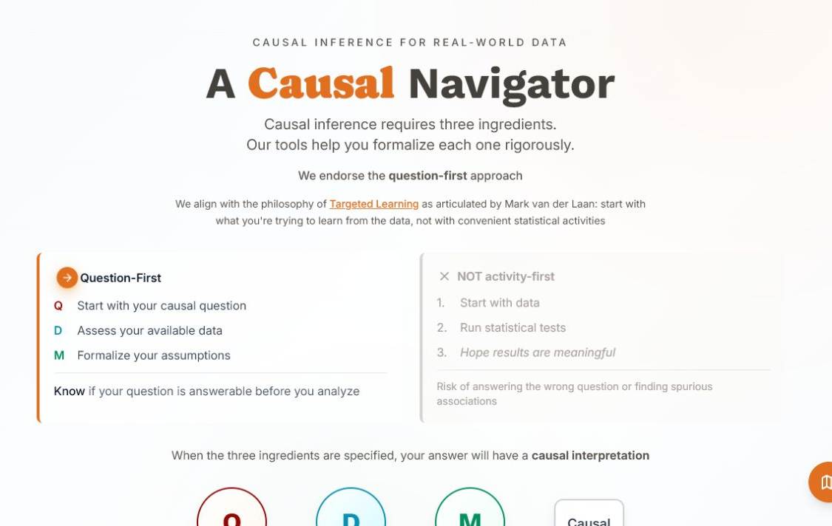
The roadmap becomes a working record
Module F
MODULE D → MODULE F
Same causal logic.
Now every decision is visible, revisable, and exportable.
The Navigator is documentation infrastructure - not an oracle.
Notes:
Keep this introduction under two minutes. The main point is continuity: the tool records the roadmap participants already know.
[Sources]
- https://navigator.tao-rwd.com/ (captured 2026-07-26)
- modules/F/art/navigator-home.png
- modules/D/SegmentD_Roadmap.tex

Slide 3
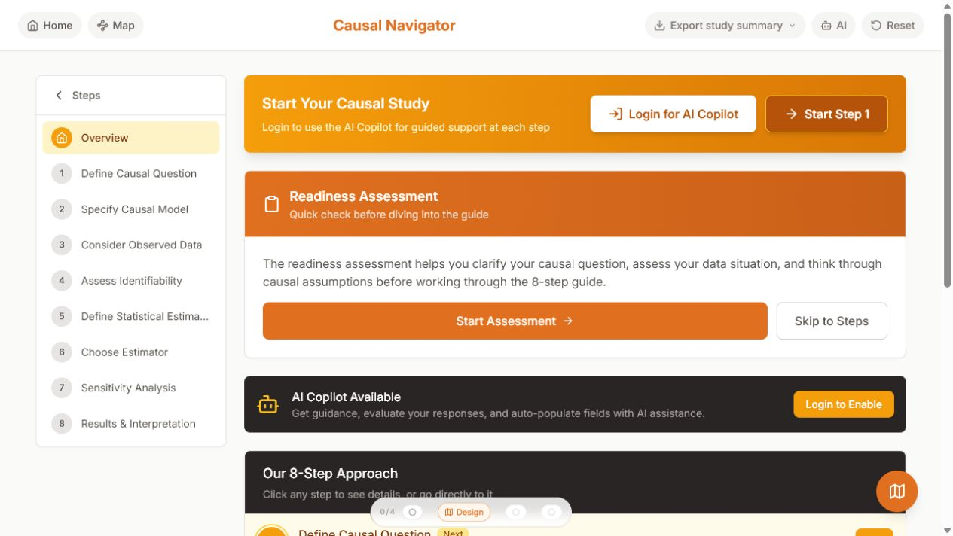
Eight steps, no login, one export
Orientation
▪
Start at Step 1. Use the manual route.
▪
Work in order. Pause at design decisions.
▪
Export at Step 8. Keep the Markdown audit trail.
AI support is optional and not used in this workshop.
Notes:
Show the no-login route and point out the export control. Avoid opening the AI panel during the live demonstration.
[Sources]
- https://navigator.tao-rwd.com/navigator
- modules/F/art/navigator-overview.png
- roadmap/src/constants/roadmapSteps.ts

Slide 4
The crude comparison tells the wrong story
The paradox
Observed 12-month pneumonia risk
Higher-risk adults are more likely to be vaccinated. The association mixes baseline risk with the vaccine effect.
7.19%
6.43%
vaccinated
unvaccinated
Crude RD
Question for the room
+0.76 percentage points
What must be specified before we decide whether this is harm, protection, or neither?
Notes:
Pause for responses. Do not reveal the adjusted result yet. Ask participants to name the missing design decisions.
[Sources]
- modules/F/data/pneumonia_data.csv
- ops/materials/sessions/Session 1a/R example/pneumonia_vaccine_example.Rmd
- modules/F/outputs/pneumonia_diagnostics.csv

Slide 5
Lock the target trial before the result
Step 1 setup
PREPARED STUDY
Population
Synthetic adult cohort, N=5,000; age centered at 65
Treatment
Vaccination at baseline (A=1)
Comparator
No vaccination at baseline (A=0)
Outcome
Pneumonia hospitalization within 12 months
Contrast
Average 12-month risk difference
Eligibility, treatment assignment, and follow-up all begin at the same time zero.
Notes:
Make the population wording explicit: the current teaching data are centered at age 65, not restricted to 65 and older.
[Sources]
- modules/F/causal-roadmap-pneumonia-worked-example.md
- modules/F/data/pneumonia_data.csv
- modules/D/SegmentD_Roadmap.tex

Slide 6
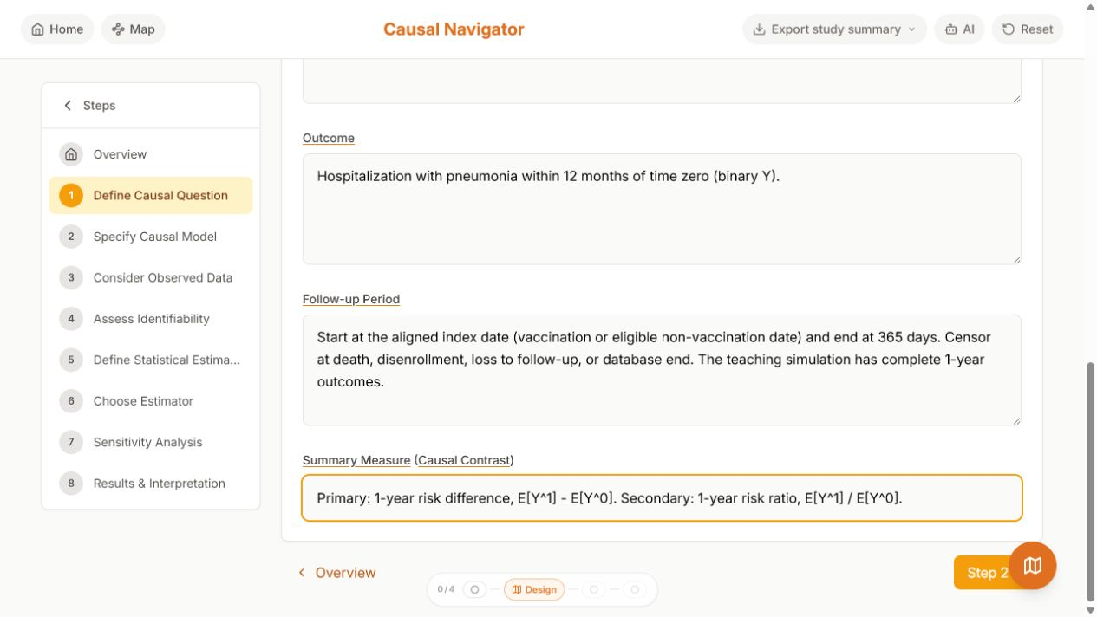
Step 1: question-first means fully specified
Navigator
1
Define the causal question
▪
Intervention, comparator, and time zero
▪
Population and eligibility
▪
Outcome horizon
▪
Causal contrast
Notes:
Populate Step 1 live. Ask which single phrase would most change the estimand.
[Sources]
- https://navigator.tao-rwd.com/navigator/1
- modules/F/art/navigator-step1-question.png
- modules/F/causal-roadmap-pneumonia-worked-example.md

Slide 7
Step 2: the DAG names the adjustment set
Causal model
The workshop view
A compact model makes the confounding structure visible.
W
age · prior pneumonia · prior vaccine
▪
Adjust for age and prior history.
▪
Do not adjust for post-baseline descendants.
A
Y
vaccination
pneumonia
▪
Paste the full DAGitty from the participant kit.
Simplified workshop DAG. The kit preserves all five nodes and nine edges.
Notes:
Use the simplified diagram for discussion, then paste the full DAGitty file through Bring your own. The full DAG includes age causing both prior-history variables.
[Sources]
- modules/F/pneumonia.dagitty.txt
- modules/F/causal-roadmap-pneumonia-worked-example.md
- ops/materials/sessions/Session 1a/R example/pneumonia_vaccine_example.Rmd

Slide 8
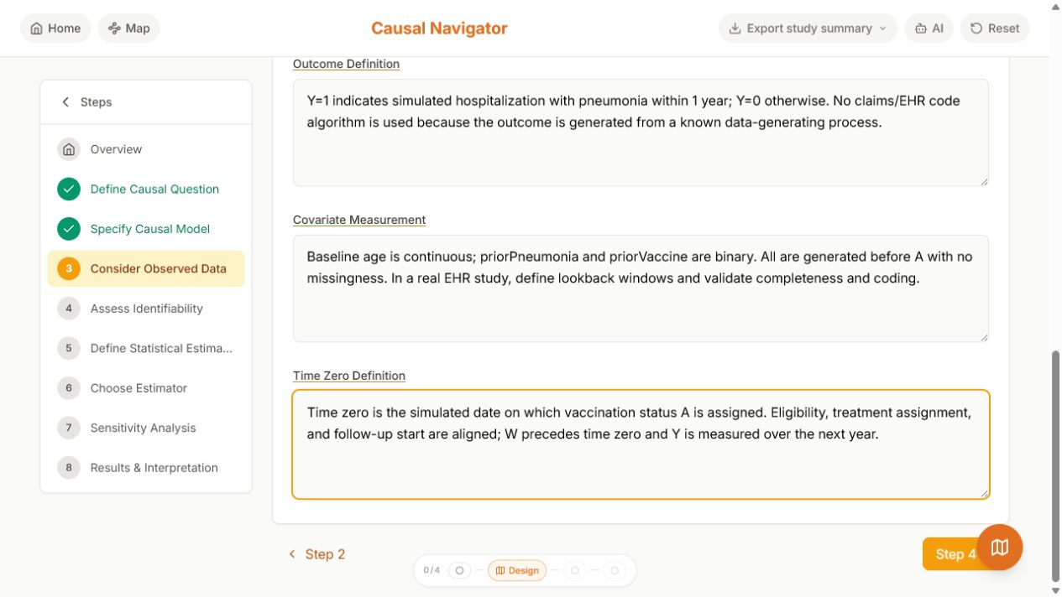
Step 3: make the protocol computable
Observed data
3
Consider observed data
5,000
people
1,627
vaccinated
334
pneumonia events
Notes:
Map each protocol element to a variable and measurement window. Stress that the simulation has perfect measurement only by construction.
[Sources]
- https://navigator.tao-rwd.com/navigator/3
- modules/F/art/navigator-step3-data.png
- modules/F/data/pneumonia_data.csv
- modules/F/outputs/pneumonia_diagnostics.csv

Slide 9
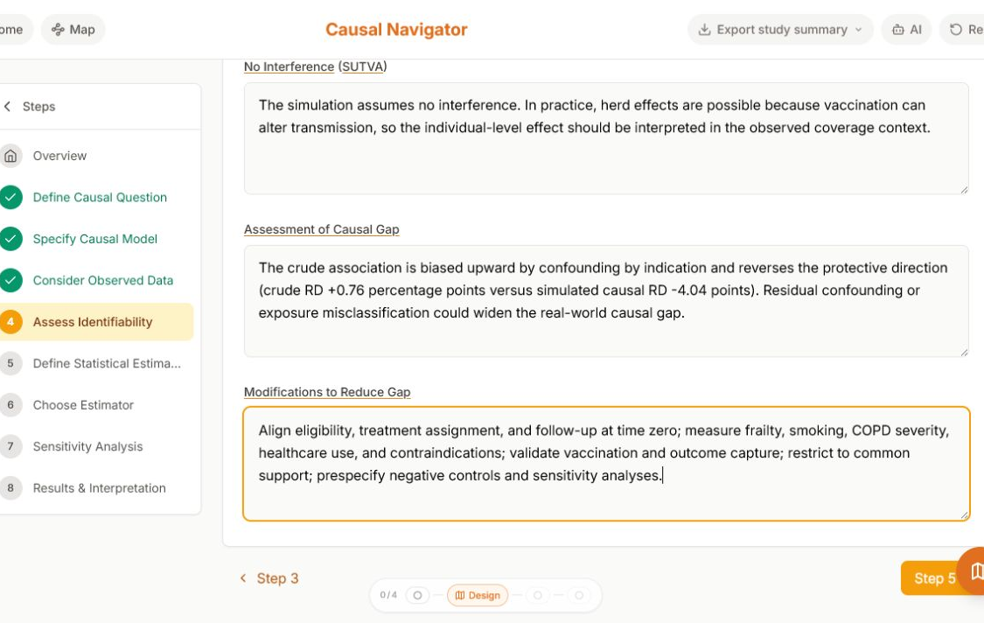
Step 4 is the audit gate
Identification
Can the observed data answer the causal question?
▪
Exchangeability given W
▪
Practical positivity
VERIFIED WORKSHOP ENTRY
Crude RD +0.76 pp reverses the seeded intervention truth (-3.70 pp): confounding by indication.
▪
Consistency
▪
No interference
If the answer is uncertain, name the causal gap before choosing an estimator.
Notes:
Pause here for the main workshop discussion. Ask which assumption would be least credible in a real EHR study and what evidence would change that judgment.
[Sources]
- https://navigator.tao-rwd.com/navigator/4
- modules/F/art/navigator-step4-identifiability.png
- modules/F/causal-roadmap-pneumonia-worked-example.md

Slide 10
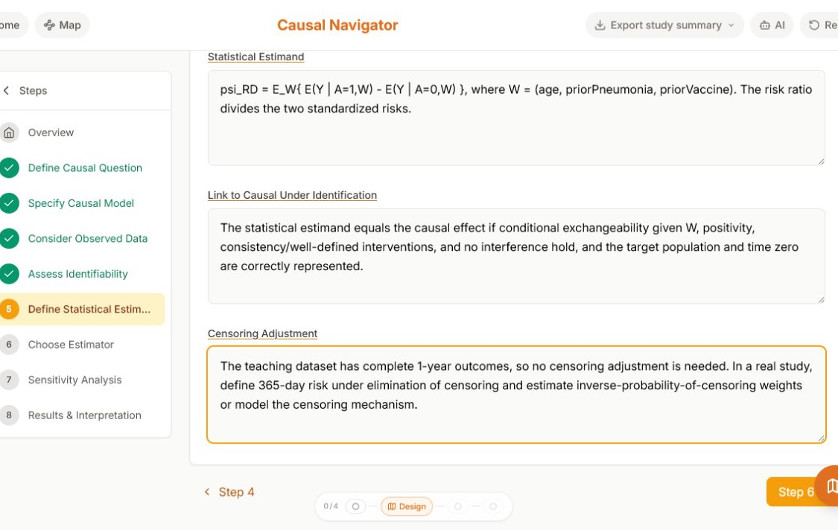
Step 5: translate the causal target, exactly
Estimand
CAUSAL
ψ = E[Y¹] - E[Y⁰]
OBSERVED-DATA MAPPING
Eₓ{ E(Y | A=1,W)
- E(Y | A=0,W) }
Equality requires the Step 4 assumptions.
Notes:
Read the mapping aloud. Ask participants what changes if the target population, outcome window, or censoring intervention changes.
[Sources]
- https://navigator.tao-rwd.com/navigator/5
- modules/F/art/navigator-step5-estimand.png
- modules/F/causal-roadmap-pneumonia-worked-example.md

Slide 11
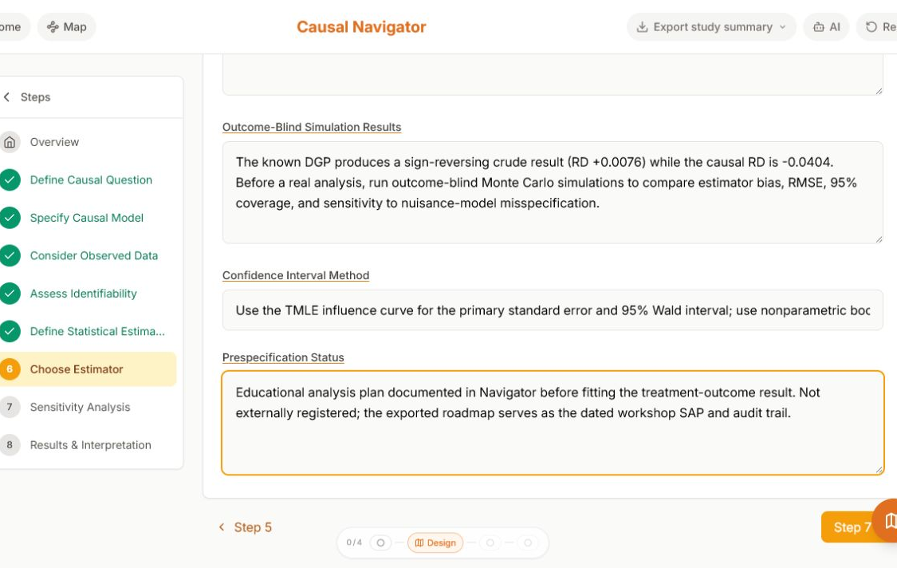
Step 6: choose an estimator for that target
TMLE bridge
6
Choose the estimator
▪
Primary: TMLE for the risk difference.
VERIFIED OUTCOME-BLIND CHECK
Crude RD +0.76 pp; seeded intervention truth -3.70 pp. Compare estimator bias and RMSE before looking at outcomes.
▪
Q(A,W): outcome regression.
▪
g(W): treatment mechanism.
▪
Uncertainty: influence-function 95% CI.
An estimator can reduce statistical bias. It cannot repair a bad question, missing time zero, or an unidentified effect.
Notes:
This is the explicit bridge to Module G. Keep the implementation detail light; focus on why the estimator is downstream of the estimand.
[Sources]
- https://navigator.tao-rwd.com/navigator/6
- modules/F/art/navigator-step6-estimator.png
- modules/F/code/pneumonia_navigator_tmle.R
- modules/G/README.md

Slide 12
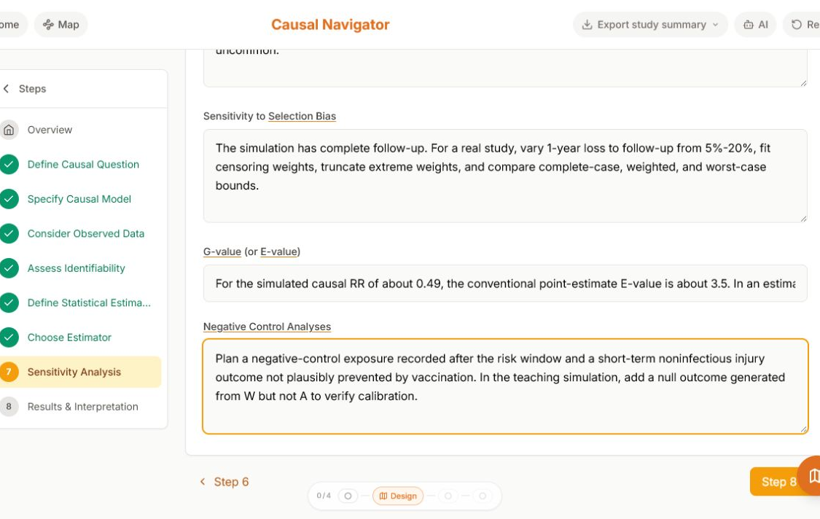
Step 7: sensitivity is part of the design
Causal gap
Prespecify the stress tests before the result.
▪
Unmeasured confounding
▪
Outcome misclassification
▪
Selection and censoring
For the simulated causal RR of 0.51, the point-estimate E-value is about 3.30.
▪
Alternative learners and truncation
Robustness threshold: about +3 percentage points would move the TMLE point estimate to the null.
Notes:
Ask whether a confidence interval can address any of these causal gaps. The answer is no: these require separate assumptions and analyses.
[Sources]
- https://navigator.tao-rwd.com/navigator/7
- modules/F/art/navigator-step7-sensitivity.png
- modules/F/causal-roadmap-pneumonia-worked-example.md

Slide 13
Adjustment reverses the sign
Result reveal
12-month risk difference (percentage points)
Crude
+0.76 pp
TMLE
-3.04 pp
95% CI: -4.61 to -1.47 pp
Same data. Different question answered.
Synthetic teaching result - not clinical evidence
Notes:
Reveal the estimates only after Steps 1-7 are fixed. Explain that estimator agreement supports the teaching story but does not prove the identification assumptions in real data.
[Sources]
- modules/F/outputs/pneumonia_results.csv
- modules/F/code/pneumonia_navigator_tmle.R
- ops/materials/sessions/Session 1a/R example/pneumonia_vaccine_example.Rmd

Slide 14
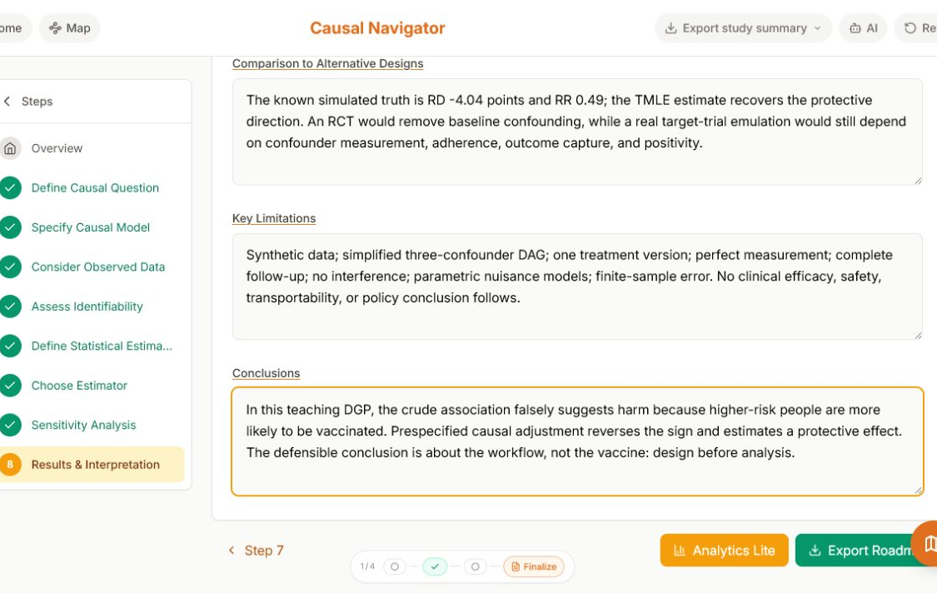
Step 8: interpretation inherits every prior assumption
Finalize
Defensible
“In this teaching simulation, roadmap-guided adjustment recovers the protective direction.”
VERIFIED COMPARISON
Known intervention simulation: RD -3.70 pp, RR 0.51. TMLE recovers the protective direction; real studies still depend on measurement, adherence, capture, and positivity.
VERIFIED LIMITATIONS
Synthetic data; three-confounder DAG; perfect measurement; complete follow-up; no interference; Super Learner nuisance models; finite-sample error. No clinical or policy conclusion follows.
Not defensible
“The vaccine prevents pneumonia in real patients.”
Notes:
Read both statements and ask participants to explain the difference using one Step 4 assumption and one limitation.
[Sources]
- https://navigator.tao-rwd.com/navigator/8
- modules/F/art/navigator-step8-results.png
- modules/F/causal-roadmap-pneumonia-worked-example.md

Slide 15
Export the plan, then defend one decision
Participant challenge
The participant kit
Complete roadmap
causal-roadmap-pneumonia-worked-example.md
ONE DECISION TO DEFEND
Choose one Navigator field.
Student guide
Pneumonia_Navigator_Student_Guide.pdf
1. What evidence makes the entry defensible?
2. What would make you revise it?
DAGitty
pneumonia.dagitty.txt
Data
data/pneumonia_data.csv
Analysis
code/pneumonia_navigator_tmle.R
Compare with a partner before the export.
Notes:
Give pairs three minutes to select and defend one field, then take two examples. Export the Markdown roadmap at the end.
[Sources]
- modules/F/facilitator-live-demo.md
- modules/F/pneumonia-navigator-student-guide.md
- modules/F/causal-roadmap-pneumonia-worked-example.md

Slide 16
The estimator is now downstream of the science
Handoff to Module G
Module F leaves us with:
Module G
▪
a specified target trial
implements the TMLE chosen here - without reopening the scientific question.
▪
an explicit causal model
▪
an identification argument
▪
a statistical estimand
▪
a prespecified estimator and sensitivity plan
Design first. Estimate second. Interpret last.
Notes:
Close the workshop by naming the handoff: Module G is implementation of the already-specified estimand, not a new search for a convenient analysis.
[Sources]
- modules/G/README.md
- modules/F/causal-roadmap-pneumonia-worked-example.md
- modules/D/SegmentD_Roadmap.tex

