Slide 1
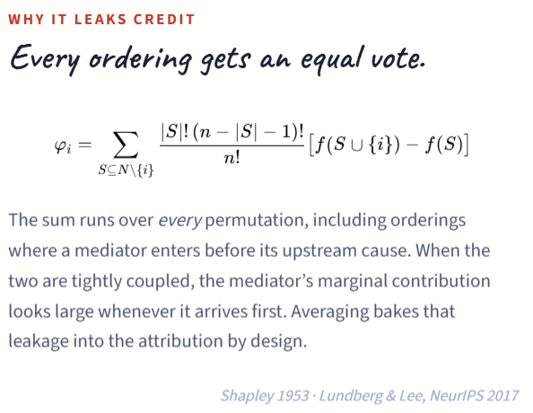
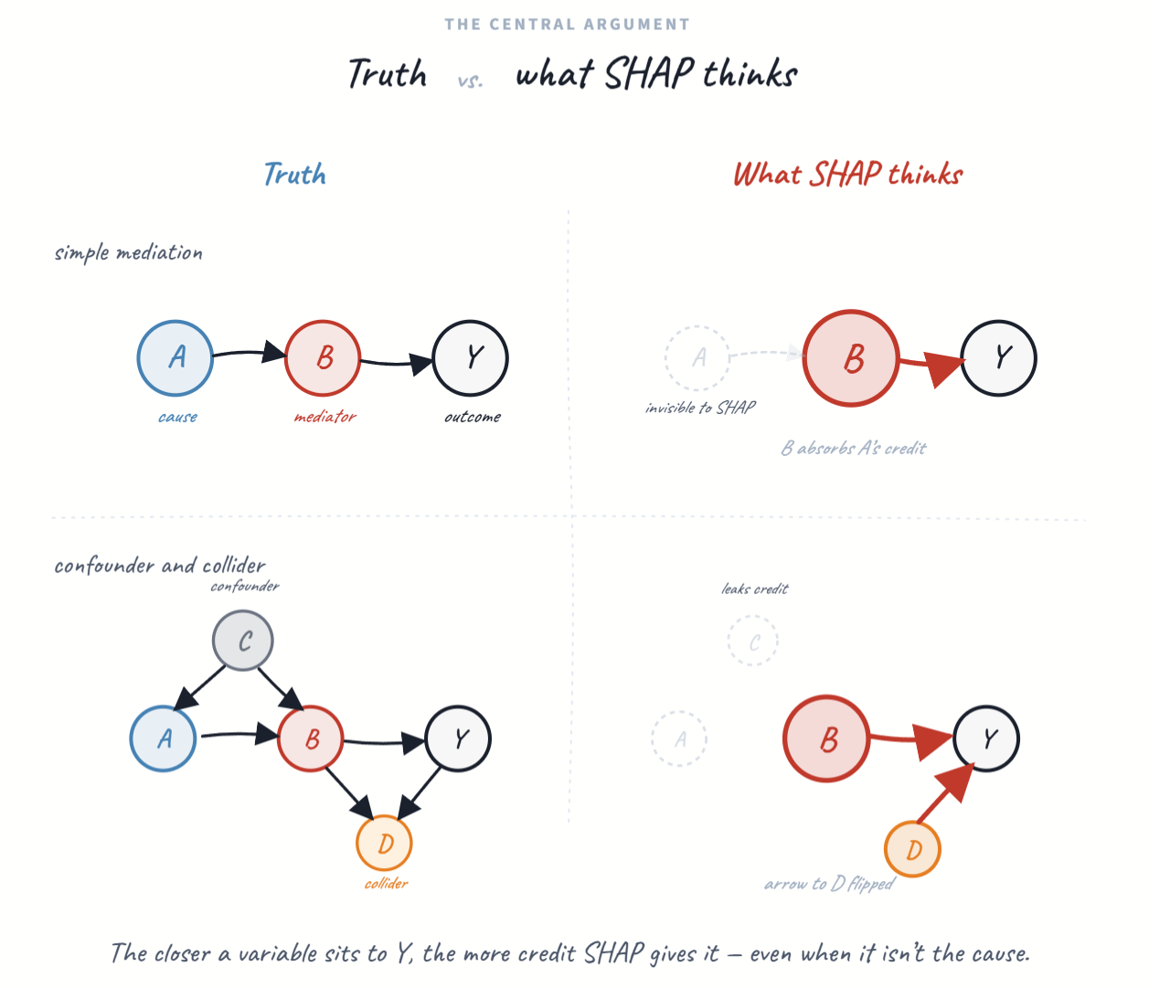
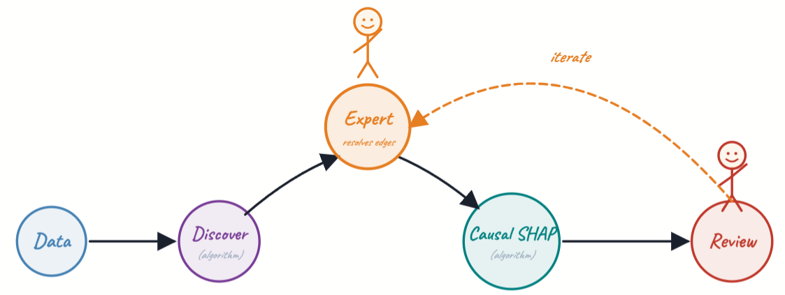
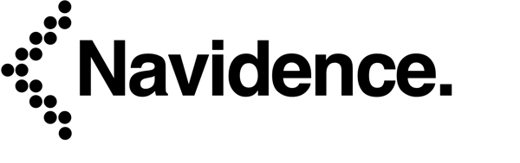
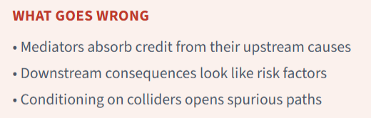


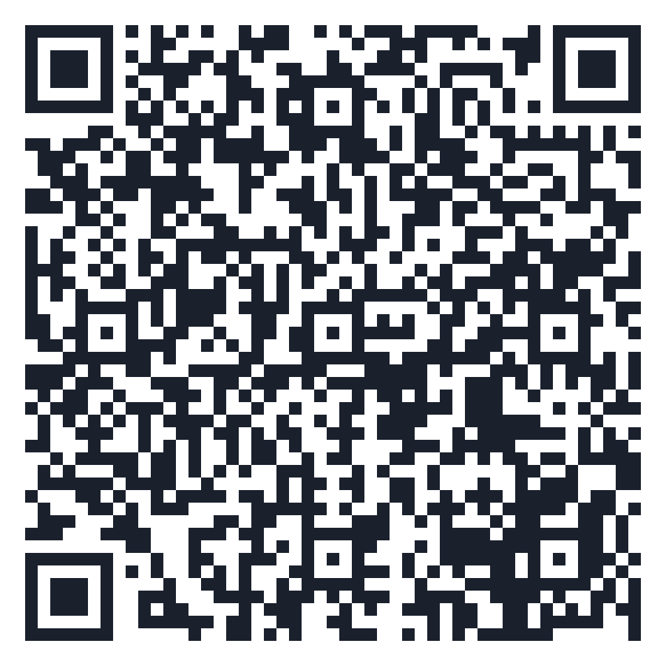
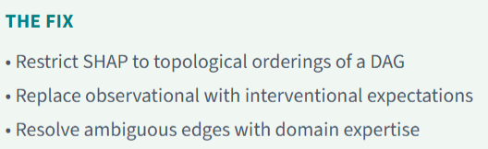
Expert-Augmented Causal SHAP: recovering DAG-consistent feature importance via iterative causal discovery and domain knowledge.
SHAP has short memory.
Downstream variables HOG credit!
Aimee Harrison¹, Lexi Pasi², Justin Ross³, Jenny Alderden⁴, Andy Wilson^{3*}
*Presenter
Causal SHAP is not an automated pipeline. It’s a disciplined collaboration: the discovery algorithm proposes, the expert disposes, and the attribution is grounded in a DAG that both parties can defend. The app (Python Shiny) threads these five steps into a single interactive environment.
Abstract
Feature importance methods such as SHAP are widely used to help explain machine learning models in health research and other areas. Yet these methods can misattribute feature importance when features have causal structure. Specifically, mediators can absorb credit from upstream causes — a topological artifact that inflates their apparent importance at the expense of upstream causal drivers.
We propose an expert-augmented workflow for DAG-consistent feature attribution that combines constrained causal discovery with an interactive DAG interface to resolve ambiguous edges before computing causal SHAP. The workflow supports iterative refinement through required and forbidden edges and compares standard, DAG-constrained, and adjustment-set SHAP.
We evaluated the approach in synthetic data generated under known DAGs using the R package simcausal and in real-world MIMIC-IV data. In simulations, standard SHAP over-attributed importance to mediators, whereas causal SHAP re-ranked features (Kendall’s τ=0.42 between methods) and reduced mediator inflation. In MIMIC-IV, the expert-informed DAG helped distinguish upstream severity drivers from downstream interventions. These results support expert-guided DAG refinement as a practical route to more causally coherent explanations in structured clinical machine learning.
No existing tool formalizes this iterative expert-in-the-loop refinement from CPDAG to resolved DAG to causal attribution. The value isn’t any single step → it’s the cycle, with immediate visual feedback on how DAG edits change the attributions.
¹Navidence,
²Lucidity Sciences,
³University of Utah,
⁴Boise State University
QR Code
Notes:
Notes:
In Powerpoint, click View > Guides
Keep text within gutter guides.
Author list: Don’t split names onto two lines (e.g., “Jimmy [break] Smith”). If that happens, use a new line, unless you need the space. Bold the first names of anybody who’s presenting in person.
Intro/methods/result: Do not drop below font size 28, but if you have extra space, jack up the font size until the space is full.
Do not use color in the sidebars except in graphs/figures. It’ll pull attention from the center and slow interpretation for passersby.

