Slide 1
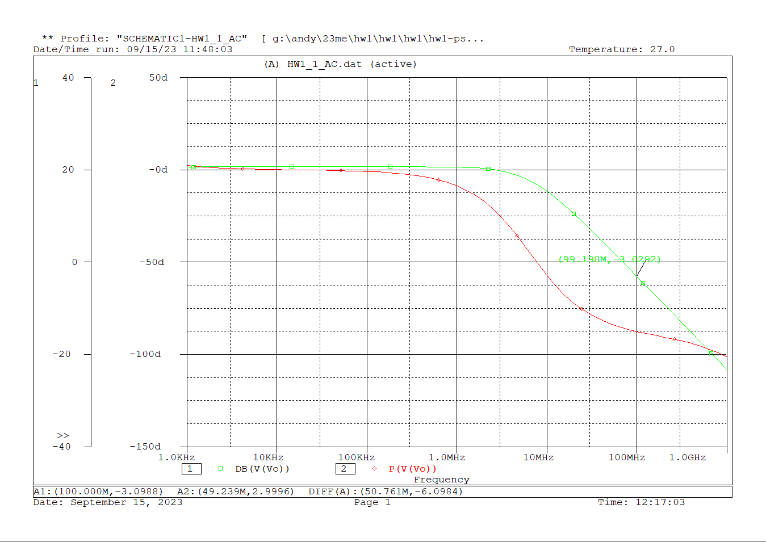


Slide 2
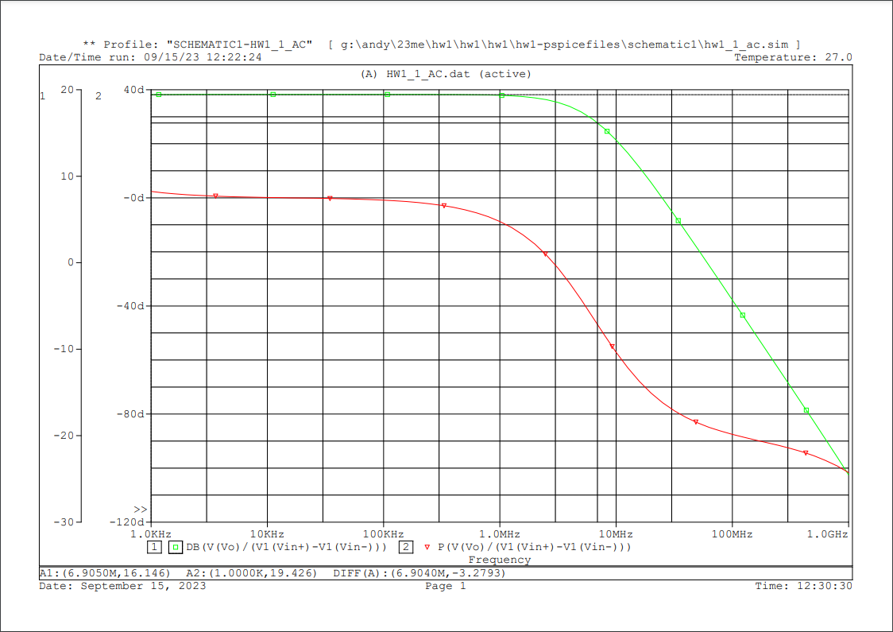
從最高的DB往下數3DB(?) a.k.a.:
max(db)-3 (?)
(^^^) If this is right, -3db freq. … =>

Slide 3
