Slide 1
VLSI System Design
Combinational Logic
李昆忠
國立成功大學電機系
06-2757575 X 62371
kjlee@mail.ncku.edu.tw

Slide 2
Combinational Logic
Multiplexor
Decoder
Priority Encoder
Adder
Parity Checker
Tri-state
Combinational.<number>

Slide 3
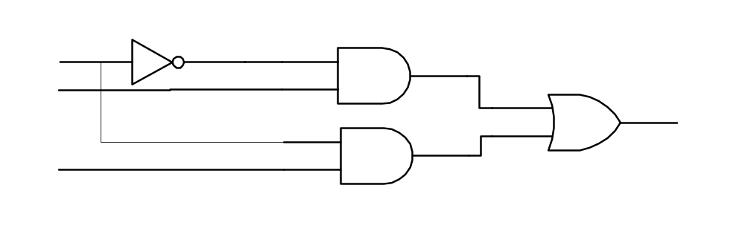
Multiplexor
Net-list (gate-level)
Continuous assignment
RTL modeling
module mux2_1(out,a,b,sel)
output out;
input a,b,sel;
not(sel_,sel);
and(a1,a,sel_);
and(b1,b,sel);
or(out,a1,b1);
endmodule
module mux2_1(out,a,b,sel)
output out;
input a,b,sel;
assign out= (a&~sel)|(b&sel);
endmodule
always @(a or b or sel)
if (sel)
out = b;
else
out = a;
not
sel_
sel
a1
a
and2
or2
out
and2
b1
b
Combinational.<number>

Slide 4
4-to-1 multiplexor
RTL
Always Assignment
4-to-1 multiplexor
4-to-1 multiplexor
module mux4_1(out,in,sel) ;
output out ;
input[3:0] in ;
input[1:0] sel ;
reg out ;
always @(sel or in) begin
case(sel)
2’d0: out = in[0];
2’d1: out = in[1];
2’d2: out = in[2];
2’d3: out = in[3];
default: 1’bx;
endcase
end
endmodule
or
module mux4_1(out,in0,in1,in2,in3,sel) ;
output out ;
input in0,in1,in2,in3 ;
input[1:0]sel ;
assign out =
(sel ==2’b00)? in0 :
(sel ==2’b01)? in1 :
(sel ==2’b10)? in2 :
(sel ==2’b11)? in3 :
1’bx;
endmodule
always @(sel or in) out = in[sel];
Combinational.<number>

Slide 5
Decoder
3-to-8 decoder with enable control
module decoder(o,enb_,sel) ;
output [7:0] o ;
input enb_ ;
input [2:0] sel ;
reg [7:0] o ;
always @ (enb_ or sel)
if(enb_)
o = 8’b1111_1111 ;
else
case(sel)
3’b000:o=8’b1111_1110 ;
3’b001:o=8’b1111_1101 ;
3’b010:o=8’b1111_1011 ;
3’b011:o=8’b1111_0111 ;
3’b100:o=8’b1110_1111 ;
3’b101:o=8’b1101_1111 ;
3’b110:o=8’b1011_1111 ;
3’b111:o=8’b0111_1111 ;
default:o=8’bx;
endcase
endmodule
Combinational.<number>

Slide 6
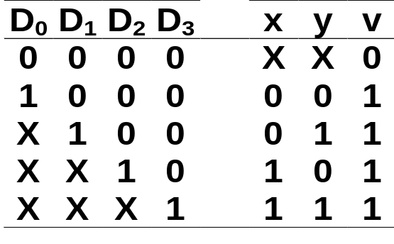
Priority Encoder
always @ (d0 or d1 or d2 or d3)
if(d3 == 1)
{x,y,v} = 3’b111 ;
else
if(d2 == 1)
{x,y,v} = 3’b101 ;
else
if(d1 == 1)
{x,y,v} = 3’b011 ;
else
if(d0 == 1)
{x,y,v} = 3’b001 ;
else
{x,y,v} = 3’bxx0 ;
inputs
outputs
Combinational.<number>

Slide 7
4-bit Adder in RTL
module fouradd(A,B,Ci,S,Co);
input [3:0] A, B;
input Ci;
output [3:0] S;
output Co;
reg [3:0] S;
reg Co;
integer i;
always begin
i=A+B+Ci;
S = i;
Co = i[4];
end
endmodule
Or
assign {Co, S} = A + B + Ci;
Combinational.<number>

Slide 8
Adder in Structural Level
module fouradd ( s, co, a, b, ci);
input ci;
input [3:0] a, b;
output [3:0] s;
output co;
fulladd fulladd0 (c0, s[0], a[0], b[0], ci);
fulladd fulladd1 (c1, s[1], a[1], b[1], c0);
fulladd fulladd2 (c2, s[2], a[2], b[2], c1);
fulladd fulladd3 (co, s[3], a[3], b[3], c2);
endmodule
module fulladd (co, s, a, b, ci);
input a, b, ci;
output co, s;
Combinational.<number>

Slide 9
Adder in Structural Level (cont.)
halfadd halfadd1 (d, g, a, b),
halfadd2 (h, s, g, ci):
or c1 (co, d, h);
endmodule
module halfadd (co, s, a, b);
input a, b;
output s, co;
and a1(co, a, b);
and a4(s, f, e);
or a2(f, a, b);
not a3(e, co);
endmodule
Combinational.<number>

Slide 10
Testfixture for adder
module test_adder;
reg [3:0] A,B;
reg Ci;
wire [3:0] S;
wire Co;
fouradd Add(S, Co, A, B, Ci);
initial begin : testfixture
integer i, j, k;
$gr_waves(“A”, A,“B”, B,”Ci”, Ci,”S”, S,”Co”, Co);
for ( i=0; i<2; i=i+1)
begin
Ci=i;
for ( j=0; j<16; j=j+1)
begin
A=j;
for (k=0; k<16; k=k+1)
Named begin-end block
Declare new local variables
in a named block
cont’d.
Combinational.<number>

Slide 11
Testfixture for adder (cont.)
begin
B=k;
#10;
end
end // for j
end // for i
$stop;
end // initial
endmodule
Delay of each iteration
Combinational.<number>

Slide 12
Parity Checker
module parity_chk(data,parity);
input[0:7] data ;
output parity ;
reg parity ;
always @(data)
begin:check_parity
reg partial;
integer n;
partial=data[0];
for(n=1;n<8;n=n+1)
begin
partial=partial^data[n];
end
parity=partial;
end
endmodule
Combinational.<number>

Slide 13
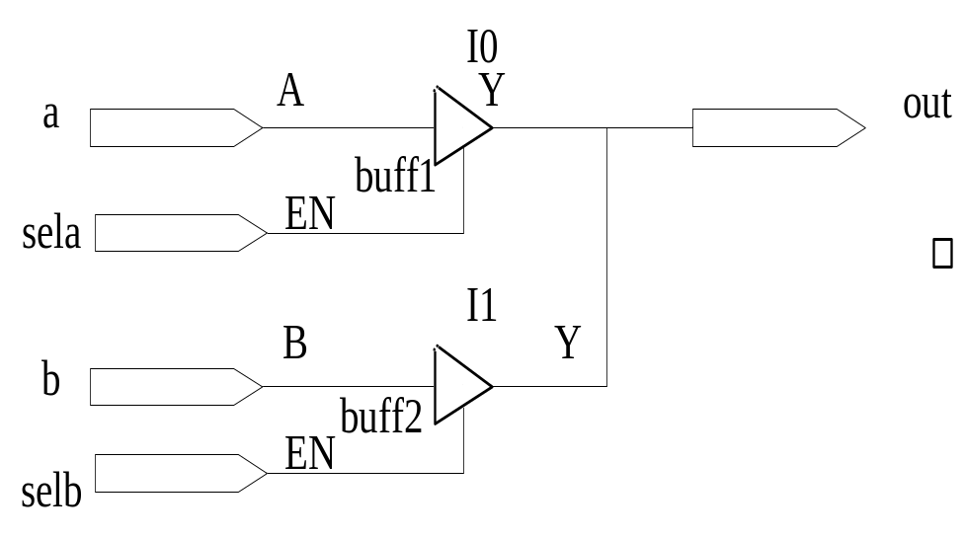
Tri-State Buffer
always @ (sela or a)
if(sela)
out=a;
else
out=1’bz;
always @ (selb or b)
if(selb)
out=b;
else
out=1’bz;
or
assign out=(sela)? a : 1’bz ;
assign out=(selb)? b : 1’bz ;
Combinational.<number>

