Slide 1


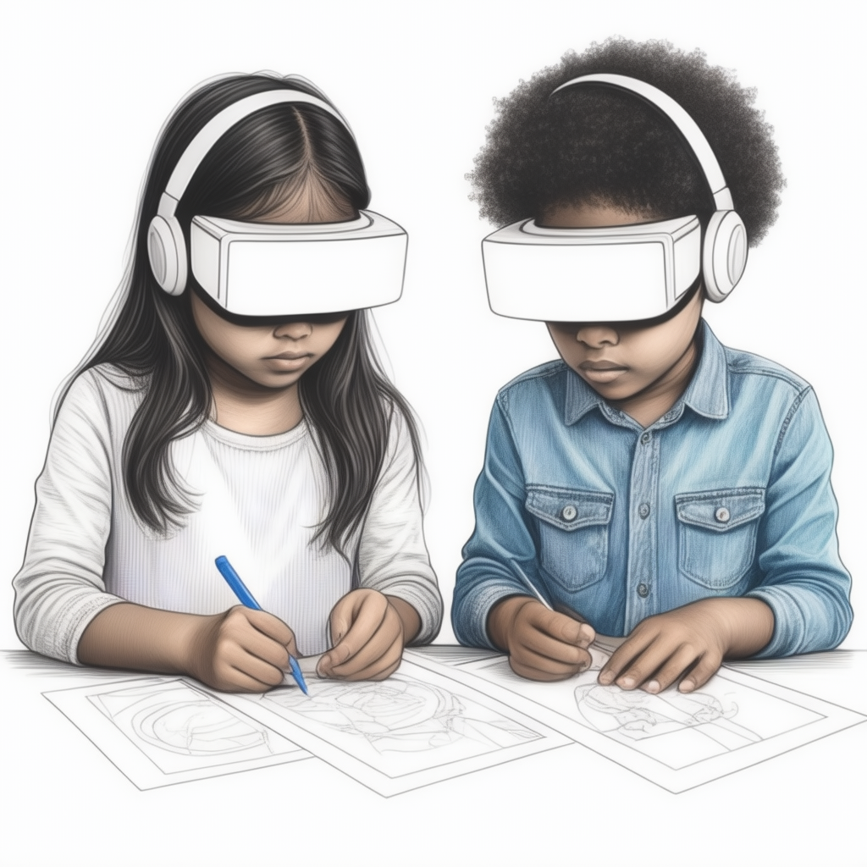
Stencil AR
Created by Andy Woods and Jackson Moore
Opensource github.com/andytwoods/StencilAR
opensource initiative logo GitHub logo (for source code)
Image via https://huggingface.co/spaces/multimodalart/stable-cascade
high quality image of two children of different ethnic backgrounds with a VR headsets looking towards drawings they are drawing on a sheet of paper on the wall

