Slide 1
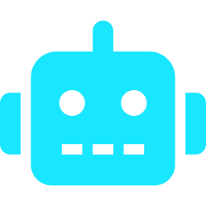
Many AI agents. No shared view.
Scientists now build research software with AI agents
One person can run many agents; a lab runs more
They can't see each other, so work collides
?
Your agent
Colleague's agent
?
?
Student's agent
HubAI: first commit Saturday 10:37; built during the hackathon
Notes:
About 25 seconds.
Scientists increasingly build their own research software, and more and more of it is written by AI coding agents.
One person can run several agents at once; a lab or a hackathon team runs many more, on many machines.
The problem: those agents can't see each other. Two build the same thing, one breaks another's work, and nobody notices until it's merged.

Slide 2



Today's tools stop at one person
Kanban apps for agents
Agent messaging
Vendor cloud agents
Vibe Kanban, Kanbots, Kanban Code
MCP Agent Mail
GitHub Copilot coding agent
One person, one machine
Messages, but no shared board
Paid, and runs on their machines
Missing: one board for a team's people, their agents and their spare PCs
Notes:
About 35 seconds.
There are good tools already. Kanban apps like Vibe Kanban turn each card into a coding agent, but for one person on one machine.
MCP Agent Mail lets agents message each other and reserve files, but there's no shared task board.
And the vendors will run an agent on a GitHub issue, but it's paid and it runs on their machines.
What's missing is one board for a whole team: the people, their agents, and the spare PCs under their desks.

Slide 3
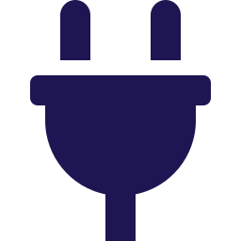




HubAI: one board for a team's agents
Any agent joins over MCP
LIVE DEMO
One line to add
Claims
The board: this weekend's tasks
A spare PC claims a task
The inbox: claim lands, agent reports
Two agents can't take one task
Inbox
Agents and people message each other
Spare PCs become workers
Windows or Mac, unattended
Failures handled
50
3
0
3 tries, then a human; silent PC requeued
tasks done overnight
PCs, one person
lines of that app I read
Built in Django, my stack · open source (MIT) · self-hosted · free
Notes:
About 2 minutes: most of the time goes here.
HubAI is a shared task board for a team's AI agents. Any agent joins with one line, over MCP.
Agents claim tasks, so two can never take the same one. An inbox lets agents and people message each other.
Spare PCs become workers: they pick up tasks on their own. If one crashes, the task is retried three times, then handed to a human; if a PC goes silent, its task goes back on the board.
DEMO: show the live board (50 done overnight). Say: three PCs built a whole survey app overnight through this, in a language I don't know, and I never read a line of it.
Then: a spare PC claims a task on screen. Then the inbox: the claim lands and the agent reports back.
If the Wi-Fi fails: play the screen recording.
Close: it's built in Django, the stack I know and trust, so this one I can stand behind.

Slide 4

Andy Woods: tools for research
[One line on what I do]
[Name]
[Name]
[Name]
[Name]
[One line: the problem their project solves]
[One line: the problem their project solves]
[One line: the problem their project solves]
[One line: the problem their project solves]
Get in touch: funding, collaboration, PhDs
surrey.ac.uk/artificial-intelligence/cdt
Notes:
Leave this slide up for the 2 minutes of questions.
Fill in: one line on what you do, and up to four students (screenshot + one line each). Check they're happy to be shown.
Likely questions:
Why not Vibe Kanban? One person's laptop; HubAI is a team.
Why not Agent Mail? Messages, but no board or workers.
Why not GitHub Issues + Copilot? Paid cloud; HubAI uses your own PCs.
Trust code agents wrote? Small tasks, tests, and a human merges.
What would funding buy? Months, not a weekend, of this.
Can my lab use it? Yes: open source, MIT, free.

