Slide 1
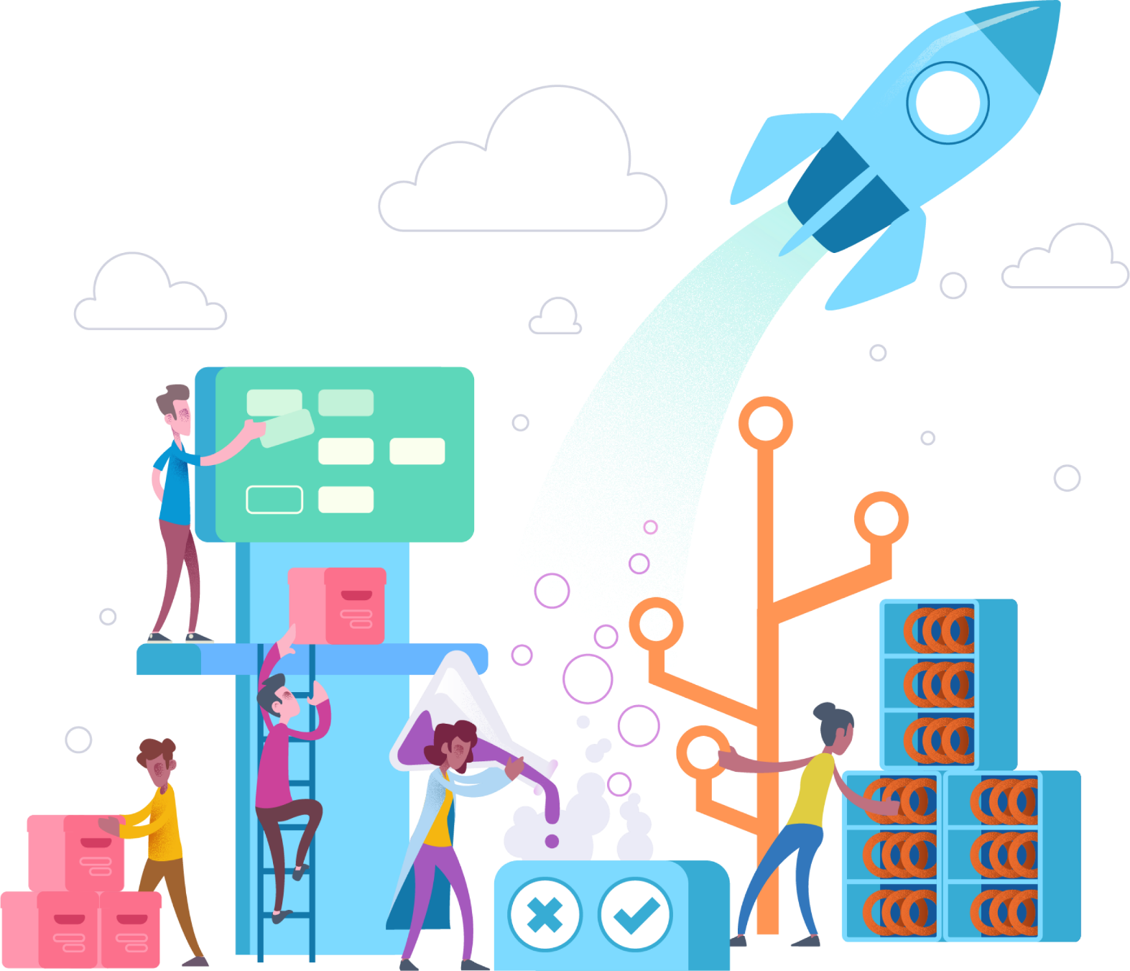
Microservices Architectural Approaches
Notes:
SPEAKER NOTES:
This slide deck may support educating the customers about Microservices. The target audience are customer architects and their senior engineers (Level 300/400).
It is mostly cloud agnostic, but Microsoft Azure can help a lot managing all this moving pieces. Microservices itself are quiet useful during app modernization and cloud migration.
Mastering microservices requires a high degree of automation, so additional education in Azure DevOps might be a possible follow-up to this presentation.
Finally looking into container orchestrators like Azure Kubernetes Service, Service Fabric and Service Fabric Mesh will also be required for adopting microservices in an efficient manner.

Slide 2
Welcome to the Microservices Discovery Day!
Enjoy a Video while we sit down!
Agenda and Housekeeping
Start with some info
Microservices Overview
Microservices in Azure
Hack and Play the rest of the day
Notes:
In a browser, open https://youtu.be/CKL3fV5UR8w and set YouTube to loop

Slide 3
Agenda
9:00–9:30am Registration
9:30-10:15am Microservices Overview
10:15-10:30am Break
10:30-11:30am Microservices in Azure
11:30-12:00pm Hack prep
12:00-12:30pm Lunch
12:30-4:00pm Hack: Deploying a working Microservices application in Azure
4:00-5:00pm Recap
Notes:
While also talking about the Agenda, get a feel for the folks in the room:
- How many people in the room their primary roles is Software Development or Software Architecture
- What development platforms are people using (.Net, Java, NodeJs, etc…)?

