Slide 1
Microservices: Deploy and Operate

Slide 2
Contoso Travel Web Overview
1 Web App
App Service
2 REST Services (Data and Itinerary)
Container Instance
1 Data Load program
Container Instance
1 Cosmos DB Account
1 Database
Individual Scalable Document Collections for Domain Isolation
App Insights to Monitor

Slide 3
Lab - Modules
Ready, Set, GO!
Always need App Insights
Get some Data!
Create the first thing!
Deploy some containers!
Deploy the Web Site
Get setup with the Azure Portal and Cloud Shell
Create a Resource Group to organize the application
Create an App Insights account to centralize application monitoring
Create the CosmosDB Account to hold the data
Deploy several containers as Container Instances
Deploy the Web Site

Slide 4
Challenge 0 - Pre-requisites
Ready, Set, Go!
Login to the Azure Portal
In another window, login to the Azure Cloud Shell
List your subscriptions with the Azure CLI

Slide 5
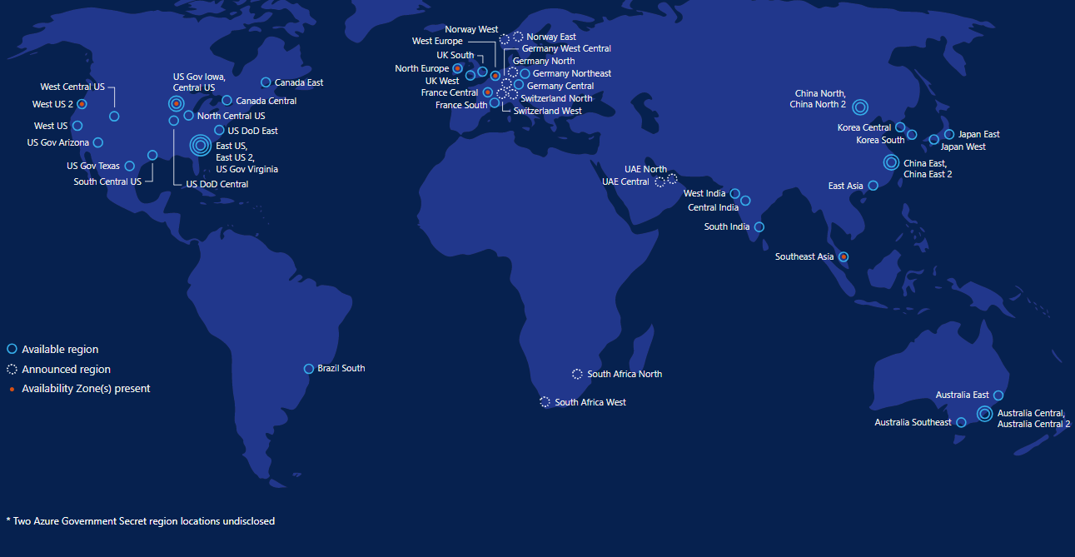
Azure Data Centers

Slide 6
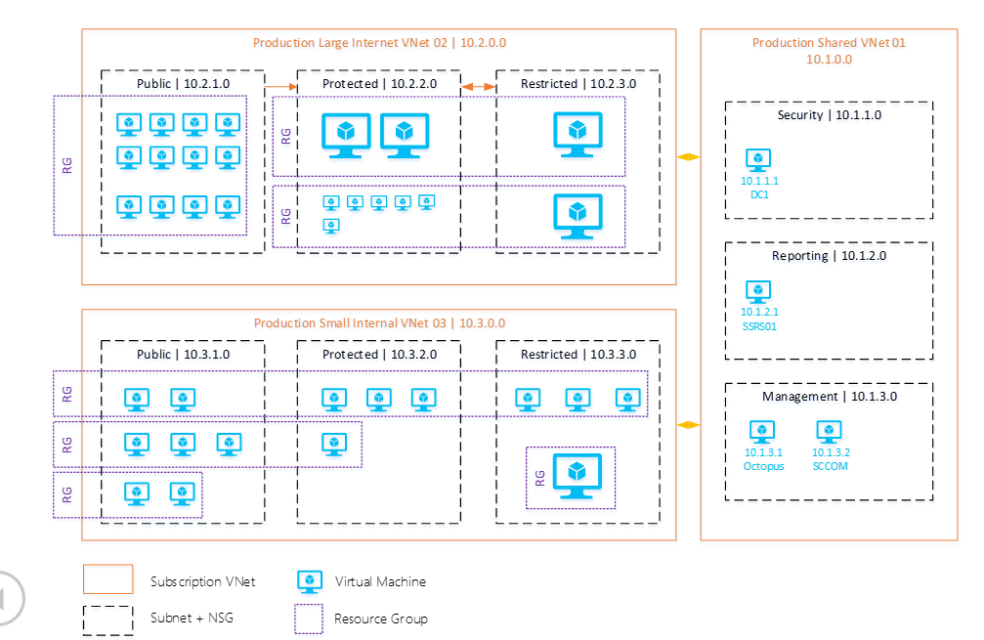
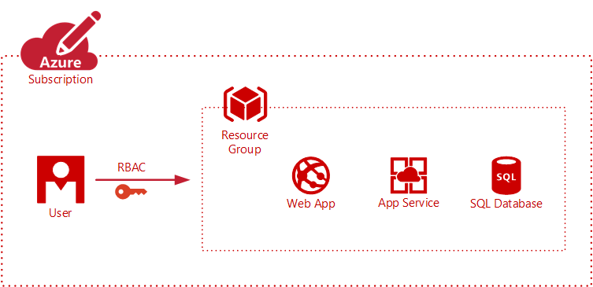
Resource Groups
Logically group related resources such as storage accounts, virtual networks, and virtual machines (VMs) to deploy, manage, and maintain them as a single entity.
This approach makes it easier to deploy applications while keeping all the related resources together from a management perspective, or to grant others access to that group of resources.

Slide 7
Challenge 1
Create the first thing!
Pick an Azure Data Center (closer is better)
Make up a 6 to 8 character (Alpha Number) code (Keep it clean ☺)
Create a variable with it’s Scripting Name
Create a Resource Group

Slide 8
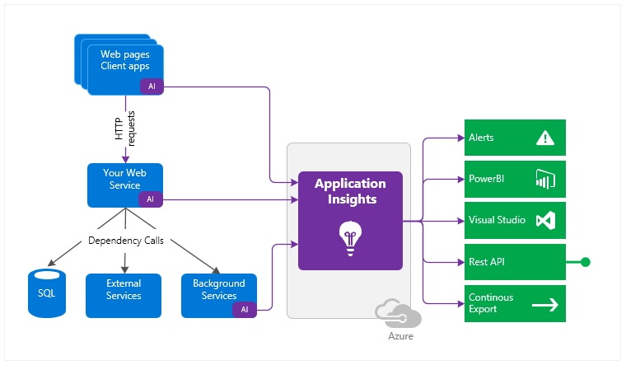
Application Insights
Azure Native APM Solution
Profiler
Application Map
Usage Analysis
Dashboarding/Alerting
Live Mentrics Stream
Supports variety of dev platforms
.Net Framework
.Net Core
Java
NodeJS

Slide 9
Challenge 2
Always need App Insights!
Deploy a publicly accessible ARM template that will deploy App Insights to your Resources Group
Set a variable with the InstrumentationKey for later

Slide 10



Azure Cosmos DB
A globally distributed, massively scalable, multi-model database service
SQL
MongoDB
Table API
Column-family
Document
Key-value
Graph
Guaranteed low latency at the 99th percentile
Elastic scale out
of storage & throughput
Five well-defined consistency models
Turnkey global distribution
Comprehensive SLAs
Notes:
Make sure to mention mulit-master with Serve <10 ms read and <15 ms write requests at the 99th percentile from the region nearest to users, while delivering data globally.

Slide 11
Request Units
Provisioned in terms of RU/sec
Rate limiting based on amount of throughput provisioned
Can be increased or decreased instantaneously
Metered Hourly
Background processes like TTL expiration, index transformations scheduled when quiescent
Rate limit
Max RU/sec
Incoming Requests
No rate limiting
Min RU/sec
Replica Quiescent
Notes:
We want to avoid throttling (rate limiting)

Slide 12
Database Representations
Account
Scaling RU‘s can occur at the
Database level (shared)
Collection level (individual)
Schema or Document Type is at the Collection level
Collection can be viewed as an isolated Domain Data Store
Database
Database
Database
Database
Database
Collection
Database
Database
Document

Slide 13
Challenge 3
Get some Data!
Create a CosmosDB Account
Set a variable with the PrimaryMasterKey for later

Slide 14
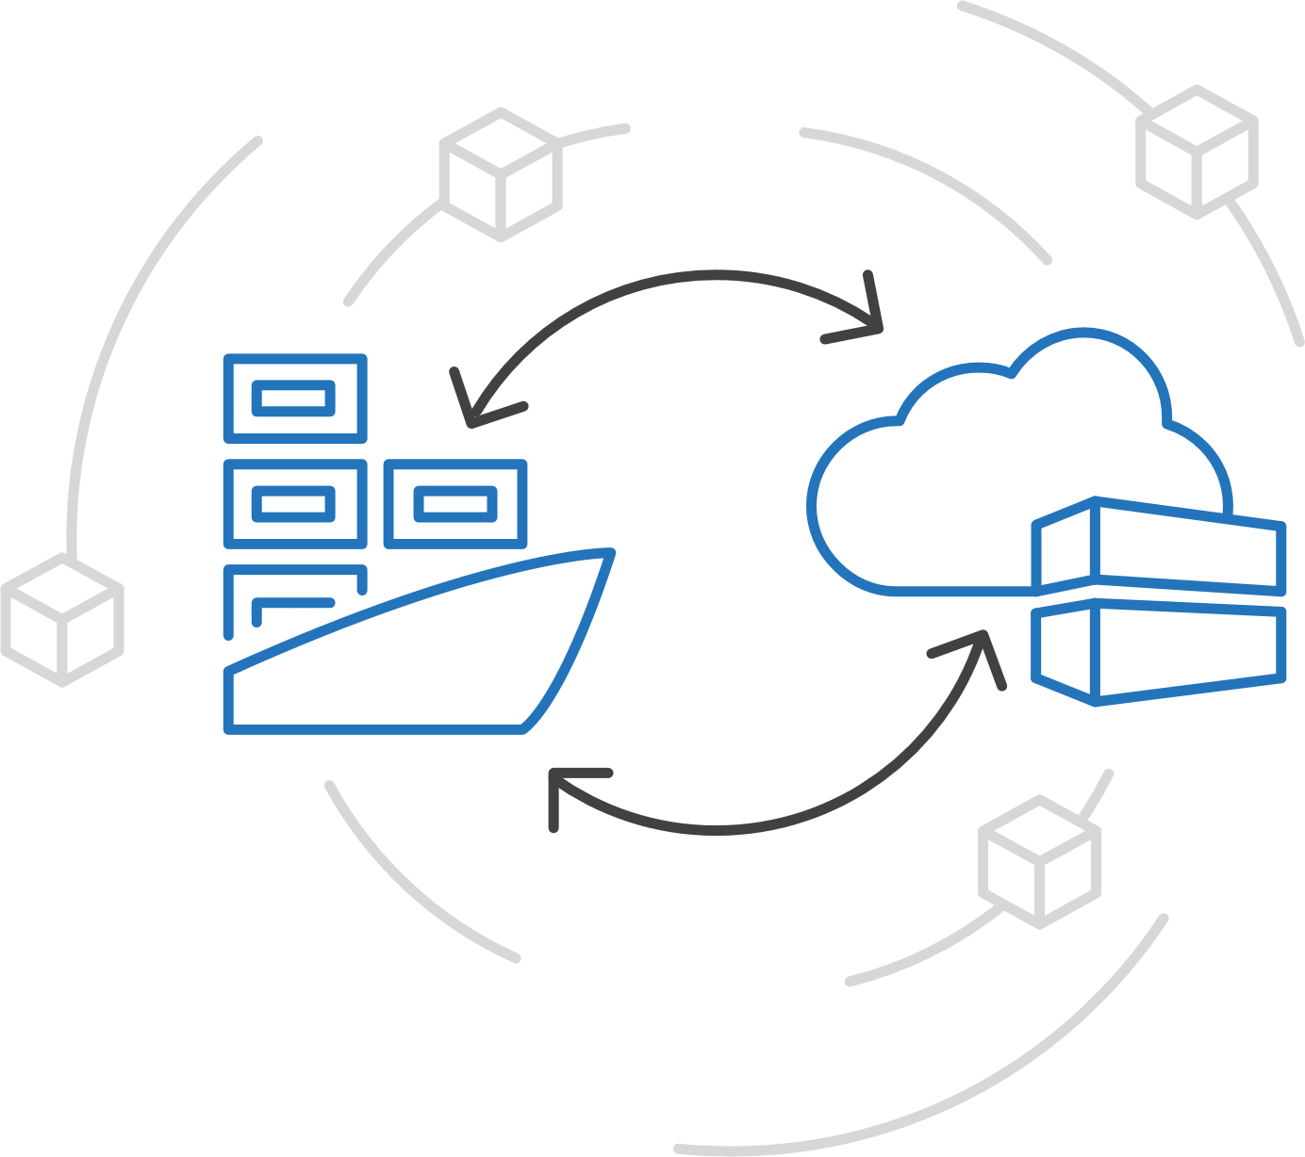
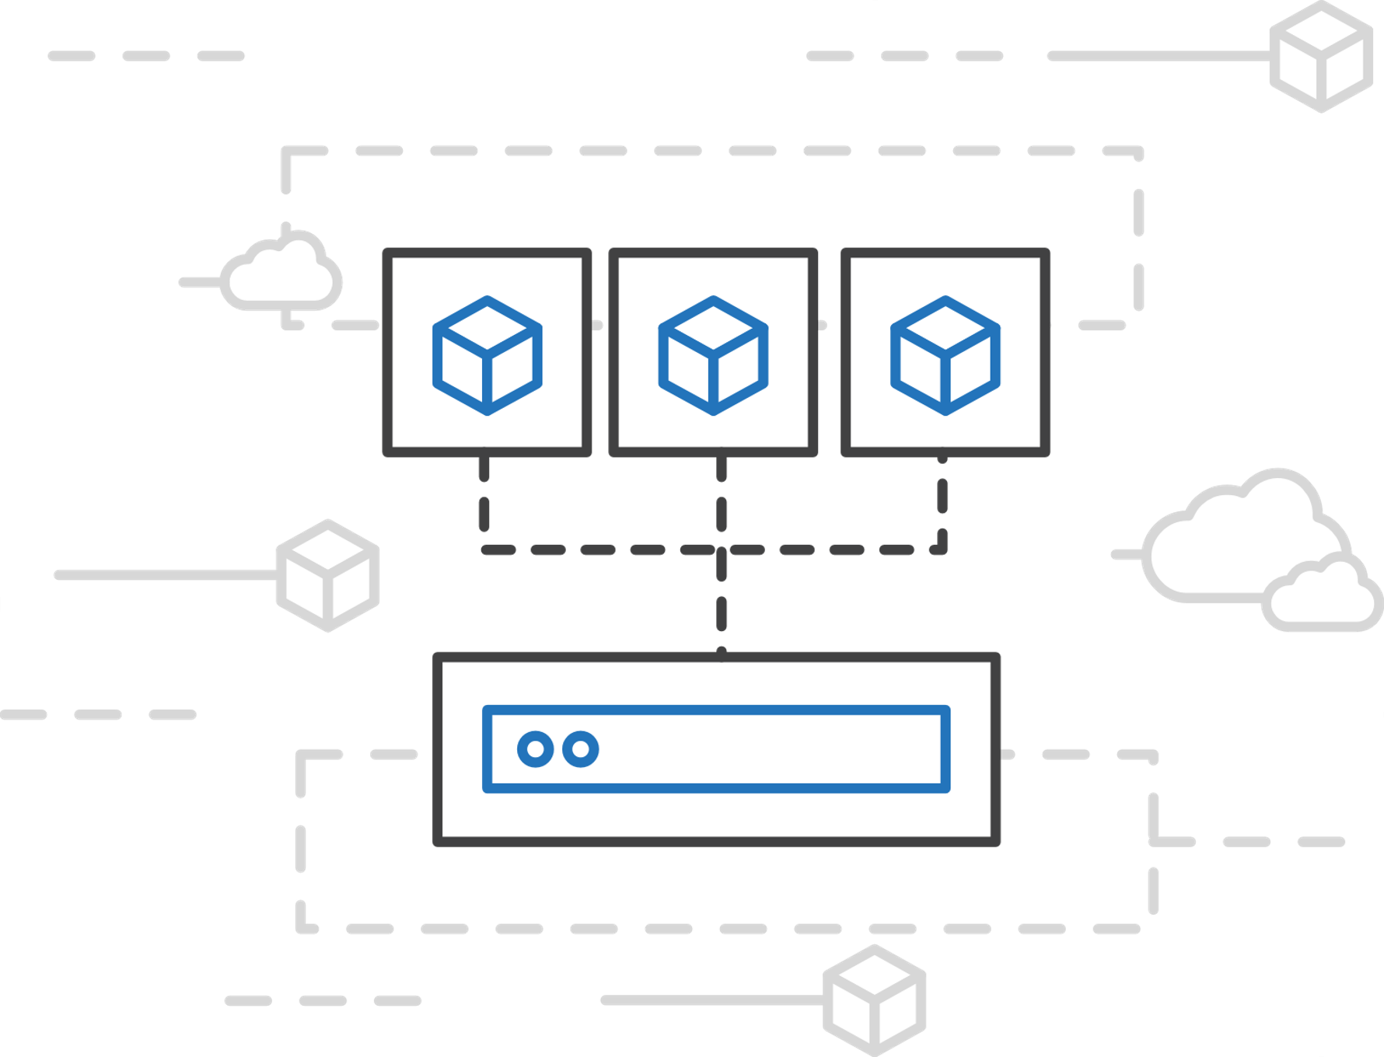
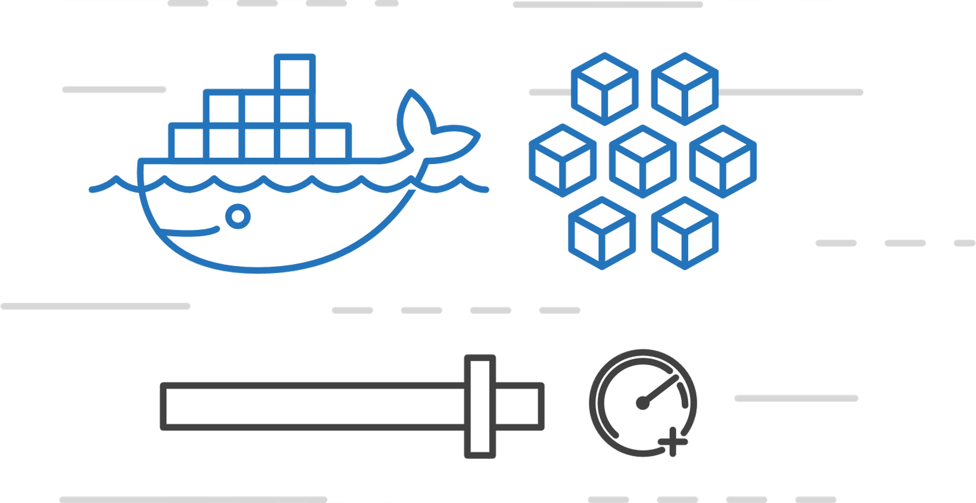
Azure Container Instances (ACI)
Easily run containers on Azure with a single command
Start using containers right away
Cloud-scale container capacity
Hyper-visor isolation

Slide 15
Challenge 4
Deploy some containers to ACI!
Deploy 3 public containers to ACI with configuration
Data Service, Itinerary Service, Data Loader
Attach to one of them to see the Console output
Get the FQDN (Fully Qualify Domain Names) for the other 2

Slide 16
Azure App Service
Quickly build, deploy and scale powerful cloud applications without worrying about infrastructure
High productivity
.NET, Node, Java, Docker, PHP, Ruby, Python
Staging & deployment
Testing in production
App gallery marketplace
Fully managed
Auto scale & load balancing
High availability w/ auto patching
Reduced operations costs
Backup & recovery
Enterprise grade
Global data center footprint
Hybrid support
AAD integration
Secure & compliance
Notes:
App Service is a managed PaaS service that lets developers focus on the unique aspects of their app, instead of spending cycles on patching and boilerplate functionality.
Rapidly create and deploy web, mobile and API apps that scale with your business, on any platform
Free your developers from management of infrastructure
Automate and simplify your Azure deployments via integrated CI/CD capabilities with GitHub, VSTS and more
Multiple deployment slots for easy blue-green testing, A/B testing and simple rollbacks. Ultimately, you have much more control over how you do your staging.
Scale vertically and horizontally without downtime with integrated load balancer and in-memory caching – these things are baked into the platform
Meet rigorous performance, scalability, security, and compliance requirements using a single back end
There are lots of advantages here – which of these is most helpful to your business?

Slide 17
Challenge 5
Deploy the Web Site!
Create a Standard Linux App Service Plan
Create a Web App on the App Service Plan and deploy a Container
Configure it with Application Settings
Click around and play!

Slide 18
The Site Works!!!!!!
Now What?
Open the website (getting the URL from the Web App)
Plan trips, switch browser, InPrivate/Incognito is your friend
Click the various services you created
Explore App Insights and all the data available
Click around and play!

Slide 19
Recap
You utilized the follow Azure Services
Cosmos DB
Container Instances
App Insights
App Services
You utilized the following Azure Tools
Cloud Shell
ARM Templates
Portal
And when you are done playing, it cleans up in a few minutes
From scratch, you deployed a working microservices solution

Slide 20
Additional Resources
Azure Cloud Shell: https://docs.microsoft.com/en-us/azure/cloud-shell/overview
Install the Azure CLI: https://docs.microsoft.com/en-us/cli/azure/install-azure-cli?view=azure-cli-latest
Azure CLI Reference: https://docs.microsoft.com/en-us/cli/azure/reference-index?view=azure-cli-latest
Azure Naming Conventions: https://docs.microsoft.com/en-us/azure/architecture/best-practices/naming-conventions
App Insights: https://docs.microsoft.com/en-us/azure/azure-monitor/app/app-insights-overview
ARM Templates: https://docs.microsoft.com/en-us/azure/azure-resource-manager/resource-group-authoring-templates
Cosmos DB: https://docs.microsoft.com/en-us/azure/cosmos-db/
Azure Container Instances: https://docs.microsoft.com/en-us/azure/container-instances/
App Service Plans: https://docs.microsoft.com/en-us/azure/app-service/overview-hosting-plans
App Services: https://docs.microsoft.com/en-us/azure/app-service/

