Slide 1
Hypermedia Driven Maps
Andrea Guerra
Github = github.com/andywar65
Mastodon = opalstack.social/@andywar65
Blog = digitalkomix.com
Other stuff = architettura.app

Slide 2
Andy War != Developer
Andy War == Architect
1983 – TI-99/4A (BASIC)
1999 – digitalkomix.com (HTML)
2012 – WordPress (PHP)
2017 – Django (Python / JavaScript)
Intrests: CAD → Maps | VR

Slide 3
Hypermedia Driven Maps
What are Hypermedia Driven Apps?
“The Hypermedia Driven Application (HDA) architecture is a new/old approach...
It combines the simplicity & flexibility of traditional Multi-Page Applications (MPAs) with the better user experience of Single-Page Applications (SPAs).
The HDA architecture achieves this goal by extending the existing HTML infrastructure of the web …”
https://htmx.org/essays/hypermedia-driven-applications/
by Carson Gross

Slide 4
Islands of Interaction
“A recent trend in web development is the notion of “islands”: … small, focused chunks of interactivity within server-rendered web pages.
This isolates non-hypermedia components from the rest of the HDA.
… it is typically easier to embed non-hypermedia islands within a larger
Hypermedia-Driven Application, rather than vice-versa.”
https://htmx.org/essays/hypermedia-friendly-scripting/#islands

Slide 5
Page structure
<head> Libraries
<body>
<div id=”hypermedia”>
Content
UI
Data
State
<div id=”island”>
Map

Slide 6
Interactions
Server (Django)
Server (OSM)
<div id=”hypermedia”>
Content
UI
Data
State
<div id=”island”>
Map

Slide 7
Django project
# requirements.in
django>=5.1,<6.0
...
django-htmx (by Adam Johnson)
django-geojson (by Mathieu Leplatre and others)

Slide 8
Django app “locations”
# models.py
from djgeojson.fields import PointField
class Location(models.Model):
title = models.CharField(...)
description = models.TextField(...)
geom = PointField(...)

Slide 9
Django app “locations”
# models.py
class Location(models.Model):
...
@property
def popupContent(self):
url = self.get_absolute_url()
return f’<a href=”{url}”>{self.title}<a>’

Slide 10
http://127.0.0.1:8000
# urls.py
path("", LocationListView.as_view(), name="location_list"),
# views.py
class LocationListView(ListView):
...
def get_template_names(self):
# if it's not an HTMX request, render full page
# if it is, render only the partial

Slide 11
base.html template
<head>
<link ref="../leaflet.css">
<script src="../leaflet.js"></script>
</head>
<body>
{% include Hypermedia partial %}
<div id="island">
<script src="../map_script.js"></script>
</div>
<script src="../htmx.js"></script>
</body>

Slide 12
Hypermedia partial
{% load geojson_tags %}
<div id="hypermedia">
<!-- Some content -->
<!-- User interface (with HTMX) -->
<script id="map_data" type="application/json">
{{ object_list|geojsonfeature:"popupContent"|safe }}
</script>
</div>

Slide 13
map_script.js (L=Leaflet)
const map = L.map('island');
const base_map = L.tileLayer(
// here we specify where we get all the map tiles
).addTo(map);
const markerGroup = L.layerGroup().addTo(map);
function getCollections() {
// remove all objects from markerGroup
// get objects from GeoJSON
collection = JSON.parse(document.getElementById("map_data").textContent);
// add collection objects to map as markers
// fit bounds around markers and zoom in
}
getCollections()

Slide 14
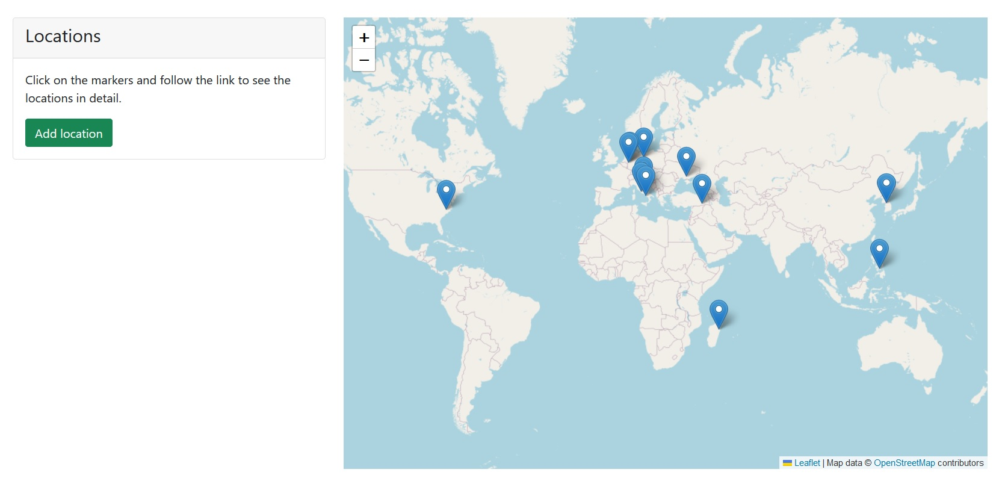

Slide 15
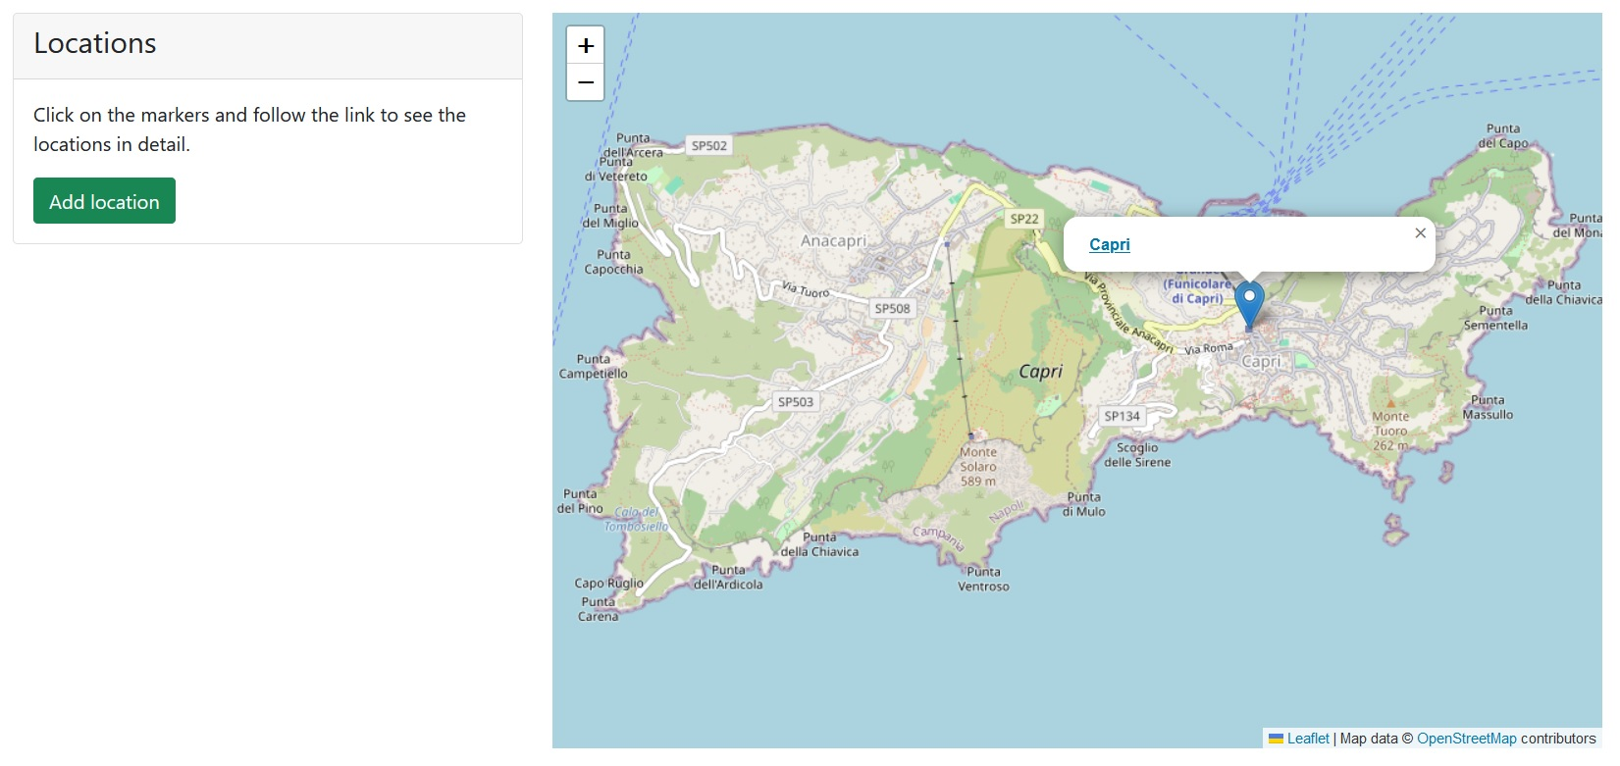

Slide 16
HDA

Slide 17
# models.py
class Location(models.Model):
...
@property
def popupContent(self):
url = self.get_absolute_url()
return f’<a href=”{url}”>{self.title}<a>’
<a href=”#” onclick=”openLocation({url})”>

Slide 18
# map_script.js
function openLocation(url) {
htmx.ajax('GET', url, '#hypermedia')
}
// async request with given method,
// url, and target id

Slide 19
Interactions
Server (Django)
Server (OSM)
<div id=”hypermedia”>
Content
UI
Data
State
<div id=”island”>
Map

