Slide 1
G2S: A General-to-Specific Learning Framework for Temporal Knowledge Graph Forecasting with Large Language Models
Amirreza Tarabkhah

Slide 2
Abstract

Slide 3
TKGs
Temporal knowlge graphs (TKGs) → consis of facts (subject, relation, object, timestamps)
Often use to represent the changes of facts over time.
Forecasting historical based on TKGs is critical for time sensitive scenarios.
The scenarios contains entities, relations and time granularities.

Slide 4
Previous vs Recent methods
Previous methods:
View TKG as a temporally ordered sequence
Mainly fouces on fitting a model to specifice TKG and generalization abilities
Recent methods:
Attept different TKGs via a unified LLM
Some of them learn by using in-context-learning (ICL)
Others by using supervised fine-tuning

Slide 5
What is G2S
By, anonymizing parameters into IDs, different scenarios reveals a commen substructure
The general patterns are common structures that can be generalized to different scenarios.
While scenario information is factual knowledge, such as specific entities and relations, which only help TKG forecasting in a certain scenario.
If model learns directly → learning processes interfere each other
G2S consists general and specific learning stage

Slide 6
Related works

Slide 7
Related Works
There are two different task settings:
Interpolation
Predicts missing entities at past
Extrapolation
Predict missing entities in future

Slide 8
Methods of working
Traditional:
Neural-based
Reinforcement learning-based
Rule-based methods
Recent:
In-context learning (ICL)
Fine-tuning

Slide 9
Formulation and Methodology

Slide 10

Formulation
A TKG is timeseries (1 to T) of KG snapshots
Each snapshot consists of entity, relation and fact
Each fact is (s_{i},r_{i},o_{i},t) –
The model required to quess the s or o in each queries

Slide 11
Methodology
They describe learning in two stages:
General learning stage
Query construction
Anonymous temporal structure conversion
Sample construction
Specific learning stage
Same steps with two key difference
Scenario information mapping
Two learning modes

Slide 12
General learning stage

Slide 13
Query
Learning general temporal patterns without exposing model to scenario specific information
Query construction:
Make two types of predictions: Subject, Object
For each qery, we use historical fact that they are sorted by time

Slide 14
Anonymizing
Anonymous temporal structure conversion:
By anonymizing parameters, it is ensure that model learns temporal patterns not real-world semantics
To apply this, instead of using real names, we use identifiers
There is three strategies:
Frequency ID (FID): ID applies based on frequency
Global ID (GID): Original ID from dataset
Random ID (RID)

Slide 15
After anonymization
After anonymization, training input consists History and Query
If we have input of (s, r, ?, t) the output will be o
If the output does not occure in FiD and RID, the ID of output will be NONE.
At last, it will fine-tune by that

Slide 16
Specific learning stage

Slide 17
Here, the paper combines temporal patterns with real-world scenario.
Entities have name, relations carry meanings and model understand what each ID relates in real world
Idea: Even using anonymization, provied mappings between IDs and real entities
Input structure:
Mapping section: act like dictionary
Historical context: same structure as general learning
Query: after giving query, model predicts answer combining two strategies
Why important? Model understands what happens but does not know what exactly is

Slide 18
Learning methods
ICL:
Parameters not updated
Just using prompt → it includes mapping, history and query
Pros: Fast adaptation, No fine-tune cost
Cons: shallow utilizing, not good performance on complex data
SFT:
Parameters updated
The model explicitly learns entitis, relation, interaction
Result: higher accuracy, better adaptation

Slide 19
Experimental Setup
Dataset: They used (ICEWS14, ICEWS18, ICEWS05-15, YAGO, GDELT, WIKI)
Metrics: They used top 1/3/10 correct answers
Experimental setting:
Standard → All training data used for fine-tune
Zero-shot → No training data for fine-tune
Low-resource → erliest 5%, 20%, 50% data used for fine-tune

Slide 20
Results

Slide 21
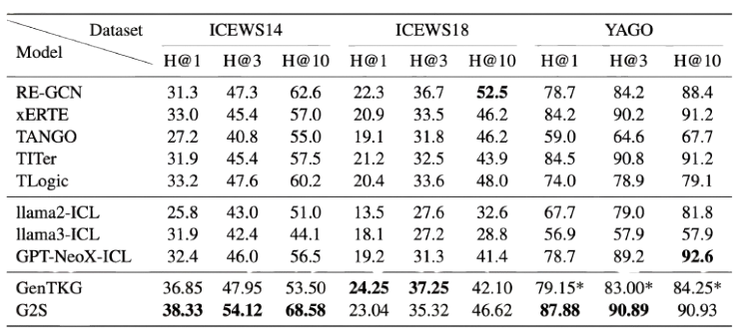
Standard setting
Train and test are from same spilit of dataset
There is no additional generalization ghallenge
Observations:
Consistent Improvement: G2S outperforms other baselines
Strong LLM utilization: architecture is more important than brute-force fine-tuning
Stability across Metrics:

Slide 22
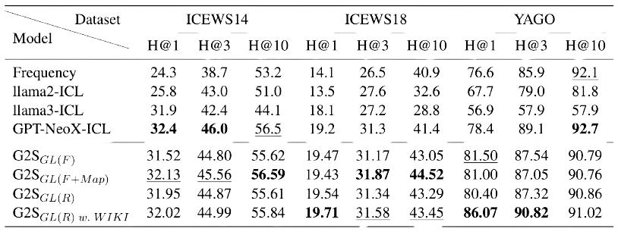
Low-resource setting
Can G2S generalize completely unseen data?
No fine-tuning used
Only ICL
G2S significantly outperforms zero-shot setting
Even perfomance is lower that standard but it is not very much

Slide 23
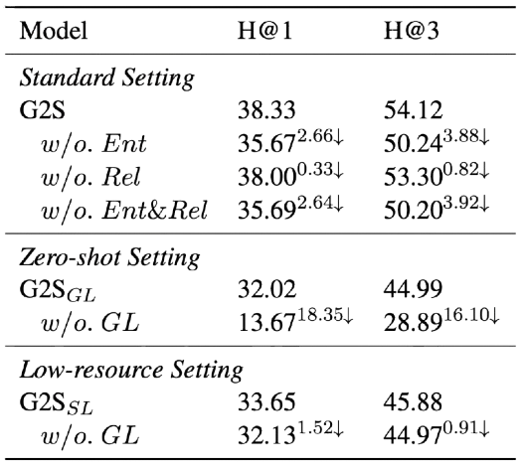
Ablation study
Paper analyses the the impact of each component
What if we do not implement General and Specific learning → Performance significantly decreased
What if we do not implement specefic learning → usable but with low accuracy
Change anonymization → shows the impact of truly anonymization

Slide 24
Analyses on Anonymazation strategies
Here we analyse that is choosing each FID, RID and GID important or not
RID: Unstable, Random
FID: Stable, Frequency
GID: Most stable
Most weak one is RID. FID and GID have the most performance
It is understandable that stable IDs are the best one. Also, cosistent mapping is more important that the ID

Slide 25
Thank you for your attention

