Slide 1
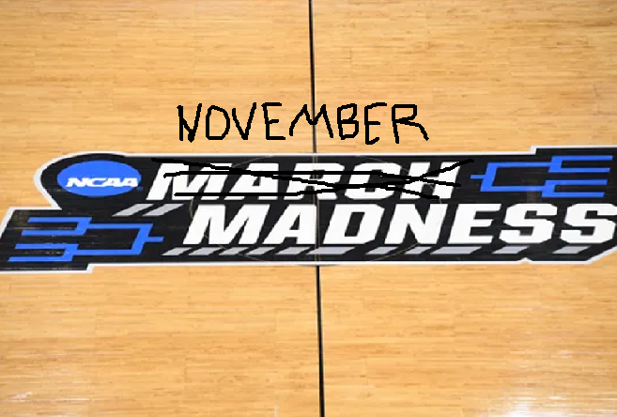


Presidential Bracket Challenge
TRUMP
1. Biden
Likely Biden
TRUMP
TRUMP
2. Sanders
??????????

Slide 2
Premise
Former President Obama was able to ride a “Blue Wave” to victory. Are Biden or Sanders able to replicate that success in 2020? Can predictive text mining show patterns or similarities that can predict a victory.
President Trump similarly was able to ride a “Red Wave” to victory in 2016. Can sentiment scores, clustering, or topic modeling help explain any changes in strategy.

Slide 3
Presidential Bracket Challenge
Data Sources
Assumptions
Speech Archives
Twitter
Any Obama Speech or Tweet prior to an election year is a victory. Hilary speech's, and tweets are codified as a loss.
Any Trump speech are codified as a victory. Any Romney speech is codified as a loss.
All are not mutually exclusive. Meaning if Biden shows similarities to Trump 2016, then that’s a win for Biden.

Slide 4
Data Vectorization And Cleaning
Token were unigram
Normalization showed promising results for TFIDF
Normalized count vector didn’t yield strong accuracy metrics sub 50%
Removal of stopwords. Also for speech data removal of all parenthesis was used. So for instance (applause) was removed.

Slide 5
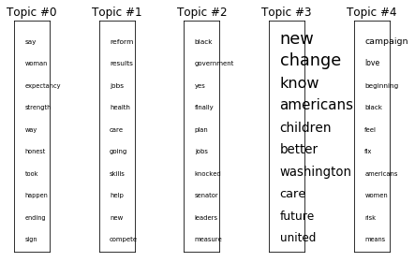
Obama Topic Modeling
Topic 0: Obama Inaugural Address 20th January 2009:
say woman expectancy strength way honest took happen ending sign
Topic 1: Acceptance Speech at the Democratic Convention 2008:
reform results jobs health care going skills help new compete
Topic 2: Night Before the Election 2008:
black government yes finally plan jobs knocked senator leaders measure
Topic 3: OBAMA Final Primary Night 2008:
new change know americans children better washington care future united
Topic 4: North Carolina Primary Night 2008:
campaign love beginning black feel fix americans women risk means
Topic 5: AP Annual Luncheon April 2008:
applause new great business jobs years young better change know
Topic 6: Super Tuesday 2008:
high renewable living road baby idea wanted defend short years
￼

Slide 6
Speech Data: Gaussian Naïve Bayes
Input Parameters:
Where does Biden Fall
Obama Speeches = 1
Hillary, and Romney = 0
Best approach was the TFIDF
The assumption here is that Obama was a powerful orator, and was able to rally his base through his speech. The same cannot be said for Hillary or Romney
Model had 71.4% accuracy
Results from the four Biden Speech's:
March 2020: Super Tuesday = Loss
Feb 2020: Iowa Caucus Speech = Loss
Feb 2020: South Carolina Victory Speech = Win
June 2019: Biden Enters Presidential Race Speech = Win

Slide 7
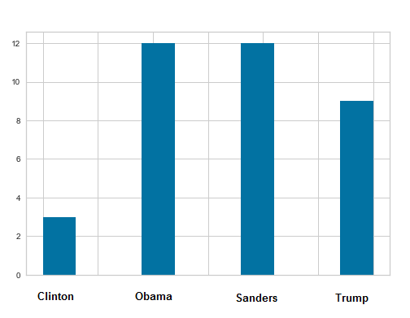
Twitter Data: Multinomial Naïve Bayes
Input Parameters:
Where does Biden Fall
Model had 77.2% accuracy
Results from the Biden Tweets:
Best approach was the TFIDF Again
The assumption here is that Trump really used Twitter to gain influence late in the 2016 election. This allowed him to rally his base and communicate to the MAGA audience.

Slide 8
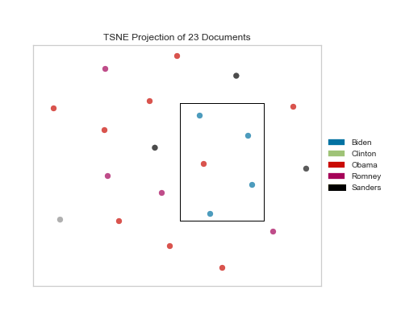
KMeans Clustering
Clustering Top Terms
Cluster 0:
raucous, contains, continue, continues, contradictions, contributed, unequivocal, controversial, conventional, conversations
Cluster 1:
lifetime, contribute, division, forever, whole, decent, walked, Obamacare, pundits, and soon
Cluster 2:
one, finally, invest, best, know, president, work, American, making, support
Cluster 3:
inducing, seize, settling, settled, service, falter, false, hatreds, faithful, concord
Cluster 4:
neglected, screen, biles, killing, billion, returns, scraped, tendency, compete, kinds

Slide 9
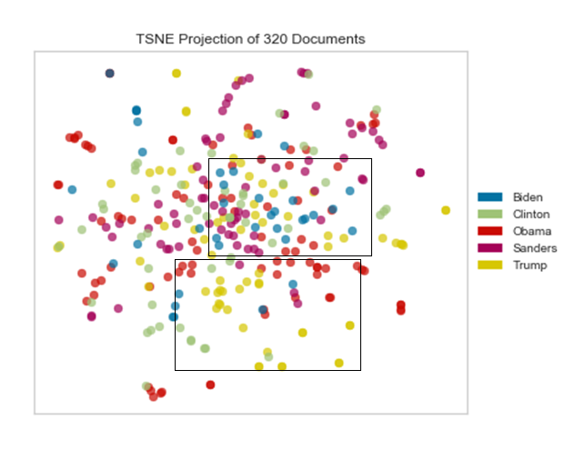
Twitter Data Cluster
The following tweets were sourced:
Trump: June – October 2016
Obama: June – October 2012
Sanders: February- June 2016
Clinton: June – October 2016
Trump and Obama = Win
Sanders and Clinton = Loss
￼

Slide 10
Twitter Cluster data:
Cluster 0:
coverage, would, Romney, fact, control, birth, allow, repealing, extreme, insurance
Cluster 1:
going, deal, nafta, debate, make, economy, running, billion, big, ideas
Cluster 2:
Vladimir, putin, pretty, person, field, puppet, toe, rather, wondering, white
Cluster 3:
heal, republicans, networks, elected, surviving, son, savaged, carry, lies, fight
Cluster 4:
Obama, president, America, debate, Romney, trump, make, must, need, hillary

Slide 11
Final Bracket
TRUMP
1. Biden
Likely Biden
TRUMP
TRUMP
2. Sanders
TRUMP

