Slide 1
Index Terms: Computation and Language (cs.CL); Artificial Intelligence (cs.AI); Machine Learning (cs.LG)
Citations:9620
DeepSeekMath: Pushing the Limits of Mathematical
Reasoning in Open Language Models
Zhihong Shao^{1,2∗†}, Peiyi Wang^{1,3∗†}, Qihao Zhu^{1,3∗†}, Runxin Xu¹, Junxiao Song¹
Xiao Bi¹, Haowei Zhang¹ ,Mingchuan Zhang¹, Y.K. Li¹, Y. Wu¹, Daya Guo^{1∗}
¹DeepSeek-AI, ²Tsinghua University, ³Peking University
arXiv:2402.03300v3 [cs.CL] 27 Apr 2024
DeepSeek-AI
Code: https://github.com/deepseek-ai/DeepSeek-Math

Slide 2
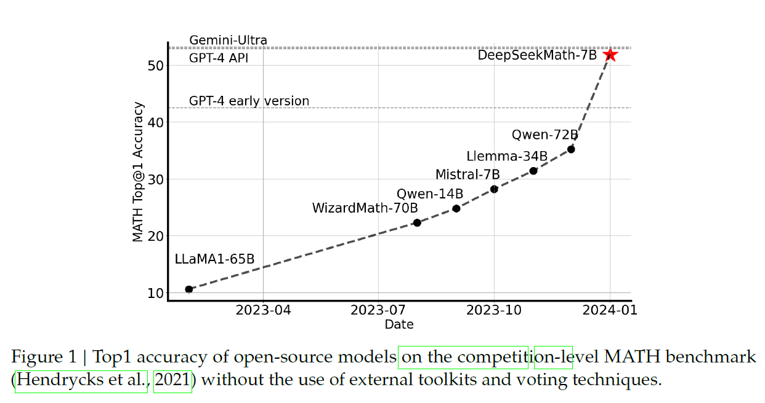
1 Introduction
Research Problem
• Mathematical reasoning: requires structured, multi-step solutions rather than surface-level pattern matching.
• Open-model gap: strong systems such as GPT-4 and Gemini Ultra were not publicly available; open models trailed behind.

Slide 3
1.1 Contributions
Math Pre-Training at Scale
Exploration and Analysis of Reinforcement Learning
• DeepSeekMathCorpus: a high-quality dataset of 120B tokens from web pages filtered for mathematical
Content; 9 times the size of the recently released OpenWebMath
• Competitive small model: DeepSeekMath-Base 7B reaches 36.2% on MATH, outperforming much larger prior systems such as Minerva 540B on this benchmark.
• Code pre-training: starting from a code-trained model improves mathematical reasoning.
• No notable improvements with training on arXiv papers in this paper
• GRPO: removes the separate value/critic model and uses relative scores of multiple outputs; reducing training resources compared to PPO
• SFT-to-RL gains: GSM8K improves 82.9% → 88.2%; MATH improves 46.8% → 51.7%.
• Unified paradigm: analyzes SFT, RFT, DPO, PPO and GRPO through data source, reward function and gradient coefficient.

Slide 4
1.2 Summary of Evaluations and Metrics
English and Chinese Mathematical Reasoning
Formal Mathematics:
Natural Language Understanding, Reasoning, and Code:
evaluate
DeepSeekMath-Base on the Massive Multitask Language Understanding (MMLU)
Benchmark, BIG-Bench Hard (BBH)
for tasks that mostly require multi-step reasoning to solve ;
HumanEval
(Chen et al., 2021) and MBPP (Austin et al., 2021) which are widely used to evaluate code
language models.
GSM8K · MATH · SAT · OCW
MMLU-STEM · CMATH
Gaokao-MathCloze · Gaokao-MathQA
evaluate models’ ability to generate self-contained text solutions without tool use, and also the ability to solve
problems using Python.
evaluate DeepSeekMath-Base using the informal-to-formal
theorem proving task from (Jiang et al., 2022) on miniF2F (Zheng et al., 2021) with Isabelle
(Wenzel et al., 2008) chosen to be the proof assistant; strong few-shot autoformalization performance

Slide 5
2 Math Pre-Training
1. Initialize: DeepSeek-Coder-Base-v1.5 7B.
2. Build corpus: 120B math tokens collected from Common Crawl.
3. Continue pre-training: 500B-token mixed training run.
4. Instruction-tune: 776K math instruction examples.
5. Reinforcement learning: GRPO produces DeepSeekMath-RL.
Design Rationale
• Data: filter a large public web crawl into a high-quality multilingual math corpus.
• Initialization: use DeepSeek-Coder-Base-v1.5 7B rather than a general-purpose base model.
• Optimization: combine continued pre-training, math-specific supervised fine-tuning and group-relative RL.
The 120B-token DeepSeekMath Corpus is the math-specific data source; the 500B tokens refer to the full Base-model continuation mix.

Slide 6
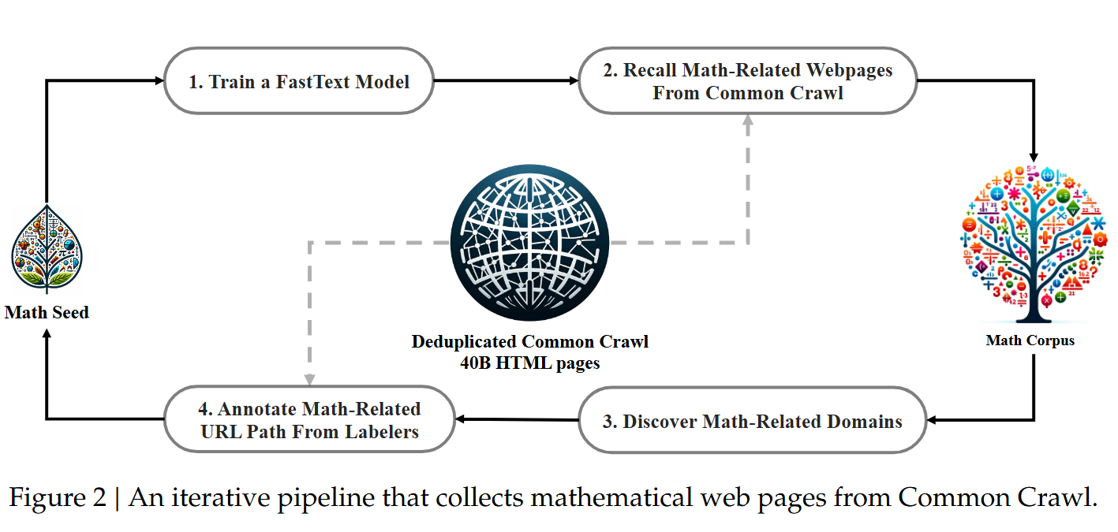
2 Math Pre-Training
*Math seed: OpenWebMath, , a collection of high-quality mathematical web text
*Randomly select 500,000 data points from the seed corpus as positive training examples and another 500,000 web pages from Common Crawl as negative ones
*use https://fasttext.cc employ an open-source library for training; configuring the vector dimension to 256, learning rate to 0.1, the maximum length of word n-gram to 3, the minimum number of word occurrences to 3, and the number oftraining epochs to 3; employ URL-based deduplication and near-deduplication techniques, resulting in 40B HTML web pages.

Slide 7
2.1 Data Collection and Decontamination
Iterative Common Crawl Mining Pipeline
1. Seed corpus: OpenWebMath supplies the positive examples.
2. Train classifier: fastText uses 500K positive and 500K negative examples.
3. Recall pages: retrieve and deduplicate about 40B HTML pages.
4. Rank and filter: retain the top 40B tokens in the first iteration.
5. Improve the seed: find mathematical domains and annotate URL paths.
6. Repeat: after four iterations, the corpus contains 35.5M pages and 120B tokens.
The fourth iteration adds little new content: nearly 98% of the final data had already been collected by iteration three.

Slide 8
2.1 Data Collection and Decontamination
Classifier configuration
Deduplication
Iterative enrichment
256-dimensional vectors
Learning rate 0.1
Word n-gram = 3
Min word occurrences = 3
3 training epochs
URL-based deduplication
Near-duplicate removal
Reduced Common Crawl to
40B HTML pages
Domains with >10% first-round
collection flagged as math-related
Human annotators label relevant
URL paths to expand the seed
Benchmark Decontamination
Main filtering rule
Short benchmark items
Remove a text segment if it contains an exact matching 10-gram
from an evaluation benchmark.
If a benchmark text is shorter than 10 grams but has ≥ 3 grams,
use exact matching to filter contaminated pages.
• Benchmarks protected: GSM8K, MATH, CMATH and AGIEval.
• Purpose: reduce evaluation leakage between pre-training pages and benchmark questions/answers.

Slide 9
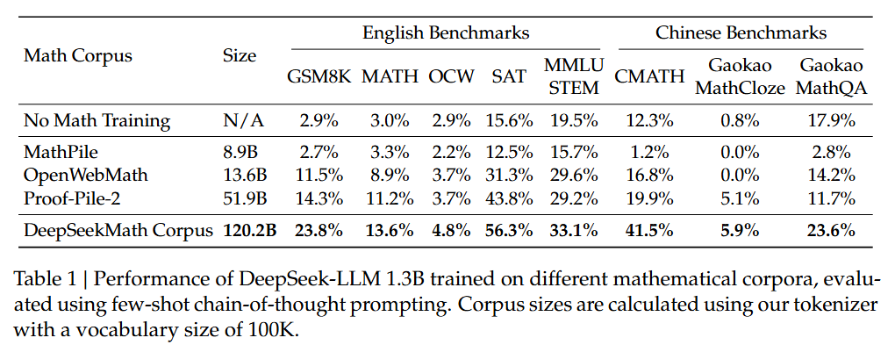
2.2 Validating the Quality of the DeepSeekMath Corpus
Downstream results of DeepSeek-LLM 1.3B trained on different math corpora (few-shot CoT)
separately train a model on each mathematical corpus for 150B tokens; experiments are conducted using the efficient and light-weight HAI-LLM (High-flyer, 2023) training framework. Following the training practice of DeepSeek LLMs, we use the AdamW
optimizer (Loshchilov and Hutter, 2017) with 𝛽1 = 0.9, 𝛽2 = 0.95, and weight_decay = 0.1,

Slide 10
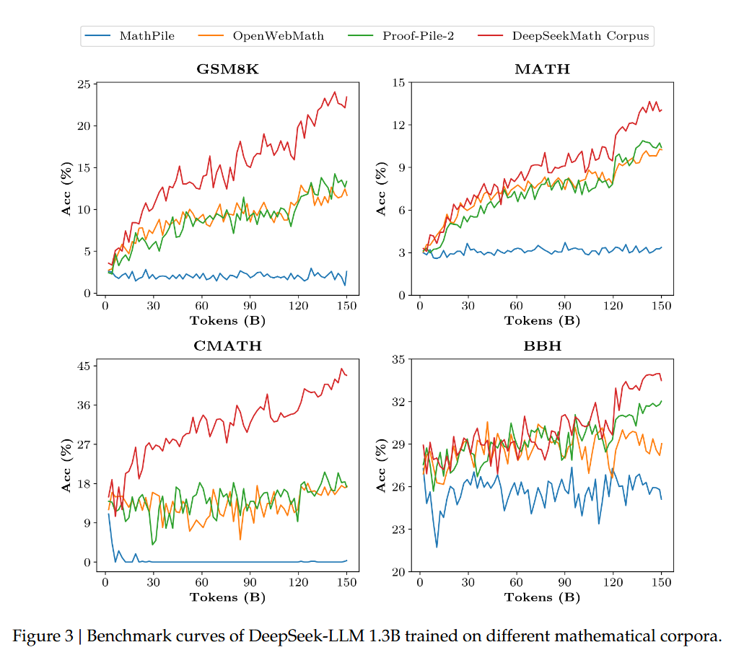
2.2 Validating the Quality of the DeepSeekMath Corpus
8 BENCHMARKS

Slide 11
2.3 Training and Evaluating DeepSeekMath-Base 7B
Continual Pre-Training Mixture · 500B Tokens
56%
10%
20%
10%
DeepSeekMath Corpus (56%)
AlgebraicStack (4%)
arXiv (10%)
GitHub code (20%)
Natural language CC (10%)
Training Configuration
Initialization
Token budget
Peak learning rate
Batch / context
DeepSeek-Coder-
Base-v1.5 7B
500B total
continual training
4.2 × 10⁻⁴
10M tokens / 4K
• Objective: continued pre-training on the mixture preserves code capability while increasing mathematical and general reasoning.

Slide 12
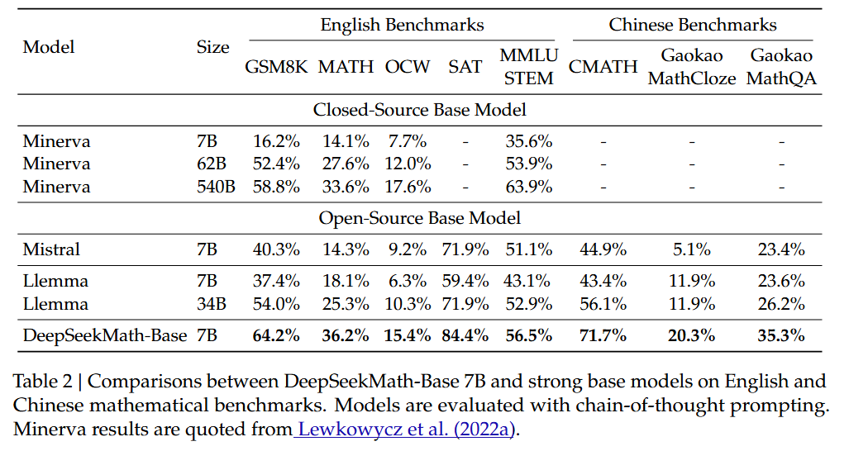
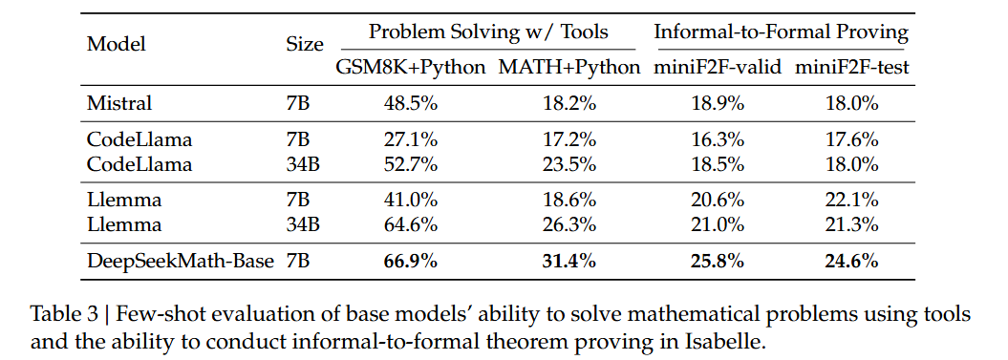
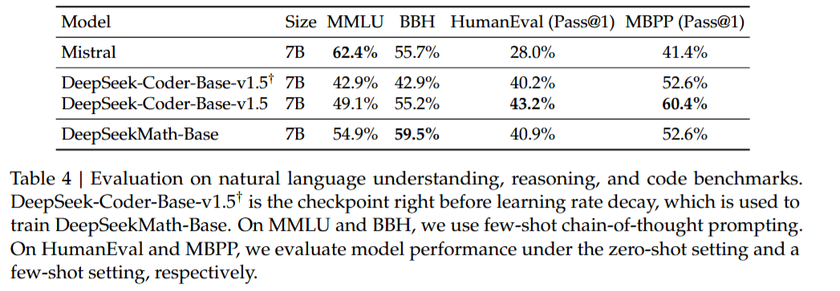
2.3 Training and Evaluating DeepSeekMath-Base 7B

Slide 13
3 Supervised Fine-Tuning
From Base Model to Instruction-Following Model
1. Base model: DeepSeekMath-Base 7B after continued pre-training.
2. SFT dataset: 776K curated mathematical instruction examples.
3. Fine-tuning: supervised fine-tuning with a 4K context length.
4. Resulting model: DeepSeekMath-Instruct 7B, supporting CoT, PoT and tool use.
Three Solution Formats
Chain-of-Thought (CoT)
Program-of-Thought (PoT)
Tool-Integrated Reasoning
Natural-language, step-by-step derivation
Generate code to carry out computation
Combine reasoning with external Python execution
SFT turns the strong base model into a model explicitly trained to respond to mathematical instructions.

Slide 14
3.1 SFT Data Curation
776K
English
Chinese
Solution diversity
Total instruction examples
GSM8K, MATH, MathInstruct, Lila-OOD subsets
K–12 questions across 76 sub-topics
CoT, PoT and tool-integrated solutions
Dataset Construction
• English: GSM8K and MATH are annotated with tool-integrated solutions; a subset of MathInstruct and Lila-OOD supplies CoT/PoT-style reasoning.
• Mathematics coverage: algebra, probability, number theory, calculus and geometry.
• Chinese: K–12 math problems include both CoT and tool-integrated solution formats, covering 76 sub-topics such as linear equations.
• Training packaging: examples are randomly concatenated to a maximum context length of 4K tokens.

Slide 15
3.2 Training and Evaluating DeepSeekMath-Instruct 7B
Instruction-Tuning Setup
Base checkpoint
Training steps
Batch size
Learning rate
DeepSeekMath-Base 7B
500
256
5 × 10⁻⁵ (constant)
Evaluation Protocol
• Benchmarks: GSM8K and MATH (English), MGSM-zh and CMATH (Chinese).
• No-tool setting: generate self-contained solutions using step-by-step reasoning.
• Tool-use setting: allow Python execution / program-based reasoning.
• Sampling: paper reports top-1 and majority-vote results; majority voting uses 32 candidates in the reported tables.

Slide 16
3.2 Training and Evaluating DeepSeekMath-Instruct 7B
Interpretation
• MATH: DeepSeekMath-Instruct reaches 57.4% when Python-assisted reasoning is allowed.
• Relative scale: it is competitive with much larger open models, though tool-integrated results are protocol-dependent.
• Role of tools: program execution can handle arithmetic reliably, complementing the model’s natural-language plan.

Slide 17
4 Reinforcement Learning
RL Fine-Tuning Pipeline
1. Prompts: start from GSM8K and MATH chain-of-thought questions.
2. Sample group: draw G candidate outputs from the old policy.
3. Score: assign each output a reward.
4. Compute advantage: normalize rewards within the group.
5. Update policy: optimize the GRPO objective with KL regularization.
Training Focus
• Starting model: DeepSeekMath-Instruct 7B.
• RL data: chain-of-thought-format questions related to GSM8K and MATH, selected from the SFT data (~144K questions).
• Research purpose: test whether reinforcement learning improves the already strong instruction-tuned model, including out-of-domain benchmarks.
• Core design: sample several answers to the same question and compare their rewards, instead of training a separate critic model.
The selected RL data is intentionally narrower than the complete SFT dataset; this makes the generalization effect measurable.

Slide 18
4.1 Group Relative Policy Optimization
PPO: Actor–Critic
• PPO components: question q, policy πθ, reward model rφ, and a separate value model Vψ.
GRPO: Group-Relative Setup
• GRPO setup: sample G outputs for each question and normalize their reward scores to obtain Â.
• Key difference: GRPO does not require a separate value/critic model.
• Memory saving: PPO often needs an extra value model comparable in size to the policy.
• Relative baseline: GRPO compares rewards among outputs for the same question.
• Regularization: KL divergence keeps the trained policy closer to the reference model.

Slide 19
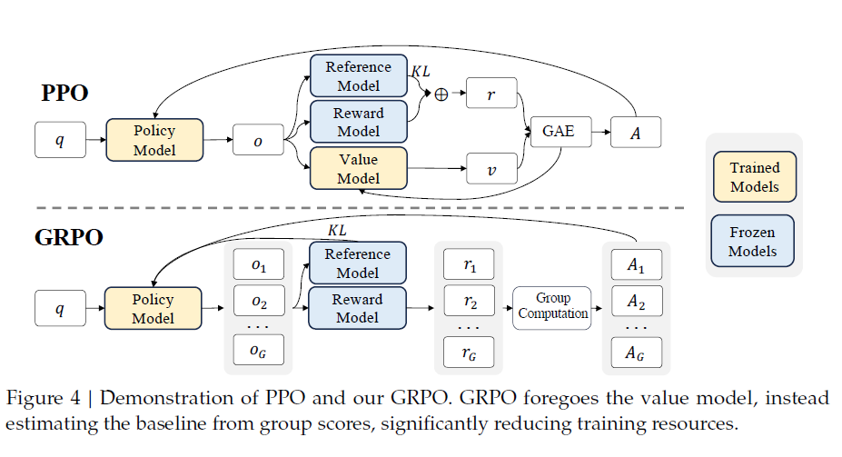
4.1.1 From PPO to GRPO
Equation (1) · PPO Clipped Objective
Equation (1)
$𝒥_{PPO}\left(θ\right)=𝔼\left[q∼P\left(Q\right),o∼π_{θ_{old}}\left(O|q\right)\right]\frac{1}{\left|o\right|}\sum_{t=1}^{\left|o\right|}{\min\left[\frac{π_{θ}\left(o_{t}|q,o_{<t}\right)}{π_{θ_{old}}\left(o_{t}|q,o_{<t}\right)}A_{t},\text{clip}\left(\frac{π_{θ}\left(o_{t}|q,o_{<t}\right)}{π_{θ_{old}}\left(o_{t}|q,o_{<t}\right)},1−ε,1+ε\right)A_{t}\right]}$, (1)
Equation (2) · Per-token KL penalty in PPO reward
• A_t: advantage estimated with Generalized Advantage Estimation (GAE) and a learned value function 𝑉𝜓..
• ε: clipping hyperparameter that limits excessively large policy updates.
𝜋𝜃 and 𝜋𝜃𝑜𝑙𝑑 are the current and old policy models
q,𝑜 are questions and outputs
~ means Distributed as
The PPO formulation uses a learned value function; GRPO replaces this baseline with group-relative rewards.

Slide 20

4.1.1 From PPO to GRPO
Equation (2) · Per-token KL penalty in PPO reward
$r_{t}=r_{φ}\left(q,o_{≤t}\right)−β\log{\frac{π_{θ}\left(o_{t}|q,o_{<t}\right)}{π_{ref}\left(o_{t}|q,o_{<t}\right)}},$ (2)
𝑟𝜑 is the reward model, 𝜋𝑟𝑒𝑓 is the reference model, which is usually the initial SFT model,
and 𝛽 is the coefficient of the KL penalty.
The PPO formulation uses a learned value function; GRPO replaces this baseline with group-relative rewards.

Slide 21
4.1.1 From PPO to GRPO
Equation (3) · GRPO Objective
Equation (3)
$$\begin{aligned}𝒥_{GRPO}\left(θ\right)&=𝔼\left[q∼P\left(Q\right),{\left\{o_{i}\right\}}_{i=1}^{G}∼π_{θ_{old}}\left(O|q\right)\right] \\ & \frac{1}{G}\sum_{i=1}^{G}{\frac{1}{\left|o_{i}\right|}}\sum_{t=1}^{\left|o_{i}\right|}{\left\{\min\left[\frac{π_{θ}\left(o_{i,t}|q,o_{i,<t}\right)}{π_{θ_{old}}\left(o_{i,t}|q,o_{i,<t}\right)}{\overset{ˆ}{A}}_{i,t},\text{clip}\left(\frac{π_{θ}\left(o_{i,t}|q,o_{i,<t}\right)}{π_{θ_{old}}\left(o_{i,t}|q,o_{i,<t}\right)},1−ε,1+ε\right){\overset{ˆ}{A}}_{i,t}\right]−β𝔻_{KL}\left[π_{θ}∥π_{ref}\right]\right\}, (3)}\end{aligned}$$
What Changes from PPO?
Sample a group
Group-relative advantage
No critic model
G outputs for the same question q
Âᵢ,ₜ depends on reward relative to siblings
Less auxiliary model memory and computation
𝜀 and 𝛽 are hyper-parameters, and ${\overset{ˆ}{A}}_{i,t}$ is the advantage calculated based on relative
rewards of the outputs inside each group only, which will be detailed in the following subsections.
ρᵢ,ₜ is the policy ratio for token t of sampled output i. Exact objective is written compactly for readability.

Slide 22
4.1.1 From PPO to GRPO
Equation (4) · Unbiased KL-Divergence Estimator
Equation (4)
$$𝔻_{KL}\left[π_{θ}∥π_{ref}\right]=\frac{π_{ref}\left(o_{i,t}|q,o_{i,<t}\right)}{π_{θ}\left(o_{i,t}|q,o_{i,<t}\right)}−\log{\frac{π_{ref}\left(o_{i,t}|q,o_{i,<t}\right)}{π_{θ}\left(o_{i,t}|q,o_{i,<t}\right)}}−1, (4)$$
Role of KL Regularization
• Reference policy: usually the initial SFT model, π_ref.
• In PPO: the KL term is incorporated into the reward at each token.
• In GRPO: the KL divergence is added directly to the optimization objective, keeping the group-relative advantage calculation separate.
• Estimator: the paper uses this positive unbiased estimator (Schulman, 2020).

Slide 23
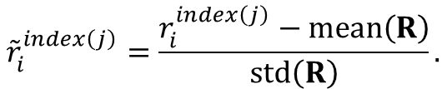

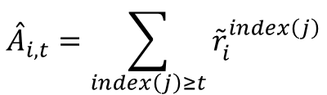
4.1.2 4.1.3
Group-Level Reward Normalization
Outcome Supervision RL with GRPO
Process Supervision RL with GRPO
Â_i,t = r̃_i for every token t in output o_i
$${\overset{ˆ}{A}}_{i,t}={\tilde{r}}_{i}=\frac{r_{i}−\text{mean}\left(r\right)}{\text{std}\left(r\right)},$$
Procedure
$${\tilde{r}}_{i}^{index\left(j\right)}=\frac{r_{i}^{index\left(j\right)}−\text{mean}\left(R\right)}{\text{std}\left(R\right)}.$$
• 1. Sample: for a question q, draw G candidate outputs from the old policy.
• 2. Score: the reward model assigns one scalar reward to each completed output.
• 3. Normalize: subtract the group mean and divide by the group standard deviation.
• 4. Broadcast: use the normalized result as the advantage for all tokens in that output, then maximize Equation (3).
$${\overset{ˆ}{A}}_{i,t}=\sum_{index\left(j\right)≥t}{{\tilde{r}}_{i}^{index\left(j\right)}}$$
Outcome supervision provides feedback at the end of each output rather than at each reasoning step.

Slide 24
4.1.3 Process Supervision RL with GRPO
Step-Level Reward Normalization
Where Rewards Enter the Reasoning Chain
Process-supervision advantages
Step 1
Step 2
Step 3
Final
r̃_i,index(j) = [ r_i,index(j) − mean(R) ] / std(R)
Â_i,t = Σ_{index(j) ≥ t} r̃_i,index(j)
reward rᵢ¹
reward rᵢ²
reward rᵢ³
reward rᵢᴷ
Difference from Outcome Supervision
• Outcome supervision: one reward at the end; every token in that answer receives the same normalized advantage.
• Process supervision: a process reward model scores each reasoning step; each token receives the sum of normalized rewards from the current and following steps.
• Motivation: fine-grained feedback may be more informative for complex multi-step mathematics.
• Optimization: both variants maximize the same GRPO objective in Equation (3); the advantage construction differs.

Slide 25
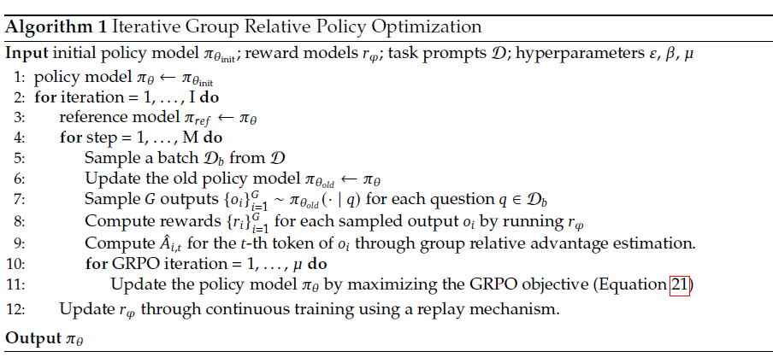
4.1.4

Slide 26
4.1.4 Iterative RL with GRPO
Algorithm 1 · Iterative Group Relative Policy Optimization
1. Initialize policy: πθ ← πθ_init.
2. Set reference: π_ref ← current πθ.
3. Sample outputs: draw G outputs per prompt.
4. Score and normalize: convert rewards into group advantages.
5. Update policy: maximize Equation (3).
6. Refresh reward model: use new samples together with replay data.
• Replay mechanism: retain 10% of historical reward-model data during continuous reward-model training.
• Iteration benefit: update the reward model to supervise the current policy as it changes.
• Paper experiment: two RL iterations were tested, with a substantial gain in the first iteration.

Slide 27
4.2 Training and Evaluating DeepSeekMath-RL
Reinforcement-Learning Training Setup
Policy initialization
RL training data
Reward model LR
Policy LR
DeepSeekMath-Instruct 7B
~144K CoT questions
from GSM8K + MATH
2 × 10⁻⁵
1 × 10⁻⁶
GRPO Hyperparameters
KL coefficient
Samples / question
Maximum length
Batch size
β = 0.04
G = 64 outputs
1,024 tokens
1,024
• Data restriction: only CoT-format SFT questions from GSM8K and MATH are used in RL; other SFT questions are excluded.
• Evaluation: GSM8K and MATH are treated as in-domain; other mathematical benchmarks measure transfer to out-of-domain tasks.
Hyperparameters transcribed from Section 4.2 of the paper.

Slide 28
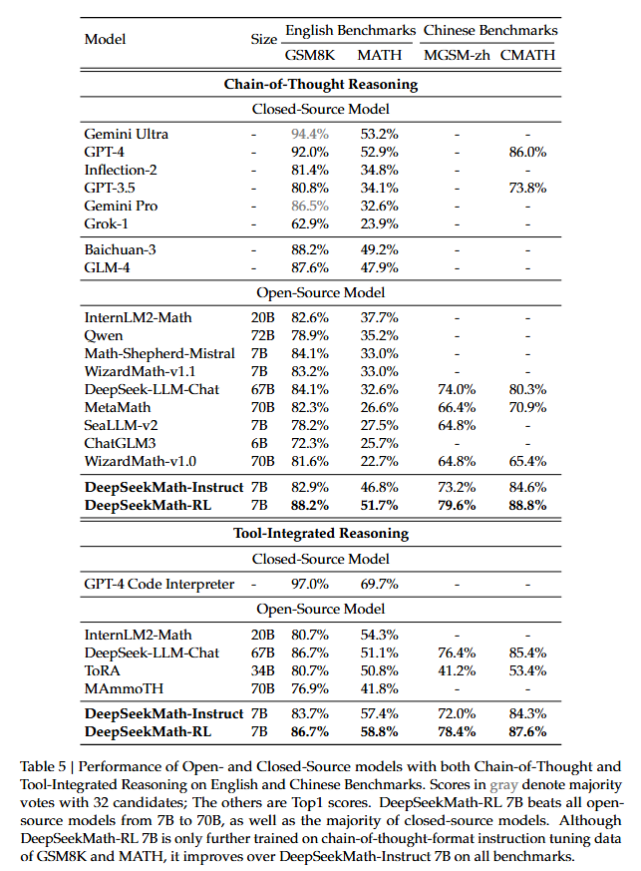
4.2 Training and Evaluating DeepSeekMath-RL
Main Finding
• Broad improvement: RL trained on GSM8K/MATH CoT data improves all four benchmarks shown.
• Beyond training data: Chinese benchmarks and tool-integrated tasks also improve even though they are not all directly supervised in RL.
• Paper claim: DeepSeekMath-RL 7B exceeds 50% top-1 accuracy on competition-level MATH without external tools or voting.

Slide 29
5 Discussion
Discussion Structure
5.1 Lessons Learnt in Pre-Training
5.2 Insights of Reinforcement Learning
6 Conclusion
Code training; arXiv data; corpus design
Unified view of RL methods; why RL helps
Data scale + SFT + GRPO
Questions the Discussion Addresses
• Pre-training: does code training help math? Do arXiv papers provide useful math-training signal?
• Reinforcement learning: is the gain caused by better fundamental capability, more robust output distributions, or both?
• Unified analysis: how do the data source, reward function and gradient coefficient differ across SFT, RFT, DPO, PPO and GRPO?
• Future direction: how can data, algorithms and reward models make RL more effective?

Slide 30
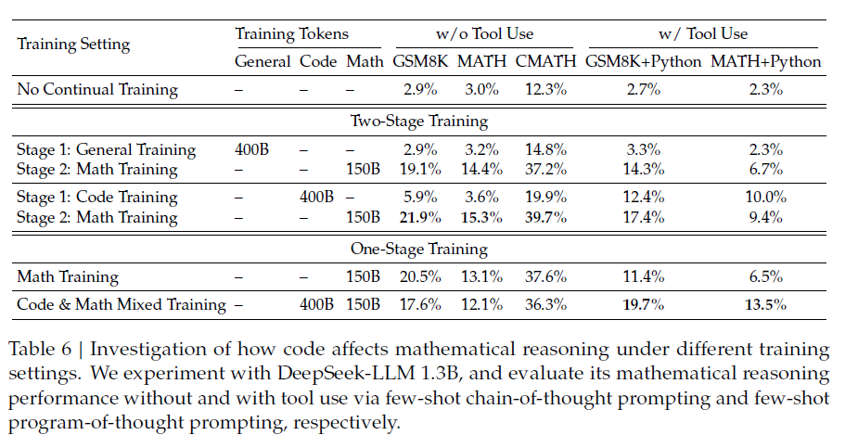
5.1 Lessons Learnt in Pre-Training
Code and Math Training Recipes · DeepSeek-LLM 1.3B
training settings outlined in Section 2.2.1.
use an 89B-token dataset from
the second iteration of
the data collection process
Takeaways
• Code first, then math: best no-tool mathematical scores among the listed training recipes.
• Mixed code + math: performs best for the shown Python-assisted scores.
• Training order matters: token count alone does not explain performance.

Slide 31
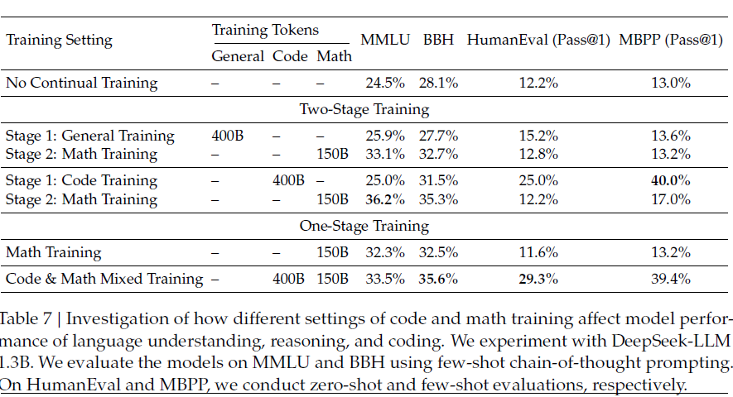
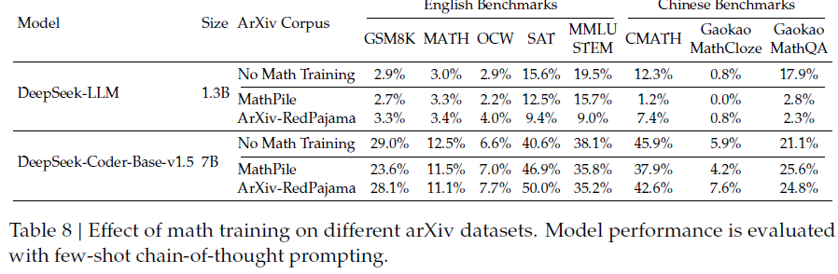
5.1.1 Code Training Benefits Mathematical Reasoning
General Reasoning and Coding · Table 7
Interpretation
• Coding capability: code + math mixing improves HumanEval and MBPP.
• Broader effect: math training can also benefit general reasoning and language tasks.

Slide 32
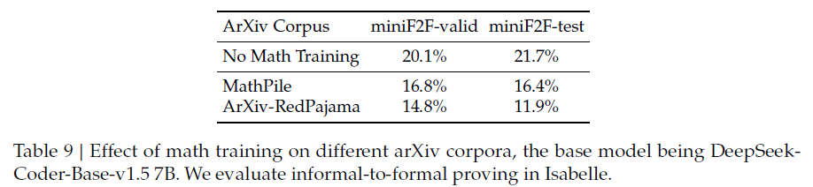
5.1.2 ArXiv Papers Seem Ineffective in Improving Mathematical Reasoning
Formal-Proving Evaluation · miniF2F (Isabelle)
Data sources tested
MathPile: 8.9B tokens, >85% arXiv
ArXiv-RedPajama: 28B tokens
Full arXiv LaTeX after cleaning
Authors’ Interpretation
• No consistent gain: arXiv-only corpora show no notable improvement and can reduce mathematical-reasoning scores.
• Possible nuance: the paper notes that future work should test arXiv when mixed with other data, for informal-to-formal theorem proving, and at larger model scales.
• Do not overgeneralize: the result concerns the corpora and experimental settings tested here, not a claim that every arXiv document is useless.

Slide 33

5.2.1 Towards a Unified Paradigm
Equation (5) · General Gradient Form
Equation (5)
$∇_{θ}𝒥_{𝒜}\left(θ\right)=𝔼\left[\underset{\text{Data Source}}{\underbrace{\left(q,o\right)∼𝒟}}\right]\left(\frac{1}{\left|o\right|}\sum_{t=1}^{\left|o\right|}{\underset{\text{Gradient Coefficient}}{\underbrace{GC_{𝒜}\left(q,o,t,π_{rf}\right)}}}∇_{θ}{\log{π}}_{θ}\left(o_{t}|q,o_{<t}\right)\right)$, (5)
Three Ingredients
D · Data source
r / π_ref · Reward source
A · Algorithm
Determines prompts and sampled outputs
Rule-based judgment or a learned reward model
Produces GC, the token-level gradient coefficient
GC controls how strongly each token probability is reinforced or penalized.
The appendix derives specific choices of data source and GC for SFT, RFT, Online RFT, DPO, PPO and GRPO.

Slide 34
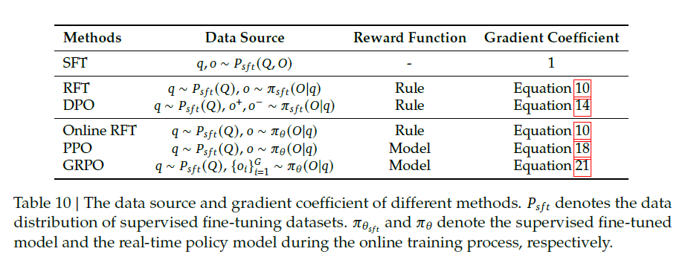
5.2 Insights of Reinforcement Learning
Three Components in the Paper’s Analysis
• Data source: prompts and outputs determine which examples train the policy.
• Reward + algorithm: scores become token-level weights that reinforce or penalize outputs.

Slide 35
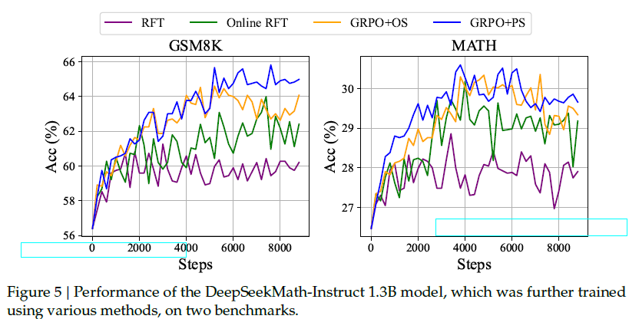
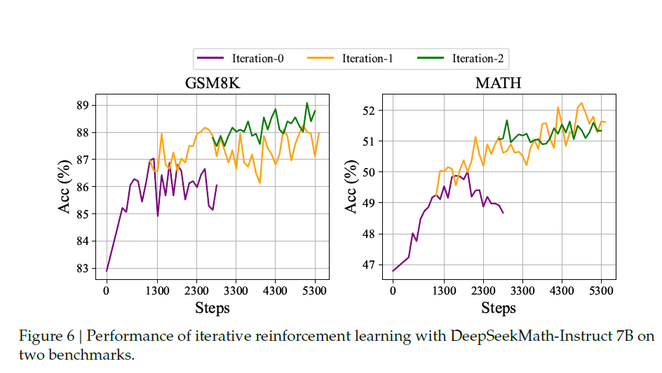
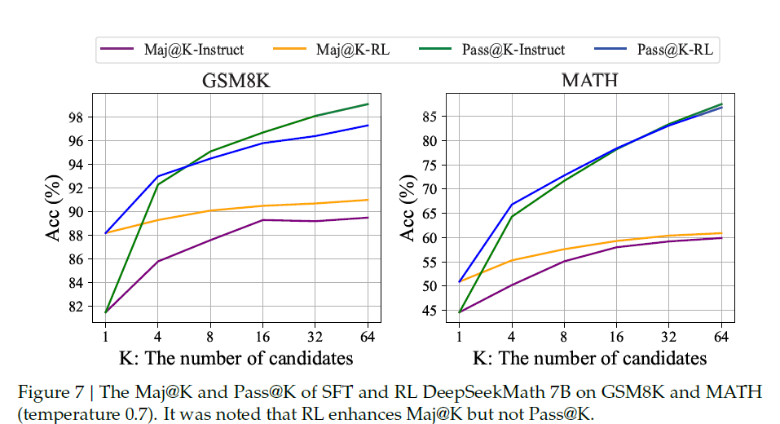
5.2 Insights of Reinforcement Learning

Slide 36
A.1.1 Supervised Fine-Tuning
Equations (6)–(7) · SFT Objective and Gradient
Equation (6)
$$J_{SFT}\left(θ\right)=𝔼_{\left[q,o∼P_{sft}\left(Q,O\right)\right]}\left(\frac{1}{\left|o\right|}\sum_{t=1}^{\left|o\right|}{{\log{π}}_{θ}}\left(o_{t}|q,o_{<t}\right)\right).$$
Equation (7)
$$∇_{θ}J_{SFT}=𝔼_{\left[q,o∼P_{sft}\left(Q,O\right)\right]}\left(\frac{1}{\left|o\right|}\sum_{t=1}^{\left|o\right|}{∇_{θ}}{\log{π}}_{θ}\left(o_{t}|q,o_{<t}\right)\right).$$
Interpretation
• Data source: question–answer pairs selected for supervised fine-tuning.
• Reward function: implicit human selection of the target response; no separate reward model is required.
• Gradient coefficient: always 1 for target tokens; standard next-token log-likelihood learning.

Slide 37
A.1.2 Rejection Sampling Fine-tuning
Equations (8)–(10) · RFT Objective, Gradient and Coefficient
Equation (8)
$$J_{RFT}\left(θ\right)=𝔼_{\left[q∼P_{sft}\left(Q\right),o∼π_{sft}\left(O|q\right)\right]}\left(\frac{1}{\left|o\right|}\sum_{t=1}^{\left|o\right|}{𝕀}\left(o\right){\log{π}}_{θ}\left(o_{t}|q,o_{<t}\right)\right).$$
Equation (9)
$$∇_{θ}J_{RFT}\left(θ\right)=𝔼_{\left[q∼P_{sft}\left(Q\right),o∼π_{sft}\left(O|q\right)\right]}\left(\frac{1}{\left|o\right|}\sum_{t=1}^{\left|o\right|}{𝕀}\left(o\right)∇_{θ}{\log{π}}_{θ}\left(o_{t}|q,o_{<t}\right)\right).$$
Equation (10)
$$GC_{RFT}\left(q,o,t\right)=𝕀\left(o\right)=\left\{\begin{matrix}1 & \text{the answer of o is correct} \\ 0 & \text{the answer of o is incorrect}\end{matrix}\right.$$
• Procedure: sample multiple outputs from the SFT model, keep correct outputs, then fine-tune on accepted outputs.
• Implication: correct answers receive positive learning weight; incorrect answers receive zero weight in this simplified formulation.

Slide 38
A.1.3 Online Rejection Sampling Fine-tuning
Equation (11) · Online RFT Gradient
Equation (11)
$$∇_{θ}J_{OnRFT}\left(θ\right)=𝔼_{\left[q∼P_{sft}\left(Q\right),o∼π_{θ}\left(O|q\right)\right]}\left(\frac{1}{\left|o\right|}\sum_{t=1}^{\left|o\right|}{𝕀}\left(o\right)∇_{θ}{\log{π}}_{θ}\left(o_{t}|q,o_{<t}\right)\right).$$
Difference from Offline RFT
Offline RFT
Online RFT
Outputs are sampled from the fixed SFT model π_SFT.
Outputs are sampled from the current policy π_θ.
• Shared rule signal: I(o) indicates answer correctness.
• Main distinction: the training examples are refreshed from the real-time policy, allowing exploration to track current behavior.

Slide 39
A.1.4 Direct Preference Optimization
Equation (12) · DPO Objective
Equation (12) · Conditional context is omitted from token notation
$$J_{DPO}\left(θ\right)=𝔼_{\left[q∼P_{sft}\left(Q\right),o^{+},o^{−}∼π_{sft}\left(O|q\right)\right]}\log{σ}\left(β\frac{1}{\left|o^{+}\right|}\sum_{t=1}^{\left|o^{+}\right|}{\log{\frac{π_{θ}\left(o_{t}^{+}|q,o_{<t}^{+}\right)}{π_{ref}\left(o_{t}^{+}|q,o_{<t}^{+}\right)}}}−β\frac{1}{\left|o^{−}\right|}\sum_{t=1}^{\left|o^{−}\right|}{\log{\frac{π_{θ}\left(o_{<t}^{−}|q,o_{<t}^{−}\right)}{π_{ref}\left(o_{<t}^{−}|q,o_{<t}^{−}\right)}}}\right)$$
Equation (13) · Pairwise Gradient
Equation (13)
$$∇_{θ}J_{DPO}\left(θ\right)=𝔼_{\left[q∼P_{sft}\left(Q\right),o^{+},o^{−}∼π_{sft}\left(O|q\right)\right]}\left(\frac{1}{\left|o^{+}\right|}\sum_{t=1}^{\left|o^{+}\right|}{G}C_{DPO}\left(q,o,t\right)∇_{θ}{\log{π}}_{θ}\left(o_{t}^{+}|q,o_{<t}^{+}\right)−\frac{1}{\left|o^{−}\right|}\sum_{t=1}^{\left|o^{−}\right|}{G}C_{DPO}\left(q,o,t\right)∇_{θ}{\log{π}}_{θ}\left(o_{t}^{−}|q,o_{<t}^{−}\right)\right)$$
Equation (14) · Token-level coefficient (abbreviated)
$$GC_{DPO}\left(q,o,t\right)=σ\left(β\log{\frac{π_{θ}\left(o_{t}^{−}|q,o_{<t}^{−}\right)}{π_{ref}\left(o_{t}^{−}|q,o_{<t}^{−}\right)}}−β\log{\frac{π_{θ}\left(o_{t}^{+}|q,o_{<t}^{+}\right)}{π_{ref}\left(o_{t}^{+}|q,o_{<t}^{+}\right)}}\right)$$
o⁺ is the preferred output, o⁻ the rejected output; full formulas condition each token probability on q and preceding tokens.

Slide 40
A.1.5 Proximal Policy Optimization
Equation (15) · PPO Objective
Equation (15)
$$J_{PPO}\left(θ\right)=𝔼_{\left[q∼P_{sft}\left(Q\right),o∼π_{θ_{old}}\left(O|q\right)\right]}\frac{1}{\left|o\right|}\sum_{t=1}^{\left|o\right|}{\min\left[\frac{π_{θ}\left(o_{t}|q,o_{<t}\right)}{π_{θ_{old}}\left(o_{t}|q,o_{<t}\right)}A_{t},\text{clip}\left(\frac{π_{θ}\left(o_{t}|q,o_{<t}\right)}{π_{θ_{old}}\left(o_{t}|q,o_{<t}\right)},1−ε,1+ε\right)A_{t}\right]}.$$
Equations (16)–(17) · Simplified Objective and Gradient
Equation (16)
$$J_{PPO}\left(θ\right)=𝔼_{\left[q∼P_{sft}\left(Q\right),o∼π_{θ_{old}}\left(O|q\right)\right]}\frac{1}{\left|o\right|}\sum_{t=1}^{\left|o\right|}{\frac{π_{θ}\left(o_{t}|q,o_{<t}\right)}{π_{θ_{old}}\left(o_{t}|q,o_{<t}\right)}}A_{t}.$$
Equation (17)
$$∇_{θ}J_{PPO}\left(θ\right)=𝔼_{\left[q∼P_{sft}\left(Q\right),o∼π_{θ_{old}}\left(O|q\right)\right]}\frac{1}{\left|o\right|}\sum_{t=1}^{\left|o\right|}{A_{t}}∇_{θ}{\log{π}}_{θ}\left(o_{t}|q,o_{<t}\right)$$
Equation (18)
$$GC_{PPO}\left(q,o,t,π_{θ_{rm}}\right)=A_{t},$$
A_t is computed with GAE from token rewards and a learned value function Vψ; PPO therefore needs a critic/value model.

Slide 41
A.1.6 Group Relative Policy Optimization
Equation (19) · GRPO Objective (Simplified Analysis)
Equation (19) · Token conditioning on q and previous tokens is abbreviated
$$J_{GRPO}\left(θ\right)=𝔼_{\left[q∼P_{sft}\left(Q\right),{\left\{o_{i}\right\}}_{i=1}^{G}∼π_{θ_{old}}\left(O|q\right)\right]}\frac{1}{G}\sum_{i=1}^{G}{\frac{1}{\left|o_{i}\right|}}\sum_{t=1}^{\left|o_{i}\right|}{\left[\frac{π_{θ}\left(o_{i,t}|q,o_{i,<t}\right)}{π_{θ_{old}}\left(o_{i,t}|q,o_{i,<t}\right)}{\overset{ˆ}{A}}_{i,t}−β\left(\frac{π_{ref}\left(o_{i,t}|q,o_{i,<t}\right)}{π_{θ}\left(o_{i,t}|q,o_{i,<t}\right)}−\log{\frac{π_{ref}\left(o_{i,t}|q,o_{i,<t}\right)}{π_{θ}\left(o_{i,t}|q,o_{i,<t}\right)}}−1\right)\right]}.$$
Equation (20) · GRPO Gradient
Equation (20)
$$∇_{θ}J_{GRPO}\left(θ\right)=𝔼_{\left[q∼P_{sft}\left(Q\right),{\left\{o_{i}\right\}}_{i=1}^{G}∼π_{θ_{old}}\left(O|q\right)\right]}\frac{1}{G}\sum_{i=1}^{G}{\frac{1}{\left|o_{i}\right|}}\sum_{t=1}^{\left|o_{i}\right|}{\left[{\overset{ˆ}{A}}_{i,t}+β\left(\frac{π_{ref}\left(o_{i,t}|o_{i,<t}\right)}{π_{θ}\left(o_{i,t}|o_{i,<t}\right)}−1\right)\right]}∇_{θ}{\log{π}}_{θ}\left(o_{i,t}|q,o_{i,<t}\right).$$
Equation (21)
$$GC_{GRPO}\left(q,o,t,π_{θ_{rm}}\right)={\overset{ˆ}{A}}_{i,t}+β\left(\frac{π_{ref}\left(o_{i,t}|o_{i,<t}\right)}{π_{θ}\left(o_{i,t}|o_{i,<t}\right)}−1\right)$$
This simplified equation assumes π_old = π_θ for the appendix derivation. The main training objective uses the clipped form in Equation (3).

Slide 42
5.2.2 Why RL Works?
Pass@K vs. Maj@K
Pass@K
Maj@K
Does at least one of K samples solve the problem?
Does the majority / most frequent answer become correct?
Observed Effect
• RL improves Maj@K: the model becomes more likely to produce a correct answer consistently across samples.
• Pass@K does not improve similarly: the best-of-K capability is not the metric showing the main RL gain.
• Authors’ interpretation: RL may primarily make the output distribution more robust by increasing the probability of correct responses among sampled candidates, rather than creating wholly new underlying capabilities.
• Implication: reasoning evaluation should distinguish “can produce a correct answer at least once” from “usually produces a correct answer.”

Slide 43
5.2.3 How to Achieve More Effective RL?
Data Source
Algorithm
Reward Function
• Broader prompts: improve generalization to out-of-distribution problems and advanced decoding or tree-search strategies.
• Robustness to noise: the algorithm should avoid blindly trusting unreliable reward signals.
• OOD generalization: reward models must score new questions and advanced outputs reliably.
• Weak-to-strong alignment: use algorithmic improvements to reduce dependence on perfect supervision.
• Uncertainty: represent reward-model uncertainty, potentially to avoid over-optimizing noisy scores.
• Efficient exploration: inference-time efficiency directly affects how much policy exploration can be done.
• Combine signals: rule-based correctness and learned reward models offer complementary supervision.
Potential Limitation Highlighted by the Paper
Even carefully annotated process-reward data (PRM800K) is reported to contain approximately 20% incorrect annotations, illustrating how noisy reward signals can become a bottleneck.
These are research directions discussed by the authors, not completed methods demonstrated by this paper.

Slide 44
6 Conclusion
Main Contributions
Scalable math corpus
Math-trained 7B model
Memory-efficient RL
120B math tokens selected from Common Crawl
Code-trained initialization + 500B-token mix
GRPO removes the separate value model
Headline Results
88.2%
51.7%
60.9%
7B
GSM8K · RL · CoT top-1
MATH · RL · CoT top-1
MATH · 64-sample self-consistency
Model parameter scale
The paper’s central message: carefully selected mathematical data, code-pretrained initialization, mathematical SFT, and group-relative policy optimization together produce strong open-model mathematical reasoning.

Slide 45
References
Primary Source
Shao, Z., Wang, P., Zhu, Q., Xu, R., Song, J., Bi, X., Zhang, H., Zhang, M., Li, Y. K., Wu, Y., & Guo, D. (2024).
DeepSeekMath: Pushing the Limits of Mathematical Reasoning in Open Language Models.
arXiv:2402.03300v3.
Benchmarks and Methods Cited Within the Paper
• Math benchmarks: GSM8K, MATH, CMATH, MGSM-zh, SAT, OCW, MMLU-STEM, Gaokao-MathQA and miniF2F.
• Training methods: SFT, Rejection Sampling Fine-tuning (RFT), Direct Preference Optimization (DPO), PPO and GRPO.
• Evaluation caveat: scores depend on prompting, tool access, sampling and voting settings reported in the paper.

