Slide 1
Seeking Oscars
By: Andrew Wu
Using Machine Learning models to predict the success of a movie at the Oscars

Slide 2
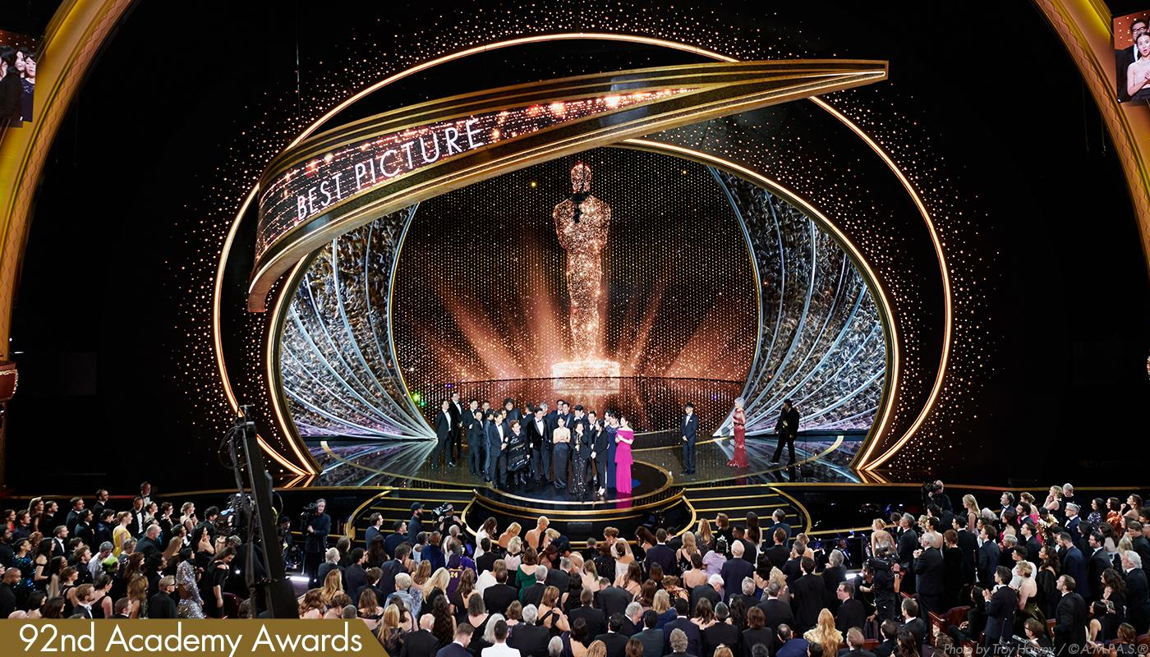
Goal: to explore characteristics that makes a film
successful at the Oscars and predicting number of
awards a film will win based on data

Slide 3
01
Methodology

Slide 4
Data collections,
Tools
& Models
Data Collection
Webscraping using Selenium&Beautifulsoup
Oscar Nominee data
Tools
Jupyter Notebook
sklearn,statsmodels,
Models
Ordinary-Least-Square(OLS) regression
LASSO regression
Ridge regression

Slide 5
02
Results

Slide 6
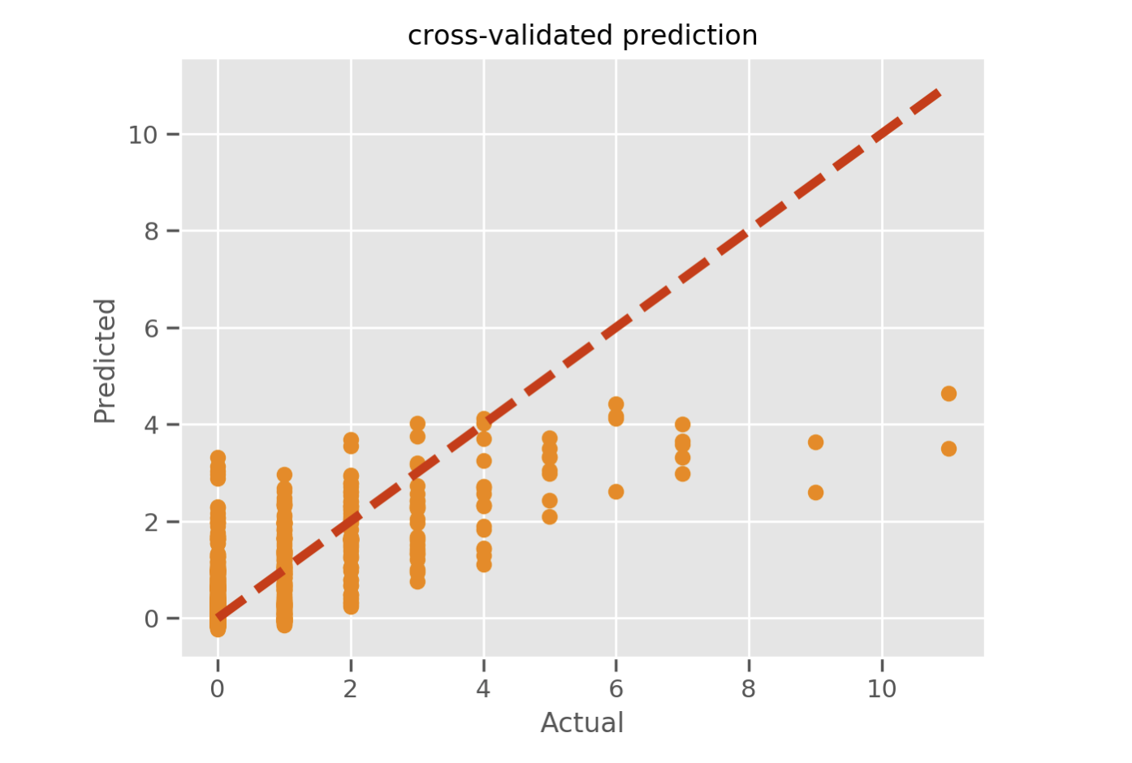
Cross-validated prediction: linear model is accurate until a certain number of awards won

Slide 7
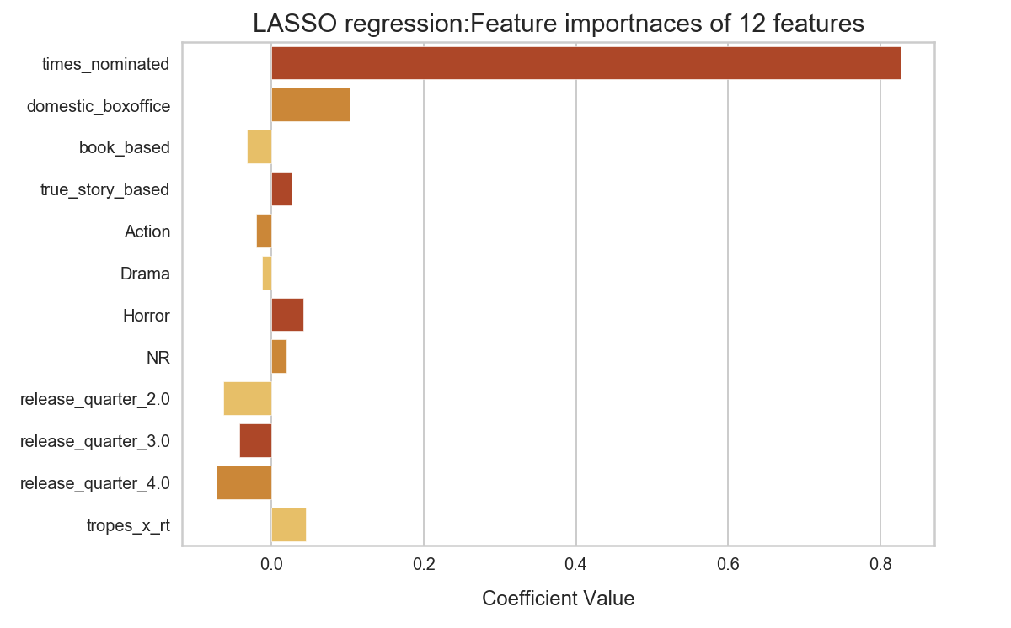
LASSO regression key Features: defying norms

Slide 8
Conclusions: The model shows promise but could be further optimized
Cond no: 1.53 e+09
Final model accuracy with cross validation test: 0.459
Alpha value of: 0.0109
Explanations:
Dynamic judging process
High multicollinearity
Oscars are political

Slide 9
03
Future improvements

Slide 10
What could be done in the future to improve the model?
Different model
More feature engineering
Introduce Time-series
Introduce classification
01
02
03
04

Slide 11

Appendix

Slide 12
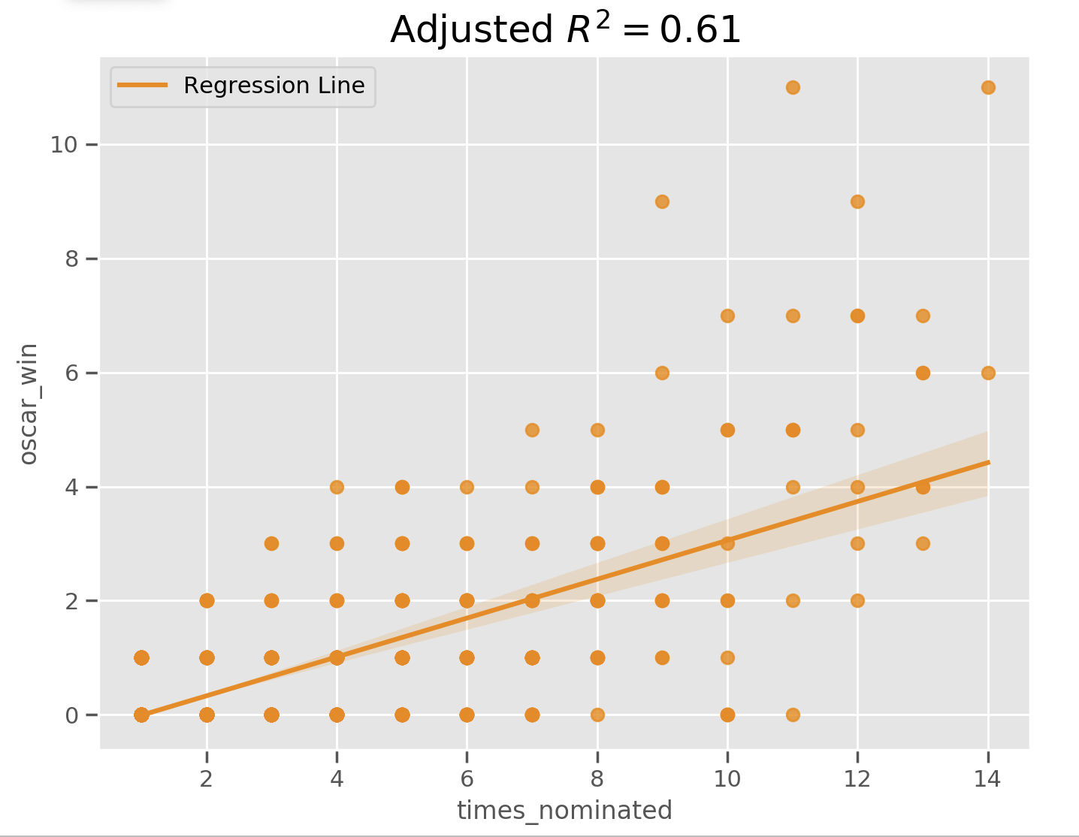

Slide 13
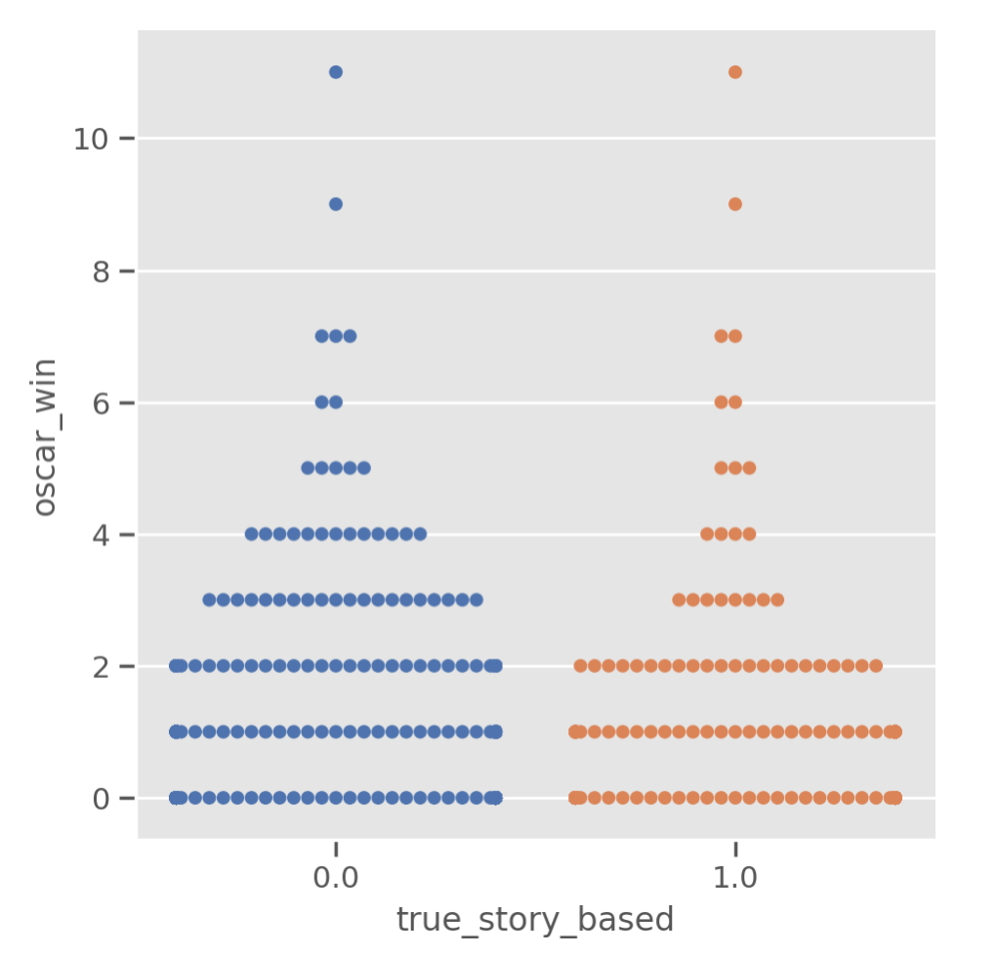

Slide 14
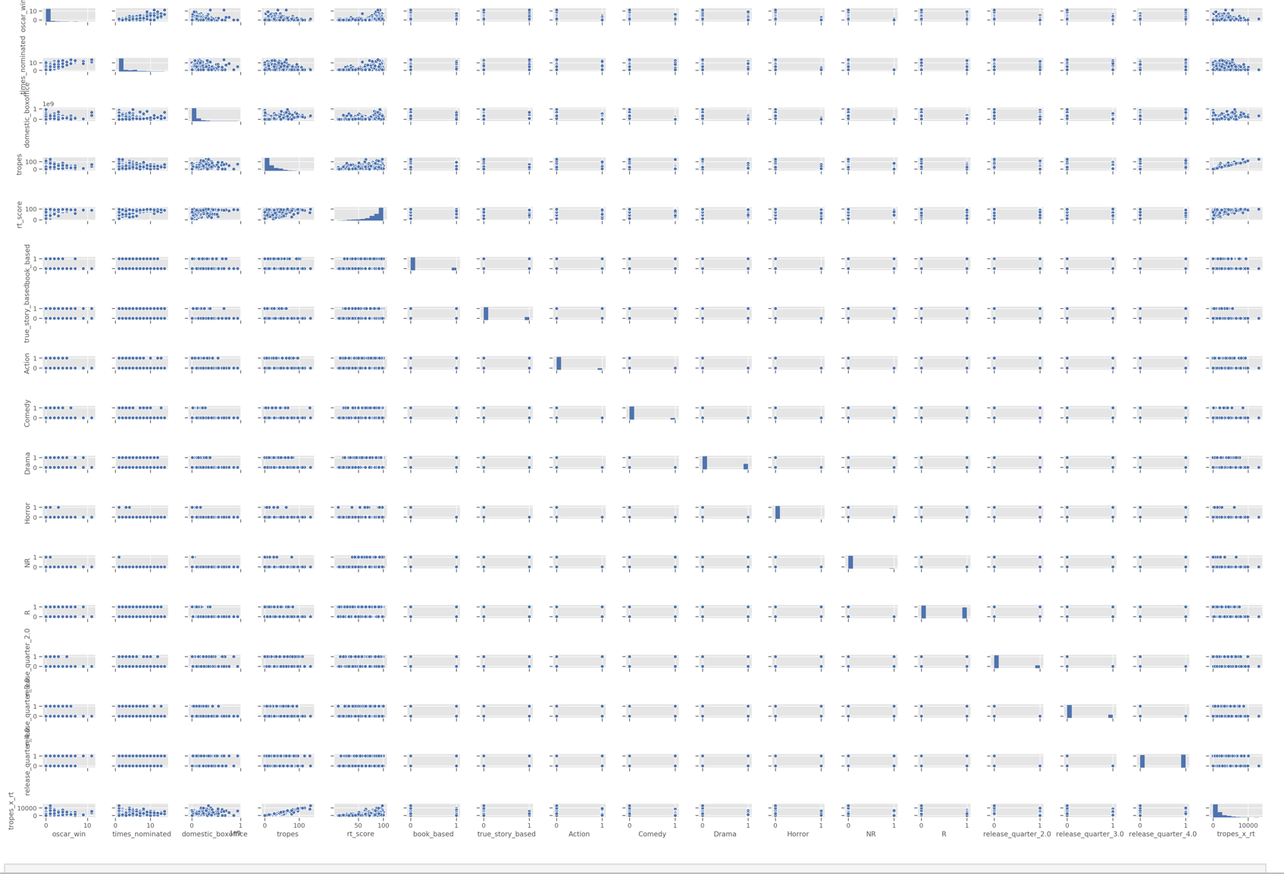

Slide 15
