Slide 1
Amazon Recommender System using Supervised Machine-Learning
By Andrew Wu
Notes:
© Copyright PresentationGo.com – The free PowerPoint library

Slide 2
Why supervised machine learning?
Clear and specific labels for data and outputs
Allows for feature engineering
Can generate better prediction results
Not as affected by the ‘cold-start’ problem

Slide 3
Methodology
Data: Amazon electronics section metadata & ratings data from 2018
metadata: user, item, price, genre, main category, similar to, bought with, viewed with
Ratings: user, item, rating(out of 5)
Classification models: KNN, Naïve Bayes, Logistic Regression, XGBoost, DecisionTree, RandomForest

Slide 4
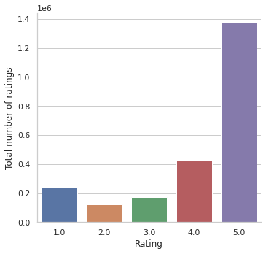
Exploratory data visualization
Average rating: 4.1/5
Average of
1.55 review per user
👍 vs 👎

Slide 5
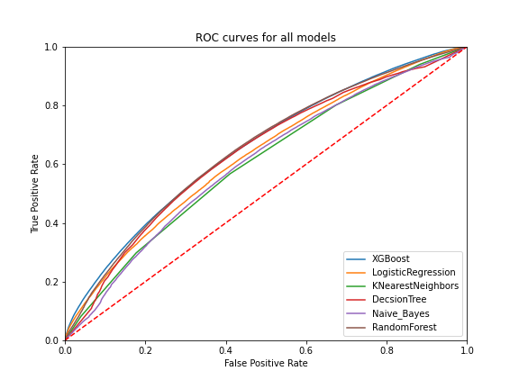
Initial results: Recall and AUC are key metrics
Model | AUC | Recall
XGBoost | 0.611123 | 0.598306
LogReg | 0.592101 | 0.581125
KNN | 0.580540 | 0.569477
DecsionTree | 0.611461 | 0.591558
NaiveBayes | 0.578334 | 0.486364
RForest | 0.613254 | 0.619221
Next: hyperparameter tuning with GridSearchCV

Slide 6
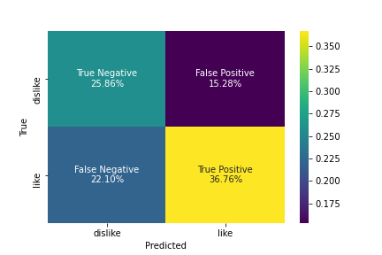
Results: XGBoost has a slight edge over RandomForest
After GridSearchCV:
Accuracy:0.626
Recall:0.622
XGBoost gave the lowest false negative percentage

Slide 7
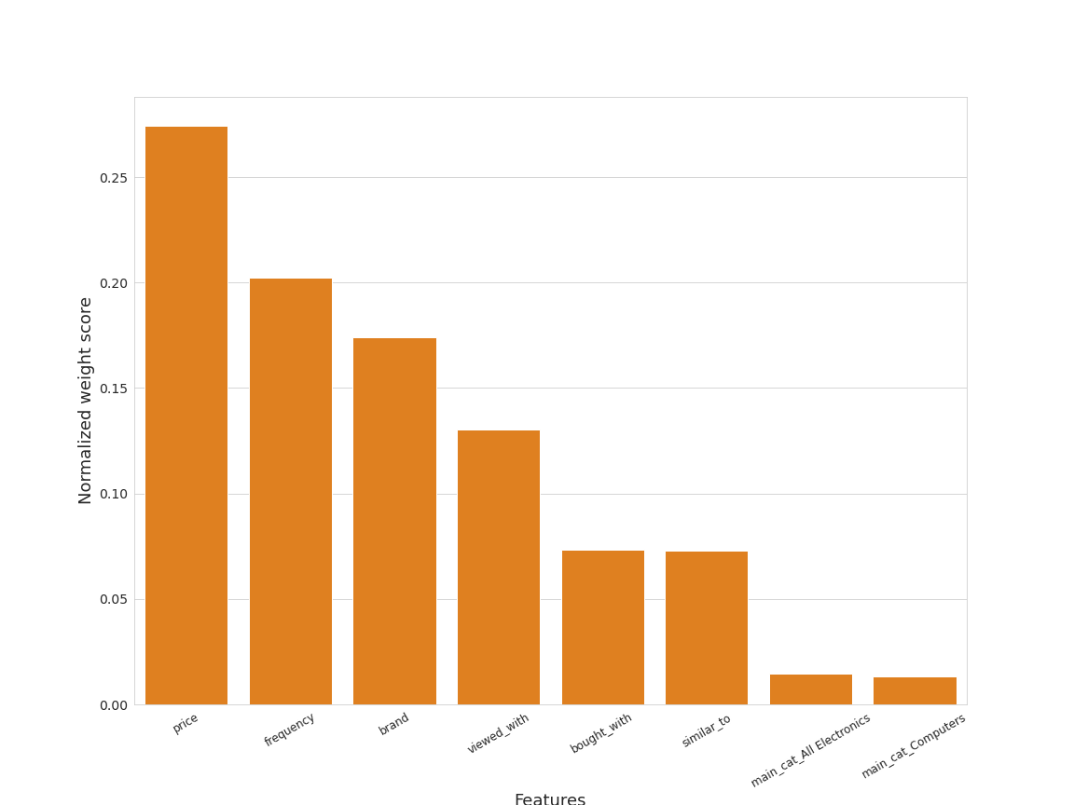
Results: Feature Importance
Hard to pinpoint all important features
Weight vs Cover vs Gain
Brand is very important to customers

Slide 8
Conclusions
RandomForest has lower metric scores, but also lower over-fit
More feature engineering and customer information needed to identify key features
Also Completed: A unsupervised(SVD) + supervised hybrid model MVP (RMSE=1.1)
Future plans: Continue development on the hybrid model
Questions?

Slide 9
Thank you! My Linkedin: https://www.linkedin.com/in/andrew-wu-939746171/ My Github:https://github.com/andywzz

Slide 10
Appendix

Slide 11
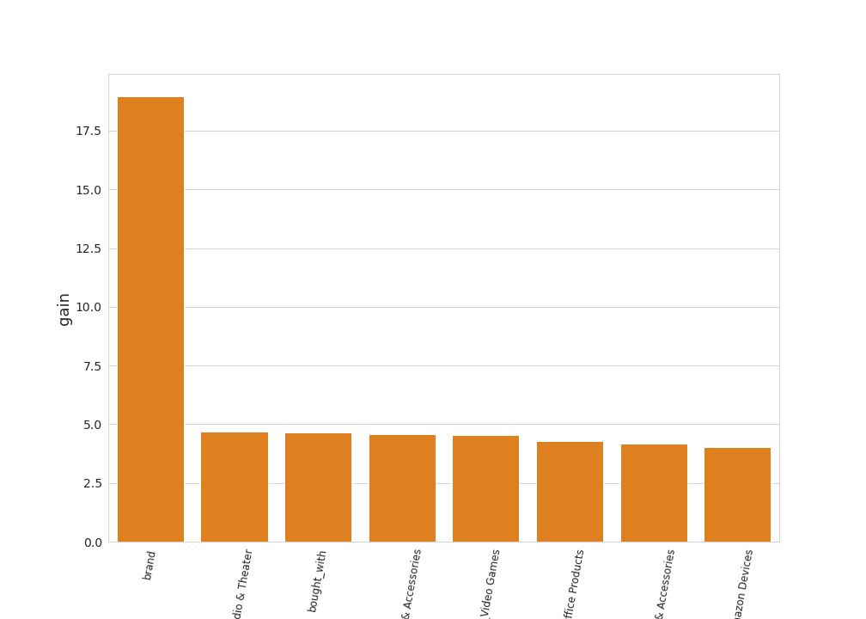
Appendix:Feature Importance

Slide 12
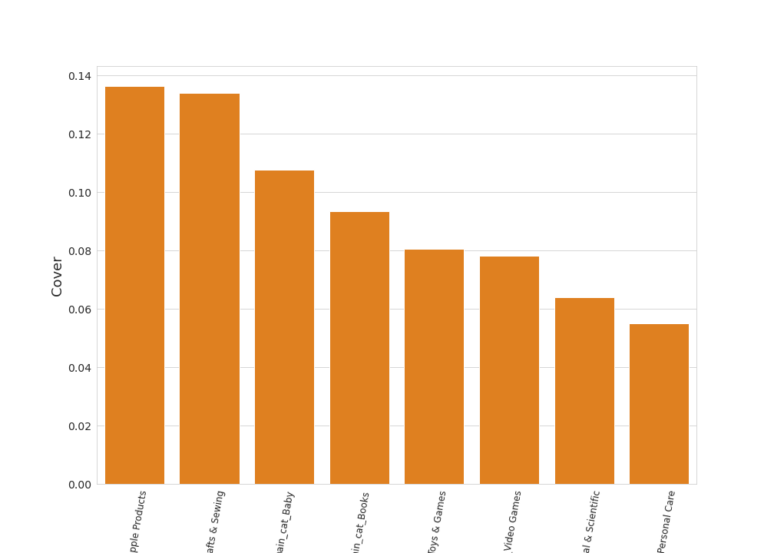
Appendix:Feature Importance

Slide 13
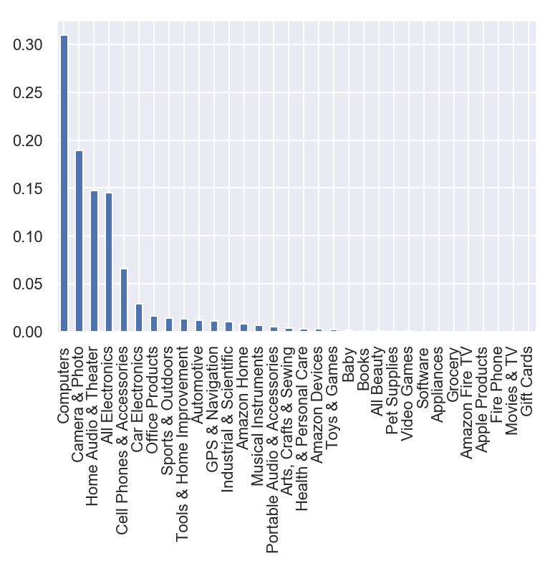
Appendix:Main category frequency

Slide 14
Notes:
© Copyright PresentationGo.com – The free PowerPoint library

