Slide 1
Midterm Test Plan
My Diary
組員： 106598024 鍾承翰 106598038 李柏霖
106598054 楊子冊 106598060 吳彥銘

Slide 2

My Diary
A real-world mobile app implementation inspired by the movie Your Name.
(君の名は、你的名字)

Slide 3
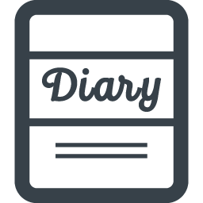






Main Features
Create topic Read topic Update topic
Delete topic
CRUD Diary, Memo and Contacts
Present calendar
Add photo
Security lock
Import and export file
Theme setting

Slide 4
Purpose of Test Plan
根據我們所訂下的測試項目，撰寫自動化測是腳本，
測試My Diary主要的基本功能，並產生測試結果報表後，
評估My Diary的基本功能是否正常運作。

Slide 5
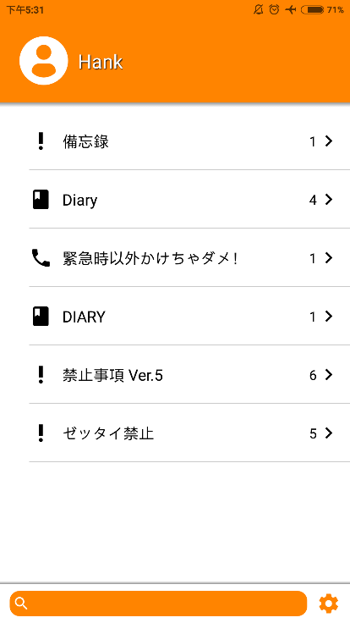
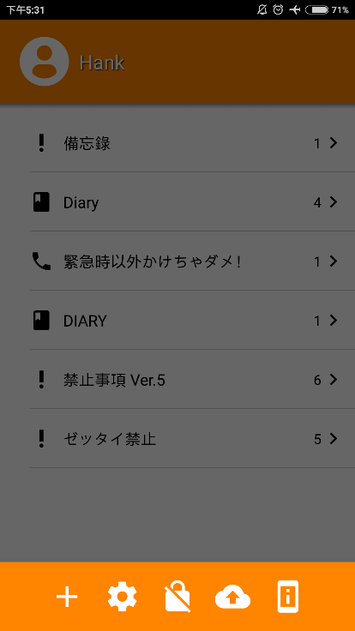
Features To Be Tested
Create topic
Read topic
Update topic
Delete topic

Slide 6
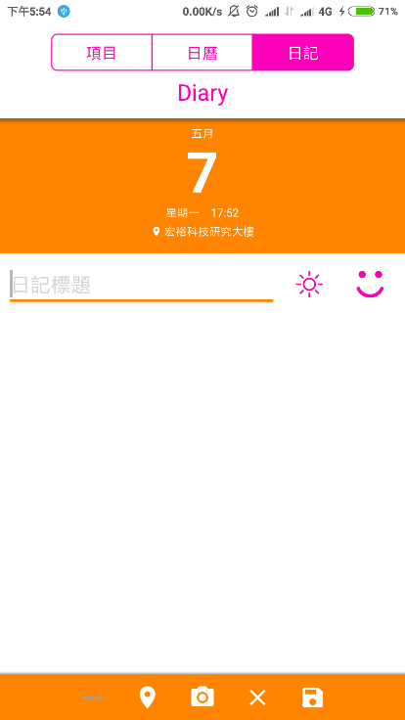
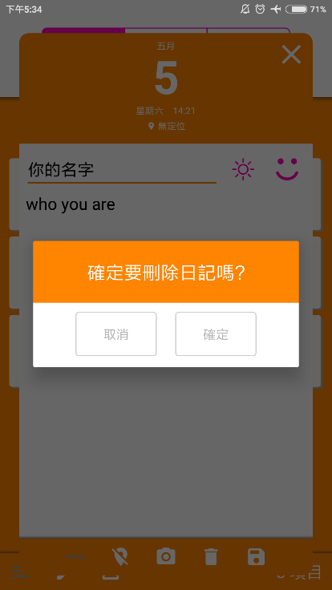
Features To Be Tested
Create diary
Read diary
Update diary
Delete diary

Slide 7
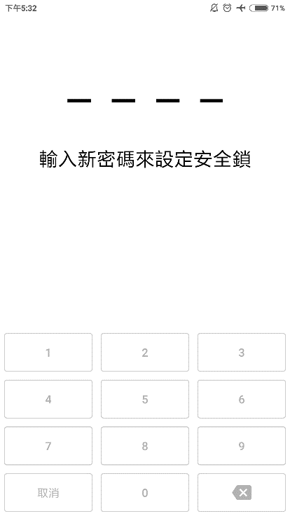
Features To Be Tested
Set the security lock
Remove the security lock

Slide 8
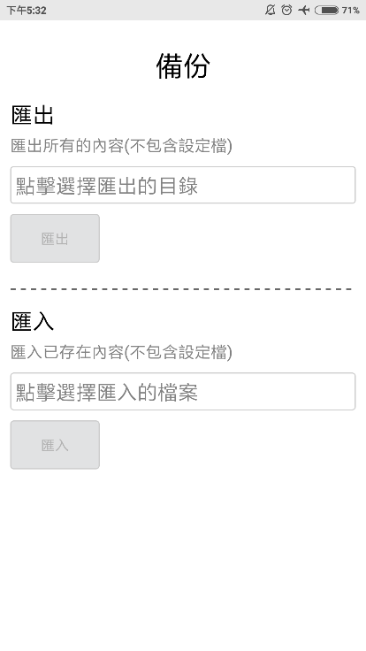
Features To Be Tested
Import the file
Export the file

Slide 9
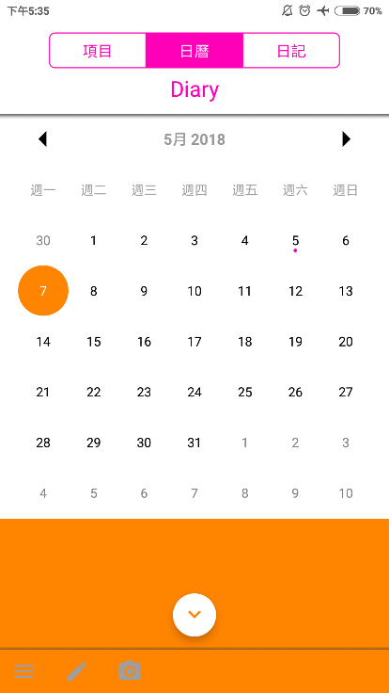
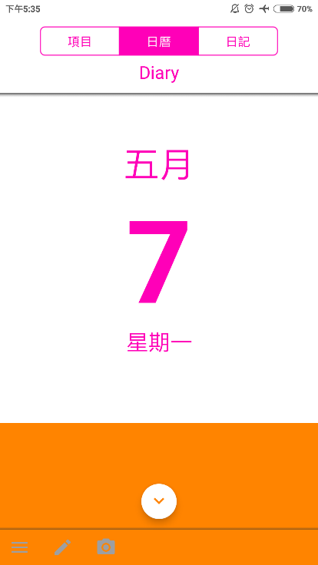
Features To Be Tested
Present the calendar right

Slide 10
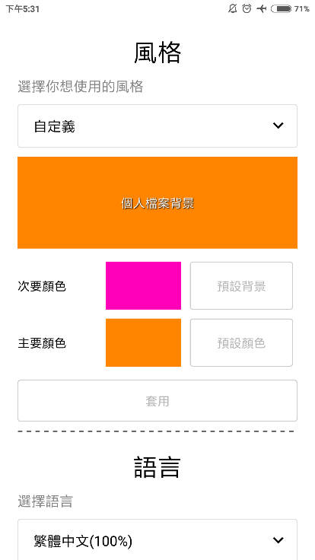
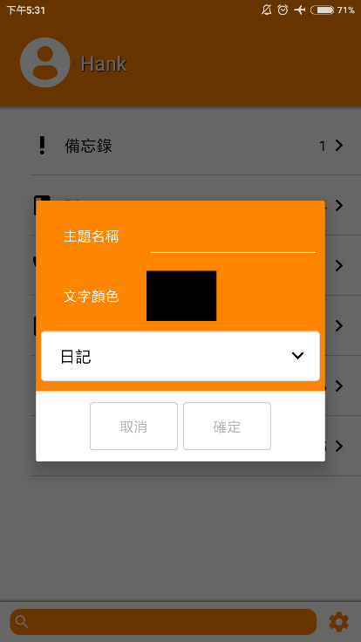
Features To Be Tested
Theme setting

Slide 11
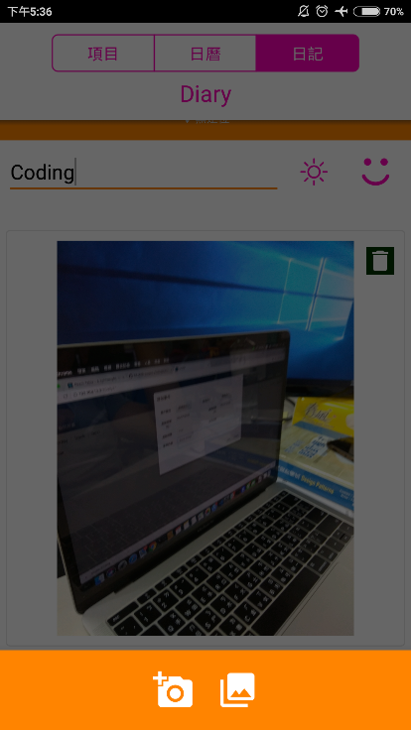
Features To Be Tested
Add photo

Slide 12
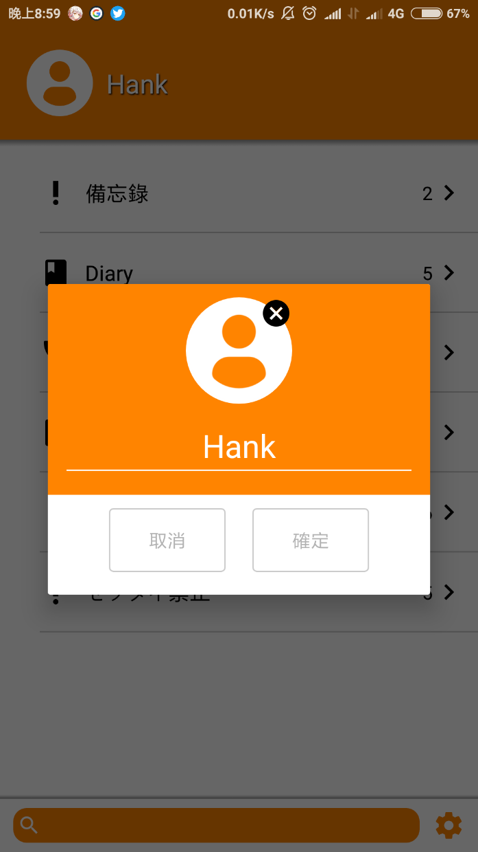
Features To Be Tested
Edit user name

Slide 13
Features Not To Be Tested
Not To Be Tested | Why
Change language | Invalid functionality
Location | Not sure to test
Weather and emoji icon | Not sure to test
Record the video | Not sure to test

Slide 14


Test Tool
Robot Framework

Slide 15
INSERT THE TITLE
OF YOUR PRESENTATION HERE
Thank you
This text can be replaced with your own text

