Slide 1
FUTURE CITY FELLOWSHIP · MILESTONE 2 · JULY 21, 2026
A Staged, Future-Ready Public EV Charging Plan
Fairfax City + Prince William County, Virginia — 12 candidate sites, 25 starter ports on a 48-port future-ready pathway
Team: Anna · Laylas · Andy · Adama · Paula
Target 13 minutes · static visuals only (all images open offline)
All model figures are screening-class outputs of canonical contract v1.0.0 (2026-07-19); nothing in this deck is a budget, permit, or client endorsement.
Notes:
Anna opens. One sentence: staged public charging that grows with evidence, not ahead of it.

Slide 2
01 · THE PROBLEM WE CARRIED FORWARD FROM PHASE 1
Build public charging that grows with demand — without repeating two local failures
Phase 1 committed us to equitable public Level 2 charging at municipal sites in Fairfax City and Prince William County.
Milestone 2 answers: which of 12 candidate sites, how many ports, on what staging logic, over 10 / 20 / 30 years (2036 / 2046 / 2056).
Failure mode 1 — retrofit cost escalation
Expansion pathways not built during the first dig force expensive trenching later (documented locally at McCoart).
Failure mode 2 — overbuild and underuse
Capacity installed ahead of demand sits idle and costs money to keep online or decommission (documented locally at Neabsco).
Scope: public AC Level 2 only — no DC fast charging, no battery storage at any of the 12 sites.
Basis: Phase 1 problem statement carried into Milestone 2 · client interview evidence (PWC, July 2026) · 12 candidate public sites
Notes:
Anna: frame the two failure modes; everything that follows is designed to avoid both at once.

Slide 3
02 · WHAT THE CLIENT'S OWN EXPERIENCE TELLS US
Two pieces of client evidence anchor the design
McCoart Government Center — trenching
“The cost driver was trenching distance — expansion pathways were not in the ground when the first ports went in.”
— [client contact], Prince William County (paraphrased from July 2026 interview)
Neabsco commuter garage — overbuild
“70 ports went in; 17 stations were later taken offline — roughly $1,000 per station per year at stake.”
— [client contact], Prince William County (paraphrased from July 2026 interview)
Also from the client record: ADA EV-space redesign cost about a year (Dominion reports the same); a ~35-station county fleet hub is in design (parallel track).
Fire / HazMat ([fire-service interviewee]): no local EV fires yet, but a responder recognition-and-education gap exists — and charger siting can block emergency access.
Evidence: recorded stakeholder interviews, July 2026 ([client contact], PWC; [fire-service interviewee], Fire/HazMat) · quotes paraphrased, attributed in the interview record
Notes:
Laylas: these are the client's own words shaping the plan — trenching drives pathway oversizing; Neabsco drives staged triggers.

Slide 4
03 · CLIENT MEETING #2 — WHERE IT HONESTLY STANDS
Strong client evidence in hand; the compliant Meeting #2 is prepared, not yet held
What we have
• A substantive July interview with [client contact] (PWC) plus fire-service evidence from [fire-service interviewee] — real client input that already changed the design.
What we do not yet have
• A fellowship-compliant Client Meeting #2: no dated session where the client reviewed our alternatives and gave recorded feedback on them.
What is prepared and ready to send
• A complete follow-up package — pre-read, agenda, plain-language alternatives briefing, feedback form, decision log — [client contact] offered a follow-up meeting or email exchange.
Claims discipline: nothing in this deck asserts that Client Meeting #2 occurred or that the client endorsed any alternative.
Artifacts: human_actions/client_meeting_2/ (pre-read, agenda, briefing, feedback form, what-changed register — register stays blank until the touchpoint)
Notes:
Laylas: say this plainly; honesty here is a strength, and the package is ready to go this week.

Slide 5
04 · SEVEN GENUINELY DIFFERENT WAYS TO DO THIS
The alternatives we compared — including the honest “do nothing”
 | Alternative | Year-1 picture | 10-yr cost order | Main risk
A | Broad immediate buildout | Dozens of ports, mostly idle | Highest | Repeating Neabsco underuse
B | Staged pilots + expandable pathways | 2–3 ports live at top sites; conduit oversized | Low–moderate | Slower geographic reach
C | EV-ready first (pathways only) | Capped conduit, little service | Lowest capital | No visible public value
D | Centralized fleet hub + selective public | County's ~35-station hub advances (its own track) | Moderate–high | ADA clustering cost; no duty-cycle data
E | Managed-charging-first | Smart charging on existing ports | Low–moderate | Needs networked EVSE + fail-safe comms
F | Hybrid portfolio (B+C+E, coord. with D) | Pilots plus EV-ready seeds | Slightly above B | More moving parts to govern
G | Do nothing / defer (comparator) | Nothing | Zero direct cost | Wastes the proactive planning window
The county fleet hub (D) is the client's real parallel track — we coordinate with it; it is not a competing recommendation.
Source: human_actions/client_meeting_2/04_ALTERNATIVES_BRIEFING.md (drafted 2026-07-19, not sent) · seven researched alternatives, none invented for show
Notes:
Adama: one line per row; linger only on B and D framing.

Slide 6
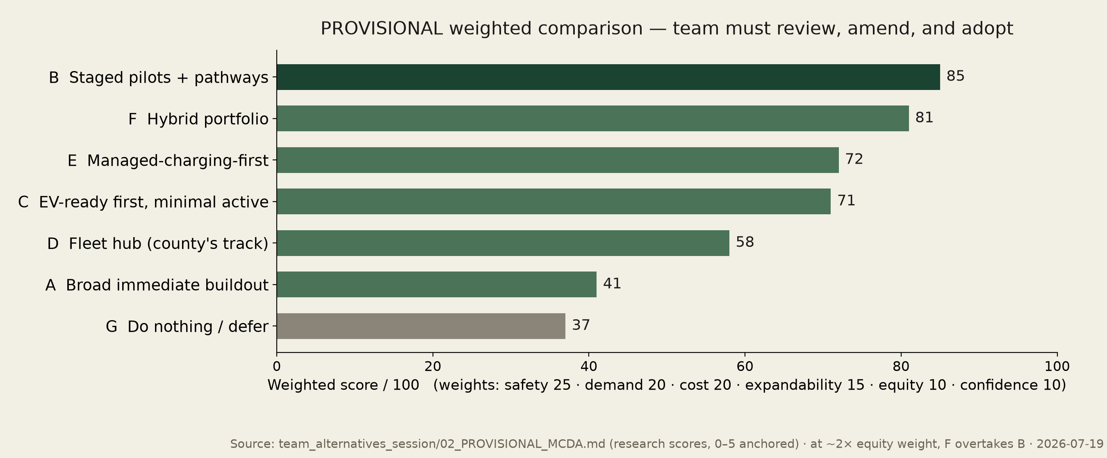
05 · WEIGHTED COMPARISON — PROVISIONAL, PENDING TEAM ADOPTION
Staged distributed pilots lead at 85/100 — hybrid portfolio close behind at 81
Why B wins: it is the only option supported by both the client's operating history (McCoart, Neabsco) and the model's low simulated utilization. Disclosed sensitivity: if equity is weighted ~2× the default, hybrid F overtakes — so we present B as the hybrid's first stage.
Source: team_alternatives_session/02_PROVISIONAL_MCDA.md — research scores; the team must review, amend, and adopt before this becomes the team's decision
Notes:
Adama: say 'provisional' out loud. The adopted matrix lives on the team scoring sheet, not in this deck.

Slide 7
06 · HOW THE STAGED SOLUTION ACTUALLY WORKS
Six steps, with hard gates before any design freeze or expansion
1 · Rank the 12 sites (model of record)
2 · Verify top sites: electrical, AHJ, ADA, fire access
3 · Pilot 2–3 ports per site; oversize conduit + panel during the dig
4 · Monitor with dual-path utilization logging
5 · Expansion trigger fires (utilization + equity override)
6 · Energize the next ports on the pre-built pathway
Gates that stop us: service-capacity confirmation (currently placeholder), AHJ permit interpretation (2020 NEC via 2021 VA USBC), ADA layout review, fire-access review, funding eligibility. No gate passed = no build.
Service capacity is a PLACEHOLDER at 12 of 12 sites — utility / facility confirmation pending; no design freeze until confirmed.
Basis: staged-pilots alternative B (provisional leader) · expansion-trigger policy is proposed, not adopted — status 'awaiting observed data'
Notes:
Andy: emphasize steps 3 and 5 — cheap pathway now, evidence-gated energization later.

Slide 8
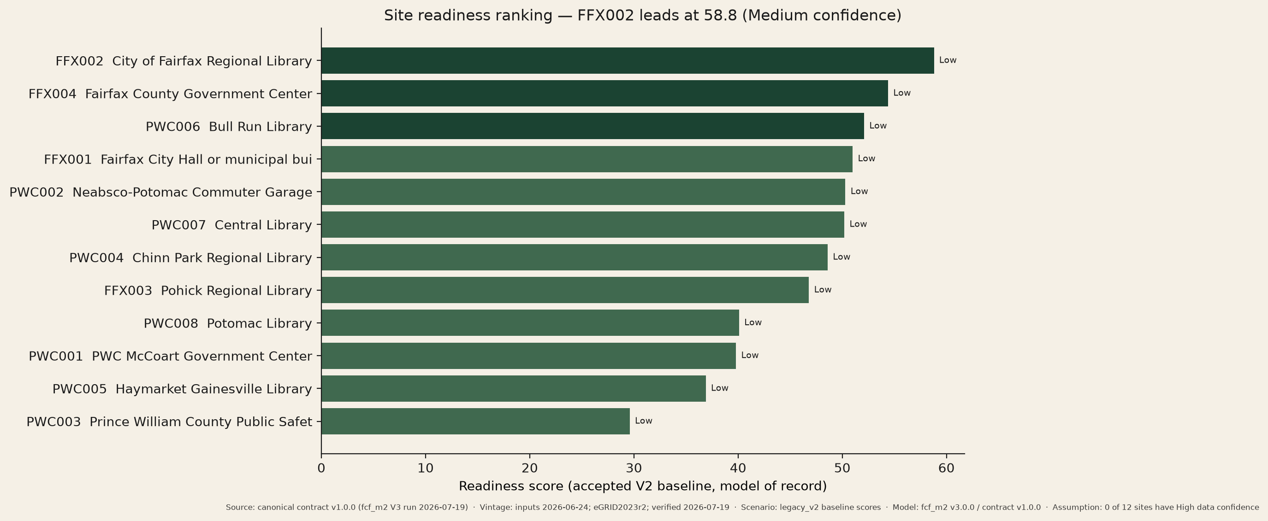
07 · CURRENT MODEL RESULTS — AND THEIR CONFIDENCE
FFX002 City of Fairfax Regional Library leads at 58.8 — no site earns High data confidence
Top three: FFX002 58.8 (Medium overall confidence) · FFX004 Fairfax County Government Center 54.4 · PWC006 Bull Run Library 52.1 (top PWC site). Per-site data confidence is Low at all 12 sites — 38 REVIEW + 12 INFO findings stand open.
Source: canonical data contract v1.0.0 (fcf_m2 v3 run 2026-07-19) · inputs 2026-06-24 · screening-class values, not budgets · eGRID2023 Rev 2 SRVC 596.3 lb CO2e/MWh, accessed 2026-07-19
Notes:
Andy: ranking is the accepted V2 baseline (model of record). Confidence labels are on the chart on purpose.

Slide 9
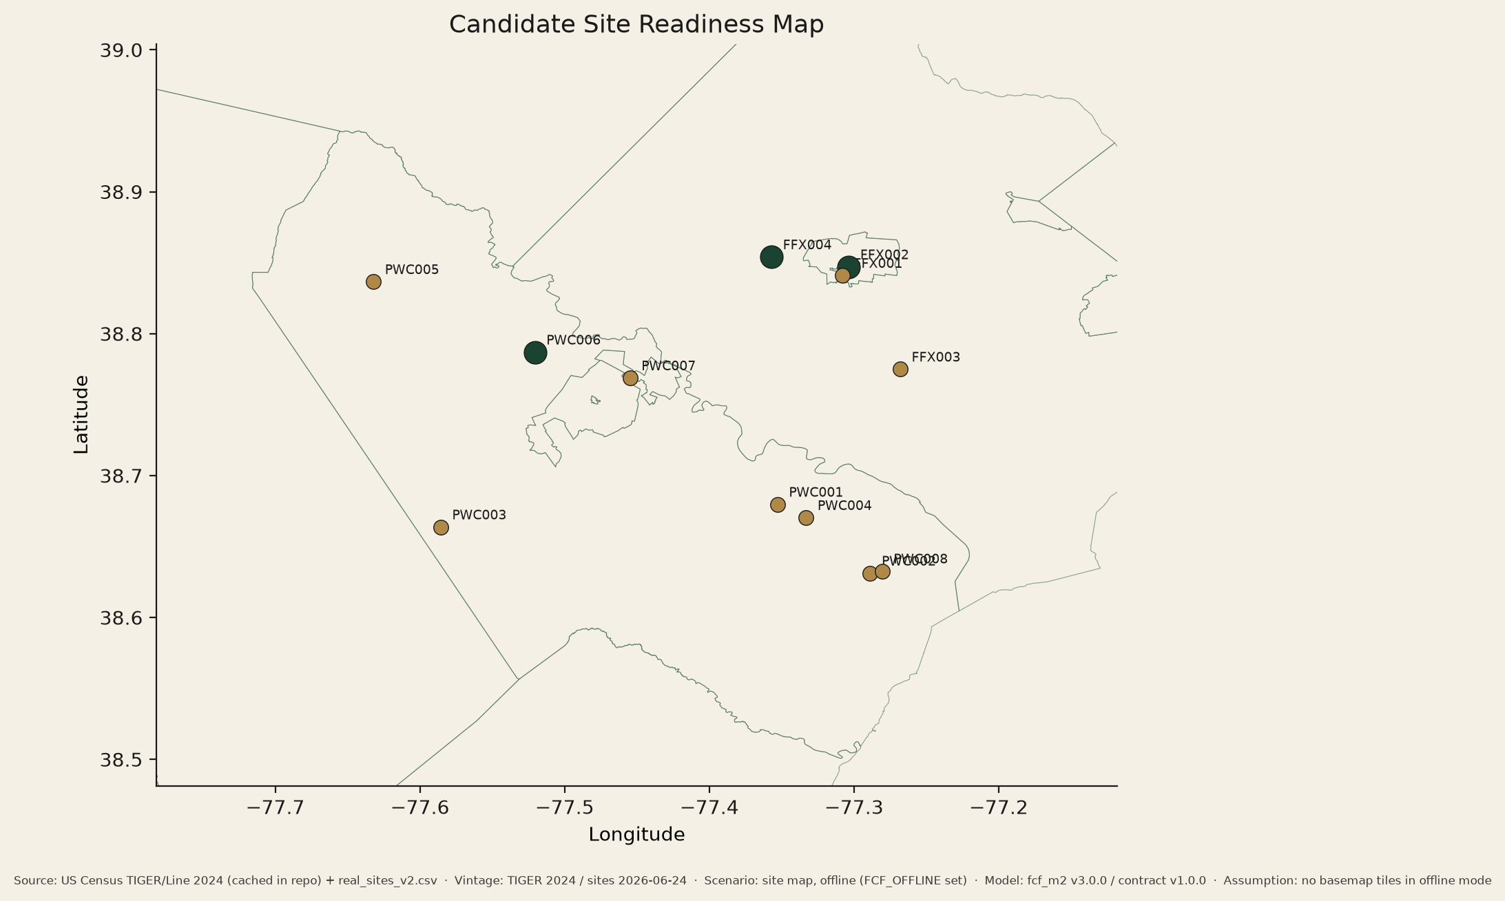
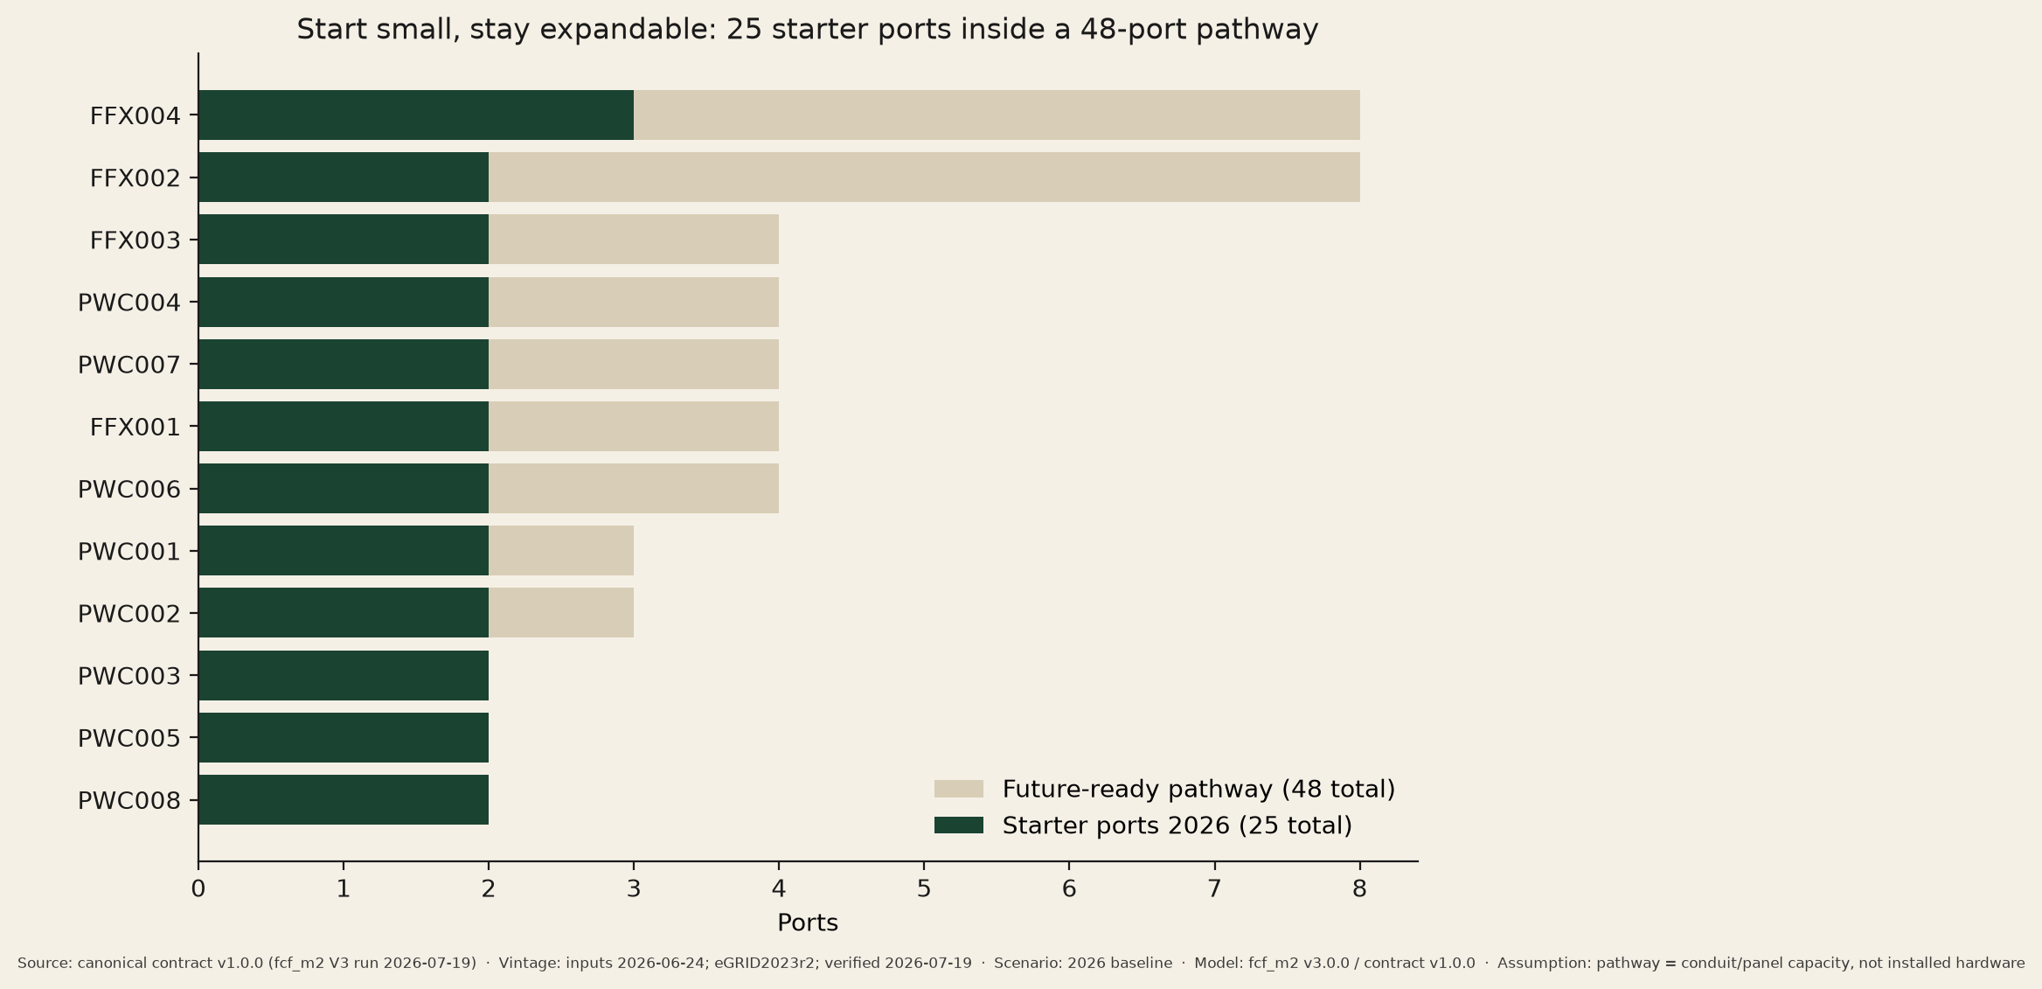
07 · CURRENT MODEL RESULTS — THE PORTFOLIO SHAPE
12 sites · 25 starter ports · 48-port future-ready pathway
Starter ports serve today's demand; the pathway (conduit + panel space) is built once, during the first dig — the direct answer to the McCoart trenching evidence.
Service capacity is a PLACEHOLDER at 12 of 12 sites — utility / facility confirmation pending; no design freeze until confirmed.
Source: canonical data contract v1.0.0 (fcf_m2 v3 run 2026-07-19) · inputs 2026-06-24 · screening-class values, not budgets · eGRID2023 Rev 2 SRVC 596.3 lb CO2e/MWh, accessed 2026-07-19 · offline map, no live tiles
Notes:
Andy: point at top-3 sites on the map; starter vs pathway is the whole strategy in one picture.

Slide 10
08 · TWO MODELED ASPECTS ACROSS THREE HORIZONS
One table: demand/ports and lifecycle cost at 2036 · 2046 · 2056
Metric (portfolio of 12 sites) | 2026 | 2036 | 2046 | 2056
Aspect 1 — active ports, base path | 25 | 44 | 47 | 47
Aspect 1 — active ports, high path | 25 | 47 | 48 | 48
Future-ready pathway capacity (built once) | 48 | 48 | 48 | 48
Aspect 2 — NPC, staged build (cumulative) | — | $1.56M | $2.29M | $3.01M
Aspect 2 — NPC, broad day-1 build | — | $1.87M | $2.64M | $3.41M
Avoided overbuild cost (staged vs broad) | — | $0.31M | $0.34M | $0.39M
Net avoided CO2e, t/yr (base / high) | ≈43 | ≈82 / 113 | ≈130 / 195 | ≈173 / 260
Service capacity is a PLACEHOLDER at 12 of 12 sites — utility / facility confirmation pending; no design freeze until confirmed. Costs are screening-class net present cost (base escalation), never budgets.
Source: canonical data contract v1.0.0 (fcf_m2 v3 run 2026-07-19) · inputs 2026-06-24 · screening-class values, not budgets · eGRID2023 Rev 2 SRVC 596.3 lb CO2e/MWh, accessed 2026-07-19
Notes:
Adama: one message — staging tracks demand and avoids $0.31–0.39M of overbuild at every horizon while CO2e benefits grow.

Slide 11
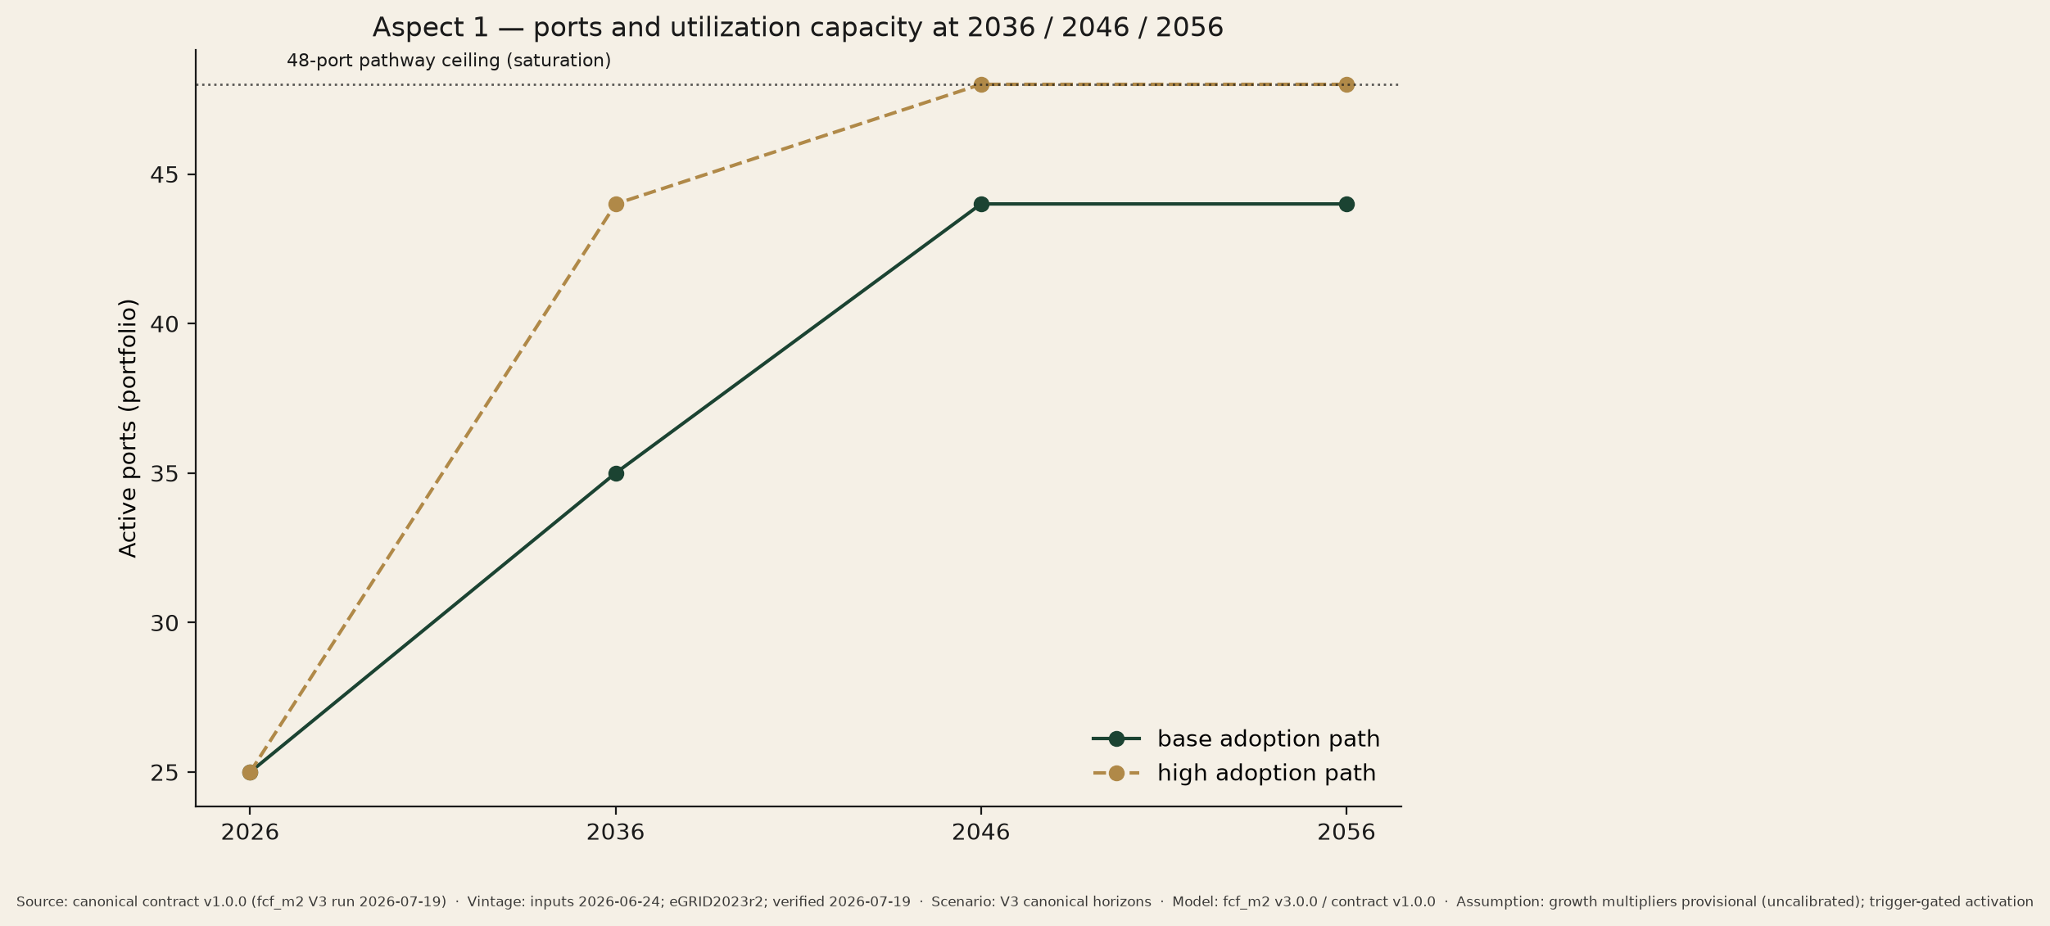
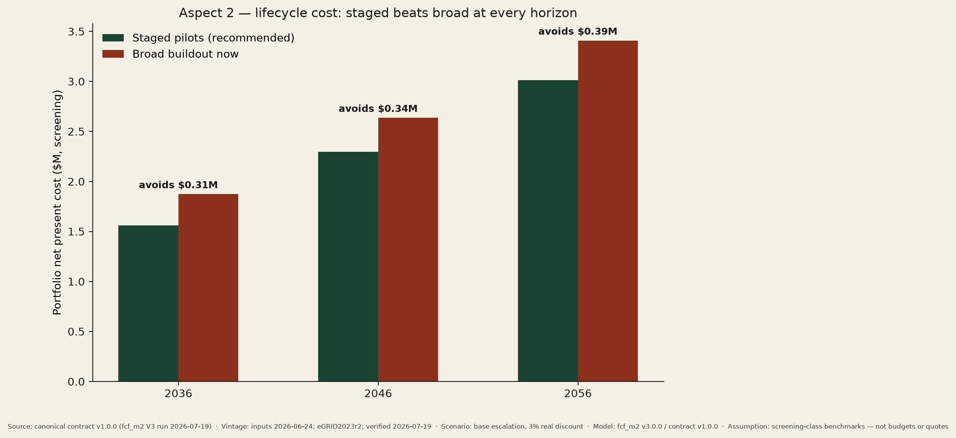
08 · THE SAME TWO ASPECTS, AS PICTURES
Ports track demand; staged spending stays below broad buildout
Left — Aspect 1: active ports climb the 48-port pathway as adoption grows (base vs high path). Right — Aspect 2: staged net present cost stays $0.31–0.39M below broad day-1 buildout at every horizon.
Service capacity is a PLACEHOLDER at 12 of 12 sites — utility / facility confirmation pending; no design freeze until confirmed.
Source: canonical data contract v1.0.0 (fcf_m2 v3 run 2026-07-19) · inputs 2026-06-24 · screening-class values, not budgets · eGRID2023 Rev 2 SRVC 596.3 lb CO2e/MWh, accessed 2026-07-19
Notes:
Adama, fast: left = aspect 1 (ports/demand), right = aspect 2 (lifecycle cost, staged vs broad).

Slide 12
09 · THE STANDARDS PACKAGE — ADOPTED EDITIONS, NOT LATEST
Two highlighted ULSE standards, the law as adopted, and one proposed standard
Highlighted (ULSE)
UL 2594 (3rd ed., 2022) — safety for the exact AC L2 equipment class proposed.
UL 3600 (2023) — circular-economy measurement; procurement disclosure + annual circularity reporting.
Supporting / law
UL 2231-1/-2 personnel protection (in the EVSE listing).
2020 NEC Art. 625 via 2021 VA USBC (eff. 2024-01-18) — the 2023 NEC is NOT Virginia law.
Access Board EVSE accessibility rule: still at NPRM — design to TA guidance now.
Conditional — NOT active
UL 2202 (DC), UL 9540/9540A + NFPA 855 (storage) apply only if DCFC or batteries enter scope.
Today: no DC fast charging, no battery storage at any of the 12 sites.
Proposed standard (fellowship design concept — not an existing or adopted standard):
“Municipal EV Charging Site Readiness and Emergency Access Standard” — modules: emergency access & disconnect · expandability / right-sizing documentation · accessibility cross-references.
Source: FINAL_STANDARDS_APPLICATION_MATRIX.md (verified 2026-07-19) · design intent only — all permit determinations rest with the AHJ
Notes:
Laylas: adopted-vs-latest discipline is the point — Virginia enforces the 2020 NEC; presenting to 2023 invites AHJ rejection.

Slide 13
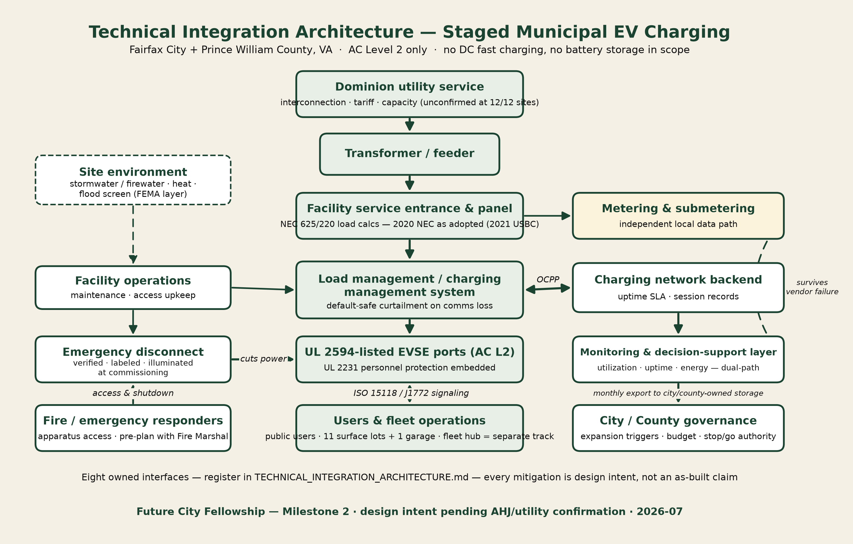
10 · TECHNICAL INTEGRATION AND WHAT COULD FAIL
One architecture, three client-resonant failure modes, three mitigations
Top-3 failure modes (each one the client has lived):
• Overbuild / underuse — Neabsco. Mitigation: staged triggers + dual-path utilization logging.
• Trenching cost blowout — McCoart. Mitigation: service-capacity confirmation before design freeze; pathways oversized in the first dig.
• Unclear emergency shutdown — fire-service evidence. Mitigation: verified, labeled, illuminated disconnect at commissioning + fire-department walkthrough.
Comms loss defaults to safe curtailment — hardwired overcurrent protection never depends on software.
Source: TECHNICAL_INTEGRATION_ARCHITECTURE.md + RISK_REGISTER.md (15 assessed failure modes) · every mitigation is design intent pending AHJ/utility confirmation
Notes:
Andy: point across the diagram's interfaces, then the three failure modes by client story.

Slide 14
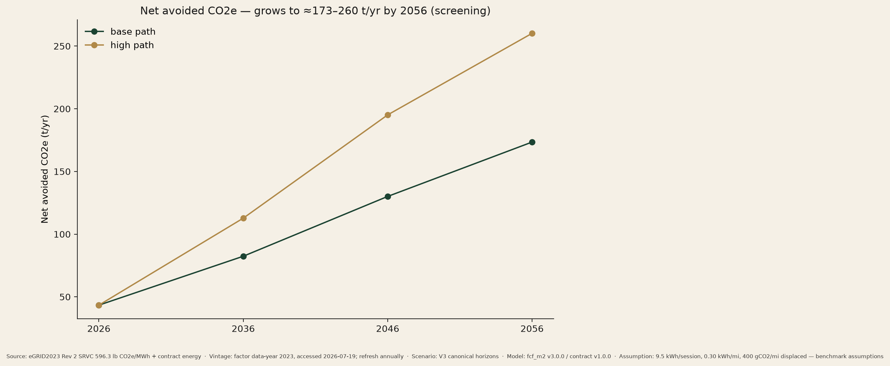
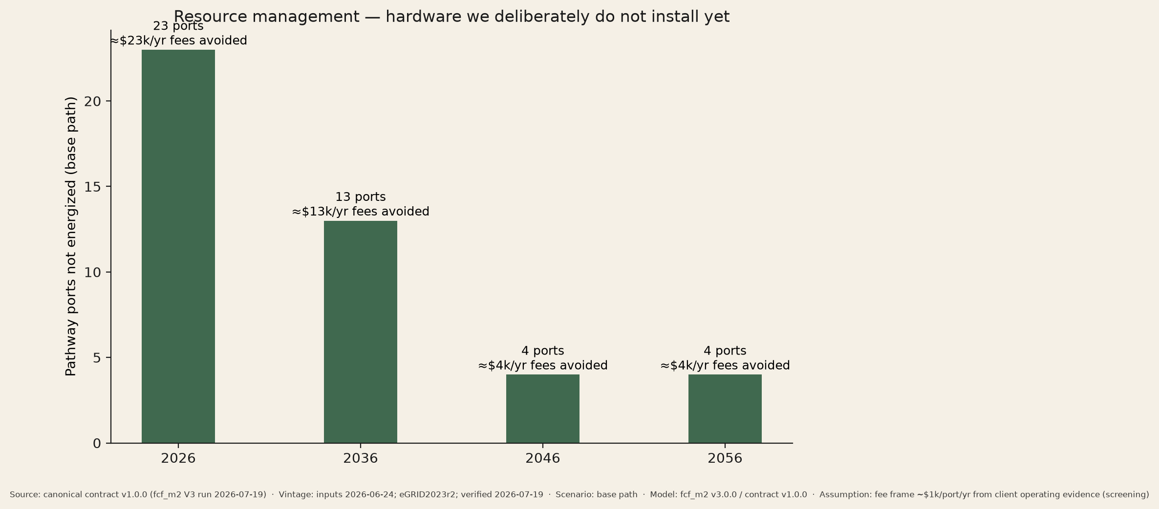
11 · THE ECONOMIC, ENVIRONMENTAL, AND STAKEHOLDER CASE
Avoided overbuild, growing CO2e benefit, and a realistic funding path
Funding: Dominion Level 2 Charging Program — 50% upfront make-ready, 100% in disadvantaged communities (eligibility/queue to confirm). NEVI is volatile (2025 freeze → court-ordered release → new guidance); treat strictly as upside, never the base. Library and commuter sites put ports where daily civic traffic already is; each site carries an equity indicator.
Source: canonical data contract v1.0.0 (fcf_m2 v3 run 2026-07-19) · inputs 2026-06-24 · screening-class values, not budgets · eGRID2023 Rev 2 SRVC 596.3 lb CO2e/MWh, accessed 2026-07-19 · no funding is awarded, applied for, or implied
Notes:
Anna: net CO2e ≈43 t/yr today growing to ≈173–260 t/yr by 2056; avoided overbuild $0.31–0.39M; funding honesty on NEVI.

Slide 15
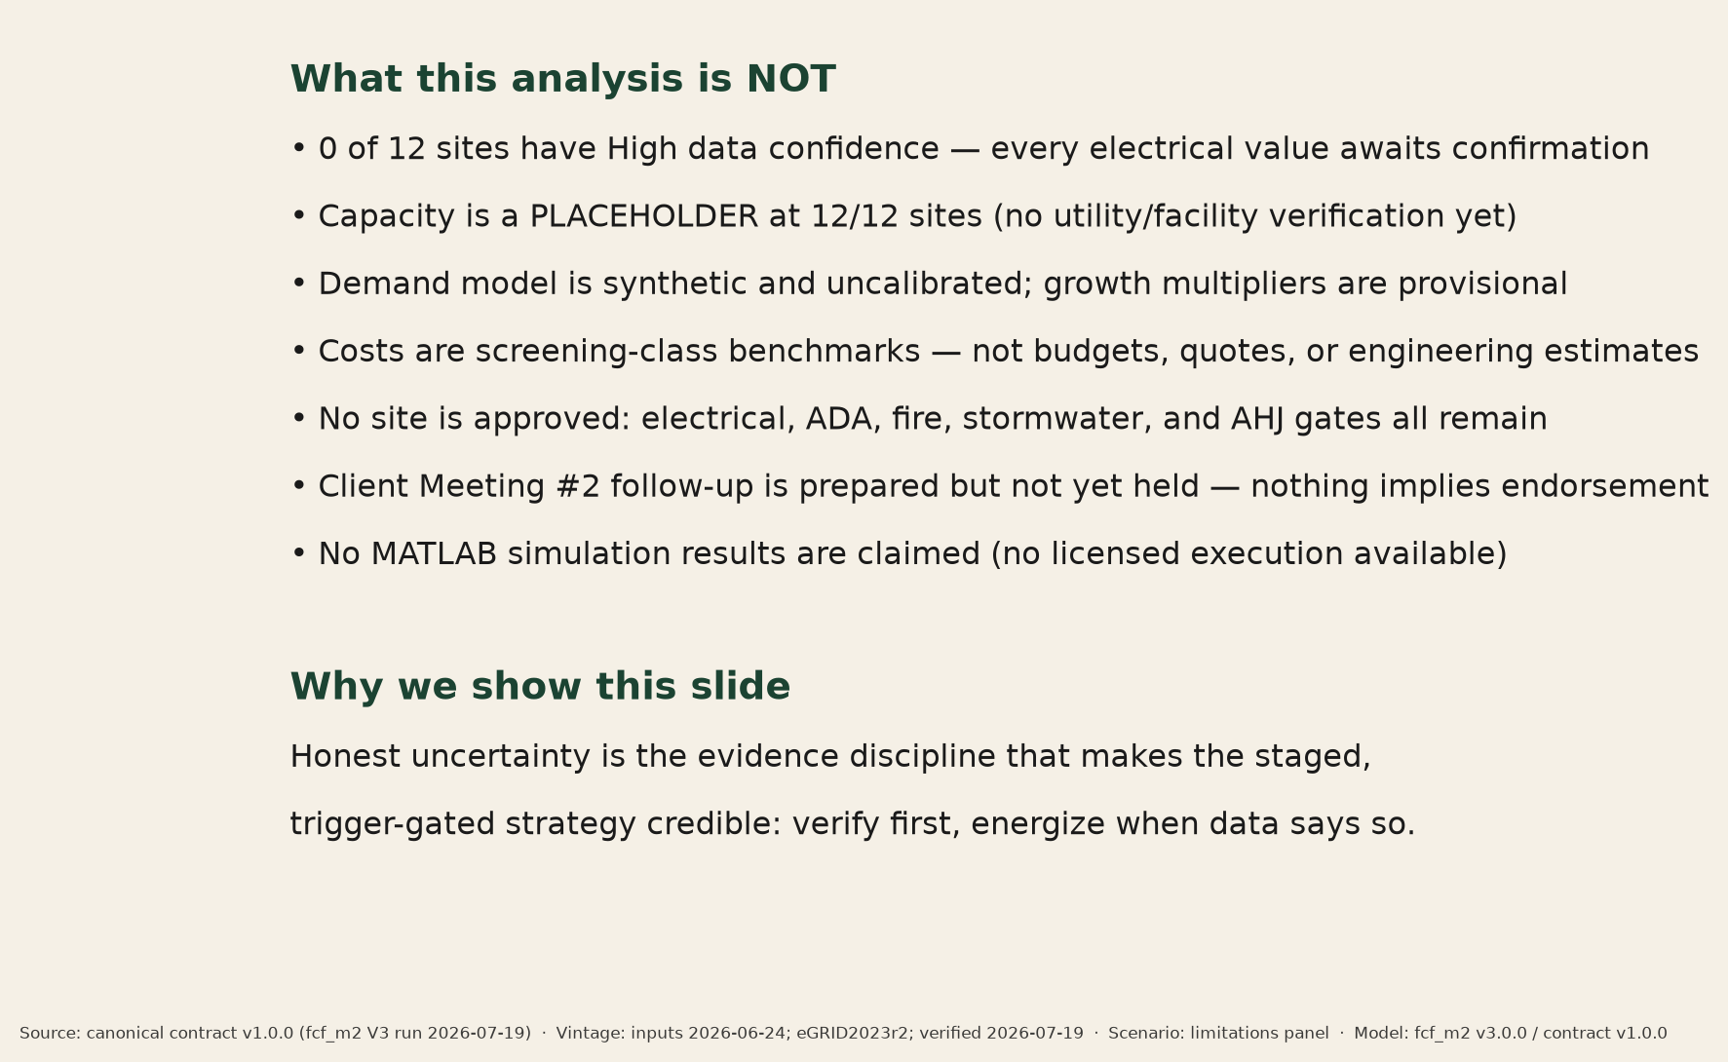
12 · LIMITATIONS — WHAT WE STILL DO NOT KNOW
The model is a screening tool; humans must validate before anyone builds
• 0 of 12 sites reach High data confidence; 38 REVIEW + 12 INFO findings remain open.
• Service capacity is a placeholder at 12/12 sites — utility / facility confirmation pending.
• Demand is synthetic and uncalibrated; costs are screening-class, never budgets.
• The MCDA is provisional until the team adopts it; Client Meeting #2 follow-up not yet held.
• Human validation still required: utility, facility managers, AHJ / electrical inspector, fire marshal, ADA review.
Source: contract v1.0.0 confidence fields + verification findings register (2026-07-19)
Notes:
Laylas: keep the '0 High-confidence sites' line verbatim — it is our credibility.

Slide 16
13 · OUR QUESTION FOR THE PEER TEAMS — AND WHAT WE DO NEXT
One question we genuinely need help with
“How should a city set an equitable expansion trigger for public EV charging when early utilization data are sparse — so it avoids both overbuilding and under-serving communities whose current EV adoption may be lower?”
Immediate next actions (this week)
• Send the utility / facility data requests for the top-3 sites (retire the capacity placeholder).
• Send the prepared Client Meeting #2 follow-up package — [client contact] offered a meeting or email exchange.
• Team session: adopt (or amend) the provisional MCDA and assign Paula's presentation role.
• Pilot ask: approve 2–3 starter ports at FFX002 / FFX004 / PWC006, screened against the Dominion Level 2 program.
Peer question ranked 95/100 in our question MCDA; two backup questions are ready in the Q&A pack
Notes:
Anna: read the question slowly, then land the four actions. The pilot ask is conditional on the gates.

Slide 17
CLOSING
Speaking roster — July 21, 2026 · target 13:00
Speaker | Sections (beats) | Slides
Anna | Opening, problem, economics, peer question, close | 1–2, 14, 16–17
Laylas | Client evidence, CM2 status, standards, limitations | 3–4, 12, 15
Adama | Alternatives, weighted comparison, three-horizon results | 5–6, 10–11
Andy | Solution workflow, model results, integration & risk | 7–9, 13
Paula | TO BE ASSIGNED at Monday rehearsal — edit this row before presenting | —
Rehearsals: Monday ~8 pm (full run, timed) and Tuesday pre-meeting (cuts drill). Static visuals only — every image in this deck opens offline from presentation/static_visuals/.
Thank you — questions welcome; a Q&A backup pack accompanies this deck.
Future City Fellowship · Milestone 2 · deck frozen against canonical contract v1.0.0 (2026-07-19)
Notes:
Anna closes. Paula's row is deliberately editable — do not present it unassigned.

