Slide 1
Solutions to gambling game
Data Science Workshop

Slide 2
A review of the gambling game

Slide 3
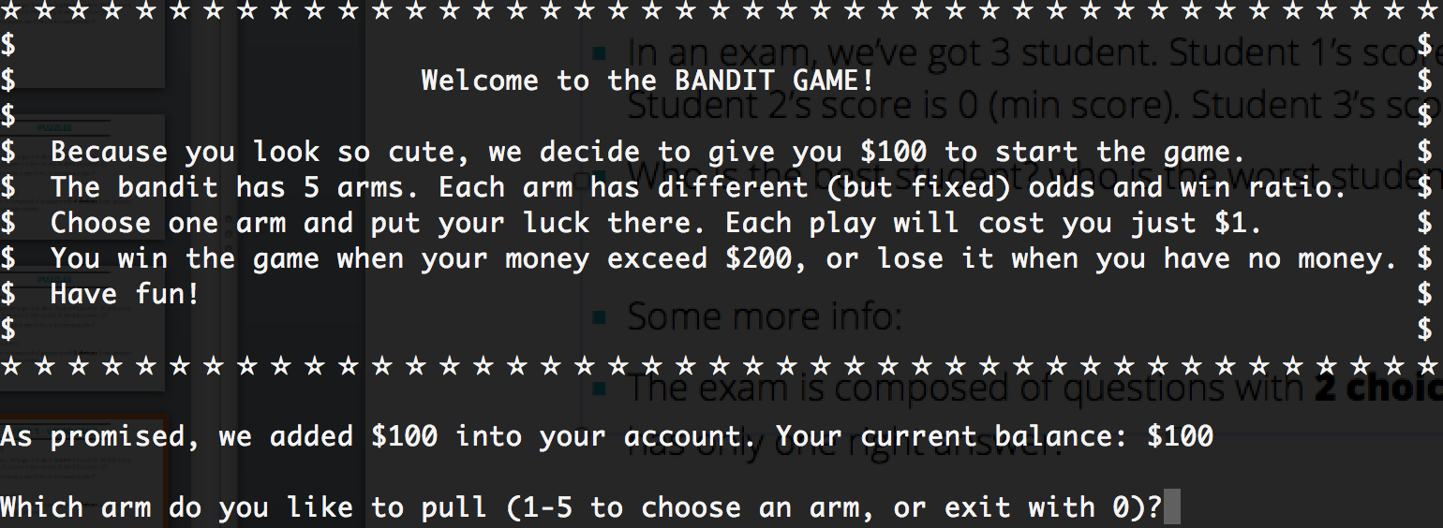
Task 1 – Gambling!!!
https://github.com/andyzeng1980/Data_Science_Workshop

Slide 4
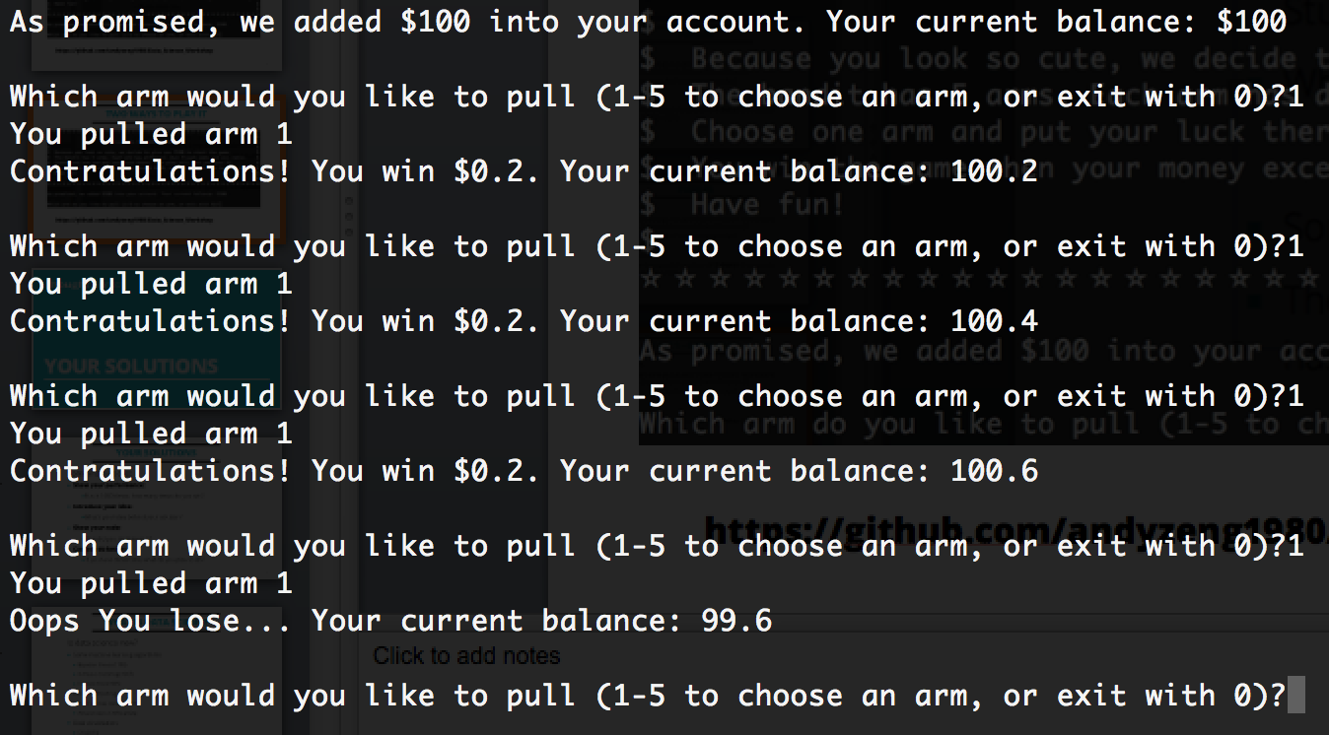
Two ways to play it
Play with it directly

Slide 5
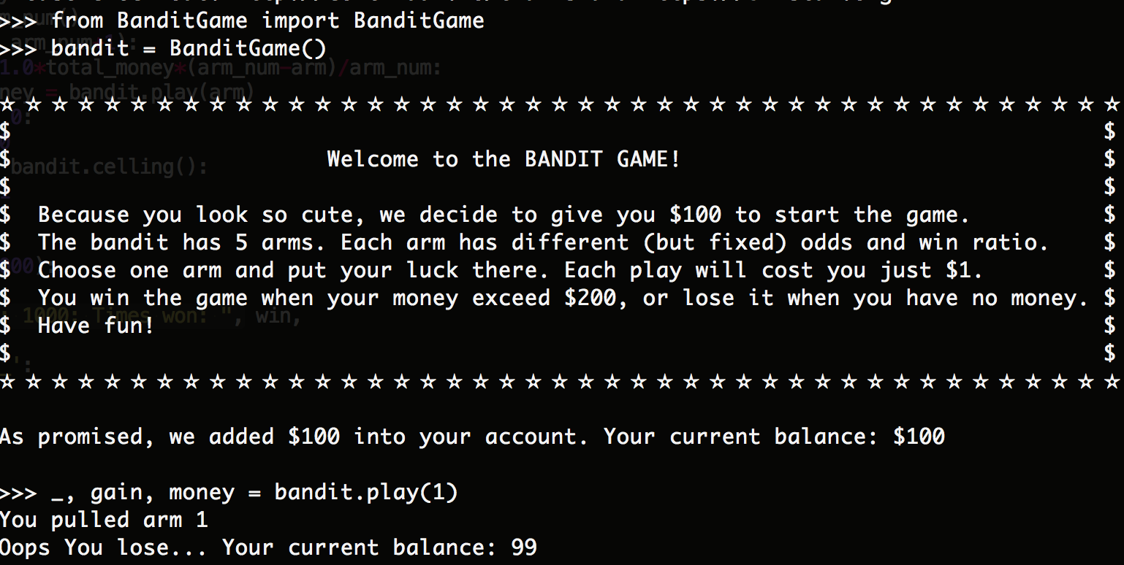
Two ways to play it
Manipulate it with your coding skills

Slide 6
Your Solutions

Slide 7
Your solutions
  Some instructions:
    Show your performance:
      Run it 1000 times, how many times do you win? _x0018_
    Introduce your idea:
      What’s your idea behind your solution?
    Show your code:
      How did you implement it?
    Can you do better:
      If you have more time, what do you plan to do?

Slide 8
My Solutions

Slide 9
Multiple solutions
  I’ve got a few solutions here:
    Simple ones, complicated ones,
    Intuitive ones, mathematically sound ones
    But no perfect ones

Slide 10
Solution 1
  The idea is really simple here:
    Give every arm the same chance (budget),
    Each arm play with its own budget, till the end of the world…

Slide 11
Discussion
  Is there better way to use the money?
    How many times do we need to try each arm to get a relatively accurate estimation of the probability?
    Do we need the same number of trials for each arm? Why?

Slide 12
Discussion
  Suppose we run each arm 10 times?
    Arm 1 win 5 times(P(win)=0.5) – I mean this arm [0.6, 0.5]
    Arm 2 win 0 times(P(win)=0) – I mean this arm [0.05, 27]
    Which estimation is more accurate?

Slide 13
Discussion
  Suppose we run each arm 10 times?
    Arm 1 win 5 times(P(win)=0.5) – I mean this arm [0.6, 0.5]
    Arm 2 win 0 times(P(win)=0) – I mean this arm [0.05, 27]
    Which estimation is more accurate?
    From the mathematical point of view:
      Error(arm1) = abs(0.5-0.6) = 0.1
      Error(arm2) =abs(0.0-0.05)=0.05
    The second one seems to be more accurate?
      But why it sounds not right??

Slide 14
Discussion
  A better way here
    I’ll run until every arm win 10 times
    Then it is fair to say
    For every arm, how many times do I need to run on average to win $XX ($XX is the reward when you win).
    Does this meet your gut feeling?
    (The following slides will be a mathematical explanation of why this is good, don’t blame your self if you feel this is insane)

Slide 15
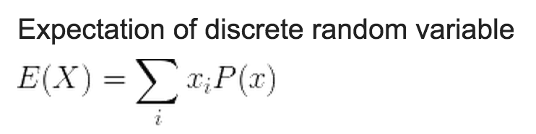
Discussion
  How do we judge if an arm can earn us money?
    We calculate the Expectation!
    E = P*Reward + (1-p)*(-1)
    If E > 0 , this arm is expected to win you money

Slide 16
Discussion
  Let’s take into the errors:
    E = P*Reward + (1-p)*(-1)
    E = (P+Error )*Reward + (1- (p+Error))*(-1)
    E = P*Reward + (1-p)*(-1) + Error*( Reward + 1 )
Total error added in our Expectation

Slide 17
Discussion
  Let’s look at the errors:
    Error_of_E(i) = Error(i)*( Reward(i) + 1 )
    The higher the reward, the higher the Error
    Usually, the higher the reward, the lower the win probability
    We need to run more experiments, to offset the impact of Reward.
    Intuitively, we need (Reward+1) times of the original trials

Slide 18
Discussion
  Let’s look at it from another angle_x0013_:
    The expectation of each arm can either be > or < 0, but usually it is not far away. (Otherwise the game is too easy!!)
    Which means
    E = p*Reward + (1-p)*(-1) ≈ 0
    => (Reward+1) ≈ 1/p
    So
    Error _of_E(i) = Error(i)*( Reward(i) + 1 )
    = Error(i) * (1/p)

Slide 19
Discussion
  So your trial should be 1/p times bigger_x0013_:
    What does this (1/p) mean?
    1/p is in general how many times on average do we need to play to win once.
    Explanation: Think about we play the arm n times, there will be np wins on average. The play times for every win is n/np=1/p
    This means –
    To be fair for each arm. Before you say I’ll run 10 time each arm, now you should say I’ll run till every arm win 10 times.

Slide 20
Solution 2
Any positive arms?
Y
N
Choose the best one and play till the end of the world
Any insufficient arms?
N
Y
Evenly divide the budge for insufficient arms
Positive arms: arms gained 10+ wins and has shown a positive expectation.
Insufficient arms: arms that hasn’t gain 10 wins yet.
Every arm play with the budget until it achieve 10 wins or used out the budget

Slide 21
Discussion
  Before we go to next solution, let’s recall something:

Slide 22
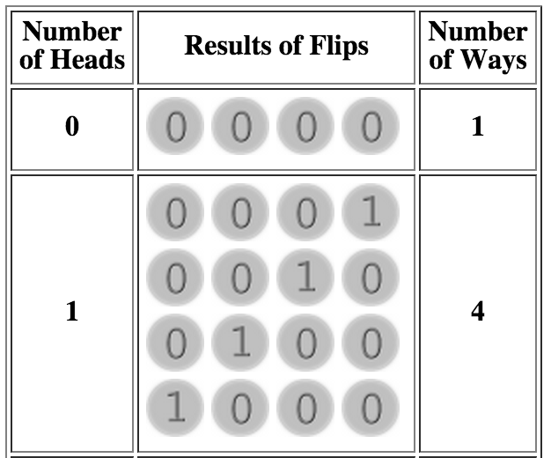
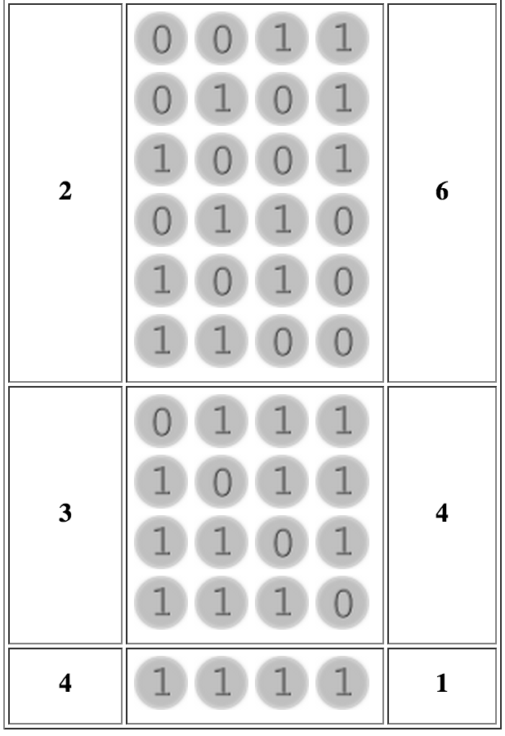
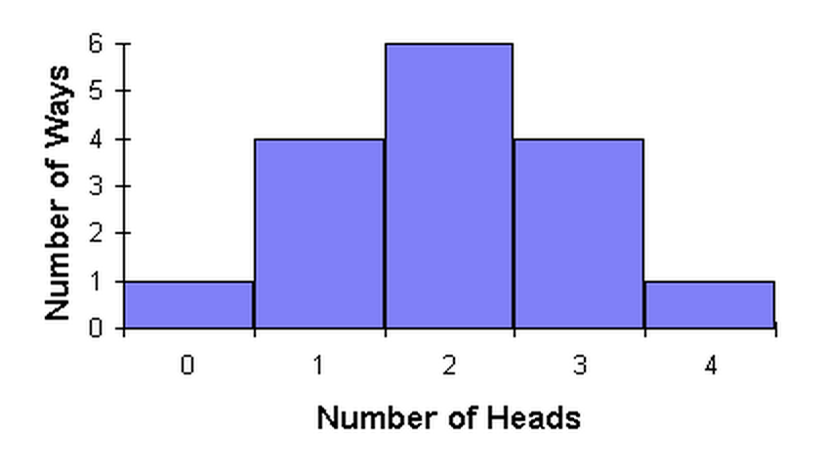
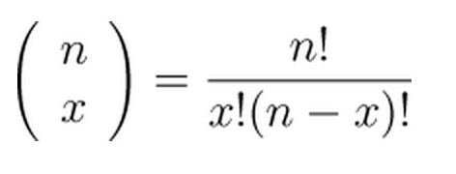
Probability

Slide 23
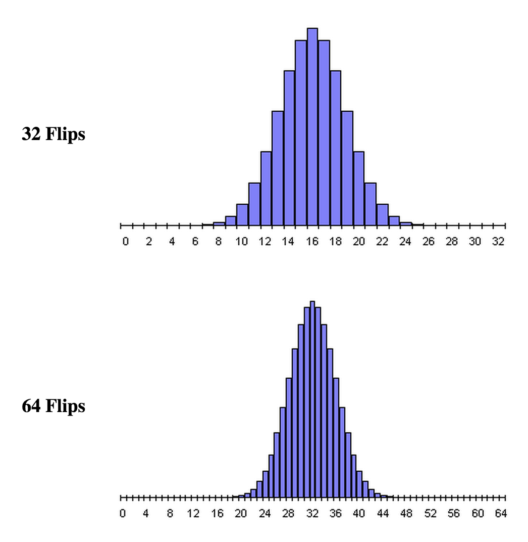
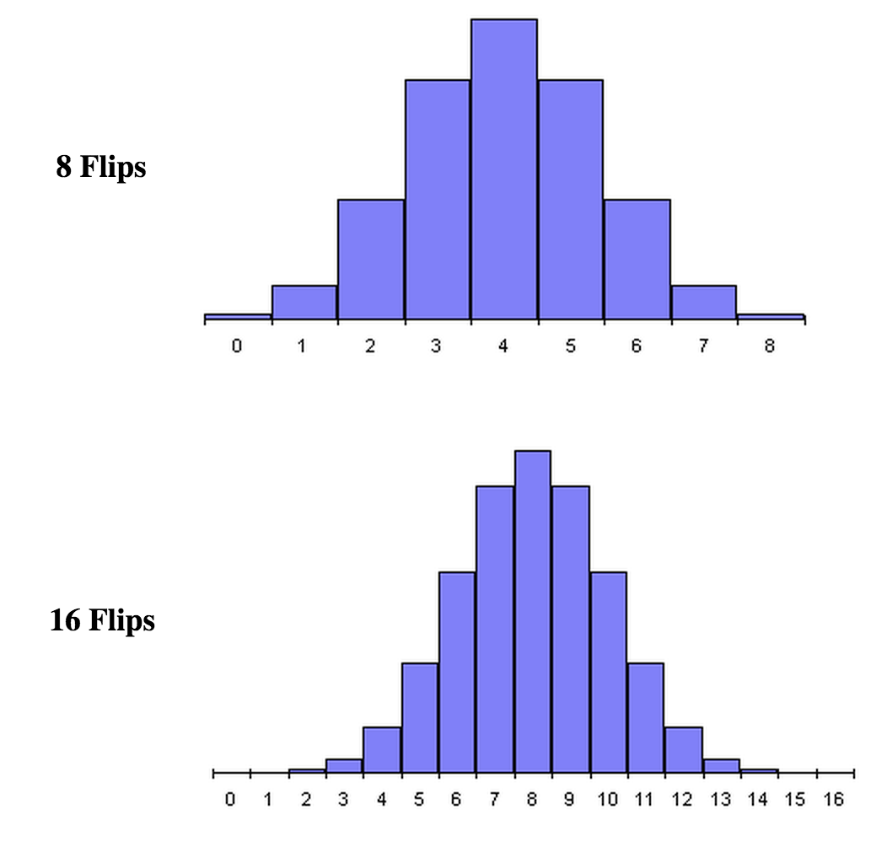
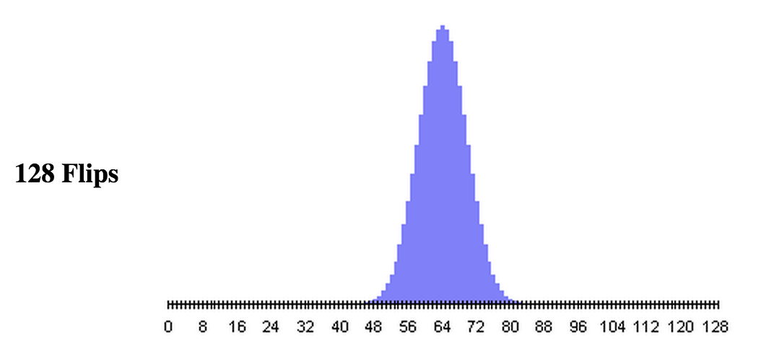
Probability

Slide 24
Discussion
  Look at this fig:
    A coin is like an arm with p = 0.5
    With limited run, the output is very uncertain.
    If we run the arm 4 times, we just win 1 time.
    Are we able to say the win probability is 0.5
    Better to say: It depends…
    Based on limited observation, there are a lot of possibilities!!!

Slide 25
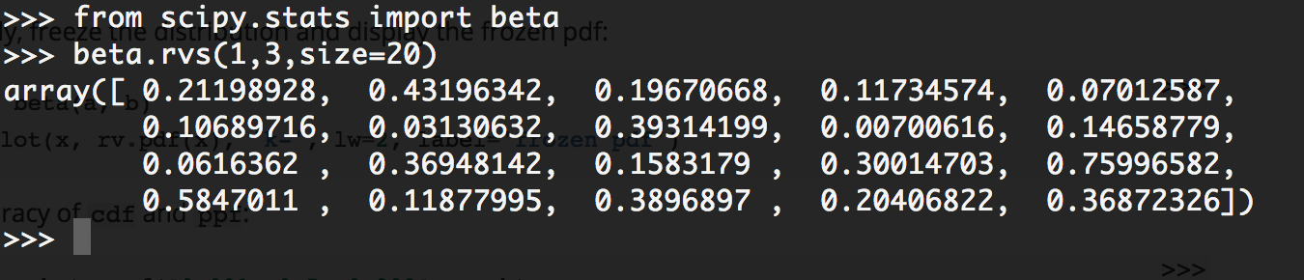
Discussion
  There are a lot of possibilities!
    How can we know the possible possibilities (based on limited observations)?
    Beta distribution gives you all the possible p’s based on limited observation.
    Beta(#win, #lose)

Slide 26
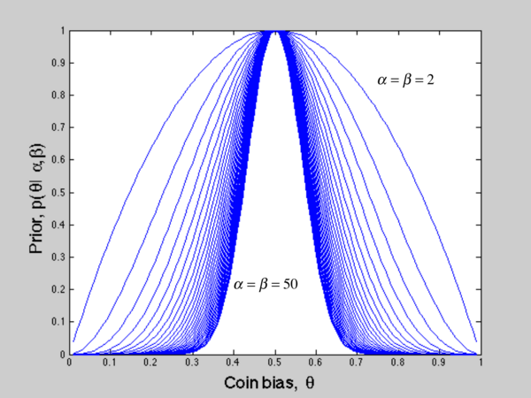
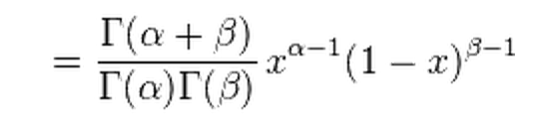

Discussion
  What does the beta function look like?

Slide 27
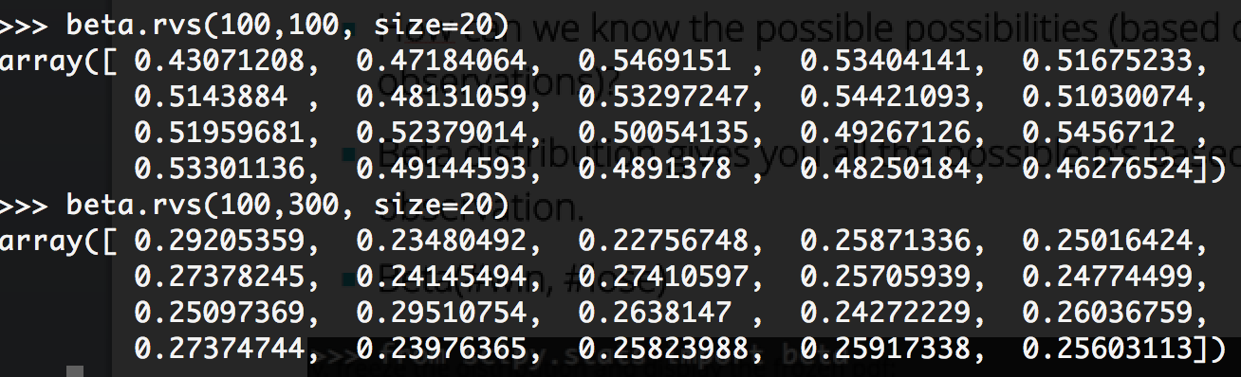
Discussion
  Let’s try some big numbers with beta

Slide 28
Discussion
  What we can do with it?
    Beta is very uncertain when sample set is small
    But quite certain when sample set is big
    You already know how to sample a value from beta
    Let’s take advantage from it

Slide 29
Solution 3
Every arm keep a beta distribution
Beta(how much we won, how much we lose)
Output win/lose
N
Still have budge?
Y
Sample a value from each Beta distribution
Play the arm with the highest value till it win once so as to update its beta distribution

Slide 30
Discussion
  Looks good right?
    Can we further improve it?
    If the arm has sufficient statistics, we can stop sampling from it
    Yes I mean combine solution 2 with solution 3

Slide 31
Solution 4
Any positive arms?
Y
N
Choose the best one and play till the end of the world
Any insufficient arms?
N
Y
Sample a value from each insufficient Beta distribution
Play the arm with the highest value till it win once so as to update its beta distribution

Slide 32
Discussion
  Why 10 wins is treated as sufficient?
    What why not 9 or 11 or 20?
    Is there any way to tell how confident you are with your estimation of p?
    Yes
    http://en.wikipedia.org/wiki/Binomial_proportion_confidence_interval

Slide 33
Discussion
  A much easier way
    Let’s do an experiment!

Slide 34
Solution 5
  Experiment on how many wins is sufficient

Slide 35
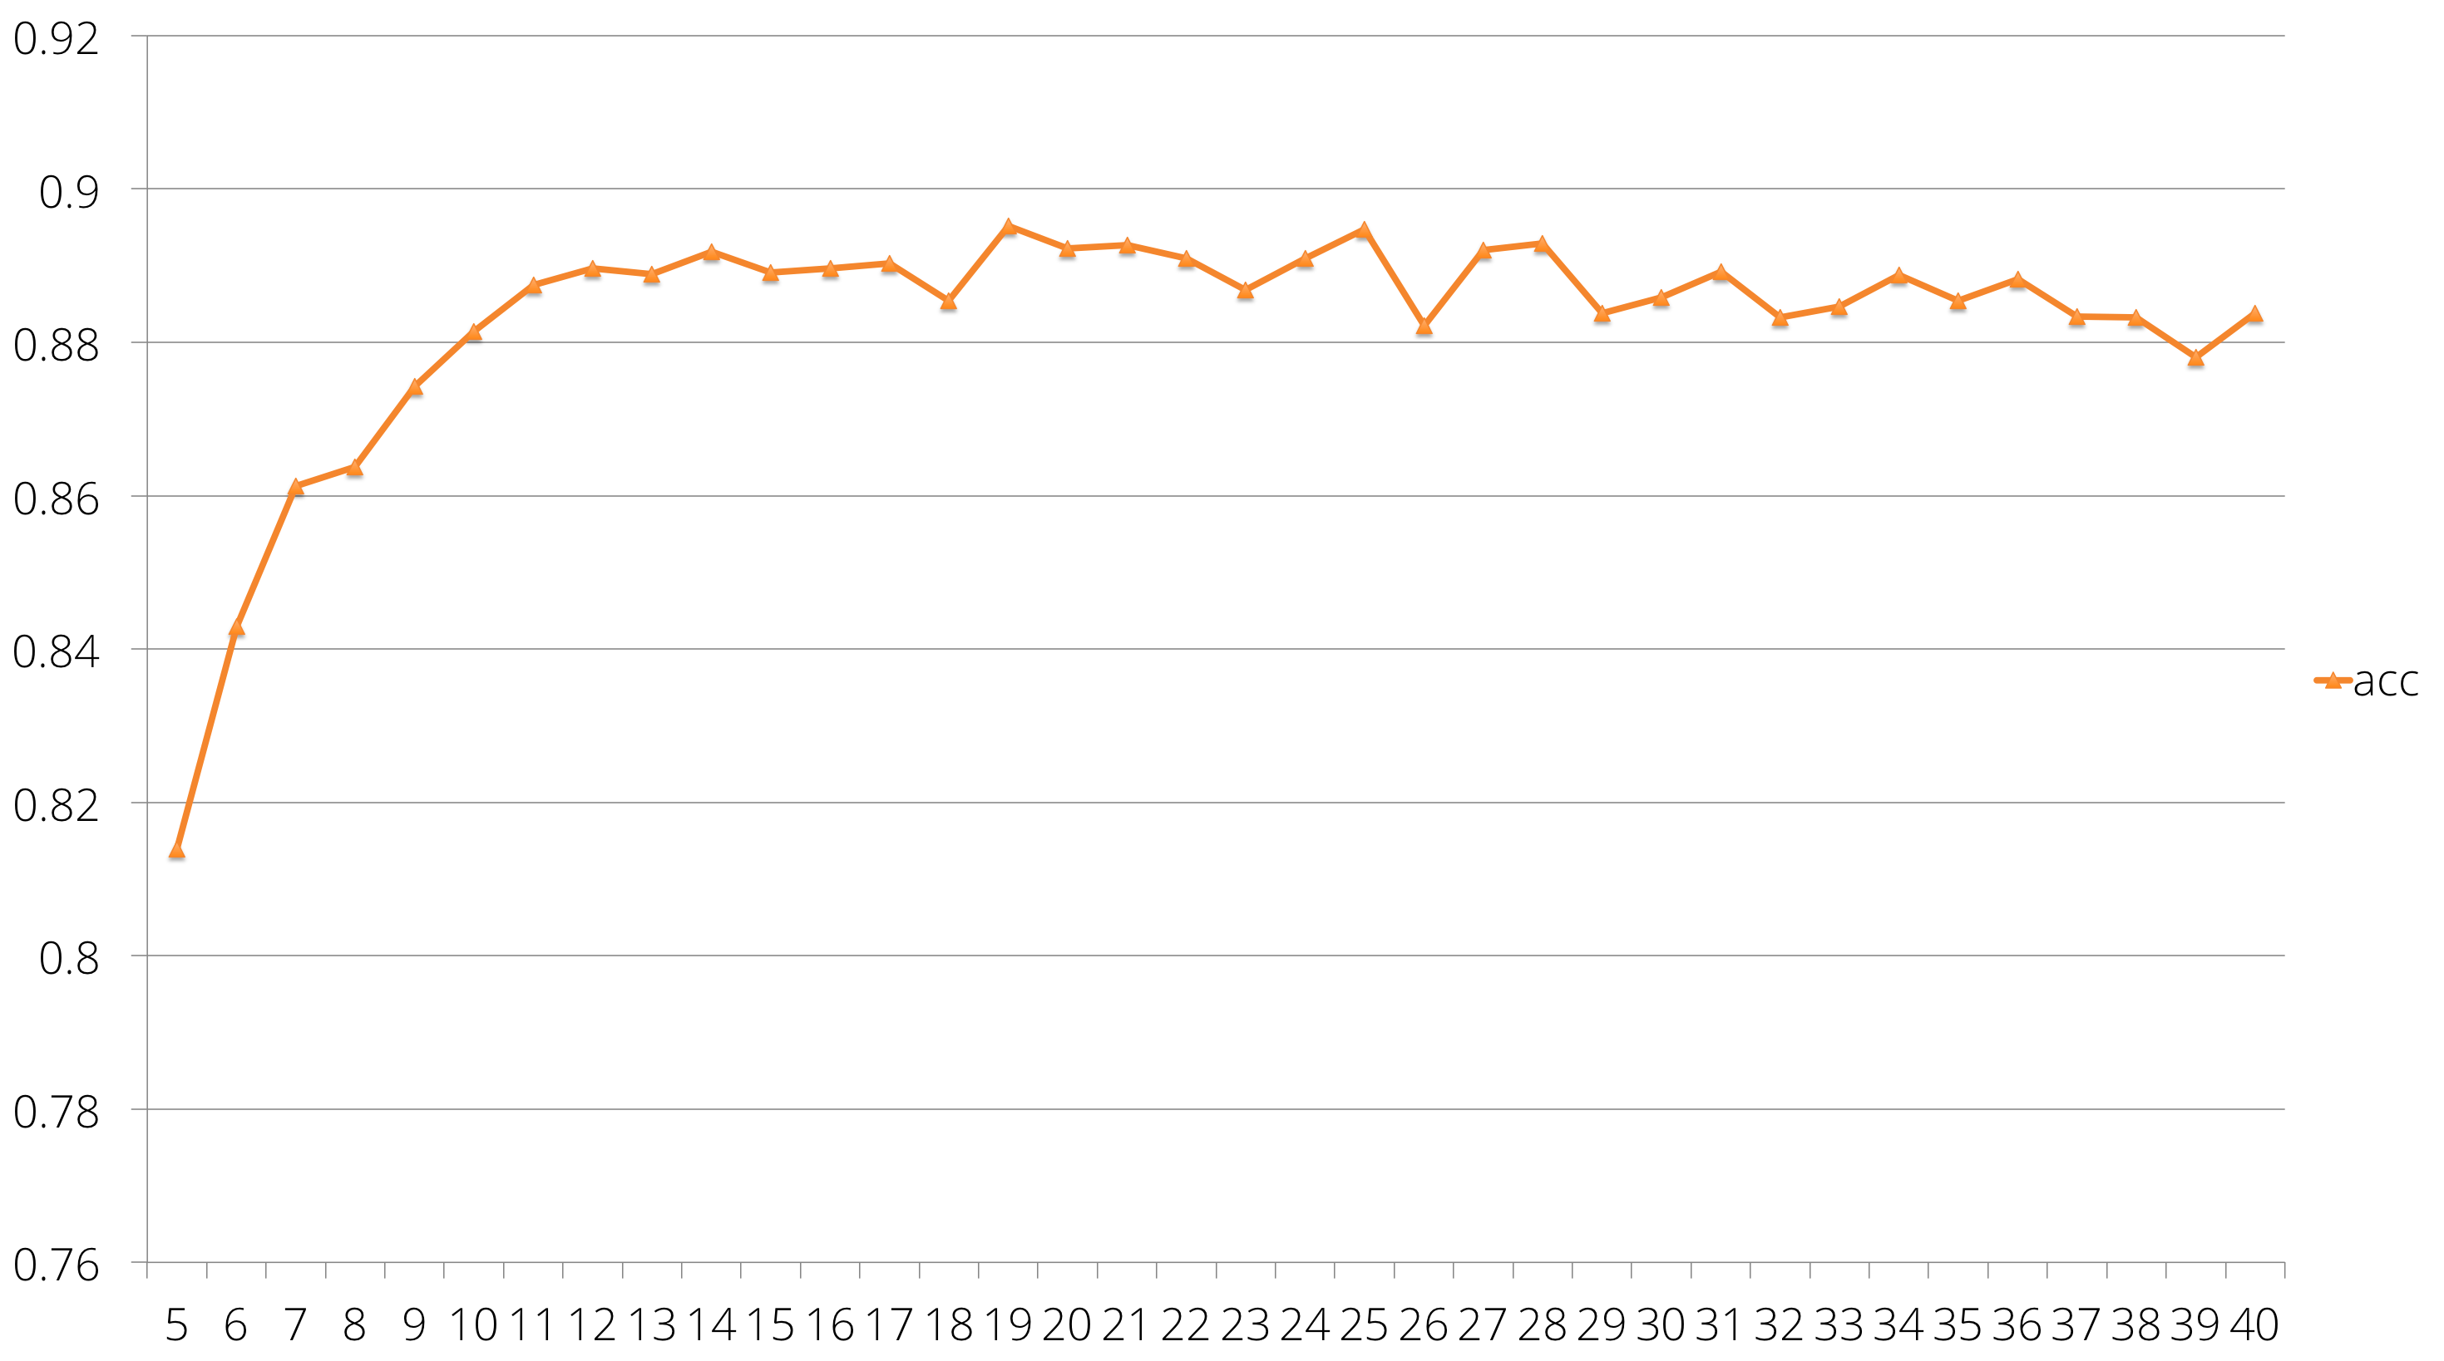
Solution 5

Slide 36
Further discussions

Slide 37
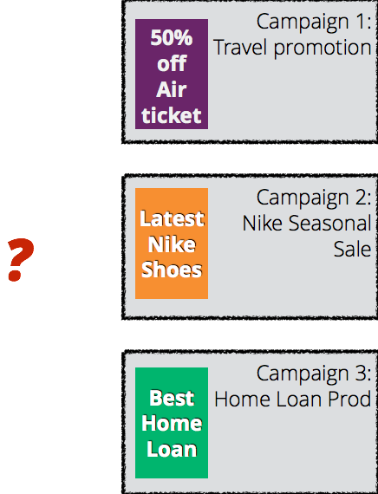

The digital advertising scenario

Slide 38
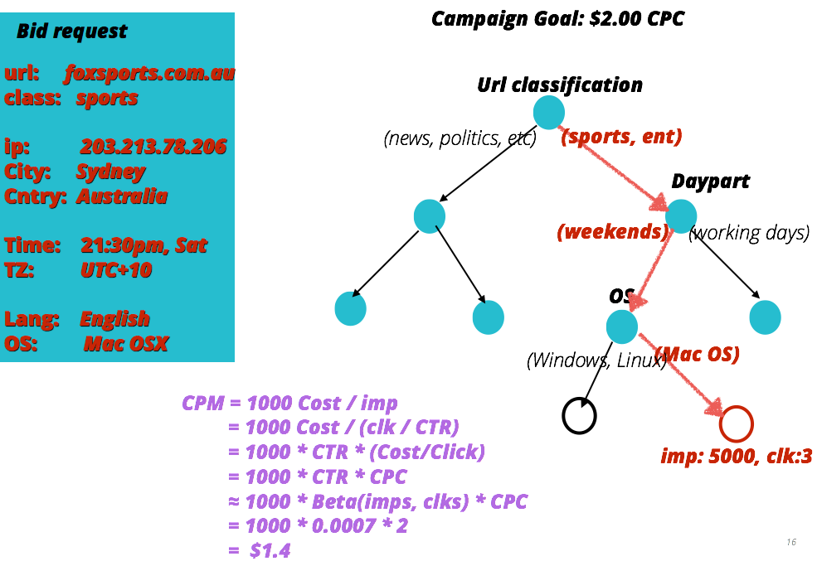
The digital advertising scenario

Slide 39
Thank you

