Slide 1
Queue && memory

Slide 2
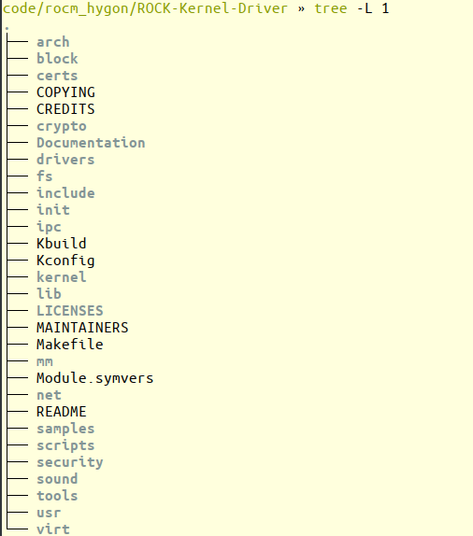
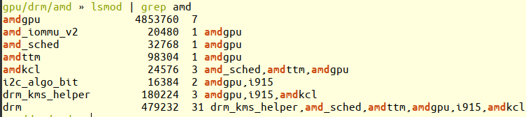
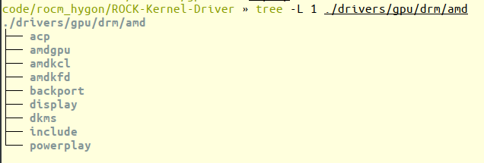
KMD
pcie driver
queue create , manage, map, unmap
process management
memory management(ttm drm)
register init,read, write
load firmware.init ip.
UMD vs KMD
1. umd depend on kmd
2. umd run in user space, kmd in kernel space.
3. umd is so, kmd is ko.

Slide 3
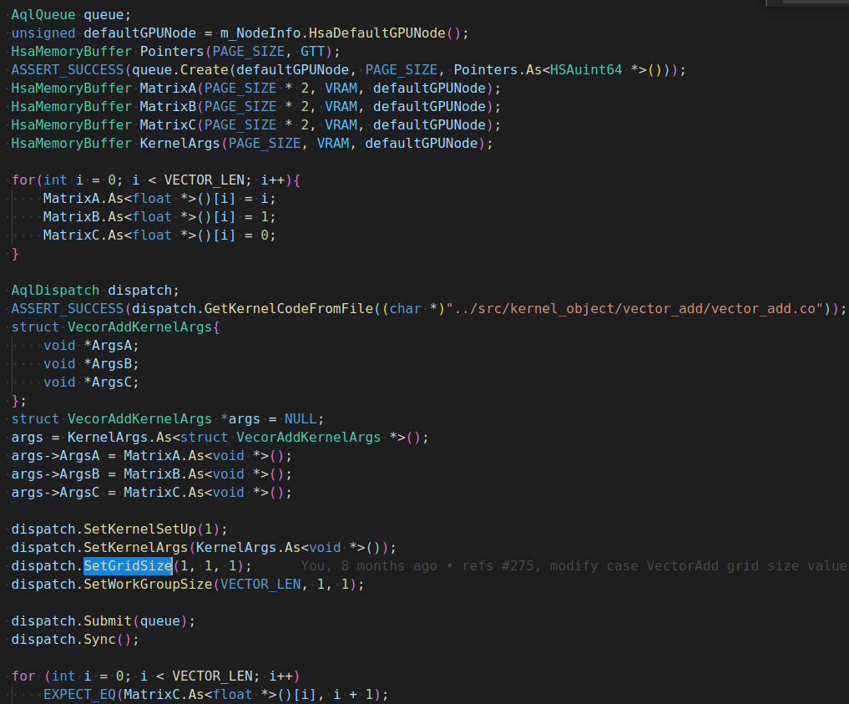
Lanuch kernel from thunk
struct AqlDispatchPacket
{
uint16_t header;
uint16_t setup;
uint16_t workgroup_size_x;
uint16_t workgroup_size_y;
uint16_t workgroup_size_z;
uint16_t reserved0;
uint32_t grid_size_x;
uint32_t grid_size_y;
uint32_t grid_size_z;
uint32_t private_segment_size;
uint32_t group_segment_size;
uint64_t kernel_object;
void *kernarg_address;
uint64_t reserved2;
uint64_t completion_signal;
};

Slide 4

Queue

Slide 5
沈祥确认：硬件不用这部分。
ctx_save_restore_size user space
mqd kernel space
HsaUserContextSaveAreaHeader
getQueueInfo
ctl_stack_size
ControlStackOffset
ControlStackSize
WaveStateOffset
WaveStateSize
cp_hqd_ctx_save_size
mqd 4k
sgpr
vgpr
lds
pc
DebugAgent relaunch event? state? vgpr spgr lsd conunt
ctl_stack_size cp
wg_data_size sq
ctl_stack_used_size
getQueueInfo
显而易见，这里出现了两个ctl_stack_size, mqd里面的size说是为了解决硬件的bug，具体什么bug，不清楚。
Notes:
那么奇怪的是我在zifang和vega20上尝试删除任意其中之一，hipNullStream起两个进程跑时，均会出现异常。

Slide 6
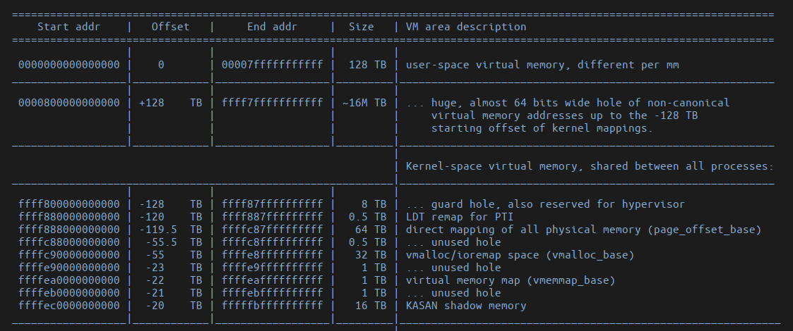
virtual Memory layout
x86_64 memory layout
From: Linux/Documentation/x86/x86_64/mm.rst
KASLR

Slide 7
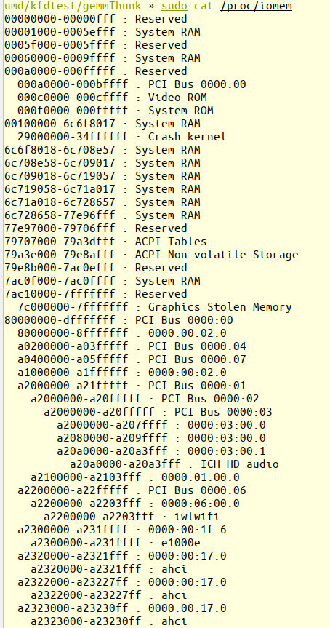
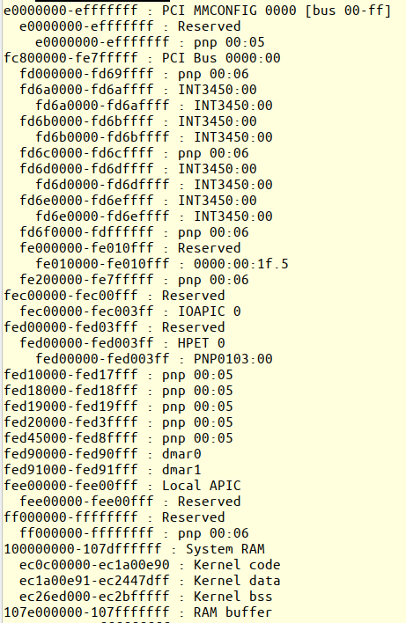
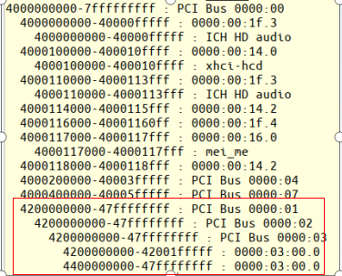
Phycial Memory layout
KASLR

Slide 8

Memory alloc in umd
vm
pm
malloc
new
mmap
userptr
stack
>128K
mmap
gtt, vram
heap
bss
data
text

Slide 9
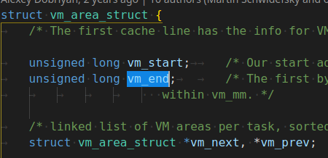
Memory map from cpu view
vma
pm
remap_pfn_range
vram
vmf_insert_pfn
io_remap_pfn_range
system

Slide 10
Memory map from Gpu view
还没有看明白,先留着.

Slide 11
Memory alloc in kmd
kmalloc
vmalloc
slab
slub
slob
Buddy
alloc_pages
get_zeroed_page
DDR

Slide 12
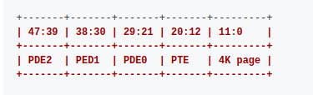
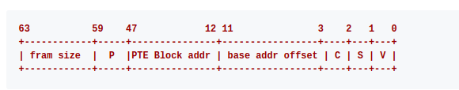
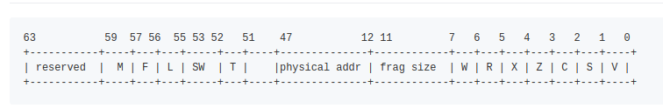
page table walk from gpu view
virtual address layout
PED format
PTE format
V: Valid
S: System memory
C: Cacheable
Z: TMS
X: Executealbe
R: Readable
W: Writeable
T: Tiled(PRI)
SW: Software
L: Log
F: translation further
P: PTE
Mtype:
0-NC: cached, Non coherent
1-WC: wirte combine
2-CC: cached, cocherent
3-UC: Uncached.

Slide 13
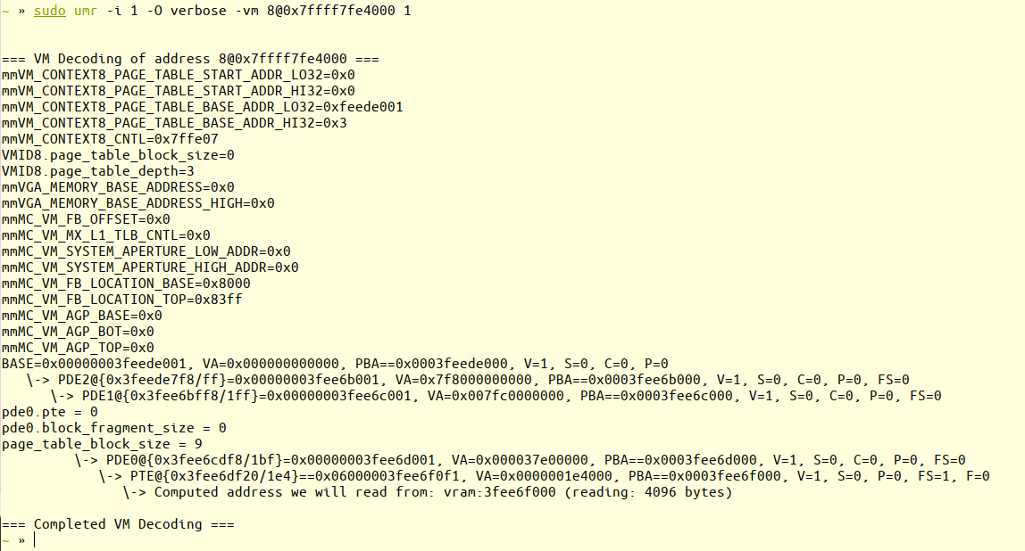
page table walk from gpu view
umr/src/lib/read_vram.c umr_access_vram_ai

