Slide 1
door_bell allocate
doorbell_offset = KFD_MMAP_TYPE_DOORBELL;
doorbell_base_dw_offset = 0x800
doorbell_offset |=KFD_MMAP_GPU_ID(args->gpu_id);
doorbell_off * sizeof(uint32_t)
+
process->doorbell_index * kfd_doorbell_process_slice(kfd) / sizeof(u32)
doorbell_index * 8*1024 / 4
args.doorbell_offset
doorbell_offset |= doorbell_offset_in_process
&
doorbell_id * kfd->device_info->doorbell_size / sizeof(u32)
doorbell_id * 8 / 4
kfd_doorbell_process_slice(dev) - 1
doorbell_offset & doorbells[NodeId].size - 1)
8*1024 - 1
doorbell_offset & (1024 * 8 -1)
queue 0
0xd134c00000000000
process door_bell_index
ida_simple_get(&doorbell_ida, 1, max_doorbell_slices(0xFF),GFP_KERNEL);
queue 1
0xd134c00000000008
queue 2
0xd134c00000000010
0xd134c00000000010
CP queue id doorbell_id = find_first_zero_bit(qpd->doorbell_bitmap, 1024)
........
idx_offset[sdma_engine_id]={
0x100,
0x10A,
0x114,
0x11E,
0x128,
0x132,
0x13C,
0x146,
};
door_bell id
SDMA queue id
idx_offset[sdma_engine_id]
+ (sdma_queue_id & 1) * 512
+ (sdma_queue_id >> 1)

Slide 2
ptr = fmm_allocate_doorbel(gpu_id, doorbells[NodeId].size,doorbell_mmap_offset)
doorbell_mmap_offset
doorbell_offset & ~(1024 * 8 -1)
map_doorbell_dgpu
fmm_map_to_gpu(ptr, doorbells[NodeId].size, NULL)
doorbells[NodeId].mapping = ptr
QueueResource->Queue_DoorBell
doorbells[NodeId].mapping + doorbell_offset
ioc_flags = KFD_IOC_ALLOC_MEM_FLAGS_DOORBELL |
KFD_IOC_ALLOC_MEM_FLAGS_WRITABLE | KFD_IOC_ALLOC_MEM_FLAGS_COHERENT;
由此可以看出,对于GPU访问doorbell时,是uc的.

Slide 3
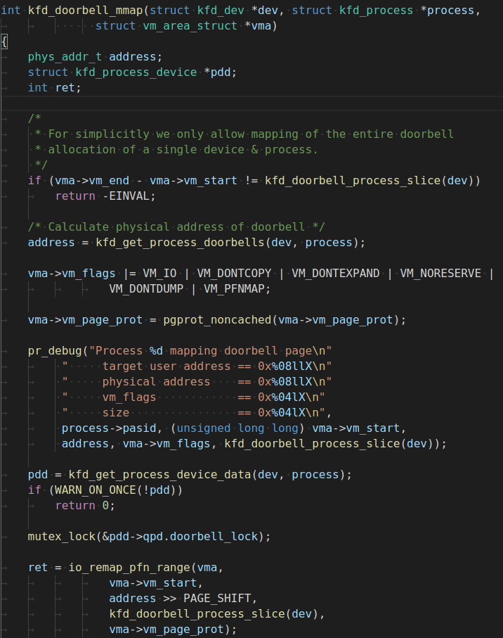
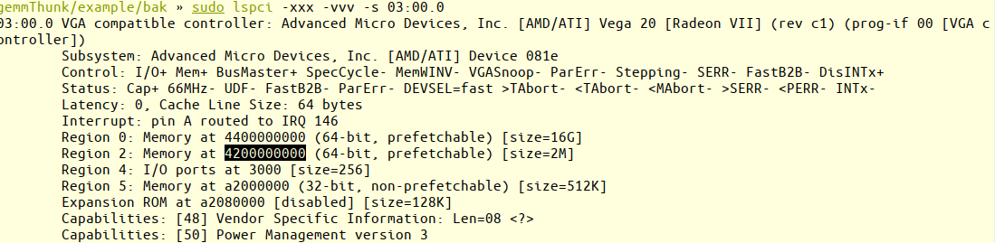
0x2000是预留给graphics用的.
pcie bar 2 pa:
0x4200000000 + 0x2000
?
8k(1024)
doorbell_offset
kernel queue
process 1
8k(1024)
queue 0
0
process 2
queue 1
8
process 3
16
process doorbell layout
......
queue 2
queue 3
24
……
doorbell_offset
0x4200200000
process n
door_bell的分配对于单个进程而言,会一次性将进程所有的door_bell空间进行映射,下次分配只需要在基地址上依次+8.

Slide 4
