Slide 1
00 / Introduction — Cloud Native AI + Inference Day
Notes:
Welcome to Cloud Native AI and Inference Day. Today we’ll look at why starting an LLM answer and keeping it flowing need different things—and when it makes sense to separate them on Kubernetes.

Slide 2
00 / Introduction — prefill here, decode there
Prefill here, decode there
Kubernetes-native LLM inference
with KAITO and llm-d
Andy Zhang — Microsoft
Linbo He — Microsoft
Cloud Native AI + Inference Day North America 2026 / KAITO + llm-d
Notes:
OK, let's start now, this session is “Prefill here, decode there, Kubernetes-native LLM inference with KAITO and llm-d”, in this session I will explain how do we use KAITO and llm-d to implement prefile and decode disaggregation.

Slide 3
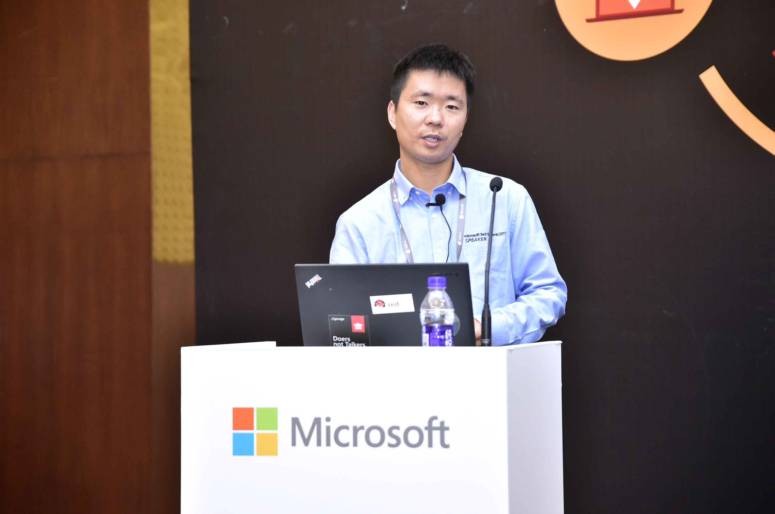
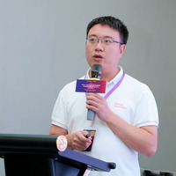

00 / Introduction — speakers
About us
Andy Zhang
Linbo He
Principal Software Engineer, Microsoft AKS team
I maintain KAITO and CSI drivers.
GitHub: andyzhangx
Principal Software Engineer, Microsoft AKS team
I maintain KAITO and OpenYurt.
GitHub: rambohe-ch
Cloud Native AI + Inference Day North America 2026 / KAITO + llm-d
Notes:
To begin with, let me introduce myself. I am Andy Zhang, Software Engineer at Microsoft AKS team, and I am the maintainer of KAITO and several CSI drivers.
Unfortunately, my co-presenter Linbo couldn’t join us because he cannot get his visa in time, so I’ll be presenting alone today.

Slide 4
00 / Introduction — agenda
Agenda
We’ll go from inference basics to running P/D on Kubernetes.
01
Inference basics: prefill and decode
02
Why P/D disaggregation
See how each phase affects latency.
Weigh the benefits against the costs.
03
llm-d and KAITO overview
04
How KAITO + llm-d supports P/D
See what each project owns.
Follow routing and KV transfer.
05
Per-role autoscaling for P/D
06
What’s next
Scale each role with its own signals.
Cloud Native AI + Inference Day North America 2026 / KAITO + llm-d
Notes:
Here’s the agenda. We’ll start with inference basics, what are the prefill and decode processes, and why it makes sense to separate them. Then, I will introduce llm-d and KAITO and show how they work together to support P/D disaggregation. Finally, I will explore how to scale prefill and decode independently when traffic changes.

Slide 5
01 / Inference basics — prefill
Prefill: process the prompt and select the first token
Prompt: “What does Kubernetes do?”
Teaching example / Words + punctuation
What
does
Kubernetes
do
?
Prefill process prompt positions together; each sees only itself and earlier positions.
5 prompt positions
Causal prefill
Select “Kubernetes”
4 words + punctuation
No position sees future tokens.
Use the final position’s scores.
prefill cache attention keys and values for all 5 prompt positions at every layer.
These are teaching tokens, not a real tokenizer’s output.
Prefill use the final position’s scores to select “Kubernetes”. Decode will consume it and cache its K/V.
Cloud Native AI + Inference Day North America 2026 / KAITO + llm-d
Notes:
Here is an example for prefill process. Our prompt is “What does Kubernetes do?” Assume one token per word, plus punctuation: five prompt positions. These word-level tokens are illustrative, not a real tokenizer’s output.
We process prompt positions together; each sees only itself and earlier positions. We cache attention keys and values for all five prompt positions at every layer.
Prefill process will use the final position’s scores to select “Kubernetes”. And then Decode will consume it and cache its K/V.
So next let’s go to decode process.

Slide 6
01 / Inference basics — decode
Decode: consume a token, select the next, repeat
Illustrative output: “Kubernetes helps teams deploy and scale applications.”
Illustrative word-level tokens; not a real model tokenizer.
Step
Consume + read past KV
Append to per-layer KV
Select next output
1
Kubernetes
K/V for “Kubernetes”
helps
2
helps
K/V for “helps”
teams
3
teams
K/V for “teams”
deploy
4
deploy
K/V for “deploy”
and
5
and
K/V for “and”
scale
6
scale
K/V for “scale”
applications
Each selected token becomes the next input. Repeat until the answer is complete.
Client arrivals / ITL = gaps / First 6 words shown / Not to scale
TTFT → first token
ITL 1
ITL 2
ITL 3
ITL 4
ITL 5
Request
Kubernetes
helps
teams
deploy
and
scale
We cache the token we consume, not the one we just select. We reuse past KV.
Cloud Native AI + Inference Day North America 2026 / KAITO + llm-d
Notes:
Decode consumes “Kubernetes”, reads past KV, appends K/V for “Kubernetes” to each layer, and selects “helps”. Next, it consumes “helps” and selects “teams”. We cache the token we consume, not the one we just select. We reuse past KV.
Each selected token becomes the next input. Repeat until the answer is complete. Below, TTFT is the wait from the request to the first token. ITL is the time between token arrivals.
The timeline below switches to the client’s view. The wait from sending the request to receiving ‘Kubernetes’ is time to first token, which is TTFT. Once the first token arrives, how long do we wait for the next one? That’s inter-token latency, or ITL.
You could see that these two metrics are different, it shows why starting an answer quickly and keeping it flowing smoothly are two different goals.

Slide 7
02 / Why P/D — latency targets
One request. Two latency targets.
We want answers to start quickly—and keep going smoothly.
Prompt
Prefill
KV cache
Decode
Input tokens
Process uncached input
Attention state
Generate tokens iteratively
Prefill → TTFT
Decode → ITL / TPOT
How soon does the answer start?
Does the answer keep flowing smoothly?
Prefill processes the input and is often compute-bound.
Decode generates tokens and is often memory-bandwidth-bound.
TTFT also includes delivery; ITL is not just decode time. TPOT = avg. time per output token. Sources: vLLM; NVIDIA Dynamo.
Our goal: serve more requests while meeting both latency targets.
SLO goodput = requests per second that meet both targets.
Cloud Native AI + Inference Day North America 2026 / KAITO + llm-d
Notes:
Apparently for one request, there two latency targets.
We want answers to start quickly—and keep going smoothly, that’s our goal.
Prefill determines how soon the answer starts, so it determines time to first token, TTFT, and Prefill processes the input and is often compute-bound.
Decode determines whether the answer keeps flowing, so it determines inter-token, ITL, and decode is often memory bandwidth bound. Queueing and delivery matter too.
Our goal is to serve more requests while meeting both latency targets. SLO goodput means the number of requests per second that meet both targets.

Slide 8
02 / Why P/D — execution interference
Long prefills can interrupt token delivery
D is ongoing decode. P is prefill for a new request. Where should P run?
Conceptual schedule · Not a benchmark · Block widths and gaps are not timings
Shared GPU
Prefill can pause decode.
One worker does both P & D
D
D
P
D
D
Separate GPUs
Decode can continue while prefill runs elsewhere.
Prefill worker
P
Requests need a KV handoff.
Decode worker
D
D
D
D
D
D
D
D = decode step; P = prefill for a new request. Chunked prefill can reduce shared-GPU pauses.
Original conceptual illustration; sources: NVIDIA and vLLM (2025) + current documentation.
Separate GPUs remove this execution conflict, but not every source of latency since it requires KV handoff between nodes.
Cloud Native AI + Inference Day North America 2026 / KAITO + llm-d
Notes:
Long prefills can interrupt token delivery.
In this slide, D is ongoing decode. P is prefill for a new request. Where should P run?
On the shared GPU graph, there are one prefill task and 4 ongoing decoding workers, you could see that prefill can pause decode.
On the separate GPUs graph, prefill and decode runs on different GPU nodes, and decode can continue while prefill runs elsewhere. The new request still needs a KV handoff between prefill and decode runtimes in separate GPUs scenario.
So Separate GPUs remove this execution conflict, but not every source of latency since it requires KV handoff between nodes.

Slide 9
02 / Why P/D — batching units
Prefill and decode batch different work
Prefill batches prompt positions; decode batches independent requests.
Conceptual illustration · Not a benchmark · Tokens and request counts are schematic
Prefill
Decode
process the prompt’s tokens in parallel
consume one new token per active request.
Request
Read history
Consume newest input
Request A
p1
p2
p3
p4
A
Prior KV
+
One token
Request B
q1
q2
q3
B
Prior KV
+
One token
C
Prior KV
+
One token
batch multiple prompts together for efficiency
Then select each request’s next output token.
More decode concurrency can raise ITL. Stay within latency and KV-memory budgets.
Prefill gets parallel work from prompt length; decode gets it from active requests.
Cloud Native AI + Inference Day North America 2026 / KAITO + llm-d
Notes:
Prefill and decode batch different work, Prefill batches prompt positions; decode batches independent requests.
On the left graph, prefill processes the prompt’s tokens in parallel. It can also batch multiple prompts together for efficiency. But within each prompt, every token can only attend to itself and the tokens before it, that’s called causal attention.
On the right graph, decode consumes one new token per active request, read its past KV cache, then select its next output token.
Prefill gets parallel work from prompt length; decode gets it from active requests. More decode concurrency can raise ITL. Stay within latency and KV-memory budgets.

Slide 10
02 / Why P/D — orchestration gap
The hard part is the Kubernetes wiring to support P/D
Two pools still have to work together as one model service.
Routing topology
Decode-side proxy
The EPP picks workers.
coordinate requests
One model service
Both roles serve one model.
KV-transfer contract
Lifecycle + scaling
KV transfer settings must match.
Keep pods ready as replicas change.
Routing, KV transfer, labels, ports and readiness must stay in sync, even when pods restart or we scale.
Cloud Native AI + Inference Day North America 2026 / KAITO + llm-d
Notes:
The hard part is the Kubernetes wiring to support prefill and decode disaggregation.
Two pools still have to work together as one model service. The EPP, or Endpoint Picker, picks workers. KV transfer settings must match. The decode-side proxy coordinates requests. We must keep pods ready as replicas change.
Routing, KV transfer, labels, ports and readiness must stay in sync, even when pods restart or we scale.
There are lots of things to combine, that is why the hard part is the Kubernetes wiring.

Slide 11
Production Distributed Inference Architecture
Application
Layer
Web / H5
Mobile Apps
Enterprise Applications
Third-party Applications
…
MaaS Operations (Token as a Service)
Gateway & Security
Inference
Layer
• Unified API Gateway (OpenAI Compatible)
AI Gateway (Business Logic) (AgentGateway , Higress)
• Safety & Content Filtering
• Rate Limiting & Access Control
Orchestration Layer (LLM-D, KAITO, Dynamo)
• WAF / DDoS / Shield
LLM-D
KAITO
Service
Orchestration
Routing &
Load Balancing
Scheduling &
Autoscaling
Policy & Strategy
Management
Elastic
Scaling
Observability &
Monitoring
Metering & Billing
• Usage Metering (Tokens / Requests)
Inference Runtime Layer (vLLM, SGLang, Triton )
• Billing & Invoicing
vLLM
Continuous Batching
Paged Attention
Speculative Decoding
Multi-LoRA
Prefix Cache
…
• Usage Analytics & Reporting
Operations Management
KV-Cache Offload & Management Layer (LMCache, KVBM, Mooncake)
• SKU & Model Management
KV Cache Management
Storage Abstraction (NIXL)
Distributed Memory KV Transport
Storage Backend
DPU Storage Gateway
• Pricing & Policy Management
KVBM
LMCache
Mooncake
…
Unified Interface
Tiered Storage Mgmt.
Cache Policy
Data Consistency
Redhare
(Distributed Memory KV Transport)
ContextStor
(Large Context Storage)
Object / File Storage
High-performance Storage
Cloud / On-prem Storage
DPU Acceleration
Protocol Offload · Data Optimization
Security Isolation · High Performance
• Coupon & Promotion
• Quota & Share Management
Kubernetes GPU & Data Scheduling
Model Hub (MatrixHub)
Model Distribution (ModelExpress)
Dataset Management
Data Catalog
Data Processing
Data Quality
• Cost Allocation & Chargeback
• FinOps & Cost Optimization
Resource Pool Management
Priority & Preemption
Fair Scheduling
Elastic Resource Allocation
Multi-tenant Isolation
Workflow Orchestration
Serving Targets
Kubernetes
GPU Operator
Device Plugin
GPU Monitoring
Topology Manager
Node Auto-discovery
Multi-tenant Isolation
Cloud
Enterprise
Infrastructure
Operations
Compute
(VM / Bare Metal)
Network
(VPC / SDN)
Storage
(Distributed)
Security
(FW / IDS)
Monitoring
(Prometheus)
Logging
(ELK)
Automation
(Ansible)
CI/CD
(GitOps)
Notes:
So, this slide shows the big picture.
Running an inference workload takes more than just a model and a GPU. We also need to route requests, manage workloads, and scale when traffic changes.
That’s where KAITO and llm-d come in—the orchestration layer in the middle.
Below that, vLLM runs the model, and the KV cache helps us reuse work instead of doing it again. Kubernetes provides the infrastructure underneath.
We also need things like security and monitoring around the whole system.
The main takeaway is simple: all these pieces need to work together.
Today, we’ll focus on how KAITO and llm-d help with that. Let’s look at some of the open-source options.

Slide 12
03 / llm-d and KAITO — ecosystem landscape
Open-source P/D has several paths, not one winner
The following table presents examples, not a ranking. Some approaches can be used together.
Approach
Serving / routing path
Kubernetes packaging
NVIDIA Dynamo
Integrated inference stack
Operator + DynamoGraphDeployment
llm-d [CNCF]
P/D-aware EPP + routing sidecar
Gateway API / InferencePool
AIBrix
P/D-aware gateway + engines
StormService / RoleSet
KServe + llm-d [CNCF]
llm-d serving integration
LLMInferenceService
Ray Serve + KubeRay
P/D app + vLLM KV connectors
RayService + Serve configuration
vLLM Production Stack
vLLM + LMCache / NIXL + router
Helm-managed P/D deployment
LWS DisaggregatedSet manages roles; engines and KV transport are still separate.
CNCF: llm-d — Sandbox; KServe — Incubating. Marked entries are CNCF-hosted projects.
P/D deployment options already exist. KAITO aims to make them easier to use.
Cloud Native AI + Inference Day North America 2026 / KAITO + llm-d
Notes:
There are already several open-source ways to deploy prefill and decode separately.
Here are a few examples, including Dynamo, llm-d, and AIBrix. This isn’t a ranking, and some of these projects can work together.
They take different approaches to routing requests and managing workloads on Kubernetes.
For KAITO, the goal is simple: make these options easier to deploy and manage, with less manual configuration.
Today, we’ll focus on llm-d. Let’s take a closer look.

Slide 13
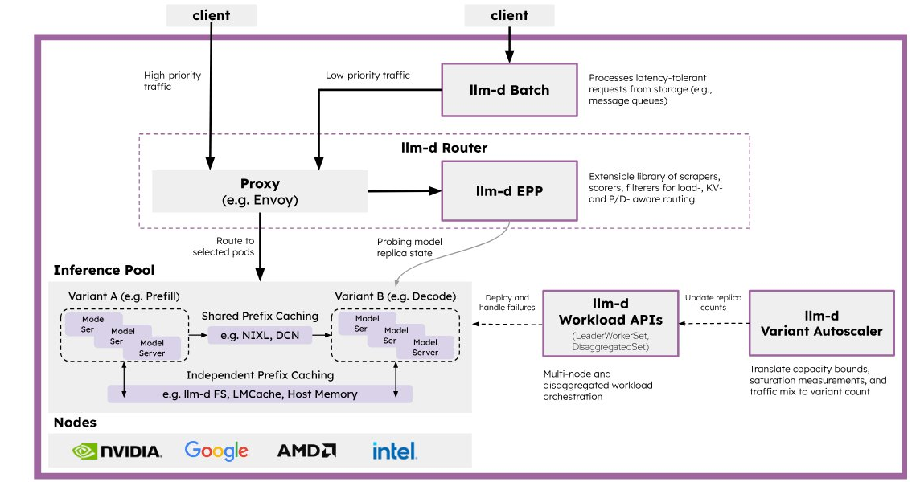
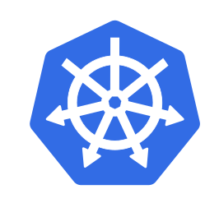


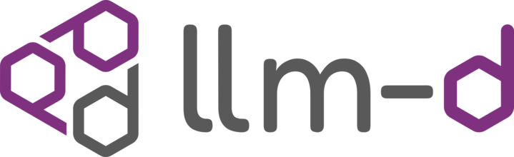

llm-d: a distributed inference stack
03 / llm-d and KAITO — distributed inference stack
CNCF Sandbox project
Kubernetes-native high-performance distributed LLM inference framework
Open
integrations
Why compose?
Modular architecture
Gateway API connects inference routing to Kubernetes.
Extensible components
combine runtimes, routing plugins and KV transport.
Well-lit paths
Tested deployment patterns make trade-offs clear.
Gateway API Inference Extension
NIXL
KV storage providers
Notes:
llm-d is a Kubernetes-native framework for high-performance distributed inference. It joined the CNCF Sandbox in March 2026. It does not replace vLLM, gateways, or storage systems; it composes them. Its value is organized into three ideas: first modular architecture: Gateway API connects inference routing to Kubernetes, second, Extensible components: combine runtimes, routing plugins and KV transport, third, Well-lit paths, there are tested deployment patterns make trade-offs clear.

Slide 14











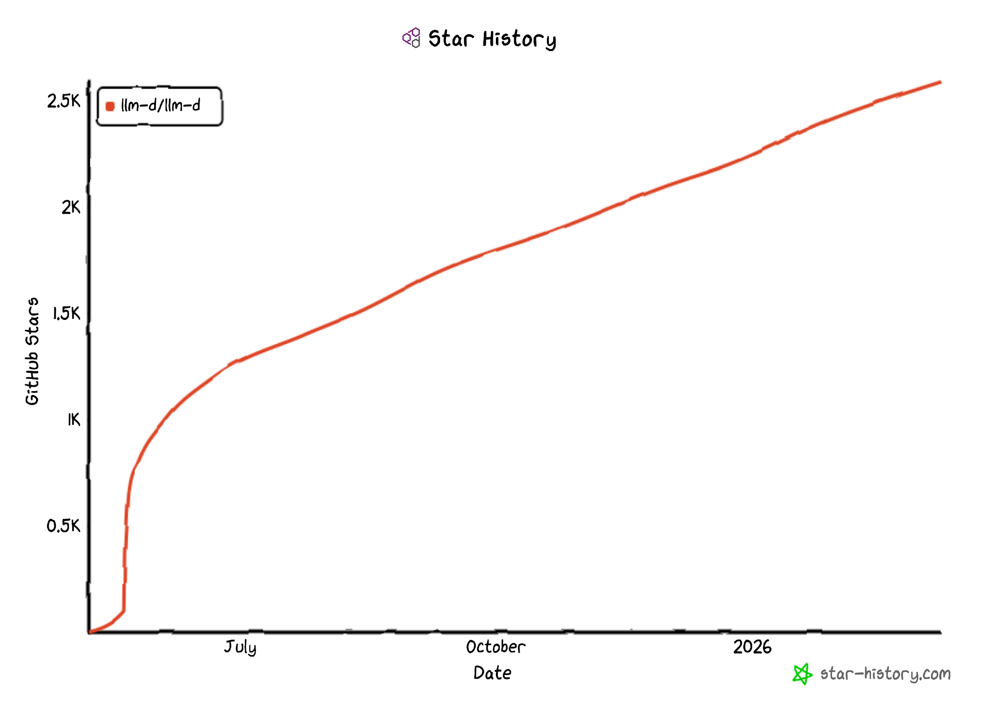

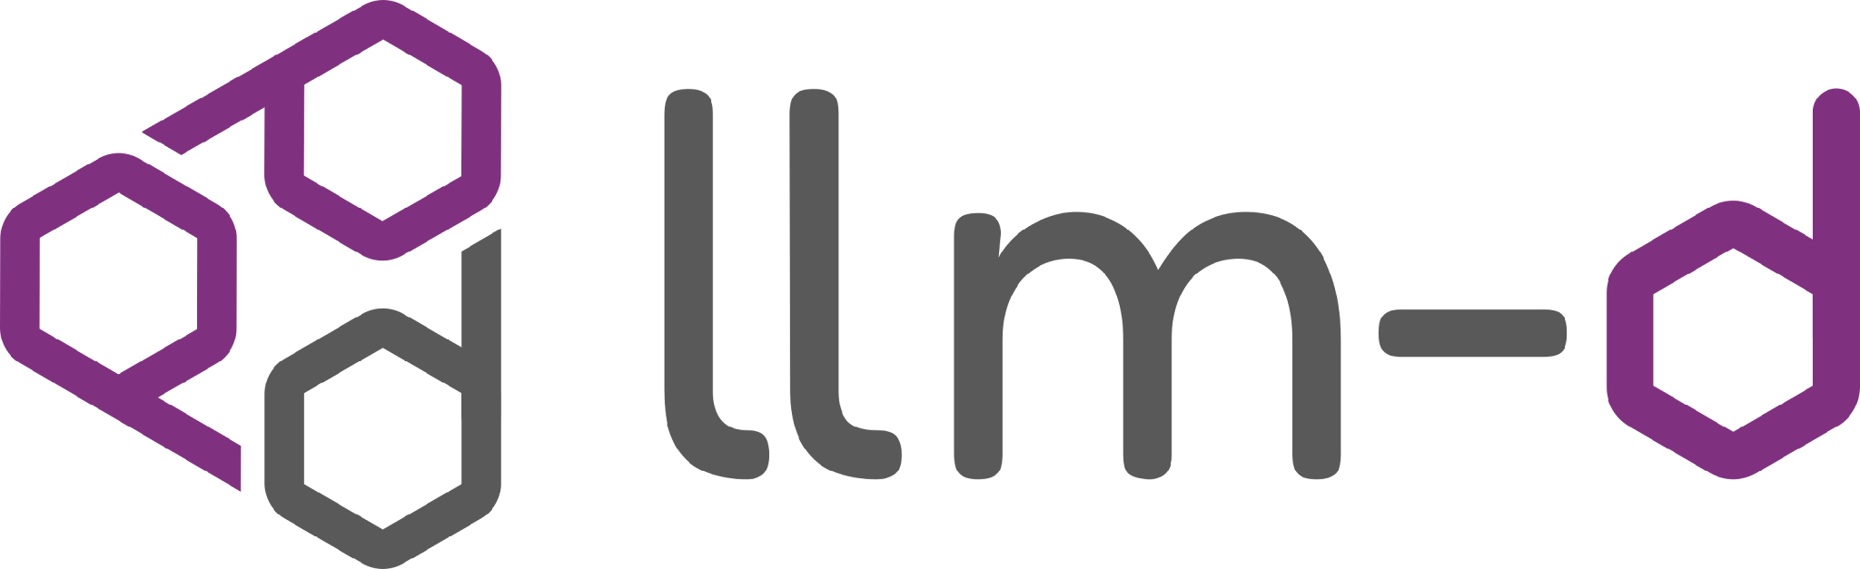
llm-d: capabilities for distributed inference
03 / llm-d and KAITO — distributed inference capabilities
These are reusable capabilities, not a performance guarantee.
A cross-vendor ecosystem
Four areas of capability
State-of-the-art MoE serving
Expert parallelism spreads expert computation across GPUs.
Prefill/decode disaggregation
We separate the phases and transfer KV between roles.
State-aware scheduling
Routing plugins use cache and load signals to pick workers.
Autoscaling architecture
Workload signals and SLOs guide capacity; each integration chooses its policy.
Since May 2025
build on the serving runtime, not replace it.
combine reusable llm-d components.
Deployment paths explain the trade-offs.
Community history
This shows project history,
not serving performance.
Notes:
These are reusable capabilities, not a performance guarantee. llm-d builds on the serving runtime, not replace it. And we combine reusable llm-d components, Deployment paths explain the trade-offs.
There are mainly four areas of capability for llm-d projects:
first: State-of-the-art MoE serving, Expert parallelism spreads expert computation across GPUs, second, prefill/decode disaggregation, we separate the phases and transfer KV between roles. Third, State-aware scheduling: Routing plugins use cache and load signals to pick workers. Last is autoscaling architecture: workload signals and SLOs guide capacity; each integration chooses its policy.

Slide 15
03 / llm-d and KAITO — well-lit paths
llm-d “well-lit paths”
tested ways to deploy, with clear guidance on what works well and what the limitations are.
Intelligent scheduling
KV cache management
Where should this request run?
Where should reusable state live?
Wide expert parallelism
P/D disaggregation
How should a large MoE model run across GPUs?
How should prompt and generation capacity differ?
MoE: Mixture of Experts—a team of specialists.
The model picks a few experts to help process each token instead of using all experts every time.
Cloud Native AI + Inference Day North America 2026 / KAITO + llm-d
Notes:
llm-d calls these “well-lit paths”—these are tested ways to deploy, with clear guidance on what works well and what the limitations are.
Intelligent scheduling determines where this request should run
KV cache management determines where should reusable state live?
Wide expert parallelism determines how should a large MoE model run across GPUs?
P/D disaggregation determines how should prompt and generation capacity differ?
These paths can work together, but we don’t need all of them at once. Results depend on the hardware. Today, we’ll focus on P/D disaggregation and use KAITO to manage the workloads.

Slide 16
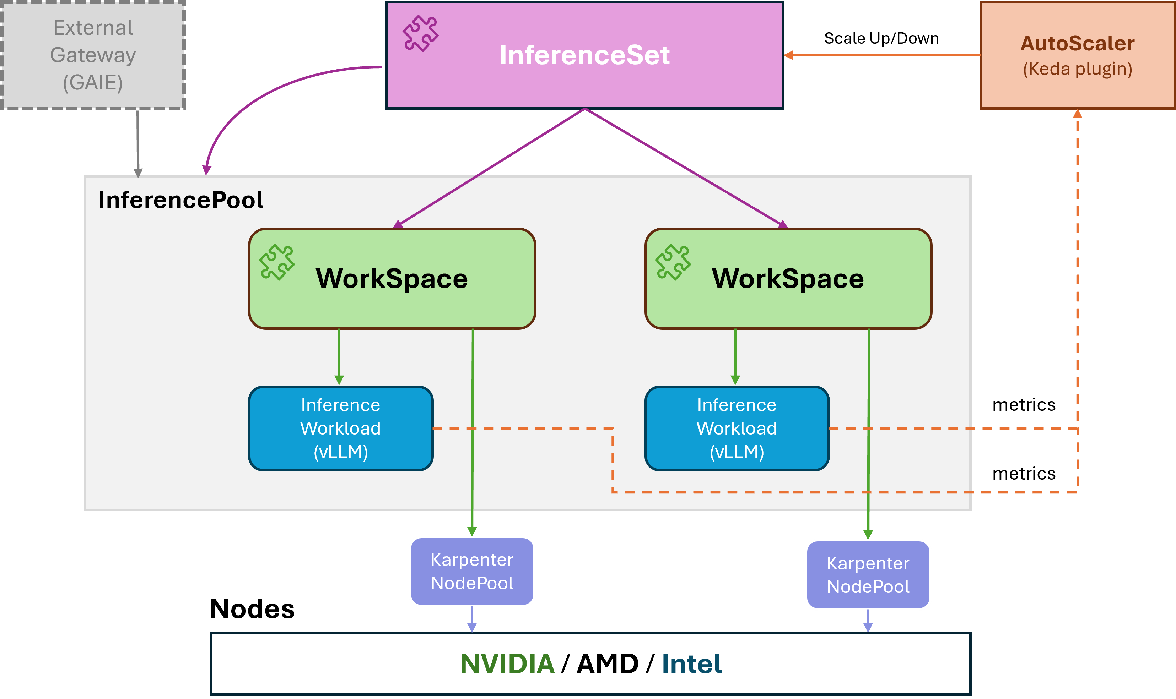
What is KAITO (Kubernetes AI Toolchain Operator)?
03 / llm-d and KAITO — CNCF Sandbox project
CNCF Sandbox project
KAITO automates LLM inference, fine-tuning and RAG with Kubernetes operators.
Specify a model name and GPU SKU
sizes the nodes to fit the model’s memory requirements
handles model setup and caching
manages inference workloads and rolling updates on Kubernetes
uses KEDA to automatically scale inference workloads
injection
Cloud Native AI + Inference Day North America 2026 / KAITO + llm-d
Notes:
Next, what is KAITO, KAITO stands for Kubernetes AI Toolchain Operator, which automates LLM inference, fine-tuning and RAG with Kubernetes operators. It is also a CNCF Sandbox project.
With KAITO, you only need to specify a model name and GPU VM SKU. KAITO sizes the nodes to fit the model’s memory requirements, handles model setup and caching, manages inference workloads and rolling updates on Kubernetes, and uses KEDA to automatically scale inference workloads.

Slide 17
KAITO workload example
03 / llm-d and KAITO — inference workload example
Specify the model name, GPU instance type and replica count.
apiVersion: kaito.sh/v1beta1
kind: InferenceSet
metadata:
name: qwen3-8-27b
spec:
replicas: 3
labelSelector:
matchLabels:
app: qwen3-8-27b
template:
resource:
instanceType: Standard_NC24ads_A100_v4 # <- GPU SKU
inference:
preset:
name: Qwen/Qwen3.8-27B # huggingface model ID
Cloud Native AI + Inference Day North America 2026 / KAITO + llm-d
Notes:
Here is a KAITO inference workload example, user only needs to specify the model name, GPU instance type and replica count.
In this example, user specifies a qwen3 model name which is a huggingface model id and specifies A100 GPU instance type with 3 replicas, three replicas does not necessarily mean three GPUs; each replica’s GPU and node needs depend on the model and runtime settings.
KAITO does all the rest of work, like provisioning the required GPU nodes to fit the model’s memory requirements, handles model setup and caching, manages inference workloads and rolling updates on Kubernetes.

Slide 18
03 / llm-d and KAITO — GPU node sizing
KAITO works out the initial GPU node count
Specify a model name and GPU SKU. KAITO estimates how many nodes the model needs.
KAITO reserves memory for overhead and KV cache, then fits the weights into the remaining GPU memory.
per-GPU budget = GPU memory × 0.84 (vLLM memory utilization)
− ~2.3 GiB fixed overhead
− KV cache ( max-model-len × bytes-per-token )
min GPUs = ceil( model weights ÷ per-GPU budget ) (weights × 1.02)
node count = ceil( min GPUs ÷ GPUs-per-node )
Save the result as status.targetNodeCount.
This path uses tensor parallelism within nodes and pipeline parallelism across nodes. It sizes memory, not how much traffic it can handle.
Notes:
This slide shows how KAITO does the math.
User specifies a model name and GPU SKU. KAITO estimates how many nodes the model needs.
KAITO reserves memory for overhead and KV cache, then fits the weights into the remaining GPU memory.
KAITO saves the result as status.targetNodeCount. This path uses tensor parallelism within nodes and pipeline parallelism across nodes. It sizes memory, not how much traffic it can handle.

Slide 19
04 / KAITO + llm-d P/D — integration rationale
Why bring llm-d into KAITO?
We want P/D routing without replacing KAITO’s Kubernetes operating model.
KAITO
llm-d
vLLM + NIXL
+
+
MRI → child InferenceSets
EPP + decode routing sidecar
vLLM runs; NIXL moves KV
Reuse the API model
Integrate, do not rebuild
Clear ownership
Keep Workspace and InferenceSet.
Give each role its own replicas,
GPU types and runtime settings.
Reuse llm-d’s P/D routing.
KAITO connects the sidecars,
ports and InferencePool.
Use Gateway API and InferencePool.
Keep routing plugins upstream,
not in a second KAITO router.
KAITO manages deployment and lifecycle. llm-d adds endpoint selection and request routing.
Cloud Native AI + Inference Day North America 2026 / KAITO + llm-d
Notes:
So why do we bring llm-d into KAITO?
We want P/D routing without replacing KAITO’s Kubernetes operating model. KAITO manages deployment and lifecycle. llm-d adds endpoint selection and request routing. vLLM runs the prefill and decode phases, and NIXL moves KV.

Slide 20
04 / KAITO + llm-d P/D — component boundaries
Where KAITO and llm-d fit
This is a map of responsibilities, not a required installation checklist.
Applications
Applications call the inference API.
Gateway
The gateway handles ingress, auth and traffic policy.
Orchestration
KAITO manages lifecycle; llm-d selects endpoints.
Runtime
vLLM runs prefill, decode and batching.
KV state
NIXL moves KV; cache systems reuse or offload it.
Infrastructure
The infrastructure supports the stack.
We will follow the roles, request routing, KV transfer and capacity control.
Cloud Native AI + Inference Day North America 2026 / KAITO + llm-d
Notes:
So where KAITO and llm-d fit.
This is a map of responsibilities, not a required installation checklist. Applications call the inference API. The gateway handles ingress, auth and traffic policy. KAITO manages lifecycle; llm-d selects endpoints.
vLLM runs prefill, decode and batching. NIXL moves KV; cache systems reuse or offload it. And we depend on Kubernetes to provide the whole infrastructure to support the stack. We will follow the roles, request routing, KV transfer and capacity control.

Slide 21
04 / KAITO + llm-d P/D — architecture
One endpoint, three separate paths
KAITO manages resources. HTTP carries requests. NIXL moves KV between vLLM runtimes.
Control plane
MultiRoleInference
KAITO controller
Child InferenceSets + InferencePool + wiring
Prefill inferenceset
llm-d Router EPP
Prefill vLLM
Direct KV data • NIXL
endpoint selection
via InferencePool
optional prefill
request
Decode inferenceset / selected decode pod
Client
Gateway
Routing sidecar
local proxy
Decode vLLM
Control / selection
Request / local proxy
KV data (separate path)
The client uses one endpoint. KV data bypasses the gateway, EPP and routing sidecar.
Cloud Native AI + Inference Day North America 2026 / KAITO + llm-d
Notes:
KAITO manages resources. HTTP carries requests. NIXL moves KV between runtimes.
Start at the top: KAITO maintains the role InferenceSets, InferencePool and runtime wiring.
For a request, the gateway consults the EPP, then forwards to the selected decode sidecar. The sidecar calls remote prefill when needed and local decode. The client uses one endpoint. KV data bypasses the gateway, EPP and routing sidecar. NIXL would move KV data between prefill and decode vLLM runtime directly.

Slide 22
04 / KAITO + llm-d P/D — declarative API
One MultiRoleInference declares both roles
This example puts one prefill replica on A100 and two decode replicas on H100.
qwen-3-8-27b
Qwen/Qwen3.8-27B
MultiRoleInference / model + role placement
apiVersion: kaito.sh/v1alpha1
kind: MultiRoleInference
metadata:
name: qwen-3-8-27b
spec:
model:
name: Qwen/Qwen3.8-27B
roles:
- type: prefill
replicas: 1
instanceType: Standard_NC24ads_A100_v4
- type: decode
replicas: 2
instanceType: Standard_NC80adis_H100_v5
One logical service / InferencePool
reconcile
Prefill role
Decode role
replicas: 1
replicas: 2
A100 / replica 1
H100 / replica 1
H100 / replica 2
Standard_NC24ads_A100_v4
Standard_NC80adis_H100_v5
Both roles serve the same model. Each has its own InferenceSet and capacity settings.
Cloud Native AI + Inference Day North America 2026 / KAITO + llm-d
Notes:
One MultiRoleInference declares both roles. This KAITO yaml example sets one prefill replica on A100 and two decode replicas on H100
On the right, we still have one logical service and InferencePool. Both roles serve the same model. Each has its own InferenceSet and capacity settings.

Slide 23
04 / KAITO + llm-d P/D — reconciliation
KAITO creates resources and keeps them aligned
KAITO turns the declared topology into workers, routing resources and runtime wiring.
MultiRoleInference
KAITO reconciles + owns
Prefill InferenceSet
Role-specific workers
Decode InferenceSet
Role-specific workers
Routing resources
InferencePool + llm-d EPP
Set llm-d role labels and
NIXL host / Pod IP.
Inject the llm-d sidecar.
Align NIXL and vLLM ports.
Connect Services, ports
and endpoint selection.
Keep ownership, roles, labels, ports and lifecycle consistent.
KAITO keeps the resources working together; it does not just generate YAML.
Cloud Native AI + Inference Day North America 2026 / KAITO + llm-d
Notes:
KAITO creates resources and keeps them aligned
KAITO turns the declared topology into workers, routing resources and runtime wiring. For prefill, KAITO set lm-d role labels and the NIXL host or Pod IP. For decode, KAITO injects the llm-d sidecar. Align NIXL and vLLM ports.
For routing, llm-d connect Services, ports and endpoint selection. So with KAITO and llm-d, we keep ownership, roles, labels, ports and lifecycle consistent.
KAITO keeps the resources working together; it does not just generate YAML.

Slide 24
04 / KAITO + llm-d P/D — request lifecycle
The decode sidecar coordinates the P/D request
The sidecar calls remote prefill when needed, then invokes local decode.
Client
Gateway
Decode sidecar
Prefill vLLM
Decode vLLM
1 Inference request
2 Route to decode sidecar
+ selected prefill header
3 Remote prefill
max_tokens=1
4 Remote KV parameters
Run prefill
5 Local decode · remote_prefill=true + IDs
6 KV data → decode
NIXL read by decode
7 Inference response
Run decode
8 Response
9 Final response
The sidecar passes calls and KV metadata. The runtimes transfer the actual KV data.
Cloud Native AI + Inference Day North America 2026 / KAITO + llm-d
Notes:
The decode sidecar coordinates the P/D request
So here is the graph which shows the whole process.
Starting with step one, the gateway sends the request to the decode sidecar.
The sidecar calls the remote prefill worker to process the prompt.
Prefill returns the KV cache metadata instead of the actual KV data.
The sidecar passes that metadata to the local decode worker, which uses NIXL to fetch the KV cache directly from prefill runtime and generate the response.
The response then goes back through the sidecar and gateway to the client.
So, the sidecar coordinates the request, while the runtimes transfer the KV data directly.

Slide 25
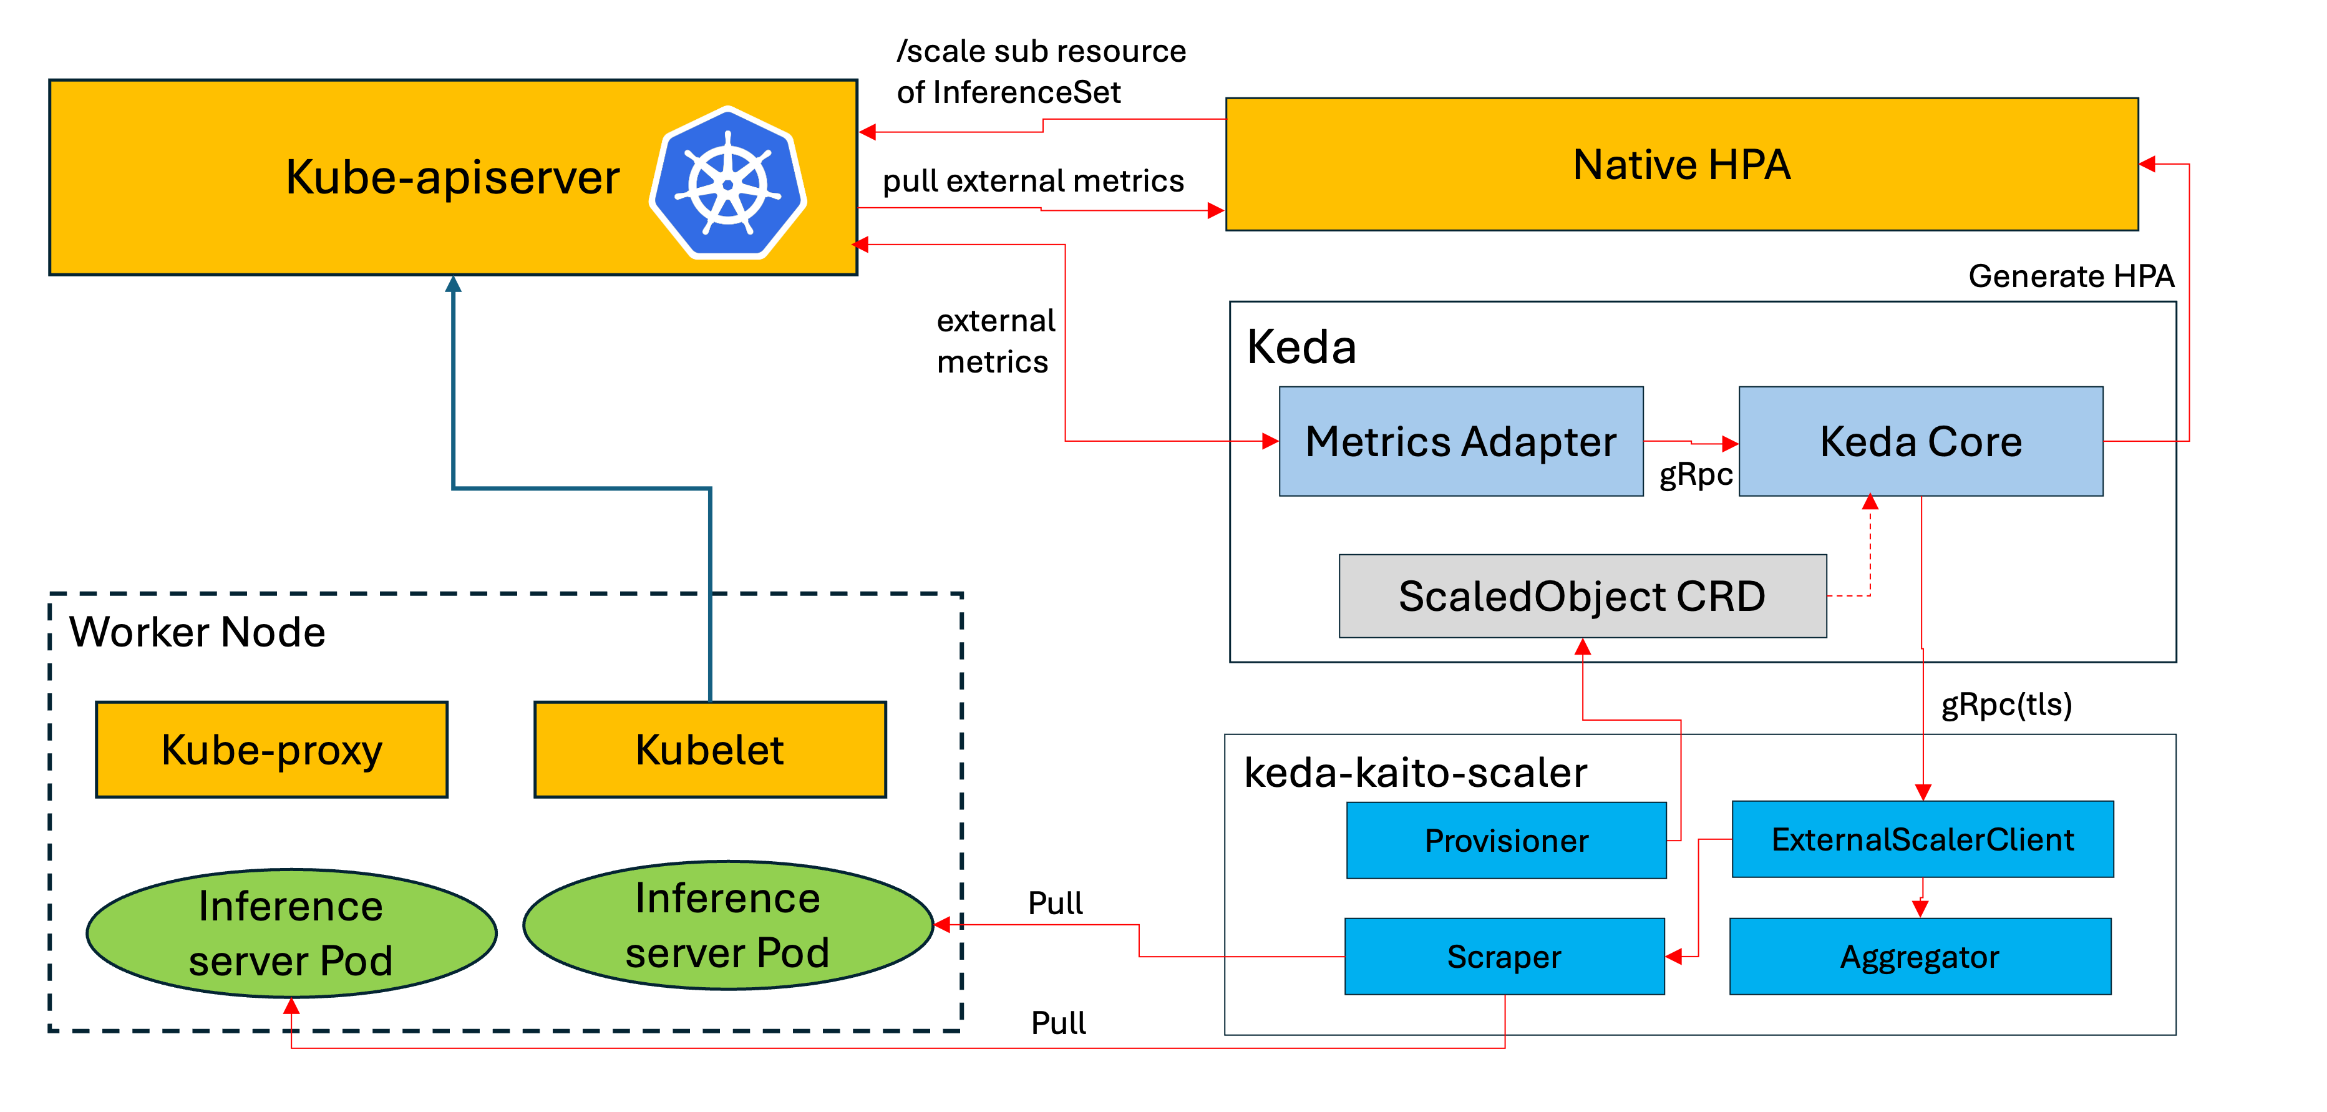
KAITO autoscaling: keda-kaito-scaler
05 / Per-role autoscaling — KEDA scaler
Scale GPU inference with KEDA—no Prometheus required
What makes it special
Direct metrics — reads metrics directly from vLLM; no Prometheus required.
Gradual scaling — adds or removes one replica at a time, with cooldown periods.
Multiple signals — can combine queue length and queue wait time; both must cross their thresholds before scaling up.
Notes:
Now, let’s talk about autoscaling—adding replicas when traffic grows, and removing them when it drops.
KAITO uses a component called keda-kaito-scaler, built on KEDA. There are three things to highlight.
First, no Prometheus is needed. The scaler reads metrics directly from vLLM pods, and it does not depend on Prometheus.
Second, it scales gradually. GPUs are expensive, and new replicas take time to get ready. So it adds or removes one replica at a time, with cooldown periods.
Third, it can combine multiple signals in one scaling policy.

Slide 26
05 / Per-role autoscaling — independent loops
Let prefill and decode scale independently
each role gets its own signal, threshold and replica target.
Prefill
Waiting requests
KEDA / HPA
Prefill InferenceSet
Observe
Decide
Reconcile replicas
Decode
Running requests
KEDA / HPA
Decode InferenceSet
Observe
Decide
Reconcile replicas
Give each target one owner. Allow warm-up time, stabilize changes and scale down safely.
Cloud Native AI + Inference Day North America 2026 / KAITO + llm-d
Notes:
And we have a new problem when doing autoscaling in prefill and decode disaggregation scenario.
We want to let prefill and decode scale independently, each role gets its own signal, threshold and replica target.
Prefill watches waiting requests and scales prefill InferenceSet. Decode watches running requests and scales decode InferenceSet.
Give each target one owner. Allow warm-up time, stabilize changes and scale down safely.
Independent capacity decisions are the goal; KEDA and HPA are the way to implement them.

Slide 27
05 / Per-role autoscaling — policy example
KAITO autoscaling example: scale prefill and decode separately
MRI metadata.annotations
autoscaling.kaito.sh/roles: |
version: v1alpha1
roles:
prefill:
min-replicas: "1"
max-replicas: "8"
combinepolicy: AND
metrics:
- name: vllm:num_requests_waiting
type: gauge
upthreshold: 8
downthreshold: 1
decode:
min-replicas: "2"
max-replicas: "16"
combinepolicy: AND
metrics:
- name: vllm:num_requests_running
type: gauge
upthreshold: 24
downthreshold: 4
MRI spec.roles (excerpt)
- type: prefill
replicas: null
- type: decode
replicas: null
ROLE AVERAGES / START AT P=1, D=2
Waiting is 12; running is 12.
Prefill requests scale-up; decode holds.
If running later exceeds 24,
decode can scale up on its own.
KUBECON + CLOUDNATIVECON NORTH AMERICA 2026 / KAITO + llm-d
Notes:
Here is the KAITO autoscaling example which could scale prefill and decode separately.
In the yaml config, we have set minimum replicas as 1, maximum replicas as 8 for prefill role, prefill would watch on vLLM number of waiting requests metrics. And we have set minimum replicas as 2, maximum replicas as 16 for decode role, decode would watch on vLLM number of running requests metrics.
On the right side, if waiting requests is 12, running is 12, then prefill requests scale up, decode holds. And later on if running requests exceeds 24, decode can scale up on it’s own.

Slide 28
05 / Per-role autoscaling — signal interpretation
Use derived signals to explain the load
Derive KV usage, latency and throughput. Check queries before use.
Native input (vllm: prefix)
Derivation
Decision support
kv_cache_usage_perc
max(role samples)
Could guard scale-down
kv_cache_usage_perc
1 - max(role samples)
Shows free fraction,
not request capacity.
time_to_first_token_seconds
(histogram buckets)
P95 over bucket rates
Shows engine-side TTFT tails.
generation_tokens_total
sum(rate(counter[5m]))
Shows output rate;
benchmark it.
KV occupancy is not demand. Throughput alone should not change replica counts.
Cloud Native AI + Inference Day North America 2026 / KAITO + llm-d
Notes:
Besides the former vLLM number of waiting requests, number of running requests metrics, we have other vLLM metrics, like kv_cache_usage_percentage,, and time to first token seconds which shows engine-side TTFT tails, and generation token total which shows the output rate. We could monitor on those metrics to write different autoscaling strategy for prefill and decode roles.

Slide 29
06 / What’s next — integration roadmap
Where KAITO + llm-d goes next
Next, explore better cache reuse, more inference roles and larger-scale execution.
Near term
Next topology
At larger scale
Precise cache-aware serving
E/P/D
Larger-scale systems
Route using KV cache events.
Tier cache across HBM, CPU RAM
and optional filesystems.
Support Encode to Prefill / Decode.
Support more inference roles.
Explore wide expert parallelism.
Improve cross-node transport
and communication.
Cloud Native AI + Inference Day North America 2026 / KAITO + llm-d
Notes:
What’s the next plan for KAITO and llm-d integration.
There are mainly three parts on the road map.
First, we should enable precise cache aware severing, make KAITO route using KV cache events, and supports tier cache across HBM, CPU RAM
and optional filesystems.
Second, Support Encode to Prefill / Decode, support more inference roles.
Third, support explore wide expert parallelism, improve cross-node transport and communication.

Slide 30
06 / What’s next — resources
Resources
Explore the projects, then try KAITO + llm-d P/D guide.
llm-d | CNCF Sandbox
https://github.com/llm-d
KAITO | CNCF Sandbox
https://github.com/kaito-project/kaito
keda-kaito-scaler
https://github.com/kaito-project/keda-kaito-scaler
KAITO + llm-d: P/D guide
https://kaito-project.github.io/kaito/docs/prefill-decode-disaggregation/
Cloud Native AI + Inference Day North America 2026 / KAITO + llm-d
Notes:
Explore the projects, then try the KAITO + llm-d P/D guide. llm-d and KAITO are both CNCF Sandbox projects. Start with their repositories for the code, check keda-kaito-scaler for scaling details, and use the P/D guide for prerequisites and configuration.
References
https://github.com/llm-d
https://github.com/kaito-project/kaito
https://kaito-project.github.io/kaito/docs/prefill-decode-disaggregation/
https://www.cncf.io/projects/llm-d/
https://www.cncf.io/projects/kaito/
https://github.com/kaito-project/keda-kaito-scaler

Slide 31




Where can you find us
llm-d.ai
github.com/llm-d
llm-d.ai/slack
https://kaito-project.github.io/kaito/docs/
https://github.com/kaito-project
https://llm-d.ai
Join Community Slack
llm-d.ai/slack
https://github.com/kaito-project
Join Community Slack
KAITO/slack
Notes:
All of these components are open. On the left, you can find the llm-d website, GitHub organization, and community Slack. On the right are the KAITO documentation and GitHub organization. We welcome you to try the well-lit paths, reproduce the experiments, and bring your real workloads and feedback back to the communities.

Slide 32
06 / What’s next — Q&A
Thank you
Q & A
Andy Zhang • Linbo He
Microsoft | KAITO + llm-d
Cloud Native AI + Inference Day North America 2026 / KAITO + llm-d
Notes:
Thank you. We’re happy to take questions.

Slide 33
KAITO Autoscaling: Composite Metrics
05 / Per-role autoscaling — KEDA scaler
One annotation combines multiple signals under a conservative AND policy.
InferenceSet — full composite-metric config
metadata:
annotations:
scaledobject.kaito.sh/auto-provision: "true"
scaledobject.kaito.sh/metrics: |
- name: vllm:num_requests_waiting
type: gauge
source: modelpod
upthreshold: 10
downthreshold: 1
- name: vllm:request_queue_time_seconds
type: histogram
source: modelpod
upthreshold: 30
downthreshold: 1
metriccachewindow: 300
scaledobject.kaito.sh/combinepolicy: "AND"
scaledobject.kaito.sh/evaluationwindow: "60"
scaledobject.kaito.sh/scaleupcooldown: "300"
scaledobject.kaito.sh/scaledowncooldown: "300"
scaledobject.kaito.sh/min-replicas: "1"
scaledobject.kaito.sh/max-replicas: "5"
name: phi-4
spec:
replicas: 1
→ every threshold, window & cooldown must be tuned today.
You configure just this
metadata:
annotations:
.../min-replicas: "1"
.../max-replicas: "5"
everything else → auto-tuned to best practice
In progress
Notes:
Here is the example config about how KAITO configures autoscaling based on two vLLM metrics, it’s all defined in the annotations of InferenceSet.
While this example only works for simple P/D aggregation mode.

Slide 34
02 / Why P/D — shared capacity
One shared pool ties two capacity decisions together
A shared pool is simple, but prefill bursts compete with active decoding.
Shared GPU pool
Where is the trade-off?
Prompt bursts can disrupt token delivery.
We scale the whole replica, even when only prefill or decode needs more capacity.
Prefill
Prefill
Prefill
Decode
Decode
Decode
One deployment scales both phases together.
We must decide how to run each phase and how much shared capacity to add.
Cloud Native AI + Inference Day North America 2026 / KAITO + llm-d
Notes:
One shared pool ties two capacity decisions together
A shared pool is simple, but prefill bursts compete with active decoding. Every worker handles both phases. One deployment scales both phases together.
Where is the trade-off? Prompt bursts can disrupt token delivery. We scale the whole replica, even when only prefill or decode needs more capacity.We must decide how to run each phase and how much shared capacity to add.

Slide 35
02 / Why P/D — capacity control
Separate GPU pools let us tune each phase independently
real benefit is scaling prefill and decode independently to match demand—not simply splitting them into two deployments
Input side
Output side
Prompt-heavy demand
Generation-heavy demand
Prefill is often compute-bound
Tune its capacity and parallelism for TTFT.
Decode is often memory-bandwidth-bound
Tune its capacity and batching for ITL.
Different latency targets
Different resource needs
Different capacity needs
TTFT versus token delivery
Compute, bandwidth, active KV
Replicas, tensor parallelism, batching policies
Split only if the gains outweigh KV transfer, extra weight copies and operating costs.
Cloud Native AI + Inference Day North America 2026 / KAITO + llm-d
Notes:
Separate GPU pools let us tune each phase independently. The real benefit is scaling prefill and decode independently to match demand—not simply splitting them into two deployments.
Prefill is often compute-bound. Tune its capacity and parallelism to get better TTFT. On the other hand, decode is often memory-bandwidth-bound. Tune its capacity and batching to get better ITL. Different latency targets and resource needs can call for different replicas, tensor parallelism and batching policies. Split only if the gains outweigh KV transfer, extra weight copies and operating costs.

Slide 36
04 / KAITO + llm-d P/D — routing
llm-d picks workers for each role
The Endpoint Picker selects workers. vLLM executes the inference phases.
pick request
decision
Gateway
GWIE integration
llm-d Router EPP
Endpoint selection + plugin chain
Selected workers
Decode + optional prefill
01
Select by role
Compose plugins
03
Extend scheduling
02
Choose workers for
prefill and decode.
Combine KV-aware and
P/D-aware plugins.
Add new policies
through plugins.
KAITO reuses llm-d’s routing decisions instead of building a second routing engine.
Cloud Native AI + Inference Day North America 2026 / KAITO + llm-d
Notes:
Now that we have separate prefill and decode workers, the next question is: which workers should handle each request?
That’s where llm-d’s Endpoint Picker, or EPP, comes in.
When there is a new request, the gateway asks the EPP to choose a decode worker—and, when remote prefill is needed, a prefill worker as well.
The selection logic is built from plugins. We can combine KV-aware and P/D-aware plugins, add new policies through plugins.
KAITO reuses llm-d’s routing decisions instead of building a second routing engine.
Next, let’s see how those choices fit into the full request path.

Slide 37
04 / KAITO + llm-d P/D — one service, two roles
KAITO + llm-d: one service, two roles
Declare both roles together. Keep orchestration separate from execution.
KAITO
One declarative topology
KAITO maintains the role topology.
Serve one model through one endpoint.
Give prefill and decode their own
placement and replica counts.
Gateway integration
InferencePool links to the gateway.
llm-d
llm-d selects and coordinates.
vLLM + NIXL
vLLM runs; NIXL transfers KV.
One service coordinates P/D requests, while each role keeps its own capacity settings.
Cloud Native AI + Inference Day North America 2026 / KAITO + llm-d
Notes:
With KAITO and llm-d, we declare both roles together. Keep orchestration separate from execution. Serve one model through one endpoint. Give prefill and decode their own placement and replica counts.
KAITO maintains the role topology. InferencePool links to the gateway. llm-d selects workers and coordinates requests. vLLM runs the prefill and decode phases; NIXL transfers KV. One service coordinates P/D requests, while each role keeps its own capacity settings.

Slide 38
05 / Per-role autoscaling — vLLM-native metrics
Scale prefill and decode using separate metrics
Verify service-to-replica mapping before averaging each role’s load.
Prefill
Decode
vllm:num_requests_waiting
vllm:num_requests_running
Watch the prefill engine queue.
Protect prompt admission latency.
Watch active decode requests.
Protect token delivery under load.
< 1
Between
> 8
< 4
Between
> 24
Scale down
Hold
Scale up
Scale down
Hold
Scale up
Example bounds: 1–8 role replicas
Example bounds: 2–16 role replicas
These thresholds are examples. Verify /metrics before enabling either policy.
Cloud Native AI + Inference Day North America 2026 / KAITO + llm-d
Notes:
This slide just explains the former yaml config, KAITO scales prefill and decode using separate metrics. Verify service-to-replica mapping before averaging each role’s load.

Slide 39
02 / Why P/D — independent pools
Split the phases. Tune the pools independently.
P/D separates prompt processing from generation, with KV transfer between them.
Prefill pool
Decode pool
KV cache transfer
Prompt processing
Token generation
Compute + latency
Bandwidth + active KV memory
Transfer and coordination
add cost.
Size prefill replicas and parallelism
for prompt pressure.
Size decode replicas and parallelism
for sustained generation.
The transfer path must be fast enough to justify the split.
Cloud Native AI + Inference Day North America 2026 / KAITO + llm-d
Notes:
Split the phases. Tune the pools independently. P/D separates prompt processing from generation, with KV transfer between them. Size prefill replicas and parallelism for prompt pressure. Size decode replicas and parallelism for sustained generation.
Transfer and coordination add cost. KV data moves from prefill to decode, even when decode initiates the read. The transfer path must be fast enough to justify the split.
References
https://kaito-project.github.io/kaito/docs/prefill-decode-disaggregation

Slide 40
05 / Per-role autoscaling — role-specific decisions
Different roles need different scaling policies
Tune each role for its workload, using per-replica signals and shared safety checks.
Policy
Prefill
Decode
Primary signal
Waiting requests
Running requests
Example replica range
1–8
2–16
Example scale-up
Signal > 8
Signal > 24
Example scale-down
Signal < 1
Signal < 4
Shared guardrails
Readiness + fresh metrics
Readiness + fresh metrics
These policies are examples. Validate thresholds, cooldown and model warm-up.
Cloud Native AI + Inference Day North America 2026 / KAITO + llm-d
Notes:
Different roles need different scaling policies. Tune each role for its workload, using per-replica signals and shared safety checks. Prefill watches waiting requests; decode watches running requests. The example ranges are one to eight and two to sixteen replicas.
Prefill scales up above eight and down below one; decode scales up above twenty-four and down below four. Otherwise, hold. Both need readiness and fresh metrics. These policies are examples. Validate thresholds, cooldown and model warm-up. These are safety requirements, not guarantees of current MRI integration.
Technical reference (not part of the spoken script)
The slide explains policy semantics without exposing configuration syntax. Values are illustrative and match the source design: waiting-request thresholds 8/1 and bounds 1–8 for prefill; running-request thresholds 24/4 and bounds 2–16 for decode. Evaluate role-scoped per-replica aggregation, not a whole-service sum. Apply strict above/below comparisons, hold between/equal to thresholds, and enforce bounds, fresh-data checks, readiness, stabilization and cooldown for both roles. Scale-down also requires safe treatment of in-flight work. Policy ownership must be unambiguous. The underlying representation is intentionally outside the external presentation.
References
https://github.com/andyzhangx/demo/blob/26c3e14a340d4b0aae5c820b43087d71b85d1554/llm/kaito-llm-d/kaito-role-aware-autoscaling-for-pd.md
https://docs.vllm.ai/en/stable/usage/metrics/

Slide 41
05 / Per-role autoscaling — existing capability
Today, KEDA scales a KAITO InferenceSet
KAITO documents scheduled scaling and metric-based scaling with KEDA.
Trigger
KEDA / HPA
InferenceSet
Cron or Prometheus query
ScaledObject target
Scale subresource
One example watches queues.
vllm:num_requests_waiting
KEDA / HPA sets replicas on the InferenceSet. KAITO adjusts serving resources.
Cloud Native AI + Inference Day North America 2026 / KAITO + llm-d
Notes:
Today, KEDA scales an InferenceSet. KAITO documents scheduled scaling and metric-based scaling with KEDA. KEDA and HPA set replicas on the InferenceSet. KAITO adjusts serving resources.
One example watches queues, using vllm:num_requests_waiting. KEDA is installed separately. This is the existing scaling mechanism, not a finished MRI policy. Scale the complete serving replica, not an individual tensor-parallel worker.

Slide 42
05 / Per-role autoscaling — overview
Scale the role that needs more capacity
let prefill and decode make separate capacity decisions.
Prefill
Decode
Prefill needs to protect
time to first token (TTFT)
Decode needs to sustain
steady token delivery
Inter-Token Latency (ITL)
Start with vLLM waiting requests.
Start with vLLM running requests.
Match signals to each role’s load. Tune thresholds against latency targets.
Cloud Native AI + Inference Day North America 2026 / KAITO + llm-d
Notes:
Next is how do we autoscale in p/d disaggregation scenario.
We scale the role that needs more capacity and let prefill and decode make separate capacity decisions. Match signals to each role’s load. Tune thresholds against latency targets.
Prefill needs to protect time to first token. Start with vLLM waiting requests. Decode needs to sustain steady token delivery, which is Inter-Token Latency, that is ITL. It starts with vLLM running requests.

Slide 43
05 / Per-role autoscaling — control-loop design
Observe each role. Act on its own capacity.
Proposed loops use valid role metrics—not GPU utilization alone—to decide capacity.
Role-specific policies
Independent decisions
Serving capacity
Validate signals and limits.
Give each target one owner.
Count only ready replicas.
Prefill vLLM /metrics
Prefill autoscaler
Prefill replicas
Waiting requests
Decide for prefill alone.
Adjust prefill capacity.
Decode vLLM /metrics
Decode autoscaler
Decode replicas
Running requests
Decide for decode alone.
Adjust decode capacity.
Routing chooses where requests go; autoscaling changes how much capacity is available.
Cloud Native AI + Inference Day North America 2026 / KAITO + llm-d
Notes:
Proposed loops use valid role metrics—not GPU utilization alone—to decide capacity. Routing chooses where requests go; autoscaling changes how much capacity is available.
Validate signals and limits. Give each target one owner. Count only ready replicas. Waiting requests inform prefill capacity; running requests inform decode capacity. Running requests measure concurrency, not GPU saturation. Require fresh, complete role metrics before trusting a scaling decision.
Technical reference (not part of the spoken script)
Architectural control pattern, independent of how policies are encoded. Each role has its own signals, controller decision and serving-replica target. KEDA/HPA targeting an InferenceSet is one implementation. Scope samples to the actual role and deduplicate engine/worker series. Scale complete serving replicas and account for model loading before counting new capacity as ready. Arrows show conceptual policy and metric flow, not strict ownership references or push-based scraping. The serving topology still coordinates P/D requests while the capacity loops act independently. Implementation-specific automatic policy projection is outside this talk slide.
References
https://github.com/andyzhangx/demo/blob/26c3e14a340d4b0aae5c820b43087d71b85d1554/llm/kaito-llm-d/kaito-role-aware-autoscaling-for-pd.md
https://kaito-project.github.io/kaito/docs/keda-autoscaler-inference

Slide 44
04 / KAITO + llm-d P/D — responsibilities
Three layers. Three clear responsibilities.
The InferencePool contract connects platform orchestration to routing.
KAITO
KAITO reconciles the role topology.
Declare + reconcile
It creates resources and manages their lifecycle.
GWIE
GWIE defines the InferencePool contract.
Define the contract
It connects backends to gateway integration.
llm-d Router
It selects endpoints via EPP.
Select endpoints
It makes role-aware routing decisions.
KAITO owns the topology. GWIE defines the contract. llm-d Router makes the selection.
Cloud Native AI + Inference Day North America 2026 / KAITO + llm-d
Notes:
Three layers. Three clear responsibilities. The InferencePool contract connects platform orchestration to routing. KAITO reconciles the role topology. It creates resources and manages their lifecycle. GWIE defines the InferencePool contract. It connects backends to gateway integration. llm-d Router selects endpoints via EPP. It makes role-aware routing decisions.
KAITO owns the topology. GWIE defines the contract. llm-d Router makes the selection. InferencePool is an API resource, not another forwarding proxy.

Slide 45
04 / KAITO + llm-d P/D — KV transfer
vLLM and NIXL move KV between workers
KV moves between runtimes, not through the gateway or routing sidecar.
Prefill worker
Decode worker
KV data →
Prefill builds KV
in GPU memory.
Decode reuses KV
to keep generating.
NIXL uses a transport backend.
Decode may initiate the read.
GPU-direct RDMA needs a supported GPU, NIC, fabric and backend.
A TCP path is not RDMA. Measure transfer latency and staging cost on your deployment.
Cloud Native AI + Inference Day North America 2026 / KAITO + llm-d
Notes:
KV moves between runtimes, not through the gateway or routing sidecar. Prefill builds KV in GPU memory. Decode reuses KV to keep generating. NIXL uses a transport backend. Decode may initiate the read.
GPU-direct RDMA needs a supported GPU, NIC, fabric and backend. A TCP path is not RDMA. Measure transfer latency and staging cost on your deployment. Next, let’s look at capacity.

Slide 46
03 / llm-d and KAITO — GPU node sizing
How KAITO estimates GPU node count
Estimate initial memory capacity—not throughput—from the model and GPU memory.
1 Memory budget
2 GPU count
3 Node count
Start with GPU memory.
Reserve runtime overhead
and room for KV cache.
Fit the weights into
usable GPU memory.
Account for parallelism.
Divide by GPUs per node.
Round up, then reconcile
the workload.
The sizing formula and safety margins depend on the KAITO and runtime version.
Cloud Native AI + Inference Day North America 2026 / KAITO + llm-d
Notes:
Here is how KAITO estimates GPU node count. Estimate initial memory capacity—not throughput—from the model and GPU memory. Start with GPU memory. Reserve runtime overhead and room for KV cache. Fit the weights into usable GPU memory. Account for parallelism. Divide by GPUs per node. Round up, then reconcile the workload.
The sizing formula and safety margins depend on the KAITO and runtime version. Fitting the model is not a latency or throughput guarantee.

Slide 47
05 / Per-role autoscaling — policy boundary
One service can scale its two roles separately
Proposed design: set service goals, then give each role its own scaling policy.
Proposed service-to-role policy
Prefill scale target
Service-level intent
Policy reconciliation
Apply the prefill policy.
Protect prompt latency.
Keep tokens flowing.
Set separate role targets.
Decode scale target
Apply the decode policy.
Scale a complete serving replica—not an individual tensor-parallel worker.
Cloud Native AI + Inference Day North America 2026 / KAITO + llm-d
Notes:
One service can scale its two roles separately. Proposed design: set service goals, then give each role its own scaling policy. Protect prompt latency. Keep tokens flowing. Set separate role targets.
Apply the prefill policy. Apply the decode policy. Scale a complete serving replica—not an individual tensor-parallel worker. Mapping service goals to those policies and handing over replica ownership still require MRI integration.
Technical reference (not part of the spoken script)
Public-facing design pattern: express service objectives, reconcile independent role policies, and scale each role as a complete serving replica. Policy representation and controller-specific wiring are implementation details and intentionally omitted here. Existing KEDA/InferenceSet capability is described on the earlier slide; this diagram is not a claim that automatic service-level policy projection is already available. Keep one authoritative autoscaler per target.
References
https://github.com/andyzhangx/demo/blob/26c3e14a340d4b0aae5c820b43087d71b85d1554/llm/kaito-llm-d/kaito-role-aware-autoscaling-for-pd.md
https://kaito-project.github.io/kaito/docs/keda-autoscaler-inference

Slide 48
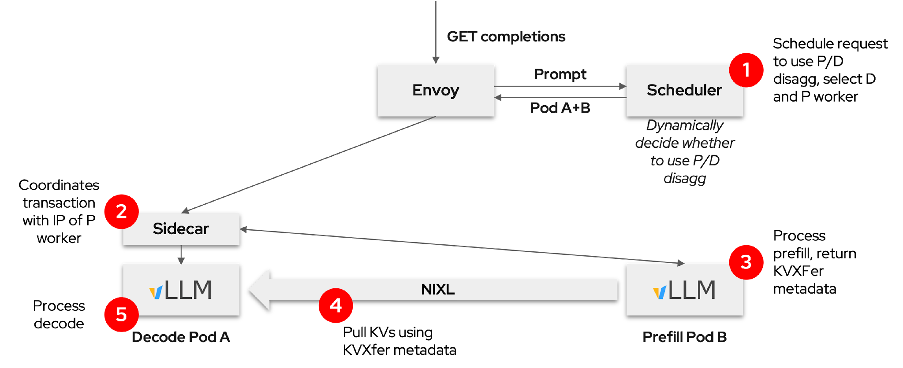
llm-d connects routing, prefill and decode
04 / KAITO + llm-d P/D — routing and execution
Route prefill and decode separately.
Choose workers dynamically.
Tune each role’s capacity and scheduling.
Target TTFT and ITL SLOs—
then measure the handoff cost.
Cloud Native AI + Inference Day North America 2026 / KAITO + llm-d
Notes:
llm-d connects routing, prefill and decode. Route prefill and decode separately. Choose workers dynamically. Tune each role’s capacity and scheduling. Target TTFT and ITL SLOs—then measure the handoff cost.
One client request can become separate internal requests. Separate pools give us more control, not a guarantee of meeting latency targets. The sidecar coordinates the handoff; vLLM and NIXL move the KV data.

Slide 49
04 / KAITO + llm-d P/D — pod boundary
The decode sidecar coordinates the request
One decode endpoint coordinates remote prefill and returns the final response.
Stable external
routing contract
Selected decode pod
Gateway
EPP-selected endpoint
Routing sidecar
Port 5000
local request
+ KV metadata
Local decode vLLM
Port 5001
optional prefill request
Remote prefill
vLLM worker
Direct KV data • bypasses sidecar
The sidecar coordinates requests. KV data goes directly to the decode runtime.
Cloud Native AI + Inference Day North America 2026 / KAITO + llm-d
Notes:
The decode sidecar coordinates the request. One decode endpoint coordinates remote prefill and returns the final response. The gateway reaches the selected decode pod’s sidecar. When needed, the sidecar requests remote prefill, then passes the request and KV metadata to local decode vLLM.
The sidecar coordinates requests. KV data goes directly to the decode runtime. Decode initiates the read; KV data bypasses the sidecar. Ports five thousand and five thousand one are configuration examples.
Technical reference (not part of the spoken script)
Ports 5000 and 5001 reflect this deployment configuration, not universal requirements for every llm-d deployment. The InferencePool targetPort must reach the sidecar’s listening port. The sidecar coordinates remote prefill, passes transfer metadata to local vLLM, and proxies the final response. KV payload does not transit through the HTTP sidecar. The decode runtime performs the KV read over NIXL.

Slide 50
02 / Why P/D — when to disaggregate
When should you use P/D—and when not?
Ask two questions: do the roles need different capacity, and what does KV transfer cost?
Expensive / weak KV transfer
Cheap / fast enough KV transfer
Different
bottlenecks /
scaling needs
Improve topology first
Strong P/D candidate
Separate capacity may help,
but transfer may erase the gain.
Tune each role separately.
Validate at matched SLOs and cost.
Stay aggregated
Usually stay aggregated
Similar
bottlenecks /
scaling needs
Similar roles gain little,
while expensive transfer adds cost.
Fast fabric alone is no reason to split.
Operational gains may be limited.
Use P/D when roles need different capacity and KV transfer does not erase the gain.
Cloud Native AI + Inference Day North America 2026 / KAITO + llm-d
Notes:
Ask two questions: do the roles need different capacity, and what does KV transfer cost? With different role needs but costly transfer, improve topology first: separate capacity may help, but transfer may erase the gain. With different needs and affordable transfer, tune each role separately. Validate at matched SLOs and cost.
With similar needs, usually stay aggregated. Similar roles gain little, while expensive transfer adds cost. Fast fabric alone is no reason to split. Use P/D when roles need different capacity and KV transfer does not erase the gain.
Technical reference (not part of the spoken script)
Source: companion Markdown section — When to use P/D, and when not to. This is a qualitative decision matrix, not measured results or a performance guarantee. The horizontal axis increases from costly/weak transfer to cheap/fast-enough transfer; the vertical axis increases from similar role bottlenecks at the bottom to meaningfully different scaling, bottlenecks or parallelism at the top. Top-right is the strongest candidate; bottom-left stays aggregated. Top-left should first improve locality/transport or investigate same-node placement. Bottom-right usually remains aggregated because cheap transfer does not by itself create a reason for role separation. Cross-node placement is a risk factor to measure, not proof that fabric is weak: fast cross-node links can satisfy the right-hand condition. Likewise single-node transfer is not automatically free. Compare actual KV payload transfer cost, contention, tail latency, reliability and operational complexity. A strong candidate still requires a matched workload/cost/SLO benchmark.

Slide 51
06 / What’s next — key takeaways
Summary
Three takeaways for operating P/D on Kubernetes
01
Separate capacity to protect latency
Prefill shapes first-token latency; decode shapes ongoing token delivery.
02
Give each layer a clear job
KAITO manages roles; llm-d routes; vLLM + NIXL execute and move KV.
03
Scale each role safely
Use role signals and safe scale-down; MRI integration still needs work.
Validate P/D against aggregated serving at matched workload, cost and latency targets.
Cloud Native AI + Inference Day North America 2026 / KAITO + llm-d
Notes:
Three takeaways for operating P/D on Kubernetes. Separate capacity to protect latency. Prefill shapes first-token latency; decode shapes ongoing token delivery. Give each layer a clear job. KAITO manages roles; llm-d routes; vLLM + NIXL execute and move KV.
Scale each role safely. Use role signals and safe scale-down; MRI integration still needs work. Validate P/D against aggregated serving at matched workload, cost and latency targets.

Slide 52
05 / Per-role autoscaling — configuration
KAITO autoscaling configuration
Tune explicitly today; aim for simpler defaults next.
Existing scaler settings
Proposed simplification
Choose queue and latency metrics.
Set thresholds and time windows.
Set replica bounds and cooldowns.
Combine signals with an AND policy.
Keep minimum and maximum replicas.
Derive more defaults automatically.
Validate for the model and workload.
This is not shipped auto-tuning.
Existing InferenceSet scaling is the base; MRI role-policy integration still needs work.
Cloud Native AI + Inference Day North America 2026 / KAITO + llm-d
Notes:
Tune explicitly today; aim for simpler defaults next. Choose queue and latency metrics. Set thresholds and time windows. Set replica bounds and cooldowns. Combine signals with an AND policy. Check available settings against your installed scaler version.
The proposal is to keep minimum and maximum replicas, derive more defaults automatically, and validate for the model and workload. This is not shipped auto-tuning. Existing InferenceSet scaling is the base; MRI role-policy integration still needs work.
Configuration reference (from the original deck; validate against the installed scaler version)

Slide 53
03 / llm-d and KAITO — CNCF Sandbox project
llm-d: composable distributed inference
Reuse the serving stack and add Kubernetes-native coordination.
Operate
Compose
Deploy
Run modular components
on Kubernetes.
Keep failure boundaries clear.
Connect gateways, routing,
runtimes and KV interfaces.
Start with tested paths.
Weigh the trade-offs.
Tune for your workload.
llm-d composes gateways, runtimes and transport; it does not replace them all.
Cloud Native AI + Inference Day North America 2026 / KAITO + llm-d
Notes:
Reuse the serving stack and add Kubernetes-native coordination. Run modular components on Kubernetes. Keep failure boundaries clear. Connect gateways, routing, runtimes and KV interfaces. Start with tested paths. Weigh the trade-offs. Tune for your workload.
llm-d composes gateways, runtimes and transport; it does not replace them all. These reference paths are starting points, not performance guarantees for every model and hardware combination.
References
https://www.cncf.io/projects/llm-d/
https://github.com/llm-d

Slide 54
05 / Per-role autoscaling — operational safeguards
Safe autoscaling needs one writer and valid data
These are safety requirements to verify, not guarantees of current MRI integration.
01 / Replica ownership
02 / Metric availability
03 / Lifecycle
Choose one writer
Verify real signals
Make handoff explicit
Give each role one replica writer.
Do not let autoscalers compete.
Inspect actual /metrics.
Scope samples per role.
Missing is not zero.
Hold and report on failure.
Stop the old writer first.
Delete only owned scalers.
Allow model warm-up.
Test safe scale-down.
Missing or invalid signals must hold decisions and report a problem—not look like zero load.
Avoid competing controllers, count only ready capacity, and protect in-flight requests.
Cloud Native AI + Inference Day North America 2026 / KAITO + llm-d
Notes:
Safe autoscaling needs one writer and valid data. These are safety requirements to verify, not guarantees of current MRI integration. Give each role one replica writer. Do not let autoscalers compete. Inspect actual /metrics. Scope samples per role. Missing is not zero. Hold and report on failure.
Stop the old writer first. Delete only owned scalers. Allow model warm-up. Test safe scale-down. Avoid competing controllers, count only ready capacity, and protect in-flight requests.
Technical reference (not part of the spoken script)
Safety contract: do not let a fixed-replica reconciler and an autoscaler compete for the same target. Stop the old writer before handing over control, and never silently adopt/delete user-managed autoscalers. Missing, stale, unreachable or non-finite metric samples should prevent activation or hold active decisions and surface a condition/event. This is the required behavior, not an assertion that all controller/HPA fallback paths implement it today; verify end to end. Partial scrape coverage must not look like zero load. Readiness includes model loading and actual serving eligibility. Protect in-flight requests and KV state during scale-down.
References
https://github.com/andyzhangx/demo/blob/26c3e14a340d4b0aae5c820b43087d71b85d1554/llm/kaito-llm-d/kaito-role-aware-autoscaling-for-pd.md

Slide 55
03 / llm-d and KAITO — capabilities
llm-d capabilities relevant to this talk
These are building blocks, not benchmark guarantees.
Distributed execution
Prefill/decode separation
Run large models with expert parallelism and tuned communication.
Choose placement, batching and capacity for each phase.
State-aware scheduling
Capacity control
Route with cache locality and runtime load in mind.
Guide scaling with workload signals and latency targets.
Validate your model, hardware, traffic and SLOs. MRI policy integration still needs work.
Cloud Native AI + Inference Day North America 2026 / KAITO + llm-d
Notes:
These are building blocks, not benchmark guarantees. Run large models with expert parallelism and tuned communication. Choose placement, batching and capacity for each phase. Route with cache locality and runtime load in mind. Guide scaling with workload signals and latency targets.
Choosing a worker and adding capacity are different decisions. Validate your model, hardware, traffic and SLOs. MRI policy integration still needs work.

