Slide 1
Notes:
Speaker script
Welcome, everyone. Thanks for joining us at Cloud Native AI and Inference Day North America. Today we will look at how Kubernetes can help us operate large language model inference when prompt processing and token generation need different resources.

Slide 2
Prefill here, decode there
Kubernetes-native LLM inference
with KAITO and llm-d
Andy Zhang — Microsoft
Linbo He — Microsoft
Cloud Native AI + Inference Day North America 2026 / KAITO + llm-d
02 / 49
Notes:
Speaker script
Our talk is called Prefill Here, Decode There. We will explain why separating these two phases can help, what it costs, and how KAITO and llm-d fit together to make the topology manageable on Kubernetes. The goal is not separation for its own sake. It is better control over capacity while protecting the experience users actually see.

Slide 3
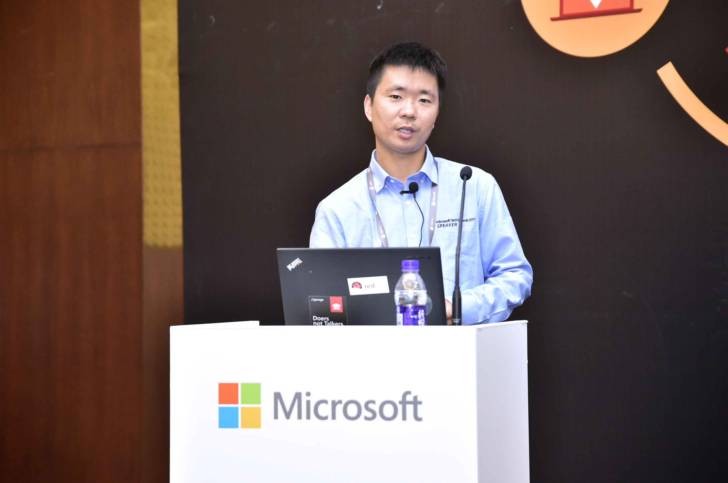


About us
Andy Zhang
Linbo He
Principal Software Engineer, Microsoft
KAITO & CSI driver maintainer
GitHub: andyzhangx
Principal Software Engineer, Microsoft
KAITO & OpenYurt maintainer
GitHub: rambohe-ch
Cloud Native AI + Inference Day North America 2026 / KAITO + llm-d
03 / 49
Notes:
Speaker script
We are Andy Zhang and Linbo He, both principal software engineers at Microsoft. Andy maintains KAITO and Container Storage Interface drivers. Linbo maintains KAITO and OpenYurt. We will connect the inference concepts to the Kubernetes resources and operational decisions that platform teams need to understand.

Slide 4
Agenda
From the inference basics to a Kubernetes operating model
01
Foundations
02
Why P/D disaggregation
Prefill, decode and latency targets
Benefits, costs and the orchestration gap
03
KAITO + llm-d
04
How KAITO + llm-d supports P/D
Components and ownership boundaries
Topology, routing and KV transfer
05
Per-role autoscaling
06
When to use P/D
Signals, policies and safe control loops
Decision framework and next steps
Cloud Native AI + Inference Day North America 2026 / KAITO + llm-d
04 / 49
Notes:
Speaker script
We will cover six topics: foundations; why prefill/decode disaggregation; KAITO and llm-d; how KAITO and llm-d support prefill/decode disaggregation through topology, routing, and KV transfer; per-role autoscaling; and finally, when to use prefill/decode disaggregation and what comes next. We will distinguish existing capabilities from proposed integration work throughout.

Slide 5
01 / Foundations — prefill
Prefill: process the prompt and select the first token
Prompt: “What does Kubernetes do?”
Teaching example / One word per token
What
does
Kubernetes
do
?
Process the prompt positions together, with attention only to earlier or current positions.
5 prompt positions
Causal prefill
Select “Kubernetes”
4 words + punctuation
No attention to future positions
Final prompt-position logits
Prompt KV = per-layer attention keys + values for the 5 processed prompt positions.
Illustrative word-level tokens; not a real model tokenizer.
Prefill caches the prompt, then selects “Kubernetes”. Its K/V is not cached until it is consumed.
Cloud Native AI + Inference Day North America 2026 / KAITO + llm-d
05 / 49
Notes:
Speaker script
Let's start with what the model actually does. This teaching example treats each word and punctuation mark as a token; a real tokenizer behaves differently. Prefill processes the five prompt positions with causal attention and creates their per-layer keys and values, or KV. The final prompt position selects the first output token, Kubernetes. Selecting that token does not add its KV to the cache. That happens when the next step consumes it. This is an authored example, not a captured model response.
References
https://huggingface.co/docs/transformers/en/cache_explanation
https://docs.nvidia.com/dynamo/dev/kubernetes/disaggregated-serving/overview

Slide 6
01 / Foundations — decode
Decode: consume a token, select the next, repeat
Illustrative output: “Kubernetes helps teams deploy and scale applications.”
Illustrative word-level tokens; not a real model tokenizer.
Step
Consume + read past KV
Append to per-layer KV
Select next output
1
Kubernetes
K/V for “Kubernetes”
helps
2
helps
K/V for “helps”
teams
3
teams
K/V for “teams”
deploy
4
deploy
K/V for “deploy”
and
5
and
K/V for “and”
scale
6
scale
K/V for “scale”
applications
Repeat until the answer is complete. Each selected token becomes the next input.
Client arrivals / First 6 words shown / Schematic, not to scale
TTFT → first word
ITL 1
ITL 2
ITL 3
ITL 4
ITL 5
Request
Kubernetes
helps
teams
deploy
and
scale
Append KV for the consumed token—not the newly selected token. Read past KV; do not recompute it.
Cloud Native AI + Inference Day North America 2026 / KAITO + llm-d
06 / 49
Notes:
Speaker script
Decode now consumes Kubernetes, reads the cached history, adds that consumed token's keys and values, and selects helps. Then it repeats. Caching avoids recomputing old keys and values, not all attention work. On the client timeline, time to first token, or TTFT, is the initial wait. Inter-token latency, or ITL, is each subsequent gap. Average time per output token summarizes the later intervals; it is not interchangeable with an individual gap or its percentile. The timeline is schematic, not measured.
References
https://huggingface.co/docs/transformers/en/cache_explanation
https://docs.vllm.ai/en/stable/usage/metrics/

Slide 7
01 / The problem
One request. Two different performance targets.
Prefill mainly shapes the wait for the first token; decode shapes the pace after it.
Prompt
Prefill
KV cache
Decode
Input tokens
Process uncached input
Attention state
Generate tokens iteratively
Prefill → TTFT
Decode → ITL / TPOT
Time to first token • lower is better
Inter-token latency / avg. time per output token
Track prefill latency + input tok/s
Often compute-bound
Lower is better • track aggregate output tok/s
Often memory-bandwidth-bound
Not exclusive: queueing / delivery also affect TTFT; shared prefill can stall decode. Sources: vLLM metrics; NVIDIA Dynamo.
Both affect total response latency and SLO goodput: requests/s meeting the latency targets.
Cloud Native AI + Inference Day North America 2026 / KAITO + llm-d
07 / 49
Notes:
Speaker script
These phases create two different performance targets. Prefill often stresses compute and mainly shapes time to first token. Decode often stresses memory bandwidth and shapes the pace of the stream. Neither relationship is exclusive: queueing, scheduling, transfer, and delivery matter too. Average time per output token, or TPOT, describes the per-request pace after the first token. Our ultimate target is service-level objective, or SLO, goodput: requests per second that meet both latency targets, rather than simply maximizing aggregate tokens per second.
References
https://docs.vllm.ai/en/latest/design/metrics/
https://docs.vllm.ai/en/latest/benchmarking/cli/#understanding-the-latency-metrics
https://docs.nvidia.com/dynamo/dev/kubernetes/disaggregated-serving/overview

Slide 8
01 / The problem
One shared pool couples two capacity decisions
Aggregated serving is simple—but prefill bursts and active decoding share resources.
Shared GPU pool
The operational tension
Prompt bursts can disrupt token delivery.
Scaling adds both phases, even when only one is saturated.
Prefill
Prefill
Prefill
Decode
Decode
Decode
One deployment • one coupled scaling boundary
The compromise is not only performance. It is how you size and scale the service.
Cloud Native AI + Inference Day North America 2026 / KAITO + llm-d
08 / 49
Notes:
Speaker script
In aggregated serving, both phases share a GPU pool and a scaling boundary. That is a sensible starting point, and continuous batching or chunked prefill can make it work well. The operational tension appears when prompt bursts compete with ongoing generation. Adding capacity also adds both phases together, even if only one is under pressure. The issue is therefore not that aggregated serving is inherently slow. It is that capacity decisions remain coupled.

Slide 9
01 / Why split — execution interference
Long prefills can interrupt token delivery
A is already decoding. B arrives with a new prompt. Where should B run?
Conceptual schedule · Not a benchmark · Block widths and gaps are not timings
Shared GPU
A waits while B runs prefill
One worker does both
D
D
Prefill B
D
D
Separate GPUs
A can continue decoding while B runs prefill elsewhere
Prefill worker
Prefill B
B still needs KV handoff
Decode worker
D
D
D
D
D
D
D
A = ongoing decode; B = new request. Chunked prefill can mitigate the shared-worker pause.
Original conceptual illustration; sources: NVIDIA and vLLM (2025) + current documentation.
Separate GPUs remove direct prefill execution from the decode GPU—not every source of latency.
Cloud Native AI + Inference Day North America 2026 / KAITO + llm-d
09 / 49
Notes:
Speaker script
Here, A is an ongoing request and B is a new arrival. Each D block represents a decode execution step, not a measured token duration. On the shared GPU, B's prefill can interrupt A. Chunked prefill can reduce that pause. Separate workers remove the direct execution conflict, but B still needs a KV handoff, and queueing or shared infrastructure can still affect latency. This is a conceptual schedule, not an equal-budget benchmark or a promise of perfectly even token delivery.
References
https://developer.nvidia.com/blog/introducing-nvidia-dynamo-a-low-latency-distributed-inference-framework-for-scaling-reasoning-ai-models/
https://vllm.ai/blog/2025-09-05-anatomy-of-vllm
https://docs.nvidia.com/dynamo/kubernetes/disaggregated-serving/overview
https://docs.vllm.ai/en/latest/features/disagg_prefill/

Slide 10
01 / Why split — different batching units
Prefill and decode batch different work
Prefill processes many prompt positions; ordinary decode advances many independent requests.
Conceptual illustration · Not a benchmark · Tokens and request counts are schematic
Prefill
Decode
Many input positions in one forward pass
One newest input position per active request
Request
Read history
Consume newest input
Request A
p1
p2
p3
p4
A
Prior KV
+
One token
Request B
q1
q2
q3
B
Prior KV
+
One token
C
Prior KV
+
One token
Batch prompt positions from one or more requests.
Then select a next output token for each request.
More decode concurrency can increase ITL. Batch within latency and KV-memory budgets.
Original conceptual illustration; sources: NVIDIA and vLLM (2025) + current documentation.
Prefill finds parallel work in prompt length; decode finds it across active sequences.
Cloud Native AI + Inference Day North America 2026 / KAITO + llm-d
10 / 49
Notes:
Speaker script
The batching opportunities are different too. Prefill can process many prompt positions together while preserving causal attention. Ordinary decode advances one newest input position for each independent request, so it finds parallelism across active sequences. More decode concurrency can improve aggregate efficiency, but it also consumes KV memory and may lengthen each iteration. Generation remains sequential within an individual request in this example. We still have to batch within the latency and memory budgets; more concurrency is not automatically better.
References
https://developer.nvidia.com/blog/introducing-nvidia-dynamo-a-low-latency-distributed-inference-framework-for-scaling-reasoning-ai-models/
https://vllm.ai/blog/2025-09-05-anatomy-of-vllm
https://docs.nvidia.com/dynamo/kubernetes/disaggregated-serving/overview
https://docs.vllm.ai/en/latest/features/disagg_prefill/

Slide 11
01 / Why split — capacity control
Independent pools remove a forced compromise
The payoff is a separate capacity decision for each phase—not separation for its own sake.
Input side
Output side
Prompt-heavy demand
Generation-heavy demand
Usually compute-bound; target TTFT.
Tune prefill capacity / parallelism first.
Often bandwidth-bound; target ITL.
Tune decode capacity / batching first.
Different latency targets
Different resource needs
Different capacity knobs
TTFT versus token delivery
Compute, bandwidth, active KV
Replicas, TP, batching policy
Sources: NVIDIA Dynamo disaggregated-serving overview + DistServe §2.3 • Conceptual; bottlenecks depend on workload
Split only when phase-specific gains outweigh KV transfer, duplicated weights and operational cost.
Cloud Native AI + Inference Day North America 2026 / KAITO + llm-d
11 / 49
Notes:
Speaker script
This is the central motivation: two capacity decisions instead of one forced compromise. Prompt-heavy demand may need different replica counts, batching, or tensor parallelism from generation-heavy demand. Tensor parallelism splits model computation across devices. The available choices depend on runtime and connector compatibility, so separate pools do not imply that every hardware combination works. Separation is worthwhile only when the measured benefit exceeds KV transfer, duplicated model weights, and the operational cost of managing two pools.
References
https://docs.nvidia.com/dynamo/dev/kubernetes/disaggregated-serving/overview
https://arxiv.org/html/2401.09670v2#S2.SS3
https://kaito-project.github.io/kaito/docs/prefill-decode-disaggregation

Slide 12
01 / The problem
Split the phases. Tune the pools independently.
P/D introduces a KV-transfer boundary between prompt processing and generation.
Prefill pool
Decode pool
KV cache transfer
Prompt processing
Token generation
Compute + latency
Bandwidth + active KV memory
New cost:
transfer + coordination
Choose replicas and parallelism
for prompt pressure.
Choose replicas and parallelism
for sustained generation.
The transfer path must be fast enough to justify the split.
Cloud Native AI + Inference Day North America 2026 / KAITO + llm-d
12 / 49
Notes:
Speaker script
The resulting topology has a prefill pool and a decode pool, with a new transfer boundary between them. Prefill capacity follows prompt pressure; decode capacity follows sustained generation and active KV memory. The data moves from prefill memory to decode memory, even if decode initiates the read. That movement and its coordination are real costs. They must fit the service's latency and cost budgets, and the supported transport depends on the deployment.
References
https://kaito-project.github.io/kaito/docs/prefill-decode-disaggregation

Slide 13
01 / The problem
P/D fits when the phases need different shapes
Start with the traffic profile, not the architecture trend.
Prompt pressure
Generation pressure
Capacity mismatch
Long prompts
Long generations
Different resources
RAG and retrieval add significant prefill work.
High concurrency keeps decode busy and KV state resident.
Each phase needs its own scaling or parallelism choices.
Cloud Native AI + Inference Day North America 2026 / KAITO + llm-d
13 / 49
Notes:
Speaker script
Start with the traffic profile, not the architecture trend. Retrieval-augmented generation, or RAG, can add substantial prompt processing. Long answers and high concurrency keep decode busy and KV state resident. These are reasons to investigate independent capacity, not automatic evidence that disaggregation wins. Longer prompts also increase transfer volume and decode attention work. The useful question is whether separate capacity choices address a bottleneck we actually observe, after accounting for the transfer path and operational complexity.

Slide 14
01 / The problem
Keep aggregated serving when simplicity wins
P/D is an option, not a default.
When aggregated fits
The split adds real costs
Small models or short prompts
Low request concurrency
Simple, stable capacity needs
KV transfer across the fabric
More routing and runtime wiring
Additional failure boundaries
Small workload + slow transfer fabric is a strong reason not to split.
Cloud Native AI + Inference Day North America 2026 / KAITO + llm-d
14 / 49
Notes:
Speaker script
Sometimes the right answer is to stay aggregated. Small models, short prompts, low concurrency, and stable capacity needs may not justify another transfer path or more failure boundaries. A shared deployment also has useful scheduling optimizations available. If it already meets the service targets simply and predictably, splitting it may be a step backward. The break-even point is empirical: it depends on the model, traffic, hardware, and fabric, not on an architectural preference.

Slide 15
02 / The orchestration gap
The hard part is the Kubernetes wiring
The two-pool idea expands into a network of runtime contracts.
Routing topology
Decode-side proxy
EPP + endpoint selection
Request orchestration
One model service
Two role-specific backends
KV-transfer contract
Lifecycle + scaling
Connector + transport settings
Ports, labels, probes, replicas
Correct routing, transfer settings, labels, ports, and readiness must agree.
Cloud Native AI + Inference Day North America 2026 / KAITO + llm-d
15 / 49
Notes:
Speaker script
The conceptual split is straightforward. The Kubernetes wiring is where the work expands. The Endpoint Picker, or EPP, selects workers; the decode-side proxy coordinates the request; and the runtimes must agree on KV transfer. Labels, ports, readiness, and lifecycle settings connect those pieces. Individually valid manifests can still form a broken service when their contracts disagree. This is the orchestration gap KAITO aims to close, rather than replacing the model execution engine.
References
https://kaito-project.github.io/kaito/docs/prefill-decode-disaggregation

Slide 16
02 / Ecosystem landscape
Open-source P/D: several paths, different abstractions
Representative approaches—not an adoption ranking or mutually exclusive stacks.
Approach
Serving / routing path
Kubernetes packaging
NVIDIA Dynamo
Integrated inference stack
Operator + DynamoGraphDeployment
llm-d
P/D-aware EPP + routing sidecar
Gateway API / InferencePool
AIBrix
P/D-aware gateway + engines
StormService / RoleSet
KServe + llm-d
llm-d serving integration
LLMInferenceService
Ray Serve + KubeRay
P/D app + vLLM KV connectors
RayService + Serve configuration
vLLM Production Stack
vLLM + LMCache / NIXL + router
Helm-managed P/D deployment
Also: LWS DisaggregatedSet orchestrates roles; engines and KV transport remain separate.
Declarative APIs already exist. The opportunity is simpler integration—not the first CRD.
Cloud Native AI + Inference Day North America 2026 / KAITO + llm-d
16 / 49
Notes:
Speaker script
The ecosystem already offers several approaches with different abstractions. Dynamo provides an integrated stack; llm-d offers reusable routing components; KServe, AIBrix, Ray, and the vLLM Production Stack provide other packaging and operating models. These are not mutually exclusive categories or an adoption ranking. Declarative Kubernetes APIs already exist. Our narrower question is how to integrate disaggregation cleanly into KAITO's operating model, while checking the release compatibility and maturity of the components we choose.
References
https://docs.nvidia.com/dynamo/v1.1.0/getting-started/kubernetes-deployment
https://llm-d.ai/docs/architecture
https://aibrix.readthedocs.io/latest/features/gateway-routing/pd-disaggregation.html
https://aibrix.readthedocs.io/latest/designs/aibrix-stormservice.html
https://kserve.github.io/website/docs/model-serving/generative-inference/llmisvc/llmisvc-overview
https://docs.ray.io/en/latest/serve/llm/user-guides/prefill-decode.html
https://docs.vllm.ai/projects/production-stack/en/latest/use_cases/disaggregated-prefill.html
https://lws.sigs.k8s.io/docs/concepts/disaggregatedset/

Slide 17
03 / Integration rationale
Why KAITO integrates with llm-d
For teams choosing KAITO’s Kubernetes operating model—not a universal best-platform claim.
KAITO
llm-d
vLLM + NIXL
+
+
MRI → child InferenceSets
EPP + decode routing sidecar
Execute phases + move KV
Reuse the API model
Integrate, do not rebuild
Clear ownership
Keep Workspace / InferenceSet.
Add role-specific replicas, GPU
instance types and runtime settings.
Reuse P/D-aware endpoint selection
and request orchestration. KAITO
wires sidecars, ports and the pool.
Use Gateway API / InferencePool.
Keep routing plugins upstream;
avoid adding a second serving API.
Current scope: alpha MRI • vLLM + Istio • GPU connectivity for KV transfer • scaling policy still needs design
KAITO owns deployment intent and lifecycle; llm-d supplies reusable inference routing.
Cloud Native AI + Inference Day North America 2026 / KAITO + llm-d
17 / 49
Notes:
Speaker script
For teams already using KAITO, llm-d is a good architectural fit. KAITO retains deployment intent and lifecycle through MultiRoleInference, or MRI, and role-specific InferenceSets. llm-d contributes endpoint selection and request orchestration. vLLM executes inference, and the NVIDIA Inference Xfer Library, or NIXL, supports KV transfer. This is an integration choice, not a universal platform ranking. The documented MRI scope is alpha, with vLLM, Istio, and suitable GPU connectivity as important constraints. Independent replica settings do not mean automatic role-level policy is already available.
Technical reference (not part of the spoken script)
SPEAKER SCRIPT
For that goal, llm-d is a good fit. KAITO keeps deployment intent and lifecycle. llm-d contributes endpoint selection and request orchestration. vLLM and NIXL execute the phases and move the state. This is an integration choice, not a universal platform ranking. Today's documented MRI scope is alpha, with vLLM, Istio, and suitable GPU connectivity as important constraints.
REFERENCE NOTES (NOT SPOKEN)
Best fit is an architecture recommendation relative to the goal of extending KAITO, not evidence that KAITO beats every serving platform. KAITO users already have Workspace/InferenceSet APIs, model presets and infrastructure lifecycle workflows. MRI reuses that model through role-specific child InferenceSets. The documented controller creates an InferencePool and llm-d EPP, injects the decode routing sidecar, and sets vLLM NIXL side-channel configuration. llm-d contributes P/D endpoint-selection plugins and request orchestration; vLLM and NIXL execute inference and transfer KV directly between pods. The three boxes are a composition diagram, not a sequential request path. Gateway/HTTPRoute, certificates, GPU capacity and fabric setup remain platform prerequisites; do not claim MRI provisions every cluster dependency automatically. Compared with introducing another serving platform API alongside KAITO, reusing llm-d components preserves KAITO as the user-facing orchestration entry point. KServe and AIBrix are legitimate alternative orchestration platforms; Dynamo offers an integrated stack; Ray Serve fits Ray-centric applications. Existing users of those platforms need not migrate solely to obtain P/D. Documented KAITO limitations: MRI is alpha, currently vLLM-only and requires Istio plus suitable GPU-to-GPU connectivity. Independent role replica settings do not imply an automatic MRI-level autoscaling policy. The existing KEDA-InferenceSet capability and proposed MRI policy UX are discussed later. No throughput, latency, cost, hardware-portability or superiority claim is made. Sources checked 2026-10-20.
References
https://kaito-project.github.io/kaito/docs/prefill-decode-disaggregation
https://kaito-project.github.io/kaito/docs/keda-autoscaler-inference
https://llm-d.ai/docs/architecture
https://kserve.github.io/website/docs/model-serving/generative-inference/llmisvc/llmisvc-overview

Slide 18
Where KAITO and llm-d fit
A focused view of the distributed inference stack—not a required bill of materials
Applications
Chat, agents and enterprise services
Gateway
API ingress, authentication and traffic policy
Orchestration
KAITO: lifecycle • llm-d: endpoint selection
Runtime
vLLM: prefill, decode and batching
KV state
NIXL: transfer • cache systems: reuse and offload
Infrastructure
Kubernetes, GPUs, networking and storage
This talk focuses on role topology, request routing, KV transfer and capacity control.
Cloud Native AI + Inference Day North America 2026 / KAITO + llm-d
18 / 49
Notes:
Speaker script
It helps to place this integration in a smaller platform map. Applications call a gateway. Orchestration manages the serving topology. A runtime executes the model, while the KV layer handles transfer and, where configured, reuse or tiering. Infrastructure supplies compute, network, storage, and observability. Our focus is KAITO and llm-d in the orchestration and routing layers, working with vLLM and NIXL beneath them. These layers are responsibilities, not a requirement to install every project in the ecosystem.

Slide 19
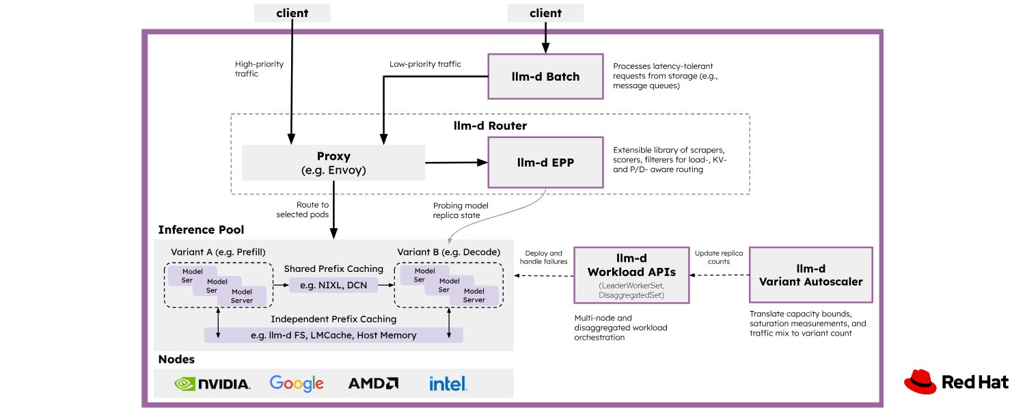
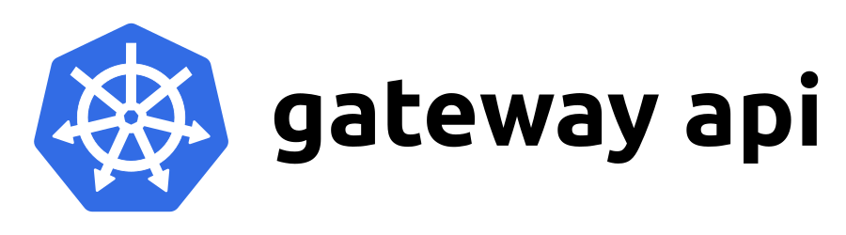

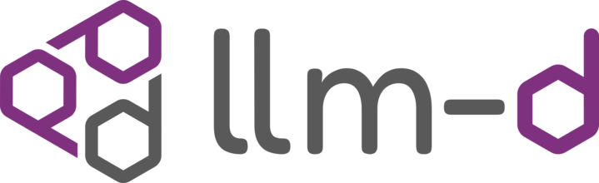

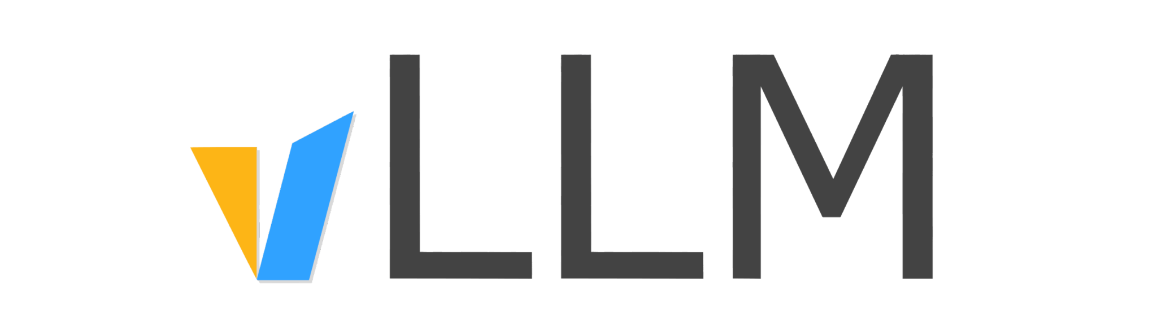
llm-d: composable distributed inference
Reuse the serving stack; add Kubernetes-native coordination
Operate
Compose
Deploy
Modular components
Kubernetes integration
Clear failure boundaries
Gateway integration
Extensible routing
Runtime and KV interfaces
Tested reference paths
Explicit trade-offs
Workload-specific tuning
llm-d composes gateways, runtimes and transport; it does not replace them all.
Cloud Native AI + Inference Day North America 2026 / KAITO + llm-d
19 / 49
Notes:
Speaker script
llm-d composes existing inference components rather than replacing the runtime, gateway, or storage system. Its architecture emphasizes modular Kubernetes integration, extensible implementations, and well-lit paths. A well-lit path gives a platform team a tested deployment pattern and makes its trade-offs easier to understand. That is valuable because distributed inference has many compatibility boundaries. A documented path reduces integration guesswork, but teams still need to validate its versions, hardware requirements, and production behavior for their own environment.

Slide 20
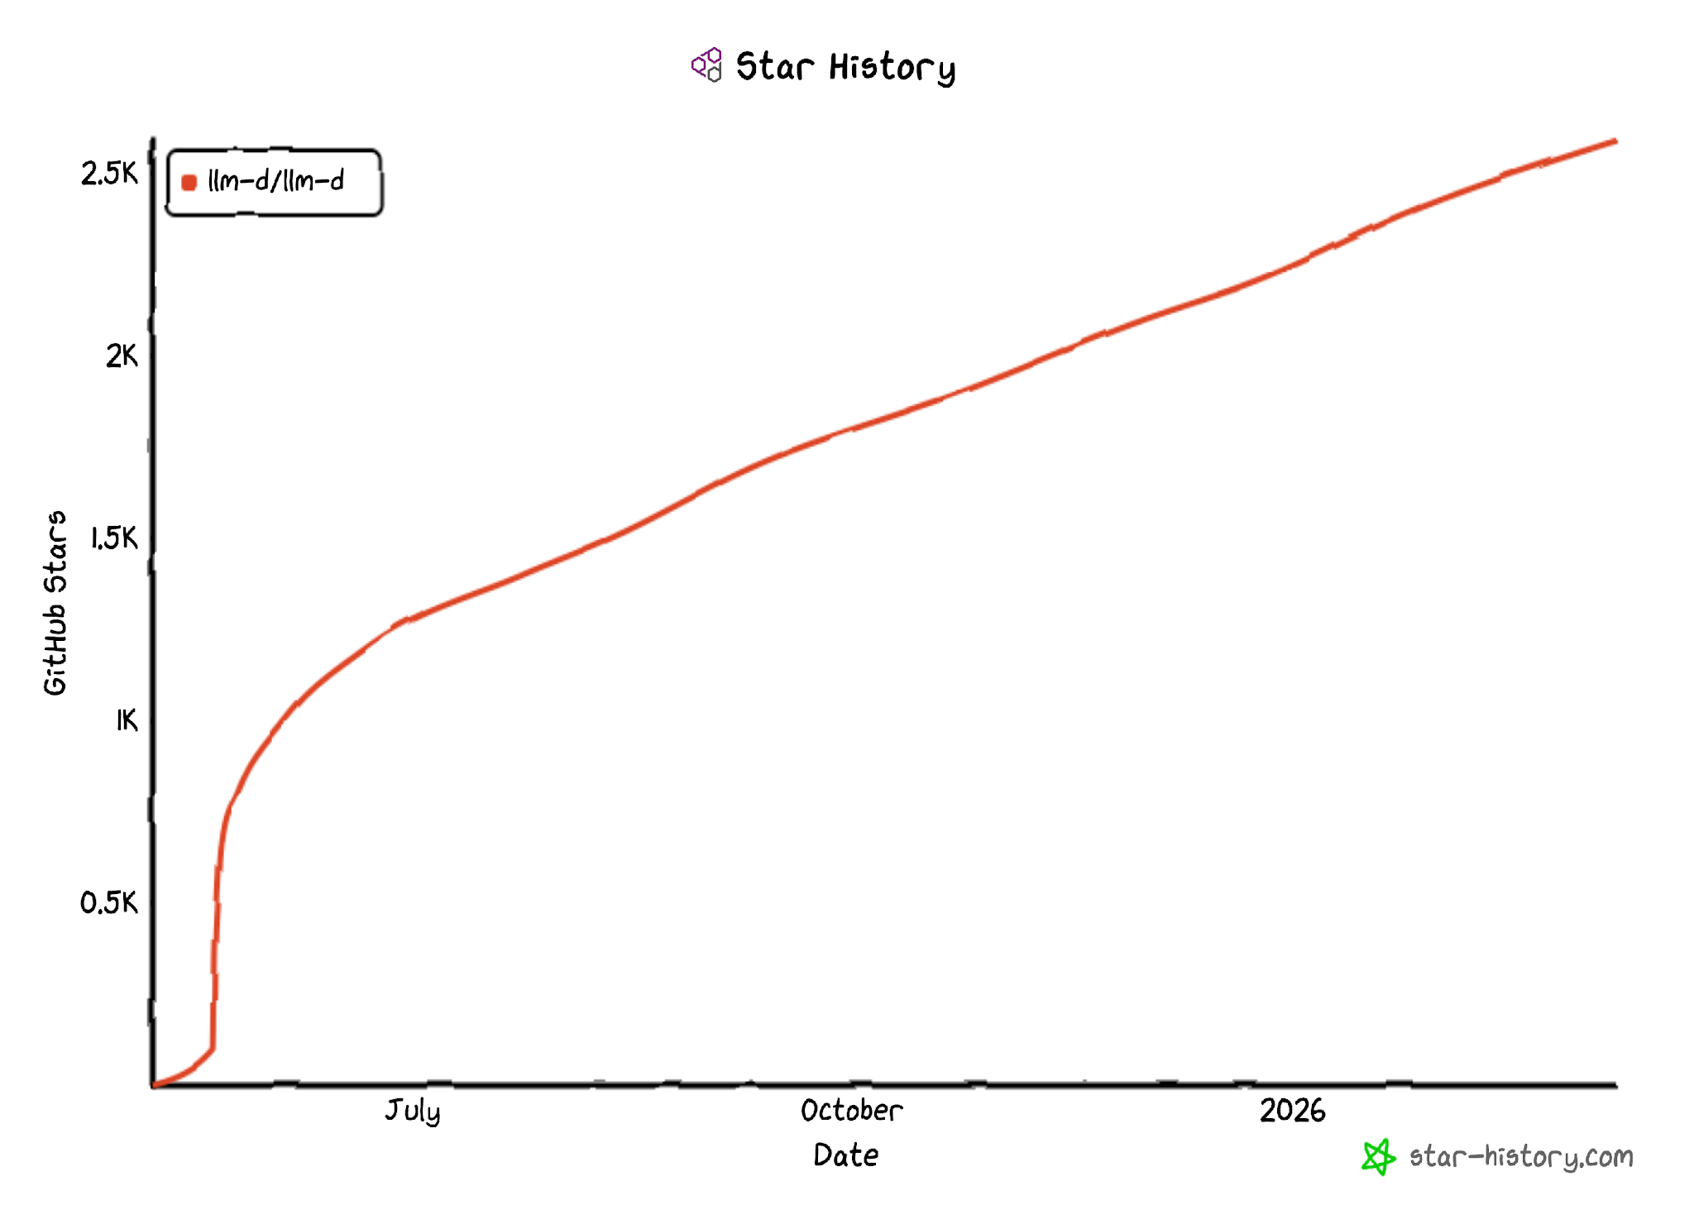











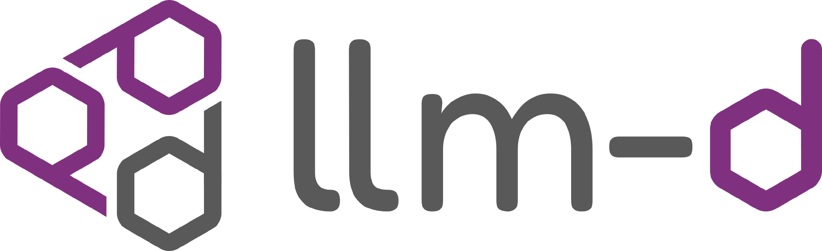

llm-d capabilities relevant to this talk
Architecture building blocks—not benchmark guarantees
Distributed execution
Prefill/decode separation
Expert parallelism and communication strategies for large models.
Different placement, batching and capacity choices for each phase.
State-aware scheduling
Capacity control
Route with cache locality and runtime load in mind.
Use workload signals and latency objectives to guide scaling.
Results depend on model, hardware, traffic and SLOs. Validate your own workload.
Cloud Native AI + Inference Day North America 2026 / KAITO + llm-d
20 / 49
Notes:
Speaker script
The useful story here is the set of capabilities the community is developing, not a leaderboard. These include distributed mixture-of-experts serving, prefill/decode disaggregation, state-aware scheduling, and approaches to predictive autoscaling. Mixture-of-experts models activate selected expert networks for each token, creating their own communication and placement challenges. Each capability addresses a different bottleneck. We are not attaching universal speedups or adoption claims to them; performance and operational readiness must be evaluated against a specific configuration and workload.

Slide 21
llm-d “well-lit paths”
Tested deployment patterns that make important trade-offs explicit
Intelligent scheduling
KV cache management
Where should this request run?
Where should reusable state live?
Wide expert parallelism
P/D disaggregation
How should a large MoE model execute?
How should prompt and generation capacity differ?
Cloud Native AI + Inference Day North America 2026 / KAITO + llm-d
21 / 49
Notes:
Speaker script
These four paths give us a way to organize the design space. Intelligent scheduling decides where a request should run. KV cache management decides where reusable attention state lives. Wide expert parallelism distributes experts across devices for mixture-of-experts execution. Prefill/decode disaggregation gives prompt processing and token generation separate resource configurations. They can complement one another, but they are not interchangeable optimizations. Our detailed walkthrough focuses on the last path and the routing and state-transfer contracts that make it work.

Slide 22
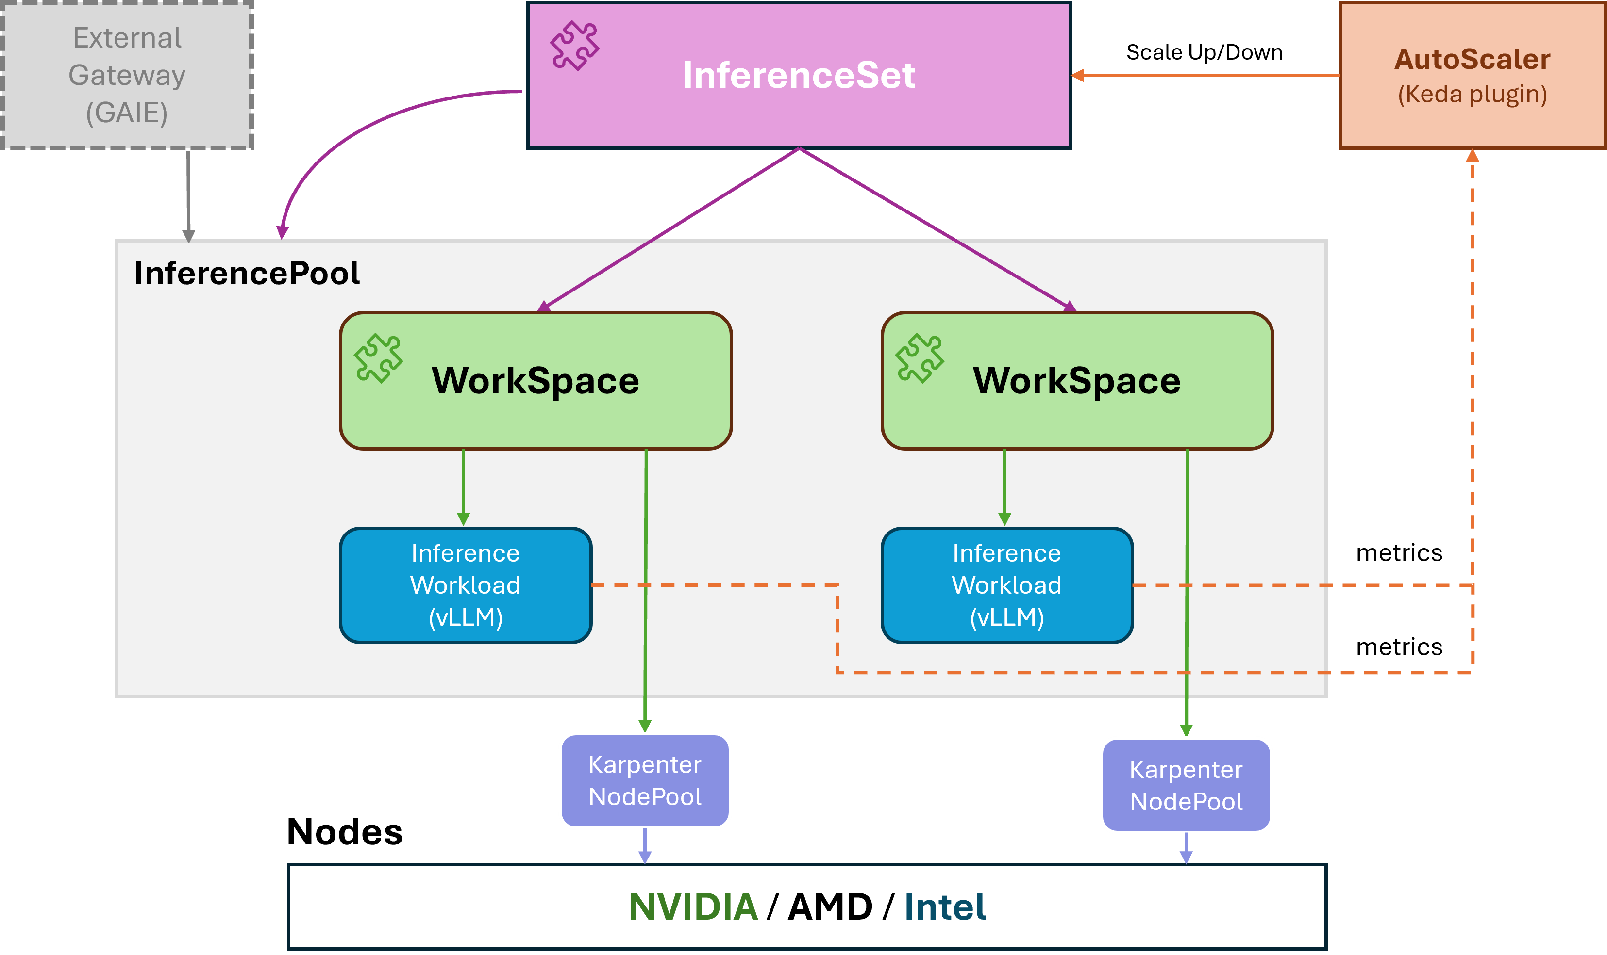
What is KAITO?
An operator suite that automates LLM inference, fine-tuning & RAG on Kubernetes.
Model and GPU selection
Node provisioning from model memory needs
Model onboarding and local caching
InferenceSet lifecycle and rolling upgrades
KEDA-based workload scaling
Cloud Native AI + Inference Day North America 2026 / KAITO + llm-d
22 / 49
Notes:
Speaker script
KAITO is a Kubernetes operator suite for model inference, fine-tuning, and retrieval-augmented generation. It aims to reduce the work of onboarding a model and managing its serving lifecycle. Depending on the supported configuration, that includes GPU provisioning, model distribution, InferenceSet reconciliation, and integration with autoscaling. The model and GPU instance type are important inputs, but platform prerequisites and workload-specific settings still matter. Think of KAITO as automation around the model service, not a guarantee that every model or cluster needs no configuration.

Slide 23
KAITO workload example
Declare a model, GPU instance type and replica count
apiVersion: kaito.sh/v1beta1
kind: InferenceSet
metadata:
name: qwen3-coder-30b
spec:
replicas: 3
labelSelector:
matchLabels:
app: qwen3-coder-30b
template:
resource:
instanceType: Standard_NC24ads_A100_v4 # <- GPU SKU
inference:
preset:
name: Qwen/Qwen3-Coder-30B-A3B-Instruct # model
Cloud Native AI + Inference Day North America 2026 / KAITO + llm-d
23 / 49
Notes:
Speaker script
This InferenceSet example uses the name qwen3-coder-30b to match the Qwen3-Coder-30B model being requested. The preset identifies the model, the instance type identifies the GPU virtual machine, and replicas requests three serving copies. KAITO reconciles the workload from that intent. This excerpt does not enable Model Mirror or demonstrate an upgrade policy, so we should not infer either capability from it. Before deployment, validate model support, the installed API schema, GPU availability, and the resulting memory requirements.

Slide 24
How KAITO estimates GPU node count
Model size, context length and GPU memory determine the initial capacity
1 Memory budget
2 GPU count
3 Node count
Start with GPU memory.
Reserve runtime overhead
and space for KV cache.
Fit model weights into
the usable memory.
Account for parallelism.
Map required GPUs to
GPUs per node.
Reconcile the workload.
The sizing formula and safety margins depend on the KAITO and runtime version.
Cloud Native AI + Inference Day North America 2026 / KAITO + llm-d
24 / 49
Notes:
Speaker script
KAITO estimates the initial capacity from the model and the selected GPU instance type. Start with GPU memory, reserve space for runtime overhead and KV state, then estimate how many GPUs can hold the weights. Map those GPUs to nodes and check the supported parallelism. This is a starting point, not a production capacity guarantee. Context length, precision, concurrency, and the installed KAITO and runtime versions all matter. Verify the computed node count and load-test before relying on the estimate.

Slide 25
KAITO + llm-d: one service, two roles
Declare the topology once; separate orchestration from execution
KAITO
One declarative topology
MultiRoleInference and lifecycle
One model and endpoint
Independent prefill and decode roles
Role-specific placement and replicas
Gateway integration
InferencePool contract
llm-d
Endpoint selection and sidecar
vLLM + NIXL
Execution and direct KV transfer
Declare topology → select workers → coordinate the request → transfer KV directly.
Cloud Native AI + Inference Day North America 2026 / KAITO + llm-d
25 / 49
Notes:
Speaker script
Now we can combine the pieces into one serving topology. KAITO's MultiRoleInference declares the roles and manages their lifecycle. The Gateway API Inference Extension, or GWIE, provides the InferencePool contract. The llm-d router supplies endpoint selection and request orchestration, while vLLM and NIXL execute the phases and move KV state. This is a responsibility stack, not a network packet path. The client sees one serving endpoint even though the platform manages two specialized roles.

Slide 26
ROUTING / KAITO + llm-d
llm-d Router brings role-aware decisions
The Endpoint Picker selects workers; the serving path executes the decision.
pick request
decision
Gateway
GWIE integration
llm-d Router EPP
Endpoint selection + plugin chain
Selected workers
Decode + optional prefill
01
Select by role
02
Compose plugins
03
Extend scheduling
Model-aware selection
across prefill and decode.
KV-cache-aware logic
and P/D-aware scheduling.
A plugin surface for
future scheduling policy.
KAITO builds on llm-d’s routing intelligence — it does not invent a second routing engine.
Cloud Native AI + Inference Day North America 2026 / KAITO + llm-d
26 / 49
Notes:
Speaker script
The Endpoint Picker makes a routing decision; it is not the proxy carrying the inference payload. The gateway asks it to select appropriate workers, which can include a decode worker and, when needed, a prefill worker. A plugin chain provides the scheduling extension points, including role-aware and cache-aware logic where configured. KAITO builds on that llm-d routing implementation instead of creating a second engine. The extension surface does not mean every possible scheduling policy is implemented or enabled by default.

Slide 27
RESPONSIBILITIES / KAITO + llm-d
Three layers. Three clear responsibilities.
The InferencePool contract connects platform orchestration to routing.
KAITO
MultiRoleInference → role topology
Declare + reconcile
Resource generation • ownership • lifecycle
GWIE
InferencePool + gateway integration
Define the contract
Kubernetes API surface • backend discovery
llm-d Router
EPP + P/D-aware scheduling
Select endpoints
Endpoint picking • role-aware routing decisions
KAITO owns the topology. GWIE defines the contract. llm-d Router makes the selection.
Cloud Native AI + Inference Day North America 2026 / KAITO + llm-d
27 / 49
Notes:
Speaker script
Keep the API contract separate from its implementation. KAITO declares and reconciles the role topology. The Gateway API Inference Extension defines Kubernetes objects and gateway integration, including InferencePool. The llm-d router implements endpoint selection and prefill/decode-aware decisions. An InferencePool is not an inline traffic proxy, and this integration does not imply use of a reference Endpoint Picker implementation. These ownership boundaries help us understand which component to inspect when deployment, discovery, or routing goes wrong.

Slide 28
ARCHITECTURE / KAITO + llm-d
One endpoint, three separate paths
Read the serving path left to right; endpoint selection is an out-of-band decision.
Control plane
MultiRoleInference
KAITO controller
Child InferenceSets + InferencePool + wiring
Prefill inferenceset
llm-d Router EPP
Prefill vLLM
Direct KV data • NIXL
endpoint selection
via InferencePool
optional prefill
request
Decode inferenceset / selected decode pod
Client
Gateway
Routing sidecar
local proxy
Decode vLLM
Control / selection
Request / local proxy
KV data (separate path)
The client sees one endpoint; KV data never needs to pass through the gateway.
Cloud Native AI + Inference Day North America 2026 / KAITO + llm-d
28 / 49
Notes:
Speaker script
There are three paths here. The upper control plane reconciles resources; it does not carry requests. The gateway consults the Endpoint Picker, then sends the inference request to the selected decode pod's routing sidecar. That sidecar coordinates optional remote prefill and local decode. KV data takes a separate, direct path between runtimes, with decode initiating the read. InferenceSets are managed resources, not network hops. We will trace the response path in the request lifecycle on slide 31.
Technical reference (not part of the spoken script)
The upper band is resource ownership, not traffic. The gateway consults the llm-d Router EPP through the InferencePool integration and forwards to the selected decode sidecar, carrying the selected prefill worker when applicable. The sidecar invokes remote prefill and local decode. The green arrow denotes the direction of KV data (prefill to decode); the decode runtime initiates the read. Response arrows are omitted for clarity and shown on slide 31. InferenceSets are managed resources, not network hops.

Slide 29
DECLARATIVE API / KAITO + llm-d
One MultiRoleInference defines the topology
One model, distinct instance types: 1 A100 prefill replica + 2 H100 decode replicas.
qwen-3-8-27b
Qwen/Qwen3.8-27B
MultiRoleInference / model + role placement
apiVersion: kaito.sh/v1alpha1
kind: MultiRoleInference
metadata:
name: qwen-3-8-27b
spec:
model:
name: Qwen/Qwen3.8-27B
roles:
- type: prefill
replicas: 1
instanceType: Standard_NC24ads_A100_v4
- type: decode
replicas: 2
instanceType: Standard_NC80adis_H100_v5
One logical service / InferencePool
reconcile
Prefill role
Decode role
replicas: 1
replicas: 2
A100 / replica 1
H100 / replica 1
H100 / replica 2
Standard_NC24ads_A100_v4
Standard_NC80adis_H100_v5
Same model, independent role placement — A100 for prefill; H100 for decode.
Cloud Native AI + Inference Day North America 2026 / KAITO + llm-d
29 / 49
Notes:
Speaker script
This example declares one logical model service with one prefill replica and two decode replicas, using different GPU instance types. Each role is managed through its own InferenceSet. The important feature is independent role placement, not a recommended one-to-two ratio or hardware pairing. The cards represent serving replicas, not GPU counts inside each virtual machine. Model identifiers, instance availability, quota, the installed schema, and cross-role runtime and transfer compatibility still need validation before this becomes a deployable configuration.
Technical reference (not part of the spoken script)
User-supplied example: kaito.sh/v1alpha1 MultiRoleInference named qwen-3-8-27b, model Qwen/Qwen3.8-27B. The prefill role has replicas: 1 and instanceType: Standard_NC24ads_A100_v4; the decode role has replicas: 2 and instanceType: Standard_NC80adis_H100_v5. The diagram shows role replicas, not the number of GPUs in each VM. Model and SKU identifiers are reproduced as provided; model availability, installed CRD schema, deployment prerequisites, quota and regional SKU support have not been validated by this presentation edit. Replica cards are illustrative workers; each role is managed through its own InferenceSet.

Slide 30
RECONCILIATION / KAITO + llm-d
KAITO generates resources and keeps them aligned
A declarative topology becomes owned resources, runtime wiring and a shared routing contract.
MultiRoleInference
KAITO reconciles + owns
Prefill InferenceSet
Role-specific workers
Decode InferenceSet
Role-specific workers
Routing resources
InferencePool + llm-d EPP
Role labels
NIXL host / Pod IP
Routing sidecar injection
NIXL + local vLLM ports
Services + targetPorts
Endpoint selection config
Shared invariants: ownership references • role consistency • labels • ports • lifecycle
Not just generated YAML: controller-owned relationships and consistent runtime contracts.
Cloud Native AI + Inference Day North America 2026 / KAITO + llm-d
30 / 49
Notes:
Speaker script
Reconciliation turns the declared topology into serving resources and keeps their contracts aligned. That includes role-specific InferenceSets, routing resources, labels, sidecar injection, transfer addresses, and matching ports. The diagram is a responsibility map: some resources can be managed through child controllers rather than being direct children of MultiRoleInference. The value is not merely producing YAML once. It is maintaining relationships through updates and failures. Automatic per-role scaling policy remains a separate integration concern, not something this resource tree proves is available.
Technical reference (not part of the spoken script)
The dashed tree is a resource and responsibility map, not an exact claim that every depicted object is a direct Kubernetes child of the MultiRoleInference. Ownership and reconciliation can be delegated through child controllers. Distinguish the resources from the wiring installed in their pods. Per-role autoscaling is an integration surface; do not imply every policy is provided automatically.

Slide 31
REQUEST LIFECYCLE / KAITO + llm-d
The decode sidecar coordinates the P/D request
Remote prefill when needed; local decode on the selected worker.
Client
Gateway
Decode sidecar
Prefill vLLM
Decode vLLM
1 Inference request
2 Route to decode sidecar
+ selected prefill header
3 Remote prefill
max_tokens=1
4 Remote KV parameters
Run prefill
5 Local decode · remote_prefill=true + IDs
6 KV data → decode
NIXL read by decode
7 Inference response
Run decode
8 Response
9 Final response
The sidecar coordinates the request; KV data moves directly between the two runtimes.
Cloud Native AI + Inference Day North America 2026 / KAITO + llm-d
31 / 49
Notes:
Speaker script
After endpoint selection, the gateway forwards to the decode sidecar with the selected prefill information. The sidecar invokes remote prefill, then receives transfer metadata rather than the KV payload itself. It passes that metadata and remote-prefill identifiers to local decode. The decode runtime initiates a NIXL read, moving KV data from prefill to decode, and generation continues. The response returns through the sidecar and gateway. Endpoint selection is omitted from this sequence because we covered it in the architecture diagram on slide 28.
Technical reference (not part of the spoken script)
Based on llm-d-router docs/disaggregation.md#pd-sequence. Step 2 follows EPP selection; the EPP consultation is omitted from this sequence and shown on slide 28. Step 4 returns transfer metadata, not the KV payload. Step 5 carries remote_prefill=true, prefill request ID and memory block IDs to local decode. Step 6 shows KV DATA direction (prefill → decode); decode initiates the NIXL read. Response arrows return via sidecar and gateway. Source: https://github.com/llm-d/llm-d-router/blob/main/docs/disaggregation.md#pd-sequence
References
https://github.com/llm-d/llm-d-router/blob/main/docs/disaggregation.md#pd-sequence

Slide 32
POD BOUNDARY / KAITO + llm-d
Why the sidecar belongs on the decode pod
A single decode endpoint coordinates remote prefill and returns the final response.
Stable external
routing contract
Selected decode pod
Gateway
EPP-selected endpoint
Routing sidecar
Port 5000
local request
+ KV metadata
Local decode vLLM
Port 5001
optional prefill request
Remote prefill
vLLM worker
Direct KV data • bypasses sidecar
Coordination lives in the sidecar. KV transport terminates at the decode runtime.
Cloud Native AI + Inference Day North America 2026 / KAITO + llm-d
32 / 49
Notes:
Speaker script
Putting the sidecar on the decode pod gives the gateway one endpoint for coordination and response delivery. The sidecar can call a remote prefill worker, then send the local decode runtime the metadata it needs. The KV payload bypasses the HTTP sidecar and terminates at the runtime. Ports 5000 and 5001 are this configuration's choices, not universal llm-d requirements. What must remain consistent is the InferencePool target port, the sidecar listener, and the local runtime endpoint.
Technical reference (not part of the spoken script)
Ports 5000 and 5001 reflect this deployment configuration, not universal requirements for every llm-d deployment. The InferencePool targetPort must reach the sidecar’s listening port. The sidecar coordinates remote prefill, passes transfer metadata to local vLLM, and proxies the final response. KV payload does not transit through the HTTP sidecar. The decode runtime performs the KV read over NIXL.

Slide 33
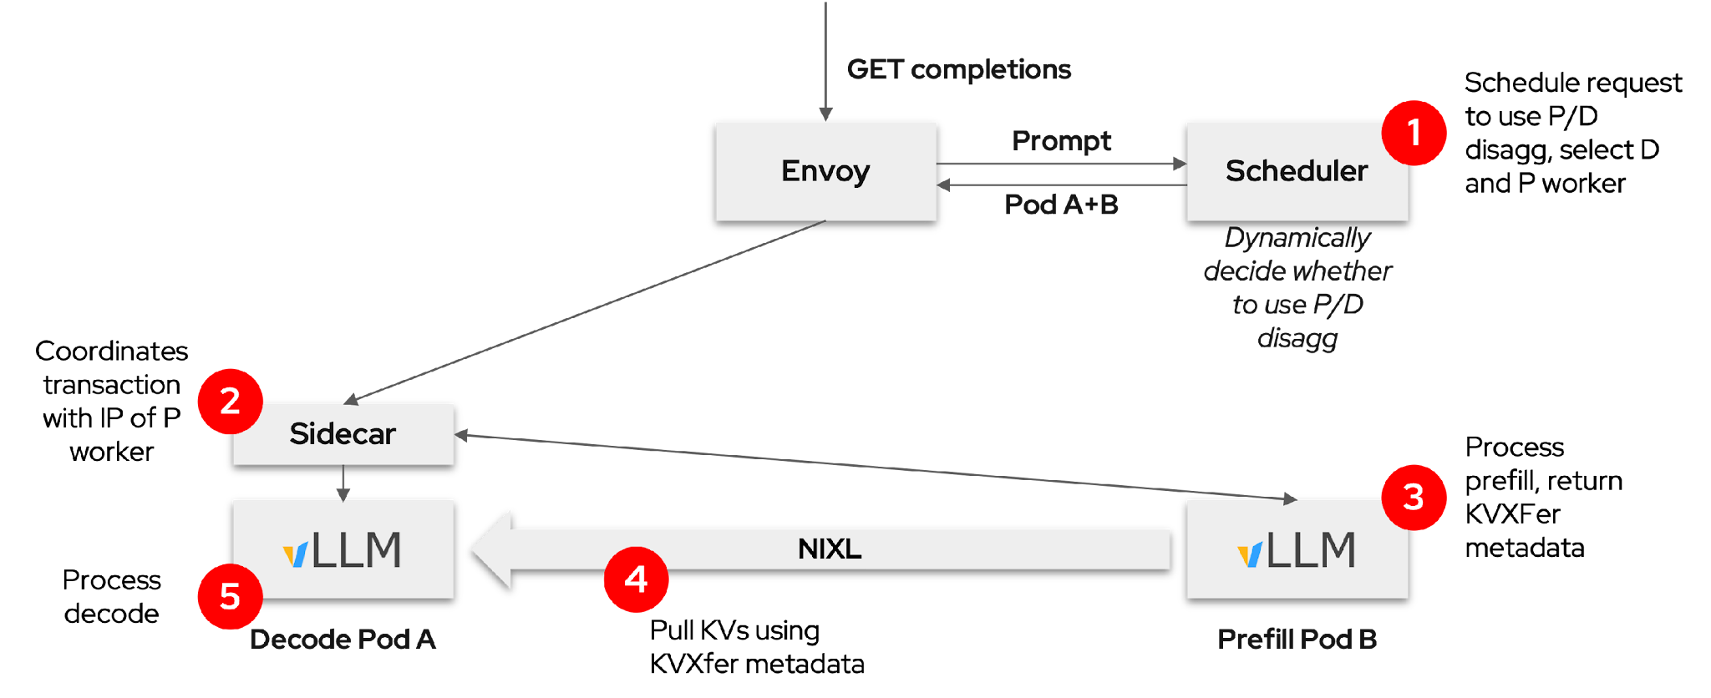
llm-d connects routing, prefill and decode
Separate requests for the prefill and decode stages
Dynamically decided
Dedicated Prefill and Decode nodes
Optimize resource allocation, utilization, and scheduling
Easier to meet TTFT and ITL SLO requirements
Cloud Native AI + Inference Day North America 2026 / KAITO + llm-d
33 / 49
Notes:
Speaker script
Stepping back, llm-d composes the gateway and runtime into a coordinated disaggregated flow. Scheduling can select a separate prefill worker when the configured policy calls for one. The sidecar orchestrates the requests, while the runtimes handle the KV data path. Separate pools make independent resource allocation possible, but they do not automatically provide an autoscaling policy or guarantee better latency. We still need to choose routing behavior, capacity, and transfer configuration against the service's first-token and token-delivery objectives.

Slide 34
Efficient KV transfer with vLLM and NIXL
KV data moves between runtimes—not through the gateway or routing sidecar
Prefill worker
Decode worker
KV data →
Prompt KV state
Source GPU memory
Reuse received KV
Continue generation
NIXL + transport backend
Decode may initiate the read
GPU-direct RDMA requires a supported GPU, NIC, fabric and backend.
A TCP path is not RDMA. Measure transfer latency and staging cost on your deployment.
Cloud Native AI + Inference Day North America 2026 / KAITO + llm-d
34 / 49
Notes:
Speaker script
Efficient transfer is essential to making the split worthwhile. Through NIXL, vLLM can use GPU-direct remote direct memory access, or RDMA, on supported hardware and backends, potentially avoiding host staging. The Unified Communication X framework, or UCX, can provide transport over different networks. InfiniBand and RDMA over Converged Ethernet, or RoCE, can support RDMA paths; TCP is a different transport, not RDMA. The takeaway is reduced copying and staging where supported, never literally zero overhead. Measure the actual deployment's transfer behavior.

Slide 35
04 / Per-role autoscaling
Autoscale the role that is actually saturated
Different bottlenecks deserve different signals and scale decisions.
Prefill
Decode
Protect prompt latency
and time to first token.
Protect token delivery
and sustained throughput.
Primary signal: vLLM waiting requests
Primary signal: vLLM running requests
Independent scaling only helps when the metrics match each role.
Cloud Native AI + Inference Day North America 2026 / KAITO + llm-d
35 / 49
Notes:
Speaker script
Once the roles are separate, scale the role that is actually under pressure. Waiting requests inside the prefill engine are a useful starting signal for prompt pressure. Running requests on decode are a useful starting signal for active generation load. These are control-pattern recommendations, not an automatically available MRI feature. Verify the metrics on your runtime and aggregate them by role. Latency and KV utilization add context, but any signal used to control capacity needs validated semantics and a safety policy.
References
https://github.com/andyzhangx/demo/blob/26c3e14a340d4b0aae5c820b43087d71b85d1554/llm/kaito-llm-d/kaito-role-aware-autoscaling-for-pd.md
https://kaito-project.github.io/kaito/docs/keda-autoscaler-inference

Slide 36
04 / Existing capability
Today: KEDA targets the InferenceSet scale API
Documented KAITO examples cover both scheduled and metric-based scaling.
Documented today
Trigger
KEDA / HPA
InferenceSet
Cron or Prometheus query
ScaledObject target
Scale subresource
Documented queue signal
vllm:num_requests_waiting
The scale target is the InferenceSet—not a manually scaled workload Pod.
Cloud Native AI + Inference Day North America 2026 / KAITO + llm-d
36 / 49
Notes:
Speaker script
There is already a documented foundation: Kubernetes Event-driven Autoscaling, or KEDA, can target an InferenceSet through its scale API. KAITO examples use scheduled triggers or Prometheus queries, including the vLLM waiting-request metric. KEDA works with the Horizontal Pod Autoscaler, or HPA, and the InferenceSet controller reconciles the desired serving capacity. KEDA is installed separately. This existing capability is important, but it does not by itself establish a native MultiRoleInference policy that automatically manages both roles.
Technical reference (not part of the spoken script)
KEDA is installed separately. The KAITO documentation shows Cron and Prometheus triggers with a ScaledObject scaleTargetRef pointing to a kaito.sh InferenceSet. The controller reconciles the desired replicas into serving resources. The queue metric example is real; it does not establish native per-role MRI autoscaling policy.
References
https://kaito-project.github.io/kaito/docs/keda-autoscaler-inference

Slide 37
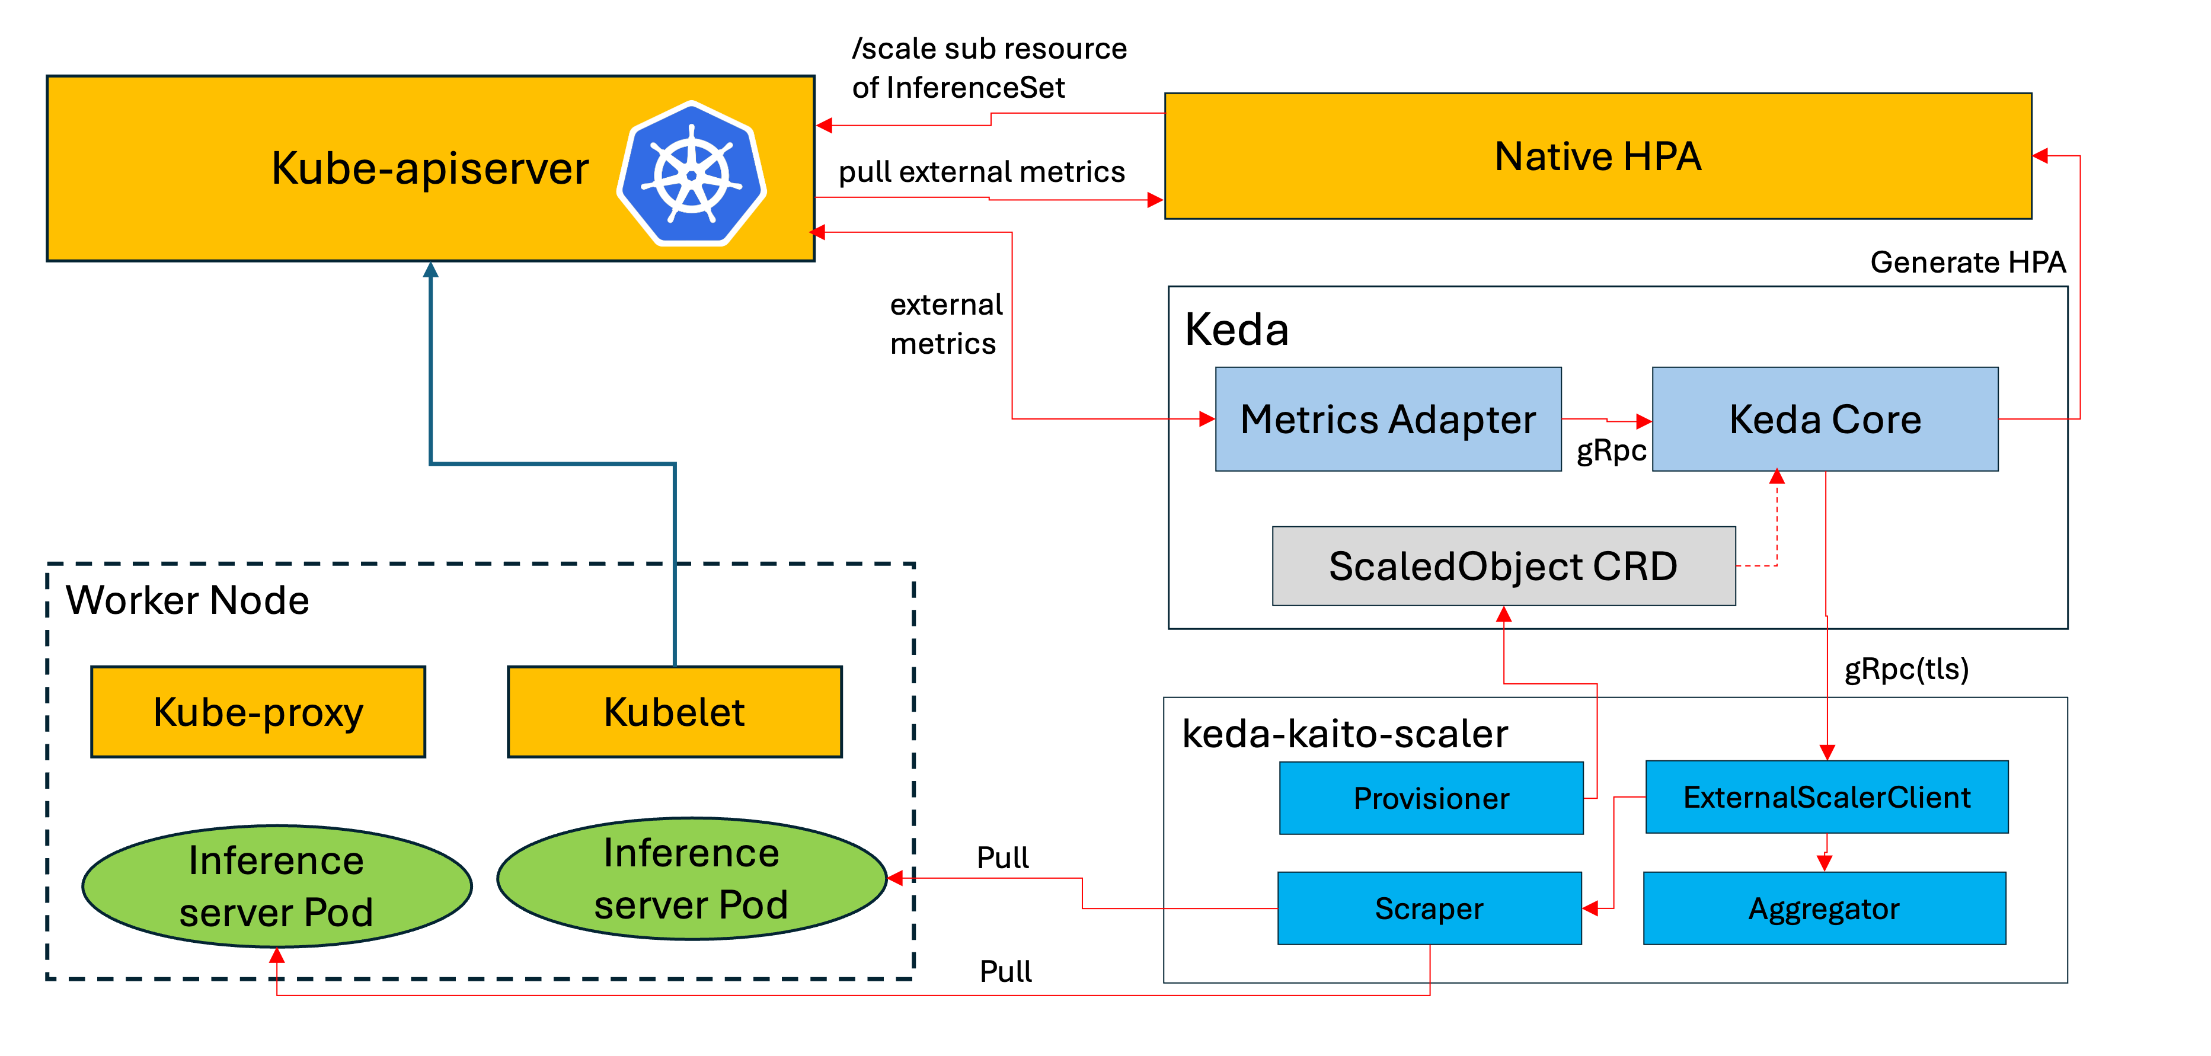
KAITO autoscaling: keda-kaito-scaler
KEDA-driven scaling with metrics scraped directly from vLLM
What it adds
No Prometheus required
Direct vLLM metric scraping
Conservative replica steps
Queue and latency signals
Configurable AND policy
Cloud Native AI + Inference Day North America 2026 / KAITO + llm-d
37 / 49
Notes:
Speaker script
The keda-kaito-scaler approach reads vLLM metrics directly, avoiding a Prometheus requirement for that path. It still depends on KEDA, the scaler, runtime endpoints, and their configuration, so no Prometheus does not mean no dependencies. The design uses conservative replica changes and can combine signals under an AND policy. Those choices can reduce abrupt reactions, but they do not guarantee GPU safety or minimum cost. Model warm-up, metric validity, ownership, and safe scale-down remain essential parts of the deployment.

Slide 38
KAITO autoscaling configuration
Today: explicit tuning. Future direction: fewer knobs.
Available configuration
Proposed simplification
Select queue and latency metrics
Set thresholds and aggregation windows
Choose replica bounds and cooldowns
Combine signals with an AND policy
Keep minimum and maximum replicas
Derive more defaults automatically
Validate against the model and workload
Not a shipped auto-tuning guarantee
Annotations express intent; controllers still create and manage scaling resources.
Cloud Native AI + Inference Day North America 2026 / KAITO + llm-d
38 / 49
Notes:
Speaker script
The annotations provide a compact way to configure the scaler, including metrics, thresholds, evaluation windows, cooldowns, and replica bounds. They do not eliminate Kubernetes objects: auto-provisioning creates the scaling objects on the user's behalf. With an AND policy, all configured signals must satisfy the relevant condition, which needs careful workload testing. The proposed simplification on the right would reduce manual tuning; it is not a shipped auto-tuning guarantee. Today, treat thresholds and timing values as explicit choices to validate, rather than assuming universal best-practice defaults.
Configuration reference (from the original deck; validate against the installed scaler version)

Slide 39
04 / Per-role autoscaling
Two independent control loops, one logical service
Conceptual design: validate signals and thresholds for the actual workload.
Prefill
Waiting requests
KEDA / HPA
Prefill InferenceSet
Observe
Decide
Reconcile replicas
Decode
Running requests
KEDA / HPA
Decode InferenceSet
Observe
Decide
Reconcile replicas
Add stabilization, warm-up awareness, and safe scale-down behavior to each loop.
Cloud Native AI + Inference Day North America 2026 / KAITO + llm-d
39 / 49
Notes:
Speaker script
The proposed control pattern has two independent loops behind one logical service. Prefill observes waiting requests and changes prefill serving capacity. Decode observes running requests and changes decode capacity. One KEDA ScaledObject per target InferenceSet is a possible implementation, but avoid competing autoscalers on the same target. Each loop needs stabilization, model warm-up awareness, fresh and correctly aggregated metrics, and safe scale-down. Independence means one role can act without requiring the other role to be equally busy.
Technical reference (not part of the spoken script)
Conceptual two-loop design. A KEDA deployment can use one ScaledObject per target InferenceSet. Native vLLM waiting and running request gauges supply role-specific signals. Do not install conflicting autoscalers for one target. Metric aggregation, freshness, model warm-up and safe scale-down require verification. The following slides explain policy and signal choices independently of the configuration API.
References
https://github.com/andyzhangx/demo/blob/26c3e14a340d4b0aae5c820b43087d71b85d1554/llm/kaito-llm-d/kaito-role-aware-autoscaling-for-pd.md
https://kaito-project.github.io/kaito/docs/keda-autoscaler-inference

Slide 40
04 / Policy boundary
One service, independently managed role capacity
Coordinate P/D at the service level; make capacity decisions separately for each role.
Design pattern / per-role control
Prefill scale target
Service-level intent
Policy reconciliation
Generated policy + target
Prefill: latency objective
Decode: delivery objective
Independent role targets
Decode scale target
Generated policy + target
Scale a complete serving replica—not an individual tensor-parallel worker.
Cloud Native AI + Inference Day North America 2026 / KAITO + llm-d
40 / 49
Notes:
Speaker script
Service objectives should coordinate the overall experience without forcing both roles to share a capacity decision. Prefill has a prompt-latency objective; decode has a token-delivery objective. A policy layer can translate those into separate role targets. This is a design pattern, not a claim that automatic service-level policy projection is already available. The scaling unit must be a complete serving replica, potentially spanning multiple workers, rather than an individual tensor-parallel process. Each target should have one authoritative replica controller.
Technical reference (not part of the spoken script)
Public-facing design pattern: express service objectives, reconcile independent role policies, and scale each role as a complete serving replica. Policy representation and controller-specific wiring are implementation details and intentionally omitted here. Existing KEDA/InferenceSet capability is described on the earlier slide; this diagram is not a claim that automatic service-level policy projection is already available. Keep one authoritative autoscaler per target.
References
https://github.com/andyzhangx/demo/blob/26c3e14a340d4b0aae5c820b43087d71b85d1554/llm/kaito-llm-d/kaito-role-aware-autoscaling-for-pd.md
https://kaito-project.github.io/kaito/docs/keda-autoscaler-inference

Slide 41
04 / Control-loop design
Observe each role. Act on its own capacity.
Independent feedback loops connect role-specific load to role-specific serving capacity.
Role-specific policies
Independent decisions
Serving capacity
Signals, thresholds and bounds
One controller per target
Count model-ready replicas
Prefill vLLM /metrics
Prefill autoscaler
Prefill replicas
Waiting requests
Evaluate this role independently
Reconcile serving capacity
Decode vLLM /metrics
Decode autoscaler
Decode replicas
Running requests
Evaluate this role independently
Reconcile serving capacity
Routing chooses where requests go; autoscaling changes how much capacity is available.
Cloud Native AI + Inference Day North America 2026 / KAITO + llm-d
41 / 49
Notes:
Speaker script
Routing and autoscaling solve different problems. Routing chooses where the next request goes; autoscaling changes how much serving capacity exists. In each loop, scope the metric samples to the correct role, remove duplicate engine or worker series, and evaluate that role's policy independently. New replicas should count as capacity only when the model is loaded and eligible to serve. The arrows describe policy and measurement relationships, not a requirement for push-based metrics or a particular Kubernetes ownership tree.
Technical reference (not part of the spoken script)
Architectural control pattern, independent of how policies are encoded. Each role has its own signals, controller decision and serving-replica target. KEDA/HPA targeting an InferenceSet is one implementation. Scope samples to the actual role and deduplicate engine/worker series. Scale complete serving replicas and account for model loading before counting new capacity as ready. Arrows show conceptual policy and metric flow, not strict ownership references or push-based scraping. The serving topology still coordinates P/D requests while the capacity loops act independently. Implementation-specific automatic policy projection is outside this talk slide.
References
https://github.com/andyzhangx/demo/blob/26c3e14a340d4b0aae5c820b43087d71b85d1554/llm/kaito-llm-d/kaito-role-aware-autoscaling-for-pd.md
https://kaito-project.github.io/kaito/docs/keda-autoscaler-inference

Slide 42
04 / Vllm-native metrics
Two native gauges, two scaling decisions
Use per-replica role aggregation; tune thresholds against the deployed model and workload.
Prefill
Decode
vllm:num_requests_waiting
vllm:num_requests_running
Queue inside the prefill engine.
Protect prompt admission latency.
Requests in decode execution batches.
Protect token delivery under load.
< 1
Between
> 8
< 4
Between
> 24
Scale down
Hold
Scale up
Scale down
Hold
Scale up
Example bounds: 1–8 role replicas
Example bounds: 2–16 role replicas
Illustrative thresholds only. Verify actual /metrics output before enabling either policy.
Cloud Native AI + Inference Day North America 2026 / KAITO + llm-d
42 / 49
Notes:
Speaker script
The example uses two native gauges: waiting requests for prefill and running requests for decode. The thresholds and replica bounds are illustrative, not production recommendations. Aggregate them per serving replica within the role, and remember that an engine-local queue excludes requests still waiting upstream. Strictly above or below a threshold requests a change; equality and the middle range hold. Missing, stale, or invalid samples must not become zero. Validate that hold-and-report behavior in the actual controller before enabling the policy.
Technical reference (not part of the spoken script)
Native vllm:num_requests_waiting and vllm:num_requests_running are the primary signals for the respective roles. Verify metric presence, type and units on the actual runtime. Engine-local queues exclude requests still waiting in the router/EPP. Thresholds and bounds are illustrative, not capacity recommendations. The design example uses bounded incremental adjustments; behavior still depends on readiness, stabilization, cooldown and the chosen controller. Equal-to-threshold values hold under the stated strict comparisons. KV utilization and latency support diagnosis; integrating them into automated decisions needs an explicit tested policy. Missing/stale/non-finite data must not become zero; hold/report semantics require implementation and validation.
References
https://github.com/andyzhangx/demo/blob/26c3e14a340d4b0aae5c820b43087d71b85d1554/llm/kaito-llm-d/kaito-role-aware-autoscaling-for-pd.md
https://docs.vllm.ai/en/stable/usage/metrics/

Slide 43
04 / Role-specific decisions
Different roles need different scaling policies
Use the same safety contract, but tune each role against its own workload and objective.
Policy
Prefill
Decode
Primary signal
Waiting requests
Running requests
Example replica range
1–8
2–16
Example scale-up
Signal > 8
Signal > 24
Example scale-down
Signal < 1
Signal < 4
Shared guardrails
Readiness + fresh metrics
Readiness + fresh metrics
Illustrative policy—not universal tuning. Validate thresholds, cooldown and model warm-up.
Cloud Native AI + Inference Day North America 2026 / KAITO + llm-d
43 / 49
Notes:
Speaker script
The two roles share a safety contract, not identical tuning. In this example, prefill has a one-to-eight replica range and reacts to waiting requests. Decode has a two-to-sixteen range and reacts to running requests. These values only illustrate independent decisions. Both policies need fresh role-scoped data, readiness checks, stabilization, cooldowns, and clear ownership. A low signal is not sufficient justification to remove capacity immediately: scale-down must also protect in-flight requests and respect the minimum replica count.
Technical reference (not part of the spoken script)
The slide explains policy semantics without exposing configuration syntax. Values are illustrative and match the source design: waiting-request thresholds 8/1 and bounds 1–8 for prefill; running-request thresholds 24/4 and bounds 2–16 for decode. Evaluate role-scoped per-replica aggregation, not a whole-service sum. Apply strict above/below comparisons, hold between/equal to thresholds, and enforce bounds, fresh-data checks, readiness, stabilization and cooldown for both roles. Scale-down also requires safe treatment of in-flight work. Policy ownership must be unambiguous. The underlying representation is intentionally outside the external presentation.
References
https://github.com/andyzhangx/demo/blob/26c3e14a340d4b0aae5c820b43087d71b85d1554/llm/kaito-llm-d/kaito-role-aware-autoscaling-for-pd.md
https://docs.vllm.ai/en/stable/usage/metrics/

Slide 44
04 / Operational safeguards
Safe autoscaling starts with ownership and valid data
The happy path is small. Correct handoff and failure behavior make it operable.
01 / Replica ownership
02 / Metric availability
03 / Lifecycle
Choose one writer
Verify real signals
Make handoff explicit
One policy owns replica count
Separate targets for P and D
No competing autoscalers
Inspect actual /metrics
Scope samples per role
Missing is not zero
On failure: hold + report
Stop the old writer first
Delete only owned scalers
Allow model warm-up
Test safe scale-down
On missing or invalid signals: hold decisions and report the problem. Missing is not zero.
Avoid competing controllers, count only ready capacity, and protect in-flight requests.
Cloud Native AI + Inference Day North America 2026 / KAITO + llm-d
44 / 49
Notes:
Speaker script
Most autoscaling failures happen outside the happy path. First, choose one writer for each replica count, and stop the old writer before handing over control. Second, verify complete, fresh metric coverage; a failed scrape is not zero load. Third, account for model loading and protect active requests and KV state during removal. Hold and report on invalid data is the required safety contract here, not an assertion that every fallback path already implements it. Test these failures end to end.
Technical reference (not part of the spoken script)
Safety contract: do not let a fixed-replica reconciler and an autoscaler compete for the same target. Stop the old writer before handing over control, and never silently adopt/delete user-managed autoscalers. Missing, stale, unreachable or non-finite metric samples should prevent activation or hold active decisions and surface a condition/event. This is the required behavior, not an assertion that all controller/HPA fallback paths implement it today; verify end to end. Partial scrape coverage must not look like zero load. Readiness includes model loading and actual serving eligibility. Protect in-flight requests and KV state during scale-down.
References
https://github.com/andyzhangx/demo/blob/26c3e14a340d4b0aae5c820b43087d71b85d1554/llm/kaito-llm-d/kaito-role-aware-autoscaling-for-pd.md

Slide 45
04 / Signal interpretation
Derived signals add context to scaling decisions
Aggregate native vLLM metrics to understand KV utilization, latency and throughput.
NATIVE INPUT (vllm: PREFIX)
Derivation
Decision support
kv_cache_usage_perc
max(role samples)
Candidate downscale guard
kv_cache_usage_perc
1 - max(role samples)
Minimum free fraction;
not effective request capacity
time_to_first_token_seconds
(histogram buckets)
P95 over bucket rates
Latency tail; tune prefill policy
generation_tokens_total
sum(rate(counter[5m]))
Output throughput;
observe and benchmark
KV occupancy is not demand. High or low throughput alone should not change replica counts.
Cloud Native AI + Inference Day North America 2026 / KAITO + llm-d
45 / 49
Notes:
Speaker script
Derived signals help explain pressure, but they need careful interpretation. KV usage is a fraction; its maximum and the complementary free fraction are not independent evidence or effective request capacity. A latency percentile requires histogram bucket rates and enough observations, and engine timing is not end-to-end client timing. Throughput counters need reset-aware rates before aggregation. These derived outputs require a query or adapter integration; they are not new native vLLM metrics. Start with observation, and do not let an indiscriminate AND rule suppress needed scale-up.
Technical reference (not part of the spoken script)
These are derived-signal design examples, not metrics natively emitted by vLLM or a claim of current MRI integration support. All table input names have the vllm: prefix. Proposed recording-rule names: kaito:decode_kv_cache_usage_max = max valid role-scoped vllm:kv_cache_usage_perc; kaito:decode_kv_cache_free_fraction_min = 1 - that maximum; kaito:prefill_ttft_p95_seconds = histogram_quantile(0.95, summed per-series 5m bucket rates preserving workload/role and le); kaito:decode_generation_tokens_per_second = sum of reset-aware rate(vllm:generation_tokens_total[5m]). Generation tokens is a native Counter exposed with the _total suffix. KV usage is a fraction 0–1; 0.8 is 80%. Maximum usage and minimum free fraction are complements, not independent evidence, bytes or effective request capacity. A fleet maximum does not identify a safe removal target. Histogram quantiles need sufficient observations and are engine-local, not client P/D latency. Apply rate before summing counters, account for resets, deduplicate engines and require fresh/full role coverage. Recording-rule outputs do not appear on vLLM /metrics; a verified adapter/query integration is required. The desired guard allows high running load to scale up independently of KV occupancy, while low load permits scale-down only with safe KV utilization. Simply appending KV to the existing conservative AND list can suppress needed scale-up and is not this policy. Start with observation; promote a signal to control only after failure and workload tests.
References
https://github.com/andyzhangx/demo/blob/26c3e14a340d4b0aae5c820b43087d71b85d1554/llm/kaito-llm-d/kaito-role-aware-autoscaling-for-pd.md
https://docs.vllm.ai/en/stable/usage/metrics/

Slide 46
Proposed MRI policy: independent role decisions
Illustrative design—not a ready-to-apply API. Full example and schema are in the notes.
Prefill policy
Decode policy
Signal: average waiting requests
Replica range: 1–8
Scale up above 8; down below 1
At waiting = 12: scale up
Signal: average running requests
Replica range: 2–16
Scale up above 24; down below 4
At running = 12: hold
Requires an MRI adapter, child opt-in and one replica-count owner per role. Values are examples.
Cloud Native AI + Inference Day North America 2026 / KAITO + llm-d
46 / 49
Notes:
Speaker script
This is a proposed annotation schema, not ready-to-apply configuration. It requires an MRI adapter, child scaling opt-in, ownership handoff, and complete-coverage metric hardening. With prefill waiting at twelve and decode running at twelve, prefill can request scale-up while decode holds. Later, decode can act independently. AND applies within a role, not across both roles. Outcomes remain subject to readiness, cooldowns, stabilization, and bounds. The full proposed YAML is linked in these notes for design review, not as a validated deployment recipe.
Full proposed YAML: https://github.com/andyzhangx/demo/blob/master/llm/kaito-llm-d/examples/proposed-pd-autoscaling-annotations.yaml
Technical reference (not part of the spoken script)
The slide summarizes a proposed per-role policy; the linked file contains the full resource example. Full YAML: llm/kaito-llm-d/examples/proposed-pd-autoscaling-annotations.yaml in this repository. Model and instanceType values in that file are illustrative and not deployment-validated. Annotation policy is a proposal and needs the integration work described in this technical reference. Role replicas are null to stop MRI enforcement; the adapter must reject non-null replicas with an enabled policy and bootstrap minima safely. The modelpod source discovers Workspaces owned by the target InferenceSet and scrapes their Workspace Service /metrics endpoints, not every GPU worker individually. The gauge default is service-avg: sum matching label series within each service, then average across successfully scraped services. Treat this as a per-serving-replica signal only after verifying the runtime/service topology; do not use an MRI-wide total or include router/EPP queues. Current source skips failed services and can treat a partially absent metric as zero, so complete-coverage missing-is-not-zero hardening is still required, not an existing guarantee. Example: with P=1 and D=2, prefill waiting=12 is above 8, so prefill has an up decision while decode running=12 lies between 4 and 24, so decode holds. Later running above 24 can independently request decode scale-up. These are illustrative decision outcomes, not observed tests or guaranteed instantaneous replica counts: readiness, cooldown, stabilization, data availability and bounds still apply. Strict comparisons mean equality holds. The generated expression produces 2.0 when ready and above up-threshold, 0.5 below down-threshold, otherwise 1.0; raw desired replicas are ceil(current replicas times that result). The generated HPA behavior limits each directional change to at most one replica per configured cooldown period, subject to stabilization and bounds. The formula is not itself N+1/N-1 and an evaluation does not guarantee immediate scaling. Values below 1 for prefill or below 4 for decode can request scale-down only after safeguards and within minima. Each role has only one metric, so AND is trivial within a role; it does NOT mean prefill and decode must both be busy. Do not claim an asymmetric KV guard is implemented by appending KV to AND. Require deployed vLLM /metrics verification and full-role sample coverage before activation.
Full proposed YAML (design example; requires adapter integration)
# PROPOSAL ONLY: not a currently deployable MRI autoscaling API.
# Requires a validated MRI role-policy adapter and explicit scaler opt-in for MRI children.
# Model, SKUs, bounds and thresholds are illustrative; no cluster validation was performed.
# See ../kaito-role-aware-autoscaling-for-pd.md for ownership, prerequisites and safety.
apiVersion: kaito.sh/v1alpha1
kind: MultiRoleInference
metadata:
name: deepseek-v3
annotations:
autoscaling.kaito.sh/roles: |
version: v1alpha1
roles:
prefill:
min-replicas: "1"
max-replicas: "8"
combinepolicy: AND
metrics:
- name: vllm:num_requests_waiting
type: gauge
upthreshold: 8
downthreshold: 1
decode:
min-replicas: "2"
max-replicas: "16"
combinepolicy: AND
metrics:
- name: vllm:num_requests_running
type: gauge
upthreshold: 24
downthreshold: 4
spec:
labelSelector:
matchLabels:
apps: deepseek-v3
model:
name: deepseek-ai/DeepSeek-V3
roles:
- type: prefill
instanceType: Standard_ND96isr_H100_v5
replicas: null
- type: decode
instanceType: Standard_ND96isr_H100_v5
replicas: null
References
https://github.com/andyzhangx/demo/blob/26c3e14a340d4b0aae5c820b43087d71b85d1554/llm/kaito-llm-d/kaito-role-aware-autoscaling-for-pd.md
https://docs.vllm.ai/en/stable/usage/metrics/

Slide 47
When should you use P/D—and when not?
Two axes matter: how different the roles are, and what the KV-transfer path costs.
Expensive / weak KV transfer
Cheap / fast enough KV transfer
Different
bottlenecks /
scaling needs
Improve topology first
Strong P/D candidate
Independent capacity may help.
Transfer overhead may erase the gain.
Different role capacity or parallelism.
Validate the gain at matched SLO + cost.
Stay aggregated
Usually stay aggregated
Similar
bottlenecks /
scaling needs
Little role separation benefit,
plus an expensive transfer path.
Fast fabric alone is not a reason to split.
Operational gains may be limited.
Use P/D when the roles want different capacity AND KV transfer does not erase the gain.
Cloud Native AI + Inference Day North America 2026 / KAITO + llm-d
47 / 49
Notes:
Speaker script
Use this as a qualitative decision framework, not a benchmark. The strongest candidate has meaningfully different role capacity needs and a transfer path cheap enough to preserve the benefit. If the roles differ but transfer is expensive, improve locality or transport first. If the roles have similar needs, fast fabric alone is not a reason to split. Cross-node transfer is not automatically slow, and same-node transfer is not free. Validate the result with matched workloads, cost, and latency objectives, including operational complexity.
Technical reference (not part of the spoken script)
Source: companion Markdown section — When to use P/D, and when not to. This is a qualitative decision matrix, not measured results or a performance guarantee. The horizontal axis increases from costly/weak transfer to cheap/fast-enough transfer; the vertical axis increases from similar role bottlenecks at the bottom to meaningfully different scaling, bottlenecks or parallelism at the top. Top-right is the strongest candidate; bottom-left stays aggregated. Top-left should first improve locality/transport or investigate same-node placement. Bottom-right usually remains aggregated because cheap transfer does not by itself create a reason for role separation. Cross-node placement is a risk factor to measure, not proof that fabric is weak: fast cross-node links can satisfy the right-hand condition. Likewise single-node transfer is not automatically free. Compare actual KV payload transfer cost, contention, tail latency, reliability and operational complexity. A strong candidate still requires a matched workload/cost/SLO benchmark.

Slide 48
What’s next for KAITO + llm-d
Build on P/D with better cache reuse, richer role layouts and larger-scale execution.
Near term
Next topology
At larger scale
Cache-aware serving
E/P/D
Larger-scale systems
KV-event-based
prefix-cache routing
Tiered cache: HBM + CPU RAM
+ optional filesystem tiers
Encode / Prefill / Decode
Extend role-based serving
to richer inference topologies.
Wide Expert Parallelism
Cross-node transport
and communication
optimization
Integration directions—not release dates or claims that every upstream capability is new.
Cloud Native AI + Inference Day North America 2026 / KAITO + llm-d
48 / 49
Notes:
Speaker script
The next directions build on the same architecture. Cache-aware routing can use KV events to improve prefix reuse, with tiered storage across GPU high-bandwidth memory, CPU memory, and optional filesystem tiers. Richer topologies can separate encode, prefill, and decode. Larger deployments also motivate wide expert parallelism and communication optimization. These are KAITO integration directions, not release dates or claims that upstream projects lack these capabilities today. Availability must remain tied to the deployed KAITO, llm-d, runtime, and transport versions.

Slide 49

Thank you
Questions and discussion
Andy Zhang • Linbo He
Microsoft | KAITO + llm-d
Cloud Native AI + Inference Day North America 2026 / KAITO + llm-d
49 / 49
Notes:
Speaker script
Thanks for joining us. The takeaway is simple: separate prefill and decode when independent capacity solves a measured problem, keep request coordination distinct from KV movement, and scale each role with validated signals and safeguards. We are happy to take questions.

