Slide 2
From Model Serving to Distributed Inference
How LLM-D and KAITO Evolve AI Platforms on Kubernetes
Kay Yan — DaoCloud
Linbo He — Microsoft
Notes:
**中文**
大家好，我是来自 DaoCloud 的 Kay。开放模型让我们很容易启动一个 OpenAI-compatible endpoint，但生产服务绝不只是一个 GPU 上的单个进程。它需要协调请求、可复用状态、模型 worker，以及昂贵的 GPU 容量。今天我和 Linbo 会介绍 llm-d 与 KAITO 如何在 Kubernetes 上共同解决这些问题。
**English**
Good afternoon. I am Kay

Slide 3
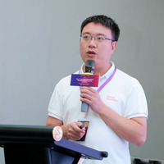




About Us
Linbo He
Kay Yan
Principal Software Engineer, Microsoft
KAITO & OpenYurt maintainer
GitHub: rambohe-ch
Principal Software Engineer, DaoCloud
LLM-D & LeaderWorkerSet maintainer
GitHub: yankay
Notes:
**中文**
我主要参与分布式推理和 Kubernetes workload primitives，也是 llm-d 与 LeaderWorkerSet 的 maintainer。Linbo 来自 Microsoft，是 KAITO 和 OpenYurt 的 maintainer。我会先讲请求路径、KV state 和分布式执行；之后 Linbo 会讲 workload 与 GPU 生命周期。
**English**
I work on distributed inference and Kubernetes workload primitives, and I maintain llm-d and LeaderWorkerSet. Linbo is a principal engineer at Microsoft and a maintainer of KAITO and OpenYurt. I will focus on the request path, KV state, and distributed execution. Linbo will then cover workload and GPU lifecycle operations.

Slide 4
Agenda
Background & Challenges
LLM-D: Scheduling & Distributed Inference
KAITO: Workload Lifecycle & GPU Operations
Production Integration
Production Inference Architecture
Notes:
**中文**
我们先从最简单的模型服务开始，看它为什么会在生产环境失效。接着画出完整的推理平台架构。然后重点介绍 llm-d 的四条路径：智能调度、KV cache 管理、Wide Expert Parallelism 和 P/D disaggregation。最后由 Linbo 介绍 KAITO、autoscaling、测试和生产集成。
**English**
We will begin with the simplest model-serving setup and see why it breaks in production. Then we will map the complete inference platform. The main part of my section covers four llm-d paths: intelligent scheduling, KV cache management, Wide Expert Parallelism, and prefill/decode disaggregation. Linbo will then cover KAITO, autoscaling, testing, and production integration.

Slide 5
Background & Challenges
Notes:
**中文**
先看背景：今天的门槛已经从“能否获得模型”转变成“能否稳定运营模型”。
**English**
Let us start with the background. The barrier has moved from accessing a model to operating it reliably.

Slide 6
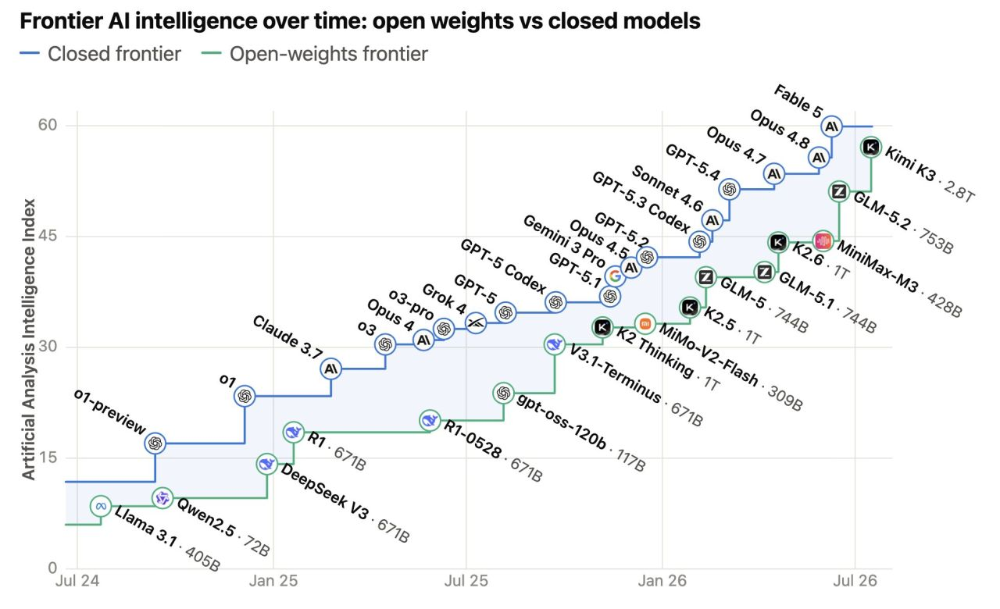
Open Models Put AI/LLM in Your Hands
Running a model is easy. Operating an inference system is hard.
Notes:
**中文**
过去一年，开放模型快速追赶闭源模型，模型权重不再是唯一门槛。现在启动一个模型已经很容易，真正困难的是持续交付稳定、可预测而且经济的 token capacity。换句话说，running a model is easy；operating an inference system is hard。
**English**
Over the last year, open models have rapidly closed the gap with closed models. Access to model weights is no longer the only barrier. Starting a model is now easy; continuously delivering stable, predictable, and economical token capacity is the hard part. Running a model is easy. Operating an inference system is hard.

Slide 7
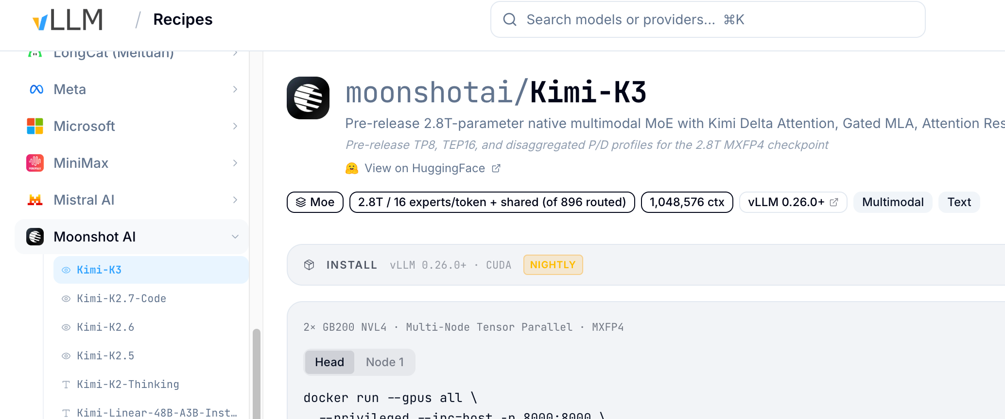
Start with Hello World: One Model Server
One command. One OpenAI-compatible endpoint.
docker run --gpus all \
--privileged --ipc=host -p 8000:8000 \
-v ~/.cache/huggingface:/root/.cache/huggingface \
vllm/vllm-openai:latest Qwen/Qwen3.5-0.8B \
--trust-remote-code
1. Download an open model.
2. Serve it with vLLM or SGLang.
3. Call it through an OpenAI-compatible API.
Explore more models and deployment configurations: https://recipes.vllm.ai/
Notes:
**中文**
最简单的起点是一条命令：下载模型，用 vLLM 或 SGLang 启动服务，再通过 OpenAI-compatible API 调用。这个方式非常适合开发和验证，它证明模型可以运行。但这里没有高可用、弹性扩缩、状态感知路由，也没有生产级资源管理。这条命令是 demo baseline，不是 production baseline。
**English**
The simplest starting point is one command: download an open model, serve it with vLLM or SGLang, and call it through an OpenAI-compatible API. This is excellent for development and validation because it proves that the model runs. But it provides no high availability, elastic scaling, state-aware routing, or production-grade resource management. This command is a demo baseline, not a production baseline.
> 口径提醒：不要逐行解释命令，也不要把 `--privileged` 或 `:latest` 描述成推荐的生产配置。

Slide 8
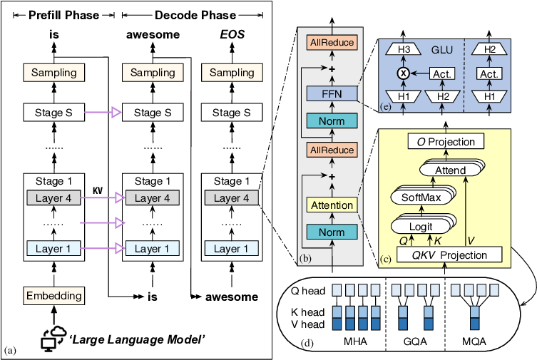
What is a large-language model?
Three Concepts Explain Most Inference Bottlenecks
KV Cache: Attention has state that needs to be managed
Prefill: Prompt processing is compute bound
Decode: Token generation is memory-bandwidth limited
LLM Inference Flow
From <LaMoSys3.5D: Enabling 3.5D-IC-Based Large Language Model Inference Serving Systems via Hardware/Software Co-Design>
Notes:
**中文**
理解后面的优化，只需要先记住三个概念。Prefill 一次处理整段 prompt，通常偏 compute-bound。Decode 一次只生成一个新 token，需要反复读取 KV cache，通常偏 memory-bandwidth-bound。KV cache 则保存 attention 的中间状态。后面所有分布式设计，基本都围绕计算、带宽和状态这三个约束展开。
**English**
To understand the rest of the talk, remember three concepts. Prefill processes the prompt in parallel and is usually compute-bound. Decode generates one new token at a time and repeatedly reads the KV cache, so it is usually memory-bandwidth-bound. The KV cache stores the intermediate attention state. Most distributed-inference designs are responses to these three constraints: compute, bandwidth, and state.

Slide 9
Real Workloads Keep Moving the Optimal Operating Point
Traffic, models, and request mix change faster than a static serving configuration can.
Demand shifts by hour and day
Models keep changing
MiniMax M3
→
GLM 5.2
→
KIMI K3
New mechanism
New interface
New cost curve
Weekday peaks → nights and weekends
Workload mix
OBSERVE → PREDICT → ADAPT
Operational outcomes
Short Q&A
Short context · high concurrency
Mixed workloads
Long context
Long prefill · memory pressure
Inference
System
Balance competing traffic patterns
RAG
Repeated prefixes · KV reuse
SLO-aware serving
Meet TTFT and TPOT objectives
Agents
Multi-turn tools · tail latency
Inference optimization
+ unified scheduling
High reliability
Coding
Long outputs · decode-intensive
Sustain token delivery through failures
Tool calls
Bursty requests · end-to-end jitter
Unit economics
Balance compute ↔ HBM ↔ KV ↔ network
Optimize model × workload × performance × cost
Batch / burst
Peak load · queueable
99.99%
10M tok/s
<2s
<30s
<40ms
>90%
Availability
Throughput
Short TTFT
Long TTFT
TPOT
KV-cache hit rate
Illustrative production targets
Notes:
**中文**
生产 workload 不会固定。流量会按小时变化，模型版本会持续变化，请求也可能是短问答、长上下文、RAG、agent、coding 或 batch。每类 workload 对 compute、HBM、KV cache 和 network 的压力都不同。因此不存在一个永远最优的静态配置；系统必须持续 observe、predict 和 adapt。底部的数字是示意目标，不是这次演讲的 benchmark 结果。
**English**
Production workloads do not stay still. Traffic changes by hour, model versions keep evolving, and requests may be short Q&A, long context, RAG, agents, coding, or batch jobs. Each workload stresses compute, HBM, KV cache, and networking differently. There is no single static configuration that remains optimal. The system must continuously observe, predict, and adapt. The numbers at the bottom are illustrative targets, not benchmark results from this talk.

Slide 10
Challenges of Real Production Inference
Production requires sustained token capacity, predictable SLOs, and measurable unit economics.
Five capabilities must hold at the same time
A model
that runs
Performance & capacity
TTFT, TPOT, goodput, TPM/RPM, load testing, and capacity baselines
Cost efficiency & SLOs
Coordinate routing, workers, and KV state without hotspots or latency spikes
↓
Workload lifecycle & elasticity
Align GPU provisioning, deployment, autoscaling, and recovery with demand
A Sustainable, Reliable Inference System
Validation & operational readiness
Test the NodeClaim → Node → Pod lifecycle without requiring real GPUs
Metering & governance
Track usage and cost while enforcing isolation, safety, and auditability
Every optimization must improve a production outcome
Useful token capacity ↑ • Cost per token ↓ • Utilization ↑ • SLO risk ↓ • Metering accuracy ↑
99.99%
10M tok/s
<2s
<30s
<40ms
>90%
Availability
Throughput
Short TTFT
Long TTFT
TPOT
KV-cache hit rate
Illustrative production targets
Notes:
**中文**
一个模型能返回答案，只说明它能运行。一个可持续的生产系统还要同时满足五件事：性能与容量、成本与 SLO、workload lifecycle 与 elasticity、验证与运维准备，以及 metering 与 governance。任何优化都必须最终改善一个生产结果，例如提高 useful token capacity、降低 cost per token、提高 utilization，或者降低 SLO risk。
**English**
A model returning an answer only proves that it runs. A sustainable production system must satisfy five capabilities at the same time: performance and capacity, cost and SLOs, workload lifecycle and elasticity, validation and operational readiness, and metering and governance. Every optimization must ultimately improve a production outcome, such as useful token capacity, cost per token, utilization, or SLO risk.

Slide 11
Production Inference Architecture

Slide 12
Production Distributed Inference Architecture
Application
Layer
Web / H5
Mobile Apps
Enterprise Applications
Third-party Applications
…
MaaS Operations (Token as a Service)
Gateway & Security
Inference
Layer
• Unified API Gateway (OpenAI Compatible)
AI Gateway (Business Logic) (AgentGateway , Higress)
• Safety & Content Filtering
• Rate Limiting & Access Control
Orchestration Layer (LLM-D, KAITO, Dynamo)
• WAF / DDoS / Shield
LLM-D
KAITO
Service
Orchestration
Routing &
Load Balancing
Scheduling &
Autoscaling
Policy & Strategy
Management
Elastic
Scaling
Observability &
Monitoring
Metering & Billing
• Usage Metering (Tokens / Requests)
Inference Runtime Layer (vLLM, SGLang, Triton )
• Billing & Invoicing
vLLM
Continuous Batching
Paged Attention
Speculative Decoding
Multi-LoRA
Prefix Cache
…
• Usage Analytics & Reporting
Operations Management
KV-Cache Offload & Management Layer (LMCache, KVBM, Mooncake)
• SKU & Model Management
KV Cache Management
Storage Abstraction (NIXL)
Distributed Memory KV Transport
Storage Backend
DPU Storage Gateway
• Pricing & Policy Management
KVBM
LMCache
Mooncake
…
Unified Interface
Tiered Storage Mgmt.
Cache Policy
Data Consistency
Redhare
(Distributed Memory KV Transport)
ContextStor
(Large Context Storage)
Object / File Storage
High-performance Storage
Cloud / On-prem Storage
DPU Acceleration
Protocol Offload · Data Optimization
Security Isolation · High Performance
• Coupon & Promotion
• Quota & Share Management
Kubernetes GPU & Data Scheduling
Model Hub (MatrixHub)
Model Distribution (ModelExpress)
Dataset Management
Data Catalog
Data Processing
Data Quality
• Cost Allocation & Chargeback
• FinOps & Cost Optimization
Resource Pool Management
Priority & Preemption
Fair Scheduling
Elastic Resource Allocation
Multi-tenant Isolation
Workflow Orchestration
Serving Targets
Kubernetes
GPU Operator
Device Plugin
GPU Monitoring
Topology Manager
Node Auto-discovery
Multi-tenant Isolation
Cloud
Enterprise
Infrastructure
Operations
Compute
(VM / Bare Metal)
Network
(VPC / SDN)
Storage
(Distributed)
Security
(FW / IDS)
Monitoring
(Prometheus)
Logging
(ELK)
Automation
(Ansible)
CI/CD
(GitOps)
Notes:
**中文**
这些目标需要一套完整的平台架构，而不是再加一个更大的 model server。
**English**
Meeting these goals requires a complete platform architecture, not simply a larger model server.

Slide 13
Inference Infrastructure Landscape
AI / Application Layer
K8s Agent Sandbox
App + Emerging
App + Mature
OpenSandbox
kagent
Dagger
Dify
E2B
AgentRegistry
Istio
kube-agentic-networking
Gateway API Inference Extension K8s
kgateway
Category
CubeSandbox
Volcano AgentCube
Semantic Router
Daytona
AI Gateway
Agent Substrate
knoway
Envoy AI Gateway
Higress
KAITO
AIBrix
KServe K8s
Kubeflow K8s
Workflow
llmaz
LLM-D
Dynamo
Kubeflow Trainer K8s
Training
OME
Kong
Knative K8s
Serverless
kubeRay K8s
rbg
Cloud-native Inference
SGLang
Early-stage
kthena
Mature / Standardized
Inference
Grove
vLLM
LWS K8s
YuniKorn
Scheduling
Godel
Triton Inference Server
JobSet K8s
Orchestration
Volcano K8s
Kueue K8s
NVIDIA AICR
WAS
Koordi
Pod In-Place Resize K8s
Kernel
KAI Scheduler
NVIDIA NVSentinel
PodRestart
DRA K8s
ORAS
Maturity
ModelPack
ImageVolume K8s
Dashed = early / exploration
KWOK K8s
Model Spec
NRI
Kubernetes K8s
Solid = mature / standardized
Infra + Mature
Infra + Emerging
gVisor
Kata Containers
KubeVirt K8s
K8s = Kubernetes native
containerd
Firecracker
Kernel / Runtime Layer
Notes:
**中文**
推理生态已经覆盖 gateway、runtime、scheduler、orchestration 和 kernel 等多层。重点不是选择一个项目替代所有其他项目，而是建立稳定接口，让不同层可以组合。组件越多，跨层状态和决策的一致性就越重要。
**English**
The inference ecosystem now spans gateways, runtimes, schedulers, orchestration, and kernel-level capabilities. The goal is not to choose one project that replaces everything else. The goal is to establish stable interfaces so the layers can compose. As the ecosystem grows, consistent state and decisions across layers become more important.

Slide 14
LLM-D: Scheduling & Distributed Inference
Notes:
**中文**
接下来进入 llm-d：它负责让调度理解推理状态，并让执行跨越多个 worker。
**English**
Now let us move into llm-d, which makes scheduling aware of inference state and coordinates execution across workers.

Slide 15
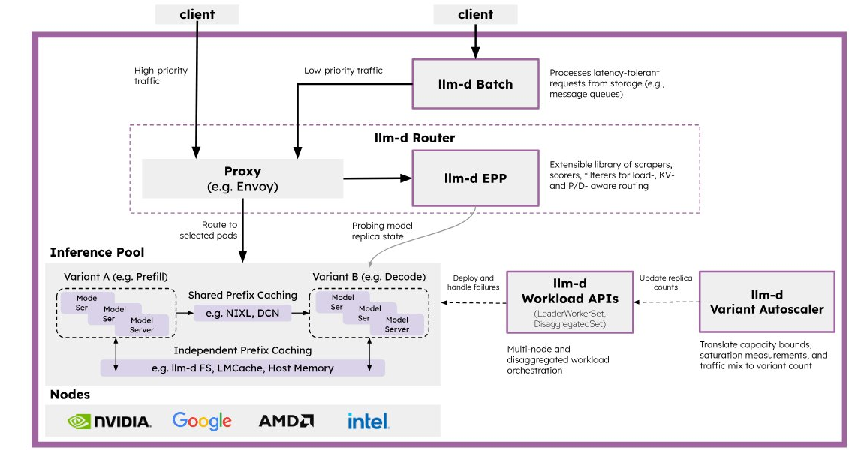





What is LLM-D?
A Kubernetes-native high-performance distributed LLM inference framework
Leveraging middleware and engaging partners
Unique value proposition
Operationalizability
modular and resilient architecture with native integration into Kubernetes via Inference Gateway API
Flexibility
cross-platform with extensible implementations of key composable layers of the stack
Well-lit paths
Helping deployers navigate key decisions from experimentation to production by exposing trade-offs through tested blueprints
Gateway API Inference Extension
NIXL
KV storage providers
Notes:
**中文**
llm-d 是 Kubernetes-native 的高性能分布式推理框架。它不是替换 vLLM、gateway 或 storage，而是组合这些组件。它强调三个价值：可运营的模块化架构、跨平台的可扩展实现，以及 well-lit paths。Well-lit path 的意义，是把经过验证的部署模式和 trade-off 直接交给平台团队。
**English**
llm-d is a Kubernetes-native framework for high-performance distributed inference. It does not replace vLLM, gateways, or storage systems; it composes them. Its value is organized around three ideas: an operable modular architecture, extensible cross-platform implementations, and well-lit paths. A well-lit path gives platform teams a validated deployment pattern together with the trade-offs behind it.

Slide 16












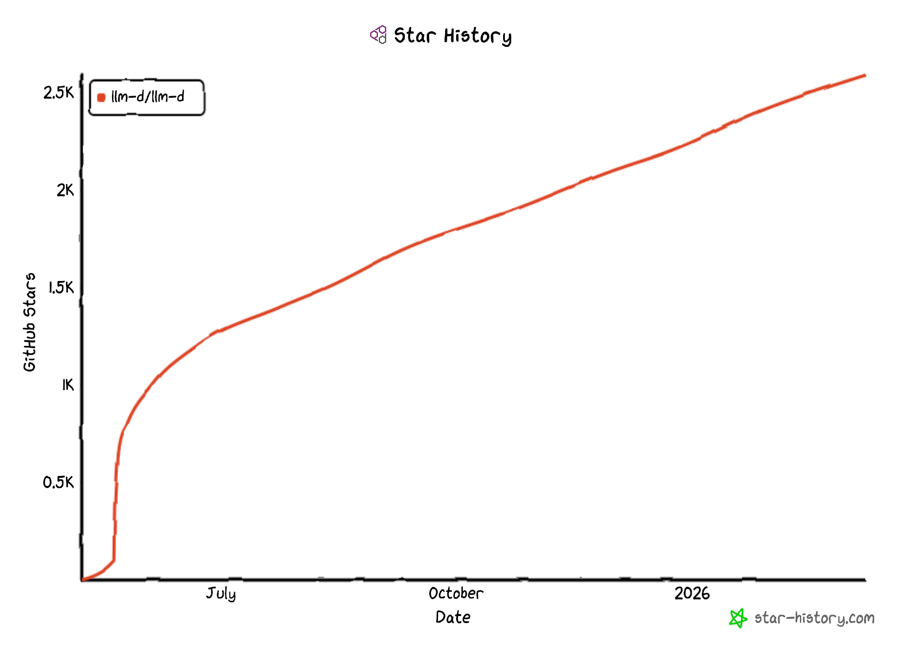

LLM-D has achieved so far
Laying the foundation for a common platform…
... delivering SoTA（ state-of-the-art ）LLM model
a large language model with the most advanced capabilities currently available.
State-of-the-art MoE serving
Advanced communication strategies like Dual Batch Overlap reaching 2.2k tokens/second per GPU
Production-ready prefill/decode disaggregation
Adaptive SLO balancer, improving P90 latency by up to 3x in long-prefill workloads.
Pioneered state-aware scheduler
Precise prefix-caching 57x faster than the default intelligent scheduler under heavy, multi-tenant load.
Predictive, SLO-driven autoscaler architecture
Enabled scale-to-zero, enabling dynamic resource allocation to maximize cluster utilization
May ’25
  Cross-vendor effort establishing a common stack for distributed inference
  Pioneered core primitives for scaling serving cost-efficiently on Kubernetes
  Among the fastest-growing projects in the inference space
  GitHub stars from 500+ unique institutions across commercial, academic,
  and research communities
  Organic engagement, exploration, and adoption, from self-hosting startups to large enterprises
  Downstream in existing and upcoming commercial offerings (e.g. Red Hat® AI 3)
Notes:
**中文**
llm-d 社区正在建立一个跨厂商的分布式推理公共栈，并把关键能力从实验推进到可复现路径。这里包括 MoE serving、P/D disaggregation、state-aware scheduling 和 predictive autoscaling。后面不会逐条重复这些结果，而是挑四个架构模式，看它们各自解决什么瓶颈。
**English**
The llm-d community is building a cross-vendor common stack for distributed inference and turning important techniques into reproducible paths. These include MoE serving, prefill/decode disaggregation, state-aware scheduling, and predictive autoscaling. Rather than reading every result on this slide, I will focus on four architectural patterns and the bottleneck each one addresses.

Slide 17
“Well-lit” Paths
“well-lit paths” philosophy: validated, production-ready deployment patterns for SoTA performance
Intelligent Inference Scheduling
KV Cache Management
Wide Expert Parallelism
P/D Disaggregation
Notes:
**中文**
今天选择四条 well-lit paths。第一，智能调度决定请求去哪里。第二，KV cache management 决定可复用状态放在哪里。第三，Wide EP 解决 MoE 的分布式执行。第四，P/D disaggregation 让 prefill 和 decode 使用不同资源配置。
**English**
Today we will follow four well-lit paths. Intelligent scheduling decides where a request should run. KV cache management decides where reusable state should live. Wide Expert Parallelism addresses distributed execution for MoE models. Prefill/decode disaggregation allows the two phases to use different resource configurations.

Slide 18
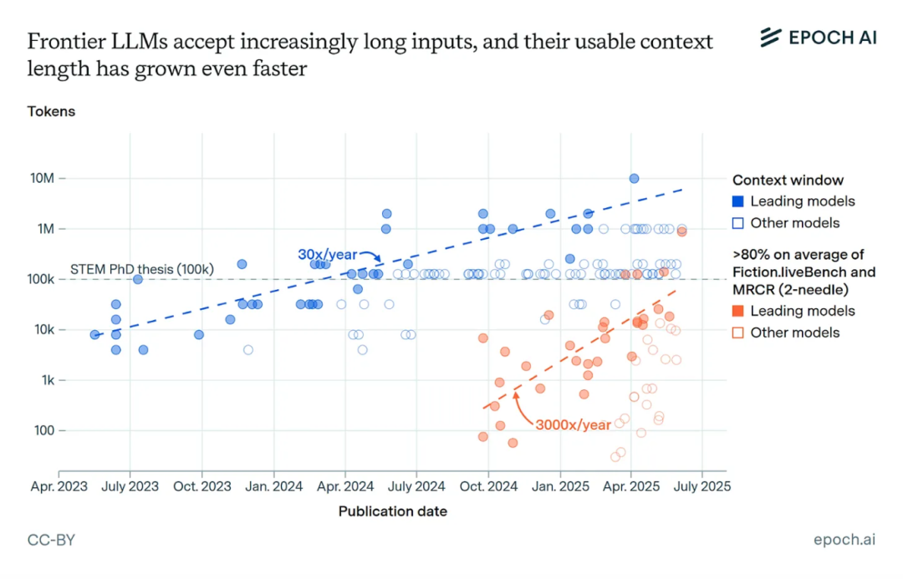
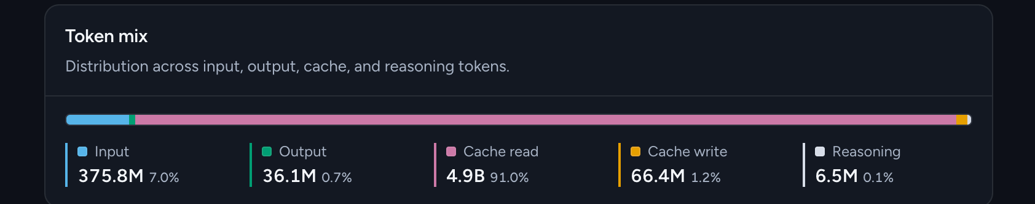
KV Cache Has Great Economic Value
“The KV-cache hit rate is the single most important metric for a production-stage AI agent. It directly affects both latency and cost.”
- Manus, Context Engineering for AI Agents
Mainstream AI API Pricing:
OpenAI GPT-5: $1.25 per 1M input tokens vs $0.125 per 1M cached input tokens
Anthropic Claude Sonnet: $3 per 1M input tokens vs $0.3 per 1M cached input tokens
Context Windows Are Expanding Rapidly
91% KVCache hit rate (Code Agent)
Notes:
**中文**
KV cache 不只是性能细节，也是经济资源。一次 cache hit 可以避免重新执行昂贵的 prefill，因此同时影响 TTFT、GPU 使用率和成本。商业 API 对 cached input 的折扣也说明了同一个逻辑。这里的价格只是评审日的具体示例，会随模型和时间变化；真正要关注的是 cache hit rate 对系统经济性的影响。
**English**
The KV cache is not only a performance detail; it is an economic resource. A cache hit avoids expensive prefill work, so it affects TTFT, GPU utilization, and cost at the same time. Commercial API discounts for cached input reflect the same principle. The prices shown here are time- and model-specific examples. The durable point is that cache hit rate directly affects system economics.

Slide 19
KV Cache Reuses ”conversation”
Shared prefixes skip repeated prefill; only new tokens are computed.
1
First Turn — Build the Cache
2
Next Turn — Reuse the Prefix
System prompt
System prompt
「横浜は綺麗ですか？」
Reuse KV
「横浜は綺麗ですか？」
Output tokens:
CACHED PREFIX
「はい、綺麗です。」
Output tokens:
「はい、綺麗です。」
Full prefill → KV state stored
Prefill new tokens only → Generate a new answer
More shared prefix → Less recomputation → Lower TTFT and GPU cost
KV cache stores attention state — not the final answer.
Notes:
**中文**
看一个两轮对话。第一轮需要完整 prefill，并把 attention state 写入 KV cache。第二轮的大部分 system prompt 和历史对话都没有变化，因此只需要处理新增 token。KV cache 保存的是 attention state，不是上一轮的最终答案。共享 prefix 越长，避免的重复计算越多。
**English**
Consider a two-turn conversation. The first turn requires a full prefill and stores the attention state in the KV cache. In the next turn, most of the system prompt and conversation history is unchanged, so only the new tokens need prefill work. The KV cache stores attention state, not the previous final answer. The longer the shared prefix, the more recomputation we avoid.

Slide 20
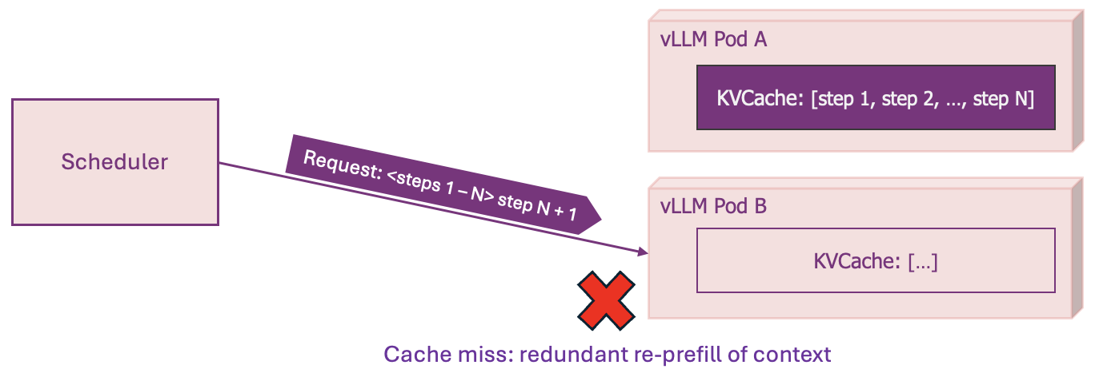
Where Standard Load-Balancing Fails
Production AI inference involves multiple vLLM instances and replicas
The once unified KV-cache becomes disaggregated
Naive load-balancing distributes traffic evenly across the pods -> destroying cache optimizations
Notes:
**中文**
单实例里，KV cache 是统一的。扩展到多个 vLLM replica 后，cache 被分散在不同 pod。传统 round-robin 只关心流量是否均匀，不知道 prefix 在哪里。于是请求可能被送到没有对应 KV 的 pod，触发一次完整 re-prefill。对普通 HTTP 服务合理的均衡策略，在 stateful inference 中可能非常低效。
**English**
On one instance, the KV cache is unified. After scaling to multiple vLLM replicas, the cache becomes distributed across pods. Traditional round-robin only balances traffic; it does not know where a prefix is cached. A request may therefore land on a pod without the required KV state and trigger a full re-prefill. A reasonable strategy for stateless HTTP services can be very inefficient for stateful inference.

Slide 21


Intelligent Inference Scheduling
vLLM-aware load-balancing enables smarter request routing that improves SLOs
Prefix-Aware Routing
Load-Aware Routing
GET completions
GET completions
Prompt
EPP
Prompt
EPP
Pod A
Pod A
Prefix-tree.
“Pod A has hit”
Scrape metrics. “A has low load”
KV Events
/metrics
Pod A
Pod B
Pod C
Pod A
Pod B
Pod C
Dramatically increase prefix-cache hit rate
Load-balancing based on actual replica state
  57x faster response time than naive scheduling
  2x throughput than load-aware scheduling

Slide 22
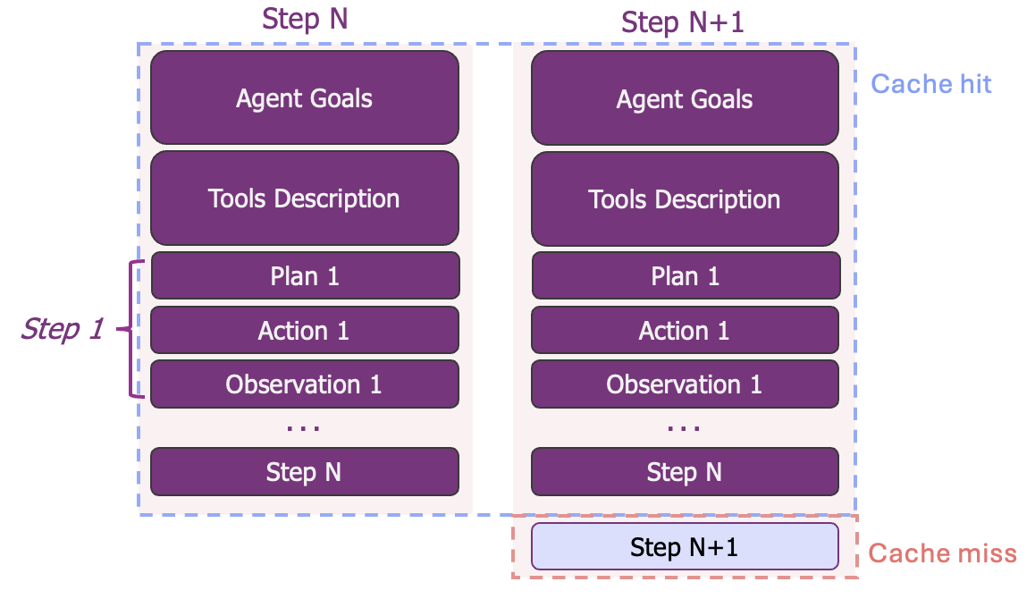
Where Prefix Reuse Appears
Linear Agents – Multi-Turn Tool Use
Notes:
**中文**
Agent workflow 是 prefix reuse 最明显的场景之一。Agent goals、tool definitions、plan 和历史 observations 会在每一步重复，新内容通常只是最新 action 或 observation。如果下一步落到持有相同 prefix 的 pod，就能把大部分上下文直接复用。
**English**
Agent workflows are one of the clearest examples of prefix reuse. Agent goals, tool definitions, plans, and previous observations repeat at every step. The new content is often only the latest action or observation. If the next step reaches a pod that already owns the prefix, most of the context can be reused.

Slide 23
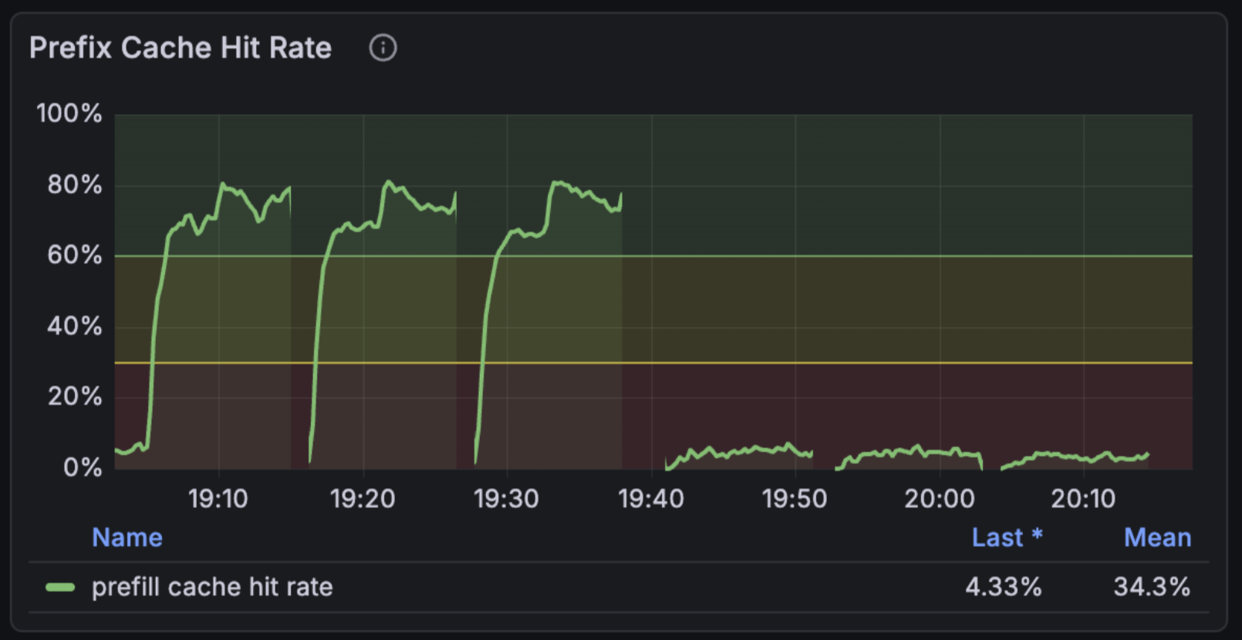
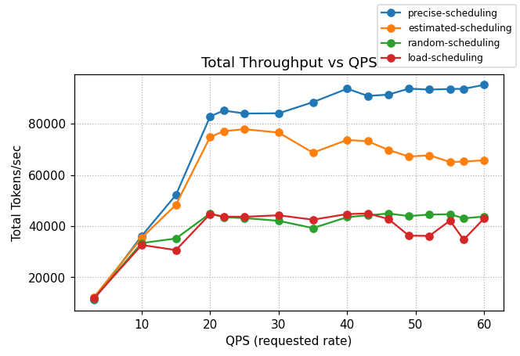
KV-Aware Routing Performance
Intelligent inference scheduling lets us avoid recomputing prefills
Without prefix caching, prefill instances can’t keep up
Left: KV-Aware
Right: Random
    llm-d provides different levels of prefix-cache aware scheduling capabilities in our guides
    In a workload that demands only 73% of a 16 H100 GPUs KV-cache capacity, optimal performance is achieved:
    x2 throughput than load-aware scheduling
Notes:
**中文**
这组实验使用 8 个 vLLM pods、总计 16 张 H100，workload 的 KV demand 是集群容量的 73%。即使总容量足够，错误的 placement 仍然会造成 cache thrashing 和 prefill queue。KV-aware routing 保持更高的 cache locality，因此在相同硬件上获得约两倍于 cache-blind load-aware baseline 的输出吞吐。
**English**
This experiment uses eight vLLM pods and sixteen H100 GPUs in total. The workload generates KV demand equal to 73 percent of cluster capacity. Even when total capacity is sufficient, poor placement can still cause cache thrashing and a growing prefill queue. KV-aware routing preserves locality and achieves roughly twice the output throughput of the cache-blind load-aware baseline on the same hardware.

Slide 24
HBM Is Precious—and Never Enough
DON‘T RECOMPUTE. hierarchy KV Cache.
TIER 1
TIER 2
TIER 3/4
GPU HBM
CPU RAM
SSD Storage
fastest, smallest
same node, spillover
Local or shared Storage
~ 30 minutes
~ 5 minutes
> 8 hours
The llm-d filesystem backend restores KV blocks from mounted POSIX storage.
Cross-replica reuse · Persistent across restarts · Async I/O (vs full prefill, long prompts)
Retention times are illustrative estimates, not fixed system limits.
Notes:
**中文**
HBM 最快，但容量最小，所以 KV cache 需要分层。热数据保留在 GPU；更大的 warm working set 可以放入 CPU RAM；需要跨副本共享或长期保留的 KV 可以进入本地或共享 storage。llm-d filesystem backend 使用 mounted POSIX filesystem，因此可以接入 NVMe、CephFS 或 IBM Storage Scale。页面上的时间只是 retention 示例，不是固定 TTL。
**English**
HBM is the fastest tier, but also the smallest, so KV cache needs a hierarchy. Hot state remains on the GPU. A larger warm working set can spill into CPU RAM. KV that needs cross-replica reuse or longer retention can move to local or shared storage. The llm-d filesystem backend uses mounted POSIX filesystems, including NVMe, CephFS, and IBM Storage Scale. The times shown are illustrative retention examples, not fixed TTLs.

Slide 25
KV Cache Management
Leverage all system resources to maximize prefix cache hit rate within the cluster
CPU KV Cache Offloading
Storage KV Cache Offloading
GET completions
GET completions
Prompt
EPP
Prompt
EPP
Pod A
Pod A
CPU RAM
CPU RAM
CPU RAM
CPU RAM
Storage
CPU RAM
Pod A
Pod B
Pod C
Pod A
Pod B
Offload KV caches to local memory with global index
Offload KV caches to global shared remote storage

Slide 26

The KV Offloading Connector
Bridges the vLLM V1 KV-Connector API into a simple, unified offloading interface for pluggable backends
Enables KV cache to live beyond GPU memory across CPU and storage tiers
Improves throughput and stability by reducing GPU memory pressure
V1 KV Connector API
Offloading connector
CPU
Storage
Notes:
**中文**
统一入口是 vLLM V1 KV Connector API。Offloading connector 把上层接口转换为可插拔 backend，让同一套 runtime 可以连接 CPU 或 storage。这样 KV state 的生命周期不再受 GPU memory 限制，同时上层 routing 和 serving 逻辑不需要理解每种存储实现。
**English**
The common entry point is the vLLM V1 KV Connector API. The offloading connector maps that API to pluggable backends for CPU or storage. This allows KV state to outlive GPU memory pressure without forcing the routing and serving layers to understand every storage implementation.

Slide 27
CPU Offloading Backend
KV blocks are copied asynchronously from GPU -> pinned CPU memory using DMA
      CPU memory acts as a high-capacity KV cache tier extending the number and lifespan of token sequences
When a request resumes, KV blocks are streamed back just-in-time instead of recomputing attention from scratch
V1 KV Connector API
Offloading connector
CPU
Storage
Notes:
**中文**
在 CPU backend 中，KV blocks 通过 DMA 异步复制到 pinned host memory。CPU RAM 仍然是 node-local，但容量通常远大于 HBM。当历史请求恢复时，系统可以 just in time 地把 KV block 传回 GPU，而不是重新计算整个 prefix。
**English**
With the CPU backend, KV blocks are copied asynchronously into pinned host memory using DMA. CPU RAM remains node-local, but it is usually much larger than HBM. When a previous request resumes, the system can stream the KV blocks back to the GPU just in time instead of recomputing the entire prefix.

Slide 28
Storage Offloading Backend
KV blocks are copied asynchronously from GPU -> shared storage using the same offloading connector (C++)
      Storage acts as a cluster-wide KV cache pool extending cache capacity beyond any single node’s GPU or RAM
      Any POSIX filesystem is immediately supported
V1 KV Connector API
Offloading connector
CPU
Storage
Storage
llm-d blog: Native KV Cache Offloading to Any Filesystem with llm-d
Notes:
**中文**
Storage backend 使用相同 connector，把 KV blocks 写入共享文件系统。它比 GPU 或 CPU memory 慢，但容量可以跨节点扩展，而且多个 replica 可以复用同一份 KV state。这里的目标不是让 storage 取代快层，而是在 working set 超出本地 memory 后保持复用和稳定性。
**English**
The storage backend uses the same connector to write KV blocks into a shared filesystem. Storage is slower than GPU or CPU memory, but its capacity scales across nodes and multiple replicas can reuse the same KV state. The goal is not to replace the fast tiers. The goal is to preserve reuse and stability after the working set exceeds local memory.

Slide 29
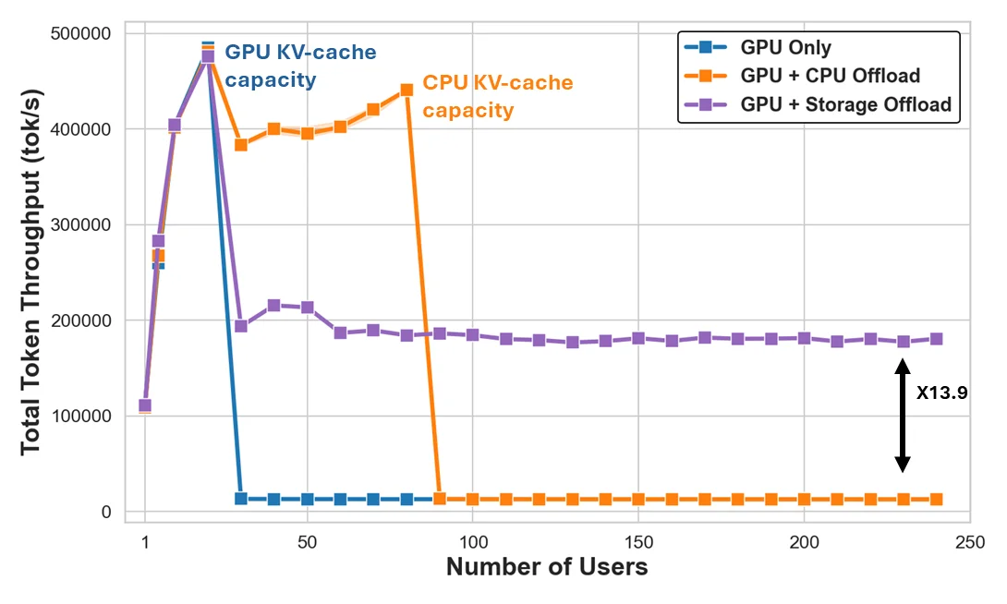
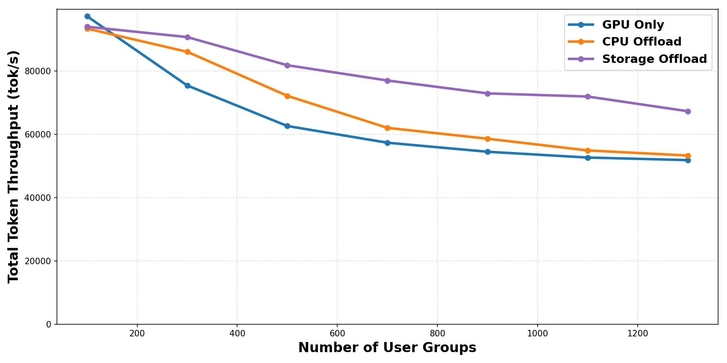
Storage Offloading Performance
HBM is fastest—until capacity runs out.
CPU offload delays the capacity cliff.
Shared storage sustains throughput at scale.
Real workloads mix KV load, prefill, and decode.
Shared storage enables cross-replica KV reuse.
Async I/O improves throughput and TTFT at scale.
llm-d blog: Native KV Cache Offloading to Any Filesystem with llm-d
Notes:
**中文**
这两张图展示的是 capacity cliff。HBM 在 cache 能装下时最快，但容量耗尽后性能会突然下降。CPU offload 把这个拐点向后推；shared storage 则在更大 working set 下维持吞吐。真实 workload 同时包含 KV load、prefill 和 decode，因此 storage 的核心价值是扩大 cache hit 范围，并让异步 I/O 与 GPU compute 重叠。
**English**
These charts show the capacity cliff. HBM is fastest while the cache fits, but performance drops sharply when capacity is exhausted. CPU offload pushes that cliff further out. Shared storage sustains throughput across a much larger working set. Real workloads mix KV loading, prefill, and decode, so the main value of storage is extending the cache-hit range while overlapping asynchronous I/O with GPU compute.

Slide 30

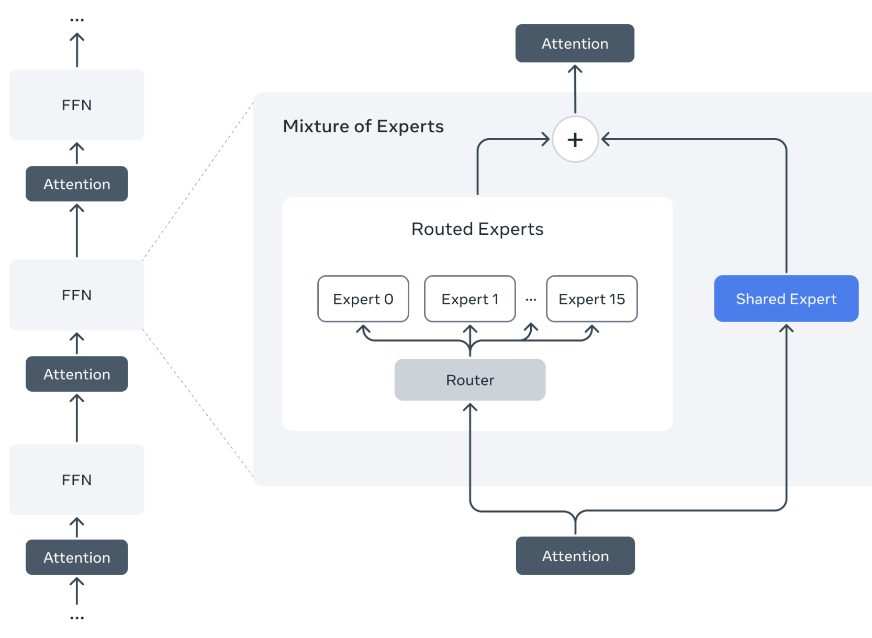




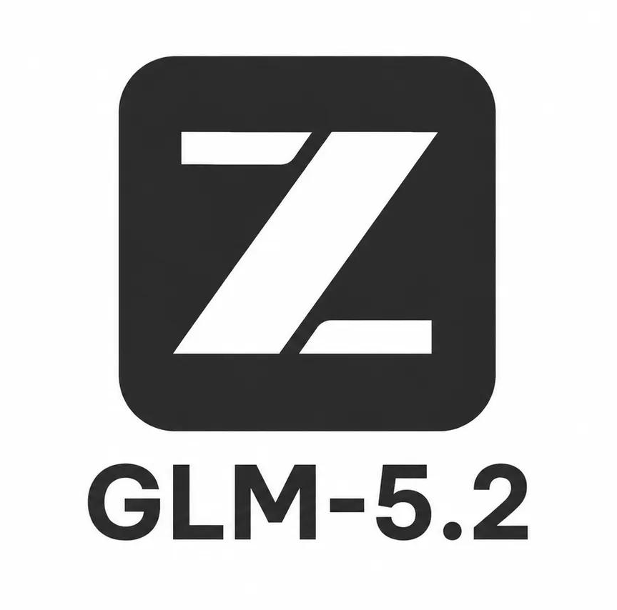

Why MoE Changes Distributed Inference
Mixture of Experts Overview
Notes:
**中文**
接下来是 Mixture of Experts。MoE 每个 token 只激活部分 experts，因此可以用较低 active parameter cost 扩大模型。但 token 会被路由到分布在不同 GPU 上的 experts，形成高频 all-to-all communication。模型从单机问题变成了 topology 与 network 问题。
**English**
Next is Mixture of Experts. An MoE model activates only a subset of experts for each token, allowing the model to grow without activating every parameter. But tokens must be routed to experts distributed across GPUs, creating frequent all-to-all communication. The model is no longer only a single-server problem; it becomes a topology and networking problem.

Slide 31
Wide Expert Parallelism
llm-d’s K8s-native design composes the EP implementation with the rest of the llm-d system
GET completions
Prompt
EPP
*Composes with other scorers*
Pod D
LeaderWorkerSet
Expert-Parallel MLP
Pod A
(DP-0)
Pod B
(DP-1)
Pod C
(DP-2)
Pod D
(DP-3)
Pod E
(DP-4)
Pod F
(DP-5)
Pod G
(DP-6)
Pod H
(DP-7)
Notes:
**中文**
Wide Expert Parallelism 把 experts 展开到更多 worker，并通过 data parallel replicas 提供 serving capacity。这里的重点是组合：EPP 负责请求 placement，LeaderWorkerSet 表达多 worker topology，runtime 执行 expert parallelism。llm-d 把这些能力接入同一个 Kubernetes-native serving system。
**English**
Wide Expert Parallelism spreads experts across more workers and uses data-parallel replicas to provide serving capacity. The important idea is composition. The EPP handles request placement, LeaderWorkerSet expresses the multi-worker topology, and the runtime executes expert parallelism. llm-d connects these capabilities into one Kubernetes-native serving system.

Slide 32
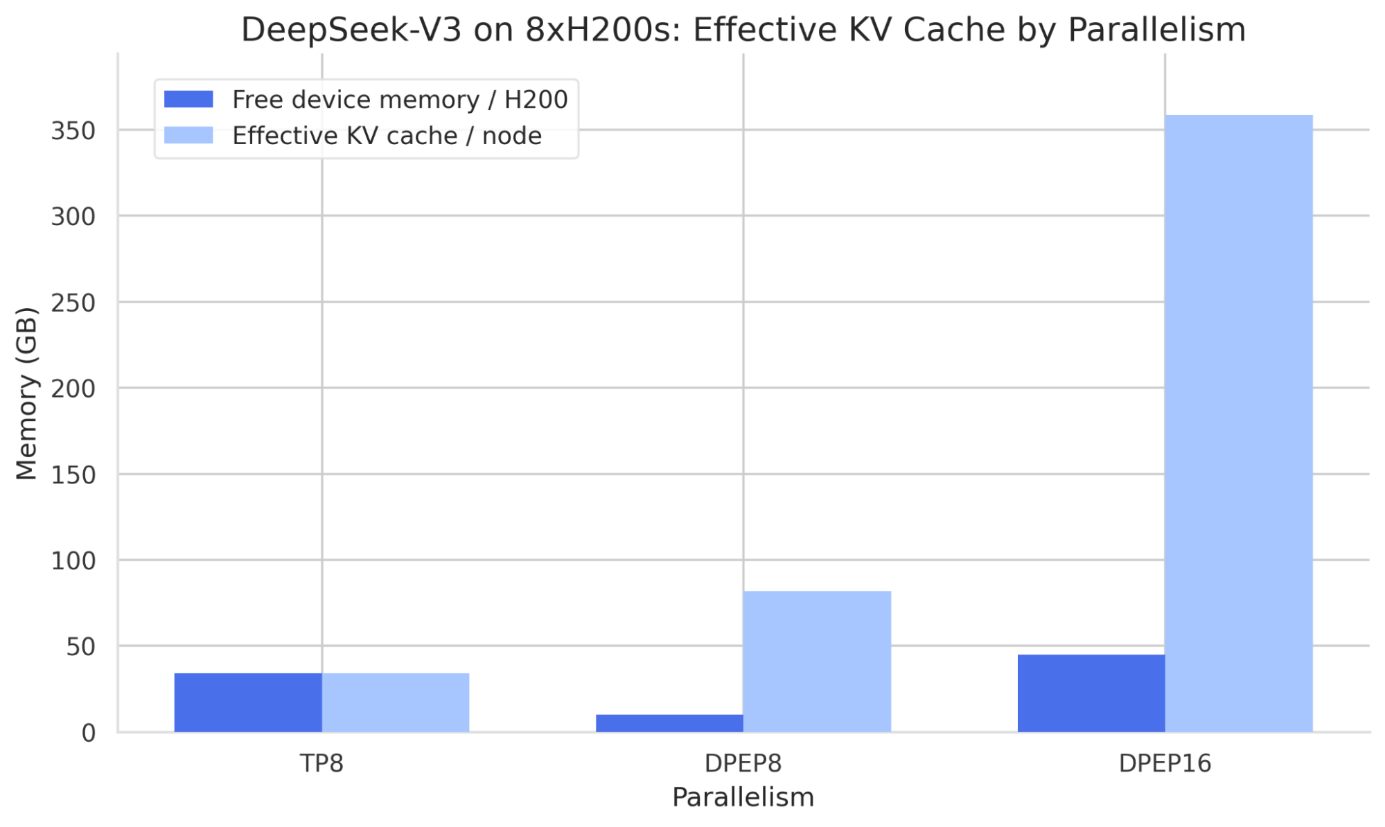
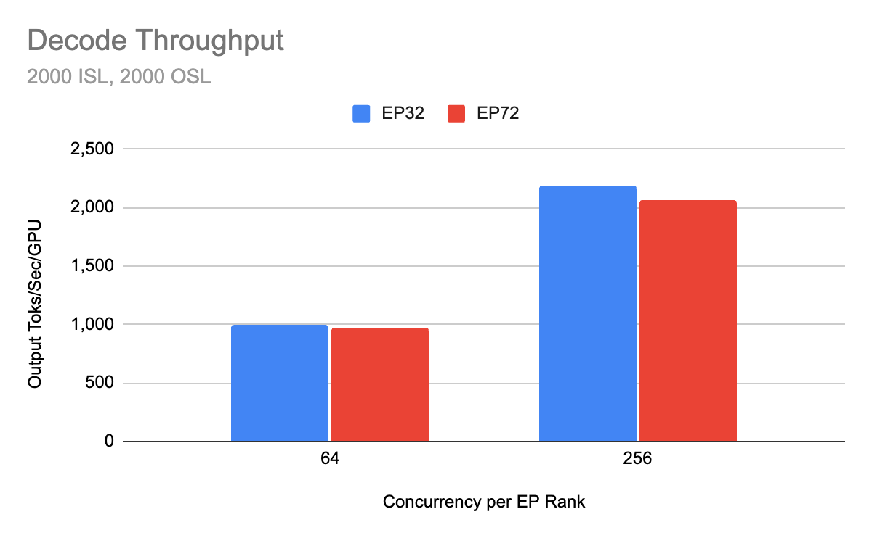
How “Wide” do we need to go?
Wider EP gives KV cache more space—but does not always improve speed.
More Room for KV Cache
DP avoids duplicating the KV Cache
Support longer contexts and more concurrent requests.
MoE layers need high concurrency to saturate GPU compute.
    ~2x going from 64 to 256 concurrent requests per GPU
High EP72 shows little gain over EP32 here.
More Concurrency, More Communication
Notes:
**中文**
EP 并不是越宽越快。更宽的 EP 可以减少每个 GPU 上的 model weight footprint，给 KV cache 留出更多空间，也支持更多并发。但它会增加通信，而且 GPU 需要足够高的并发才能被充分利用。这里 EP72 相对 EP32 的收益很小，说明应该根据 concurrency、KV capacity 和 network cost 一起选择宽度。
**English**
Wider EP is not automatically faster. It reduces the model-weight footprint per GPU, leaves more space for KV cache, and supports more concurrency. But it also increases communication, and the GPUs need enough concurrent work to stay saturated. In the example shown, EP72 adds little over EP32, so the width should be chosen from concurrency, KV capacity, and network cost together.

Slide 33
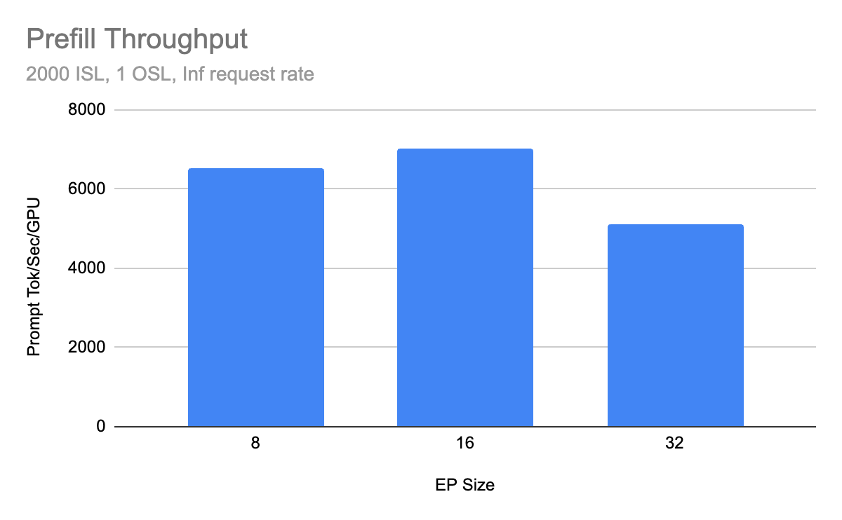
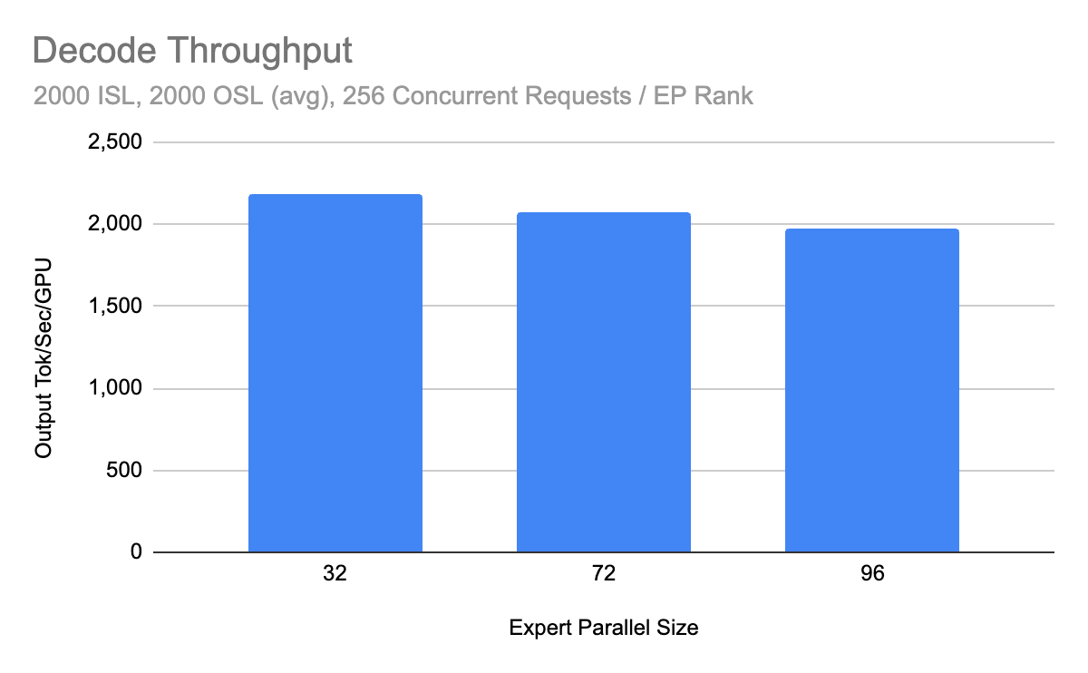
Wide Expert Parallelism Performance
Reached 2.2k tokens/s per H200 GPU for DeepSeek-R1 in community benchmarks on H200
Confirms that kernel optimizations (silu-mul-quant fusion, custom CUTLASS kernels, MLA attention tuning)
and the addition of fast EPLB + DBO for decode are delivering compound gains.
https://llm-d.ai/blog/llm-d-v0.3-expanded-hardware-faster-perf-and-igw-ga
Notes:
**中文**
这是 llm-d v0.3 的历史 community benchmark：DeepSeek-R1 在多节点 H200 上达到每张 GPU 约 2.2K output tokens per second。结果不是来自单一优化，而是 kernel、EPLB、Dual Batch Overlap 和 parallel topology 的叠加。关键结论是，Wide EP 的收益依赖端到端协同，而不是只增加 GPU 数量。
**English**
This is a historical community benchmark from llm-d v0.3. DeepSeek-R1 reached roughly 2.2 thousand output tokens per second per H200 GPU in a multi-node setup. The result did not come from one optimization. It compounded kernel work, EPLB, Dual Batch Overlap, and the parallel topology. The key point is that Wide EP requires end-to-end coordination, not simply more GPUs.

Slide 34
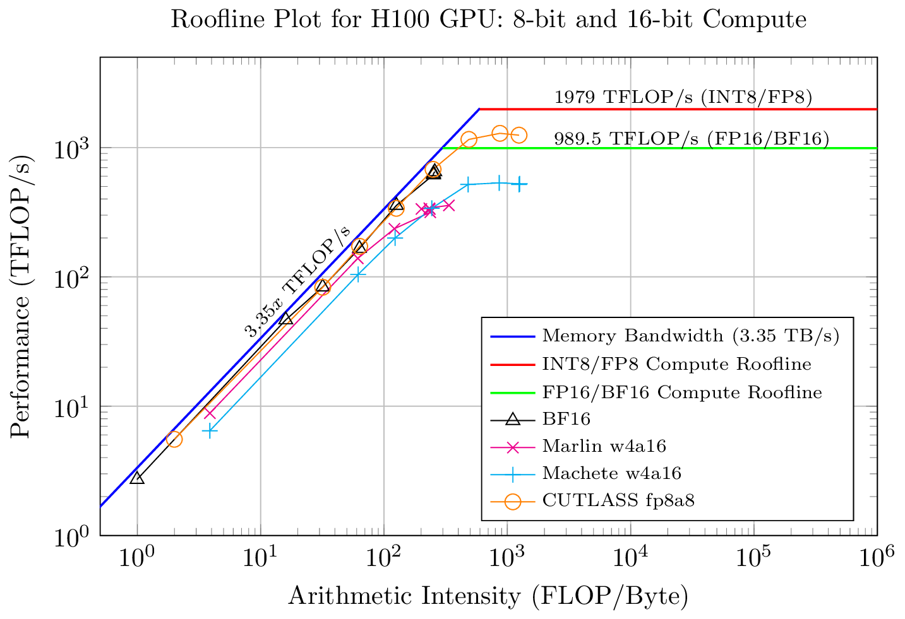
Why P/D? Prefill and Decode
Two Phases of LLM Inference - different computational regimes
Prefill - Prompt Processing
All tokens processed in one pass
Reads the KV Cache once
Compute-intensive
Attention: Matrix-matrix multiplication
Decode - Token Generation
Each token processed sequentially
KV cache is loaded each forward pass
Bandwidth-limited
Attention: Matrix-vector multiplication
Decodes are limited by VRAM Bandwidth!
Prefills are compute-bound!
Notes:
**中文**
现在回到每个请求的两个阶段。Prefill 并行处理整段输入，主要执行 matrix-matrix operations，因此偏 compute-bound。Decode 每次生成一个 token，并在每一步读取 KV cache，主要受 memory bandwidth 限制。两种 phase 的资源需求不同，却经常被迫运行在同一组 worker 上。
**English**
Now return to the two phases of every request. Prefill processes the input in parallel and is dominated by matrix-matrix operations, so it is compute-bound. Decode generates one token at a time and reads the KV cache at every step, so it is constrained by memory bandwidth. These phases want different resource profiles, but they are often forced onto the same workers.

Slide 35
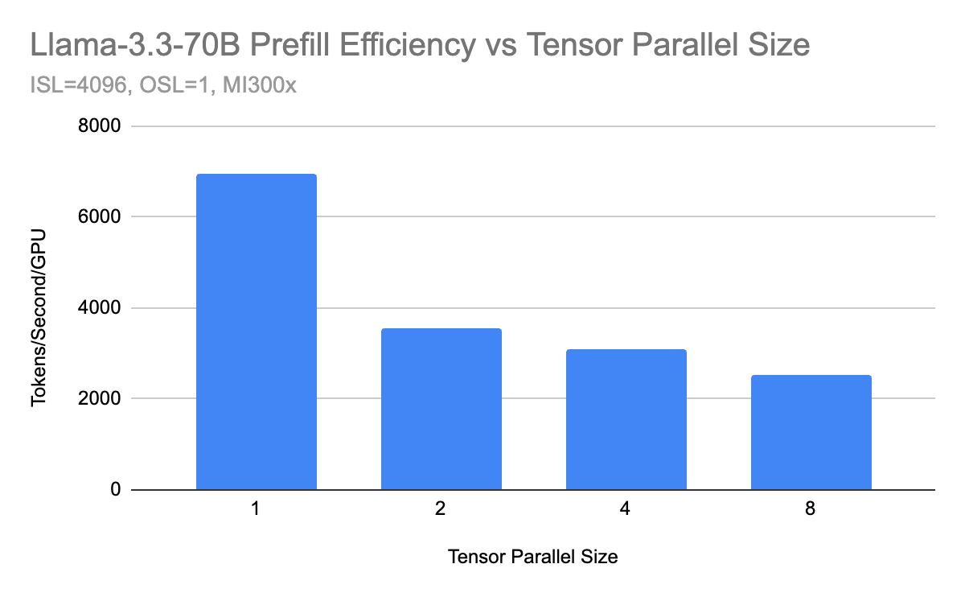
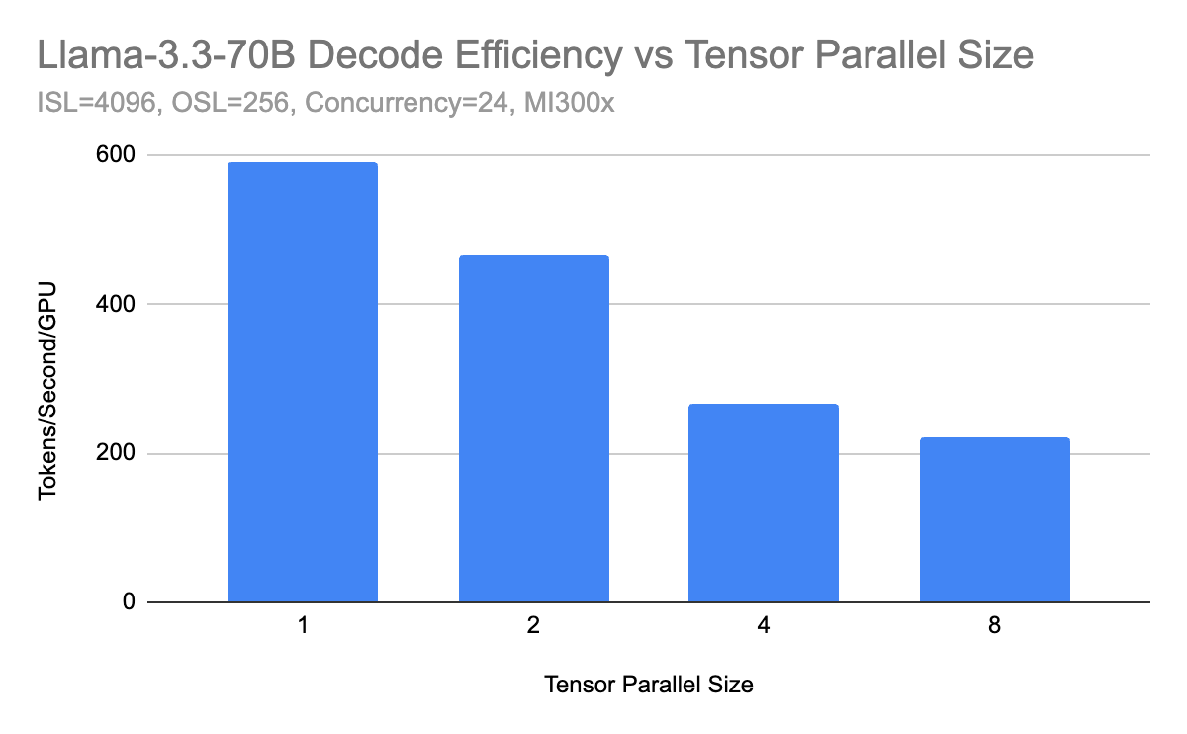
Why P/D? Prefill and Decode Scale Differently
Decode retains efficiency better at small TP sizes
TP=1 delivers the highest throughput per GPU for both phases.
Prefill loses efficiency quickly as TP communication increases.
Decode benefits more from additional memory bandwidth at small TP sizes.
P/D disaggregation allows each phase to use a different parallel configuration.
Notes:
**中文**
图里的 benchmark 显示，TP=1 在两个 phase 上都有最高的 per-GPU throughput，但扩展曲线不同。Prefill 对 TP communication 更敏感，效率下降更快；decode 在小 TP 下还能从额外 memory bandwidth 获益。P/D disaggregation 让我们可以分别选择 prefill 与 decode 的 parallel configuration。
**English**
The benchmark shown here finds the highest per-GPU throughput at TP equals one for both phases, but the scaling curves are different. Prefill is more sensitive to tensor-parallel communication and loses efficiency faster. Decode can still benefit from additional memory bandwidth at small TP sizes. P/D disaggregation lets us choose a different parallel configuration for each phase.

Slide 36
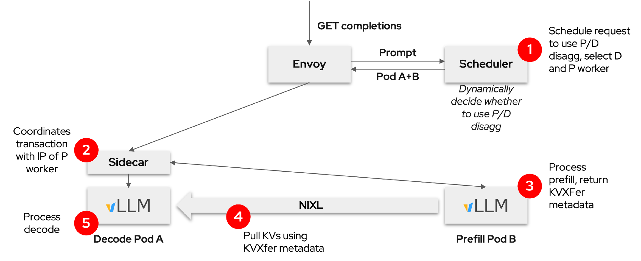
llm-d composes vLLM and Gateway to enable P/D disaggregation
Separate requests for the prefill and decode stages
Dynamically decided
Dedicated Prefill and Decode nodes
Optimize resource allocation, utilization, and scheduling
Easier to meet TTFT and ITL SLO requirements
Notes:
**中文**
在 disaggregated flow 中，gateway 接收请求，scheduler 决定是否使用独立 prefill worker。Prefill worker 计算 prompt 并产生 KV state；sidecar 协调传输；decode worker 接收 KV 后继续生成 token。这个决定可以根据 workload 和 SLO 动态做出，因此 prefill pool 与 decode pool 可以独立扩展。
**English**
In the disaggregated flow, the gateway receives the request and the scheduler decides whether to use a separate prefill worker. The prefill worker processes the prompt and produces KV state. A sidecar coordinates the transfer, and the decode worker continues token generation after receiving the KV. This decision can be made dynamically from workload and SLO requirements, allowing the prefill and decode pools to scale independently.

Slide 37
Efficient KV Transfer in vLLM vis NIXL
For high performance KV Transfer, vLLM uses GPU direct RDMA via our NIXL integration
D Worker
KV Cache
P Worker KV Cache
“RDMA [0,5] to [4,6]”
0
1
2
0
1
2
NIXL
3
4
5
UCX
3
4
5
6
7
8
IB / RoCE / TCP
6
7
8
Zero Copy, GPU Direct, Zero Memory Overhead
Notes:
**中文**
P/D 分离只有在 KV transfer 足够高效时才有意义。vLLM 通过 NIXL 集成，在支持的 RDMA path 上实现 GPU-direct transfer，避免不必要的 host staging。底层可以使用 UCX，并运行在 InfiniBand、RoCE 或 TCP 等网络上。这里应该理解为降低 copy 和 staging overhead，而不是绝对零开销。
**English**
P/D disaggregation only works when KV transfer is efficient. Through the NIXL integration, vLLM can use GPU-direct transfer on supported RDMA paths and avoid unnecessary host staging. The transport can use UCX over InfiniBand, RoCE, or TCP. The correct takeaway is reduced copy and staging overhead, not literally zero overhead.

Slide 38
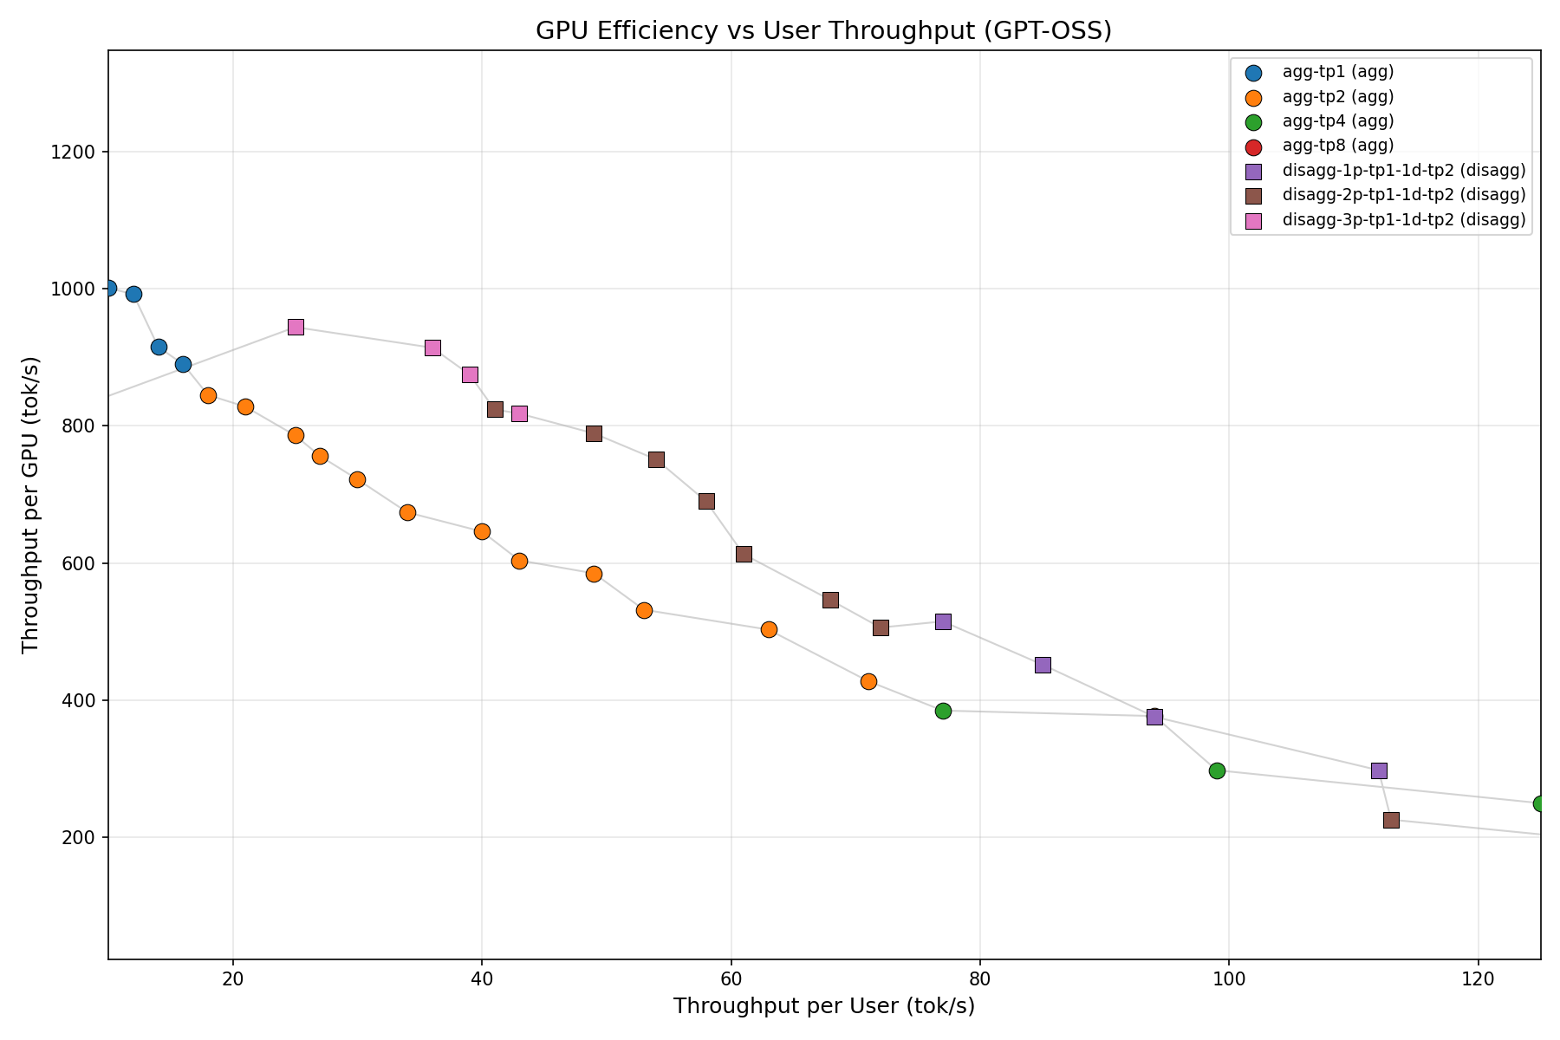
Aggregated vs Disaggregated Pareto Frontier
Balance TTFT, TPOT, and GPU Efficiency
Prefill Pool
  Scale to meet the TTFT target
Decode Pool
Scale to meet the TPOT target
Result
Better GPU efficiency under latency SLOs
Choose the serving topology based on TTFT and TPOT targets—not throughput alone.
Notes:
**中文**
是否使用 P/D，不能只看 peak throughput。在线服务要同时考虑 TTFT、TPOT 和 GPU efficiency。Disaggregated topology 可以按 TTFT 目标扩展 prefill pool，按 TPOT 目标扩展 decode pool。它的价值是在 latency SLO 下找到更好的 Pareto frontier，而不是保证所有 workload 都更快。
**English**
The decision to use P/D should not be based only on peak throughput. An online service must balance TTFT, TPOT, and GPU efficiency. A disaggregated topology can scale the prefill pool for the TTFT target and the decode pool for the TPOT target. Its value is a better Pareto frontier under latency SLOs, not a guarantee that every workload becomes faster.

Slide 39
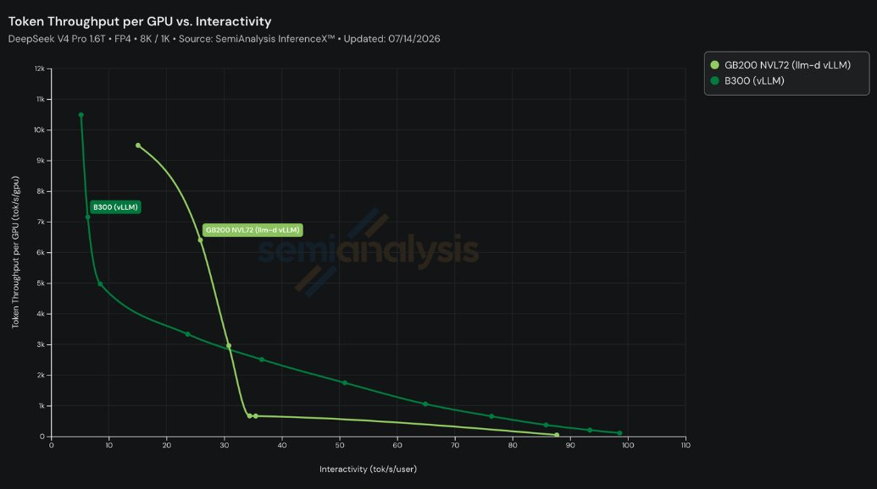
P/D disaggregation Benchmark
DeepSeek V4 Pro 1.6T, FP4 · 8K input / 1K output
2x token/s/GPU
llm-d on GB200 NVL72:
~7,500 output tokens/s/GPU
Standard vLLM on B300:
~4,500 output tokens/s/GPU
More benchmark data: https://inferencex.semianalysis.com/
Notes:
**中文**
这张外部数据展示 DeepSeek V4 Pro 在两个 Blackwell 系统上的 Pareto curve。图中选定 operating point 大约是 GB200 NVL72 每张 GPU 7,500 output tokens per second，对 B300 约 4,500。但这不是同硬件的软件 A/B test；硬件、NVLink domain、topology、配置和软件都在共同影响结果。应该在相同 interactivity target 下比较曲线。
接下来把话题从 request 与 data path 交给 Linbo，请他介绍 KAITO 如何管理 workload 和 GPU lifecycle。
**English**
This external data shows the Pareto curves for DeepSeek V4 Pro on two Blackwell systems. At the selected operating point, the slide shows roughly 7,500 output tokens per second per GPU on GB200 NVL72 and about 4,500 on B300. This is not a same-hardware software A/B test. Hardware, NVLink domain, topology, configuration, and software all contribute, so the curves should be compared at the same interactivity target.
With that, I will hand over to Linbo to explain how KAITO manages the workload and GPU lifecycle around this request and data path.

Slide 40
KAITO: Workload Lifecycle & GPU Operations

Slide 41
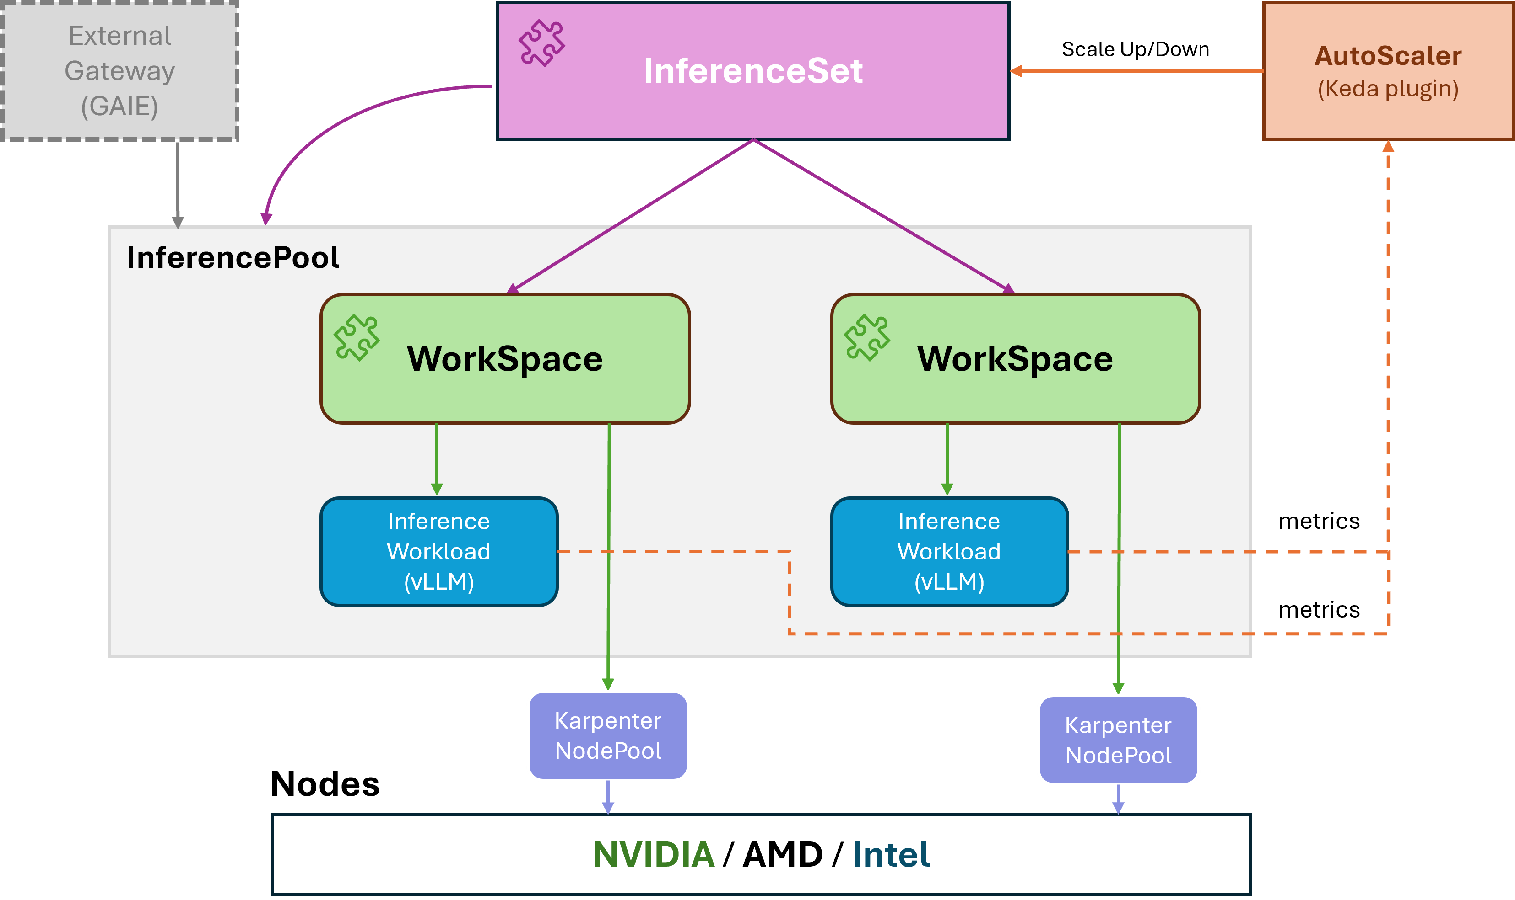
What is KAITO?
An operator suite that automates LLM inference, fine-tuning & RAG on Kubernetes.
You bring a model name + GPU SKU — KAITO does the rest.
Node Auto Provisioning — node count auto-sized from model memory footprint
Model onboarding — any vLLM HF model, Model Mirror + local NVMe cache
Workload lifecycle — InferenceSet: multi-replica, rolling upgrade
Autoscaling — KEDA on live vLLM metrics (queue / latency) or cron schedule
Notes:
We just saw how llm-d handles the request path. Now let's look at the other side: KAITO.
So what is KAITO? It is one operator for Kubernetes that runs large language models for you. It covers three jobs - inference, fine-tuning, and RAG - so you do not have to build and connect them yourself.
It is mainly for teams who host open models on their own cluster, but who do not have a dedicated GPU or inference platform team.
The main idea is simple: you give KAITO only two things, the model name and the GPU type. From there it does the rest - it sizes and creates the GPU nodes, loads the weights, serves the model, and scales it with traffic.
So you bring a model and a GPU type, and KAITO handles the machines, the weights, the serving, and the scaling. Let's look at a few of these, starting with the workload lifecycle.

Slide 42
Workload Lifecycle
You set only the model and the GPU SKU — autoUpgrade keeps it current.
apiVersion: kaito.sh/v1beta1
kind: InferenceSet
metadata:
name: qwen3-8b
spec:
replicas: 3
labelSelector:
matchLabels:
app: qwen3-8b
autoUpgrade:
enabled: true # turn on auto base-image update
template:
metadata:
annotations:
kaito.sh/model-mirror-storage-class: blob-fuse # <- Model Mirror on
resource:
instanceType: Standard_NC24ads_A100_v4 # <- GPU SKU
inference:
preset:
name: Qwen/Qwen3-8B # <- model
Notes:
On the last slide I said KAITO manages the full workload lifecycle. Here is a small example.
This is an InferenceSet - the object you use to serve a model in production. Notice how short it is. Really, only two lines matter: the model name, and the GPU type. You write no vLLM flags, no node count, no parallelism - KAITO fills all of that in.
replicas is optional; here it runs three copies for more capacity and higher availability, and it heals them if one dies. And autoUpgrade, when on, rolls your copies to a new tested image one at a time, with no downtime.
I also turned on Model Mirror here, with this annotation. It downloads the weights once into shared blob storage, in parallel with node startup, so cold starts are much faster.
One more thing worth showing is how KAITO decides the number of GPU nodes. Let's look at that next.

Slide 43
How the GPU Node Count Is Computed
You give model + GPU SKU. KAITO computes the node count — you never do the math.
Inputs KAITO reads: model weight size, context length (max-model-len), and the GPU SKU (memory + GPUs per node).
per-GPU budget = GPU memory × 0.84 (vLLM memory utilization)
− ~2.3 GiB fixed overhead
− KV cache ( max-model-len × bytes-per-token )
min GPUs = ceil( model weights ÷ per-GPU budget ) (weights × 1.02)
node count = ceil( min GPUs ÷ GPUs-per-node )
→ saved as status.targetNodeCount.
If it is > 1, KAITO serves the model multi-node automatically: tensor-parallel inside each node, pipeline-parallel across nodes.
Notes:
You might wonder how KAITO picks the number of GPU nodes. You do not set it - KAITO computes it from the model and the GPU type.
The idea is simple. First, it takes the GPU memory and keeps about 84 percent, the part vLLM can actually use. From that it subtracts a small fixed overhead, and the KV cache, which grows with the context length. What is left is the budget on each GPU for the model weights.
Then it divides the model size by that budget to get the smallest number of GPUs, and divides again by the GPUs per node to get the node count.
This number is saved as targetNodeCount. And if it is more than one, KAITO serves the model across nodes on its own - tensor parallel inside a node, and pipeline parallel across nodes. So both the sizing and the parallel setup are automatic. Now, once it is running, how do we handle changing traffic? That is autoscaling, which is next.

Slide 44
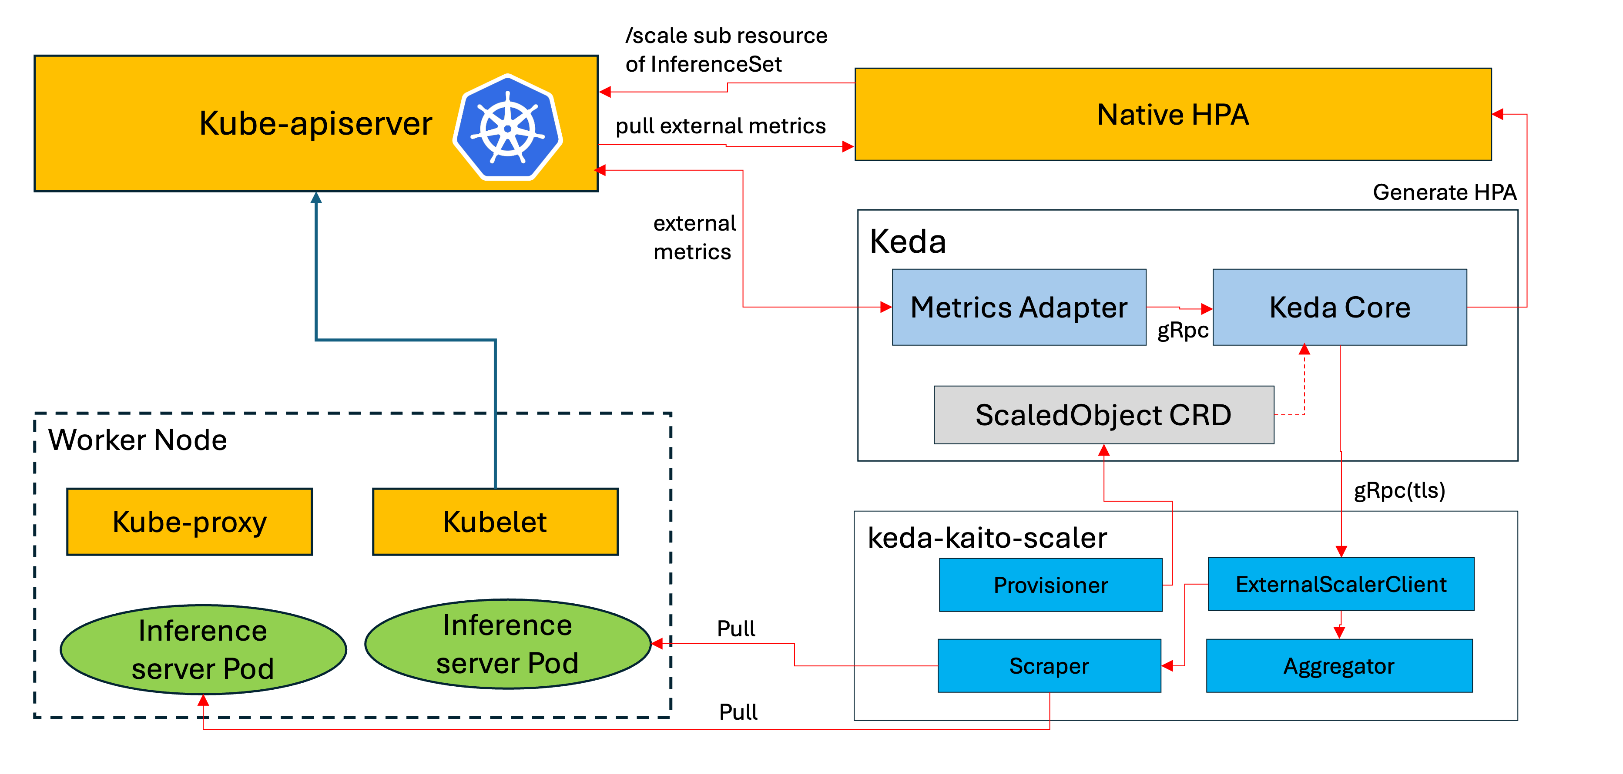
Autoscaling: keda-kaito-scaler
Load-aware autoscaling: KEDA-driven, metric-aware scaling for GPU inference (no Prometheus).
What makes it special
Zero dependencies — no Prometheus; scrapes vLLM directly
GPU-safe scaling — conservative ±1 replica per step
Composite metrics — combine queue length + latency under a conservative AND policy
Notes:
Now, autoscaling. This is how KAITO changes the number of copies as load moves. The component is keda-kaito-scaler.
It builds on KEDA, but adds three things that matter for GPUs.
First, no extra dependencies - it does not need Prometheus. It reads metrics straight from vLLM, on each pod. Less to install, less to break.
Second, it is GPU-safe. GPU nodes are expensive and slow to start, so it moves gently - only one copy up or down at a time. That keeps things smooth and avoids waste.
Third, it can watch more than one signal at once - like queue length and latency together - and it only scales up when both agree there is real pressure.
So it is autoscaling made for GPU inference: simple, safe on cost, driven by what the server really sees. Next, how you configure these signals.

Slide 45
Autoscaling: Composite Metrics
One annotation combines multiple signals under a conservative AND policy.
InferenceSet — full composite-metric config
metadata:
annotations:
scaledobject.kaito.sh/auto-provision: "true"
scaledobject.kaito.sh/metrics: |
- name: vllm:num_requests_waiting
type: gauge
source: modelpod
upthreshold: 10
downthreshold: 1
- name: vllm:request_queue_time_seconds
type: histogram
source: modelpod
upthreshold: 30
downthreshold: 1
metriccachewindow: 300
scaledobject.kaito.sh/combinepolicy: "AND"
scaledobject.kaito.sh/evaluationwindow: "60"
scaledobject.kaito.sh/scaleupcooldown: "300"
scaledobject.kaito.sh/scaledowncooldown: "300"
scaledobject.kaito.sh/min-replicas: "1"
scaledobject.kaito.sh/max-replicas: "5"
name: phi-4
spec:
replicas: 1
→ every threshold, window & cooldown must be tuned today.
You configure just this
metadata:
annotations:
.../min-replicas: "1"
.../max-replicas: "5"
everything else → auto-tuned to best practice
In progress
Notes:
Here is how you configure it - all through annotations on the InferenceSet, with no extra objects.
On the left is the full config today. You list the metrics you care about - here the queue length and the request wait time - and for each you set an up and a down threshold. Then the shared rules: the AND policy, the evaluation window, the cooldowns, and the min and max copies.
This gives full control, but I will be honest - it is the hard part. Today every threshold, window, and cooldown must be tuned by hand.
So we are building something simpler, on the right: you set just the min and max copies, and everything else is tuned for you to safe defaults.
It is the same idea as the rest of KAITO - you set what you care about, and the system fills in the rest. Now let's see how this comes together in production.

Slide 46
Production Integration
Notes:
So far I showed the parts one by one - provisioning, lifecycle, and autoscaling. Now let's step back and see how they come together in production.
Production is more than serving one model. You often need to serve many teams safely, deploy in a repeatable way, and stay up under load.
So the next slides cover three things: a production stack that joins llm-d and KAITO, how we test it without real GPUs, and how that gives us confidence. These are not separate demos - they are packaged to run in production from day one.

Slide 47
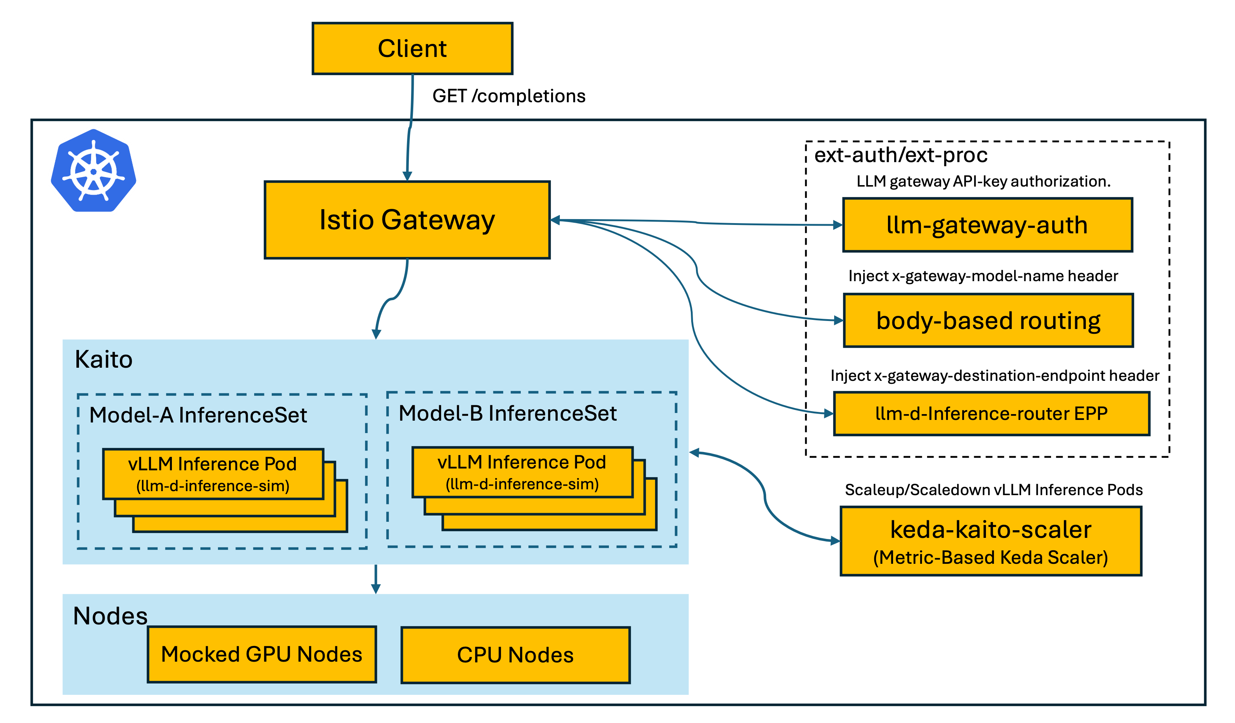
Production-Stack
Built on the llm-d + Kaito integration — one complete, E2E inference solution
Multi-tenant — serve isolated Inference Services to many tenants
Layered delivery — 3 Helm charts: production-stack / modelharness / modeldeployment
Notes:
Let's start with the production stack. It brings the two projects together: llm-d for the request path, KAITO for the infrastructure - one complete, end-to-end solution, already wired up.
It is multi-tenant: many teams share one cluster, and each gets its own isolated service, so one team cannot disturb another.
And it ships in layers, as three Helm charts - the bottom sets up the platform, the middle prepares a model, the top deploys a running service. You install only the layer you need.
So a platform team offers serving as a service, and app teams just ask for a model. It is production-ready, not a demo. But a stack like this is hard to test, because it needs GPUs - so let's see how we solve that.

Slide 48
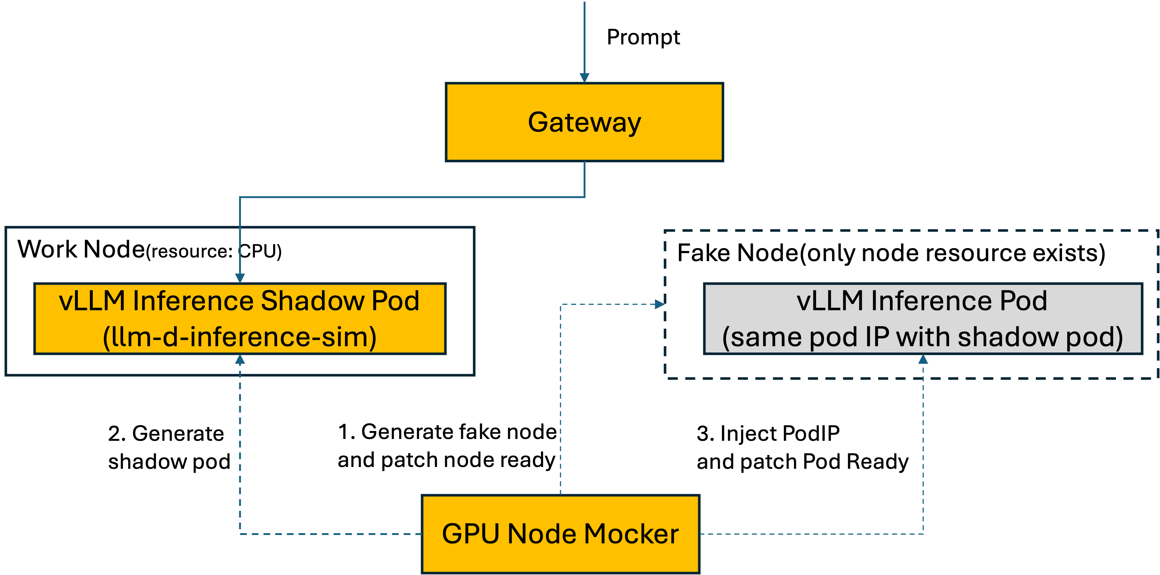
GPU Node Mocker
Run the full GPU inference stack on a CPU-only cluster — same NodePool/NodeClaim → Node → Pod flow, no real GPUs.
What it does
Faithful Karpenter flow — imitates real KAITO GPU provisioning
Phase 1: fake GPU node — per NodeClaim: gpu labels/taints, capacity, NodeClaim Ready, 10s lease heartbeat
Phase 2: shadow pod — runs llm-d-inference-sim on a real CPU node; writes its real IP into the inference pod status
CPU-only E2E: the whole GPU inference stack runs unchanged — at zero GPU cost.
Notes:
Testing GPU systems is painful, because GPUs are expensive and scarce. So we built the GPU Node Mocker. It runs the whole GPU inference stack on a normal CPU-only cluster.
The key idea: it follows the exact same flow as the real system - a node request comes in, a node is created, a pod is scheduled. Nothing in the real code path changes.
It works in two steps. First, it creates a fake GPU node that looks completely real: right labels, taints, and capacity, reports ready, and sends a heartbeat every ten seconds. Second, it runs a shadow pod - a light simulator on a CPU node - and writes its real IP into the status, so the system thinks it is a real model server.
The result: the full stack runs end to end, on CPUs, at zero GPU cost. So you can test on every change, not only when a GPU is free. Let's see what that gives us.

Slide 49
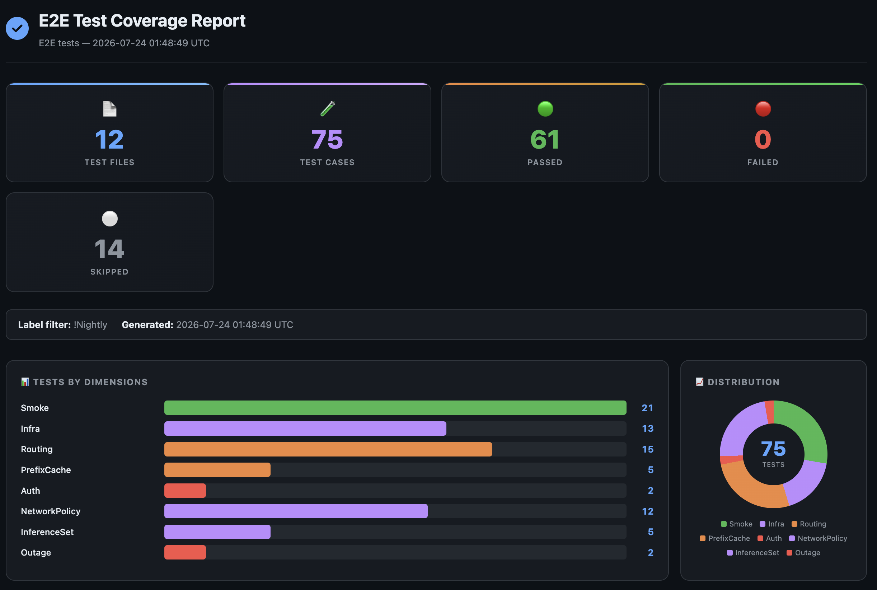
Testing=Confidence
70+ end-to-end test cases — comprehensive coverage for production-stack
Two paths, one suite — mocked GPU nodes (gpu-node-mocker) + real GPU nodes via Karpenter
Notes:
Good testing is what turns code into confidence. KAITO ships with more than seventy end-to-end tests that cover the whole production stack.
And they run two ways from one suite: most runs use the mocked GPU nodes we just saw, so they are fast and cheap; some use real GPU nodes from Karpenter, to prove it works on real hardware.
So every change is checked end to end - cheaply on CPUs first, then confirmed on real GPUs. Same tests, two paths.
That means we can move fast and still trust that production keeps working. And that brings the KAITO section together - from a two-field config, to lifecycle, autoscaling, a production stack, and testing we rely on. With that, I am happy to take your questions.

Slide 50




Where can you find us
llm-d.ai
github.com/llm-d
llm-d.ai/slack
https://kaito-project.github.io/kaito/docs/
https://github.com/kaito-project
https://llm-d.ai
Join Community Slack
llm-d.ai/slack
https://github.com/kaito-project
Join Community Slack
KAITO/slack
Notes:
**中文**
所有组件都是开放的。左侧可以访问 llm-d 网站、GitHub 和社区 Slack；右侧是 KAITO 文档与 GitHub。欢迎试用 well-lit paths、复现实验，并把实际 workload 和反馈带回社区。
**English**
All of these components are open. On the left, you can find the llm-d website, GitHub organization, and community Slack. On the right are the KAITO documentation and GitHub organization. We welcome you to try the well-lit paths, reproduce the experiments, and bring your real workloads and feedback back to the communities.

Slide 51


Q&A
Welcome to Contact Kay
Welcome to Contact linbo
Question & Discussion
LLM-D | KAITO
Notes:
**中文**
谢谢大家。今天的核心结论是：从 model serving 走向 distributed inference，不是增加一个单独优化，而是让 request、KV state、distributed workers、workload lifecycle 和 GPU capacity 进入同一个控制闭环。llm-d 优化请求和分布式执行，KAITO 运营 workload 与 GPU 生命周期。下面欢迎提问。
**English**
Thank you. The main takeaway is that moving from model serving to distributed inference is not one isolated optimization. It brings requests, KV state, distributed workers, workload lifecycle, and GPU capacity into one connected control loop. llm-d optimizes request placement and distributed execution, while KAITO operates workloads and GPU lifecycles. We welcome your questions.

