Slide 1
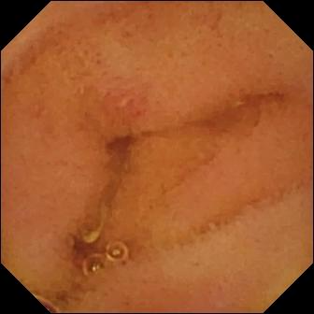
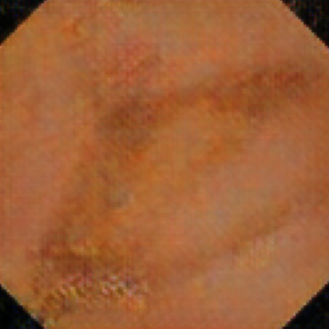
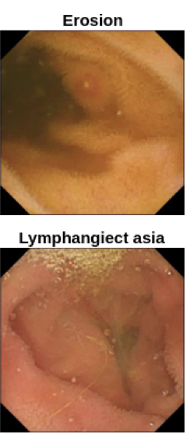
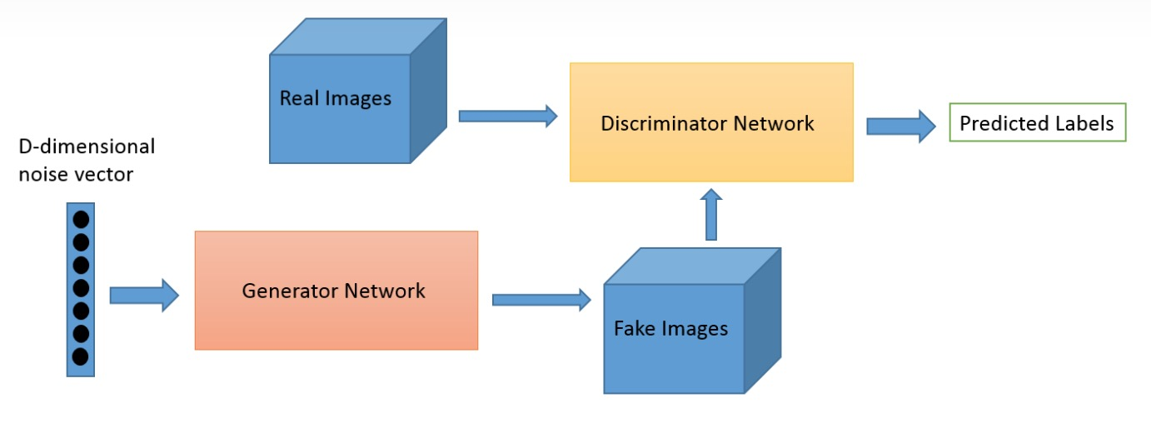
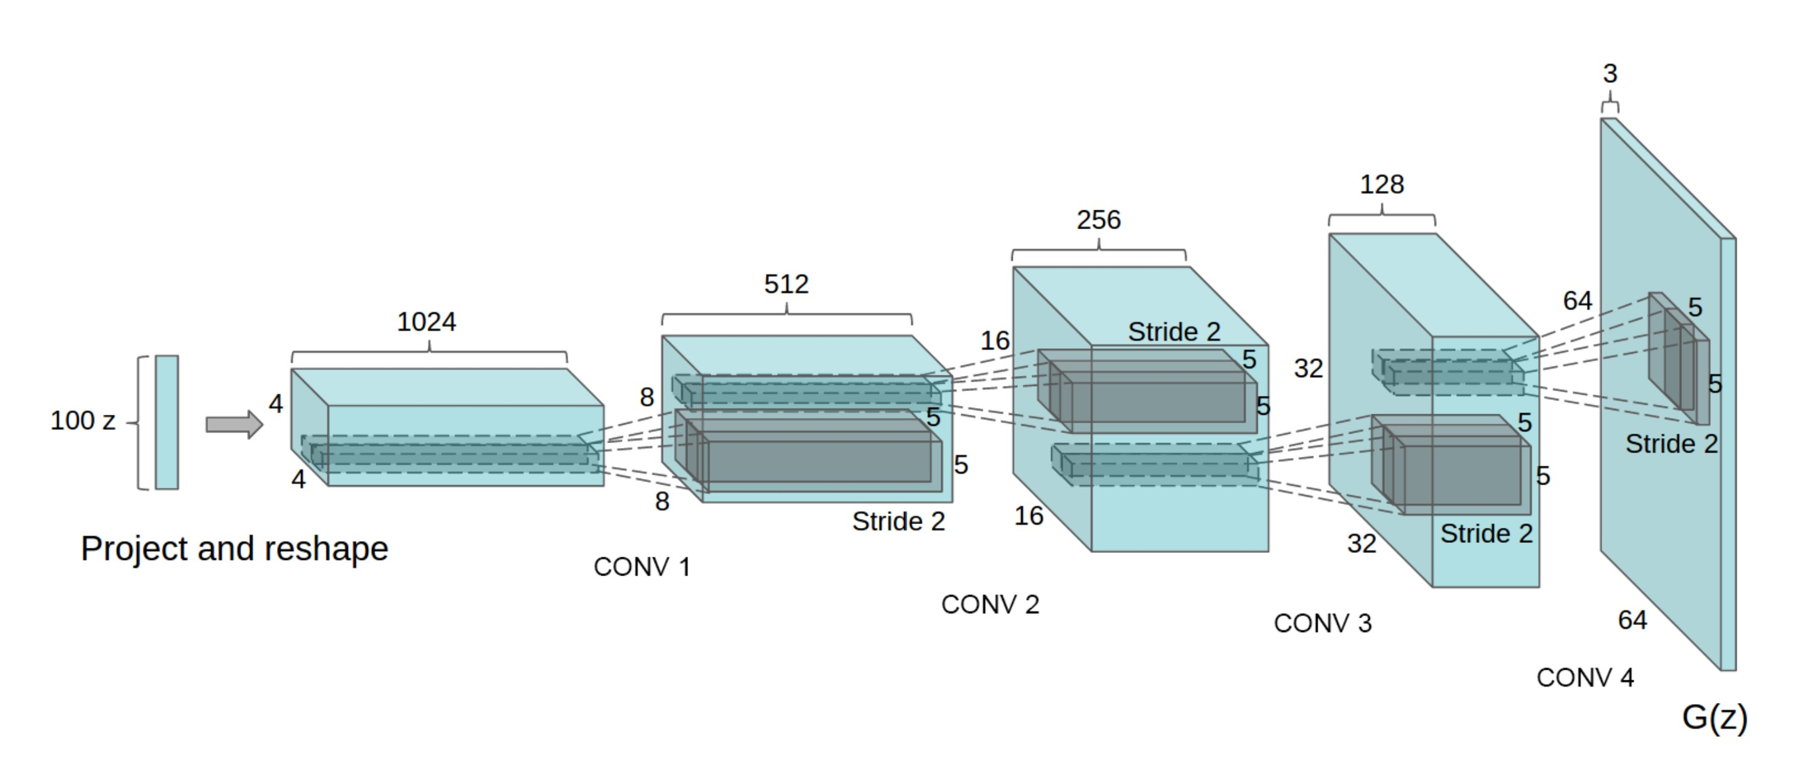
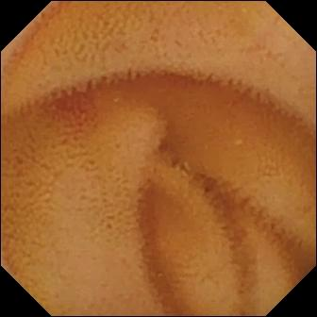
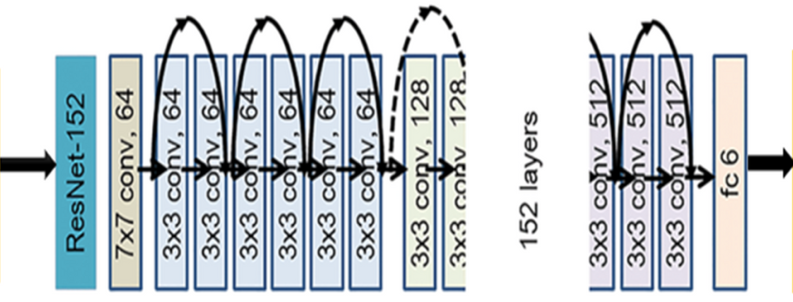
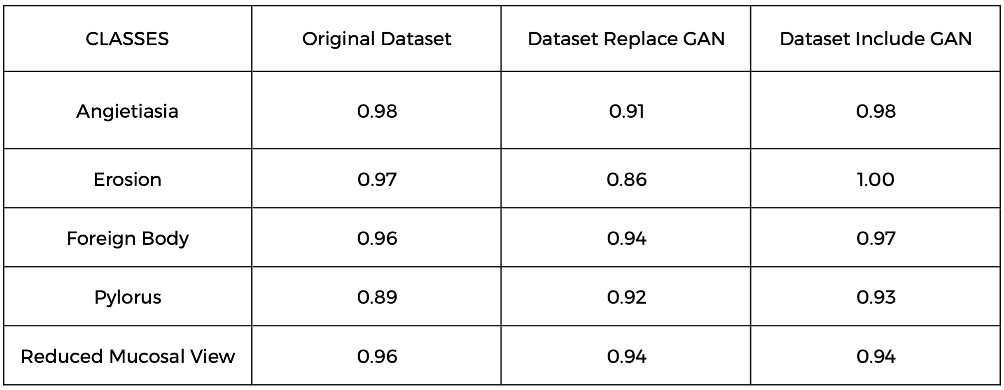
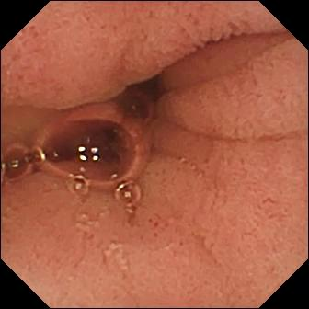
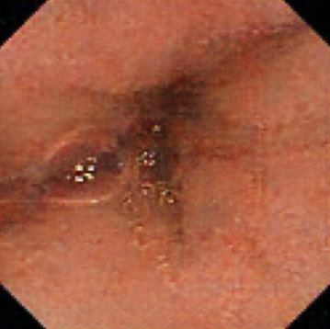
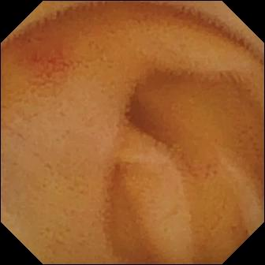
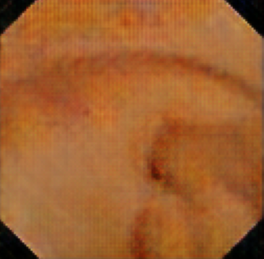
Improving CNN Kvasir-Capsule Classification based on GAN
Abstract
Image Generating Model - GAN
Dataset
Kvasir-Capsule, a large-scale VCE dataset with 44,228 frames with 13 classes of different anomalies
Background
A good classification model on the diseases can improve the anomaly detection rate, reduce physicians’ time for screening, and aid in real-world clinical analysis.
Why a better classification accuracy
The current classification accuracy still have low accuracy on some anomaly class detection.
Erosion
Results
Classification Model - ResNet152
DCGAN Generator
Precision of ResNet152
Output Classification
Input Image
A residual neural network is an artificial neural network (ANN). It’s a gateless or open-gated variant of the HighwayNet, the first working very deep feedforward neural network with hundreds of layers. The model focus on solving complex problems, additional layers are stacked in the Deep Neural Networks which results in improved accuracy and performance. The intuition behind adding more layers is that these layers progressively learn more complex features.
Comparation of original and generated images
Dataset we used for generating new images (50 images per class)
The output image generated by GAN
(10 images per class)
The discriminator of GAN has accuracy 80% - 100% with 4000 epochs
Conclusion
Objectives
The result of ResNet152 improves by just adding a few generated images, so we conclude generating new Kvasir-Capsule images by using GAN is feasible. However, there are some limitations at this point such as heavy human intervention is needed to distinguish fake and duplicate images. Future research and experiment are required to address and solve these issues, but we believe the potential to further improve the result is promising and those GAN-generated images can be used in contexts outside of the convolutional neural network.
We hope to use existing images in the dataset to generate new images for training. The new images should include features from one or more original images. Although the difference may not be significant if observed with naked eyes, they should still provide meaningful characteristics if the numbers behind them are different. Using the newly generated images, we hope the final performance of ResNet152 can be significantly improved.
Pylorus
Methods
References
We are utilizing the Generative adversarial network (GAN) model for producing new images from the existing dataset. This technique learns how to generate new images with the same statistics as the training set. GAN trained on images can generate new images that look at least superficially authentic to human observers, having many realistic characteristics.
Number of images in dataset for training
We select images five classification group, in each group we have two subclasses, and each subclass has 50 images. 500 images in total.
Number of images generated
Images generated for five classification group, in each group we have two subclasses, and each subclass has 10 images. 100 images generated in total.
1. Srivastava, A., Tomar, N. K., Bagci, U., & Jha, D. (2022). Video capsule endoscopy classification using focal modulation guided Convolutional Neural Network. 2022 IEEE 35th International Symposium on Computer-Based Medical Systems (CBMS). https://doi.org/10.1109/cbms55023.2022.00064
2. Aggarwal, A., Mittal, M., & Battineni, G. (2021). Generative Adversarial Network: An overview of theory and applications. International Journal of Information Management Data Insights, 1(1), 100004. https://doi.org/10.1016/j.jjimei.2020.100004
3. Radford, A., Metz, L., & Chintala, S. (2015). Unsupervised Representation Learning with Deep Convolutional Generative Adversarial Networks. doi:10.48550/ARXIV.1511.06434
Angiectasia

