Slide 1

Deception Detective Fact - Checker

Slide 2
Team Members
Andrew Nease: neaseaw@mail.uc.edu
Daniel Wood: wooddj@mail.uc.edu
Lando Slack: slacklj@mail.uc.edu
Advisor
Dr. Yiming Hu: huyg@ucmail.uc.edu

Slide 3
Goals
This project was conceived to address the growing issue of misinformation spread online. Our goals are as follows --
Provide a convenient and widely usable fact-checking experience
Assign an easily understood factual rating to questionable statements
If a factual rating cannot be assigned through our software, applicable resources (pertinent web links) are provided to the user to investigate further

Slide 4
Intellectual Merits
“Atomic Statement Finding”:
Using part-of-speech tagging and syntax rules, we were able to develop a tool that approximates all the statements made within a body of text
"Website Scraping and Crawling"
Querying a URL, reading the website's content, sorting the content for links to other pages, and consequently querying the links retrieved

Slide 5
Broader Impacts
Misinformation is a powerful tool used in manipulating populations. We believe that convenient access to the truth can help individuals overcome the novel dangers of today’s Internet experience.
With continued development on this project, we envision automated fact-checking that would highlight falsehoods without user input.

Slide 6
Design Specifications

Slide 7
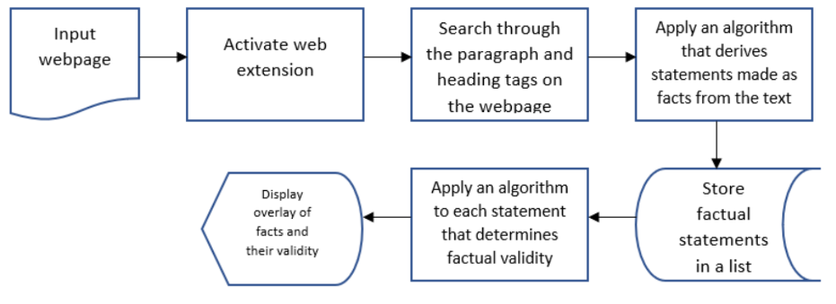
Our project consists of four main components:
Web extension
Statement-finder backend
Fact-checker backend
Output report
The above design diagram for our project shows how these components work together.
Design Specifications

Slide 8
Web extension: The user interacts with the extension to activate the tool
Statement-finder: The input from the web extension is processed to create a list of statements within the provided text
Fact-checker: Each statement is checked against one or more online source to determine its factual integrity
Output report: Using the statements and their results from the fact-checker tool, a report is displayed to show each statement’s factuality rating and citation links for the user to explore
Design Specifications

Slide 9
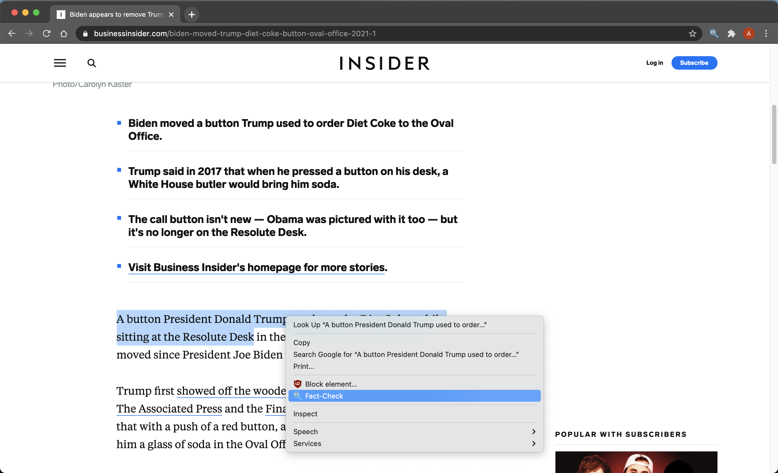
Technologies
Fact-checking is accomplished by a separate server, so our front-end implementations are quite flexible.
We chose to create a Google Chrome extension for maximum end-user simplicity. Communication to the back-end server is accomplished with REST API endpoints.

Slide 10
Technologies
neuralcoref: a Python library that provides tools for coreference resolution. We used this to develop a simple method for pronoun replacement
Natural Language Toolkit (nltk): Python library with natural language processing methods. We used this for preprocessing our text data before running it through our statement-finder function
Spacy: Another natural language processing library in Python. We used this for dependency and part-of-speech tagging in our atomic statement finder function

Slide 11
Technologies
Beautiful Soup – a Python library that allows smooth HTML parsing and splitting. Finding specific element tags and checking them for desired content such as links or paragraph text is at the crux of our web scrapers.
requests – a Python library with tools to query website URLs straight from script code. We use the request() method to retrieve the HTML from the links we're interested in. The HTML is then passed into a Beautiful Soup object.

Slide 12
Milestones
 | Start | Finish
Research | October 2020 | January 2021
Back-End Design | January 2021 | March 2021
Front-End Design | January 2021 | February 2021
Testing and Refactoring | March 2021 | April 2021

Slide 13
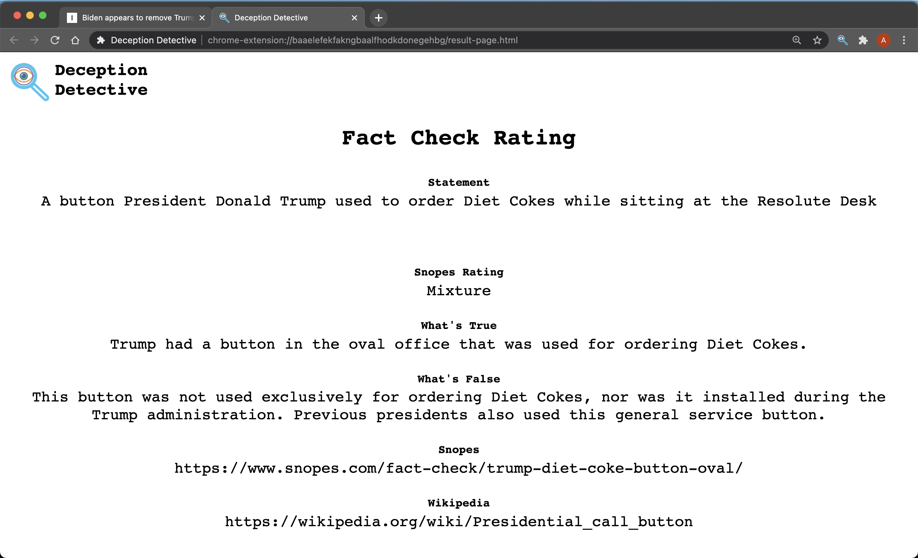
Results
Manual fact-checking interface on Google Chrome
Atomic statement finder that returns all statements that meet the syntax criteria
Web scraper that parses Wikipedia and Snopes pages for fact-check ratings plus text content
Coming soon…

Slide 14
Challenges
Natural language complexity complicates programmatic statement finding
What to do when our algo fails
Automated fact-check
Efficient web crawling and scraping
Speeding up our software execution time for scalability

