Slide 1




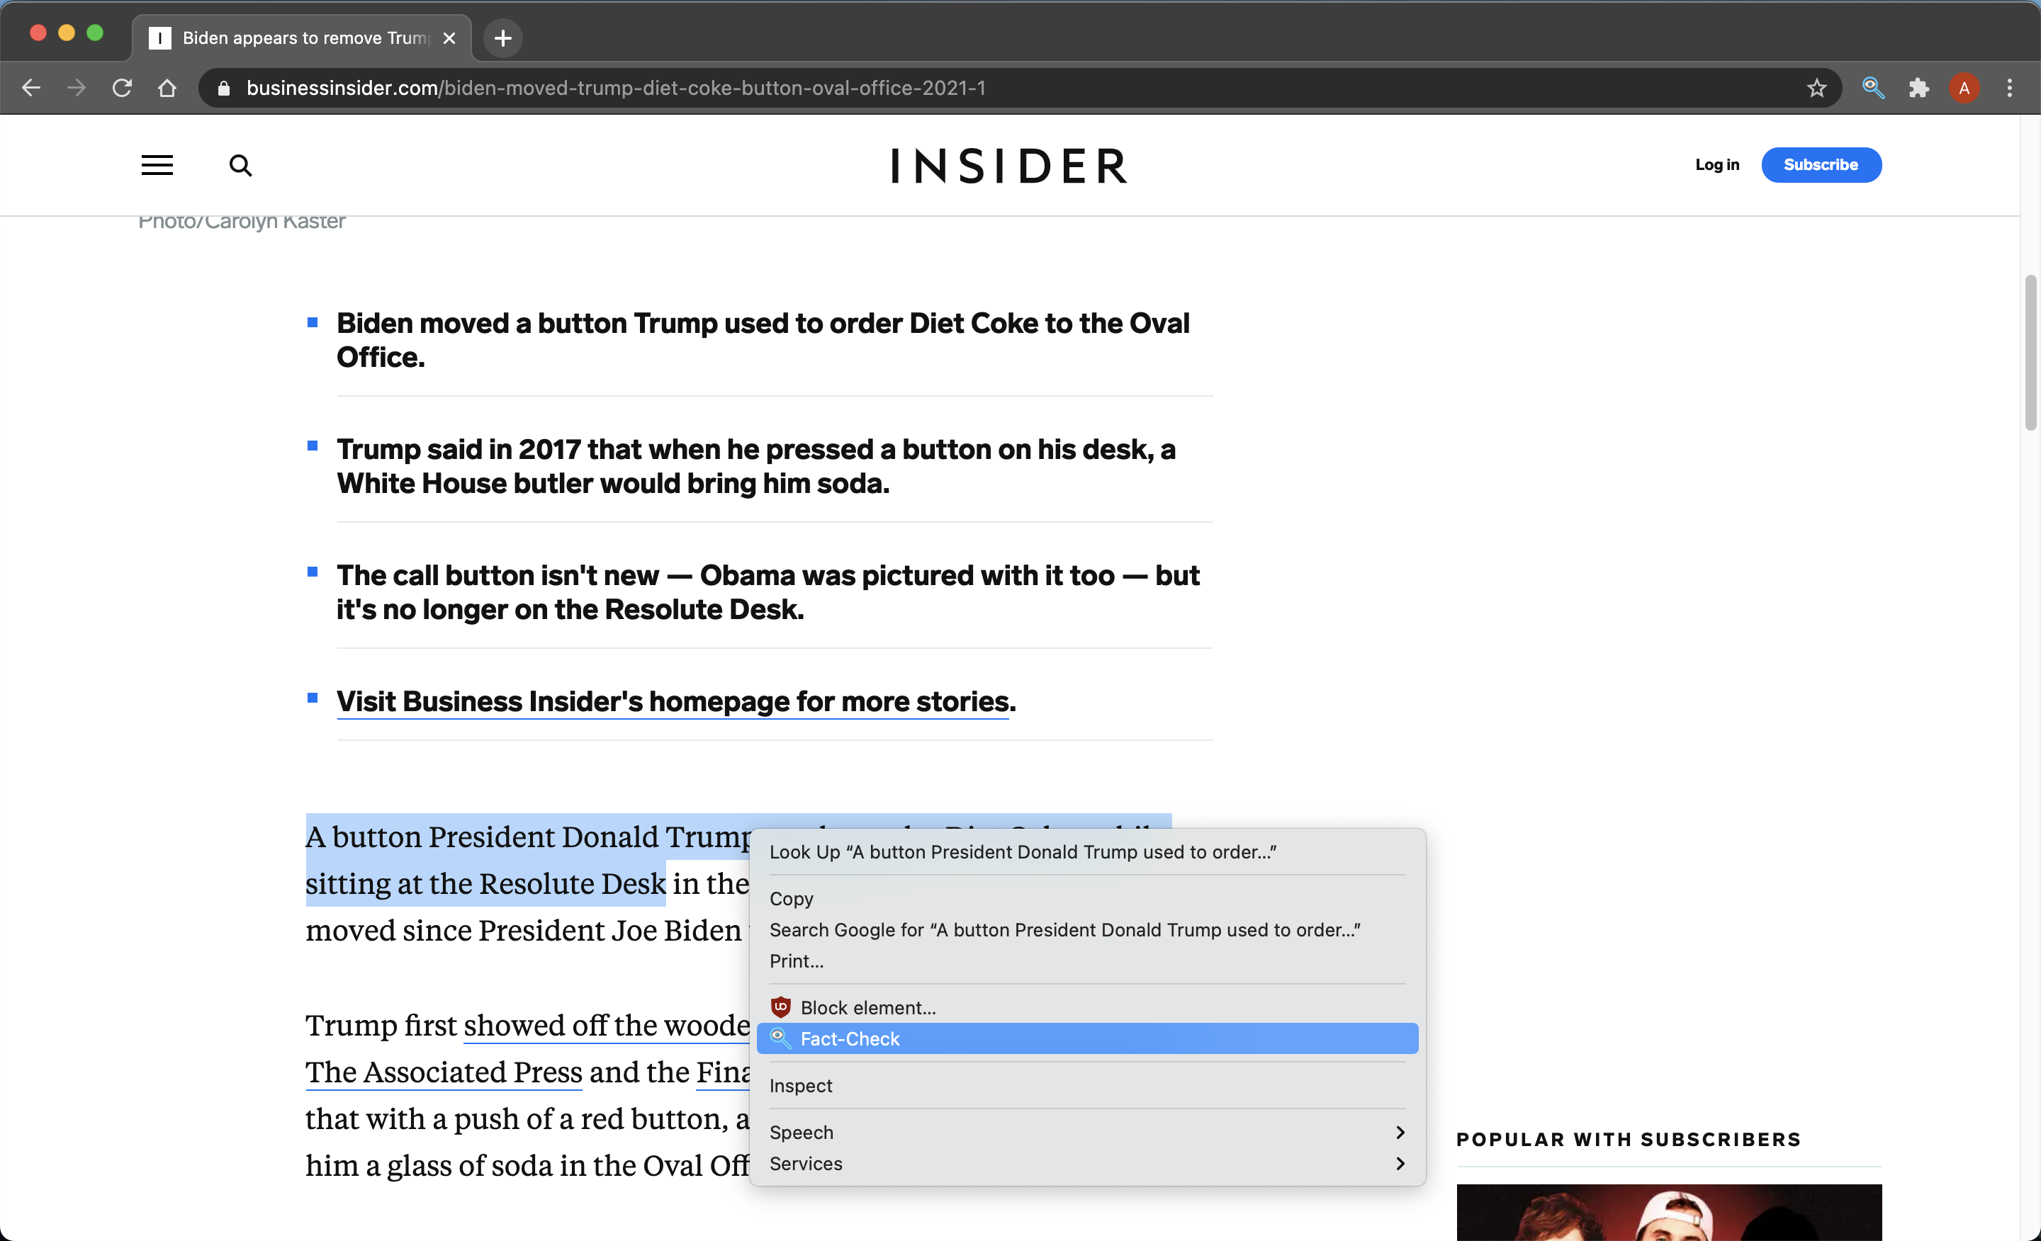
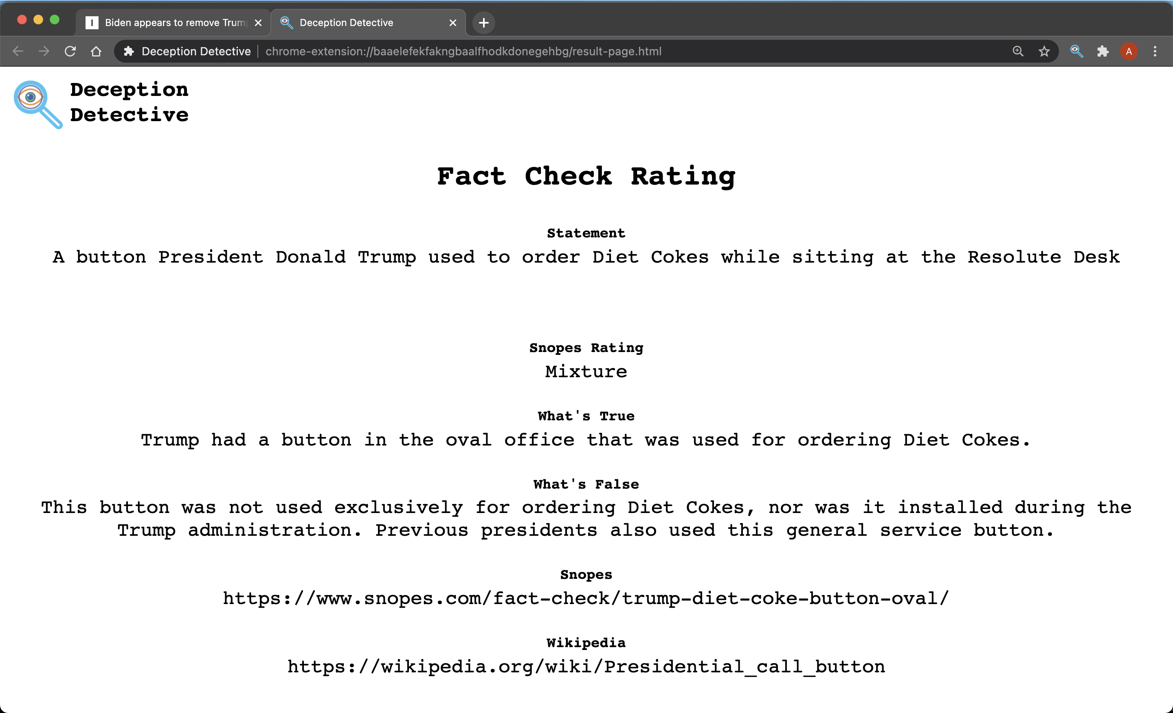
Deception Detective Fact-Checker
Purpose
We want to enable anyone to be able to fact-check content on the web with as little effort as possible. By doing so, we encourage users to verify anything they read online. This will ideally limit the spread of misinformation online and increase user's confidence in their online research.
Design
Use neuralcoref library as our method for pronoun replacement to avoid going beyond the scope of the project.
Use spacy library in Python to identify statements from dependency and part-of-speech tags.
Use Snopes and Wikipedia to check facts against: We believe that checking against a variety of trustworthy sites will provide us with results we can be confident in.
Andrew Nease
Lando Slack
Daniel Wood
Advisor - Prof. Yiming Hu
Challenges
What source to check facts against
Natural language complexity
Full page automated fact-checking
Parsing and scraping different website HTML structures
Overview
Our tool enables user to quickly and accurately fact check all or some of the text on a webpage
Improvements
Develop a pronoun replacement tool from the ground up to deliver better results
Selection based fact-checking, rather than full page
Chrome Extension Activation
Fact Check Rating Page

