Slide 1

The effects of word segmentation quality on word alignments
Master thesis
Student: Ane Berasategi
Supervisor: Masoud Jalili Sabet, Hinrich Schütze
August 2020

Slide 2
Plan
Part 1: Literature review
Tokenization
Translation
Part 2: BPE pipeline
Part 3: Improvements
learn-BPE algorithm
Chaos mode
Part 4: Results
Part 4: Conclusion

Slide 3
Plan
Part 1: Literature review
Tokenization
Introduction
Word level tokenization
Character level tokenization
Subword level tokenization
BPE
BPE-dropout

Slide 4
1. Literature review: tokenization
Tokenization: task of compressing the input text into tokens
Tokens have semantic meaning
It creates a big vocabulary of tokens and shorter sequences

Slide 5
1.1. Literature review: tokenization
Tokenization: task of compressing the input text into tokens
Tokens have semantic meaning
It creates a big vocabulary of tokens and shorter sequences
Input sentence: ‘I ate a burger today, and it was good.’
Text after tokenization: [’I’, ’ate’, ’a’, ’burger’, ’today’, ’and’, ’it’, ’was’, ’good’]

Slide 6
1.1. Literature review: tokenization
The example did word level tokenization
I ate a burger → I, ate, a, burger
Other types of tokenization:
Character level: I, a, t, e, a, b, u, r, g, e, r
Subword level: I, ate, a, burg, er
Subword level without space boundary: I ate, a burg, er

Slide 7
1.1.1. Word level tokenization
Simply split by whitespace, keep punctuation and special signs
Several python libraries: NLTK, SpaCy, Gensim, Keras, etc.

Slide 8
1.1.1. Word level tokenization
Simply split by whitespace, keep punctuation and special signs
Several python libraries: NLTK, SpaCy, Gensim, Keras, etc.
Drawbacks:
What about compound words such as New York?
What to do with out of vocabulary words? Misspellings, foreign words?
Huge vocabulary size

Slide 9
1.1.2. Character level tokenization
Split text into characters
OOV words, misspellings are handled better
Lower vocabulary size

Slide 10
1.1.2. Character level tokenization
Split text into characters
OOV words, misspellings are handled better
Lower vocabulary size
Drawbacks:
Longer sequences, more time to compute
Characters are semantically void
Can require post-processing

Slide 11
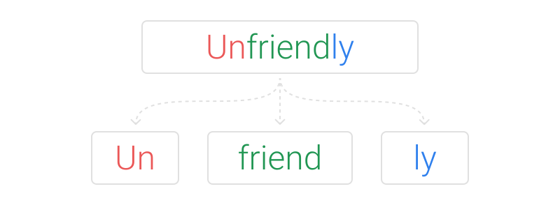
1.1.3. Subword level tokenization

Slide 12
1.1.3. Subword level tokenization
Split common words into words, and uncommon words into subwords
For new OOV words, unsofaly will be segmented into un-sofa-ly
Many algorithms: BPE, unigram LM, WordPiece, SentencePiece
But how to segment unfriendly into un-friend-ly?

Slide 13
1.1.4. BPE
Subword tokenization algorithm that merges the most frequently occurring character or character sequences iteratively
Neural Machine Translation of Rare Words with Subword Units, Sennrich et al., 2015

Slide 14
1.1.4. BPE
Subword tokenization algorithm that merges the most frequently occurring character or character sequences iteratively
Algorithm steps:
Get corpus and set vocabulary size
Split word to sequence of characters and append a beginning-of-word token (in this thesis, _)
Calculate pairs of sequences in the text and their frequencies
Obtain the most frequent sequence pair
Merge the most frequent pair in corpus
Repeat steps 3-5 until reaching desired vocabulary size or maximum frequency of pairs is 1
Neural Machine Translation of Rare Words with Subword Units, Sennrich et al., 2015

Slide 15


1.1.4. BPE - example
Set corpus and desired vocabulary size:
Split text into sequence of characters and append _ to each beginning of word

Slide 16

1.1.4. BPE - example
Set corpus and desired vocabulary size:
Split text into sequence of characters and append _ to each beginning of word
Calculate pairs of sequences in the text and their frequencies
Obtain the most frequent sequence pair

Slide 17
1.1.4. BPE - example
Set corpus and desired vocabulary size:
Split text into sequence of characters and append _ to each beginning of word
Calculate pairs of sequences in the text and their frequencies
Obtain the most frequent sequence pair
Merge the most frequent pair in corpus

Slide 18
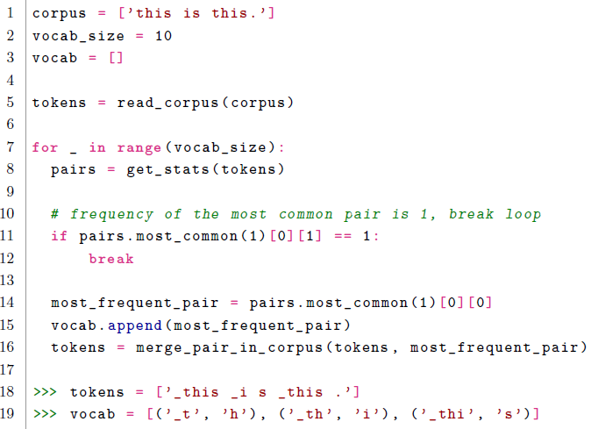
1.1.4. BPE - example
Repeat steps 3-5 until reaching desired vocabulary size or maximum frequency of pairs is 1

Slide 19

1.1.4. BPE
Most common pairs in English
Text after 200 merges
Text after 2000 merges:
BPE is greedy: it makes the locally optimal choice at each stage
BPE only outputs one segmentation
Neural Machine Translation of Rare Words with Subword Units, Sennrich et al., 2015

Slide 20
1.1.5. BPE-dropout
When applying BPE to a corpus, discards some merges with a probability
Each time the algorithm is run there are different segmentations →
For consistency, the algorithm is run several times
BPE-Dropout: Simple and Effective Subword Regularization, Provilkov et al., 2019

Slide 21
Plan
Part 1: Literature review
Translation
Word alignments
Fastalign, Eflomal

Slide 22
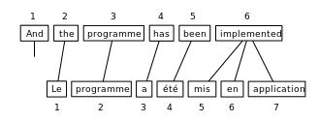
1.2.1. Translation – word alignments
This tesis evaluates BPE units via word alignments
Word alignments were originally used in statistical machine translation
Example of word alignments: ‘2-1 3-2 4-3 5-4 6-5 6-6 6-7’

Slide 23
1.2.2. Word alignment algorithms
Fastalign is a log-linear reparametrization of IBM Model 2. It uses the symmetrization step GDFA
Eflomal is defined as efficient low-memory aligner
Fastalign is based on an IBM model vs. Eflomal is based on a hidden Markov Model
To evaluate alignments, precision, recall, F1 and AER (alignment error rate) are used
A simple, fast, and effective reparameterization of IBM model 2, Dyer et al., 2013
Efficient word alignment with markov chain monte carlo, Östling et al., 2016

Slide 24
Plan
Part 1: Literature review
Tokenization
Translation
Part 2: BPE pipeline
Part 3: Improvements
learn-BPE algorithm
Chaos mode
Part 4: Results
BPE-dropout for various languages
learn-BPE algorithm improvement
Chaos mode results
Part 4: Conclusion

Slide 25
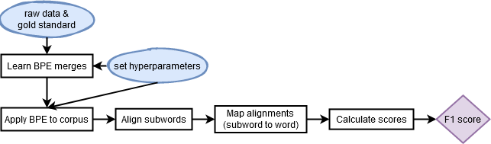
2. BPE pipeline
English sentence after 4000 merges:
_they _will _certain ly _en h ance _the _feeling _of _the _right _of _mo vement
Languages
Num merges to learn
Num merges to segment
Alignment algorithm
Dropout rate

Slide 26
Plan
Part 1: Literature review
Tokenization
Translation
Part 2: BPE pipeline
Part 3: Improvements
learn-BPE algorithm
Chaos mode
Part 4: Results
BPE-dropout for various languages
learn-BPE algorithm improvement
Chaos mode results
Part 4: Conclusion

Slide 27
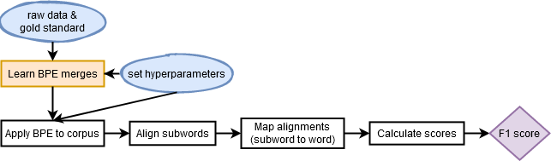
3. Improvements
English sentence after 4000 merges (chaos mode):
_they_will _cert ain ly _en h ance _the _feel ing_of_the _ri ght_of _mo vement
Languages
Num merges to learn
Num merges to segment
Alignment algorithm
Dropout rate
Chaos mode

Slide 28
3. Improvements
Algorithm improved: only update frequency of the pairs next to the merged pair
Languages
Num merges to learn
Num merges to segment
Alignment algorithm
Dropout rate
Chaos mode

Slide 29
Plan
Part 1: Literature review
Tokenization
Translation
Part 2: BPE pipeline
Part 3: Improvements
learn-BPE algorithm
Chaos mode
Part 4: Results
Part 4: Conclusion

Slide 30
4. Results
Best hyperparameters:
Dropout rate: 10%
Num units to segment: 2000
BPE-dropout improvement over BPE
Eng-Deu (10k sentences): 3.5%
Eng-Ron (50k sentences): 1.5%
Eng-Hin (3k sentences): 2.8%

Slide 31
4. Results
Best hyperparameters:
Dropout rate: 10%
Num units to segment: 2000
BPE-dropout improvement over BPE
Eng-Deu (10k sentences): 3.5%
Eng-Ron (50k sentences): 1.5%
Eng-Hin (3k sentences): 2.8%
2.5x speedup of learn-BPE
chaos mode: 3.5x longer
Chaos mode: BPE-dropout improvement over BPE
Eng-Deu: 10.5%
Eng-Ron: 8.6%
Eng-Hin: 6.4%

Slide 32
5. Conclusion
BPE + word alignment pipeline
Proved the improvement of BPE-dropout over BPE in 3 language pairs
Improvement of learn-BPE algorithm
Implementation of chaos mode in the pipeline
Chaos mode: improvement of BPE-dropout over BPE in all languages

Slide 33
The effects of word segmentation quality on word alignments
Master thesis
Student: Ane Berasategi
Supervisor: Masoud Jalili Sabet, Hinrich Schütze
August 2020

