Slide 1

The effects of word segmentation quality on word alignments
Master thesis
Student: Ane Berasategi
Supervisor: Masoud Jalili Sabet, Hinrich Schütze
August 2020

Slide 2
Plan
Part 1: Literature review
Tokenization
Translation
Part 2: Replication of results
BPE
BPE dropout
Part 3: Improvements
learn-BPE algorithm
Chaos mode
Part 4: Results
BPE-dropout for various languages
learn-BPE algorithm improvement
Chaos mode results
Part 4: Conclusion

Slide 3
Plan
Part 1: Literature review
Tokenization
Introduction
Word level tokenization
Character level tokenization
Subword level tokenization
BPE
BPE-dropout
Subword algorithm comparison

Slide 4
1. Literature review: tokenization
Tokenization: task of compressing the input text into tokens
Tokens have semantic meaning
It creates a big vocabulary of tokens and shorter sequences

Slide 5
1.1. Literature review: tokenization
Tokenization: task of compressing the input text into tokens
Tokens have semantic meaning
It creates a big vocabulary of tokens and shorter sequences
Input sentence: ‘I ate a burger today, and it was good.’
Text after tokenization: [’I’, ’ate’, ’a’, ’burger’, ’today’, ’and’, ’it’, ’was’, ’good’]

Slide 6
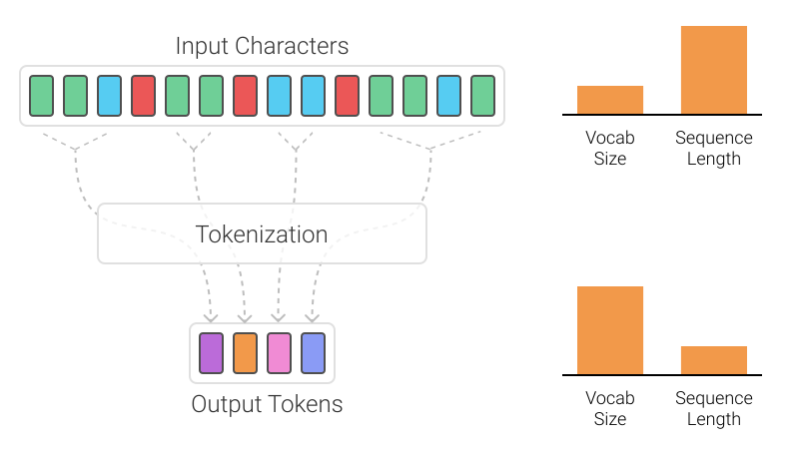
1.1. Literature review: tokenization

Slide 7
1.1. Literature review: tokenization
The example did word level tokenization
I ate a burger → I, ate, a, burger
Other types of tokenization:
Character level: I, a, t, e, a, b, u, r, g, e, r
Subword level: I, ate, a, burg, er
Subword level without space boundary: I ate, a burg, er

Slide 8
1.1.1. Word level tokenization
Simply split by whitespace, keep punctuation and special signs
What about compound words such as New York?
Several python libraries: NLTK, SpaCy, Gensim, Keras, etc.

Slide 9
1.1.1. Word level tokenization
Simply split by whitespace, keep punctuation and special signs
What about compound words such as New York?
Several python libraries: NLTK, SpaCy, Gensim, Keras, etc.
Drawbacks:
What to do with out of vocabulary words? Misspellings, foreign words?
Huge vocabulary size

Slide 10
1.1.2. Character level tokenization
Split text into characters
OOV words, misspellings are handled better
Lower vocabulary size

Slide 11
1.1.2. Character level tokenization
Split text into characters
OOV words, misspellings are handled better
Lower vocabulary size
Drawbacks:
Longer sequences, more time to compute
Characters are semantically void
Can require post-processing

Slide 12
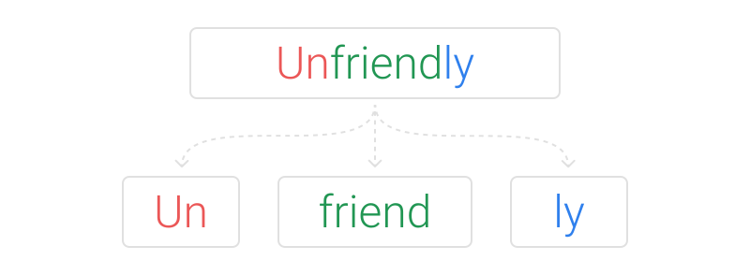
1.1.3. Subword level tokenization

Slide 13
1.1.3. Subword level tokenization
Split common words into words, and uncommon words into subwords
But how to segment unfriendly into un-friend-ly?
Many algorithms: BPE, unigram LM, WordPiece, SentencePiece

Slide 14
1.1.3. Subword level tokenization
Split common words into words, and uncommon words into subwords
But how to segment unfriendly into un-friend-ly?
Many algorithms: BPE, unigram LM, WordPiece, SentencePiece
For new OOV words, unfiendly will be segmented into un-fiend-ly

Slide 15
1.1.4. BPE
Subword tokenization algorithm that merges the most frequently occurring character or character sequences iteratively
Neural Machine Translation of Rare Words with Subword Units, Sennrich et al., 2015

Slide 16
1.1.4. BPE
Subword tokenization algorithm that merges the most frequently occurring character or character sequences iteratively
Algorithm steps:
Get corpus and set vocabulary size
Split word to sequence of characters and append a beginning-of-word token (in this thesis, _)
Calculate pairs of sequences in the text and their frequencies
Obtain the most frequent sequence pair
Merge the most frequent pair in corpus
Repeat steps 3-5 until reaching desired vocabulary size or maximum frequency of pairs is 1
Neural Machine Translation of Rare Words with Subword Units, Sennrich et al., 2015

Slide 17


1.1.4. BPE - example
Set corpus and desired vocabulary size:
Split word to sequence of characters and append _ to each beginning of word

Slide 18

1.1.4. BPE - example
Set corpus and desired vocabulary size:
Split word to sequence of characters and append _ to each beginning of word
Calculate pairs of sequences in the text and their frequencies
Obtain the most frequent sequence pair

Slide 19
1.1.4. BPE - example
Set corpus and desired vocabulary size:
Split word to sequence of characters and append _ to each beginning of word
Calculate pairs of sequences in the text and their frequencies
Obtain the most frequent sequence pair
Merge the most frequent pair in corpus

Slide 20
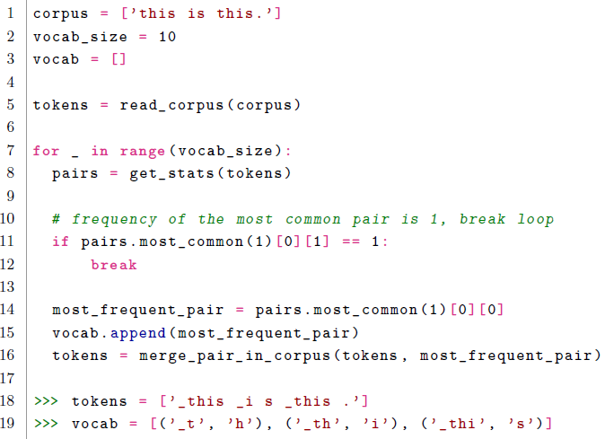
1.1.4. BPE - example
Repeat steps 3-5 until reaching desired vocabulary size or maximum frequency of pairs is 1

Slide 21

1.1.4. BPE - example
Repeat steps 3-5 until reaching desired vocabulary size or maximum frequency of pairs is 1
BPE-dropout

Slide 22
1.1.5. BPE-dropout
Given a dropout rate, usually 10%, discards some of the merges
Each time the algorithm is run there are different segmentations →
For consistency, the algorithm is run several times

Slide 23
1.1.6. Subword algorithms comparison
BPE is greedy: it makes the locally optimal choice at each stage
BPE only outputs one segmentation (fixed by BPE-dropout)

Slide 24
1.5. BPE-dropout
Given a dropout rate, usually 10%, discards some of the merges
Each time the algorithm is run there are different segmentations →
For consistency, the algorithm is run several times

Slide 25
1.1.6. Subword algorithms comparison
BPE is greedy: it makes the locally optimal choice at each stage
BPE only outputs one segmentation (fixed by BPE-dropout)
Unigram language model outputs multiple segmentations, the algorithm is more complicated
Subword Regularization: Improving Neural Network Translation Models with Multiple Subword Candidates, Kudo et al., 2018

Slide 26
1.1.6. Subword algorithms comparison
BPE is greedy: it makes the locally optimal choice at each stage
BPE only outputs one segmentation (fixed by BPE-dropout)
Unigram language model outputs multiple segmentations, the algorithm is more complicated
WordPiece has a different way of deciding which pair to merge
BPE only considers the frequency of the sequence pair
WordPiece also considers the frequency of each individual sequence
Japanese and Korean voice search, Schuster and Nakajima, 2012

Slide 27
1.1.6. Subword algorithms comparison
BPE is greedy: it makes the locally optimal choice at each stage
BPE only outputs one segmentation (fixed by BPE-dropout)
Unigram language model outputs multiple segmentations, the algorithm is more complicated
WordPiece has a different way of deciding which pair to merge
BPE only considers the frequency of the sequence pair
WordPiece also considers the frequency of each individual sequence
SentencePiece is an unsupervised text tokenizer and detokenizer.
Ambiguity in character grouping is seen as a source of regularization for downstream models during training
Uses a simple language model to evaluate the most likely character groupings
SentencePiece: A simple and language independent subword tokenizer and detokenizer for Neural Text Processing, Kudo et al., 2018

Slide 28
Plan
Part 1: Literature review
Translation
Word alignments
Fastalign, Eflomal

Slide 29
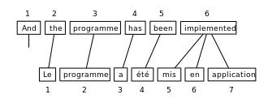
1.2.1. Translation – word alignments
This tesis evaluates BPE units via word alignments
Word alignments were originally used in statistical machine translation
Example of word alignments: ‘2-1 3-2 4-3 5-4 6-5 6-6 6-7’

Slide 30
1.2.2. Word alignment algorithms
Fastalign is a log-linear reparametrization of IBM Model 2. It uses the symmetrization step GDFA
Eflomal is defined as efficient low-memory aligner
Fastalign is based on an IBM model vs. Eflomal is based on a hidden Markov Model
To evaluate alignments, precision, recall, F1 and AER (alignment error rate) are used
A simple, fast, and effective reparameterization of IBM model 2, Dyer et al., 2013
Efficient word alignment with markov chain monte carlo, Östling et al., 2016

