Slide 1
Learning Sentiment values from Movie Reviews
By Aneek Basu Neogi

Slide 2
Introduction
The goal of this project is to correctly predict a value to the sentiment expressed in movie reviews from IMDb.

Slide 3
Motivation
Nowadays, automated rating and recommendation systems are prevalent whether you are buying some goods from Amazon our searching for movies in Netflix.
But in order to do that, one need to predict the overall sentiment of different reviews and combine it with your preferences to determine how to present the best options.

Slide 4
Dataset
The core dataset contains 50,000 reviews split evenly into 25k train and 25k test sets.
The overall distribution of labels is balanced (25k positive and 25k negative).
In the labeled train/test sets, a negative review has a score <= 4 out of 10, and a positive review has a score >= 7 out of 10. Thus reviews with more neutral ratings are not included in the train/test sets.
The average size of reviews is 265 words.
The largest review has 2730 words.

Slide 5
Approach
First, I created list of all reviews. List of tuples - each tuple contains full text, id, rating, sentiment.
Then I tokenized the text.
Then I added <PAD> tokens to the reviews which was less than the average words and pruned the reviews which has more than the average number of words to the 265.
Then I found a word vector of each word using the fasttext model.

Slide 6
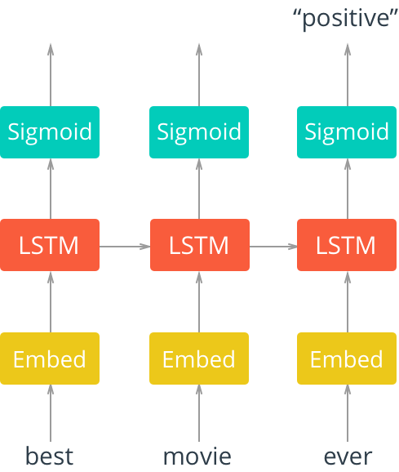
Model

Slide 7
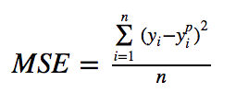
Loss function
I used an MSE(Mean Squared Loss) function.
It is the most commonly used loos function used regression loss function.

Slide 8
Optimizer
I used Adam as an optimizer.
It is the most popular optimizer for deep neural networks since its inception in 2014.

Slide 9
Epoch, Batch Size, Embedding Size, Hidden state size
I trained the model for 100 epochs. It took me approximately 2.5 hours to train the whole model.
The batch size was 512.
The embedding size was 300.
The hidden state size was 128.

Slide 10
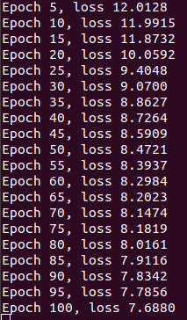
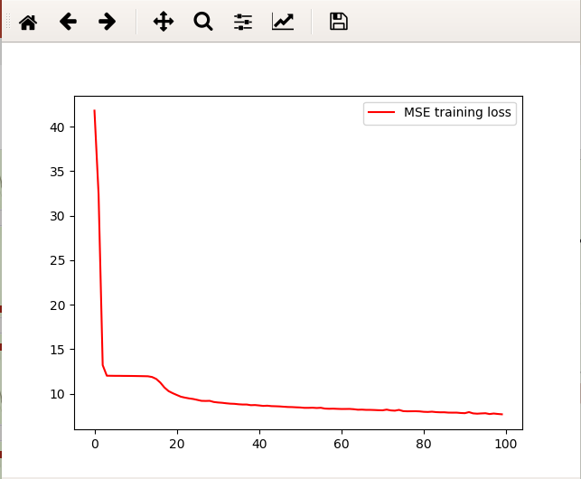
Loss Curve

Slide 11
Libraries Used
PyTorch(for training the model),
Matpoltlib(for visualization),
os,
re(regular expression),
gensim(to load fas)

Slide 12
Future Work
Use the Bert word embeddings to see the difference of result between bert and fasttext.
Use other loss functions.

Slide 13
Thank You

