Slide 1
MARKET BASKET ANALYSIS A desktop based application

Slide 2
Team member: Anil Akheli

Slide 3
1. Introduction:
Market Basket analysis system(MBAS) is one of the key techniques used by large relations to show interrelation between items.
Market basket analysis is a data mining technique used by retailers to increase sales by better understanding customer purchasing patterns
It involves analyzing large data sets of purchase history, to reveal product groupings, as well as products that are likely to be purchased together.

Slide 4
2.Problem statement
There are many Malls and Supermarkets in cities to make customers easy to buy product.
They don’t know which product is related to each other and how to make more product to sell
And if supermarket want to give offer in one product how it would be manage,
The related items searching in one Floor/Mall cannot found in that Floor/Mall. so that customer have to search in different Floor/Mall and that makes customer inconvenience and unmanaged .

Slide 5
3. Project objective:
The objective of market analysis system are as follows:
To analyzing large data sets, of purchase history, to reveal product groupings, as well as products that are likely to be purchased together.
To give relation between the products and items.

Slide 6
Literature review:
Data Mining provides a lot of opportunities in the market sector. Decision making and understanding the behavior of the customer has become vital and challenging problem for the organization in order to sustain in this competitive environment.
data mining is to reveal hidden knowledge from data and various algorithms have been proposed
Association rule mining is used for market basket analysis.
Apriori algorithm is used, level-wise search, uses previous knowledge of frequent item-set properties, breadth first search algorithm

Slide 7
Association Rule Mining
Association rules mining is used for Market basket analysis.
Association rule learning is a rule-based machine learning method for discovering interesting relations between variables in large databases.
An association rule has 2 parts:
An antecedent(if), and
A consequent(then).
An antecedent is something that’s found in data, and a consequent is an item that is found in combination with the antecedent.

Slide 8
Contd.
Association rules are created by thoroughly analyzing data and looking for frequent if/then patterns.
Then, depending on the following three parameters, the important relationships are observed:

Slide 9
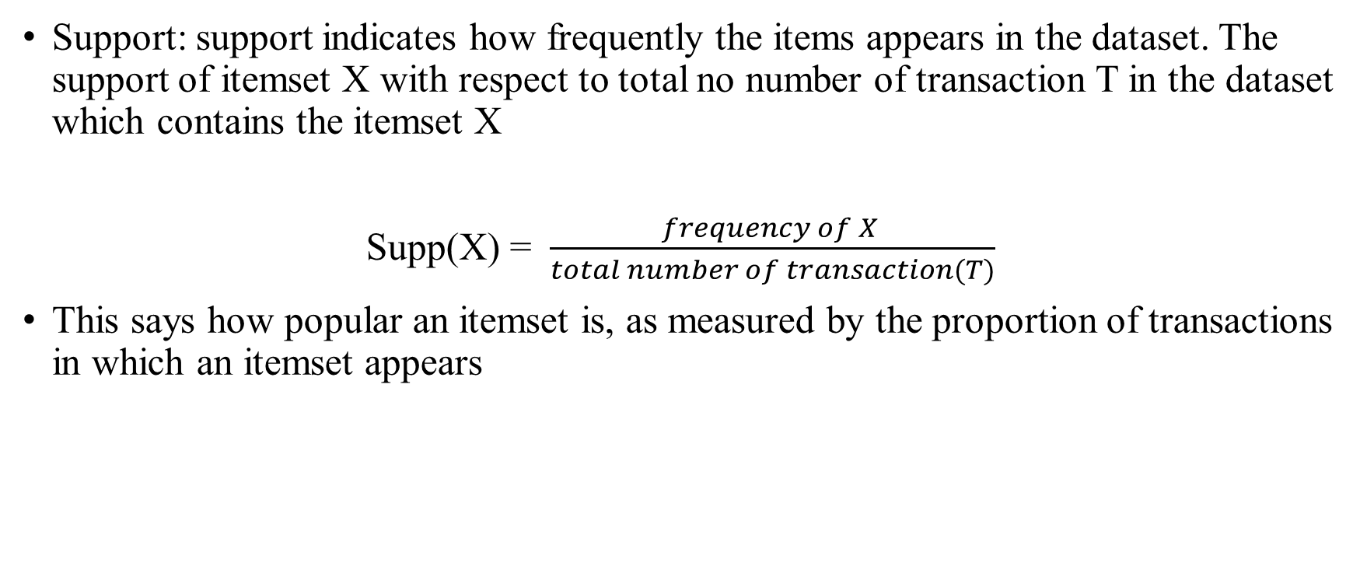
1. Support
Support: support indicates how frequently the items appears in the dataset. The support of itemset X with respect to total no number of transaction T in the dataset which contains the itemset X
Supp(X) = $\frac{frequency of X }{total number of transaction(T)}$
This says how popular an itemset is, as measured by the proportion of transactions in which an itemset appears

Slide 10
2. Confidence :
Confidence is an indication of how often the rule has been found out rule.
The confidence value of a rule, X=> Y, with respect to a set of transaction T, is the proportion of the transaction that contains X which also contains Y.
Confidence is defined as:
Conf(X=>Y) = supp(X∪Y)/supp(X)
This says how likely item Y is purchased when item X is purchased, expressed as {X -> Y}. This is measured by the proportion of transactions with item X, in which item Y also appears.

Slide 11
3. Lift
Lift refers to the increase in the ratio of sale of Y when X is sold.
This says how likely item Y is purchased when item X is purchased, while controlling for how popular item Y is.
Lift(X =>Y) = supp(X∪Y)/supp(X) * supp(Y)
If the rule had a lift of 1, it would imply that the probability of occurrence of the antecedent and that of the consequent are independent of each other. When two events are independent of each other, no rule can be drawn involving those two events.
If the lift is > 1, that lets us know the degree to which those two occurrences are dependent on one another, and makes those rules potentially useful for predicting the consequent in future data sets. otherwise, lets us know the items are substitute to each other. This means that presence of one item has negative effect on presence of other item and vice versa.

Slide 12
4. Methodology:
4.1Data collection : data is collect in csv file.
Transaction no |  |  | items
1. | Milk | Bread | Biscuit | Cornflakes
2. | Maggi | Tea | Biscuit
3. | Jam | Milk | Bread | Milk

Slide 13
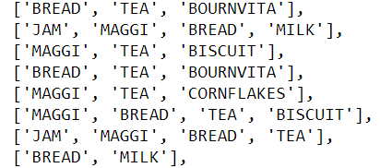
4.2Data processing:
The data collected was mapped manually as integer values as shown in Figure. The mapped integer’s values were then saved in a text file and given as the input to the system.
figure 2: mapped into list

Slide 14
4.3.Apriori Algorithms:
Apriori is an algorithms for frequent item set mining and association rule learning over relational databases. It proceeds by identifying the frequent individual items in the database and extending them to larger and larger item sets as long as those item sets appear sufficiently often in the database.
Apriori property insists that all non-empty subsets of a frequent item set must also be frequent. It is one of the Data Mining Algorithm which is used to find the frequent items/item set from a given data repository
The algorithm involves 2 steps:
pruning
Joining/subset creation

Slide 15
5.Feasibility study:
The feasibility of the system has been studied from the various aspects like whether the system is feasible technically, operationally and economically. The present technology is found to be sufficient to meet the requirements of the system. This system is believed to work well when it is developed and installed. Hence, operational feasibility is achieved. Since the requirements for the project are easily available, ware headed with the intention to use the available resources to fulfill the system requirement.

Slide 16
5.System analysis:
Functional requirement:
For this system the functional requirement analysis are:
The system shall take input as a file of data containing the transaction data
The system shall provide insight into customer behavior patterns
Non-functional requirement analysis:
for this system
User should get the data as fast as possible.
It is user friendly, system reliable
The system shall respond in a timely fashion to user’s requests.

Slide 17
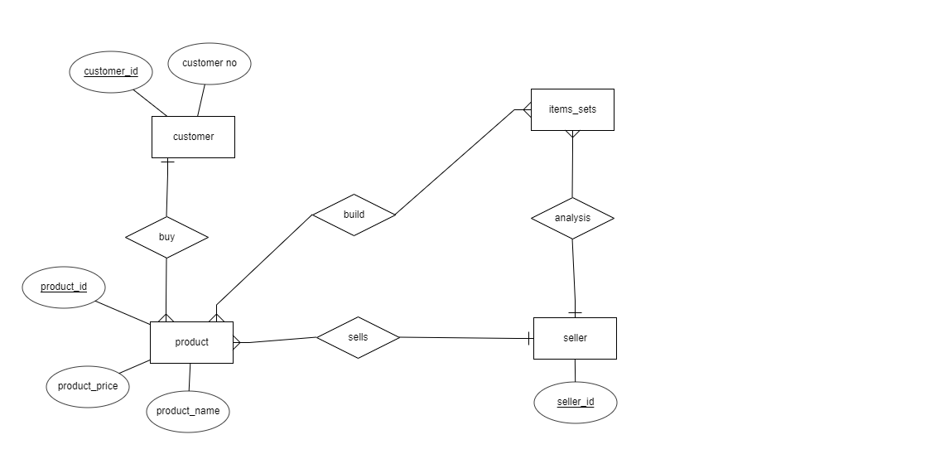
6. Requirement analysis:
For requirement analysis we do object oriented as well as structured system analysis and design(ooad and ssad):
Fig. 1.0 ER diagram of market basket analysis

Slide 18
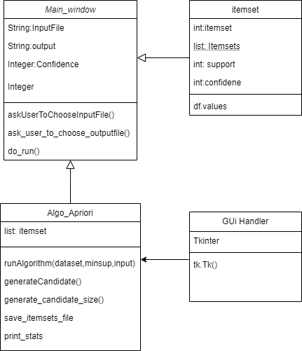
a. Class diagram fig.2 class diagram

Slide 19
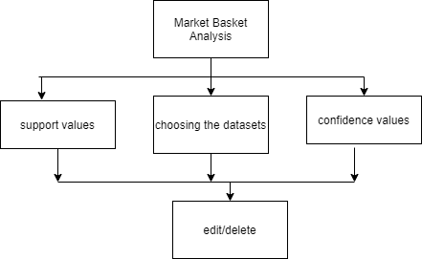
b. Interface design:

Slide 20
9. Limitation:
This system does not recommend product to customer to buys the goods and services,
This system is only for the supermarket company not for the customers,
The application will be desktop and will not be available online.

Slide 21
10.Conclusion:
Using this system we can analyze the market selling process in malls, supermarkets and other retailers .
This system is used in nepali malls supermarkets and local retailers .

Slide 22
Thank you!!

