Slide 1
Dining Philosopher’s Problem
Name: Aneeq Asghar
Roll number: 17L-4525
Section: EL-6A2

Slide 2
Process Synchronization
Process Synchronization is a way to coordinate processes that use shared data.
To keep up information consistency requests systems to guarantee synchronized execution of collaborating forms.

Slide 3
Execution techniques of processes
Serial processing means strictly sequential, without overlap of the successive processing times on objects. It is common is independent processes
Parallel processing is the opposite of serial processing and is common is cooperative processes (share information).

Slide 4
Race condition and its solution
A race condition is actually a situation that several tasks access and manipulate the same data concurrently and the outcome of the execution depends on the particular order in which the access take place.
Rules for avoiding Race Condition:
No two processes may be simultaneously inside their critical regions. (Mutual Exclusion)
No assumptions may be made about speeds or the number of CPUs.
Progress: No process running outside its critical region may block other processes.
Bounded Wait: No process should have to wait forever to enter its critical region.

Slide 5
Solving Synchronization problem in processes using semaphores:
A semaphore is a variable to control access of a common resource by multiple processes in a concurrent system such as a multitasking operating system.
There are types of semaphores:
- Binary (0 or 1)
- Counting (-inf to inf)

Slide 6
Locking and unlocking of semaphores
Binary semaphores are locked by using the wait()and unlocked by post() commands in LINUX.
wait () command decrements the value of the semaphore by 1 so that it goes in the critical region and post () command does the opposite of wait ().

Slide 7
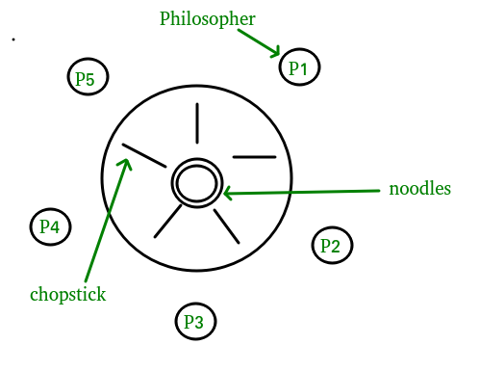
Dining philosopher’s problem
The Dining Philosopher Problem states that K philosophers seated around a circular table with one chopstick between each pair of philosophers. There is one chopstick between each philosopher.
A philosopher may eat if he can pickup the two chopsticks adjacent to him.

Slide 8
Rules:
Philosopher should pick left fork first followed by right fork.
Philosopher should put left fork first followed by right fork.
Problem:
If more than one philosopher wants to eat, race condition may occur.
Race condition is resolved by synchronizing the forks using semaphores.
Deadlock condition may occur.

Slide 9
Solution using semaphore:
Forks are the resource and hence, semaphores are used to handle forks. According to the rules mentioned:
Process | Left fork | Right fork
Process 0 | S[0] | S[1]
Process 1 | S[1] | S[2]
Process 2 | S[2] | S[3]
Process 3 | S[3] | S[4]
Process 4 | S[4] | S[0]

Slide 10
Following pseudo code is applied in Dining Philosopher’s problem:

Slide 11
How semaphores work?
Process/ Philosopher 0 requires fork 0 and 1 for it to enter in the critical region/eat. Forks of the semaphores are computed using the pseudo code given above:
Left fork of process zero= P(0) ->s(0)
Right fork of process zero= P(0) -> s(0+1 % 5)= s(1)
Semaphore | Initial State | Final State
S[0] | 1 | 0
S[1] | 1 | 0
S[2] | 1 | 1
S[3] | 1 | 1
S[4] | 1 | 1
Philosopher | p0 | p1 | p2 | p3 | p4
State | Eating | Thinking | thinking | thinking | Thinking

Slide 12
Now Philosopher 1 also wants to eat food or is hungry. He has to acquire fork 1 and 2 to change its state from hungry to eating.
Left fork of process 1= P(1) ->s(1)
Right fork of process 1= P(1) -> s(1+1 % 5)= s(2)
Semaphore 1 is already acquired hence, philosopher 1 goes in blocked state.
Now, philosopher zero finished eating and philosopher 1 can acquire both his left and right fork as follows:
Hence, the philosopher 0 moves from eating to thinking state as well as philosopher 1 moves from blocked to eating state as follows:
Philosopher | p0 | p1 | p2 | p3 | p4
State | Eating | Blocked | Thinking | thinking | Thinking
Semaphore | Initial State | Final State
S[0] | 1 | 0
S[1] | 1 | 0
S[2] | 1 | 1
S[3] | 1 | 1
S[4] | 1 | 1
Philosopher | p0 | p1 | p2 | p3 | p4
State | Thinking | Eating | Thinking | Thinking | Thinking

Slide 13
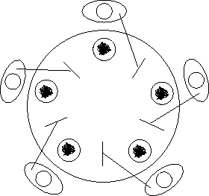
What is deadlock condition?
Deadlock condition may arise depending on the scheduling algorithm.
Deadlock condition occurs if all the processes occupy there left fork and therefore, not a single process can go into the eat condition.

Slide 14
How deadlock condition is resolved?
To remove the deadlock last philosopher must pick his right fork first followed by the left fork.
In our case last philosopher is philosopher 4 and hence, philosopher 4 picks 1 its right fork first (Semaphore 0) followed by its left fork (Semaphore 4) as follows:
Process | Fork | Fork
Process 0 | S[0] | S[1]
Process 1 | S[1] | S[2]
Process 2 | S[2] | S[3]
Process 3 | S[3] | S[4]
Process 4 | S[0] (Right fork) | S[4] (Left fork)

Slide 15
Semaphore applied in LINUX using threads and processes
Single terminal solution (using threads):
Threads
Semaphores
Multiple terminal solution (using processes):
Processes
Shared memory
Semaphores
Memory mapping

Slide 16
Single Terminal Solution (using threads):
Five number of philosophers are declared.
Global array of semaphores is declared of the data type sem_t of the size of the number of fork which is five in our case.
Five threads are created as the number of philosophers using pthread_create function each having a different thread ID.
Five pthread_join function is used to terminate the thread (mini process).

Slide 17
Sem_wait function is used for the semaphore to get locked by decrementing the value of semaphore.
Sem_post command is used for the semaphore to get unlocked
if any other process/thread executes the sem_wait while one process has already executed it, it moves to the block state and hence, is removed only when the sem_post command is executed.
Sleep command is used for the process/thread to remain in the idle state.

Slide 18
HEADERS REQUIRED FOR SINGLE TERMINAL SOLUTION:
#include <stdio.h>
Used for standard input/output.
#include <pthread.h>
Used for pthread_create.
#include <semaphore.h>
Used for synchronization using semaphores.
#include <unistd.h>
Used for sleep command.
#include <stdlib.h>
Used for printf command.

Slide 19
HEADERS REQUIRED FOR MULTIPLE TERMINAL SOLUTION:
#include <unistd.h>
Used for sleep function.
#include <semaphore.h>
Used for synchronization using processes.
#include <sys/shm.h>
Used for shared memory of processes.
#include <sys/ipc.h>
Used for inter process communication.
#include <string.h>
Used for string operations.
#include <stdio.h>
Used for standard input/ ouput.
#include <fcntl.h>
Used for file handling purposes.

Slide 20
FUNCTIONS USED FOR MULTIPLE TERMINAL SOLUTION:
Functions shm_get(), shm_at(), shmdt(), and shmctl() are used for shared memory among processes.
Functions sem_init(), sem_wait(), sem_post(), and sem_destroy() are used for semaphores.
Functions open(), read() and write() are used for file handling.
Functions strlen() is used for string operations.

Slide 21
Merits/ Demerits of your solution:
Advantage is that CPU is not idle and it is using the resources every time and the other processes are in waiting state
Disadvantage is that we have to take care of the order of the functions and moreover we have to exclude the issue of deadlock
Improvements in your solution:
We can use monitor base solution which is entirely deadlock free solution for this problem.

