Slide 1
Leveraging Sensitive Data with Federated Machine Learning - a Primer
Amir Anees
8 May 2024

Slide 2
Contents
Problem
Federated Learning
A practical demonstration
Types
Conclusions

Slide 3
Machine Learning: A general intro
Inputs
Inputs
Machine
Outputs
Machine
Rules
Rules
Outputs
Traditional Programming
Machine Learning (Training)
Inputs
Data analysis: Learning meaningful patterns
Machine
Outputs
Learning will then apply on new data
Predict the likelihood of a particular outcome
Rules
Machine Learning (Testing)

Slide 4
Machine Learning: Success
Success in vast variety of applications
Mainly due to the quality and quantity of the data gathered

Slide 5



Machine Learning: Privacy Issues
Server
Client
Client
Client
Client

Slide 6

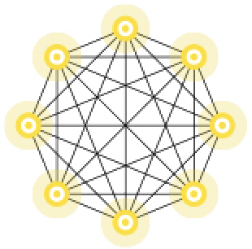
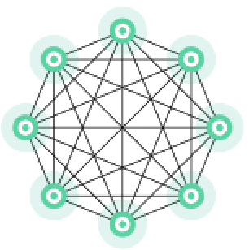
Federated Learning
Local
Models
Server
Global Model
Local
Model
Local
Model
Client
Client
Local
Model
Local
Model
Client
Client

Slide 7
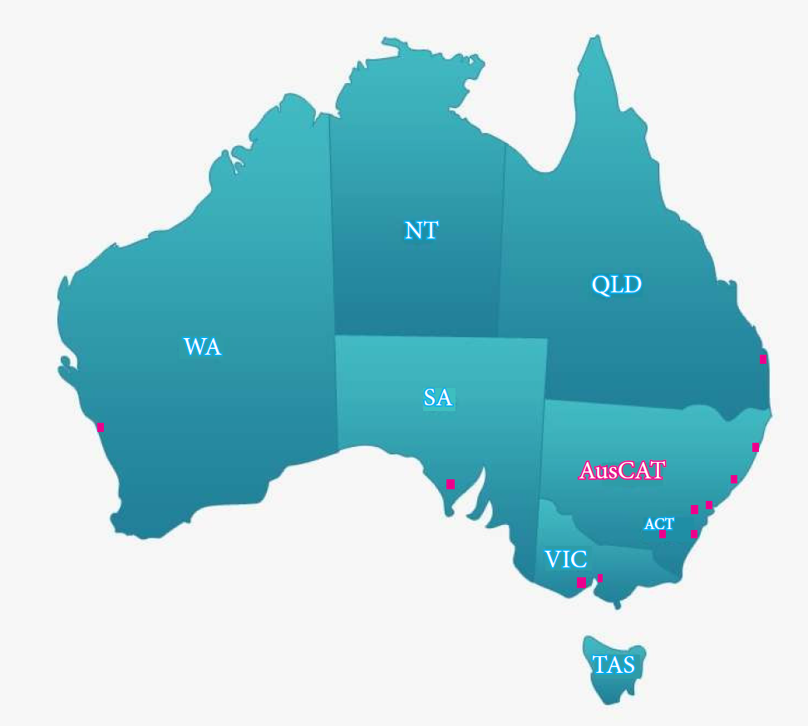



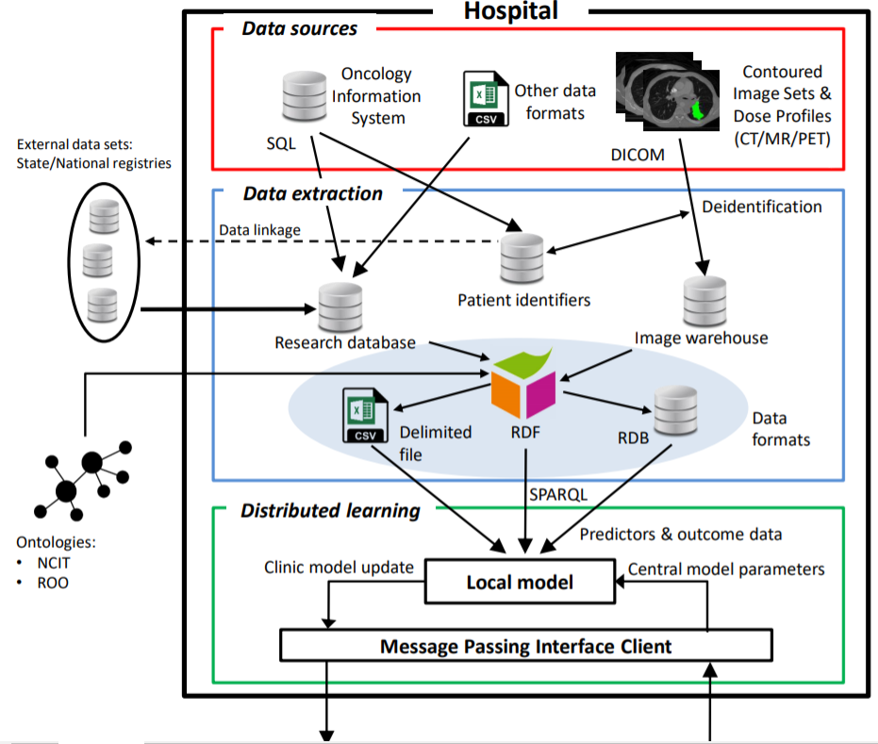
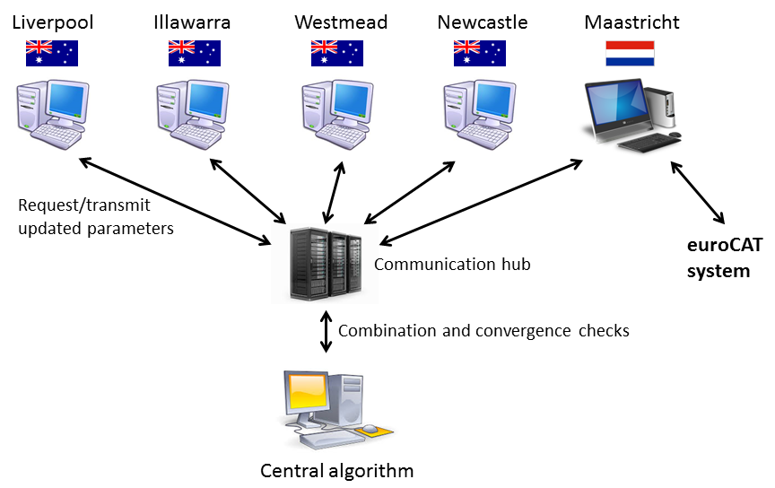


Cancer Alliance QLD
CaVa
Communication hub
AusCAT
Australian Research Data Commons
Notes:
Cancer patients and their clinicians often have questions that can’t be answered from or can be biased in gold standard clinical trial data. Health service providers often struggle to find evidence on new treatment technologies and how these will influence practice patterns and care and service needs.
Gaining access to real world large varied datasets is challenging but necessary to provide personalised evidence based treatment for all patients. The Cancer Data Network links clinical practice, registry and trial data allowing learning across jurisdictions without the data leaving it’s host institution. This will improve data accessibility and provide governance to support data users providing information for health care planning and decision support for patients and clinicians.

Slide 8
Distributed Client Architecture
Its own local data.
Machine learning model (should be same across all the clients).
Training and Testing.
Communication with the Server to exchange model parameters.
Hyperparameters (learning rate, No. of Epochs etc)

Slide 9
Server Architecture
Communication with the Clients to exchange model parameters.
Aggregation strategy (simple average, weighted average etc).
Setting of hyperparameters (No. of clients, rounds)

Slide 10
Practical Demonstration
Using FLOWER open-source FL framework.
A centralized server.
Three distributed clients, each with their own dataset.
https://github.com/adap/flower/tree/main/examples/quickstart-pytorch

Slide 11
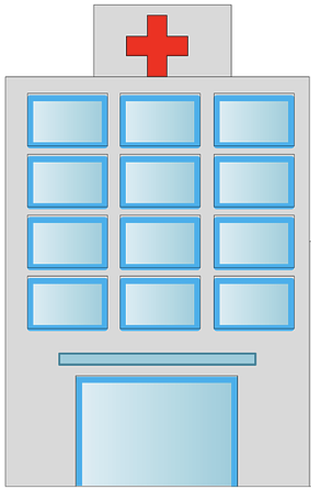

Horizontal Data Partitioning
x₁
x₂
x₃
y
P1
P2
x₁
x₂
x₃
y
P5
P6
x₁
x₂
x₃
y
P3
P4

Slide 12
Open-Source Horizontal FL Tools
FLOWER
Nvidia Flare
FEDn
IBMFL
OpenFL
AusCAT

Slide 13
Vertical Data Partitioning
x₁
P1
P2
P3
P4
x₃
y
P1
P2
P3
P4
x₂
P1
P2
P3
P4

Slide 14
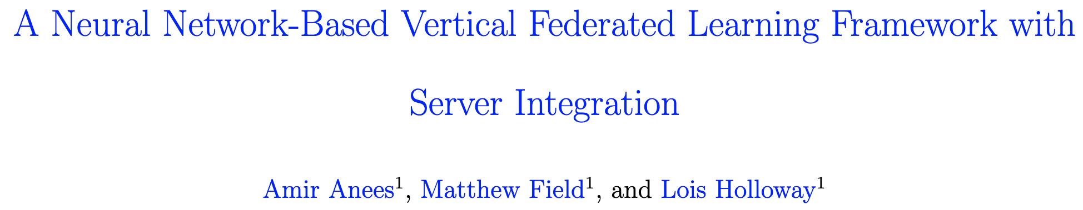
Open-Source Vertical FL Tools
Very limited as compared to Horizontal:
PySfyt
FLOWER
We have developed a work on vertical FL.

Slide 15
Combined Data Partitioning
x₁
x₂
y
P1
P2
x₃
y
P1
P2
P3
P4
x₁
x₂
y
P3
P4

Slide 16
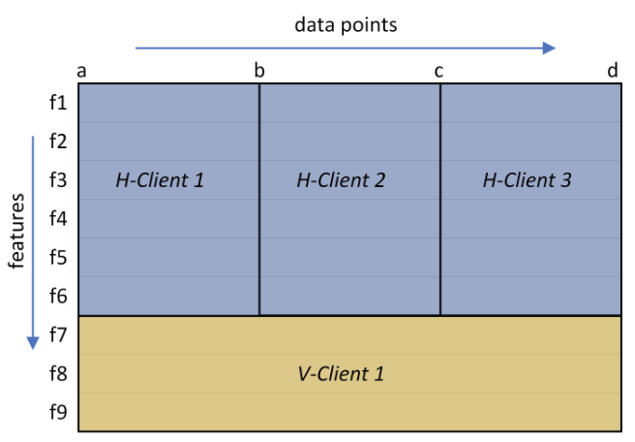
Combined Data Partitioning

Slide 17
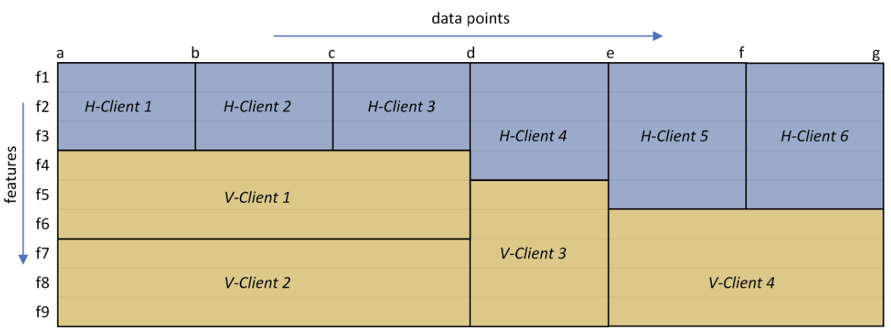
Combined Data Partitioning

Slide 18
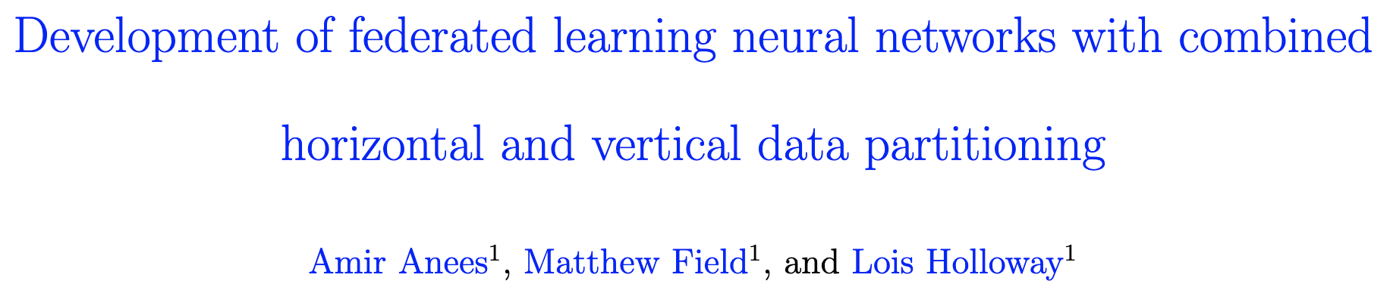
Open-Source Combined FL Tools
No available tool
We have developed a work on combined FL.

Slide 19
FL Aspects and Challenges
Data Acquisition, Pre-Processing
Communication
Computation
Aggregation
Performance
Privacy
Deployment

Slide 20
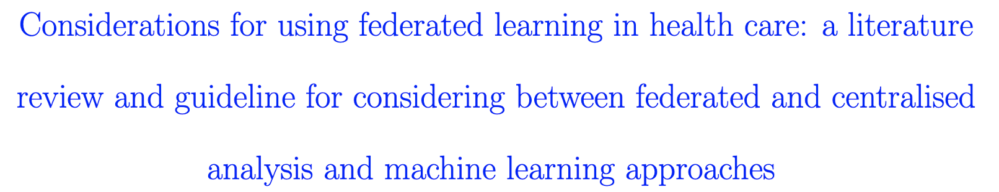
GuidePaper: Federated vs Centralized

Slide 21
Conclusion
FL is a great framework for distributed learning that enhances data incorporation and utilization
Emerging technology, a lot of room to work
Future work: Deployment

Slide 22
Acknowledgements
Prof. Lois Holloway
Dr. Matthew Field
Supported by the Australian Research Data Commons (ARDC) 2020 Platforms program. The ARDC is funded by National Collaborative Research Infrastructure Strategy (NCRIS).

Slide 23
Thank you
Questions?

