Slide 1
DevOps
Trainer Name : Mr. Shaik Saleem Afroz
Date: 08-March-2025
About Trainer: Masters in Computer Science Masters in Mathematics Bachelor in Psychology Google & Microsoft Certified Trainer (GCT & MCT) 12 + Years IT experience in multiple domains.

Slide 2
Agenda
What is DevOps?
Why DevOps?
Core Principles of DevOps
DevOps Lifecycle
Popular Tools
Benefits of DevOps
Challenges and Solutions

Slide 3
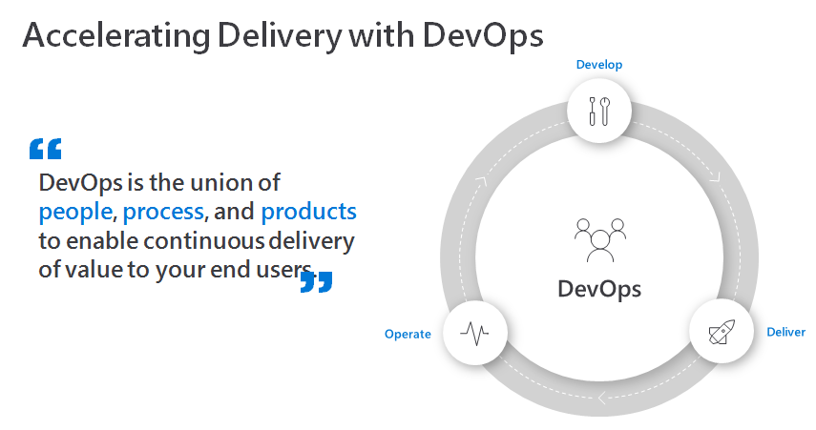
What is DevOps?

Slide 4
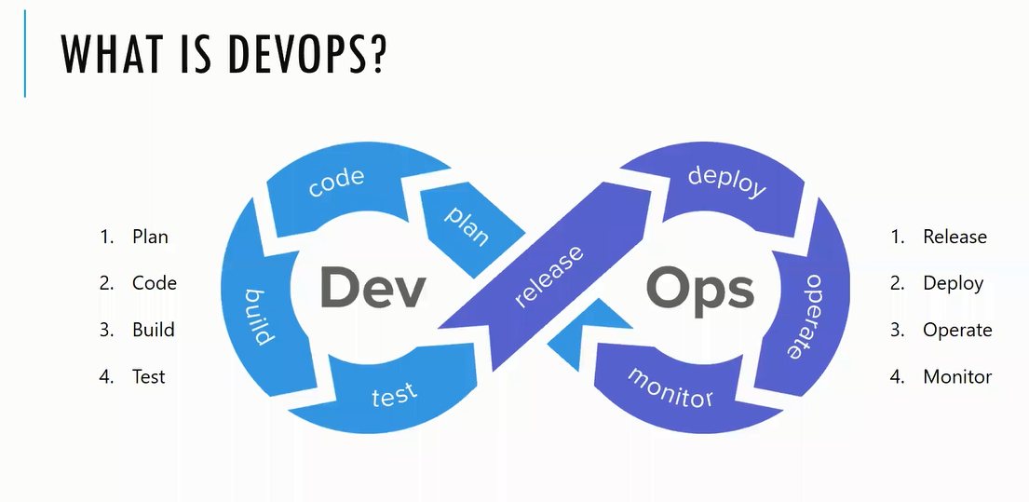

Slide 5
Why DevOps?
Challenges in Traditional Development Models
The Need for Speed, Collaboration, and Reliability
Market Trends and Demand

Slide 6
Core Principles of DevOps
Collaboration and Communication
Continuous Integration (CI)
Continuous Delivery (CD)
Infrastructure as Code (IaC)
Monitoring and Feedback

Slide 7
DevOps Lifecycle
Plan: Requirements gathering
Develop: Coding and building
Build: Continuous Integration
Test: Automated testing
Release: Deployment pipelines
Operate: Monitoring in production
Monitor: Feedback and improvement

Slide 9
Popular DevOps Tools
CI/CD: Jenkins, Git Hub
Containerization: Docker, Kubernetes
Visual Studio Code

Slide 10
Benefits of DevOps
• Faster Time-to-Market
• Improved Collaboration
• Reduced Failures and Faster Recovery
• Enhanced Automation

Slide 11
Challenges and Solutions
Challenge: Resistance to Change
Solution: Leadership Support and Training
Challenge: Tool Overload
Solution: Streamlined Toolchain
Challenge: Security Concerns

Slide 12
Real-World Case Studies
• Example 1: Netflix (Microservices and Automation)
• Example 2: Amazon (Continuous Deployment)

Slide 13
Q&A
• Invite questions and discussion

