Slide 1
Introduction to Numpy
Introduction

Slide 2
Introduction
NumPy, short for Numerical Python, is one of the most important foundational pack‐ ages for numerical computing in Python.
ndarray, an efficient multidimensional array providing fast array-oriented arith‐ metic operations and flexible broadcasting capabilities.
Mathematical functions for fast operations on entire arrays of data without hav‐ ing to write loops.
Tools for reading/writing array data to disk and working with memory-mapped files.
Linear algebra, random number generation, and Fourier transform capabilities.
A C API for connecting NumPy with libraries written in C, C++, or FORTRAN.

Slide 3
Why numpy?
NumPy internally stores data in a contiguous block of memory, independent of other built-in Python objects. NumPy’s library of algorithms written in the C lan‐ guage can operate on this memory without any type checking or other overhead. NumPy arrays also use much less memory than built-in Python sequences.
NumPy operations perform complex computations on entire arrays without the need for Python for loops

Slide 4
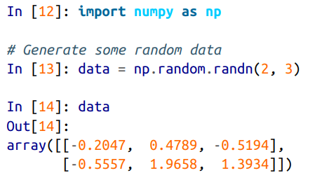
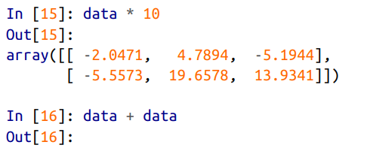
A small example

Slide 5
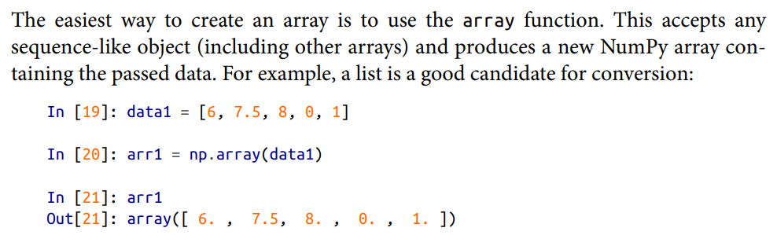
ndarray
An ndarray is a generic multidimensional container for homogeneous data; that is, all of the elements must be the same type. Every array has a shape, a tuple indicating the size of each dimension, and a dtype, an object describing the data type of the array

Slide 6
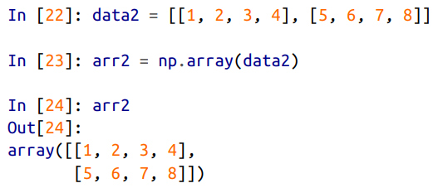

Creating array from list

Slide 7
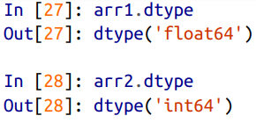
dtype

Slide 8
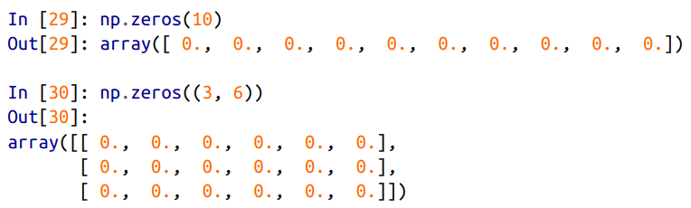
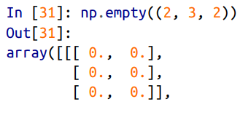
Other functions for creating arrays

Slide 9
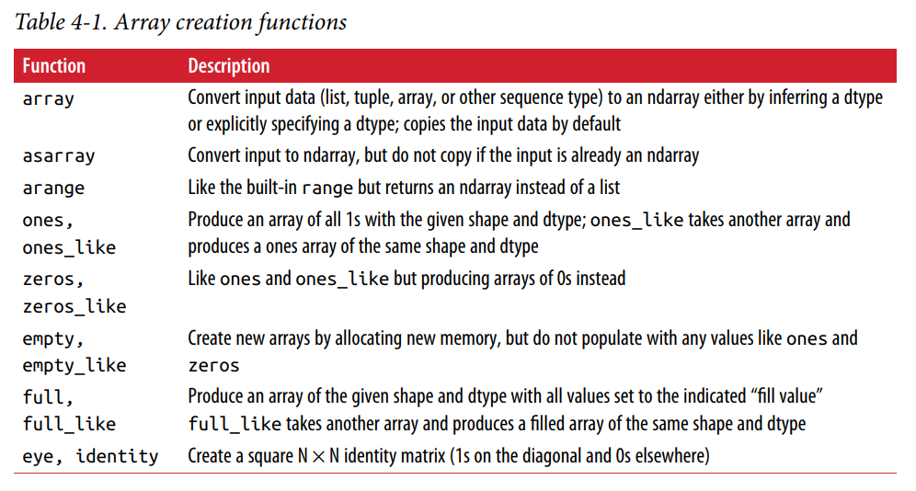

Slide 10
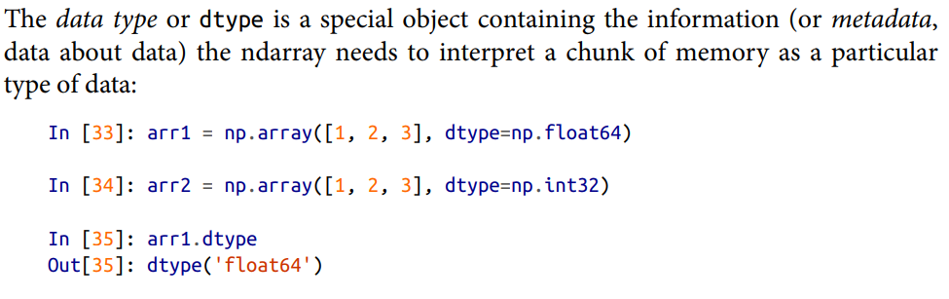
Data types for array

Slide 11
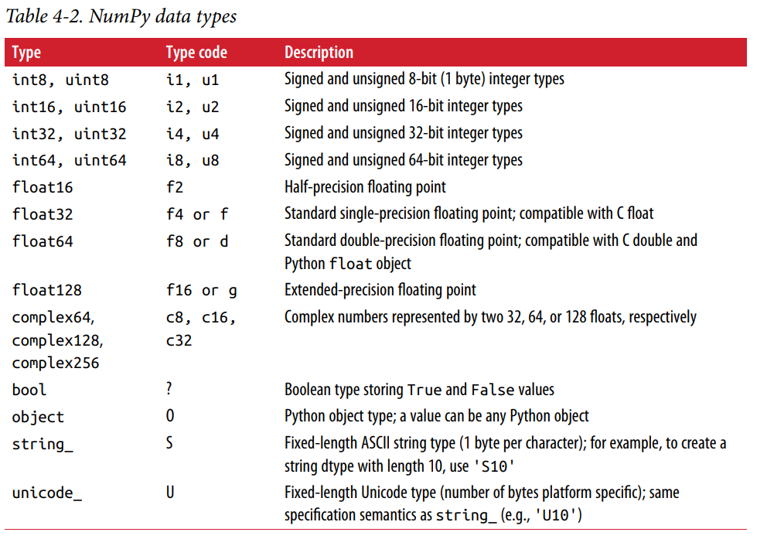

Slide 12
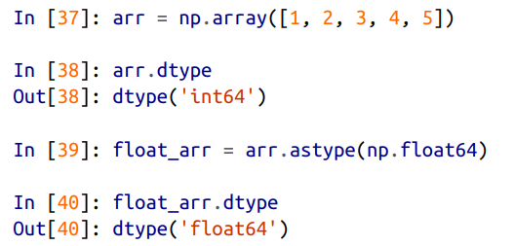
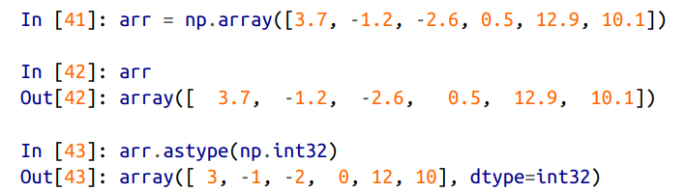
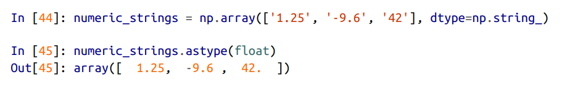
Type casting

Slide 13
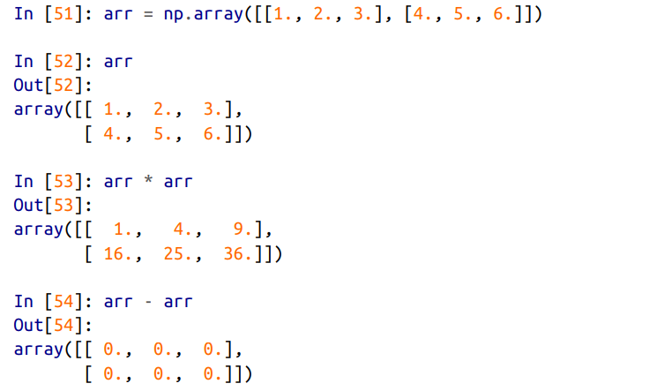
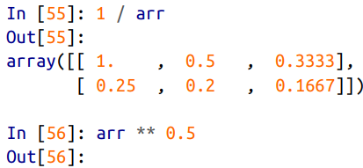
Arithmetic with arrays

Slide 14
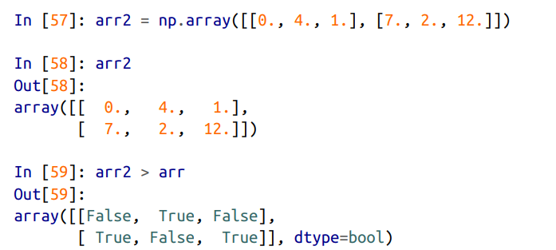
Comparison

Slide 15
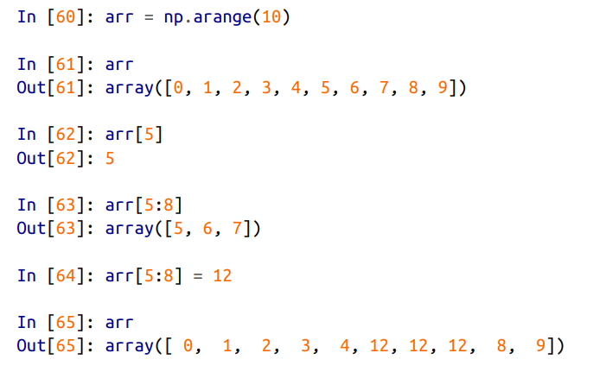
Indexing and slicing
An important first distinction from Python’s built-in lists is that array slices are views on the original array

Slide 16
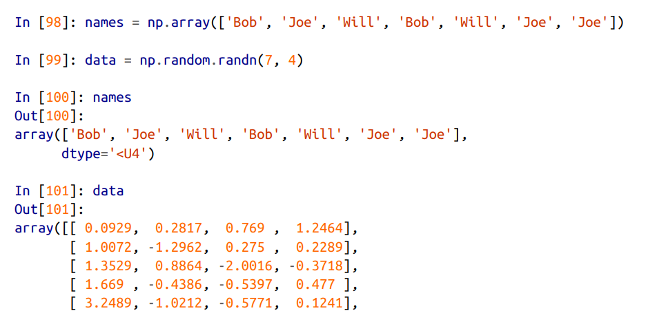
Boolean indexing

Slide 17
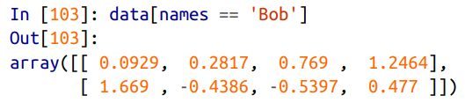
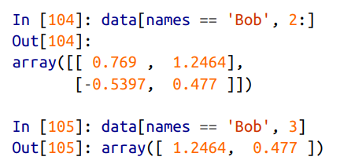
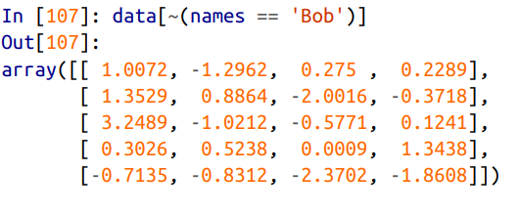

Slide 18
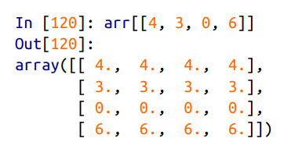

Fancy indexing

Slide 19
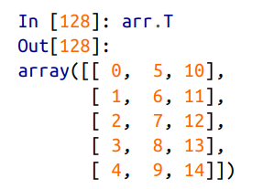
Transposing

Slide 20
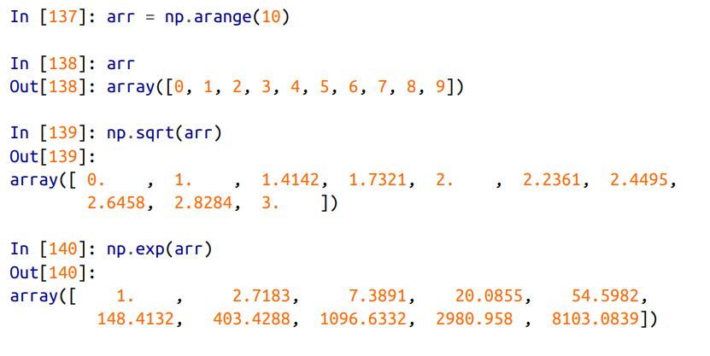
Fast element wise functions

Slide 21
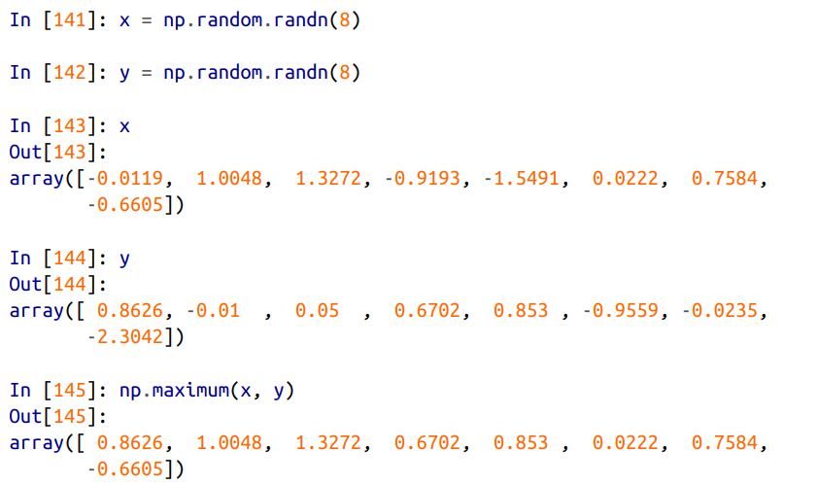

Slide 22
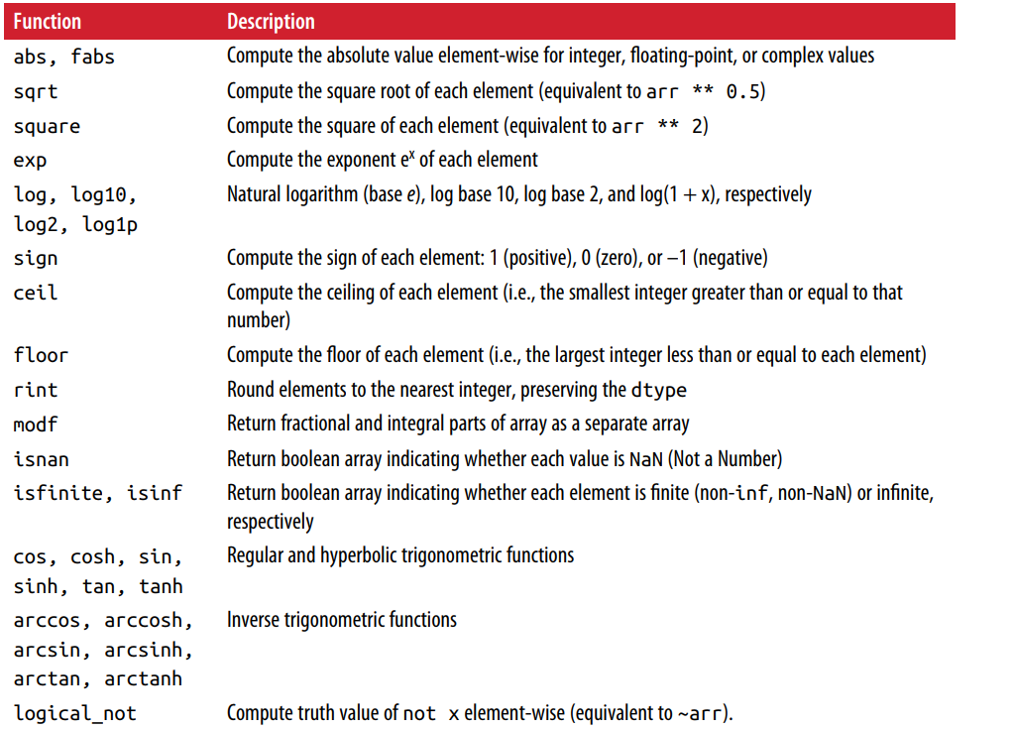

Slide 23
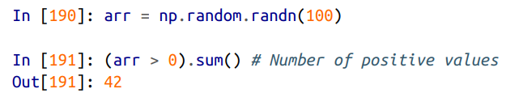
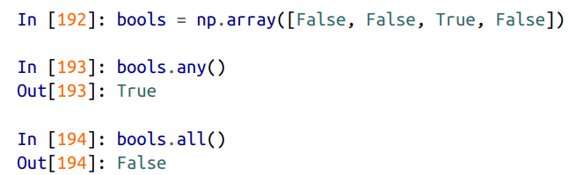
Boolean arrays

Slide 24

Sorting

Slide 25


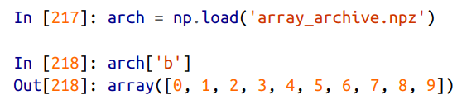
File Input and Output

