Slide 1


Slide 2
Introduction
Warf Engine is an open source platform for developers to create enterprise level web application in MERN stack.
This platform already contains components like user management, roles management, module management, access management, content management with production ready setup which helps developers to develop their application in minimum cost.
Since anything in our codebase can be extended, overwritten, or installed as a package, you may also develop, scale, and customize anything on our platform
Super Admin can provide roles to user as Admin, Normal User.

Slide 3
Objective and Scope of the Project
To Enable the developers to create enterprise level MERN Web Application.
To Create Easy to use modules for the developers
To allow the admin to monitor traffic to their application

Slide 4
Novelty Of The Project
Big Companies like Wix, Wordpress etc. give a User-friendly interface to make website as per the client use.
They use old tools like PHP, MySql etc to build the website. But as the technologies and tools are upgrading, new modern tools have came to market which are more efficient, fast, easy to use and many more.
So Warf Engine, is a platform which uses the latest MERN technologies to build the websites more efficiently and easily.
The difference are:
• MERN Technologies to build website
• Image Password matcher which are more secure and easy to use
• A component based structure to make the editing of the website easier

Slide 5
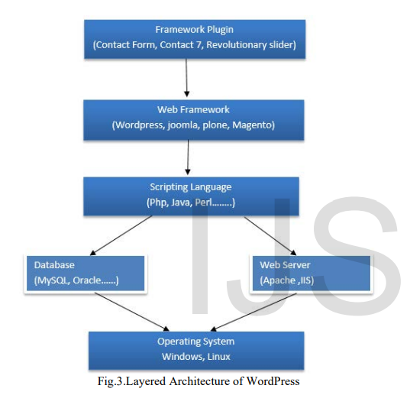
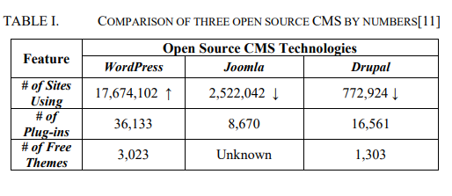
Literature Review
Wordpress
The oldest and the most commonly used web development tool, WordPress has been prevalent – or rather dominant – in the market ever since its inception in 2003. Statistics released in the year 2019 reveal that close to 34% of the internet is powered by WordPress websites.
Wordpress is the open-source CMS technology and
approximately 17,674,102 sites are using Wordpress.

Slide 6
Disadvantages of using Wordpress
Due to the use of third party plugins, there is a security risk.
It requires constant updation.
One has to be very careful while dealing with SEO.
There seems to be no proper documentation.

Slide 7
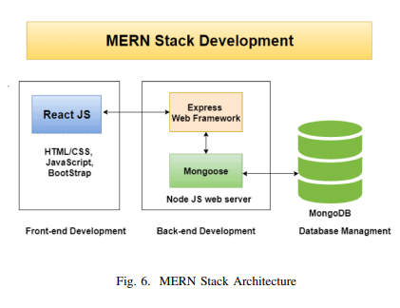
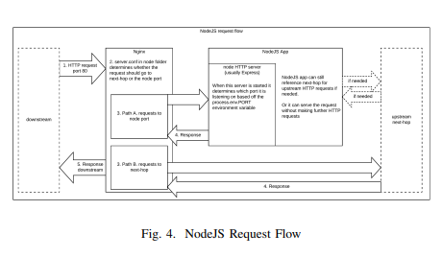
MERN Stack
The web application was developed using the MERN stack using Mongoose and MongoDB database. Chrome developer tools were utilized while testing using redux tools for simulation. The following section discusses MERN stack components and their implementation.
NodeJS
Node.js is authored in C ++ language, which is a JS operating environment. Node.js is a JS runtime environment.
Node.js uses the Google Chrome V8 engine for good performance.
Node.js uses event-driven, asynchronous programmingcallback functions, and designed using single-thread architecture.
Node.js design uses the event-driven as the fundamental core concept for its environment, which gave us the various number of APIs that are event-based and asynchronous in nature which has helped us in building the website using node.js for our back-end development.

Slide 8
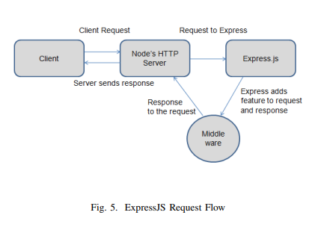
ExpressJS
We used Express as it is a Node.js framework.
While building the application we studied that instead of creating loads of node modules and writing the code with NodeJS, Express made it simpler and easier to write the back-end code and implement it in a structured format.
Express helped us in designing our web applications and APIs required in our project as it supports many middlewares which makes the code shorter and easier to write.
Asynchronous programming and Single-threaded architecture are the biggest advantages of using Express in our application

Slide 9
ReactJs
React.JS is the front-end library of the JavaScript programming language.
We used React.JS for building our user interface for the web application, as it is used for the development of a single-page application because it can render dynamically changing data at a high speed.
React allows developers to code in JS and create User Interface components
We studied virtual DOM objects in React.JS, which we implemented in our project.
Any changes we made in our e-commerce web application caused the entire User-Interface to re-render the virtual DOM.
This allows us to compare the potential difference between the DOM Object and Virtual DOM.
MongoDB
We used Document-Oriented Database i.e. MongoDB for our project MongoDB is a database where every record is a document format.
Behind the scenes on the server, MongoDB converts our JSON data into a binary version of it which is basically stored and queried more efficiently.
MongoDB uses BSON to query database.
MongoDB stores BSON format both internally, and over the network, but that does mean we can’t think of MongoDB as a JSON database

Slide 10
Proposed Methodology
• React JS – Front End
• Node JS – Backend
• MongoDB – Database

Slide 11
Technical Specifications
HARDWARE SPECIFICATION
2 GB RAM
1 GB Hard Disk/ SSD storage.
Dual Core Processor min 1.8 Ghz
SOFTWARE SPECIFICATION
Any Browser with flash player enabled
Chrome , Mozilla Firefox, Opera, Microsoft Edge.

Slide 12
Module Descriptions
Dashboard Module
This module Enables the admin to view the details about total traffic of the application.
Admin can view Roles, Day By Day traffic and recent users information.
Users can also view version releases of the application.
Content Module
This Module enables users to add sections/pages to the application.
Interactive Text Editor.
This module manages all the resources used in the application.
User can also create/manage the blog of the application.

Slide 13
3. Access Control Module
This module Enables the admin to control access to the application.
Admin can grant special permission to some user.
Admin can give controlled access to developers working for the application.
4. Module Management Module
Module to manage modules.
Add/Edit Modules.
Group Several Modules together.
Setting Module
Email Templating
Global Authentication Setting.

Slide 14
Reports Module
Service Subscription Monitoring Feature.
Contacts Information Management.
Error Logs.

Slide 15
Description Of The Project
Warf Engine is an open source platform for developers to create enterprise level web application in MERN stack.
Warf Engine core features include:
User Manage and Login flow
Role Manage
Module Manage with Access level Definition
Access Management associated with roles
Email Template and settings
Media Manage and server side processing
Error handling and log Management
Authentication and Authorization
Content Management
State Management using redux
Development ready setup
Production ready setup

Slide 16
Implementation Snapshot

Slide 17
Content > Section
Content > Media Management

Slide 18
Content >Gallery

Slide 19
Future Scope
Add More Modules.
Optimize the currently available modules.

Slide 20
Timeline of the Project
Project Planning Phase
Gathered information about the project.
Implemented Modules of the application using MERN Stack
Oct
2022
Dec
2022
Sep 2022
Nov
2022
Created Design for the application.
Developed alpha prototype
Tested the application.
Deployment Phase

Slide 21
References
https://www.ijert.org/research/performance-optimization-using-mern-stack-on-web-application-IJERTV10IS060239.pdf
https://www.ijser.org/researchpaper/WordPress-A-Versatile-Tool-for-Managing-Contents.pdf
Usage Statistics and Market Share of WordPress for Websites,Available:https://w3techs.com/technologies/details/cm -wordpress/all/all.
Benefits-of-theCMS,Available:https://cms.drupa.ku.edu/benefits-cms.
WordPress Statistics,Available:https://wordpress.com/activity/.
Sorav,”How to optimize the WordPress database”, Available : http://www.wpexplorer.com/optimize-wordpressdatabase/.
JavaScript specification. Retrieved from http://www.w3.org/standards/ webdesign/script, November 1, 2014.
First mention of HTML Tags on the www-talk mailing list”. World Wide Web Consortium. October 29, 1991. Retrieved April 8, 2007.
R. Irony, D. Cohen-Or, and D. Lischinski, Colorization by example, in Proc. Eurograph. Symp. Rendering, vol. 2. 2005, pp. 201-210.

Slide 22
THANK YOU

