Slide 1
CASE STUDY: BANK TELEMARKETING CAMPAIGN
Created by Aneesh sharma
ABADS-Batch-11

Slide 2
BUSINESS OBJECTIVES:-
The business objective in this scenario is to conduct an end-to-end Exploratory Data Analysis (EDA) on the campaign dataset to identify patterns and provide insights that can improve the positive response rate of the telemarketing campaign for term deposits among existing customers.
The ultimate goal is to enhance revenue by conducting a cost-efficient campaign that fosters long-term customer relationships through term deposits.

Slide 3
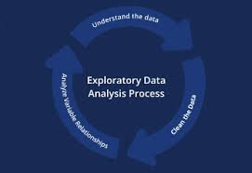
WHAT IS EXPLORATORY DATA ANALYSIS (EDA)?
Exploratory Data Analysis (EDA) is a critical step in data analysis that helps data scientists understand the structure of a dataset and make informed decisions. It's an important step before implementing statistical or machine learning models. The ultimate goal is to enhance revenue by conducting a cost-efficient campaign that fosters long-term customer relationships through term deposits.

Slide 4
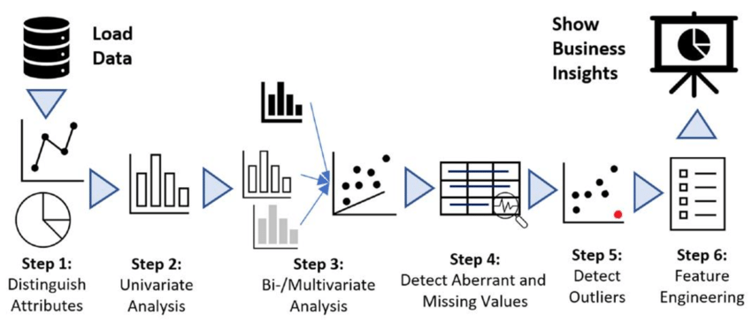
STEPS INVOLVED IN EXPLORATORY DATA ANALYSIS :-
Understanding the Dataset.
Descriptive Statistics.
Univariate Analysis.
Bivariate Analysis.
Categorical Variables Analysis
Temporal Analysis
Feature Engineering
Correlation Analysis
Outliers detection

Slide 5
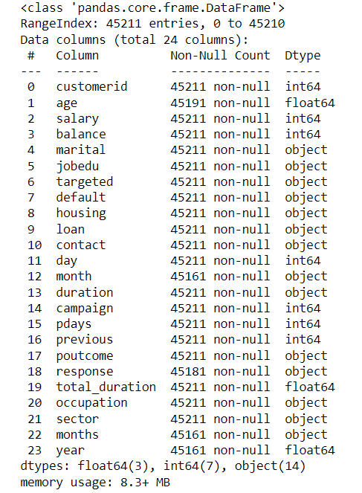
UNDERSTANDING THE DATASET :-
Importing the data sets and necessary libraries inside the Jupiter notebook.
Using 2nd row as headers and checking up for missing values.
Converting mins to seconds and separating jobedu column.
Splitting month & year in 2 different columns to get better insights of data.

Slide 6
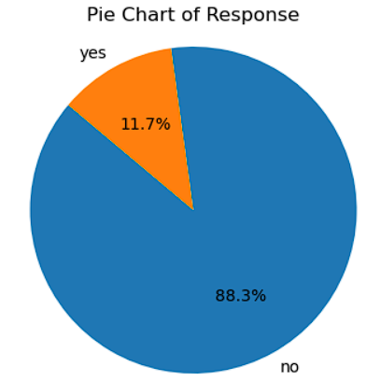
DESCRIPTIVE STATISTICS:-
Display count, mean, median, min & max value of numerical columns, to show the overall summary of data.
Mean for duration column was more than that of median, which shows data is positively skewed.
Response category,is chosen as the main target variable because it summarizes total customer behavior.
Univariant analysis showed that there were more negative responses the positive responses.

Slide 7
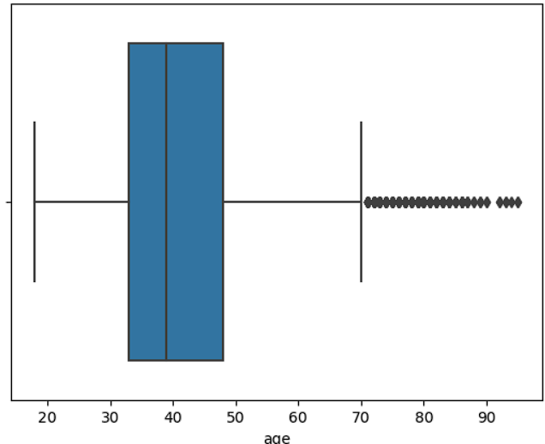
UNIVARIATE ANALYSIS:-
To check for the outliers all the numerical data was plotted using box plot .
Age column has small number of outliers while campaign has highest number of outliers which shows that less number of customers were approached.

Slide 8
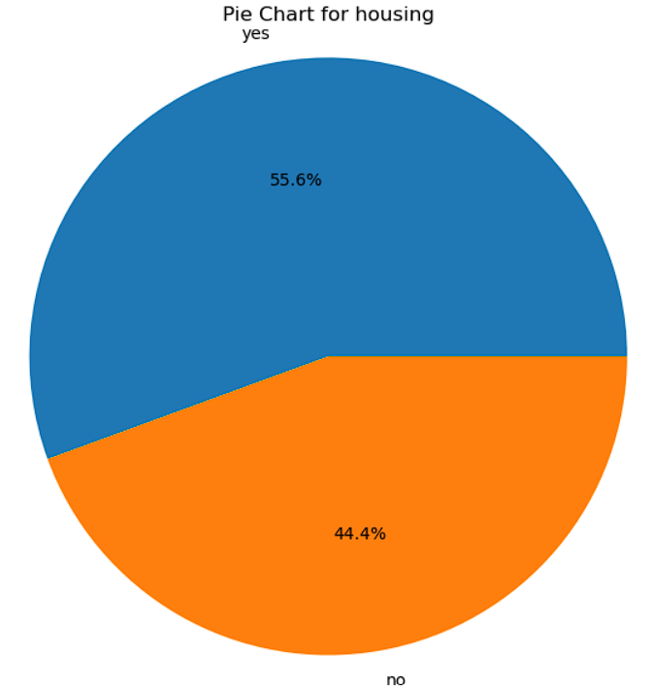
UNIVARIATE ANALYSIS:-
To check univariant analysis of categorical values pie charts were used.
Also following insights can be drawn from categorical values:-
Small %age of customers defaulted.
Large %age of customers have opted for personal loan & whereas very low opted for housing.
Large %age of customers were contacted through mobile network.
Large % age of customers are married.

Slide 9
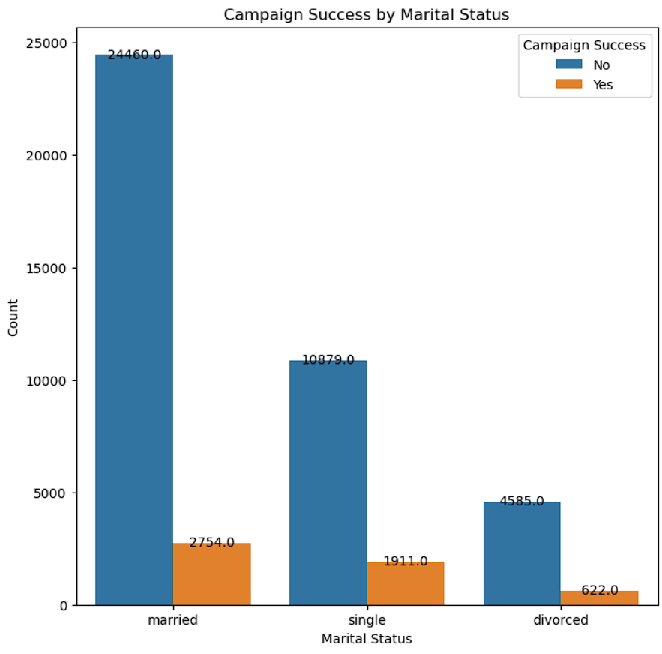
BIVARIATE ANALYSIS :-
To check bivariant analysis of categorical values ,bar charts were used. Following insights were observed:-
Campaign was successful was more in married population.
Large number of population in secondary sector was interested.
Customer segment with management background was more interested.
Moreover more than half of the population shows negative response overall.

Slide 10
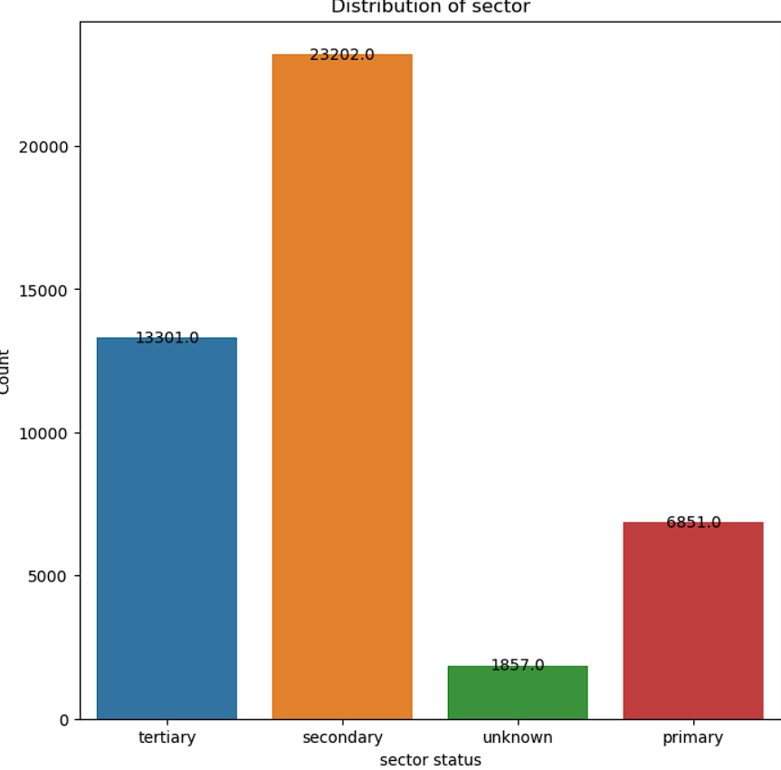
CATEGORICAL VARIABLE ANALYSIS :-
To check categorical variable analysis bar chart was used. Following insights were observed:-
Married customer population was highest in securing the loans
Most of the customer were contacted during the month of May.
Most of the customer were of blue collar background.
Overall response were negative.

Slide 11
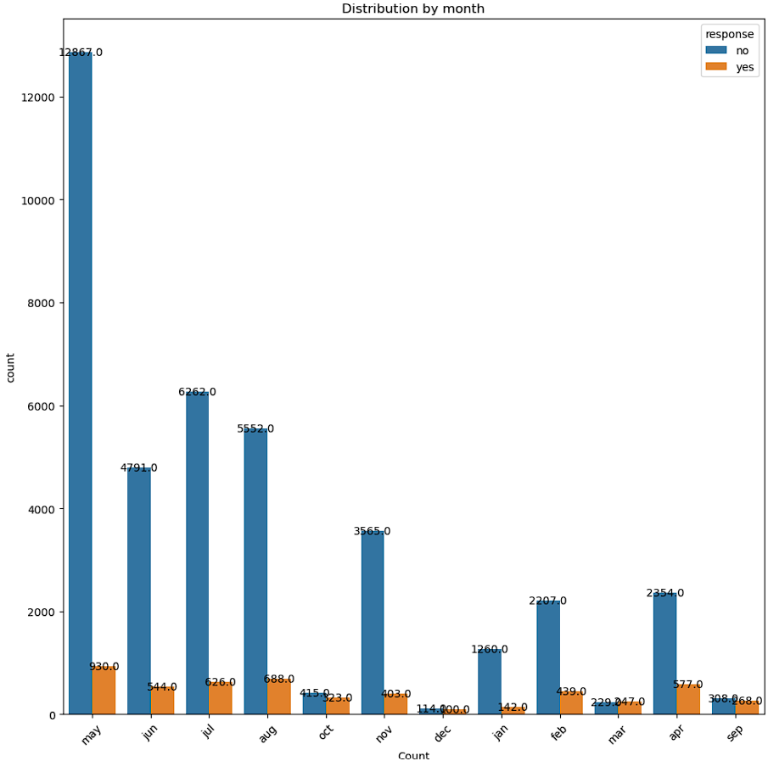
TEMPORAL ANALYSIS:-
To check categorical temporal analysis, month category was used.
Distribution between response and month was shown and it was observe that may , customer was contacted at highest.
Moreover customer was contacted less during December.

Slide 12
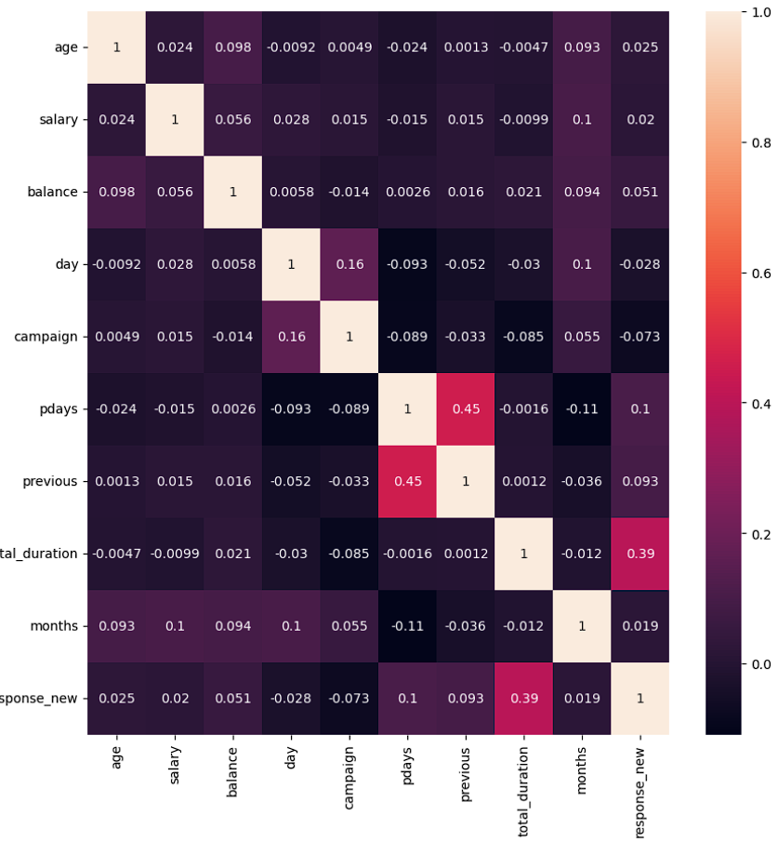
FEATURE ENGINEERING & CORRELATION:-
New categories for age and income added.
Heat map was generated displaying correlation between different variables.
Response was directly proportional to total duration, days.
But inversely proportional to campaign, days.
However Pdays was directly proportional to previous means a lot of customers were approached earlier.

Slide 13
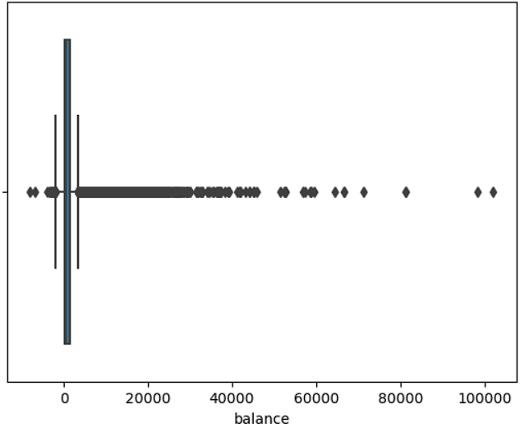
OUTLIER DETECTION:-
For age has less number of outliers as compared to balance.

Slide 14
CONCLUSION:-
Cellular mode of communication can be made favorite option, so that campaign can be moved vigorously.
As the number of married couple are highest in this segment so attractive discount can be introduce to attract more customers in this segment.
A lot of customers are opting for housing loan so complimentary offers can be used to attract more customers
Sales person can target more customers with age group of 30-50 years .
More schemes should be introduce to benefit the secondary sector.

Slide 15

QUESTIONS?

