Slide 1

DevSecOps at CP Integration
Security built into every build: what it is, what changed, how every application joins, and what is already running
Notes:
Four beats: what DevSecOps is, what changed around us, how an application integrates, and what CP Integration has already built on its pipeline.

Slide 2




The story in four beats
What it is
What changed
How to integrate
What is done
Security as a stage of every build, not a review at the end: scan the code, the dependencies, the secrets and the image on every pull request, and keep the evidence.
The scan group now expects every application accounted for: web and API scanned, and a stated, accepted reason for anything that is not. Supply-chain controls (SBOM, signing, pinned digests) are the new baseline.
Onboard to the BBH DevSecOps pipeline library: one config.yaml, a two-line Jenkinsfile, credentials by reference, every stage validated, then the merge trigger.
The Hub runs the standard pipeline's roles plus its own gates: schema, transformation, performance, DAG standards; a Liquibase schema stage; a build-scan-sign image pipeline; the Cyber Security 360 inventory.
Notes:
One slide per beat follows. If time is short, this slide and the scorecard carry the message.

Slide 3
What DevSecOps is
Part one
Shift security left: the same controls a penetration test or an audit would apply, run by the pipeline on every change, with the result recorded.

Slide 4







Security runs at every stage, not at the end
Plan
Code
Build
Test
Release
Deploy
Operate
threat model, data classification, PII flagged
secrets scan on the pull request, lint and standards
SAST on the code, SCA on the dependencies, SBOM written
unit and contract tests, DAST where there is a web surface
image scanned and signed, artefact promoted by digest
policy as code, approval recorded, rollback ready
runtime monitoring, exceptions expire, findings fed back
Before DevSecOps, security was a scan of the running web application once a release. The pipeline moves the same questions to the pull request, where a finding costs minutes instead of a release.
Notes:
Walk the seven stages. The five in navy are the ones the pipeline owns; plan and operate are the people around it.

Slide 5
The controls, and what each one catches
Control | Looks at | Catches | Runs
SAST | static analysis of our own code | injection, unsafe calls, insecure defaults | every pull request
SCA | software composition: the dependencies | known CVEs in libraries, licences | every pull request and nightly
Secrets scan | credentials committed to the repository | passwords, tokens, keys in code or history | every pull request; full history on main
Container scan | the image and its packages | CVEs in the base and the OS packages | every image build, on a CVE or a bump
Signing and SBOM | the artefact's identity and contents | an image nobody built, a dependency nobody declared | every image push
DAST | the running web surface | what the application scan finds today | web and API applications, per release
Policy as code | rules on owners, PII, deploy | an unowned model, a PII column without a class, a deploy without approval | compile and before promotion
Notes:
DAST is the application scan the scan group runs today. The rest are what DevSecOps adds in front of it.

Slide 6
What changed around us
Part two
The scan policy was restated, the inventory was asked for, and the supply chain became part of the control set.

Slide 7



Three changes, one direction
The scan policy, restated
A complete inventory, owned
A standard pipeline exists
Every application on the web goes through the application scan, APIs and web interfaces included.
.NET utilities, KSH and Java under RMJ schedules do not; SharePoint goes through the server scan.
For each unscanned application the group needs to know why; with no valid constraint, it gets scanned.
Home-grown, vendor and SaaS applications accounted for in one place.
Each owning team declares what is scanned and why a scan is not required where it is not.
The scan group accepts the constraint or sends the application to scan.
One shared Jenkins library: checkout, unit tests, Nexus IQ, SonarQube, AppScan SAST and DAST, delivery, deployment.
Dependencies scanned on every build; GoldenFix raises the fix as a pull request.
Every team meets the same gate; thresholds are the DevSecOps team's, not the project's.
Notes:
The first card is the scan group's own words. The second is the ask that led to Cyber Security 360. The third is the industry baseline we build to.

Slide 8
From one scan a release to evidence on every build
Before
Now
Where security ran
a scan of the running web application, once a release
code, dependencies, secrets and image on every pull request; the web scan still runs
What was covered
web applications and APIs
every application, with a declared constraint where the scan cannot apply
Who was held to it
the teams the scan reached
every team, through one pinned pipeline library
What was kept
a report by e-mail
a row per control per build in CP 360 metadata
How exceptions worked
a conversation
a record: one control, one asset, two approvers, an expiry the deploy policy enforces
Where secrets lived
configuration and job environment
a vault, a short-lived token per stage

Slide 9
How it has to be integrated
Part three
BBH has one standard security pipeline, a shared Jenkins library. Integration is onboarding to it: one config.yaml, a two-line Jenkinsfile, credentials by reference.

Slide 10


The BBH DevSecOps security pipeline, stage by stage
Checkout
Unit tests
Nexus IQ
SonarQube
SAST
Delivery
Deploy
Report
repository, branch and commit recorded
JUnit results published; JaCoCo coverage, 60% floor
dependency scan (SCA); GoldenFix raises the bump PR
code quality against the BBH Official quality gate
HCL AppScan on Cloud; DAST optional for a web surface
artefact to the Nexus snapshot repository
OpenShift (image build, registry, rollout) or VM (DoD, SSH)
pipeline-report.html: stages, coverage, gates, release policy
One shared library
One file
Runs on merge
Zero is not clean
devsecops-pipeline-library, global in Jenkins; stage order and thresholds come from it, projects only configure
config.yaml at the repository root, top-level key projects:, the project name matching the Jenkinsfile exactly
a Bitbucket webhook on merge to the integration branch starts the job; a first run is manual
a missing report leaves a scanner's counts at zero; the AppScan, Nexus IQ and SonarQube consoles are the evidence
Notes:
This is the pipeline the DevSecOps team ships today (guide version 73, November 2026). The gold stages are the security scanners; the rest is build, quality and delivery.

Slide 11
Onboarding an application: eight steps, in order
1
Branch and config
2
Jenkinsfile
an onboarding branch; config.yaml at the root with projects: and your project name; buildTool, build goals, unit-test report paths
two lines: load the shared library, call devSecOpsSecurityPipeline with the project name and the agent name from your existing Jenkinsfile
3
Jenkins folder and job
4
Register in the tools
a DevSecOps folder with the shared library configured; a Pipeline job from SCM pointing at the branch and the Jenkinsfile; run it once by hand
a SonarQube project with the BBH Official quality gate and the Jenkins webhook; a Nexus IQ application; an AppScan application in your asset group
5
Credentials by reference
6
Validate every stage
secrets live in Jenkins, named project-secret; on OpenShift a key/value secret with the sync label; config.yaml holds only the IDs
checkout on the right commit; test count and coverage; a Nexus IQ report; the SonarQube callback; an IRX and a visible AppScan scan; the artefact in snapshots
7
Switch on the merge trigger
8
Then the options
the Bitbucket webhook and the push-and-pull-request plugin, action Merged, the integration branch
GoldenFix, DAST, Influx DORA metrics, downstream smoke, regression and performance jobs, OpenShift or VM deployment
Skipping a step shows up later as a credential or stage failure; the guide is sequential for that reason.

Slide 12
config.yaml is the whole integration
projects:
my-app:
buildTool: maven
appId: '' # AppScan application
coverage:
minLine: 60
build:
maven: { goals: [clean, package] }
tests:
unitTests: { reportOutDir: surefire-reports }
tools:
nexusIq: { application: '', credentialsId: '' }
sonar: { projectKey: '', authToken: '' }
asoc:
keyId: '' token: '' sourceCodeOnly: true
dast: { enabled: false }
goldenFix: { enabled: true }
deploy: { openshift: { rd: ... } }
Project basics
buildTool (maven, gradle, flutter), deployTarget (vm, openshift), source and excluded directories, Java path
Build and tests
goals or tasks, flags as separate items, unit-test report paths, JaCoCo coverage at 60% unless the library says otherwise
tools.nexusIq, tools.sonar
application and project identity, scan patterns that exist after the build, credential IDs
asoc and dast
AppScan key ID and token reference, source-code-only scanning with an appscan-config.xml, DAST target and presence ID
delivery, deploy
Maven snapshot upload; OpenShift rd and qc blocks, VM rd, qc and DoD blocks
scm.bitbucket, goldenFix, influx, tests
the remediation PR, DORA metrics, downstream smoke, regression and performance jobs
Notes:
Keep only the settings the project needs; omitted values take the library defaults. Example files exist for Maven on VM and Gradle on OpenShift. Never a secret in this file: credential IDs are references into Jenkins.

Slide 13

What a green run has to show, stage by stage
Stage | What good looks like
Checkout | the correct repository, branch and commit
Unit tests | the expected test count published; the coverage report found; 60% enforced
Nexus IQ | a report for the expected application and lifecycle stage; the scan pattern matched at least one file
SonarQube | analysis under the configured project key; the quality-gate callback reached Jenkins
SAST | IRX generation succeeded; the scan is visible under the AppScan application
Nexus delivery | the artefact uploaded with the expected group, artefact and version
Pipeline report | every stage's result, coverage, Critical to Low per scanner, release policy, GoldenFix status; WARN gates can block release and QC deployment
Zero findings is not a clean scan
A missing AppScan HTML report leaves the counts at zero.
Nexus IQ counts fall back to parsing the build log.
SonarQube PASS is not the quality gate: the service does not wait for it. Check the gate in SonarQube.
Policy limits and thresholds are set by the DevSecOps support team, not in config.yaml.

Slide 14
Applications the web scan cannot reach still onboard
Application | Why the application scan does not apply | What covers it instead
Batch under RMJ (.NET utilities, Windows services, KSH, Java, Python) | no web or API surface | checkout, unit tests, Nexus IQ, SonarQube, SAST source-code-only; DAST not required
Legacy web application being retired | old stack, retirement in progress | SAST and DAST now, or an accepted retirement date recorded as an exception
Vendor package (batch, backend services) | vendor binaries, no source | vendor attestation, server scan of the hosts; our integration code goes through the pipeline
Desktop terminal emulator | no web or API surface of ours | vendor attestation, endpoint controls, server scan of the hosts it reaches
Platform with a server scan (SharePoint) | the install is part of the server setup | server scan, in place; recorded as accepted
SaaS | vendor hosted | vendor SOC report and penetration-test attestation; our integration code still onboards
The pipeline's SAST runs on source, so a batch job with no web surface onboards like any other: only DAST is not required. These are the rows the scan group asked for; the constraint is the owner's, accepting it is the group's, both recorded in Cyber Security 360.

Slide 15
CP Integration Hub: the standard pipeline plus its own gates
Part four
The BBH stages cover code, dependencies and the artefact. A data platform also has a schema, transformations, DAGs and performance to govern, so the Hub adds gates of its own.

Slide 16
What the Hub runs on every pull request
From the standard pipeline
The Hub's own gates
1
Checkout
1
Schema validation
repository, branch, commit recorded by the webhook bridge
the dbt contracts against the Oracle dictionary after the Liquibase changelog applied
2
Code quality
2
Transformation quality
lint, formatting, standards: the SonarQube role for SQL and Python
dbt compile, schema and data tests, the custom assertions
3
Security scan
3
Performance benchmark
Bandit over the Python, SAST findings normalised by severity: the AppScan and Nexus IQ role, to be taken from the shared library
runtime and plan thresholds per model
4
Report
4
DAG standards
summary per gate, archived, uploaded to CP 360 metadata, e-mailed: the pipeline-report role
the Airflow DAGs checked statically against the standard
The Hub's gates 2 to 4 are what a data platform needs and the standard pipeline does not have. They stay, and run as the extended pipeline or downstream jobs once the Hub is on the shared library.

Slide 17


Two more pipelines, built: the schema and the image
Database, Liquibase
Infrastructure image and security
per release, the first stage of the application job
on a CVE or a version bump, on its own clock
Changeset with a rollback block, labels and contexts; destructive changes only after an expand release
Validate, then a checksum compare against what the target already holds; a changed checksum stops the job
Update under the application's own changelog table and lock, with the environment as context
Tag env-build only after every changeset applied; the deploy refuses a target with no tag for the release
Gate 2 then checks the dbt contracts against what Oracle now holds
Base pinned by digest, no floating tags; Dockerfile checks: no root, no privileged, limits present
Build base, then workbench and agent on the new base digest
Scan the image and its dependencies: CRITICAL fails the job, HIGH fails an image bound for production
Sign, attach the SBOM and provenance; an unsigned image never reaches the registry
Push one immutable sha256, then raise the bump pull request into every repository that pins it

Slide 18
Design against built: 26 stages of the Hub's DevSecOps design
Built
intake and checkout, the five gates' core checks, parse and compile, the report block, the schema stage, the image pipeline
Partial
PR validation evidence, pinned bootstrap, policy stages replaced by the schema comparer, Gate 3 against a fixed target, secrets from an OpenShift secret, results per gate rather than per control, dashboards on CP 360 only
Pending
secrets scan as a gate, documentation coverage, unit-test coverage floor, integration tests, deployment and promotion inside the job, the control catalogue, exceptions as records, the shared library connected
Notes:
The counts come from the DevOps 360 reconciliation of the design's stages against the job as it runs today. Most of the pending column is exactly what the standard pipeline already provides.

Slide 19
What comes next: put the Hub on the standard pipeline
1
Onboard to devsecops-pipeline-library
config.yaml and the two-line Jenkinsfile for the Hub repositories; SonarQube, Nexus IQ and AppScan applications registered; credentials by reference
2
Retire the local security gate
Gate 5's Bandit and local thresholds give way to AppScan SAST, Nexus IQ and SonarQube with the library's policy limits
3
Keep gates 2 to 4 as the extended pipeline
schema, transformation and performance run as downstream jobs the standard report records
4
Coverage and the unit-test floor
JaCoCo-equivalent coverage for the Python and dbt tests, so the 60% rule applies to the Hub too
5
Switch on GoldenFix, Influx and the merge trigger
dependency bumps as pull requests; DORA metrics in Grafana; the pipeline on every merge to the integration branch
6
A control ID on every result
the Hub's own gates write a row per control per build to CP 360 metadata, beside the standard pipeline report
The first three take the Hub from its own five gates to the standard stages plus its own; nothing the Hub governs today is lost.

Slide 20
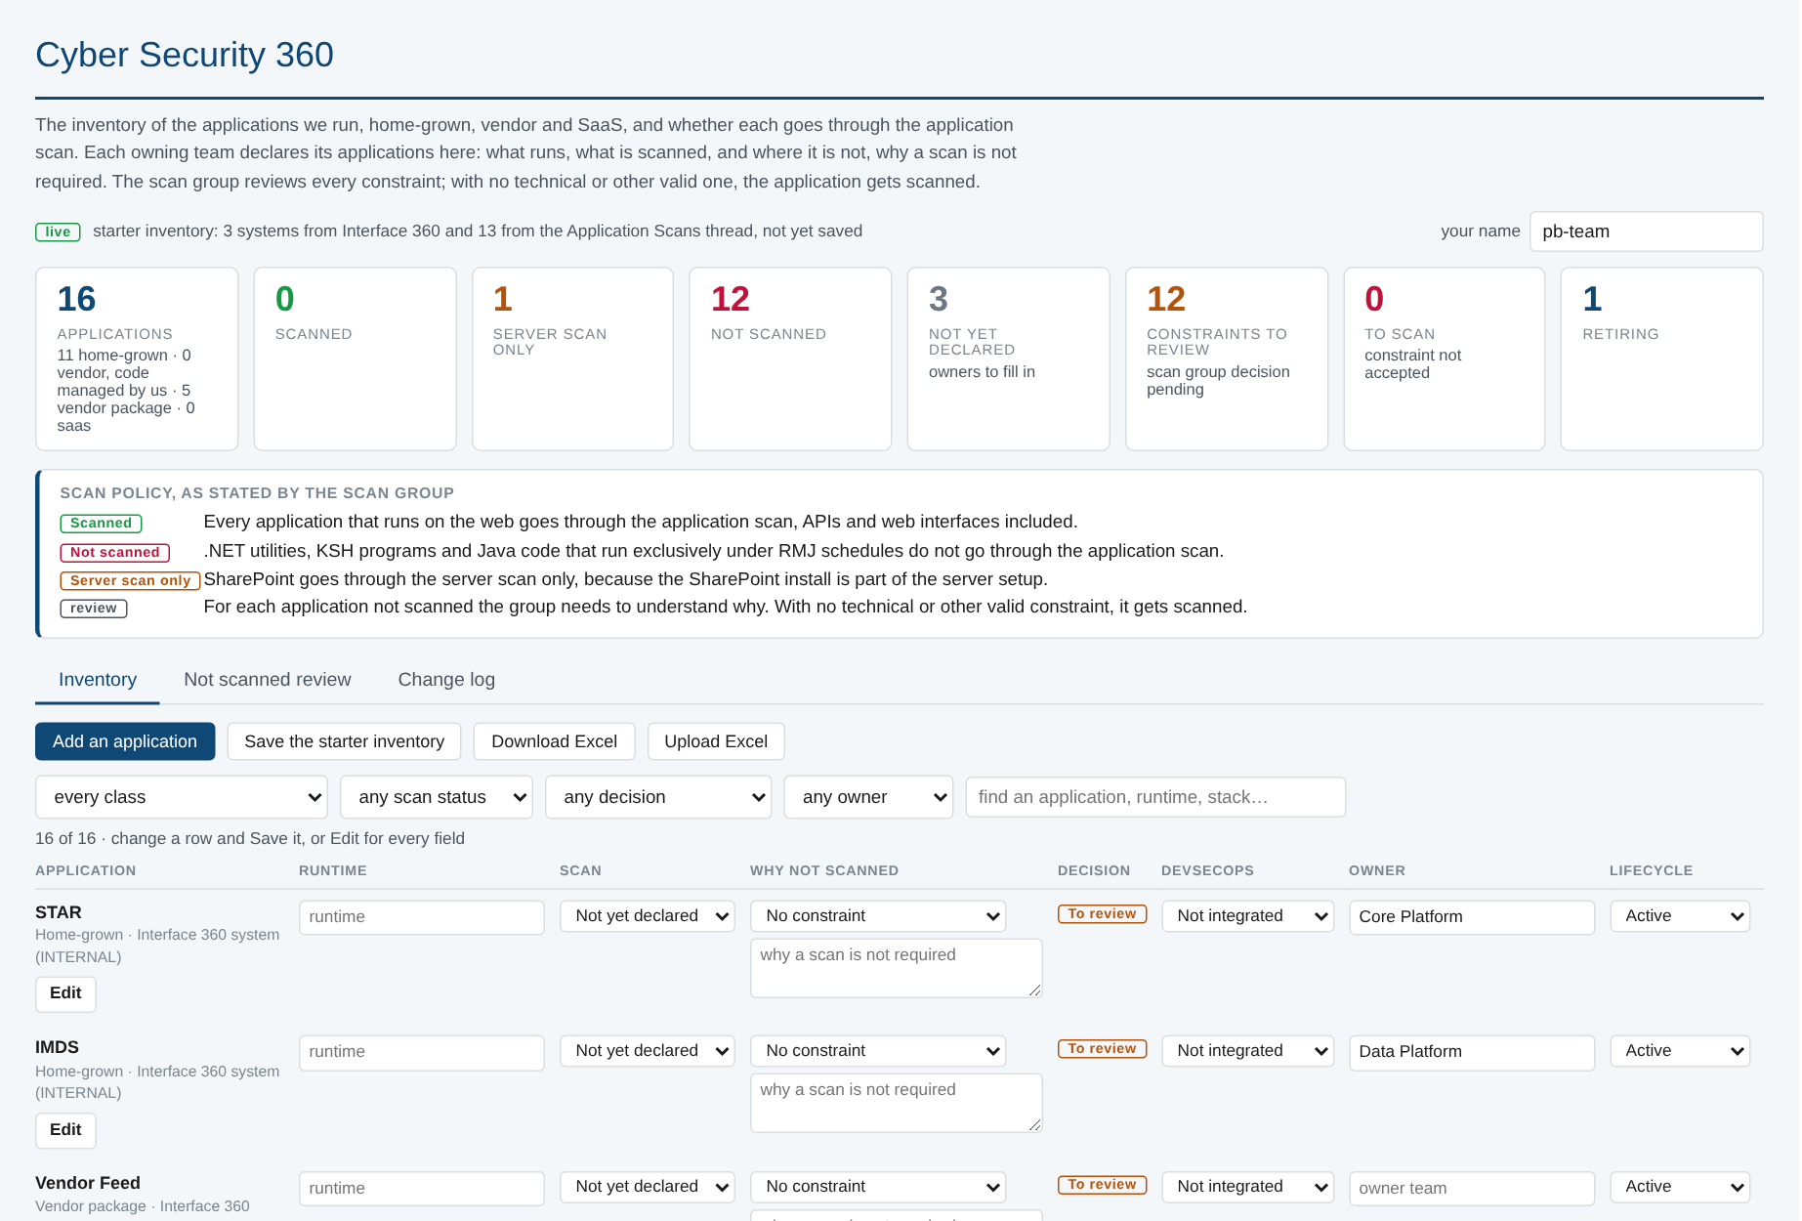

Cyber Security 360: the inventory every team fills in
One list
home-grown, vendor and SaaS, started from every system Interface 360 knows, with the owner its interfaces name
Declared by owners
what runs, whether it is scanned, and why a scan is not required where it is not; edited in place or in the workbook
DevSecOps column
whether the application is on the standard pipeline: none, partial, integrated, not applicable
Reviewed by the scan group
constraint accepted, or sent to scan; every decision logged with who and what it replaced
Notes:
Screen rendered from sample rows, no client data. The link to the page goes to every development team; the workbook download carries dropdowns for those who prefer Excel.

Slide 21
Asks of this group
Three decisions to leave with
Every application onboards to the standard pipeline
Declare every application in Cyber Security 360
Put the Hub on the library this quarter
config.yaml, the two-line Jenkinsfile, credentials by reference; DAST where there is a web surface
owners by month end; the scan group reviews the constraints as a group
standard stages for code, dependencies and artefact; the Hub's own gates kept as the extended pipeline

