Slide 1
Taints and Tolerations
Taints are set on Node
Tolerations are set on POD
#kubectl taint nodes node-name key=value:taint effect
Pod
Pod
Pod
Pod
NoSchedule , PreferNoSchedule, NoExecute
Taints=Green
#kubectl taint nodes node1 app=myapp:NoSchedule
Node1
Node2
Node3
NoSchedule instructs Kubernetes scheduler not to schedule any new pods to the node unless the pod tolerates the taint..
PreferNoSchedule then Kubernetes will try to not schedule the pod onto the node but no guaranty.
NoExecute new pod will not be scheduled and existing pod will be evicted if they do not tolerate the taint.
taints and toleration does not tell the POD to go to a particular
node. Instead it tells the node to only accept PODs with certain toleration.
If your requirement is to restrict a POD to certain nodes, it is achieved through node affinity.

Slide 2
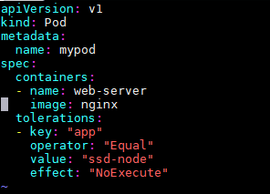
Taints and Tolerations
Taints are set on Node
Tolerations are set on POD
#kubectl describe nodes server | grep “Taint”
Pod
Pod
Pod
Pod
Taints=Green
Master Node
Node1
Node2
Node3
#kubectl taint nodes NODE-NAME key-

Slide 3
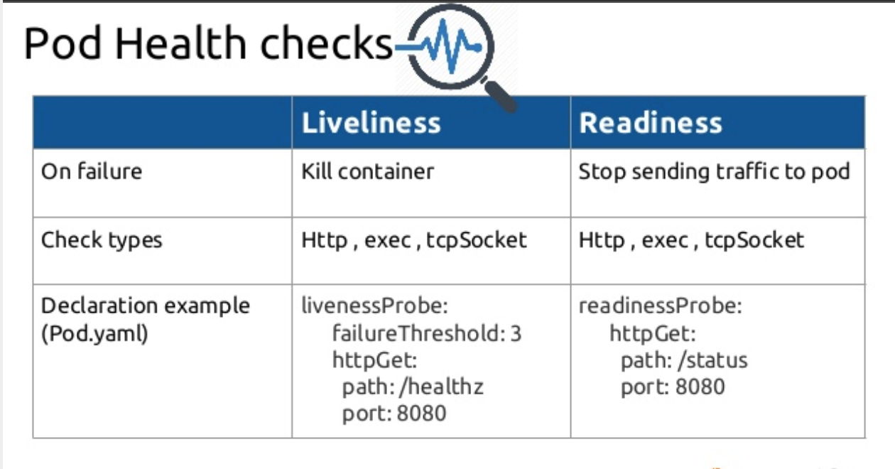
ExecAction - executes a command inside the container.
TCPSocketAction - performs a TCP check against the container’s IP address on a specified port.
HTTPGetAction - performs an HTTP GET request on the container’s IP.
A handler can then return the following:
Success - the diagnostic passed on the container.
Fail - the container failed the diagnostic and will restart according to its restart policy.
Unknown - the diagnostic failed and no action will be taken.

