Slide 1
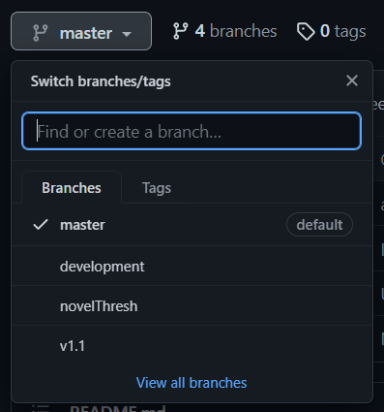
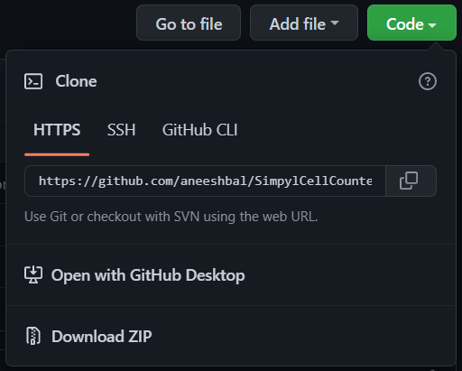

Installation
Download ‘scc.py’ from github
Switch to your desired branch via the dropdown menu
‘master’ branch is the most stable version
‘development’ branch is the most current version, but could have bugs
Option 1: Download entire branch
In the code dropdown menu, select ‘Download Zip’
Move the .zip file to your desired file location and extract it using a file archiver like WinRAR or 7-Zip
Option 2: Download scc.py only
In the file list, select scc.py
On the new page, select ‘Raw’
On the new page, right click and select ‘Save as…’
Save the file in your desired file location (keep the name as ‘scc.py’)
Notes:
<>

Slide 2
Installation cont.
Install Anaconda Distribution
If you want to install the program for every user on the PC, select this option during the install. All other defaults are fine.
Run ‘Anaconda Prompt’ as Administrator
On Windows: Right click app, select “Run as Administrator”
Type “conda create –n desired name of environment python=3.9”
Remember the name you use! Recommended: “sccenv”
Eg: “conda create –n sccenv python=3.9”
Type “conda activate name of your environment”
Notes:
<>

Slide 3
Installation cont.
Install python modules:
Type “pip install pandas”
Type “pip install opencv-python”
Type “pip install matplotlib”
Type “pip install configparser”
Type “pip install PySimpleGUI”
Notes:
<>

Slide 4
Running the Program - Basics
Copy file location of ‘scc.py’
On Windows: Right click file, select Properties, copy the Location field.
Run ‘Anaconda Prompt’
Type “conda activate name of your environment”
Type “cd paste file location”
Type “python scc.py”
When the interface opens, edit variables as desired
Current variables can always be saved by choosing the ‘Export’ option under the ‘Config’ menu bar. These variables can be later retrieved by choosing ‘Import’.
Press ‘Run’

Slide 5
Running - Configs
Batch/Preview Mode
Batch mode will count cells in all images within a specified folder (including all subfolders). An excel file with counts will be generated and optional output images can be generated as well.
Preview mode will count cells in a single image and display images that reflect how the program processed the image. Use it to tune the program to your data.
Spreads Only
Causes Batch mode to forgo counting cells, instead only reporting the background brightness and the difference between background and cell brightness of each image. Use to quickly get a report on image properties.
Output Image Files
Causes Batch mode to generate images files with counted cells and uncounted contours marked.

Slide 6
Running – Configs cont.
Selection Strength
Affects how much cells must stand out from the surrounding tissue to be outlined.
Fluorescent
Check if counting fluorescent images (SCC will not work on brightfield and fluorescent images simultaneously!).
Size
Affects the minimum radius of cells and the minimum and maximum area filters. Value is the approximate radius, in pixels, of the smallest cells that will be counted.
Min/Max Area
Affect the minimum and maximum area filters, respectively. Tune these to prevent small and large artifacts from being counted as cells.
Circularity Threshold
Range [0.0,1.0]. Affects the circularity filter. The higher the value, the more circular a contour must be to be counted as a cell.

Slide 7
Running – Coexpression
The coexpression tab should only be used if counting cells in images taken from multiple staining channels.
To use, image files of the same sections must share the exact same name, with only the channel identifier differing between them.
Eg: “subjR4_PFC_mCherry.tif” and “subjR4_PFC_DAPI.tif”
To analyze coexpression, first run SCC on each of the channels to be assessed. When running, fill in the Channel Identifier field with the name of the channel used in the image file names.
SCC will only find image files with the channel identifier in their names.
It will generate an excel file with counts as well as a ‘.npz’ file, which stores the outline of counted cells in each image.
On the Coexpression tab, choose Select Contour Files and select the files for the channels you want to compare.
SCC will look for coexpression among all selected channels. E.g., if three channels are selected, coexpressing cells will be those that appear in all three channels.
If ‘Add contours…’ is selected, coexpressing cells will be marked in white on output images.

Slide 8
Running – Coexpression cont.
To count cells that appear on multiple fluorescent channels, contour files for each channel must be made first.
If a Channel Identifier is present, SCC will automatically generate a contour file when it runs.
Image files of the same sections must share the exact same name, with only the Channel Identifier differing between them.
Eg: “subjR4_PFC_mCherry.tif” and “subjR4_PFC_DAPI.tif”
Tune SCC to the specific cell parameters of the channel you plan to analyze, enter the Channel Identifier, and run.
Double check the output csv file to make sure only images from the desired channel were analyzed.
Repeat for each channel.
Switch to the Coexpression tab, and select the desired contour files.

Slide 9
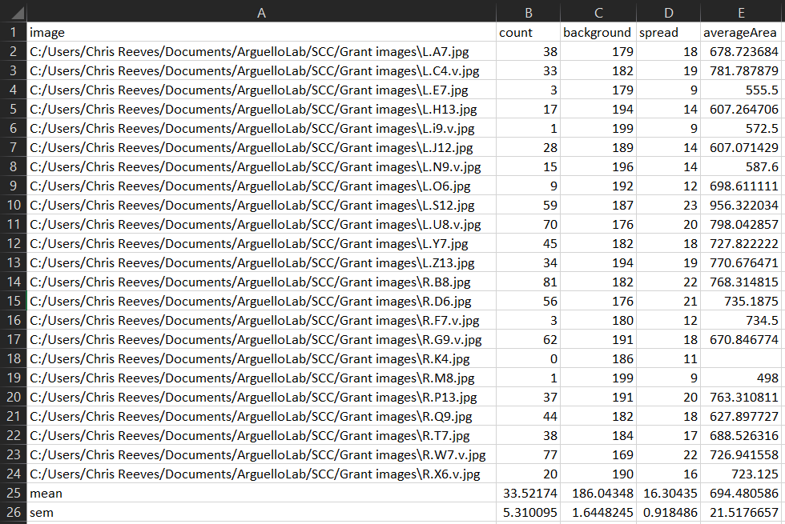
Output Data
Image: Full path to and name of image
Count: Counted cells in image
Background: Background brightness of image
Spread: Difference between background and cell brightness
AverageArea: Average area of all cells in image

Slide 10
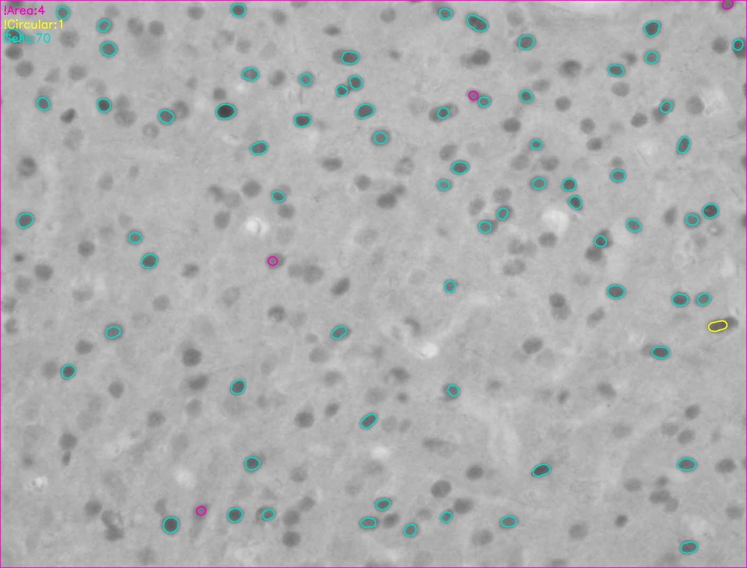
Output Data cont.
Cyan: Counted cells
Yellow: Contours not circular enough
Magenta: Contours too small or large
Legend displays counts of each contour type

Slide 11
Updating to New Version
Download the new ‘scc.py’ and replace the old version with it.
Run the program as described in Running the Program
Note: Old config files may not work properly with new versions.
To reference old config files, you can right click the file, select Open With > Notepad, and manually enter configs into SCC
A new config file can then be Exported from the new version of SCC

