Slide 1


Enterprise Work
Intelligence Platform
Unify People, Projects, Resources, Payroll, Finance, Governance, and AI Intelligence in one enterprise operating platform.
One Platform. Complete Enterprise Execution.
People → Revenue
Enterprise Control
Connected operating model
Buyer-ready view
Sales Deck

Slide 2
The Enterprise Execution Gap
High-growth organizations often operate across fragmented systems that cannot explain the full path from workforce capacity to delivery, cost, payroll, and revenue.
👥
HRMS
📁
Projects
📊
Resources
💰
Payroll
📈
Finance
✓
Approvals
▥
Reporting
✦
AI / Insights
Result: duplicated data, delayed approvals, payroll blockers, project risk blind spots, and weak executive visibility.
Enterprise Work Intelligence Platform
2/25

Slide 3

Tracopus Connects the Enterprise Operating Model
A single system of execution that links workforce operations, delivery planning, resource capacity, payroll readiness, financial controls, governance, analytics, and AI.
Enterprise Work Intelligence
A connected operating layer for people, projects, resources, payroll, finance, governance, and AI.
Plan Work
Staff Work
Execute Work
Track Time
Run Payroll
Bill Revenue
Generate Intelligence
Enterprise Work Intelligence Platform
3/25

Slide 4
One Platform. Complete Enterprise Execution.
Tracopus brings together the capabilities normally split across HRMS, PSA, project management, payroll, finance, analytics, workflow, and AI platforms.
⌂
Workspace
👥
People
▣
Projects
◉
Resources
Daily command center
Employee lifecycle
Delivery execution
Capacity & staffing
$
Payroll
▥
Finance
★
Performance
▤
Analytics
Pay runs & paychecks
Billing & revenue
Goals & growth
Reports & dashboards
✦
AI
↔
Integrations
⚙
Admin
Agentic insights
Connected ecosystem
Policy & control
Designed to replace fragmented toolchains with one enterprise operating platform.
Enterprise Work Intelligence Platform
4/25

Slide 5
Built for Every Enterprise Role
Each persona receives a focused workspace, relevant dashboards, scoped records, and role-aware actions without losing the single source of truth.
Employee
Manager
HR & Payroll
Self-service work, attendance, leave, timesheets, expenses, paychecks, and documents.
Team approvals, staffing, delivery progress, utilization, risks, and operational control.
Lifecycle, policies, payroll readiness, compliance, workforce metrics.
Finance
Executive
Admin
Billing, reimbursements, invoices, project cost, revenue visibility.
Portfolio health, workforce trends, revenue, risk, approvals, intelligence.
Configuration, access control, integrations, audit, policies, governance.
Enterprise Work Intelligence Platform
5/25

Slide 6
Employee Experience
A modern self-service workspace that helps every employee manage daily work and HR operations with clarity.
• My work, tasks, calendar, notes, and notifications in one command center. • Attendance, leave, timesheets, paychecks, expenses, documents, assets, and approvals. • Personalized dashboards with upcoming actions, status, and reminders. • Mobile-ready workflows aligned with web permissions and Tracopus security.
Enterprise Work Intelligence Platform
6/25

Slide 7
Manager Command Center
Managers see what matters: team capacity, approvals, workload, delivery progress, risks, leave coverage, and timesheet compliance.
82%
14
3 projects
2 weeks
Team Utilization
Pending Approvals
Delivery Risk
Coverage Gaps
✓
Approve work
◉
Balance capacity
!
Manage risks
★
Coach teams
⌂
Manager action queue
Enterprise Work Intelligence Platform
7/25

Slide 8
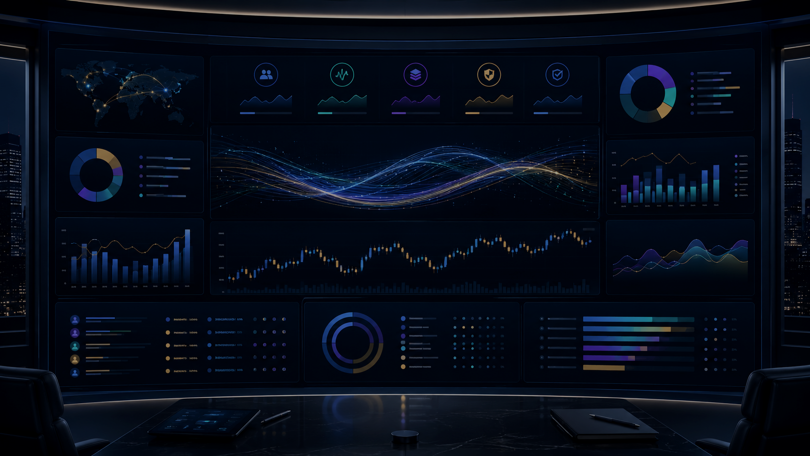
Executive Control Tower
A leadership-grade operating dashboard for workforce, delivery, resource capacity, payroll readiness, financial control, risk, approvals, and business performance.
92%
96%
$24.5M
8
89%
Portfolio health
Payroll readiness
Revenue visibility
Open high risks
Approval SLA
Enterprise Work Intelligence Platform
8/25

Slide 9
People Intelligence: Employee 360
A single operational profile connects employee master data with work, attendance, leave, timesheets, payroll, documents, assets, projects, approvals, and activity history.
▤
Profile & Employment
$
Payroll & Paychecks
👤
Employee 360
◷
Attendance & Leave
▣
Projects & Allocation
◫
Timesheets
◼
Documents & Assets
✓
Approvals & Audit
Enterprise Work Intelligence Platform
9/25

Slide 10
Attendance, Leave, and Timesheets Work as One System
Time signals become more valuable when they are connected to leave approval, attendance exceptions, delivery work, payroll locks, and financial controls.
Attendance
Leave
Timesheet
Approval
Payroll Lock
Insight
• Leave balances and regularization feed attendance truth. • Approved timesheets feed payroll, billing, utilization, and project cost. • Managers get exception panels for missing time, late approvals, and coverage gaps. • Audit trails capture all submissions, approvals, rejects, locks, and overrides.
Enterprise Work Intelligence Platform
10/25

Slide 11
Payroll and Employee Finance
Operational payroll that connects salary structures, attendance, leave, timesheets, deductions, expenses, reimbursements, paychecks, and audit controls.
• Payroll groups, salary structures, components, deductions, allowances, and adjustments. • Payroll readiness score before processing to expose missing approvals and blockers. • Paychecks, payslip preview/download, publish controls, and secure employee self-service. • Designed for statutory integrations without hardcoding country-specific rules into the core.
Enterprise Work Intelligence Platform
11/25

Slide 12
Performance, Growth, and Workforce Development
Tracopus turns performance management into a connected lifecycle across goals, reviews, feedback, skills, delivery evidence, and growth plans.
Goals & OKRs
Review Cycles
Evidence-based Reviews
Growth Plans
Team and individual goals with alignment to business outcomes.
Self, manager, peer, and calibration workflows.
Delivery, feedback, utilization, quality, and leadership signals.
Skills, certifications, development actions, and promotion readiness.
Enterprise Work Intelligence Platform
12/25

Slide 13
Project and Delivery Intelligence
Plan, execute, govern, and report delivery across project portfolios, programs, deliverables, milestones, tasks, risks, issues, and decisions.
▥
Portfolio
▣
Projects
□
Deliverables
☑
Work Items
≋
Timeline / Gantt
!
Risks & Issues
✓
Approvals
Delivery data flows into resource planning, timesheets, invoices, revenue forecasts, executive dashboards, and AI recommendations.
Enterprise Work Intelligence Platform
13/25

Slide 14
Resource Intelligence and Staffing
Connect demand, skills, capacity, availability, cost, utilization, leave, and project allocation into one workforce planning engine.
• Capacity planner, allocation timeline, resource Gantt, skills matrix, and staffing requests. • Bench visibility, over-allocation warnings, upcoming roll-offs, and demand forecasts. • What-if scenarios for staffing, delivery date, cost, and margin impact. • Staffing Intelligence Agent recommends the best fit using skills, availability, cost, location, and delivery context.
Enterprise Work Intelligence Platform
14/25

Slide 15

Governance by Design
A universal approval engine powers leave, attendance, timesheets, expenses, payroll, documents, assets, project gates, budgets, invoices, and exceptions.
Policy-driven workflows
Multi-level approval
Delegation & acting-for
SLA & escalation
Comments & attachments
Unified audit trail
Enterprise Work Intelligence Platform
15/25

Slide 16
Financial Intelligence: Work to Revenue
Tracopus connects the operating flow from project work and employee time to payroll, billing, cost, revenue, and margin intelligence.
Opportunity
Estimate
Project
Resource
Timesheet
Invoice
Revenue
• Project financials, billing plans, purchase orders, invoices, revenue forecast, and margin visibility. • Expense and reimbursement controls with project/client allocation. • Revenue leakage detection for missing time, unbilled work, delayed approvals, expired POs, and margin erosion.
Enterprise Work Intelligence Platform
16/25

Slide 17
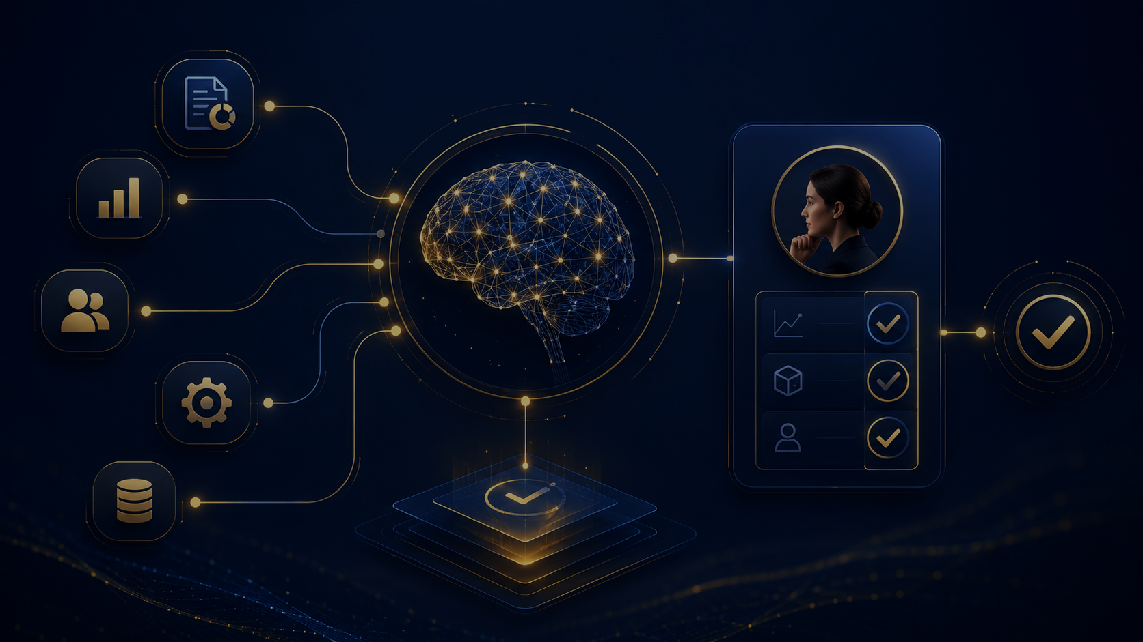
AI Agent Framework
AI is embedded into workflows as evidence-based recommendations with confidence, audit, human approval, and controlled actions — not just chat.
WBS Agent
Staffing Agent
Timesheet Agent
Payroll Readiness
Risk Agent
Revenue Agent
Executive Briefing
Integration Health
Enterprise Work Intelligence Platform
17/25

Slide 18
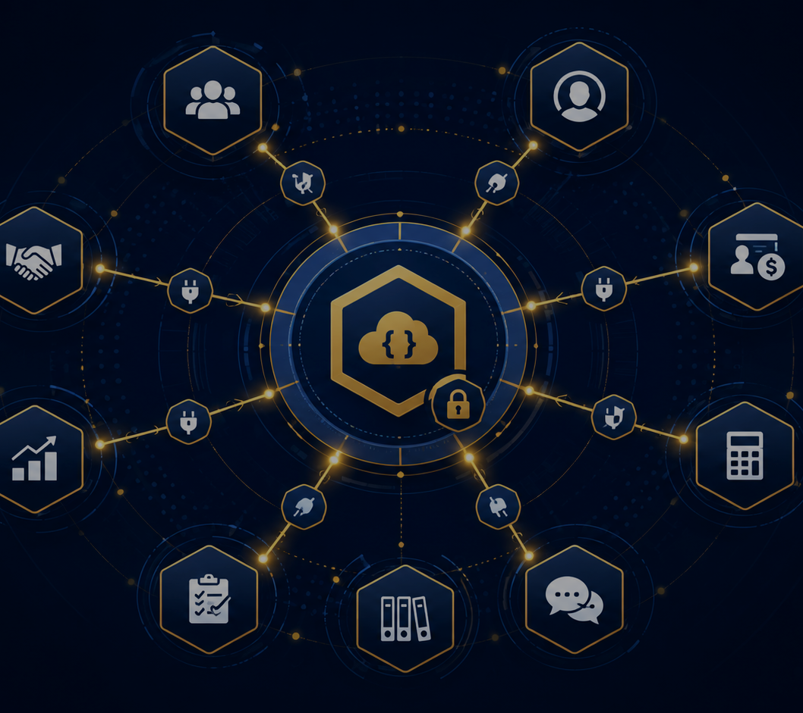
Enterprise Integration Hub
A connector framework makes Tracopus extensible across identity, CRM, work management, DevOps, payroll, accounting, communications, CSV/SFTP, APIs, and webhooks.
• Connector catalog, setup, mapping, sync schedules, logs, retry queue, and health dashboard. • Adapters for Salesforce, Jira, Azure DevOps, GitHub, Teams, Slack, ADP, Gusto, QuickBooks, Xero, and more. • Connector trust score: success rate, stale windows, latency, failures, and recovery metrics. • API-first architecture supports enterprise ecosystem expansion without changing core domain models.
Enterprise Work Intelligence Platform
18/25

Slide 19
Enterprise Security, Audit, and Compliance
Production-ready controls are built into every feature: role scope, field masking, approvals, audit events, retention, export controls, and integration security.
SSO & Session
RBAC & Scope
Data Masking
Microsoft Entra ID, team-scoped context, session controls.
Role templates, CRUD matrices, manager/team scope, self-service limits.
Salary, tax, bank, payroll, documents, performance, and PII.
Unified Audit
Feature Flags
Secure APIs
Actor, entity, event, before/after data, comments, attachments, and evidence.
Org-level switches, page flags, rollout controls, pilot-safe defaults.
Versioned endpoints, tenant scope, validation, logs, and integrations.
Enterprise Work Intelligence Platform
19/25

Slide 20
Analytics and Reporting Across the Enterprise
Dashboards, charts, reports, scheduled exports, and AI insights span people, projects, resources, payroll, finance, approvals, risk, integrations, and executives.
Workforce
Delivery
Resource
Payroll
Finance
Approvals
Risk
Integrations
Enterprise Work Intelligence Platform
20/25

Slide 21
Mobile-Ready Workflows and Collaboration
Tracopus supports employee and manager workflows across web and mobile, with shared context through notes, files, chat, comments, activity feeds, and notifications.
• Android mobile app parity for assigned projects, tasks, timesheets, and personal insights. • Collaboration surfaces connected to project, employee, approval, risk, file, and decision context. • Notification center and Today activity panel keep users focused on required actions. • Guided navigation, onboarding tours, help center, and embedded assist dock improve adoption.
▣
Web
▯
Mobile
◉
Notifications
▥
Files & Notes
☰
Chat & Activity
Enterprise Work Intelligence Platform
21/25

Slide 22
Extensible Architecture for Enterprise Scale
The platform is designed to preserve existing capabilities while adding enterprise intelligence through versioned APIs, shared services, adapters, feature flags, and AI gateway controls.
Experience Layer
Role-based UI, dashboards, mobile, assist dock
Domain Modules
People, Projects, Resources, Payroll, Finance, Performance
Shared Services
Approvals, audit, notifications, documents, analytics, RBAC
Integration & AI
Connector registry, sync engine, AI Gateway, agent registry
Data & Governance
Scoped records, events, audit evidence, policy enforcement
Enterprise Work Intelligence Platform
22/25

Slide 23
Adoption Roadmap
Tracopus can be rolled out progressively by persona, module, and feature flag — enabling a controlled enterprise adoption path.
1
Foundation
2
Operations
3
Delivery
4
Intelligence
Navigation, personas, dashboards, Employee 360
Leave, attendance, timesheets, approvals, payroll
Gantt, risks, issues, portfolio, resources
AI agents, control tower, revenue leakage, integrations
Enterprise Work Intelligence Platform
23/25

Slide 24
Business Outcomes Tracopus Enables
The value is not only feature coverage — it is faster decisions, better control, less leakage, stronger governance, and a unified operating model.
Faster decisions
Better delivery
Higher utilization
Shared operational visibility
Risks and delays surfaced earlier
Capacity and staffing intelligence
Improved payroll readiness
Reduced revenue leakage
Stronger governance
Fewer blockers before processing
Time, billing, and approval controls
Audit, policy, and evidence by design
Enterprise Work Intelligence Platform
24/25

Slide 25
Tracopus Enterprise Work
Intelligence Platform
Unify People, Projects, Resources, Payroll, Finance, Governance, and AI Intelligence in one enterprise operating platform.
One Platform. Complete Enterprise Execution.
Ready to unify work, workforce, and intelligence?
Enterprise Work Intelligence Platform
25/25

