Slide 1

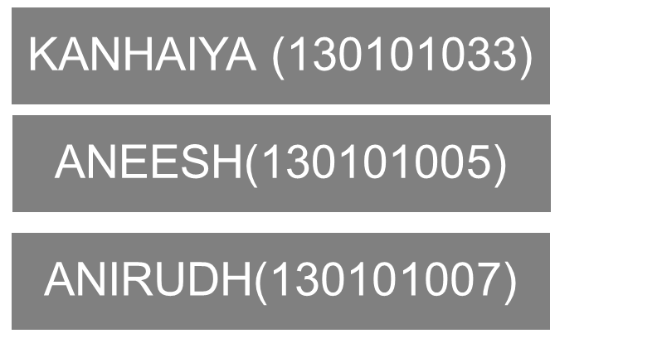
ASSEMBLER, LINKER
&
LOADER

Slide 2

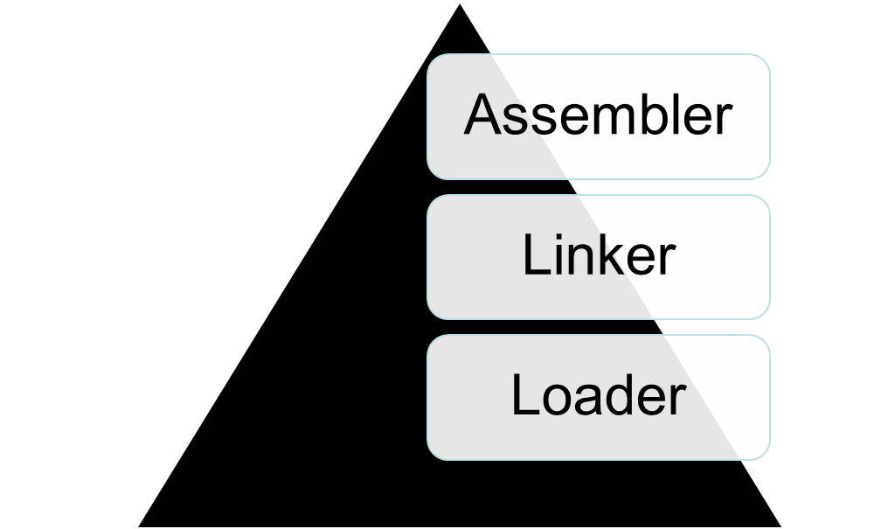
components

Slide 3
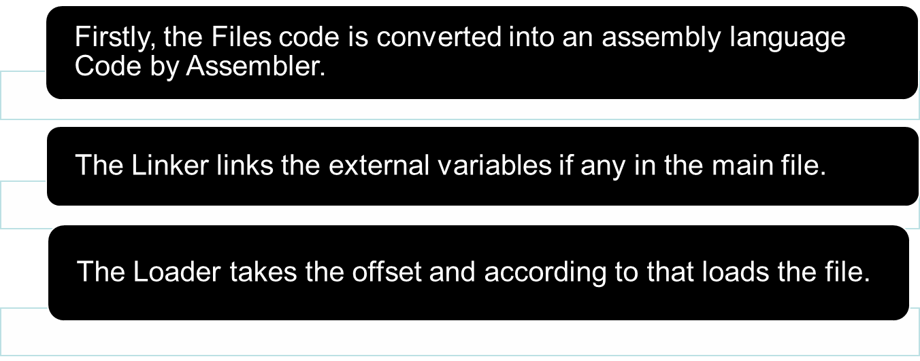
HOW IT WORKS !
Initially the files needed to be run are taken and following operations takes place :

Slide 4
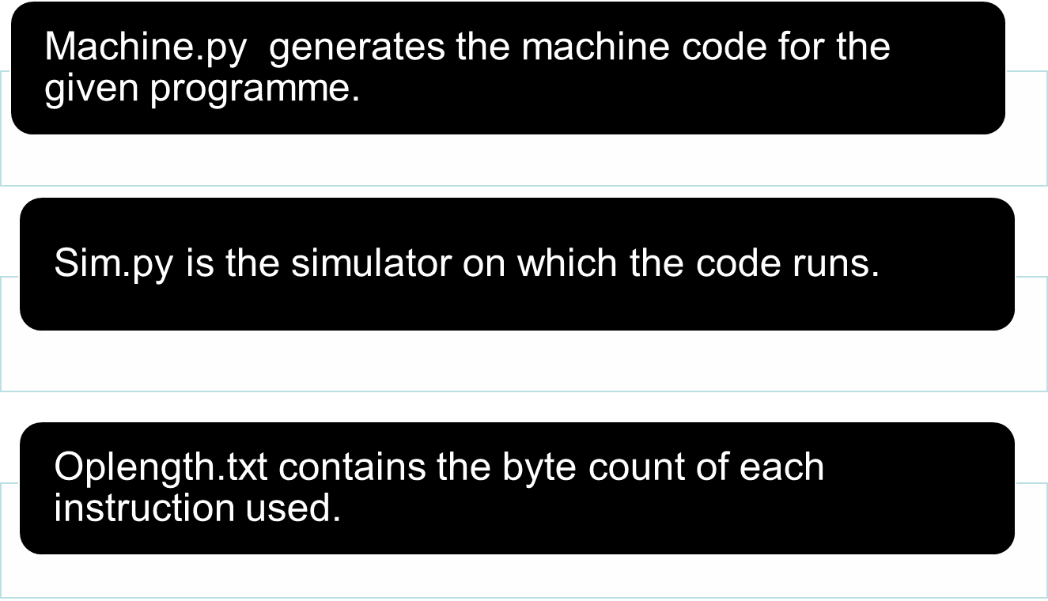

Slide 5
PROCESSING
Firstly, the ‘c.g’ & ‘h.g’ files are run.
It takes the filename of the files and the offset vale
It then calls the assembly function and convert all the file’s code into assembly code and concatenate them into one file.
This assembly function return Symbol table which contains the information about address and data stored in each instruction.

Slide 6
Linker takes the Symbol table and the assembly code and links all the external variables in the main file.
Machine code is also generated using machine.py
The given code is simulated using sim.py which shows the values of all registers after all the operations in code.

Slide 7
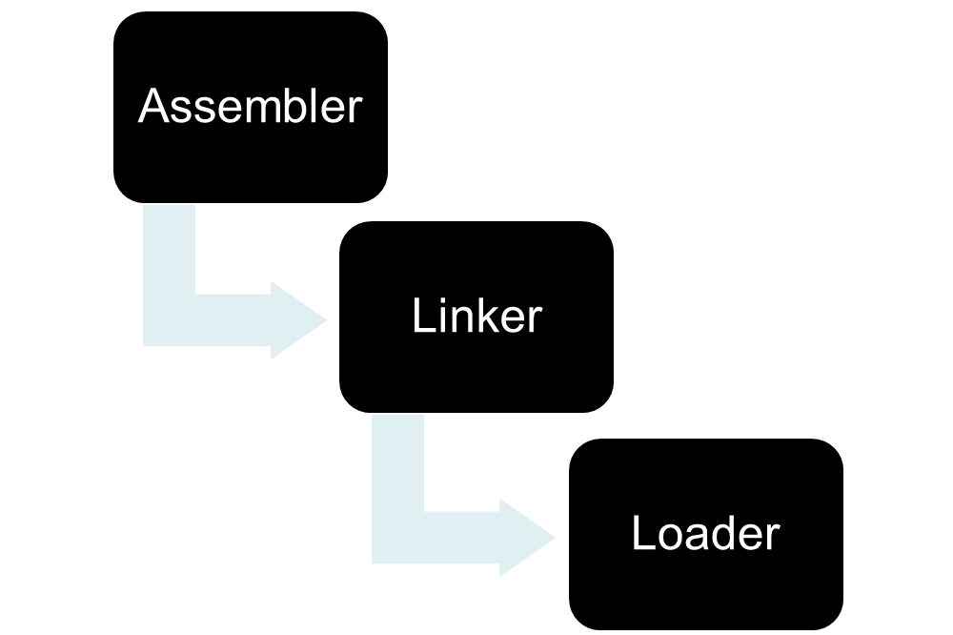

Slide 8
THANK YOU

