Slide 1
APPLIED HUMAN FACTORS · SPRING 2026 · FINAL RESEARCH REPORT
Deploying Conversational Agents to Bridge the
Learning Transfer Gap in Duolingo
Evaluate · Analyze · Improve
Preston Cusick and Aneesh Harwalkar
April 24, 2026

Slide 2
AGENDA
Five phases. One thesis: system failure, not user failure.
PHASE 1
PHASE 2
PHASE 3
PHASE 4
PHASE 5
SYSTEM & CONTEXT
TASK & USER ANALYSIS
DATA & METHODOLOGY
HF ANALYSIS & FINDINGS
REDESIGN
Duolingo as a human machine system at 500M learner scale.
Cognitive, perceptual, motor, and workload demands on the learner.
A 15 source research corpus and a proposed 24 week experiment.
An HFACS walk across all four Swiss Cheese layers.
Three pillars, a working prototype, and a multi agent future.
Macro arc: Evaluate, Analyze, Improve.
Language Learner Agent · AHF · 2026
2

Slide 3
WHY THIS PROJECT
Months of streaks. And still, no conversation.
A pattern we have all seen, and the reason this report exists.
THE PATTERN
A learner opens Duolingo every day. A long streak. Thousands of XP. The bird is happy. Then the moment arrives, which could be a trip abroad, a new coworker, a family visit. The learner opens their mouth and nothing comes out, or is too nervous or embarrassed.
This is the transfer gap. The app is the system. The specific moment where the learner is tasked with speaking is where transfer either happened or did not.
WHAT THIS IS NOT
WHAT THIS IS
Not a story about lazy learners. Not a story about bad apps.
The learner did what the system asked them to do. The streak is real. The XP is real.
A Human Factors investigation of why the system does not produce the outcome its learners came for, and a prototype redesign that puts the right signal in the loop.
Language Learner Agent · AHF · 2026
3

Slide 4
PHASE 1 · SYSTEM & CONTEXT
Duolingo is a 500 million learner human machine system.
The people who build it, the people who use it, and the environment they use it in.
THE PEOPLE WHO BUILD IT
THE PEOPLE WHO USE IT
THE ENVIRONMENT
• Content and curriculum designers who write lessons.
• The engineering team behind Birdbrain, Duolingo's in house algorithm that decides which exercise you see next.
• Growth and engagement product teams who manage streaks, notifications, and daily return.
• 500M+ monthly active learners, mostly adults, mostly self directed.
• Mobile first. No classroom and no in person tutor.
• Motivated by visible progress: streak count, XP, crown level.
• Stated goal: hold a real conversation.
• Measured behavior: daily login.
• Short sessions under 15 minutes on a phone.
• In between moments: commute, couch, waiting room.
• A dense gamified interface.
• No other person is in the loop.
• The same visual context every session.
Language Learner Agent · AHF · 2026
4

Slide 5
PHASE 1 · SYSTEM & CONTEXT
Every human machine system sits under three stressor layers.
INTERNAL STRESSORS
EXTERNAL STRESSORS
ORGANIZATIONAL STRESSORS
The learner's own mind at work. A feeling of fluency that comes from seeing a word again. Attention pulled toward XP counters and streak flames instead of the lesson itself.
Streaks, XP, leaderboards, crown progression, and push notifications engineered to create daily return pressure. The app rewards showing up far more than it rewards learning.
Daily Active Users is the primary business metric. Christensen's Innovator's Dilemma at work: a profitable item-based product is hard to leave behind, even when the better version is conversational. Outcome research only covers reading and listening.
These three layers set the stage. The rest of the report traces how they line up into an incident.
Language Learner Agent · AHF · 2026
5

Slide 6
PHASE 1 · SYSTEM & CONTEXT
The constraint used to be technology. It isn't anymore.
The gap that the 2012 design cannot close, and the 2026 technology that now can.
2012
2023
2026
DUOLINGO LAUNCHES
GENERATIVE AI ARRIVES
THE GAP PERSISTS
Gamified and item based. Consumer language apps don't have conversational AI. The technology doesn't exist yet.
Conversational agents with distinct personas become practical at consumer scale. The technology barrier falls.
Duolingo's core architecture is unchanged. Jiang et al. (2021) still describes the ceiling. The constraint is now design, not compute.
Language Learner Agent · AHF · 2026
6

Slide 7
PHASE 1 · SYSTEM & CONTEXT
What has actually been tested, and what those tests found.
The published evidence about Duolingo and mobile language apps, in plain terms.
JIANG ET AL. (2021)
n = 225 adults, 4 semesters of Duolingo study. Reading reached Intermediate Low. Listening reached Novice High. Speaking and writing were never assessed.
BICKNELL & BRUST (2020) · DUOLINGO'S OWN DESCRIPTION
Birdbrain, Duolingo's in house AI, is optimized to pick the next exercise you are likely to get right. Not calibrated to speaking.
MIHAYLOVA ET AL. (2022) · META ANALYSIS OF 23 STUDIES
Mobile apps show large short term gains. But only 3 of 23 studies measured retention after the intervention. Those 3 showed small effects.
KRISTENSEN ET AL. (2024) · 8 WEEK APP STUDY
The rate at which learners repeated the same mistakes stayed stable over 8 weeks. More app time did not reduce the pattern. (Caveat: Norwegian second graders.)
ACTFL, IN ONE LINE
The national scale universities use to rate how well someone can use a foreign language. Intermediate Low means simple daily transactions. Real conversation sits two or three levels higher.
7
Language Learner Agent · AHF · 2026

Slide 8
PHASE 1 · SYSTEM & CONTEXT
A 500 million learner system that doesn't measure the skill its users came for.
500M+
0
~14%
MONTHLY ACTIVE LEARNERS
SPEAKING ASSESSMENTS
OF US ADULTS
One of the largest learning systems on Earth.
In the peer reviewed Duolingo outcome research we surveyed.
Report learning a second language. Duolingo dominates the tool choice.
When the world's largest learning system doesn't measure the skill its users say they want, the result isn't individual under performance. It is a system wide mismatch between what gets measured and what learners actually need, and that is what makes this a Human Factors problem worth solving.
Language Learner Agent · AHF · 2026
8

Slide 9
PHASE 1 · SYSTEM & CONTEXT
If this were an aviation incident, we would call it a system failure.
What we know now, and what the next generation of technology makes possible.
WHAT WE KNOW NOW
WHAT COMES NEXT
• A measured ceiling at Intermediate Low reading and Novice High listening.
• Incentives built around daily return, not real transfer.
• Hundreds of millions of engaged learners with rising streaks.
• No measured speaking gains in the published research.
The holes are already open. Phase 4 shows how they line up.
• Generative AI is the first technology positioned to close this gap. Conversational, dialect aware, real time.
• But only if we name the right enemy first: the business metric that excludes the goal.
• Phase 5 is our architectural response.
System failure, not user failure.
Language Learner Agent · AHF · 2026
9

Slide 10
PHASE 2 · TASK & USER ANALYSIS
Who the learner actually is.
A portrait of the adult self directed learner the app has to work for.
PERSONA · THE SELF DIRECTED ADULT LEARNER
• Adult. Self directed. No formal classroom partner.
• Mobile first. Daily session under 15 minutes. No one else in the loop.
• Motivated by visible progress: streak count, XP, crown level.
• Learning for a reason: a trip, a job, a family visit.
• Stated goal: hold a real conversation in the target language.
• Actual measured behavior: daily login and XP.
• Never speaks inside the app.
• Believes the streak is proof of progress.
The learner wants to speak. The system rewards showing up.
Language Learner Agent · AHF · 2026
10

Slide 11
PHASE 2 · TASK & USER ANALYSIS
What the app measures vs. what the learner signed up for.
Two different skills. The app exercises one. The learner's goal lives in the other.
RECOGNITION · WHAT DUOLINGO MEASURES
PRODUCTION · WHAT THE LEARNER SIGNED UP FOR
• Multiple choice translation.
• Word bank sentence assembly.
• Listening practice with clean machine voice clips.
• Tap to match vocabulary.
• Fill in the blank grammar.
Demand on the learner:
• Perceptual: scan the screen and pick.
• Motor: tap, swipe, type.
• Cognitive: pick from a small set of options.
• Speaking in real time, without prompts.
• Picking the right words for the situation.
• Understanding messy, accented speech.
• Recovering after a misunderstanding.
• Reading the formality of the room.
Demand on the learner:
• Perceptual: hearing messy, accented speech.
• Motor: speaking out loud.
• Cognitive: build a sentence on the fly, under time pressure.
Language Learner Agent · AHF · 2026
11

Slide 12
PHASE 2 · TASK & USER ANALYSIS
Cognitive, perceptual, motor, and workload demands.
Where Duolingo over loads and under loads each kind of demand on the learner.
COGNITIVE
PERCEPTUAL
Under loaded. No problem solving, no situational reasoning, no sentence building on the fly. The task is pick from a small menu of choices.
Narrow. The visual channel is busy with UI ornaments. The audio channel is limited to clean machine voice. No demand to hear accented or messy speech.
MOTOR
WORKLOAD
Tap and swipe only. The muscles the learner needs for speaking never get exercised inside the app.
Kept artificially low. Tuned to protect daily retention. Friction is the enemy of showing up, so the system never stretches the learner.
Language Learner Agent · AHF · 2026
12

Slide 13
PHASE 2 · TASK & USER ANALYSIS
Ideal state versus failure state.
What the learner signed up for, and where the system actually lands.
IDEAL STATE
FAILURE STATE (NOW)
• Hold a five minute conversation in the target language.
• With a native speaker, in country, in context.
• Recover from a misunderstanding without panic.
• Pick the right words for a market, a restaurant, or a workplace.
• Understand accented, spontaneous speech.
This is what the user signed up for.
• Complete daily streak. Earn XP.
• Recognize vocabulary in isolation.
• Feel confident, without any way to check whether the confidence is earned (Kornell, 2008).
• Cannot speak spontaneously under real conditions.
• Cannot pick between regional accents of the same language.
This is where the system actually lands.
Phase 3 is built to trace the gap between these two columns.
Language Learner Agent · AHF · 2026
13

Slide 14
PHASE 3 · DATA & METHODOLOGY
Two weeks, fifteen sources, one prototype, one proposed experiment.
Research driven and build driven. Transparent about what it can and cannot prove.
APPROACH
BENEFITS
• A 15 source peer reviewed research corpus.
• Two meta analyses (Bibauw 2022, Mayer 2021) carry the intervention claims.
• A working conversational agent, built in the repo.
• No primary data was collected in this window.
• Synthesis leverages a far larger evidence base than a two week primary study could ever produce.
• The prototype constrains the redesign space to what is actually buildable.
• Every claim in this deck ties back to one of our sources
• The proposed experiment closes what this window could not.
Language Learner Agent · AHF · 2026
14

Slide 15
PHASE 3 · DATA & METHODOLOGY
How we built it: five scoped agents, one coordinated project.
We used Claude Code to run five sub agents, each with a single role and a single directory.
RESEARCH
HF ANALYSIS
FRONTEND
BACKEND
QA
Assembled the 15 source corpus. One note per paper. Direct quotes, sample sizes, effect sizes. Flagged paraphrases.
Produced the HFACS walk across all four Swiss Cheese levels. Mapped every claim to a source and a course concept.
Built the chat UI in plain HTML, CSS, and JavaScript. Dialect pill, scenario pill, severity badges, translation toggle.
Built the Flask server and the agent. Scenario openers, dialect aware prompts, severity graded corrections.
Reviewed every deliverable against the research files and the API contract. Produced the blocker, warning, and note report that drove the final polish.
One directory per agent. One instruction file per agent. That is how we kept the work coordinated and every deliverable traceable to an owner.
Language Learner Agent · AHF · 2026
15

Slide 16
PHASE 3 · DATA & METHODOLOGY
Corpus: 15 peer reviewed sources, grouped by function.
Two meta analyses carry the intervention claims. Full source files live in the repo.
DUOLINGO & MOBILE APPS
MEMORY & CONTEXT
INTERVENTION EVIDENCE
SUPERVISION & TRANSPARENCY
• Jiang et al. (2021). ACTFL ceiling study.
• Mihaylova et al. (2022). Mobile app meta analysis.
• Kristensen et al. (2024). Error repetition.
• Bicknell (2020). Birdbrain (Duolingo's own description).
• Baddeley (2000). Working Memory and the Episodic Buffer.
• Essoe et al. (2022). Context reinstatement.
• Godwin-Jones (2018). Isolated drill problem.
• Kornell (2008). Why learners can't tell what's working.
• Bibauw et al. (2022). Dialogue practice (d = 0.58).
• Mayer (2021). Conversational style (d = 1.3).
• Geeslin and Long (2014). Regional language variation.
• Wang (2024). GenAI chatbot (affect only).
• Cannon-Bowers et al. (1998). TADMUS framework.
• Loft et al. (2021). Transparency as a system variable (course source).
HOW TO READ EFFECT SIZES (D)
A standard way to measure how big a gap is between two groups. d = 0.2 is small, d = 0.5 is medium, d = 0.8 is large. Anything above 1.0 is very large for education research. You will see d = 0.58 and d = 1.3 later in this report.
Language Learner Agent · AHF · 2026
16

Slide 17
PHASE 3 · DATA & METHODOLOGY
Proposed experiment: what a real test would manipulate and measure.
A 24 week randomized controlled trial. Retention is a co-primary outcome, not a follow up.
MAIN EFFECT 1 · AGENT TYPE
Four levels: dialect specific (Carlos or Elena), generic chatbot, embodied avatar (per Wang 2024), Duolingo only control.
MAIN EFFECT 2 · TIME
Four measurement points: week 0 (baseline), week 12 (post), week 24 (durable), and a 6 month follow up.
INTERACTION · AGENT TYPE × DIALECT MATCH
Does a Mexican Spanish learner gain more from Carlos than from Elena? Does any dialect agent beat a generic one?
INTERACTION · AGENT TYPE × TIME (RETENTION)
Do gains from the dialect agent decay more slowly than gains from the generic agent or the control? This is the transfer test.
WHAT WE WOULD MEASURE
ACTFL Oral Proficiency Interview, scored by a blinded rater. The standard live speaking test universities use.
WHAT WE'D CONTROL FOR
Prior proficiency. Baseline streak length. Daily engagement time. Age. First language. Prior motivation. Intended use context.
POST HOC ANALYSES
Sub scales of speaking (pragmatics, register, repair). Self reported confidence. App engagement during the trial.
Language Learner Agent · AHF · 2026
17

Slide 18
PHASE 3 · DATA & METHODOLOGY
Threats to validity, and how we would address each one.
NO PRIMARY DATA
Two week build window. Addressed by relying on two meta analyses (Bibauw, Mayer) and a proposed future experiment.
NO A/B OF THE PROTOTYPE
A proof of concept only. Addressed by the proposed 24 week study with random assignment.
SELF SELECTION ON DIALECT
Dialect is a product input: learners pick based on where they're going or who they talk to. To isolate the dialect effect, the future RCT randomly assigns dialect and stratifies by self reported intended use context.
WHY 24 WEEKS, NOT WANG'S 12
Wang (2024) ran 12 weeks and found no speaking gain. We extend the window to 24 weeks plus a 6 month follow up so retention has room to show up in the data.
KRISTENSEN (2024) GENERALIZABILITY
That study sampled Norwegian second graders. We use it only for the mechanism it shows, with the caveat stated.
SHORT TERM BIAS IN THE APP LITERATURE
Mihaylova (2022) reports 78% of mobile app studies had high risk of bias and only 22% used randomization. We lean on meta analytic effects, not single study claims.
Language Learner Agent · AHF · 2026
18

Slide 19
PHASE 4 · HF ANALYSIS & FINDINGS
Reason's Swiss Cheese Model. We walk it backward, not downward.
HFACS is the method used to investigate aviation and industrial incidents. Same method, new domain.
L4 · ORGANIZATIONAL INFLUENCES
THE SWISS CHEESE MODEL, IN PLAIN TERMS
Culture, policy, business metrics, resources
Every layer of a system has small weaknesses (holes). Most of the time the holes don't line up. When they do, the failure slips all the way through. Reason's model came out of aviation accident investigation.
L3 · UNSAFE SUPERVISION
Oversight, planning, algorithmic control
THE METHOD
L2 · PRECONDITIONS
• Identify the observable failure. Learners can't speak after months of app use.
• Work backward through all four HFACS layers.
• Use evidence to support each layer.
• Look for the system breakdown. Avoid blaming the individual.
• Propose system level interventions in Phase 5.
Environment, mental state, context
L1 · UNSAFE ACTS
Errors and violations at the operator level
Course tenet: error is a system property, not a human shortcoming. Exxon Valdez. Sully. Now Duolingo.
Language Learner Agent · AHF · 2026
19

Slide 20
PHASE 4 · LEVEL 4 · ORGANIZATIONAL INFLUENCES
Daily Active Users is the wrong metric, and the business is locked into keeping it.
Level 4 sets the frame every layer below inherits. This is the Innovator's Dilemma at work.
THE INNOVATOR'S DILEMMA (CHRISTENSEN)
Established companies are so good at their existing, profitable product that they get blindsided by disruptive alternatives. The best thing for the business in the short term is also what blocks the bigger change.
THE METRIC
Daily Active Users is Duolingo's primary business metric. It shapes streak design, notification timing, exercise sequencing, and what gets measured in outcome research.
THE DILEMMA
A disruptive alternative (dialect specific conversation, adaptive speaking practice) costs more to build and does not move the daily return metric in the short term.
THE CONSEQUENCE
Every layer downstream inherits this optimization. The algorithm, the interface, and the learner all act on what drives daily return. The cheese is pre holed at the top.
Language Learner Agent · AHF · 2026
20

Slide 21
PHASE 4 · LEVEL 4 · ORGANIZATIONAL INFLUENCES
Conversational style moves learning the most. The business underweights it.
median d = 1.3
median d = 0.8
MAYER (2021) · CONVERSATIONAL STYLE
MAYER (2021) · NATIVE ACCENTED VOICE
Supported in 10 of 10 experiments. For context, anything above 0.8 is considered large in education research.
Motivates the proposed voice agent in Phase 5. The current prototype ships conversational style. Voice is future work.
TRANSPARENCY IS A VARIABLE, NOT A CONSTANT (LOFT ET AL., 2021)
Older Human Factors research treated transparency as a fixed feature (always show more information). Modern research, including the Loft study assigned in this course, treats transparency as a design variable that can be tuned. The catch: showing confident projected outcomes to a user can make them feel justified moving faster, even when the underlying system is wrong.
Duolingo's progress UI is exactly this kind of projected outcome. It is highly transparent about a signal (XP and streaks) that does not include speaking.
Language Learner Agent · AHF · 2026
21

Slide 22
PHASE 4 · LEVEL 3 · UNSAFE SUPERVISION
The supervisor inside the app is optimizing for the wrong signal.
Birdbrain is the in app algorithm. Signal Detection Theory tells us what it can and cannot catch.
"Birdbrain makes an educated guess about whether a learner will get a given exercise right."
TADMUS MISMATCH (CANNON-BOWERS, 1998)
TADMUS (Tactical Decision Making Under Stress) is the Navy funded research program we covered in Week 3. One core principle: operators under pressure need feedback that diagnoses the actual task, not feedback calibrated to a proxy the system happens to be tracking.
Duolingo's progress display is calibrated to Birdbrain's memorization state. The learner's mental model is of speaking competence. These are two different things. That is the textbook TADMUS mismatch.
Godwin-Jones (2018) makes the same point in language teaching terms. Duolingo's spaced drill scheduler optimizes for memorizing words, not for using them correctly in real conversation.
Duolingo engineering blog (Bicknell, 2020). Duolingo's own description of what its algorithm optimizes for.
WHAT BIRDBRAIN IS
Duolingo's in house AI. Every time you open the app, Birdbrain picks the next exercise for you. It is the layer between the content library and the learner.
SIGNAL DETECTION THEORY · WHAT BIRDBRAIN CAN SEE
In SDT terms, a detector's sensitivity (d') is how well it separates signal from noise. Birdbrain's d' for item correctness is high. Its d' for conversational failure is effectively zero. It cannot detect what it never measures.
Language Learner Agent · AHF · 2026
22

Slide 23
PHASE 4 · LEVEL 2 · PRECONDITIONS
The memory system Duolingo never engages.
Baddeley's Working Memory model has four parts. Duolingo exercises one of them.
BADDELEY'S WORKING MEMORY, IN PLAIN TERMS
The Phonological Loop is the part of working memory that rehearses words in your head (repeating a phone number silently). The Episodic Buffer binds what you are hearing right now to everything you already know: the setting, the situation, the meaning. Vocabulary without the Episodic Buffer does not transfer.
PHONOLOGICAL LOOP
VISUOSPATIAL SKETCHPAD
CENTRAL EXECUTIVE
EPISODIC BUFFER
Verbal rehearsal
Visual imagery
Attention and control
Binds context and memory
Heavily engaged
Partially engaged
Partially engaged
Never engaged
ESSOE ET AL. (2022) · CONTEXT MATTERS
Duolingo's gamified interface looks the same every session. Context binding never happens. This is why short term memorization gains don't turn into long term conversation skill. The Episodic Buffer simply never gets engaged.
92% versus 76%
One week retention when vocabulary was studied in distinct contexts versus the same context. Also: 38% fewer cross language mix ups.
Language Learner Agent · AHF · 2026
23

Slide 24
PHASE 4 · LEVEL 1 · UNSAFE ACTS
The learner acts on the only signal the system displays.
That signal is the wrong one. The patterns that follow are well studied.
FALSE ALARM (SDT)
KORNELL (2008) · THE CONFIDENCE PROBLEM
In Signal Detection Theory, a false alarm is when the detector says "present" for a signal that isn't actually there. The learner feels confident because XP and streaks are visible. Those signals don't include real speaking ability. The confidence is a false alarm on a signal that was never there.
"Even after testing, and contrary to their own test performance, participants rated massing as more effective than spacing." Learners cannot tell what is working. They rely on what the system shows them, and the system is showing them the wrong thing.
KRISTENSEN (2024) · ERROR REPETITION
PLAN CONTINUATION BIAS
"The propensity to repeat mistakes remained stable over time." More app time did not reduce the pattern. Caveat: this study sampled Norwegian second graders. We use it for the mechanism, not as evidence about adults specifically.
A well documented pattern we covered in Week 4 (Air India Express 812). People keep executing a plan even after the evidence says to stop. Learners keep extending streaks past mounting evidence of no real transfer, because the system suppresses the signals that would argue for a change.
FUNDAMENTAL ATTRIBUTION ERROR
From Week 9: blaming a person's character for behavior that was actually caused by the situation around them. Calling the learner "lazy" for missing a streak is textbook FAE when the system design never gave them a real signal to act on.
Language Learner Agent · AHF · 2026
24

Slide 25
PHASE 4 · FAIL POINT MAP
The holes line up. Name the enemy.
L1 · THE LEARNER HAS NO REAL SIGNAL
01
THE ISOLATED DRILL
Vocabulary taught as isolated items, never embedded in a real situation.
L2 · EPISODIC BUFFER NEVER ENGAGED
02
THE WRONG SIGNAL
Confident feedback about XP and streaks. The wrong variable, amplified.
L3 · BIRDBRAIN OPTIMIZES ITEM CORRECTNESS
03
THE RECEPTIVE ONLY EVIDENCE BASE
Published outcome research covers reading and listening. Speaking is unsupervised by design.
L4 · DAILY ACTIVE USER METRIC EXCLUDES SPEAKING
04
THE ALIGNED HOLES
↓
Fix one layer alone and the cheese still lines up. The redesign has to span layers.
Rosling. Tufte. Musk. Name the enemy.
Language Learner Agent · AHF · 2026
25

Slide 26
PHASE 4 · DISCONFIRMING EVIDENCE
The finding that complicates our own story.
Not every AI chatbot has moved the needle on speaking. We have to say so.
WANG (2024) · AI CHATBOT · 12 WEEK STUDY · n = 99 · INTERMEDIATE ADULT LEARNERS
WHAT IT DID MOVE
WHAT IT DID NOT MOVE
• Willingness to communicate (less anxiety about speaking)
• Self rated ability to hold a conversation
• Reported enjoyment of practice
• Measured speaking performance
• Between group differences on objective speaking tests
• Transfer to real conversation outside the app
Engagement is not transfer. A proof of concept is proof of plausibility, not proof of effect. This is why our proposed RCT runs 24 weeks with a 6 month follow up, and adds a dialect matched condition Wang did not test.
Language Learner Agent · AHF · 2026
26

Slide 27
PHASE 5 · REDESIGN & RECOMMENDATIONS
Every intervention traces back to an HFACS finding.
Each finding on the left points to one pillar of the redesign on the right.
L4 · WRONG METRIC · CONVERSATIONAL STYLE UNDERWEIGHTED
→
PERSONA PILLAR (SHIPPED) · Carlos and Elena · Mayer d = 1.3
L3 · BIRDBRAIN OPTIMIZES ITEM CORRECTNESS
→
DIALOGUE PILLAR (SHIPPED) · scaffolded conversation · Bibauw d = 0.58
L2 · EPISODIC BUFFER NEVER ENGAGED
→
CONTEXT PILLAR (SHIPPED) · scenario specific sessions (restaurant, market, meeting)
L1 · WRONG SIGNAL · NO PRODUCTION FEEDBACK
→
VOICE PILLAR (PROPOSED) · future voice agent · Mayer d = 0.8 · adds a production signal
Language Learner Agent · AHF · 2026
27

Slide 28
PHASE 5 · REDESIGN
Three pillars shipped. Each backed by a meta analysis or a replicated finding.
DIALOGUE WORKS
PERSONA MATTERS
DIALECT IS THE INPUT
Bibauw et al. (2022)
d = 0.58 across 17 studies and 100 comparisons.
A medium meta analytic effect for dialogue based language practice over traditional methods.
"System guided interaction outperformed fully free conversation." That is the design guidance for our scaffolded agent.
Mayer (2021)
Conversational style: d = 1.3 across 10 of 10 experiments.
One of the largest effect sizes in multimedia learning.
This is not UX decoration. Mayer's research shows conversational style is the mechanism, not the garnish. (Voice and embodiment are future work.)
Geeslin and Long (2014)
Real conversation requires learning the regional differences in how people actually speak.
Mexican Spanish and Castilian Spanish differ in sounds, idioms, and formality. The learner needs real regional input, matched to where they are going.
Carlos and Elena are regionally authentic, not generic "Spanish."
Language Learner Agent · AHF · 2026
28

Slide 29
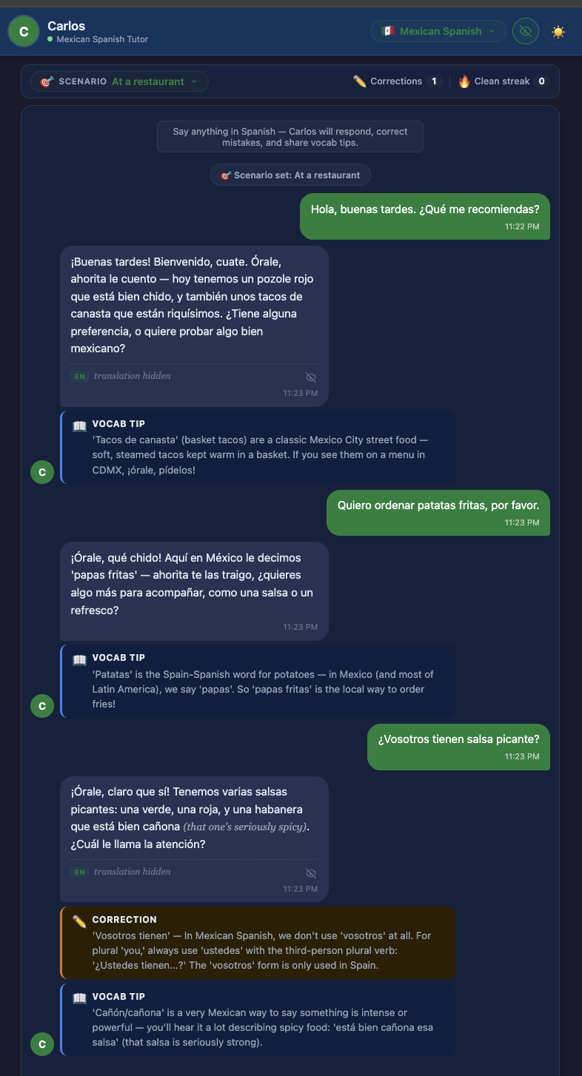
PHASE 5 · PROTOTYPE
Carlos. The Mexican Spanish tutor.
Built in the repo. Dialect pill, scenario pill, correction callouts, and severity badges.
REGIONAL AUTHENTICITY
Carlos uses:
• Mexican pronunciation (soft /s/, ustedes, no voseo)
• Mexican idioms (chido, órale, qué onda, ahorita)
• Restaurant vocabulary aligned with Mexican dining (la cuenta, propina, tortillas over pan)
• A warm but corrective tutor tone.
This is Geeslin and Long (2014) put into practice.
Language Learner Agent · AHF · 2026
29

Slide 30
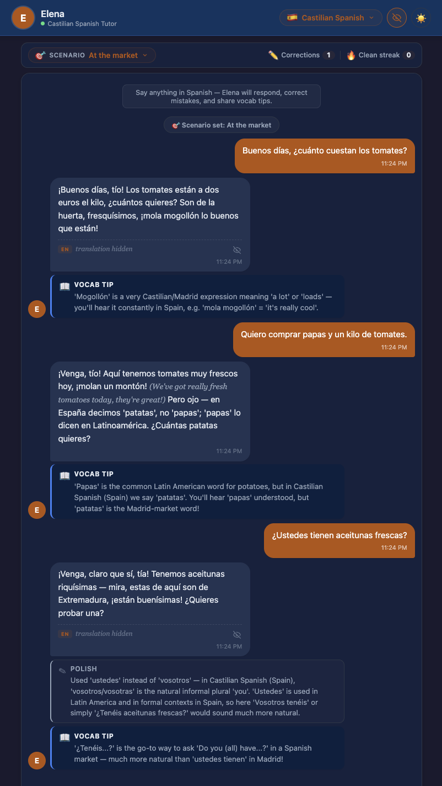
PHASE 5 · PROTOTYPE
Elena. The Castilian Spanish tutor.
Same UI, different dialect. One click in the dropdown swaps the linguistic profile.
REGIONAL AUTHENTICITY
Elena uses:
• Castilian pronunciation (distinción; /s/ versus /θ/)
• Peninsular grammar (vosotros forms)
• Castilian idioms (vale, tío and tía, guay)
• Peninsular market vocabulary (metric weights, regional produce, Mercadona norms)
Same framework. One dropdown switch changes the whole regional identity.
Language Learner Agent · AHF · 2026
30

Slide 31
PHASE 5 · SYSTEM MAP
The loop changes shape when we change what it measures.
BEFORE is today's Duolingo. TARGET is the full redesign, including the proposed voice agent.
BEFORE (TODAY)
Learner → Item → XP
A closed loop on the wrong variable. The learner's goal (speaking) is not in the circuit.
TARGET (FULL REDESIGN · INCLUDES FUTURE VOICE AGENT)
Learner ↔ Dialect Agent ↔ Scaffolded Dialogue → bound context → production feedback
The agent sits in the middle. Context binds. Feedback is about what the learner produced, not what they recognized.
Language Learner Agent · AHF · 2026
31

Slide 32
PHASE 5 · GAP ANALYSIS & TRADE OFFS
What we did not build, and the trade offs if we did.
A gap analysis exposes blind spots. The trade offs keep the proposal honest.
GAPS · WHAT IS MISSING
TRADE OFFS · WHAT WE WOULD WEIGH
• Voice input and output is not yet implemented.
• The content agent (blogs, songs, news) was descoped from the original proposal.
• No A/B test was run. This is a proof of concept only.
• No eye tracking data yet. The IX Lab is the next step.
• No long term retention data on the prototype.
• Two dialects shipped (Mexican and Castilian). Spanish alone has dozens.
• Regional authenticity vs. voice model availability. The Castilian voice pool is deeper than the Mexican one (applies once voice is built).
• Latency vs. response quality. Fast turn taking competes with deeper model reasoning.
• Scope vs. feasibility. A four agent vision against a two week build window.
• Correction strength vs. learner anxiety. Too harsh a correction kills willingness to communicate (per Wang 2024).
• Regional specificity vs. user reach. A Mexican agent underserves an Argentine learner.
Language Learner Agent · AHF · 2026
32

Slide 33
PHASE 5 · FUTURE WORK
Four agents. One coherent architecture.
What we shipped is one layer. The voice agent closes the Level 1 signal gap.
CONTENT AGENT
CONVERSATIONAL AGENT
DIALECT AGENTS
VOICE AGENT
PROPOSED
BUILT
BUILT
PROPOSED
Surfaces target language material: blogs, songs, news, speeches.
Addresses the Level 2 hole by giving the learner real context to bind to, even outside of a conversation.
Scaffolded dialogue, scenario lock, and severity graded corrections.
Bibauw's d = 0.58 evidence put into practice in a working proof of concept.
Carlos (Mexican) and Elena (Castilian).
Mayer's conversational style research and Geeslin's regional variation research put into practice.
Speech to text in. Dialect authentic text to speech out. Fast enough turn taking to feel conversational.
Closes the Level 1 signal loop: the learner speaks, the system hears, and the system can finally measure production.
The voice layer follows three design principles from this course: recovery (fall back to text if speech fails), redundancy (show the correction even when it is spoken), and reduced cognitive load (voice for production, visual for feedback).
Language Learner Agent · AHF · 2026
33

Slide 34
PHASE 5 · ACTION PLAN
Feasible, and actionable.
Each step converts one gap analysis item into evidence.
IMMEDIATE · 0 TO 4 WEEKS
An eye tracking study at UT's IX Lab. Sharpens the Level 1 attention claim from conceptual to measurable. Where does the learner actually look: at UI ornaments (XP, streak flame) or at linguistic content?
NEAR TERM · 1 TO 6 MONTHS
A 24 week randomized controlled trial that extends Wang (2024) in three ways: adds a dialect matched condition, extends measurement to week 24, and adds a 6 month follow up for retention. ACTFL speaking interview scored by a blinded rater. Random assignment stratified by baseline proficiency and intended use context.
LONG TERM · 6 TO 12 MONTHS
A longitudinal speaking assessment, which is the metric Duolingo's outcome research has never published. Retention of productive skills at 6 and 12 months, with voice agent condition learners as the primary cell.
Language Learner Agent · AHF · 2026
34

Slide 35
PROJECT CLOSE
Thank you.
Recovery. Redundancy. Reduced cognitive load.
PRESTON CUSICK · ANEESH HARWALKAR
Applied Human Factors · Spring 2026 · Prof. John L. Neumann, Ph.D.
github.com/aneeshharwalkar/language-learner-agent
Language Learner Agent · AHF · 2026
35

