Slide 1
APPLIED HUMAN FACTORS · SPRING 2026
Bridging the Learning-Transfer Gap
Deploying conversational agents in Duolingo.
PRESTON CUSICK · ANEESH HARWALKAR
Notes:
SPEAKER: Preston · 0:15
[AUNT HOOK — told to the room before clicking forward]
"My aunt kept a Duolingo streak for three years. Italian, every day. Last summer she finally went to Italy. She stood in front of her own family. And she couldn't speak to them. Three years of correct answers. No conversation. That gap, right there, is our project."
[Click to slide 2]

Slide 2
RESEARCH
500M+ monthly active users.
One of the largest human-machine learning systems on Earth.
INTERNAL
EXTERNAL
ORGANIZATIONAL
Cognitive load. The illusion that recognizing a word means you know it.
Streaks. XP. Gamification that rewards showing up, not speaking.
Daily-active-user incentives. Innovator's Dilemma locks in the wrong metric.
Notes:
SPEAKER: Preston · 0:50
"Duolingo is a human-machine system with over 500 million monthly active users. From Week 1 of class, every system sits under three kinds of stressors.
Internal: cognitive load, and the illusion that seeing a word again means you know it.
External: streaks, XP, the stuff the app makes you feel bad about when you miss a day.
Organizational: Duolingo's business rewards daily active users. Christensen's Innovator's Dilemma — they can't rebuild around real conversation without breaking the metric paying the bills."
[~50 seconds. Hand off to Aneesh.]

Slide 3
RESEARCH
The measurable ceiling.
Jiang, Rollinson, Plonsky et al. (2021). ACTFL proficiency scale.
READING
LISTENING
SPEAKING
Intermediate
Novice
Not Assessed
Low
High
"No other skills were assessed."
Notes:
SPEAKER: Aneesh · 0:50
"Jiang, Rollinson, and Plonsky put Duolingo learners through the ACTFL proficiency scale. Reading topped out at Intermediate Low. Listening at Novice High. Speaking — speaking was never tested.
In the peer-reviewed outcome research we surveyed, the paper itself says: 'no other skills were assessed.'
So the ceiling is real, it's measurable, and the productive skills, the ones that let you actually have a conversation, are invisible to the system that claims to be teaching you."
[~50 seconds.]

Slide 4
ANALYSIS
Four lenses on the failure.
The class demand framework: where the system loads and unloads the learner.
ATTENTION
MEMORY
Learner gaze fixates on XP and streaks. Inattentional blindness to the linguistic content.
Phonological Loop is exercised. Episodic Buffer is never engaged. Words don't bind to context.
WORKLOAD
COGNITION
Over-loaded on gamification. Under-loaded on speech production.
No real-world knowledge built. No regional speech patterns. No conversation skills.
Notes:
SPEAKER: Aneesh · 0:45
"We ran the four HF demand lenses from class.
Attention: the learner's gaze and mental budget go to XP bars and streaks, not to language.
Memory: Duolingo exercises Baddeley's Phonological Loop — verbal rehearsal — but never the Episodic Buffer, the part of working memory that binds words to context.
Workload: over-loaded on gamification. Under-loaded on speech production.
Cognition: the real-world knowledge you need for actual conversation is never built.
The recognition task succeeds. The production task fails."
[~45 seconds.]

Slide 5
ANALYSIS
How we got here.
Two-week timeline. No primary data. We are upfront about that.
EVIDENCE BASE
EFFECT SIZES
PROPOSED RCT
15 peer-reviewed sources.
Two meta-analyses carry the claims.
24-week, dialect-matched.
Spans HF, SLA, working memory, and dialogue-based learning.
Bibauw 2022 · d = 0.58.
Mayer 2021 · d = 1.3.
Extends Wang 2024. Speaking performance is the outcome.
Cohen's d is a standardized effect size. d = 0.5 is medium, d ≥ 0.8 is large.
Notes:
SPEAKER: Preston · 0:40
"Two-week timeline, so we are upfront: the biggest threat to validity is no primary data.
Our approach is research-and-build. Fifteen peer-reviewed sources. Two meta-analyses carrying the effect-size claims: Bibauw at d = 0.58 for dialogue-based learning, Mayer at d = 1.3 for personalized agents.
For causal evidence, we propose a 24-week randomized controlled trial that extends Wang's 2024 design, with dialect-matched conditions and speaking performance as the dependent measure."
[~40 seconds. Hand off to Aneesh.]

Slide 6
ANALYSIS
Reason's Swiss Cheese.
Four layers of defense. Don't blame the operator. Work backward through all of them.
HAZARD
L4 · ORGANIZATIONAL INFLUENCES
L3 · UNSAFE SUPERVISION
L2 · PRECONDITIONS
L1 · UNSAFE ACTS
INCIDENT
Notes:
SPEAKER: Aneesh · 0:35
"For the Human Factors analysis itself we used HFACS — the Human Factors Analysis and Classification System, built on Reason's Swiss Cheese model.
Four layers of defense. Level 4: Organizational Influences. Level 3: Unsafe Supervision. Level 2: Preconditions. Level 1: Unsafe Acts at the operator.
The course's core tenet: work backward through all four. When the holes line up, an incident gets through. Don't blame the person — look for where the system failed."
[~35 seconds. Set up the star slide.]

Slide 7
ANALYSIS
The holes line up.
Each level fails into the next. The incident is structurally predicted.
L1 · UNSAFE ACTS
The learner sees XP. Gets no real signal on speaking.
Episodic Buffer never engaged. Words don't bind to context.
L2 · PRECONDITIONS
Birdbrain optimizes item-correctness, not conversation.
L3 · UNSAFE SUPERVISION
L4 · ORGANIZATIONAL INFLUENCES
DAU metric excludes speaking entirely.
Notes:
SPEAKER: Aneesh · 1:10 ★ STAR SLIDE — earns the Systems Thinking points
"Walk it with me, top to bottom.
Level 1: the learner acts on the only signal available, which is XP. In Signal Detection terms, every streak is a False Alarm on the variable that matters.
Level 2: without a supervisor asking for speech, the environment never engages the Episodic Buffer, and words never bind to context. Essoe's working-memory study showed this cleanly: distinct contexts produced 92% retention versus 76% in uniform contexts.
Level 3: Birdbrain, Duolingo's own algorithm, optimizes item-correctness. By TADMUS principles, the supervisor's sensitivity, d-prime, on conversational failure is effectively zero.
Level 4: the organization measures Daily Active Users, which explicitly excludes speaking.
The holes line up. This isn't a user mistake. The incident is structurally predicted."
[~70 seconds. This is the rigor + systems-thinking slide.]

Slide 8
ANALYSIS
Name the enemy.
Rosling. Tufte. Musk. Make the failure concrete.
01
THE ISOLATED DRILL
02
THE WRONG SIGNAL
Vocabulary taught as isolated items, never embedded in a real situation.
Confident feedback about XP and streaks. The wrong variable, amplified.
03
THE RECEPTIVE-ONLY EVIDENCE
04
THE ALIGNED HOLES
Outcome research covers reading and listening. Speaking is unsupervised.
Fix one layer alone and the cheese still lines up. The redesign spans levels.
Notes:
SPEAKER: Preston · 0:40
"The course says: name the enemy. Rosling, Tufte, Musk. So here they are, named.
One: the Isolated Drill. Vocabulary taught as isolated items, not embedded in any real situation.
Two: the Wrong Signal. Confident feedback about XP and streaks. The wrong variable, amplified.
Three: the Receptive-Only Evidence Base. Duolingo's own research measures reading and listening. Speaking is unsupervised by design.
Four: the Aligned Holes. Fix any single layer in isolation and the cheese still lines up. Our redesign has to span levels."
[~40 seconds. Hand back to Preston for redesign.]

Slide 9
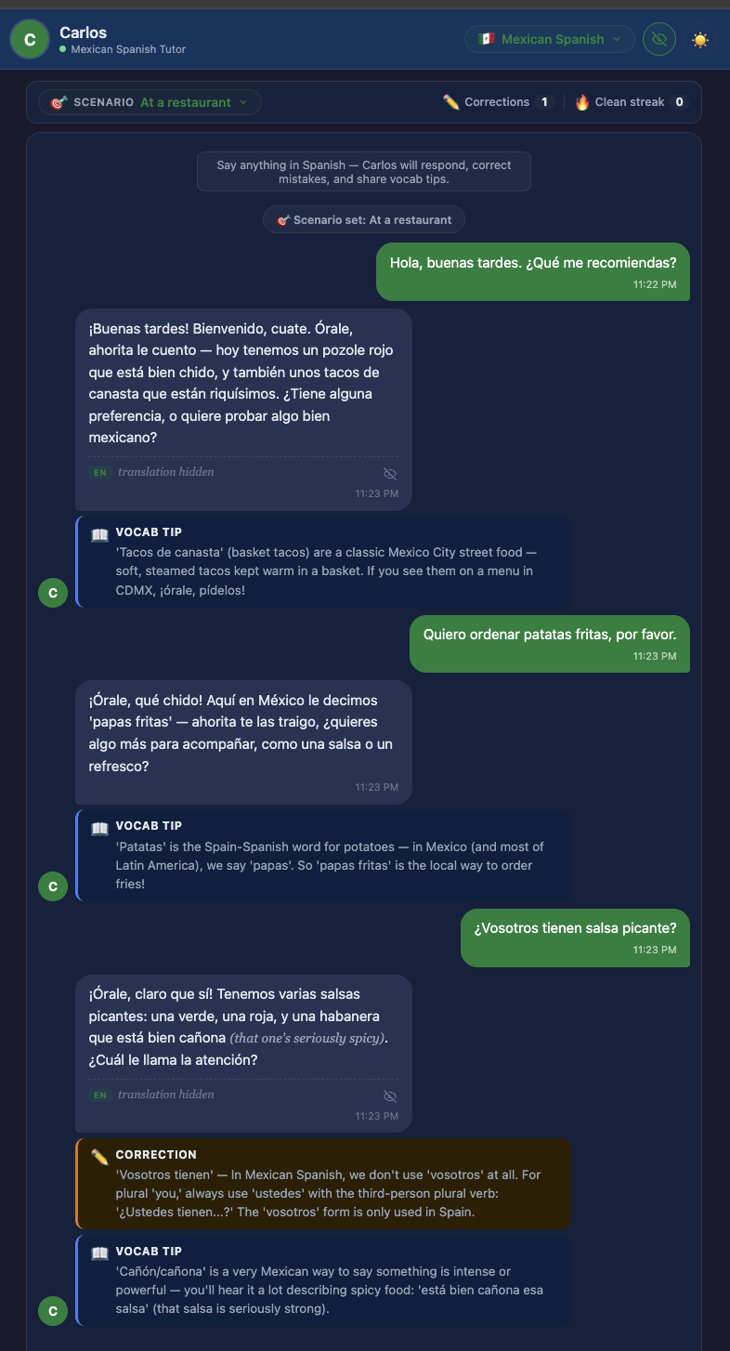
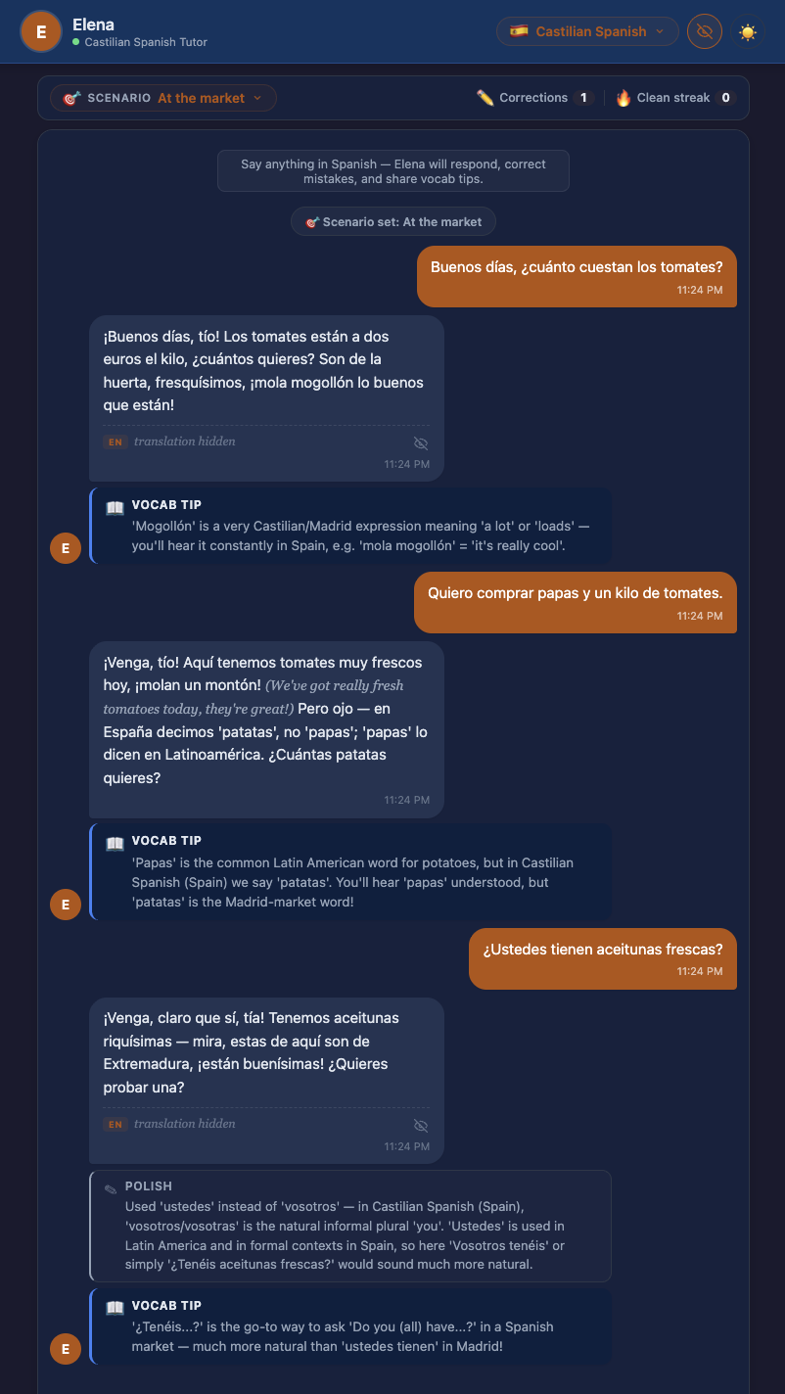
REDESIGN
Carlos. Elena. Real dialect, real conversation.
A dialect-specific conversational agent that scaffolds the interaction.
DIALOGUE WORKS
Bibauw 2022. d = 0.58 across 17 studies.
PERSONA MATTERS
Mayer 2021. d = 1.3 across 10 of 10 experiments.
DIALECT IS INPUT
Geeslin and Long 2014. Real regional speech patterns matter.
Notes:
SPEAKER: Preston · 1:10 ★ DESIGN / ARCHITECTURAL INSIGHT slide
"Here's the proof-of-concept. A dialect-specific conversational agent — Carlos, Mexican Spanish, and Elena, Castilian — that scaffolds the interaction rather than just responding.
It rests on three findings.
One: Bibauw's 2022 meta-analysis across seventeen studies. Dialogue-based learning produces a medium effect, d equals point-five-eight, on second-language proficiency.
Two: Mayer's Personalization Principle. d equals one-point-three across ten of ten experiments. Embodiment and conversational style aren't UX decoration — they're the mechanism.
Three: Geeslin and Long. Communicative competence requires acquiring real regional speech patterns. Classrooms don't provide that. Duolingo doesn't provide that. That's our wedge."
[~70 seconds. Hand off to Aneesh.]

Slide 10
REDESIGN
Before. After. What's still missing.
BEFORE
AFTER
Learner → Item → XP
Learner → Dialect Agent → Speaking
Loop closes on the wrong variable.
Feedback on production, not recognition.
Honest gaps.
•
No primary data.
Two-week window.
•
No A/B vs. a generic agent.
Dialect-effect is theorized, not tested.
•
Wang 2024 moved affect, not skill.
Closest comparable RCT. Plausibility, not proof.
NEXT · Eye-tracking at UT's IX Lab to sharpen the Level 1 attention claim.
Notes:
SPEAKER: Aneesh · 0:55
"Here's the system map. Before, Duolingo's loop runs learner to item to XP, and the loop closes on the wrong variable. After, the agent sits in the middle, dialogue scaffolds context, and feedback is about production — speaking — not recognition.
Three honest gaps. No primary data. No A/B comparing dialect-specific to generic agents. And Wang 2024 — the closest adult-learner GenAI chatbot study — moved willingness to communicate over twelve weeks, but it did not move measured speaking performance.
A proof-of-concept is proof of plausibility, not proof of effect. Our next step is an eye-tracking study at UT's IX Lab to turn the Level 1 attention claim from conceptual to measurable."
[~55 seconds. Hand back to Preston for close.]

Slide 11
"Error is a system property,
not a human shortcoming."
System failure, not user failure.
PRESTON CUSICK · ANEESH HARWALKAR
Applied Human Factors · Spring 2026
Prof. John L. Neumann, Ph.D.
Notes:
SPEAKER: Preston · 0:25
"The course taught us one tenet above all: error is a system property, not a human shortcoming.
Duolingo's learners aren't failing. The system is measuring the wrong thing, so it's teaching the wrong thing.
We built a piece that measures what matters. Thank you."
[~25 seconds. End at 8:00.]

