Slide 1

Delhi Weather and Air Quality Analysis
A comprehensive data-driven study examining hourly weather patterns and air pollution dynamics across Delhi in 2025, supporting evidence-based urban sustainability policy development.

Slide 2
DATASET OVERVIEW
Data Collection Framework
Dataset Specifications
Key Variables Measured
Temporal coverage: January–December 2025
Meteorological: temperature (°C), humidity (%), atmospheric pressure (hPa), wind speed (m/s)
Air quality indicators: AQI index, PM2.5, PM10 concentrations (µg/m³)
Gaseous pollutants: carbon monoxide (CO), nitrogen dioxide (NO₂) levels
Geospatial: latitude and longitude coordinates for spatial analysis
Resolution: Hourly measurements
Monitoring stations: Multiple locations across Delhi NCR
Total observations: 8,760 hourly records per variable

Slide 3
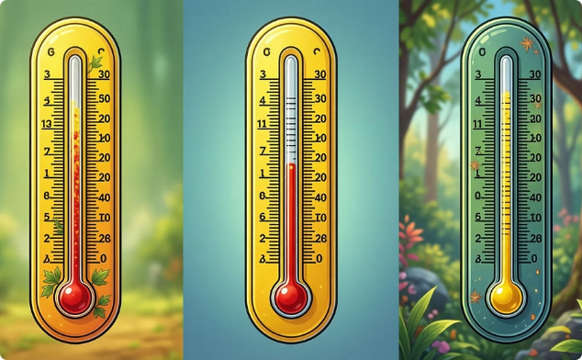


WEATHER ANALYSIS
Meteorological Patterns Throughout 2025
Temperature Trends
Humidity Dynamics
Wind Speed Variability
Delhi experienced typical seasonal variation with summer peaks reaching 45°C (May–June) and winter lows dropping to 4°C (December–January). Average annual temperature: 26.3°C.
Relative humidity ranged from 15% during dry summer months to 95% during monsoon season (July–September). Monsoon period showed sustained high humidity above 80%.
Average wind speeds: 2.8 m/s. Pre-monsoon months exhibited higher wind speeds (4–6 m/s), whilst winter months showed stagnant conditions (<2 m/s), contributing to pollutant accumulation.

Slide 4


AIR QUALITY INDEX
AQI Distribution and Pollution Events
Critical Findings
Delhi's air quality remained predominantly unhealthy, with 55% of days registering 'Poor' or worse AQI levels. Annual average AQI: 187 (Poor category).
Severe pollution episodes: Concentrated during post-Diwali period (November) and winter months when AQI exceeded 400, triggering public health advisories.
Good
Satisfactory
Moderate
Poor
Very Poor
Severe
Only 23% of days achieved 'Good' or 'Satisfactory' air quality, typically during monsoon months when rainfall provided natural cleansing.

Slide 5

Particulate Matter: The Primary Health Threat
PM2.5 Concentrations
PM10 Patterns
Health Implications
Annual average: 98 µg/m³ (nearly 20× WHO guideline of 5 µg/m³)
Annual average: 156 µg/m³ (exceeding WHO guideline of 15 µg/m³)
Chronic exposure to elevated PM levels correlates with increased hospital admissions for asthma, bronchitis, and heart attacks.
Peak levels: 450 µg/m³ during winter smog episodes
Sources: Construction dust, road traffic, and industrial emissions
These fine particles penetrate deep into lungs and bloodstream, causing cardiovascular and respiratory diseases.
Coarse particles cause respiratory irritation and aggravate existing lung conditions.
Children and elderly populations face disproportionate health risks from sustained particulate matter exposure throughout the year.

Slide 6

GASEOUS POLLUTANTS
Carbon Monoxide and Nitrogen Dioxide Trends
CO Emissions Profile
Carbon monoxide levels exhibited strong diurnal patterns, with morning peaks (7–9 AM) and evening spikes (6–9 PM) coinciding with rush-hour traffic congestion.
Average concentration: 1.8 mg/m³
Peak periods: Winter mornings when temperature inversions trapped vehicular emissions near ground level
Primary sources: Incomplete combustion from vehicles, particularly older diesel engines and two-wheelers
NO₂ Concentrations
Nitrogen dioxide levels: 45 µg/m³ annual average. Strong correlation with vehicular traffic density and industrial combustion activities, particularly in industrial zones of East and West Delhi.

Slide 7




Weather-Pollution Correlation Analysis
Wind Speed
Pressure
Humidity
Temperature
Statistical analysis reveals significant meteorological influence on pollution dynamics. Wind speed demonstrates inverse correlation with AQI (r = -0.67), with winds above 4 m/s effectively dispersing pollutants.
67%
52%
78%
Wind Speed Impact
Humidity Effect
Temperature Inversion
Negative correlation: higher winds reduce AQI by dispersing pollutants
Moderate positive correlation: high humidity aids particle settling
Winter inversions trap pollutants, creating severe episodes

Slide 8
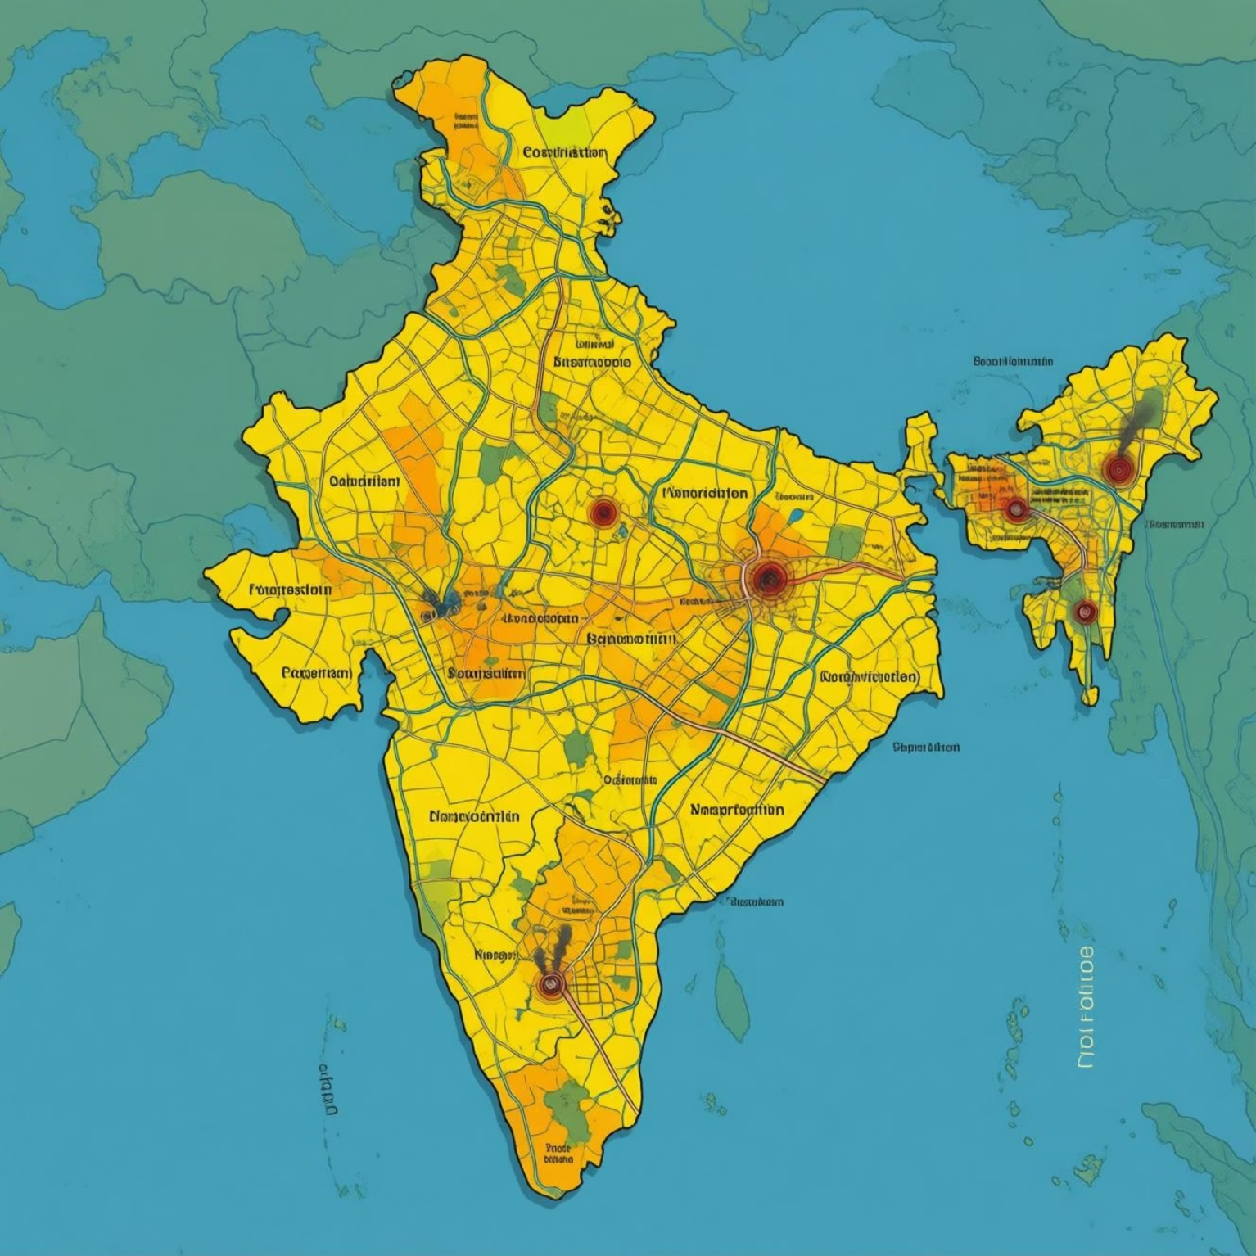
SPATIAL ANALYSIS
Pollution Hotspots Across Delhi
Location-Based Findings
Industrial corridors (East and West Delhi) recorded highest pollution levels, with AQI frequently exceeding 300.
Traffic intersections near Connaught Place, ITO, and Anand Vihar showed elevated NO₂ and CO concentrations throughout the day.
Residential areas in South Delhi exhibited relatively lower but still unhealthy pollution levels (AQI: 150–200).
Green zones near Central Ridge Forest showed 15–20% lower PM2.5 levels compared to urban centres, demonstrating natural filtration benefits.

Slide 9

Critical Insights and Public Health Risks
Persistent Air Quality Crisis
Seasonal Vulnerability
Vehicular Emissions Dominance
Delhi experienced hazardous air quality for 55% of the year, with particulate matter levels consistently exceeding safe thresholds by factors of 10–20, creating chronic public health emergency.
Winter months (November–February) present extreme risk due to meteorological conditions favouring pollutant accumulation: low temperatures, calm winds, and atmospheric inversions trap emissions near ground level.
Traffic-related pollutants (CO, NO₂) show strong temporal patterns aligned with commuting hours, indicating that transportation sector remains primary contributor requiring urgent intervention and policy reform.

Slide 10
STRATEGIC RECOMMENDATIONS
Policy Framework for Sustainable Air Quality
Industrial Emission Controls
Transport Sector Transformation
Mandate real-time emission monitoring systems in industrial zones, enforce stricter pollution standards, and incentivise adoption of cleaner production technologies.
Accelerate transition to electric public transport, implement congestion pricing in central zones, and expand metro network to reduce vehicular emissions by 40% within 5 years.
Early Warning Systems
Green Infrastructure Expansion
Establish AI-powered pollution forecasting platform integrated with meteorological data to issue advance public health advisories and trigger emergency response protocols.
Develop urban forests and green corridors along major roads to provide natural air filtration, targeting 25% increase in tree canopy cover across Delhi NCR.
Future Research Scope: Longitudinal health impact studies, source apportionment analysis using advanced receptor models, and evaluation of policy intervention effectiveness through continued monitoring.

